Slide 1
Homework
Reading
  Tokheim, Section 5-1, 5-2, 5-3, 5-7, 5-8
Machine Projects
  Continue on MP5
Labs
  Continue labs with your assigned section

Slide 2
Designing Logic Circuits
We want to be able to design a combinational logic circuit from a truth table methodically
  Sum of Products
  Product of Sums
Then we want to be able to simplify it to use the fewest possible gates to implement it
  Factoring the Boolean logic equation
  Karnaugh Maps

Slide 3
Sum of Products
Also known as Minterm expression
We take each line of the truth table that results in a value of 1 for the output
We develop a “sum” (an OR of each product term that should create an output value of 1)
Results in a layer of AND gates followed by an OR gate

Slide 4
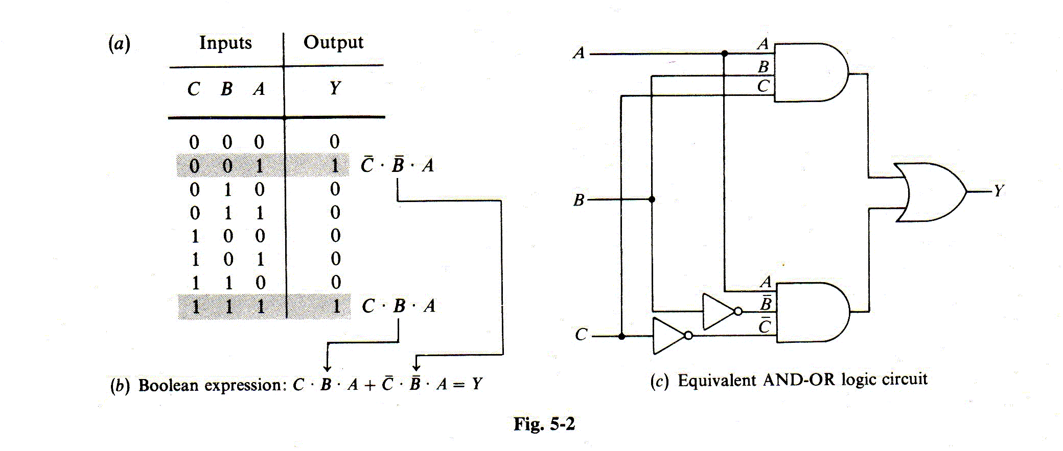
Sum of Products

Slide 5
Product of Sums
Also known as Maxterm expression
We take each line of the truth table that results in a value of 0 for the output
We develop a “product” (an AND of each sum term that should create an output value of 0)
Results in a layer of OR gates followed by an AND gate

Slide 6
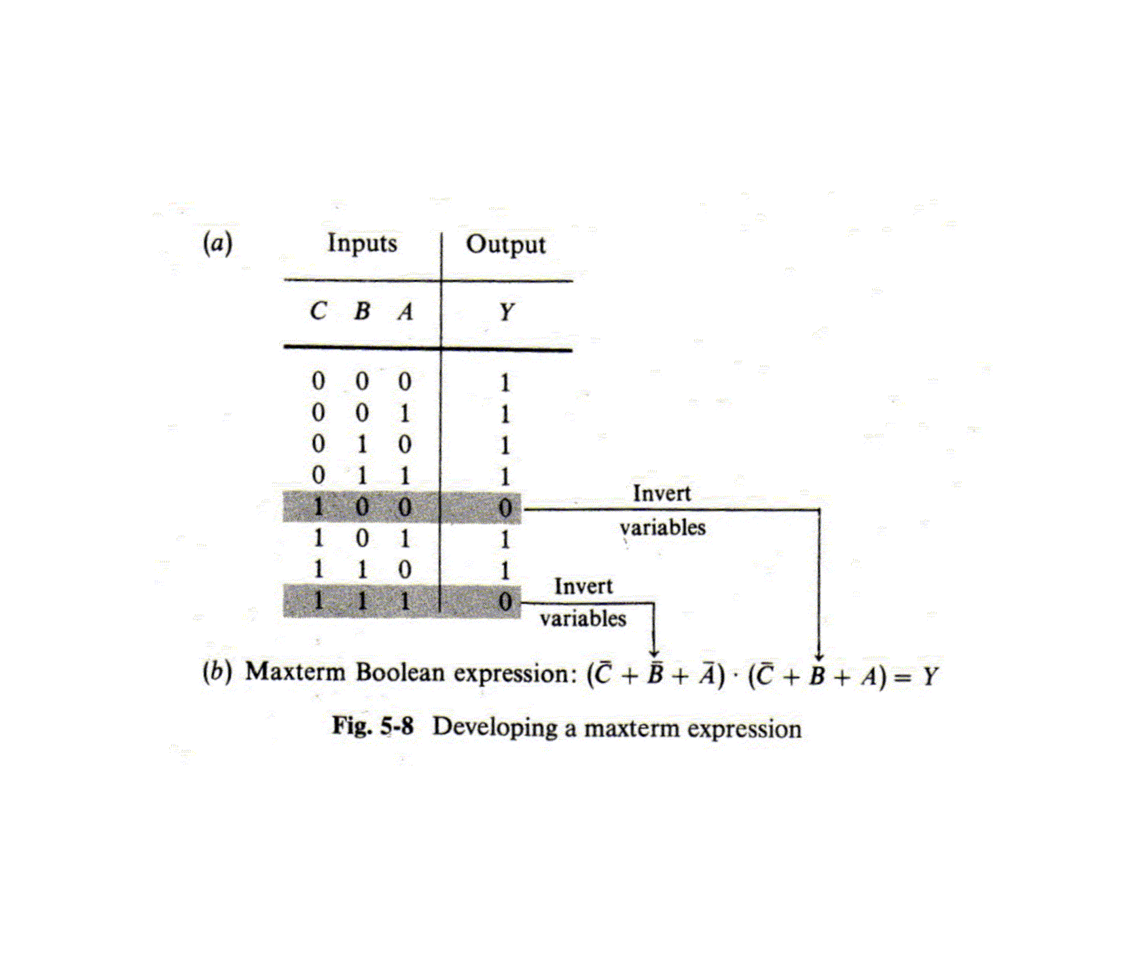
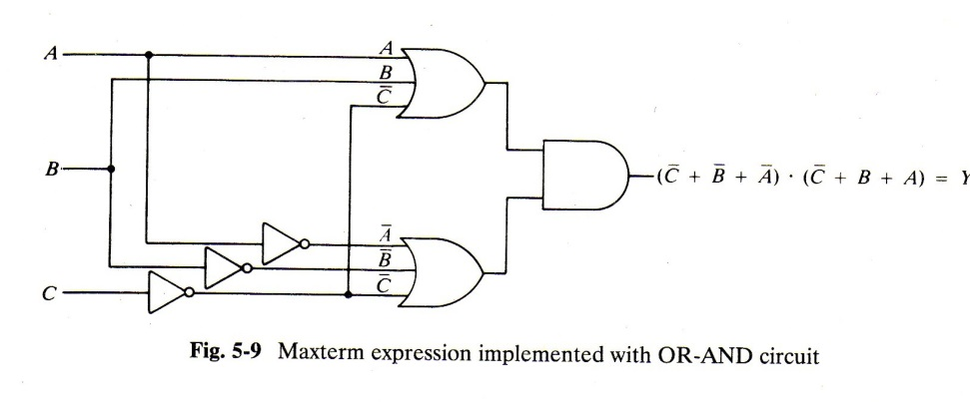
Product of Sums

Slide 7
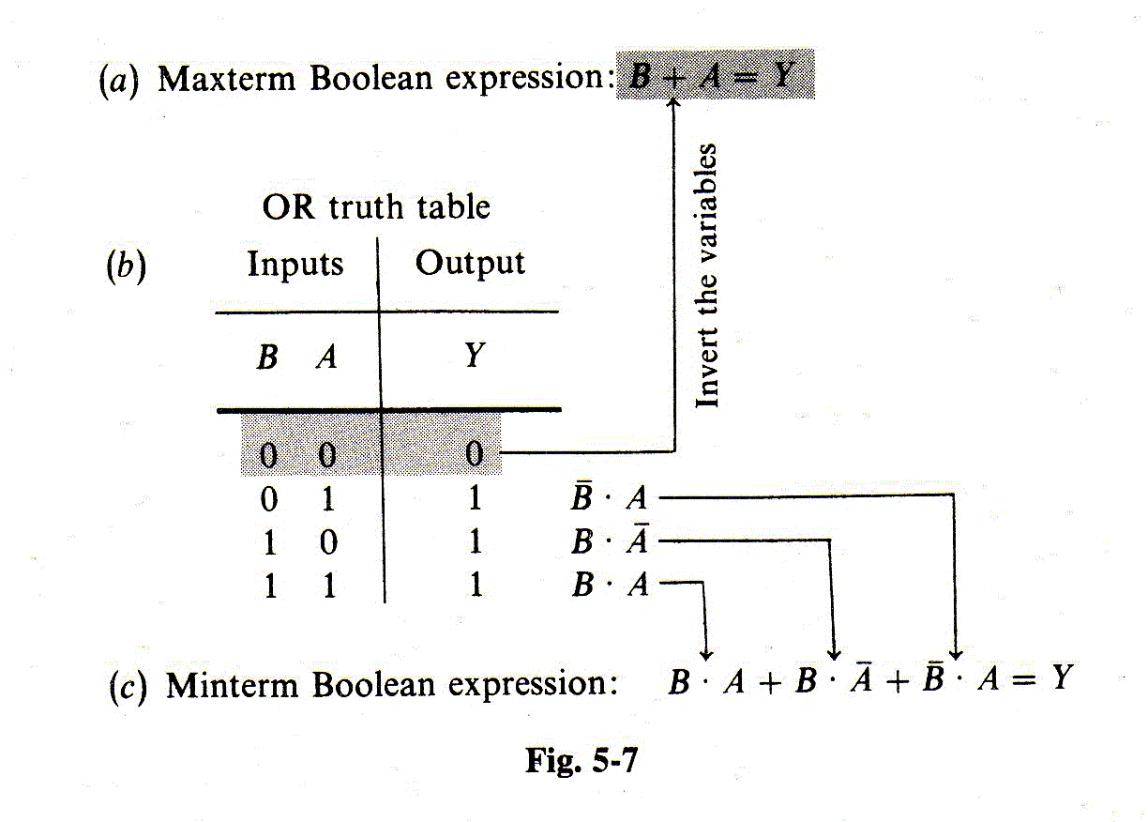
Maxterm / Minterm

Slide 8
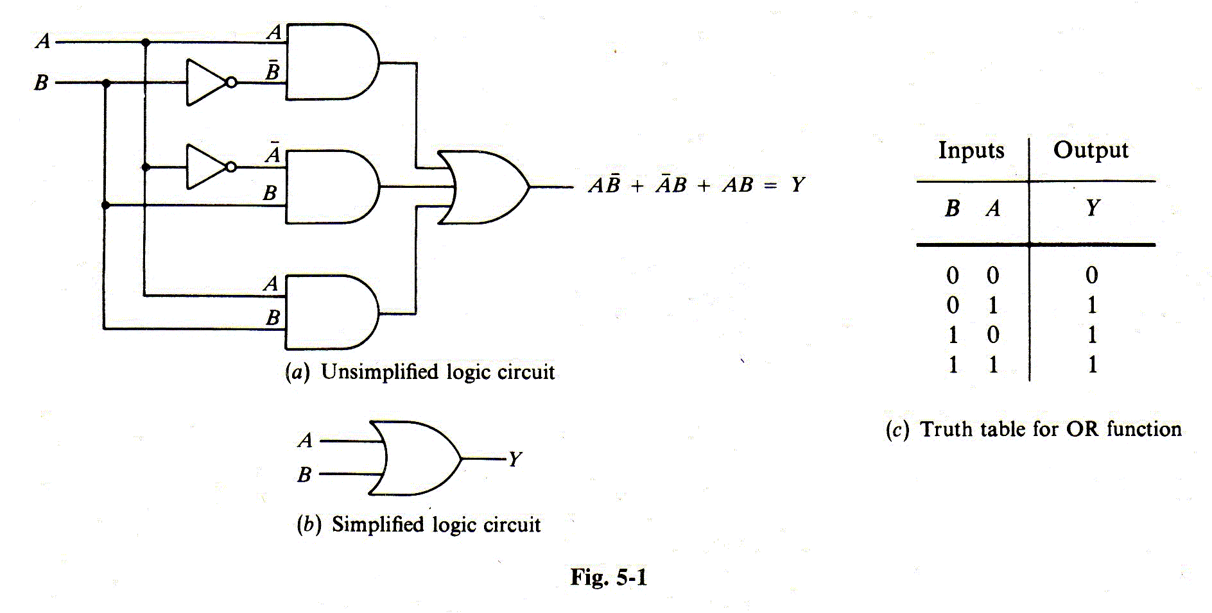
Simplifying Logic Circuits

Slide 9
Factoring the Boolean Equation
Expand the original sum of products:
  Y = AB + AB + AB + AB
  = AB + AB + AB + AB
Factor out A and B from pairs of terms:
  Y = A(B + B) + (A + A)B
  = A(1) + (1)B
  = A + B
Not easy to see the order in which to factor

Slide 10
Karnaugh Maps
A graphical way to reduce the complexity of a logic equation or truth table
A tool to bring into play the human ability to recognize patterns
Draw out the pattern of output 1’s and 0’s in a matrix of input values
Loop the 1’s and derive product terms to sum
Notice the order of inputs along edge of matrix

Slide 11
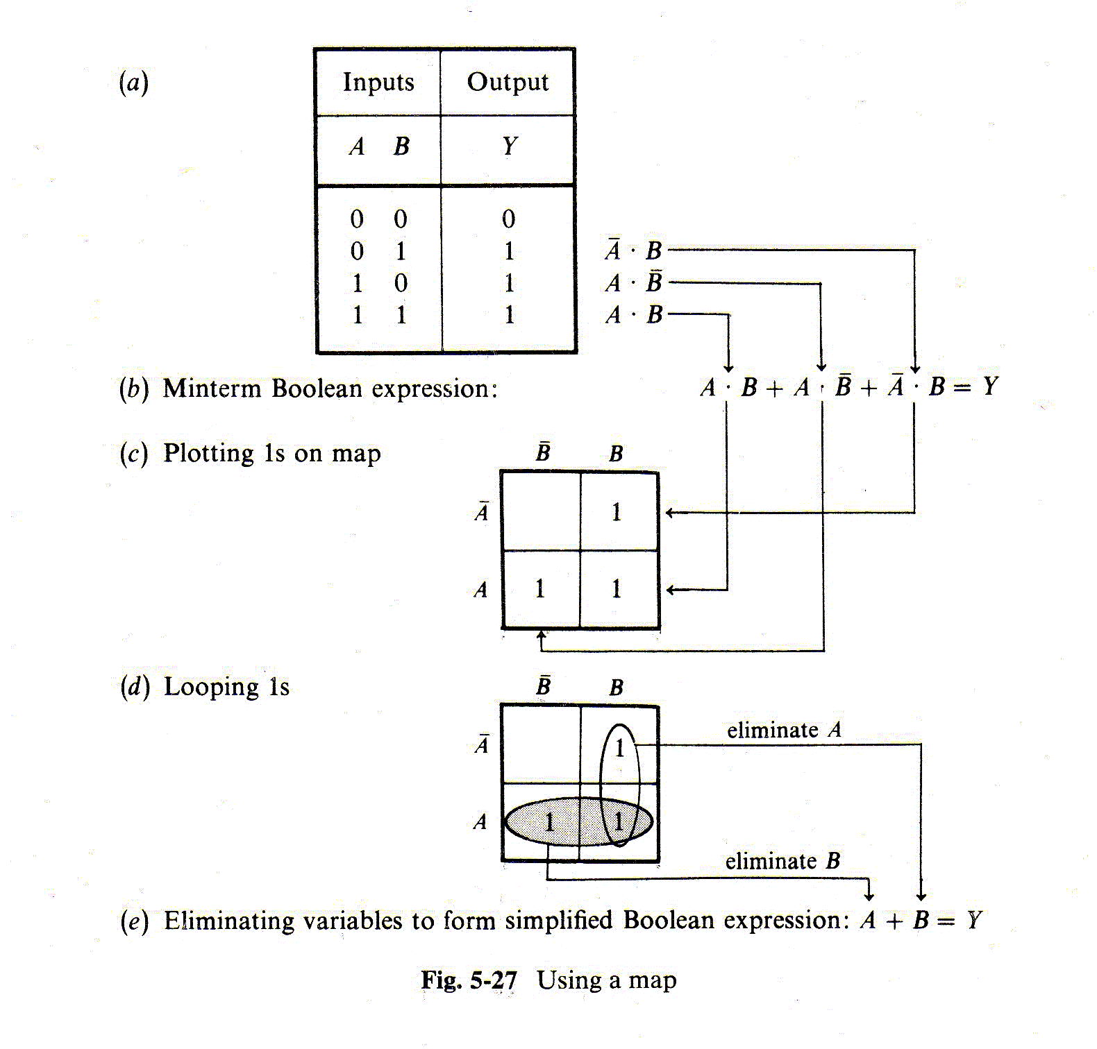
Karnaugh Maps (2 Inputs)

Slide 12
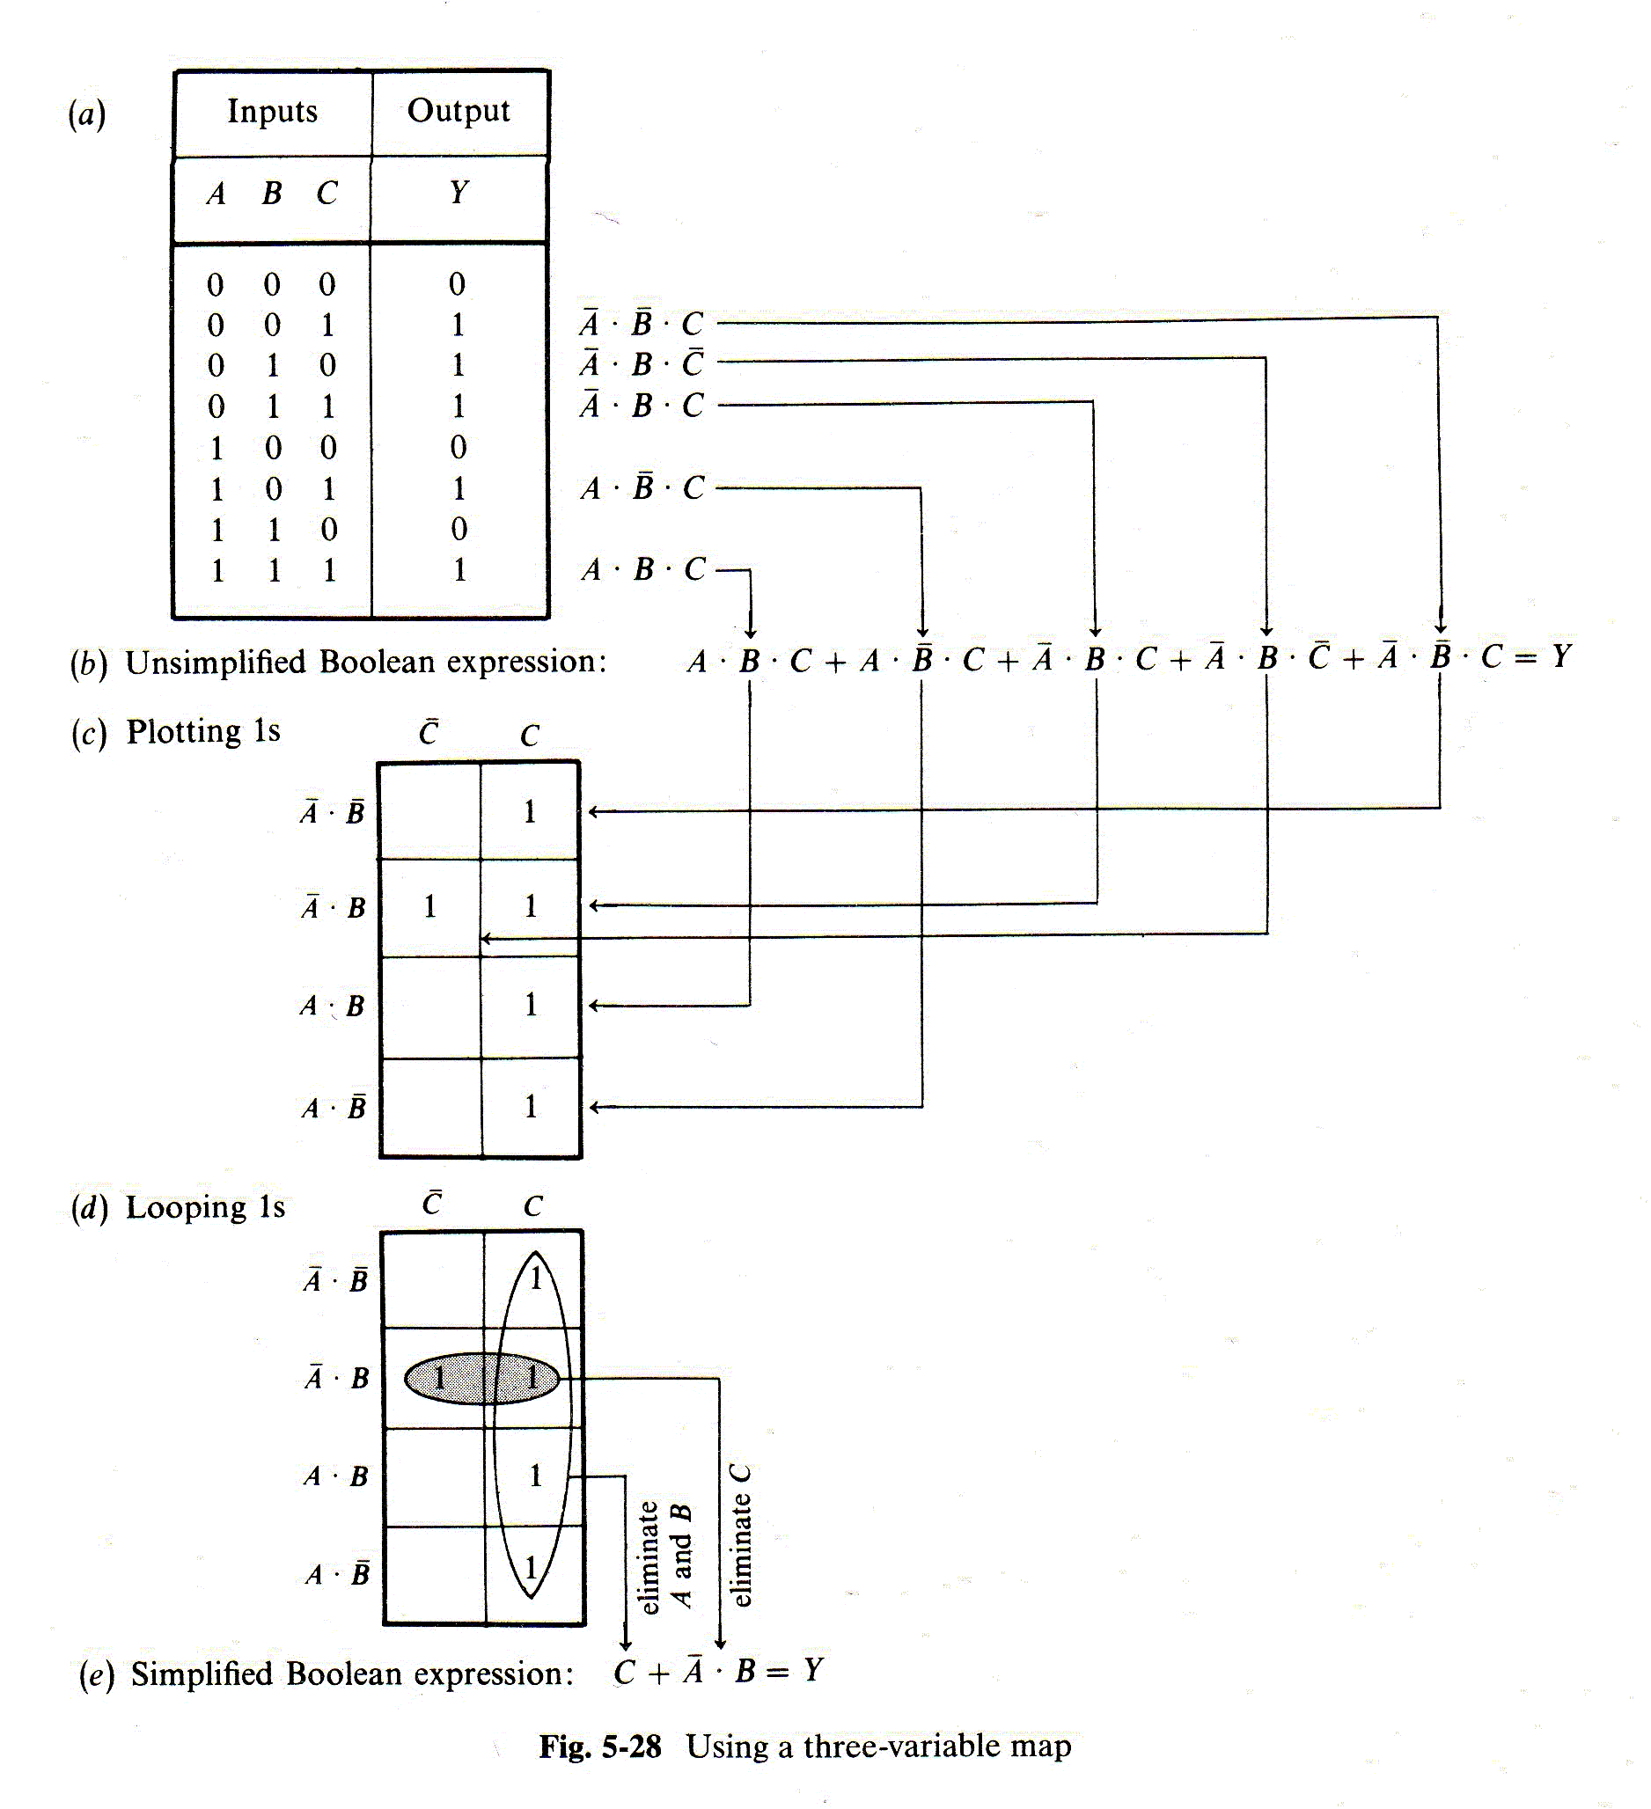
Karnaugh Maps (3 Inputs)

Slide 13
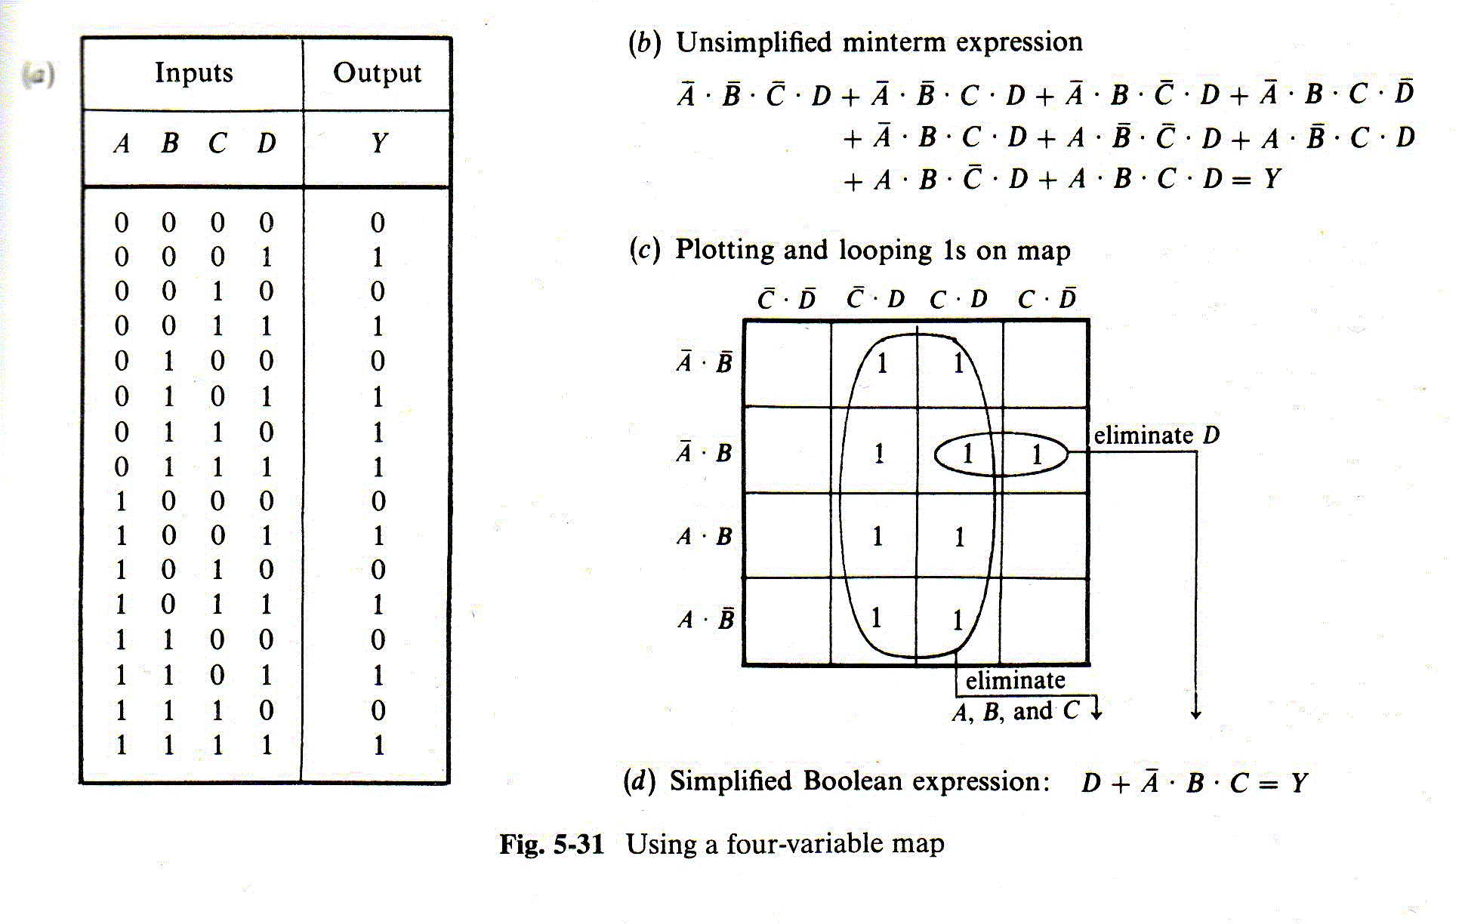
Karnaugh Maps (4 Inputs)

Slide 14
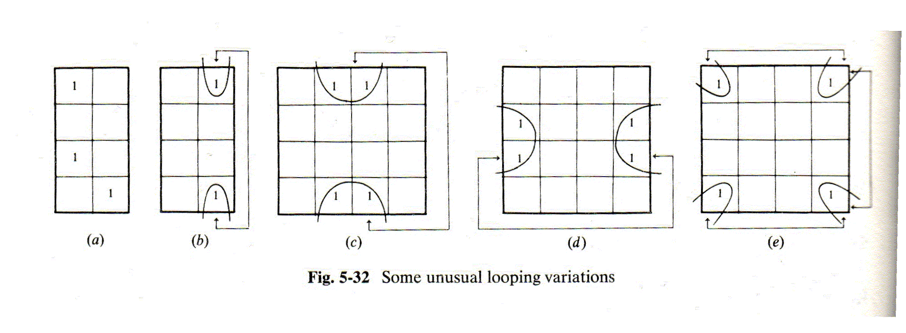
Karnaugh Maps

Slide 15
Karnaugh Map Blank (4 Input)
C D
C D
C D
C D
A B
A B
A B
A B

Slide 16
Karnaugh Map (5 Input)
C D
C D
C D
C D
A B
A B
A B
= A * B * C
A B
E
A B
A B
A B
A B
E
= A * B * C * E
C D
C D
C D
C D

Slide 17
Karnaugh Map Blank (5 Input)
C D
C D
C D
C D
A B
A B
A B
A B
E
A B
A B
A B
A B
E
C D
C D
C D
C D

