Slide 1
Homework
Reading
  Tokheim, Section 5-10, 7-4

Slide 2
Seven Segment Display
Used for output of a single decimal digit
Driven by a binary coded decimal (BCD) nibble
A separate set of combinational logic turns on or off each segment to create the digit display

Slide 3
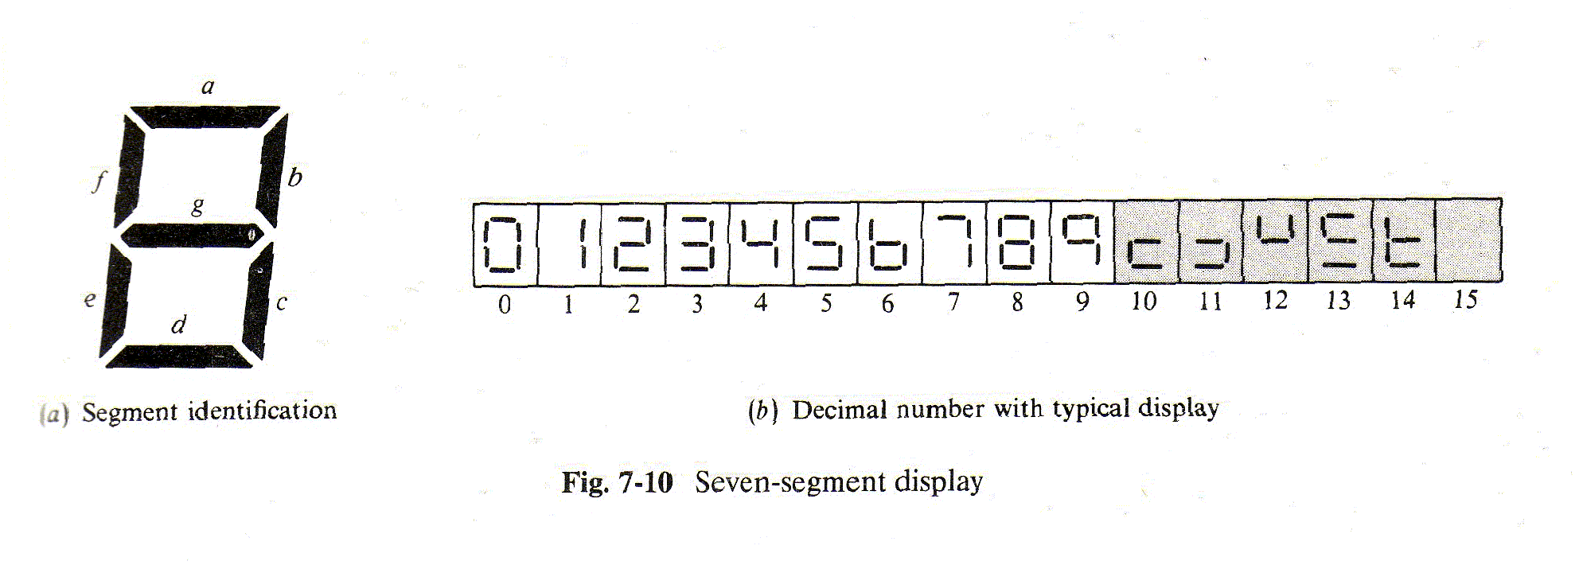
Seven Segment Display

Slide 4
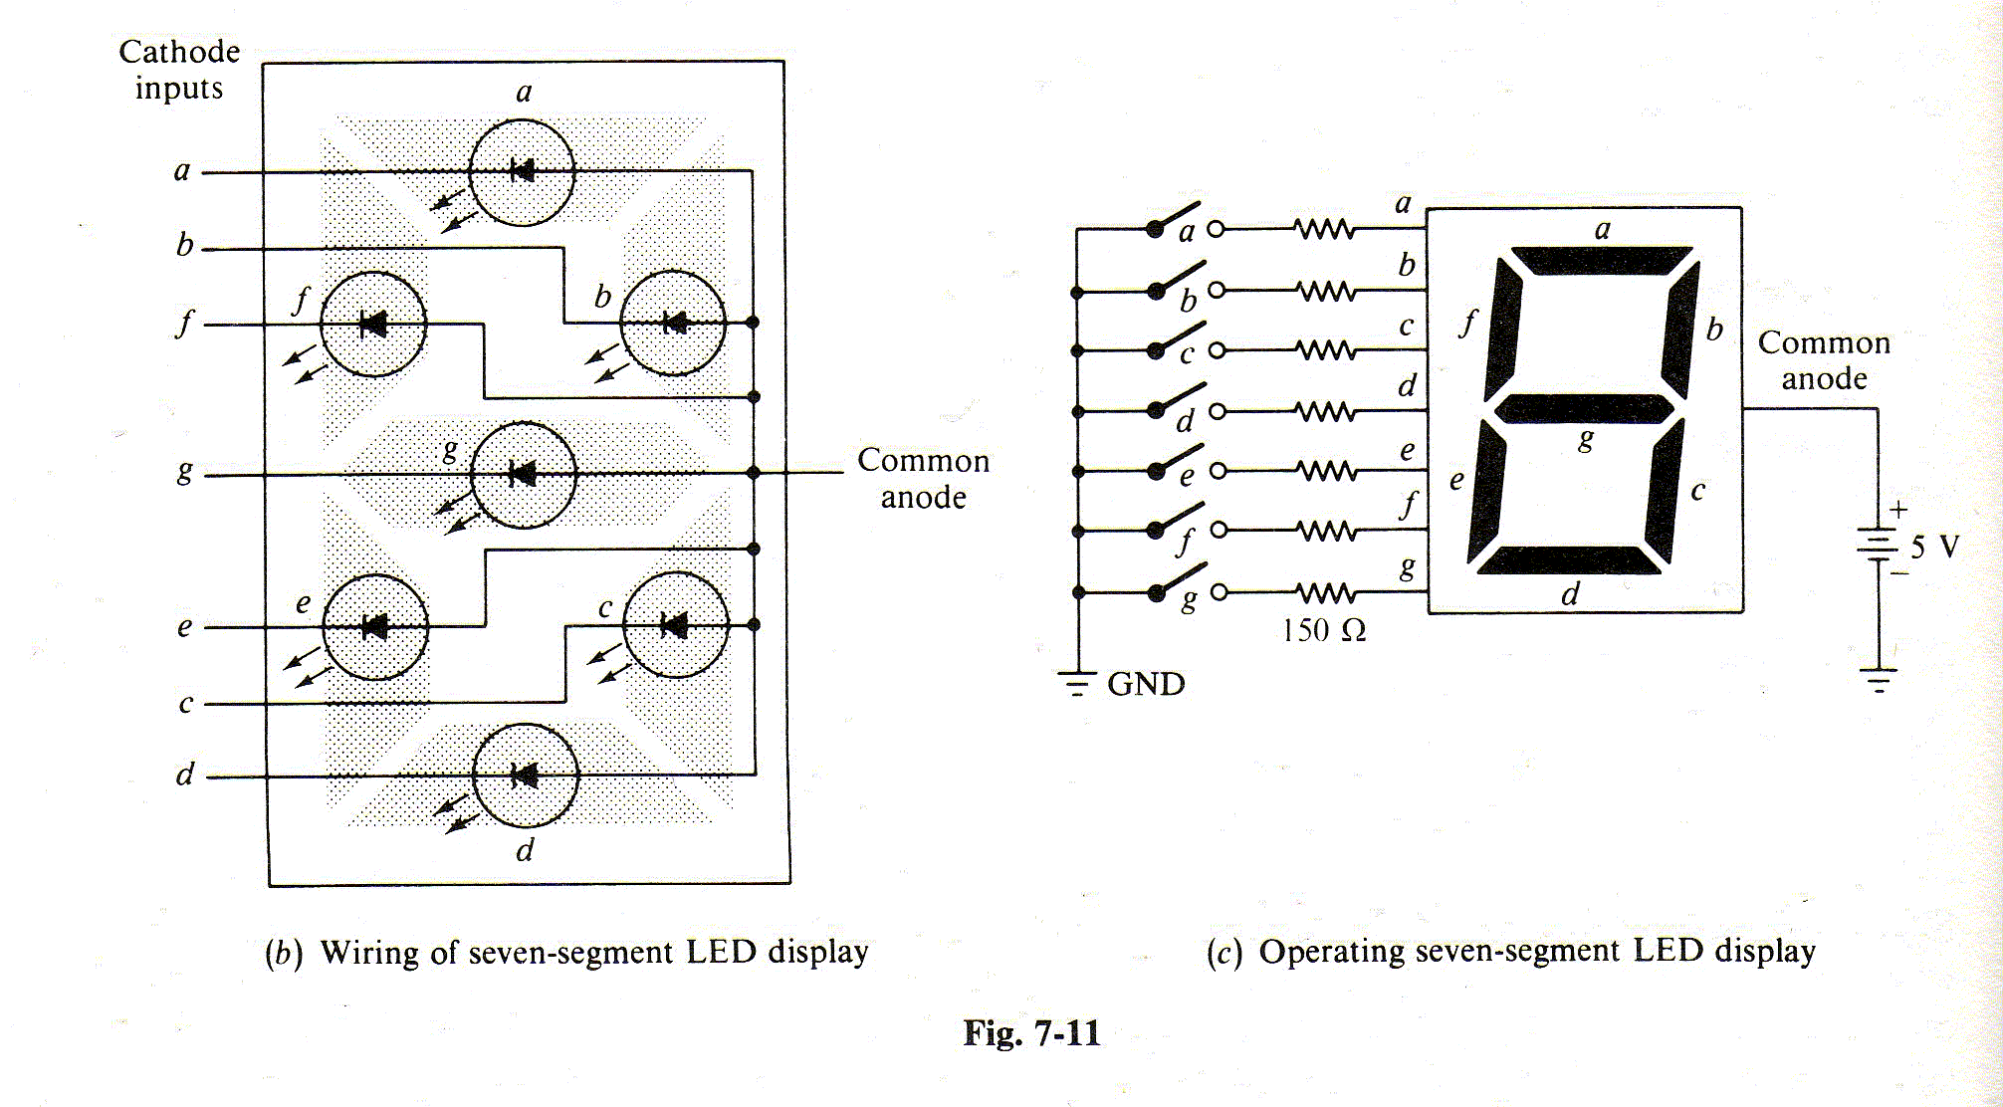
Seven Segment Display

Slide 5
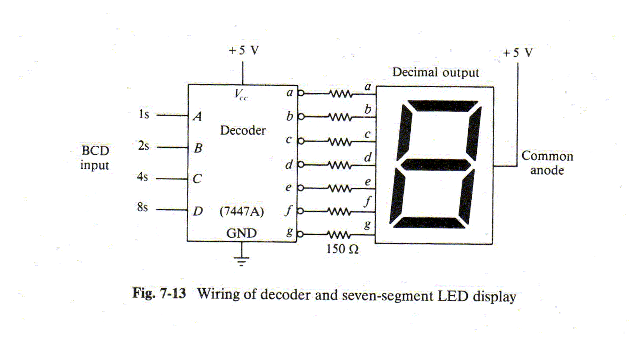
Seven Segment Display
Seven Segment Display Driver

Slide 6
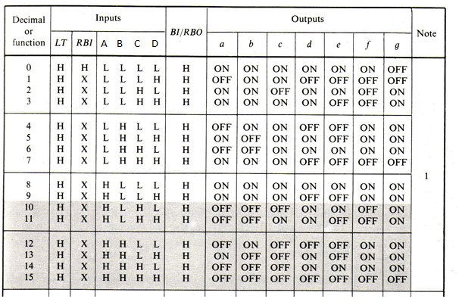
Seven Segment Display
Truth Table for Seven Segment Display Driver

Slide 7
Seven Segment Display Logic
Seven combinational logic circuits - one for each segment
Look at the logic for segment e – when is it on?
  A B C D Sum of Product Terms
  L L L L A B C D
  L L H L A B C D
  L H H L A B C D
  H L L L A B C D
How to factor this sum in order to simplify?

Slide 8
Karnaugh Map for Segment e
Put down all the 1’s for D, C, B, A = 0 through 9
Then, fill in 0’s for all other valid BCD input values
C D
C D
C D
C D
A B
1
0
0
1
A B
0
0
0
1
A B
A B
1
0

Slide 9
Don’t Cares in Karnaugh Map
That takes care of 10 out of 16 combinations
What about the other 6? They are “don’t cares”
C D
C D
C D
C D
A B
1
0
0
1
A B
0
0
0
1
A B
X
X
X
X
A B
1
0
X
X

Slide 10
Karnaugh Map for Segment e
Now we loop the largest areas that we can
Use “don’t cares” as 1’s if loops can be larger
  Segment e = B D + C D
C D
C D
C D
C D
A B
1
0
0
1
A B
0
0
0
1
A B
X
X
X
X
A B
1
0
X
X

Slide 11
Segment e Logic Circuit
BCD Inputs
A
B
C
D
B D
Not Used
e
C D

Slide 12
Test Segment e Logic Circuit
BCD Inputs
e
0
0
0
0
B D = 1
Not Used
e = 1
C D = 0

Slide 13
Test Segment e Logic Circuit
BCD Inputs
e
0
0
0
1
B D = 0
Not Used
e = 0
C D = 0

Slide 14
Test Segment e Logic Circuit
BCD Inputs
e
0
0
1
0
B D = 1
Not Used
e = 1
C D = 1

Slide 15
Test Segment e Logic Circuit
BCD Inputs
e
0
0
1
1
B D = 0
Not Used
e = 0
C D = 0

Slide 16
Test Segment e Logic Circuit
BCD Inputs
e
0
1
0
0
B D = 0
Not Used
e = 0
C D = 0

Slide 17
Test Segment e Logic Circuit
BCD Inputs
e
0
1
0
1
B D = 0
Not Used
e = 0
C D = 0

Slide 18
Test Segment e Logic Circuit
BCD Inputs
e
0
1
1
0
B D = 0
Not Used
e = 1
C D = 1

Slide 19
Test Segment e Logic Circuit
BCD Inputs
e
0
1
1
1
B D = 0
Not Used
e = 0
C D = 0

Slide 20
Test Segment e Logic Circuit
BCD Inputs
e
1
0
0
0
B D = 1
Not Used
e = 1
C D = 0

Slide 21
Test Segment e Logic Circuit
BCD Inputs
e
1
0
0
1
B D = 0
Not Used
e = 0
C D = 0

Slide 22
Test Segment e Logic Circuit
BCD Inputs
e
1
0
1
0 = DON’T CARE!
B D = 1
Not Used
e = 1
C D = 1

Slide 23
Can we do better than the map result?
Sometimes, if we look at the Boolean equation from the Karnaugh map for segment e:
Segment e = B D + C D
It can be factored:
Segment e = (B + C) D
Simpler Logic Diagram (Product of Sums):
B
C
e
D

