Slide 1
Homework
Reading
  Tokheim, Chapter 12-1 through 12-4

Slide 2
Read Only Memory (ROM)
PC uses it to hold BIOS for system and I/O drivers
Slow (100-200 nanoseconds)
Various forms:
  Read Only Memory (ROM)
  Programmable Read Only Memory (PROM)
  Erasable Programmable Read Only Memory (EPROM)
  Electrically Erasable Programmable ROM (EEPROM)
  Flash memory

Slide 3


Read Only Memory (ROM)
Diode Matrix Design
A2
A1
A0
Chip Enable
Three bit Decoder
O0
O1
O2
O3
O4
O5
O6
O7
D0
+5V
D1
Gnd
D2
Presence of a diode means a 1, absence of a diode = 0

Slide 4
Programmable ROM
Diode Matrix Design
A2
A1
A0
Chip Enable
Three bit Decoder
O0
O1
O2
O3
O4
O5
O6
O7
D0
+5V
D1
Gnd
D2
Starts with all diodes/all ones. Burn out diodes where value needs to be zero.

Slide 5
Random Access Memory (RAM)
Static RAM = an array of full flip-flops
Simple interface and fast (10-20 nsec) but more costly (2 - 4X) than ROM
Small capacity compared to Dynamic RAMs
A0 - A14
RAM
Chip
D0 - D7
CS#
W/R#
OE#

Slide 6
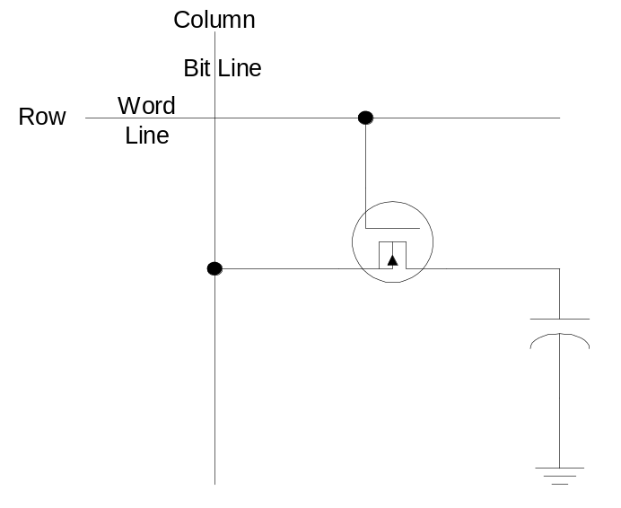
Dynamic RAM (DRAM)
Square array of simple one transistor memory cells
Capacitance at input to transistor remembers a 0 or 1
Reading contents of the cell is destructive
Over time, the charge leaks away (in milliseconds)

Slide 7
Dynamic RAM (DRAM)
For both reasons, HW must perform a memory refresh
Regularly reading/writing on a row and column basis
Advantages are:
  Cells are simple
  Uses less power
Disadvantage:
  Slower (20 - 30 nsec access time)
  Total cycle time is 2X due to refresh after read
Bottom line
  2-4X less chip area and 2-4X less power
  Interleaving and access in column or page mode

Slide 8
Example Layouts of Memory Parts
Organized 1 Meg x 1 or Organized 128K x 8
Address Bits
Address Bits
20
17
* * *
(1 Meg Bits)
(1 Meg Bits)
One Data Bit
Per Chip →
Need 32 Chips
For a 32 bit bus
Eight Data Bits
Per Chip →
Need 4 Chips
For 32 bit bus
Number of Data Bit Pins Attached to Data Bus

Slide 9
Full Address Decoding
Each location within a memory component responds to only one unique address
Need to use all the address lines in decoding
May choose not to fill-in some portions of the address space with real memory (empty spots)

Slide 10
Addressing Memory Components
CPU
A₂₃
Combinational
Logic
. . .
CS1#
A₁₂
CS0#
A₁₁
. . .
A₀₁
A₀₀
M0
4K x 8
M1
4K x 8
CS0#
CS1#
D₀-D₇
W/R#
D₀-D₇
W/R#
D₀-D₇
W/R#

Slide 11
Memory Map and Comb. Logic
00 0000
00 0FFF
A23
A22
A21
A20
A19
A18
A17
A16
A15
A14
A13
A12
A11
A10
A09
A08
CS0
CS0
0
0
0
0
0
0
0
0
0
0
0
0
X
X
X
X
CS1
00 1000
00 1FFF
00 2000
CS1
0
0
0
0
0
0
0
0
0
0
0
1
X
X
X
X
Empty Space
(Bus Error
If Accessed)
A₂₃
*
*
*
A₂₂
.
.
.
.
.
.
CS1#
A₁₃
CS0#
A₁₂
FF FFFF

Slide 12
Partial Address Decoding
Simpler and less expensive
Some address lines are NOT used in the address decoding process to generate chip enable signals
Many groups of addresses can map to the same physical memory chip

Slide 13
Partial Address Decoding
CPU
A₂₃
.
A₁₂
A₁₁
.
A₀₁
A₀₀
M0
4K x 8
M1
4K x 8
D₀-D₇
R/W*
CS0#
CS1#
D₀-D₇
R/W#
D₀-D₇
R/W#

Slide 14
Memory Map for Partial Decoding
00 0000
00 0FFF
CS0
CS0
00 1000
00 1FFF
CS0 is repeated 2,048 times in the
memory space 00 0000 to 7F FFFF
* * *
CS0
7F FFFF
80 0000
CS1
CS1
CS1 is repeated 2,048 times in the
memory space 80 0000 to FF FFFF
* * *
CS1
FF FFFF

Slide 15
Comb. Logic for CS0 and CS1
00 0000
00 0FFF
A23
A22
A21
A20
A19
A18
A17
A16
A15
A14
A13
A12
A11
A10
A09
A08
CS0
CS0
0
X
X
X
X
X
X
X
X
X
X
X
X
X
X
X
CS0
00 1000
00 1FFF
CS1
1
X
X
X
X
X
X
X
X
X
X
X
X
X
X
X
* * *
CS0
CS1#
7F FFFF
80 0000
CS1
CS1
A₂₃
CS0#
* * *
CS1
FF FFFF

Slide 16
Mixed Address Decoding
A mixture or a compromise between partial and full address decoding
Divide the memory space into a number of fully decoded blocks, generally of equal size
Use high-order address bits to select the block and low-order address bits to select a sub-block

Slide 17
Comb. Logic for CS0, CS1, CS2, & CS3
A23
A22
A21
A20
A19
A18
A17
A16
A15
A14
A13
A12
A11
A10
A09
A08
CS0
0
0
0
0
0
0
0
0
0
0
0
0
X
X
X
X
CS1
0
1
0
0
0
0
0
0
0
0
0
0
X
X
X
X
A23
A22
A21
A20
A19
A18
A17
A16
A15
A14
A13
A12
A11
A10
A09
A08
CS2
1
X
X
X
X
X
X
X
X
X
X
0
X
X
X
X
CS3
1
X
X
X
X
X
X
X
X
X
X
1
X
X
X
X
A₂₃
CS2#
Logic Diagram for CS0# and CS1#
Similar to Diagram on Slide 11
Except A₂₂ and A₁₂ are swapped
CS3#
A₁₂

Slide 18
Memory Map for Mixed Decoding
CS0
00 0000
00 0FFF
Empty
00 1000
3F FFFF
CS0/CS1 each decoded only once in the
memory space 00 0000 to 7F FFFF
CS1
40 0000
40 0FFF
Empty
40 1000
7F FFFF
80 0000
CS2
CS3
CS2/CS3 are repeated 1,024 times in the
memory space 80 0000 to FF FFFF
* * *
CS3
FF FFFF

