Slide 1
Homework
Reading
  Tokheim, Section 13-5 (Three State Buffers only)

Slide 2
Buses
Concept is to link together multiple functional units over a common data highway at a lower cost than using multiple point to point links
E
E
A
A
OR
Bus
D
D
B
B
C
C
Number of Links = n * (n – 1) / 2

Slide 3
Bus - Essential Part of Any Computer
CPU
Primary
Memory
Secondary
Memory
I/O
Data
Address
Control

Slide 4
Tri-state Logic Outputs
Since we can have multiple masters on a bus, we need Tri-state logic for attachment to a bus so that each device can choose to drive or not drive the bus depending on whether it is the bus master for a given bus cycle
Tri-state logic prevents a bus conflict where one device is driving a signal to 1 and another device is driving it to 0 at the same time - generates high current through wires (and smoke?)

Slide 5
Tri-State Logic
The problem with connecting multiple “normal” outputs together on a bus is that each has to be in one logic state (0) or the other (1) - driving voltage on each bus signal high or low
This represents a conflict over the state of the signal
We resolve this conflict with tri-state logic
Logically
Electrically
Truth Table
A
A
+5v
enable A Output
  0 0 (Z)
  0 1 (Z)
  1 0 1
  1 1 0
enable
output
0v

Slide 6
Tri-State Logic and Buses
The logical element has output enable pin to go from a floating output to drive the output from the circuit
Inverters and buffers are used as bus drivers or buffers
  Two such drivers or buffers in opposite directions are used to make the connection bi-directional
  The gates also provide more “drive” onto the bus so that the bus signals are stronger and the bus can be longer
enable_{in}
Device
Bus
enable_{out}

Slide 7
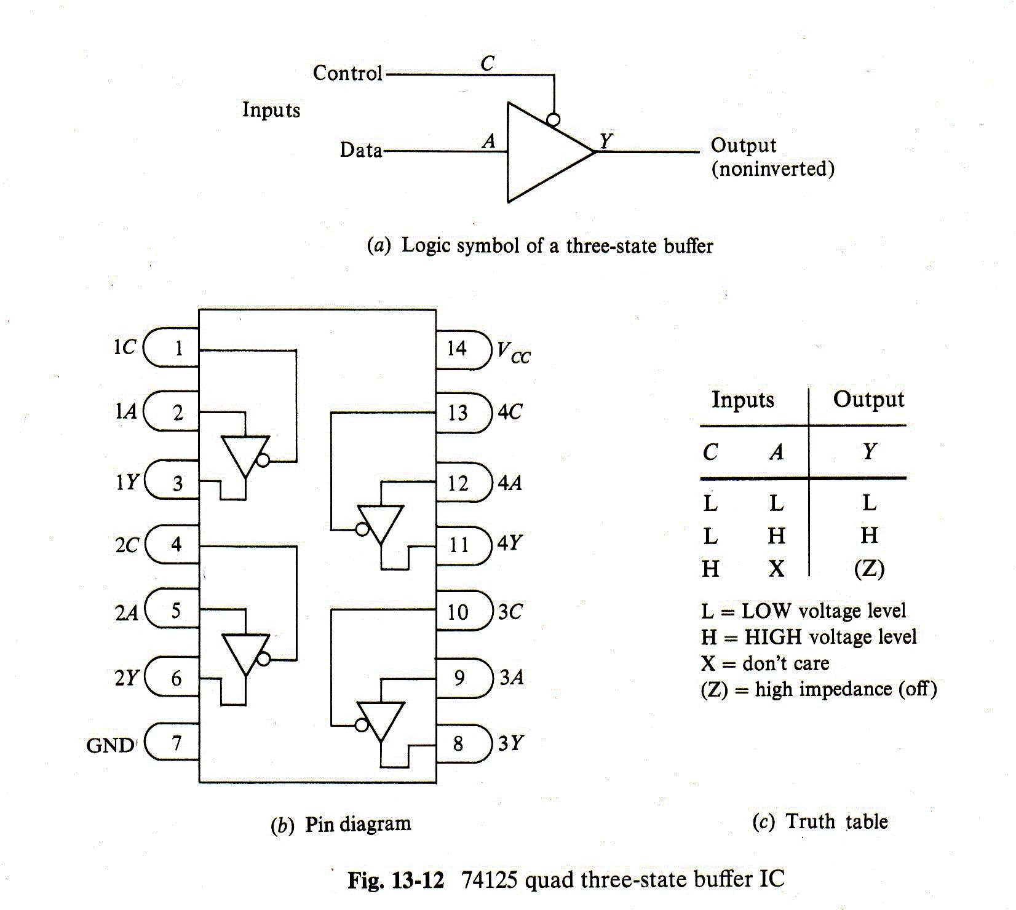
Tri-State Logic and Buses

Slide 8
Bus Master – Slave Relationships
During any specific bus cycle, only one device attached to the bus is allowed to drive it
Driving the bus means that a device is forcing each signal on the bus to a high or low state
For the data bus, the processor, a memory chip, or an I/O device may be driving the data bus during a specific read or write bus cycle
Specific signals on the address and control bus select a device to be the master on the data bus

Slide 9
Bus Master – Slave Relationships
Up till now, I have said that the address bus and the control bus are always driven by the processor, however that is NOT really true!
That was only a “lie of simplification”!
The processor is NOT the only device that may be driving the address and control busses
Hopefully you are now well-prepared for me to un-simplify a bit ☺

Slide 10
Bus Arbitration
Bus arbitration is used to hand off a bus between one of several potential bus masters using signals that are a part of the bus itself
A bus arbitration protocol implements some form of bus request and bus grant handshake to determine which device will be the master on the bus for the next bus cycle

Slide 11
Bus Master – Slave Relationships
Other devices that potentially can be the master on the address and control bus are:
  Direct Memory Access (DMA) Controller
  DRAM controller to refresh the stored bits
  Other processors in multiprocessor architectures
We’ll only discuss the first application above, but not at the level of programming for it in detail – too hard to un-simplify that

Slide 12
Direct Memory Access
You thought that handling an I/O device under interrupt control was pretty good – right?
Wrong!
The overhead to process an interrupt for each byte of data is still relatively costly in terms of processor time
  Process interrupt and stack context of processor
  Fetch and execute instructions of ISR
  Move data from I/O device or memory to processor register
  Move data from processor register to memory or I/O device
  Restore context of processor and resume background code
It is better if an I/O device like a disk can transfer data directly to or from the memory without the processor needing to execute any in or out instructions!

Slide 13
Direct Memory Access
We add a DMA Controller (DMAC) to our system, e.g. Intel 8237A DMA controller chip
The DMAC has the capability of becoming the bus master on the address and control bus for one or more “channels” transferring data between an I/O device and memory, e.g. 8237A supports 4 channels
We connect DMA Request and DMA Acknowledge signals between the I/O device and the DMAC
Software in the CPU sets up the DMAC to transfer an entire sequence of bytes between memory buffer and the I/O device or vice versa
During each byte transfer, the DMAC drives address and control bus signals instead of the processor

Slide 14
Direct Memory Access
Processor
Control Bus (M/IO#, W/R#, and D/C# Signals)
Tri-state
Control
DMAC
Interface
Address Bus
Hold Req
Tri-state
Control
DMA
Req
I/O
Device
Memory
Hold Ack
DMAC
DMA
Ack
P
I
C
Tri-state
Control
Tri-state
Control
Tri-state
Control
Int
TC
(Transfer
Complete)
Tri-state
Control
Data Bus
DMA Fetch-and-Deposit
Data Transfer

Slide 15
Direct Memory Access
Processor
Control Bus (M/IO#, W/R#, and D/C# Signals)
Tri-state
Control
DMAC
Interface
Address Bus
Hold Req
Tri-state
Control
DMA
Req
I/O
Device
Memory
Hold Ack
DMAC
DMA
Ack
P
I
C
Tri-state
Control
Tri-state
Control
Tri-state
Control
Int
TC
(Transfer
Complete)
Tri-state
Control
Data Bus
DMA “Fly-by” Data Transfer
(More Efficient)

Slide 16
DMA Controller Details
Hold Req
4
DMA Req
Hold Ack
DMA Arbitration Logic
DMA Ack
4
Control Register(s)
DMA Channels 1 - 3
Enables
DMA Channel 0
Status Register(s)
Base Count
Transfer
Complete
-1
Current Count
Current Count = -1
Fetch and Deposit
Data Register(s)
Base Address
Current Address
+1
Data Bus
(Tri-State Drivers)
Address Bus
(Tri-State Drivers)

Slide 17
DMAC Programming
Generalized Steps for Programming DMAC
  Allocate a suitably-sized memory buffer
  Disable the DMA channel being programmed (Note that cli does not stop DMA cycle stealing)
  Set the Base Address Register with buffer address
  Set the Base Count Register with size of transfer
  Set the DMA transfer mode
  Enable the DMA channel to start the transfer

Slide 18
DMAC Operation
When requested, the DMAC arbitrates with the CPU to be the master on the address and control busses
It executes a bus cycle to transfer a byte of data from memory (or I/O device) to I/O device (or memory)
While DMA controller is bus master, the CPU can not access memory or I/O devices
This is called “Cycle Stealing” (the DMA controller steals bus cycles from the processor)
It takes less time than executing an ISR for each byte

Slide 19
DMAC Bus Arbitration
I/O Device
DMAC
Memory
Processor
DMA Request
Hold Request Asserted
Time
Hold Acknowledge asserted
DMA Acknowledge
Data Transfer to/from Memory via Busses)
Cycle Stealing
Time Interval
Data Transfer to/from Memory via Busses)
Hold Request De-asserted
Hold Acknowledge de-asserted

Slide 20
DMAC Operation
When the DMAC finishes transferring an entire block of data between I/O device and memory
  It interrupts the processor (via Transfer Complete (TC) signal to the PIC)
  ISR software in the processor sets up DMAC again for transferring the next block of data
Processor gets interrupted for I/O handling much less often than once per byte of data
Hence, much better processor performance

Slide 21
Tri-State Bus Summary
All devices have tri-state logic connections to the data bus – may be driving or receiving
Memory and I/O devices don’t need tri-state logic on address/control bus (never drive them)
Because the processor may need to yield the control/address busses, it must have tri-state logic for driving those bus signals
DMAC controller must have tri-state logic for driving the control and address bus signals

