Slide 1
Homework
Reading
  None (Finish all previous reading assignments)
Machine Projects
  Continue with MP4

Slide 2
X86-64 Architecture
The x86-64 architecture is a 64-bit superset of the 32-bit x86 instruction set architecture
x86-64 was designed by AMD who named it AMD64
It has been cloned by Intel under the name Intel 64
This leads to the vendor-neutral names x86-64 or x64
All instructions in the x86 instruction set can be executed by x86-64 CPUs
x86-64 should not be confused with the Intel Itanium architecture known as IA-64 which is not compatible at native instruction set level with x86 or x86-64

Slide 3
X86-64 Architecture
Full support for 64-bit integers
  All general-purpose registers are expanded from 32 bits to 64 bits
  All arithmetic and logical operations, memory-to-register, and register-to-memory operations are now directly supported for 64-bit integers
  Pushes and pops on the stack are always in eight-byte strides, and pointers are eight bytes wide

Slide 4
X86-64 Architecture
Additional registers
  The number of named registers is increased from 8 (i.e. eax, ebx, ecx, edx, ebp, esp, esi, edi) to 16
  Compilers can keep more local variables in registers rather than on the stack
  Can use registers for frequently accessed constants
  Arguments for small and fast subroutines may also be passed in registers to a greater extent

Slide 5
X86-64 Architecture
Larger virtual address space
  Current models can address up to 256 terabytes (1 TB =1000 gigabytes)
  Expandable in the future to 16 exabytes (1 EB = 1million TB)
  Compared to just 4 gigabytes for 32-bit x86
Larger physical address space
  Current models can address up to 1 terabyte
  Expandable in the future to 4 petabytes (I PB=1000 TB)

Slide 6
Intel/HP Itanium Processor
Intel Itanium architecture (formerly called IA-64)
The architecture originated at Hewlett-Packard and was jointly developed by HP and Intel
Intel released two processor families using this brand name: the original Itanium and Itanium 2
Starting November 1, 2007, new members of the second family are again called Itanium
The processors are marketed for use in servers and high performance computing systems

Slide 7
Intel/HP Itanium Processor
Itanium's architecture differs dramatically from the x86 architectures (and x86-64 extensions) used in other Intel processors.
It is based on explicit instruction-level parallelism with the compiler making decisions about which instructions to execute in parallel
This approach allows the processor to execute up to six instructions per clock cycle
By contrast with other superscalar architectures, Itanium does not have elaborate hardware to keep track of instruction dependencies during parallel execution – instead the compiler must keep track of these at build time

Slide 8
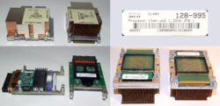

Intel/HP Itanium Processor

Slide 9
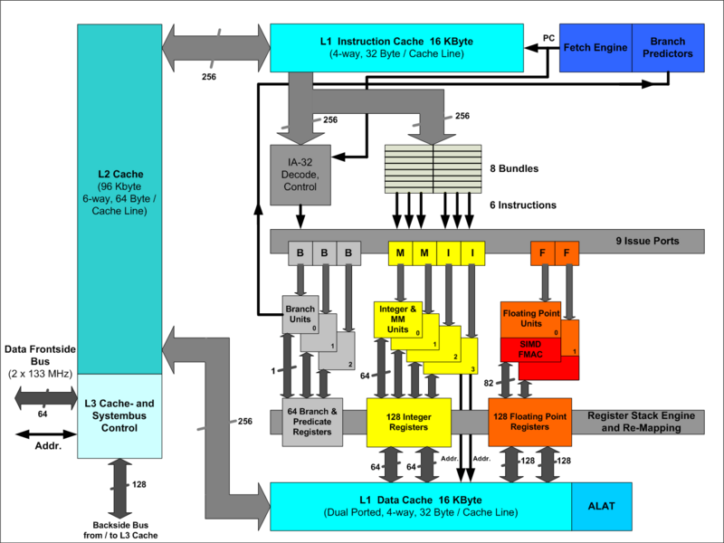
Intel/HP Itanium Processor

Slide 10
Intel/HP Itanium Processor
HP produces most the Itanium-based systems, but several other manufacturers have developed systems based on Itanium
As of 2007, Itanium is the fourth-most deployed microprocessor architecture for enterprise-class systems behind x86-64, IBM POWER, and SPARC
Intel released its latest Itanium (codenamed Montvale) in November 2007

Slide 11
Evolution of Computer Power
Electronic Numerical Integrator and Computer (ENIAC) in 1946-47
    17,500 Vacuum Tubes
    7200 Crystal Diodes
    1500 Relays
    70,000 Resistors
    10,000 Capacitors
    Five million hand soldered joints
    Weighed 30 tons, took 1800 ft², 150 KWatts of power
In 1995, 7.44mm x 5.29 mm, 20MHz chip

Slide 12
Moore’s Law
Gordon Moore made a famous observation in 1965, just four years after the first planar integrated circuit was discovered
Moore observed an exponential growth in the number of transistors per chip and predicted that this trend would continue
Moore's Law, the doubling of transistors every couple of years, has been maintained, and still holds true today

Slide 13
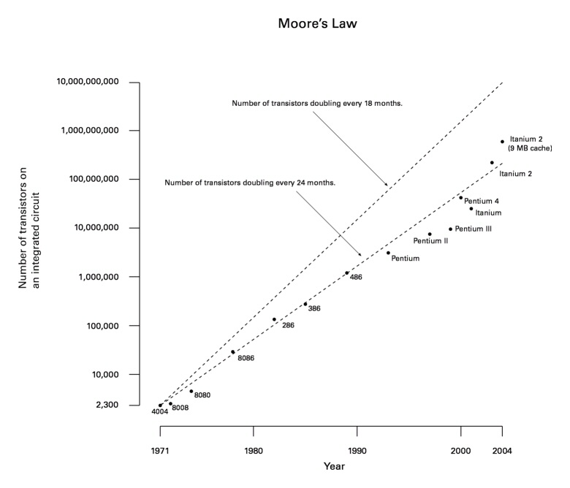
Moore’s Law

Slide 14
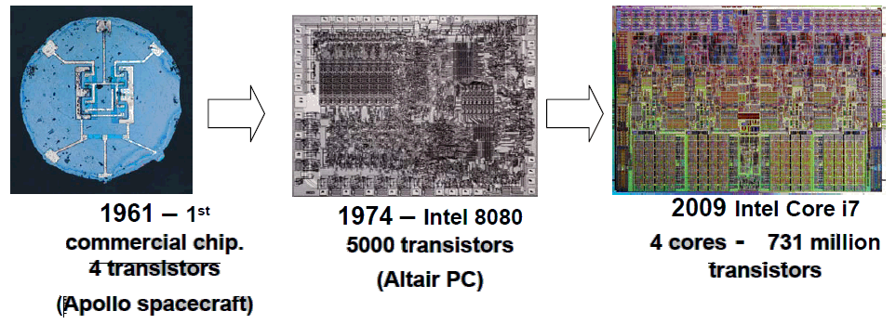
Moore’s Law

