Slide 1
Descriptive statistics for continuous features
Fundamentals of Machine Learning for Predictive Data Analytics,
John Kelleher and Brian Mac Namee and Aoife D’Arcy
Appendix A

Slide 2

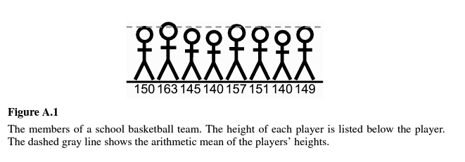

Central tendency
Central tendency refers to the value that is typical of the sample
Arithmetic mean (or sample mean, or mean)

Slide 3
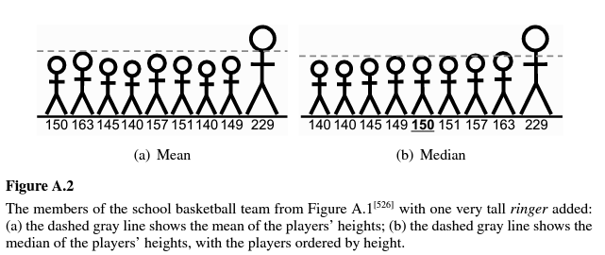
Median and mode
Median: the middle value when you order the values from lowest to highest
Mode: most commonly occurring value

Slide 4
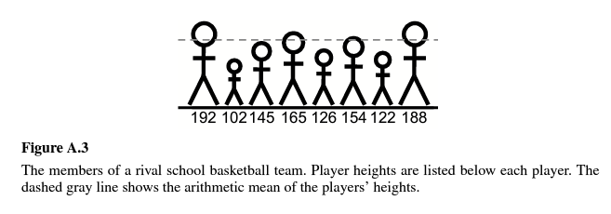
Variation
Range = max – min
Very sensitive to outliers
Range(sample_Fig1) = 163-140 = 23
Range(sample_Fig3) = 192-102=90

Slide 5



Variance
Variance
(for the sample in Fig 1)
(for the sample in Fig 3)

Slide 6
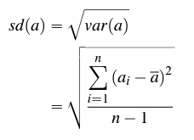
Standard deviation
Standard deviation
sd(sample_Fig1) = 8.08
sd(sample_Fig3) = 31.94

Slide 7
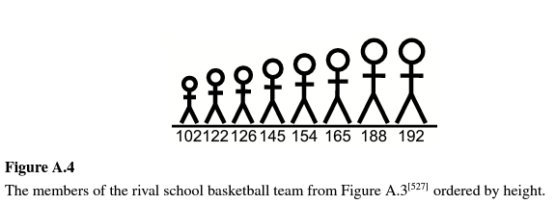

Percentiles
i^{th} percentile:
proportion of $\frac{i}{100}$ of the values in a sample are equal or lower than the i^{th} percentile

Slide 8
1st and 3rd quartile
Lower quartile (or 1st quartile)
the median of the lower half of the data
Upper quartile (3rd quartile)
the median of the upper half of the data

Slide 9
Descriptive statistics for categorical features

Slide 10
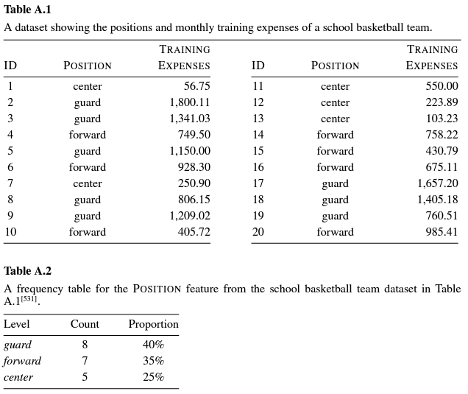
Frequency count and proportion

Slide 11
Mode
Mode – most frequent level
Second mode – 2nd most frequent level
Example
Mode → “guard”
2nd mode → “forward”

