Slide 1
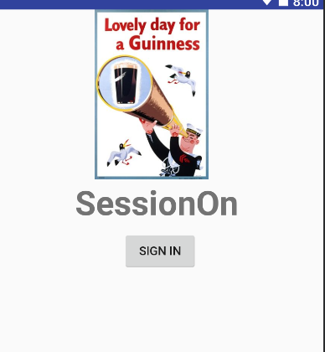
SessionON
By: Céin O’Rourke

Slide 2
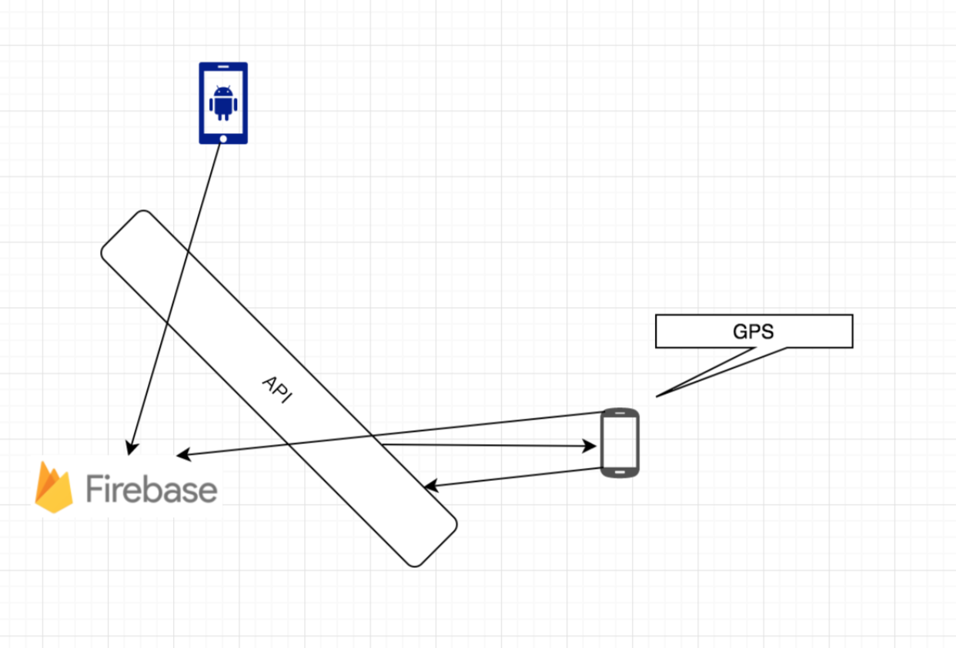
Components
Architecture
Libraries
Authentication
Realtime Database

Slide 3
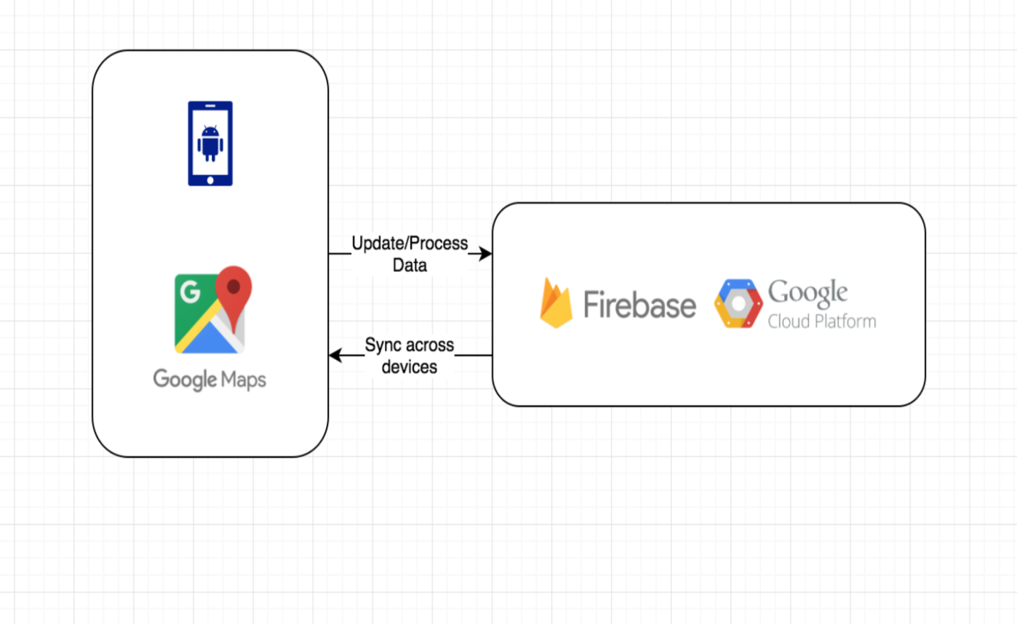
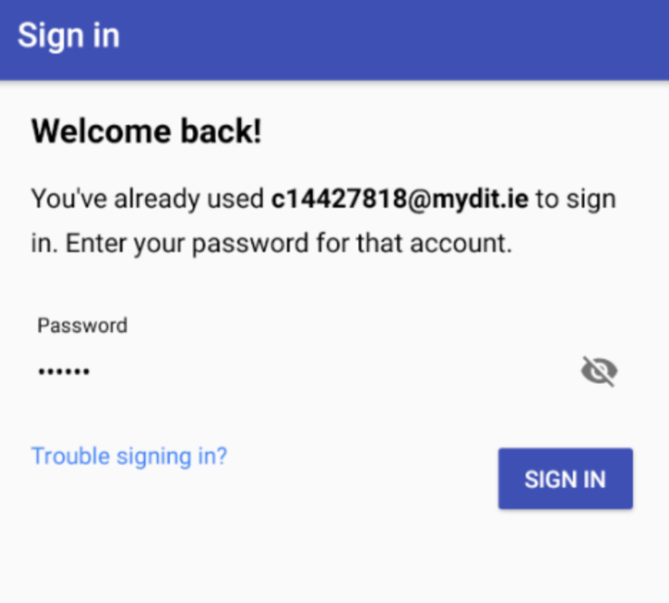
Layout
Functionality
Google Maps activity
Sign In
Online List

Slide 4
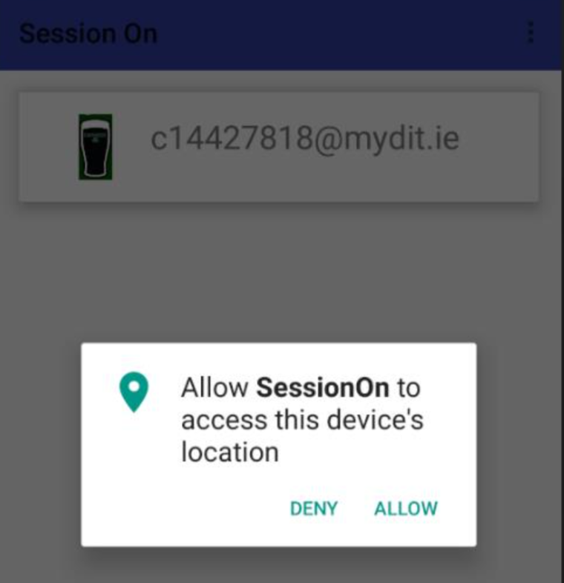
Abilities
User Abilities
Location Broadcasting

Slide 5
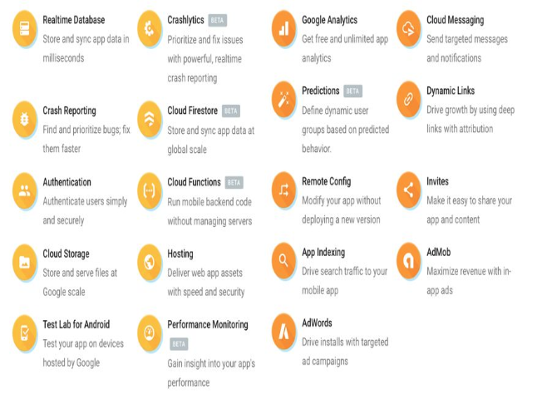
Firebase
Abilities
What it gives to the app
Security
Stability

Slide 6
The App
Sign In
Join the Online list
See Who else is online and where
Live location tracking and updating

Slide 7

Questions

