Slide 1
Card Game Assistant
By Kyle Heffernan, Eoin Gallagher & Ryan Byrne

Slide 2
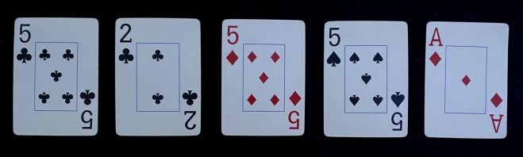
Basic Idea
The program will take in a hand of cards
It isolates each card
It extracts the value and symbol
It uses character recognition to determine the value
It compares with sample symbols to determine the symbol
It determines the value of the hand and displays results

Slide 3
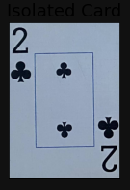
Isolating Card
It finds the biggest 5 contours
Uses WarpPerspective to straighten cards
Left with 5 equal size cards

Slide 4
Isolating Value and Symbol
For each card, get a percentage of the dimensions
Crop the top left corner
Split the crop into Value and Symbol

Slide 5
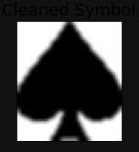
Symbol Comparison
Threshold to get mask of symbol
Fill mask with fillPoly and resize
Compare with sample suits
Return most similar suit

Slide 6
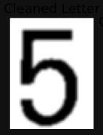
Character Recognition
Clean cropped image
Use Tesseract method to convert to string
Error checking

Slide 7
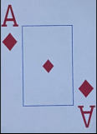
Determining Hand and Result
All of the card values are displayed
Using rules of poker, hand is determined
The card values and the hand is displayed

Slide 8
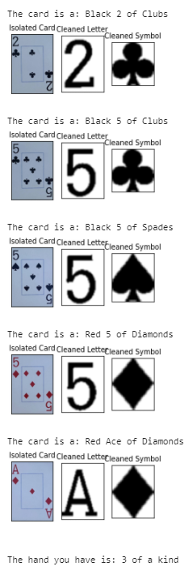
In summary
Assuming reasonable quality of input our program determines the value, suit and colour of all cards
It also tells the user what poker hand they have
Thank you for listening.
Any Questions?

