Slide 1
Advanced Analytics in IDM

Slide 2


Slide 3
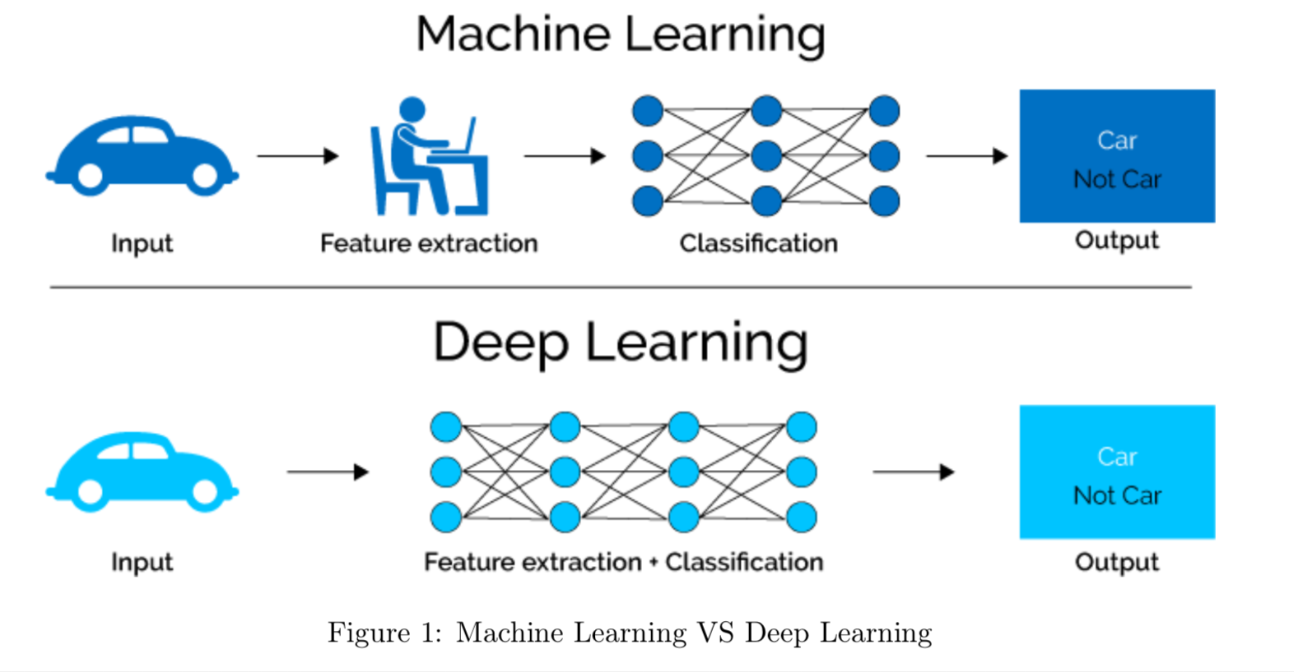

Slide 4
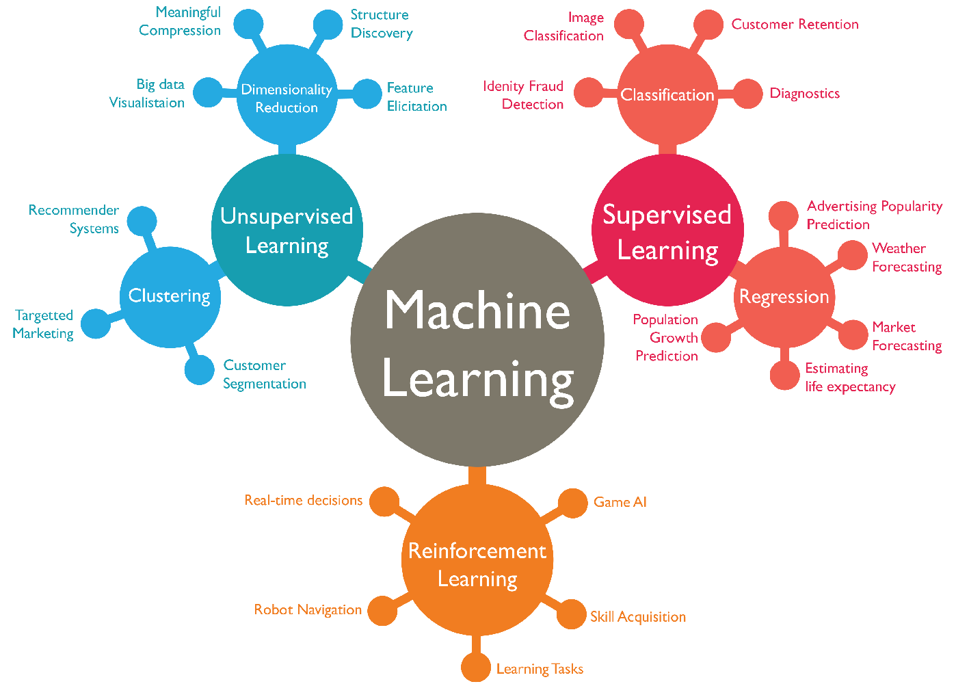
What is Machine Learning
Notes:
We are going to be working in the supervised learning space. This is made up of classification and regression. Classificatoin is if you want to know if something belongs to a category. Say you are coming up with an algorithm to determine the picture is a dog or a cat. Or is it a hot dog?

Slide 5
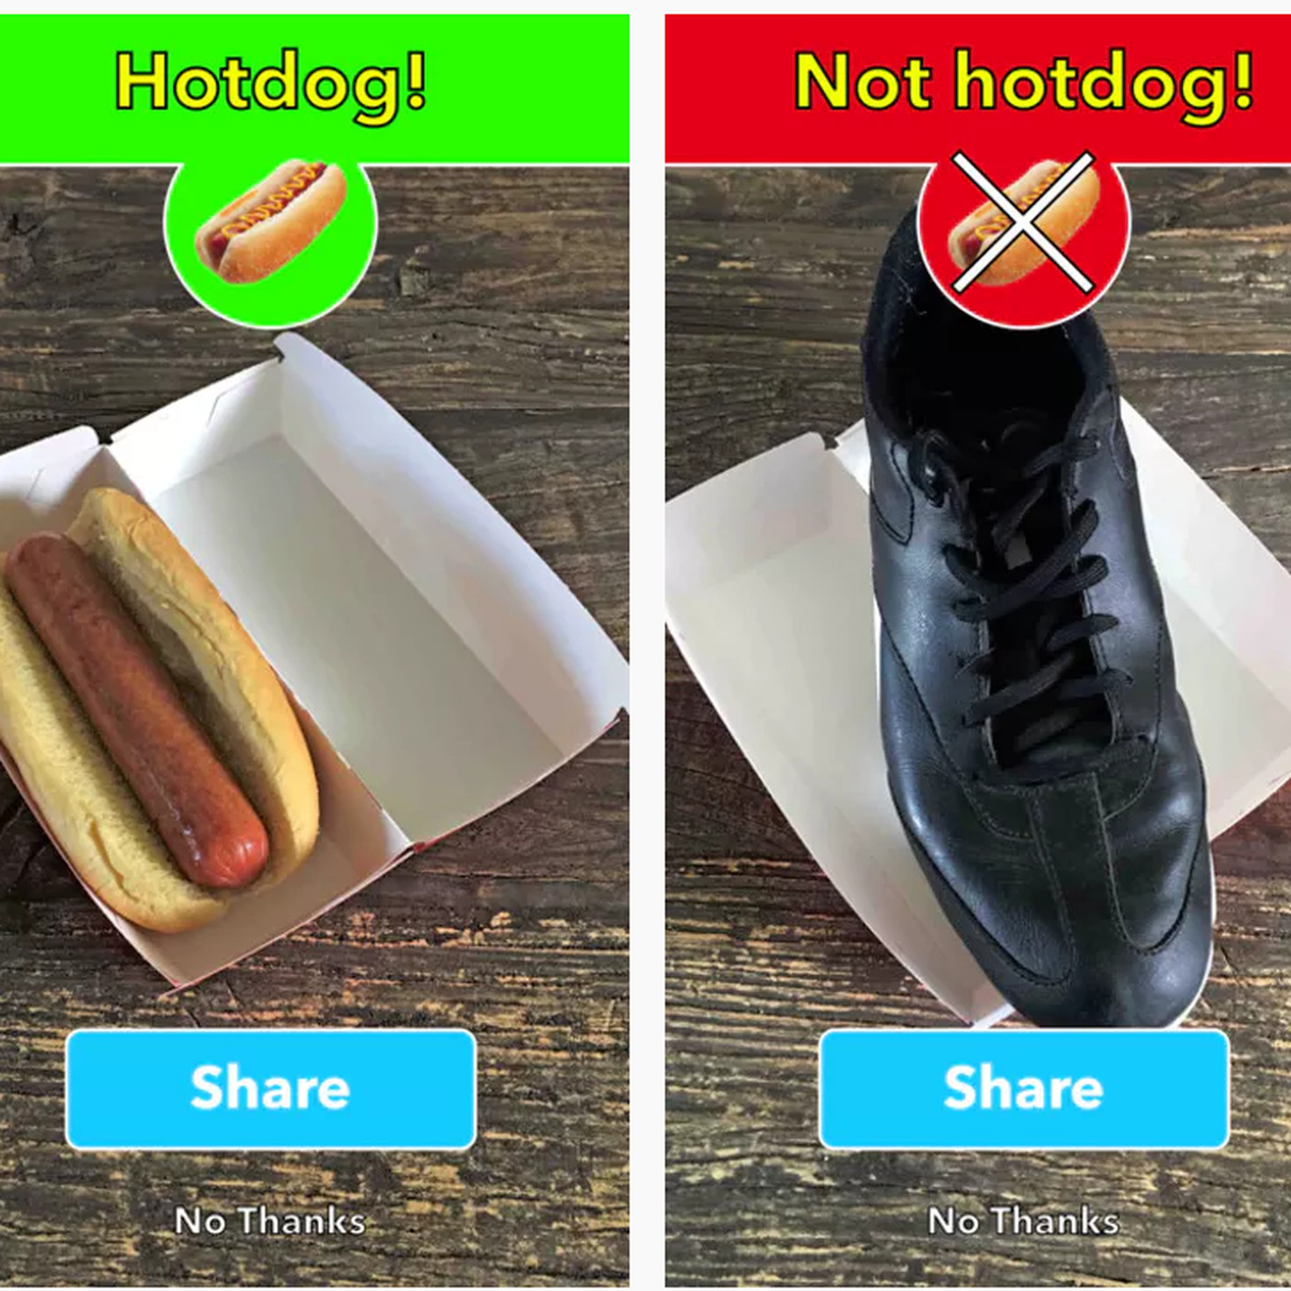
Example of Classification

Slide 6
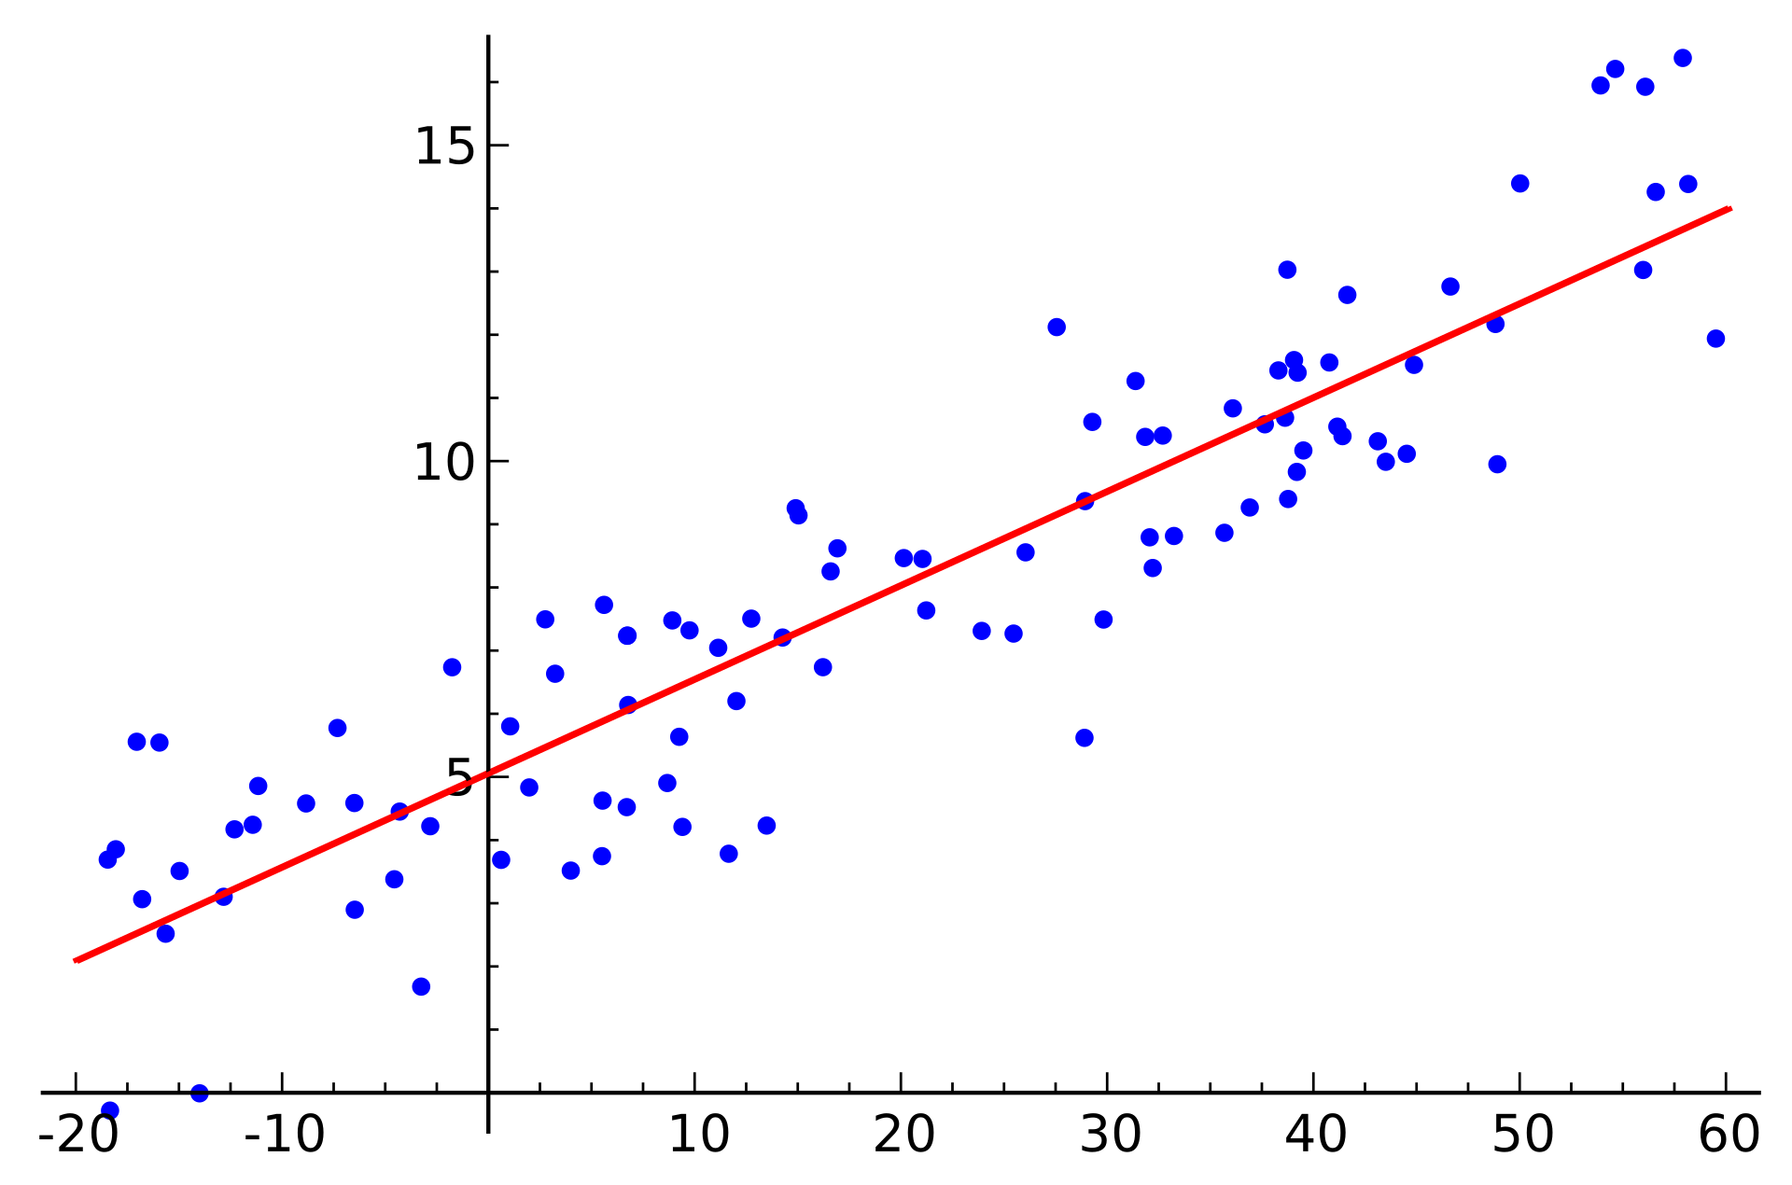
Regression
Notes:
Yes, it bugs me that there are no labels on these axis

Slide 7
Want to learn more about Machine Learning
Enjoy

Slide 9
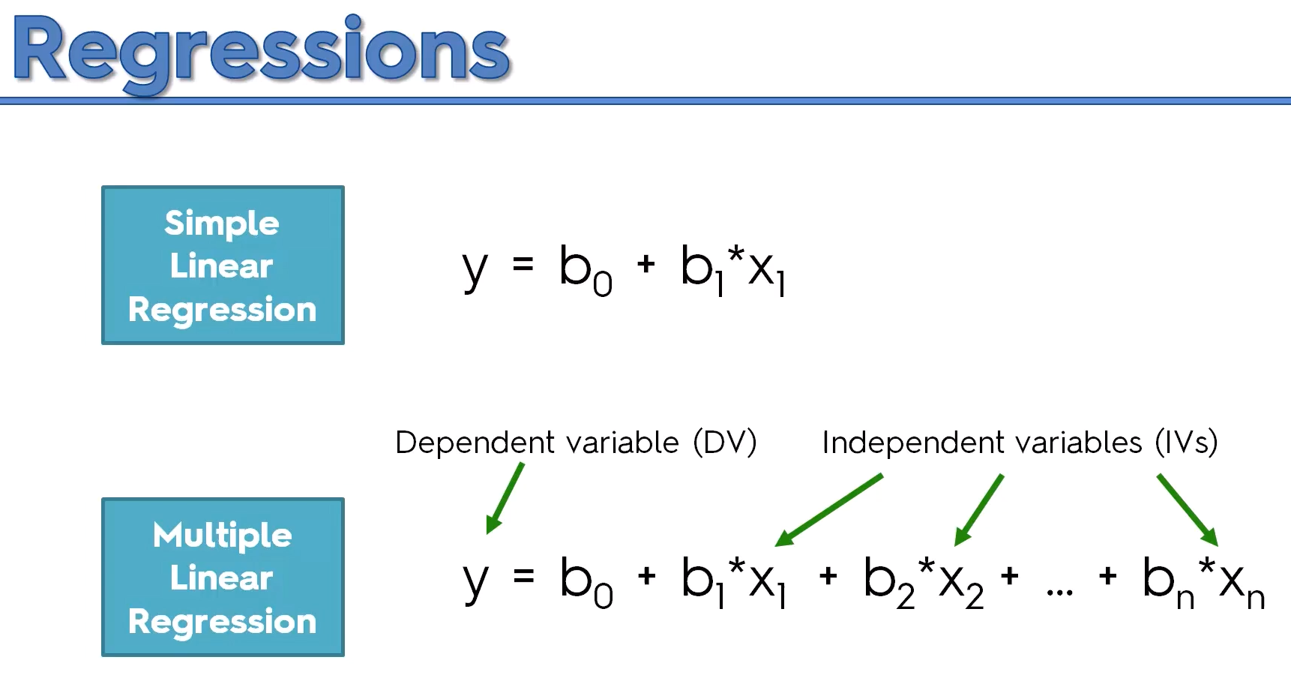

Slide 10
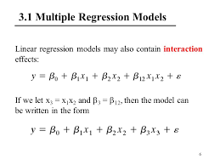

Slide 11
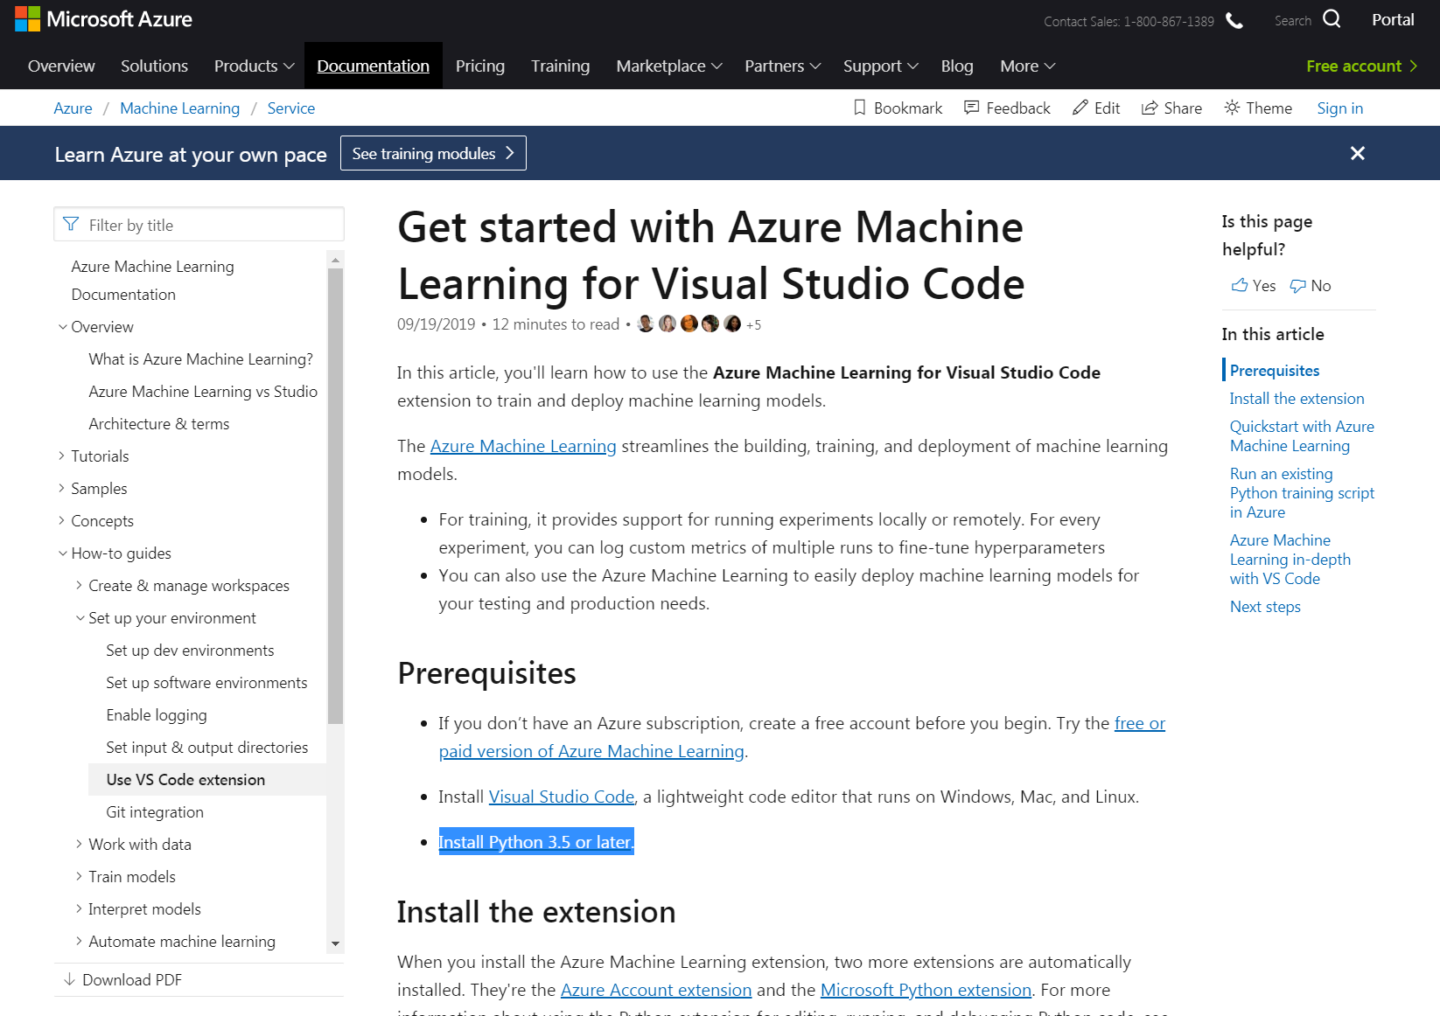
Python is industry standard for Machine Learning

