Slide 1
1-Number System
This section reviews binary numbers, hexadecimal numbers, and binary arithmetic
© 2014 B. Wilkinson Modification date: Sept. 2015 (edited by Mostafavi)
This material is for the sole and exclusive use of students at UNC-Charlotte. It is not to be sold, reproduced, or generally distributed.

Slide 2
Number representation
Decimal Numbers
A positional number system - uses digits multiplied by powers of 10 that depend upon the position of the digit.
Example
Decimal number 235 = 2 x 10² + 3 x 10¹ + 5 x 10⁰
The 10 is the base of the number system and results in ten different digits values, 0, 1, 2, 3, 4, 5, 6, 7, 8, and 9.
Ten chosen probably because we have ten fingers.
However any fixed value could be used for the base.

Slide 3
Binary Numbers
The base is two. Two digits - 0 and 1.
Example
Binary number 110001 = 1x2⁵ + 1x2⁴ + 0x2³ + 0x2² + 0x2¹ + 1x2⁰
= 49 in decimal.
Binary more convenient in computers as then only two digits to represent. Less engineering problems.
Digits of a binary number called bits (binary digits).
Eight bits called a byte.

Slide 4
Question
What is the binary number 1101 in decimal?
What is the largest binary number that can be held in a byte, given only positive numbers are represented?

Slide 5
Number conversion
Small decimal numbers easily converted to binary by adding powers of 2:
Decimal 64 32 16 8 4 2 1
2⁶ 2⁵ 2⁴ 2³ 2² 2¹ 2⁰
Binary 1000000 0100000 0010000 0001000 0000100 0000010 0000001
Powers of 2 that add up to the number found, starting with largest power of 2 less than number.
Example
25 = 16 + 8 + 1 = 10000 + 01000 + 00001 = 11001
Formal conversion methods exist.

Slide 6
Question
What is the decimal number 234 in binary?

Slide 7
Hexadecimal numbers
Positional number system using base 16. Sixteen different digits.
Use 0, 1, 2, 3, 4, 5, 6, 7, 8, 9 for the first ten values, 0 to 9.
Letters of the alphabet used for remaining values, 10, 11, 12, 13, 14, 15, i.e.
A is used for 10
B is used for 11
C is used for 12
D is used for 13
E is used for 14
F is used for 15
A hexadecimal digit is often referred to as a “hex” digit

Slide 8
Hexadecimal number system has a special part to play because very simple way of converting between binary numbers and hexadecimal numbers.
Because base (16 = 2⁴) is the fourth power of binary base (2), a group of four binary bits corresponds to one hex digit.
To convert a binary number into hexadecimal number
Divide binary number into groups of four digits and convert each group into one hexadecimal digit:
Example
To convert binary number 11110111₂ into hexadecimal:
1111 0111₂ = F7₁₆
15 = F
7

Slide 9
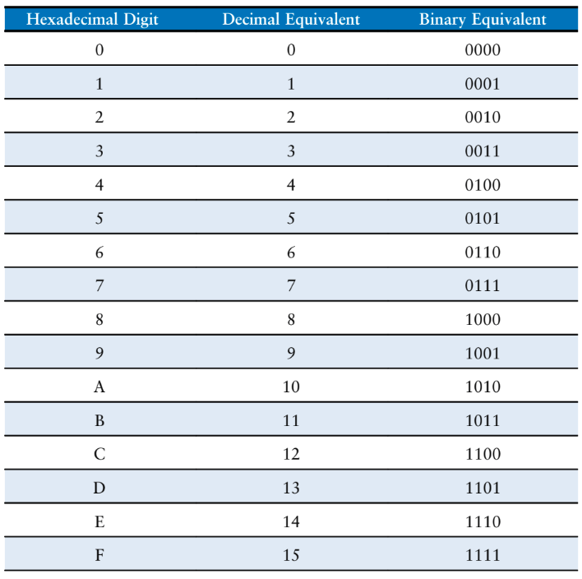

Slide 10
Question
Convert the hexadecimal number A3D₁₆ into binary.

Slide 11
Performing arithmetic with binary numbers
Addition
We learn the tables for decimal addition, subtraction, and multiplication, which requires every combination of the ten digits in decimal.
In binary, similar tables can be constructed, but there are only four combinations of two digits, 0 and 0, 0 and 1, 1 and 0, and 1 and 1.
For addition: 0 + 0 = 0
0 + 1 = 1
1 + 0 = 1
1 + 1 = 10

Slide 12
Binary addition in tabular form:
Adding two binary digits together
A | B | SUM |  | Decimal
0 | 0 | 0 | 0 | 0
0 | 1 | 0 | 1 | 1
1 | 0 | 0 | 1 | 1
1 | 1 | 1 | 0 | 2

Slide 13
Adding two binary numbers
First least significant pair of digits added together as in decimal.
In decimal, if result greater than 9, a “carry” is generated which is added to the next pair of digits (e.g. 7 + 8 = 5 and a carry of 1) and so on with subsequent pairs of digits.
In binary, if the number is greater than 1, a carry is generated to be added to the next pair of digits (e.g. 1 + 1 = 0 and a carry of 1).

Slide 14
Comparison of adding in decimal and adding in binary
Suppose the numbers 22₁₀ and 28₁₀ are to be added.:
Decimal Binary
2 2 1 0 1 1 0
2 8 1 1 1 0 0
5 0 1 1 0 0 1 0
1
1
1
1
Carry
Rules essentially the same whether decimal or binary. Pairs of digits added together, starting with least significant digits.
For decimal, results greater than 9 produce a carry
For binary, results greater than 1 produce a carry.
Just as in decimal, we may now need to add three digits, the two digits of the two numbers together with a carry digit.

Slide 15
Eight combinations of three binary digits
Adding three binary digits together
A | B | Cin | Cout | SUM | Decimal
0 | 0 | 0 | 0 | 0 | 0
0 | 0 | 1 | 0 | 1 | 1
0 | 1 | 0 | 0 | 1 | 1
0 | 1 | 1 | 1 | 0 | 2
1 | 0 | 0 | 0 | 1 | 1
1 | 0 | 1 | 1 | 0 | 2
1 | 1 | 0 | 1 | 0 | 2
1 | 1 | 1 | 1 | 1 | 3

Slide 16
Question
Add 81₁₀ and 63₁₀ in binary. Confirm the binary answer by converting it back to decimal.
Answer

Slide 17
Negative numbers and subtraction
For implementation reasons, subtraction usually done by the “addition of complements.”
Can be applied to any number system.
Revolves around the “complement” of a number being used to represent the negative of the number.

Slide 18
2’s complement (for binary numbers)
The 2’s complement of a binary number, N, is given by :
2^{n} - N
where there are n digits in the number.
Example
Suppose there were four digits.
The 2’s complement of the binary number 0010 (2) would be:
10000 - 0010 = 1110
Represents -2

Slide 19
Decimal | Binary
+7 | 0111
+6 | 0110
+5 | 0101
+4 | 0100
+3 | 0011
+2 | 0010
+1 | 0001
0 | 0000
-1 | 1111
-2 | 1110
-3 | 1101
-4 | 1100
-5 | 1011
-6 | 1010
-7 | 1001
-8 | 1000
Two’s complement representation

Slide 20
Subtraction
To perform subtraction of Y from X, the 2’s complement of Y is formed to create -Y. Then, we add -Y to X. In doing this, we perform:
X - Y = X + (-Y) = X + (2^{n} - Y) = X - Y + 2^{n}

Slide 21
Question
Convert the binary number 0101010 into its 2’s complement negative using the method “invert the digits and add 1”.
Convert previous answer back to a positive number using the same method.
Subtract 63₁₀ from 14₁₀ in decimal. Repeat in binary.

Slide 22
Appendix

Slide 23
Subtraction
To perform subtraction of Y from X, the 2’s complement of Y is formed to create -Y. Then, we add -Y to X. In doing this, we perform:
X - Y = X + (-Y) = X + (2^{n} - Y) = X - Y + 2^{n}
Next, we have to prove that this is the correct answer no matter what value X and Y are.

Slide 24
X - Y = X + (-Y) = X - Y + 2^{n}
X - Y positive: The term 2^{n} is a number given by 1 and n zeros (1000 … 000). If we truncate the number at n digits, the 2^{n} term will be ignored and we get the correct positive answer.
X - Y negative: Get correct negative answer in the 2’s complement representation is produced naturally, i.e. 2^{n} - (Y - X).

Slide 25
Examples
(a) X and Y positive, and X > Y. The answer is positive.
Suppose X = 0110 (6) and Y = 0011 (3). Then -Y = 1101 (-3), and 6 - 3 is given by:
Decimal Binary
6 0 1 1 0
-3 1 1 0 1
3 0 0 1 1
1
1
Notice a final carry generated corresponding to the 2^{n} term, but ignored.

Slide 26
Examples
(b) X and Y positive, and X < Y. The answer is negative.
Suppose X = 0011 (3) and Y = 0110 (6). Then -Y = 1010 (-6), and 3 - 6 is given by:
Decimal Binary
3 0 0 1 1
-6 1 0 1 0
-3 1 1 0 1
1
A final carry is not generated in this case, and the answer is the correct negative representation of 3.

Slide 27
Examples
(c) X positive and Y negative. The answer is always positive.
Suppose X = 0011 (3) and Y = 1101 (-3). Then -Y = 0011 (+3), and 3 - (-3) is given by:
Decimal Binary
3 0 0 1 1
-(-3) 0 0 1 1
6 0 1 1 0
1
1
A final carry is not generated in this case, and the answer is the correct positive representation of 6.

Slide 28
Examples
(d) X negative and Y positive. The answer is always negative.
Suppose X = 1101 (-3) and Y = 0011 (3). Then -Y = 1101 (-3), and -3 - 3 is given by:
Decimal Binary
-3 1 1 0 1
-3 1 1 0 1
-6 1 0 1 0
1
1
1
A final carry is generated corresponding to the 2^{n} term but is ignored.

Slide 29
Forming 2’s complement
The definition:
2^{n} - N
suggests subtraction If this subtraction had to be done by the normal means, we have not eliminated the subtraction process.
Fortunately, the 2’s complement can be obtained without subtracting Y from 2^{n}.

Slide 30
Rule of thumb - “invert the digits and add 1”
Starting from:
2^{n} - X = (2^{n} - 1) - X + 1
and
2^{n} - 1 = 011 … 11
(because 2^{n} is 100 … 00). Therefore
2^{n} - X = (011 … 11 - X) + 1
If we subtract any number from 011 … 11, digits inverted (all 1’s to 0’s and all 0’s to 1’s). Then, we must add one to the result.
Therefore, simple method to create the 2’s complement of any number: “invert the digits and add 1”.

Slide 31
VERY IMPORTANT
“Invert the digits and add 1” is only a method.
It is not the definition of the 2’s complement number – that is given by 2^{n} - N.

