Slide 1
2-Logic Gates
Circuits to manipulate 0’s and 1’s. 0’s and 1’s used for numbers
Also to make decisions within the computer. In that context, 1 corresponds to TRUE and 0 corresponds to FALSE.
© 2015 B. Wilkinson Modification date: Sept. 2015 (edited by Mostafavi)
2015
This material is for the sole and exclusive use of students at UNC-Charlotte. It is not to be sold, reproduced, or generally distributed.

Slide 2
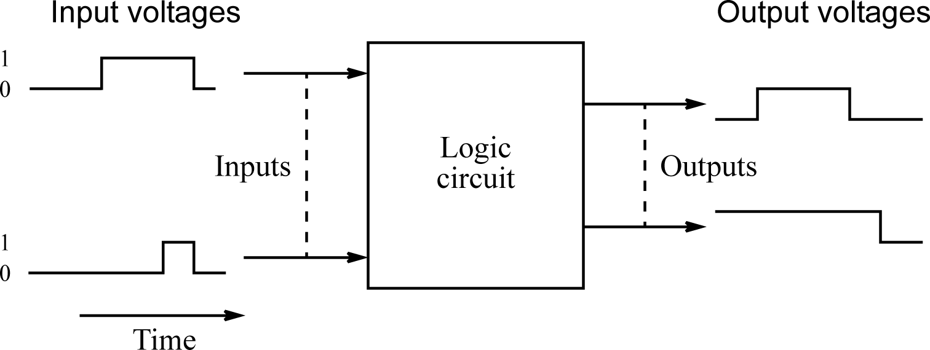
A voltage level will represent each of the two logic values.
For example +5V might represent a logic 1 and 0V might represent a logic 0.
The logic signals change over time during operation:

Slide 3
Algebraic manipulation of two-valued variables
Expressions with two-valued variables were developed by Boole in the 19th century.
Then, the motives were not to produce a digital system; it was to reason about the truth or otherwise of statements.
However, there is a direct relationship between the algebra of Boole (Boolean algebra) and “switching” circuits.

Slide 4
Basic logic functions
There are three fundamental operations in Boolean algebra from which all logic functions can be developed, namely:
NOT
AND
OR
These and some other simple functions are implemented by circuits called gates.
A gate accepts one or more logic signals and produces a logic output according to a basic logic function of the inputs.

Slide 5
NOT Operation
Often need to be able to change a variable from one value to the value, i.e. from a 1 to a 0 or from a 0 to a 1.
The NOT operation is applied to a single variable, A say, and produces the opposite logic value to A.
If A is a 1, NOT A is a 0 and if A is a 0 NOT A is a 1.
NOT operation on a variable A is written as A¯

Slide 6
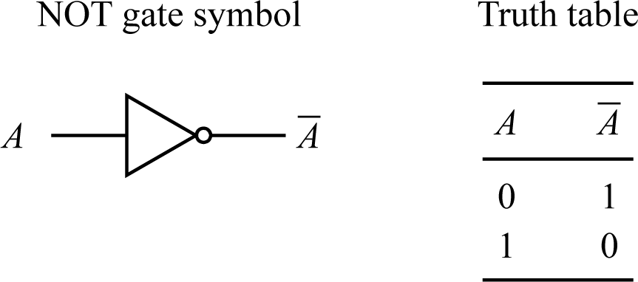
NOT gate
NOT gate sometimes called an inverter. The bubble on the output of the symbol shows inversion. Bubbles are used freely in logic symbols to show inversion and can be applied to both inputs and outputs.
A truth table lists the output for each possible input value.

Slide 7
AND Operation
A fundamental operation is detecting when two logic signals are both a 1. The AND operation captures these situations with the following definition:
The AND operation, operating on two variables A and B, produces a 1 if A is a 1 “and” B is a 1, otherwise the result is a 0.
AND operation indicated by the symbol ⋅, i.e. A “and” B written as A⋅B.
Usually the ⋅ symbol is omitted, i.e. A⋅B is written as AB.

Slide 8
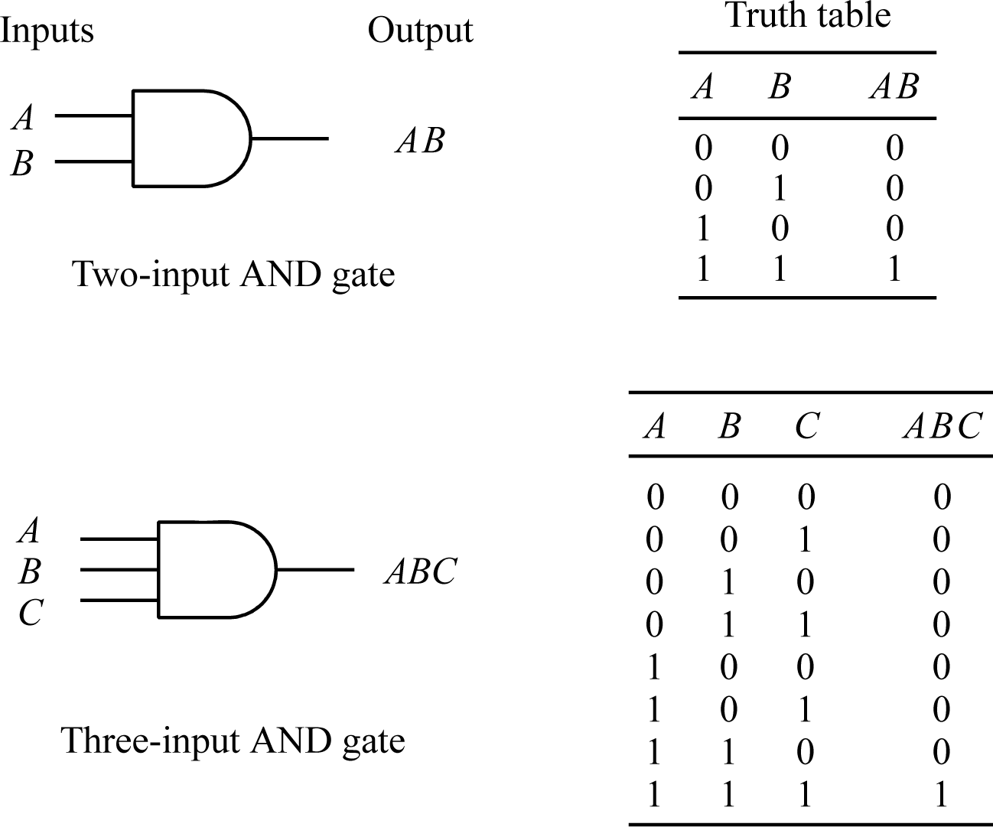
AND gate symbol and truth table

Slide 9
OR gate
Common requirement to show if at least one event is present as indicated by a variable being a 1. Can be captured in the OR operation, the final basic operation in Boolean algebra:
The OR operation applied to two variables, A and B, results in a 1 if A = 1 “or” B = 1, or both A and B are 1, otherwise the result is a 0 (i.e. when A and B are both a 0).
Symbol for OR operation is +.
A “or” B written as A + B.
Same symbol as arithmetic addition, but no ambiguity because arithmetic addition would not normally appear in a Boolean expression.

Slide 10
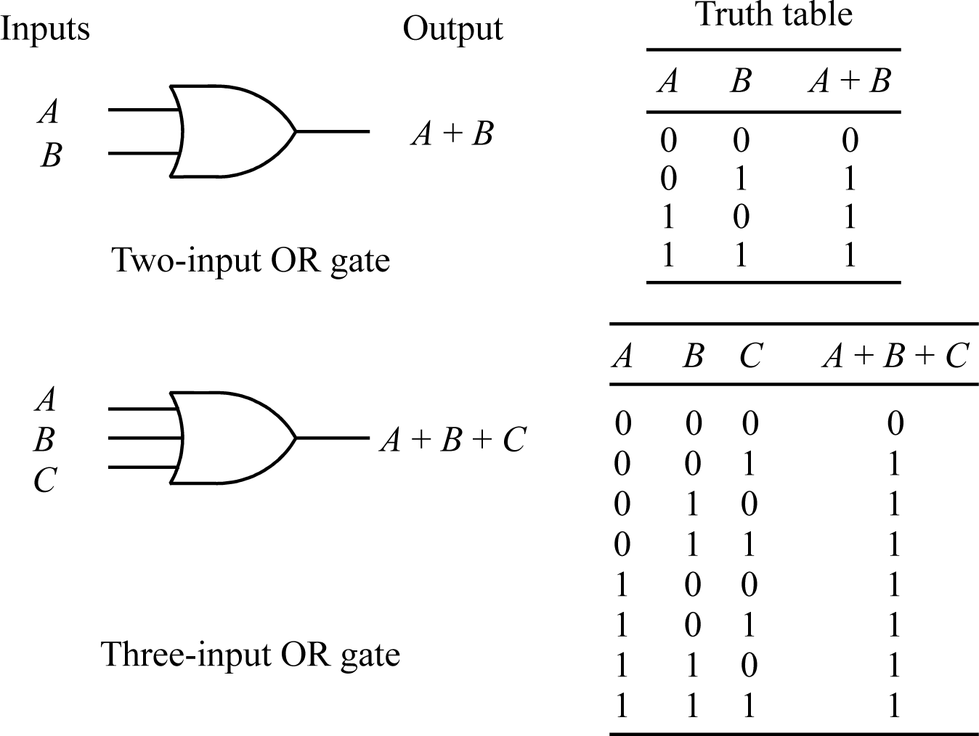
OR gate and truth table

Slide 11
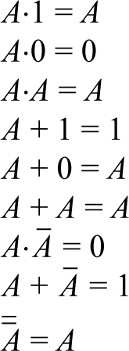
Boolean Identities
One question was posed after slides on NOT, AND, and OR gates. In fact, answers part of a set of basic identities, namely:

Slide 12
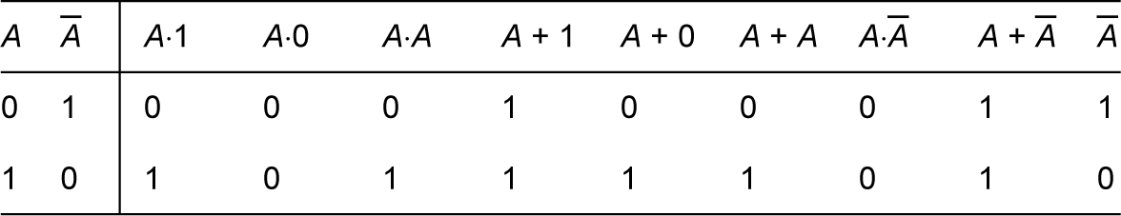
Can easily prove basic identities by simply listing all possible values of variables in a truth table.

Slide 13
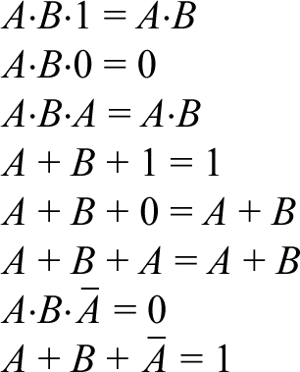
The basic identities can be extended to more variables, i.e.:
Question
Prove the identity A⋅B⋅1 = A⋅B using a truth table.
Answer

Slide 14
DeMorgan’s Theorem
A + B can only be a 0 in one instance, when both A and B are a 0. In all other instances, A + B is a 1.
AB can only be a 1 in one instance, when both A and B are a 1. In all other instances, AB is a 0.
Must be a relationship between AND and OR, given by:
A¯ + B¯ = AB
and the dual:
A ¯ B¯ = A + B
Known as DeMorgan’s Theorem.
Can be extended to more variables, i.e. A¯ + B¯ + C¯ = ABC
.

Slide 15
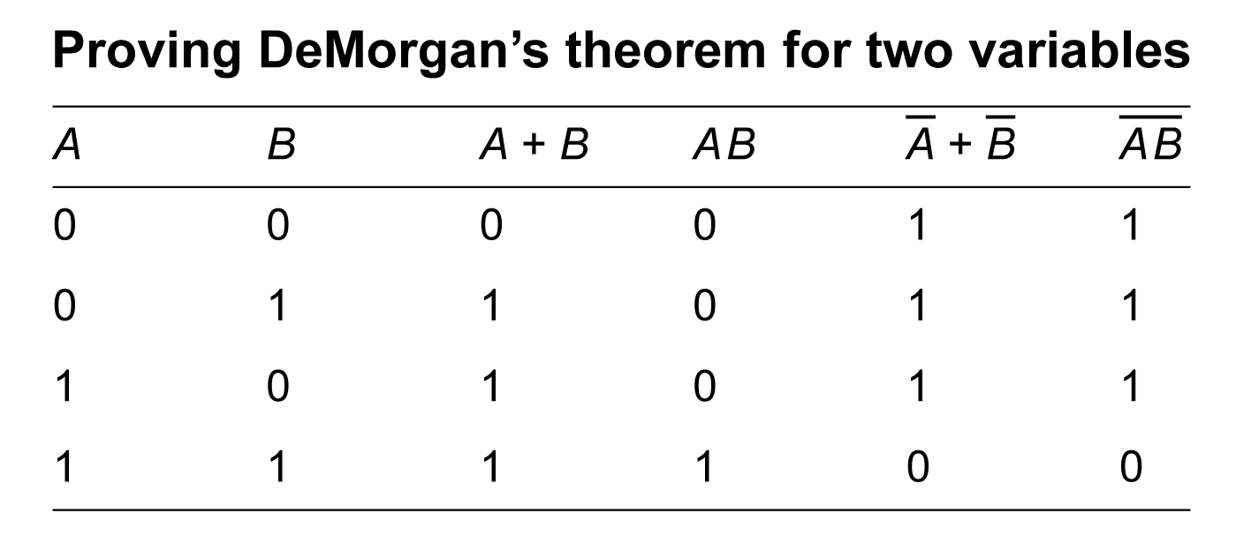
DeMorgan’s theorem (for 2 variables) can be proved by listing each function in a truth table and confirming that both are the same for each combination of A and B
(More variables done by induction.)

Slide 16
NAND gate
DeMorgan’s theorem provides a relationship between AND and OR.
Hence, of the three “basic” operations, AND, OR and NOT, only two are strictly necessary (AND and NOT or OR and NOT) because the third can be replaced by a function of the other two.
Can combine AND and NOT to form a “universal” operation, NOT– AND or NAND, which can be used to implement any Boolean expression. The NAND operation with two variables, A and B, is:
A “NAND” B = AB

Slide 17
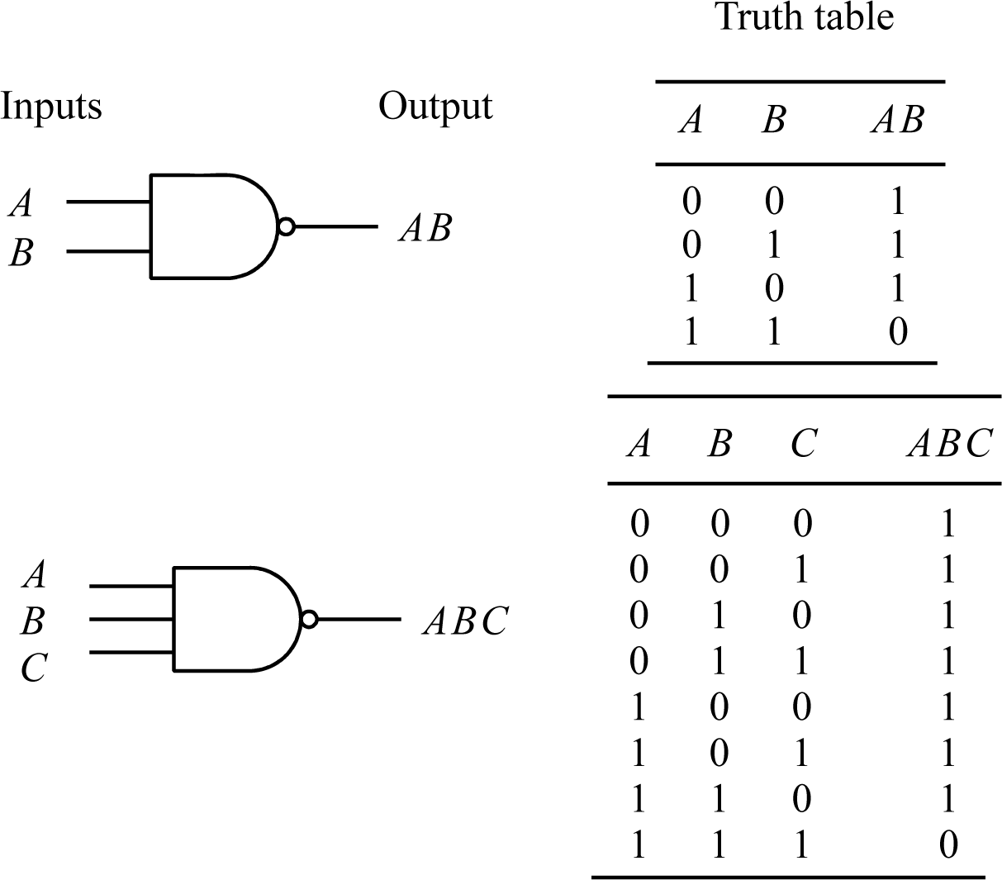
NAND gate symbol and truth table

Slide 18
NOR gate
Instead of combining AND and NOT, can combine OR and NOT to form a “universal” operation, NOT–OR or NOR, which can be used to implement any Boolean expression.
The NOR operation with two variables, A and B, is:
A “NOR” B = A + B

Slide 19
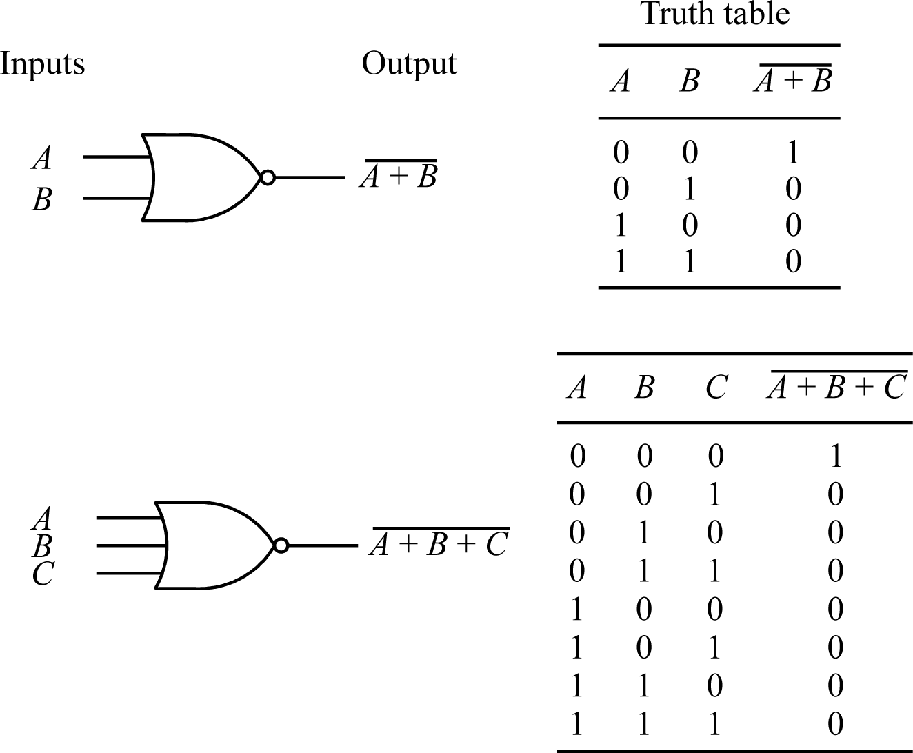
NOR gate symbol and truth table

Slide 20
Question
Draw a logic circuit to implement the function:
f = A + AB
first using AND and OR gates, and then using NAND gates.

Slide 21
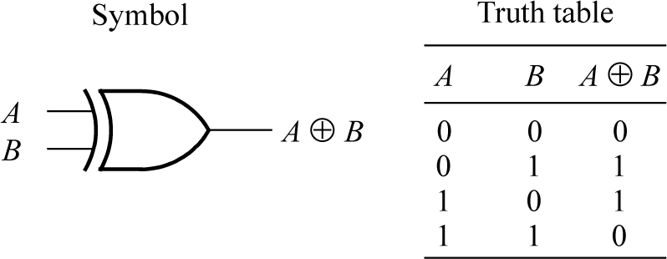
Other gates - Exclusive-OR gate
OR operation, A + B, when producing a 1 includes when both A and B are a 1. More accurately should be called the inclusive-OR operator.
“OR” operation which does not produce a 1 when A and B are both a 1, i.e. produces a 1 if A = 1 or B = 1 but not both A and B a 1, is called the exclusive-OR operator:

Slide 22
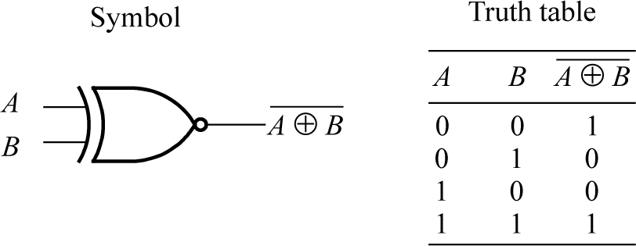
Exclusive-NOR gate
The inverse operation of the exclusive-OR is called the exclusive-NOR operation.
Operation useful because it compares two binary digits and returns a 1 only when both digits are the same (i.e. either both a 1 or both a 0). Implements a comparator or equivalence function.
Exclusive-OR operation results in a 1 when the digits are different (a not-equivalence function).
Exclusive-OR/NOR operation also obeys the commutative and associative laws. It is left as an exercise to determine whether they obeys the distributive law.

Slide 23
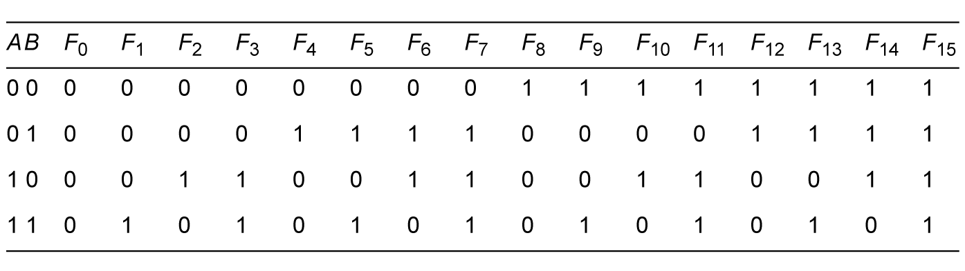
Functions of two variables
Sixteen different functions of two Boolean variables, including permanent 1 and permanent 0:
Identify six functions : AND, OR, NAND, NOR, exclusive-OR and exclusive-NOR.

Slide 24
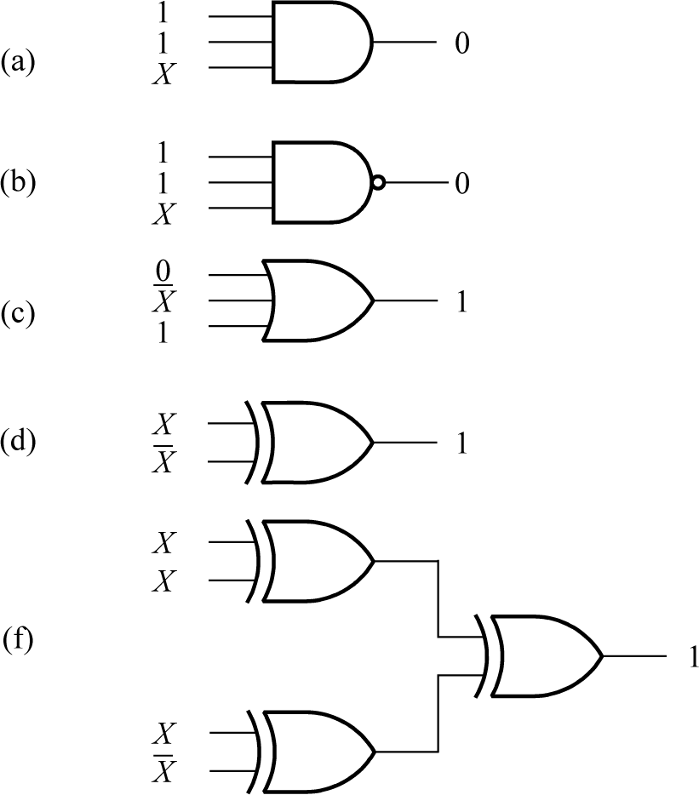
Question
Determine the value of X in each of the logic circuits show

Slide 25
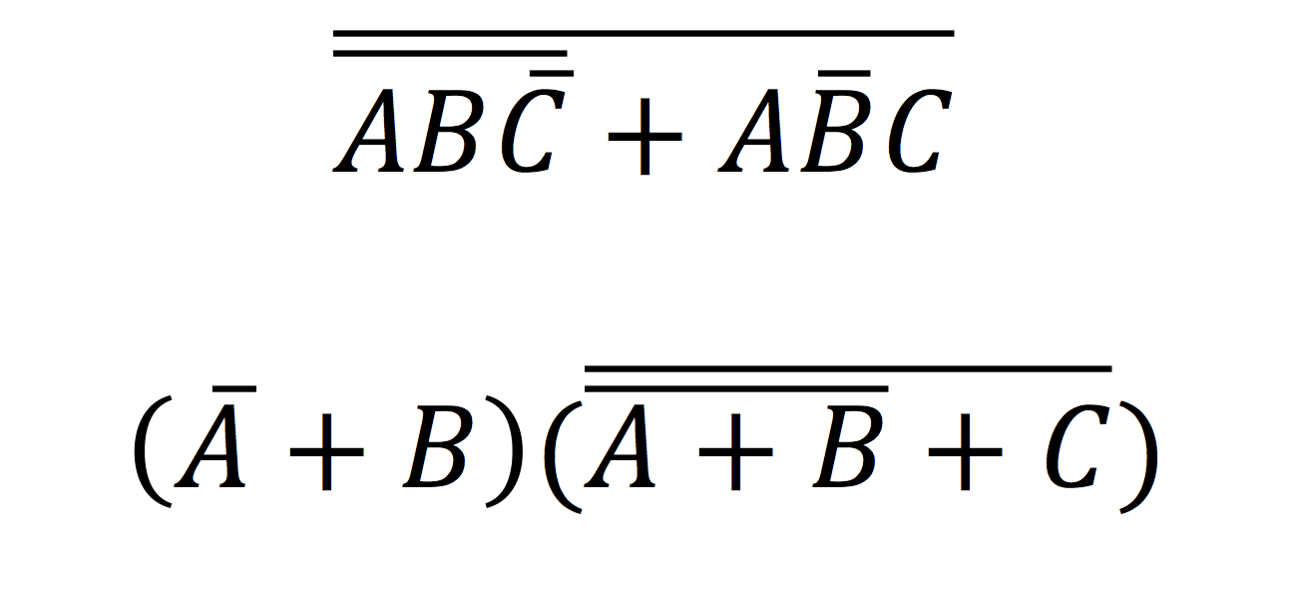
Question
Reduce the following expressions using DeMorgan’s theorem

Slide 26
Appendix

Slide 27
Basic algebraic rules
Commutative law
In ordinary algebra, certain “rules” of algebra are assumed without thought. For example, A + B = B + A and A.B = B.A where + is arithmetic addition and . is arithmetic multiplication.
It so happens that this rule also applies to both OR and AND operators in Boolean algebra, but only because the truth table of the Boolean operators are symmetrical, i.e. we can swap A and B in the table and still get a correct table for the function.
So in Boolean algebra:
A + B = B + A
AB = BA

Slide 28
Associative law
The order that we compute an expression composed of variables connected by the same operator is not important in ordinary algebra.
For example, in ordinary arithmetic, ABC = (AB)C = A(BC) where the parentheses indicate which pair of variables are processed first.
Similarly the order is not important in Boolean algebra:
ABC = (AB)C = A(BC)
A + B + C = (A + B) + C = A + (B + C)

Slide 29
Distributive law
In ordinary algebra, we can use parentheses to enforce a particular order of computation, which may be necessary when the operators are different.
Order can be enforced with parentheses in Boolean algebra.
Parentheses also used in ordinary algebra to show that multiplication applies to a group. For example A(B + C) means A is multiplied by the summation of B and C. Can expand out the expression to AB + AC, i.e. multiplication distributed across both B and C.
Also true in Boolean to both AND and OR operators:
A(B + C) = AB + AC
A + (BC) = (A + B)(A + C)
Notice OR operation “distributes” through both B and C terms.
Distributive law does not apply to arithmetic addition, i.e. A + (BC) ≠ (A + B)(A + C) in ordinary algebra.

Slide 30
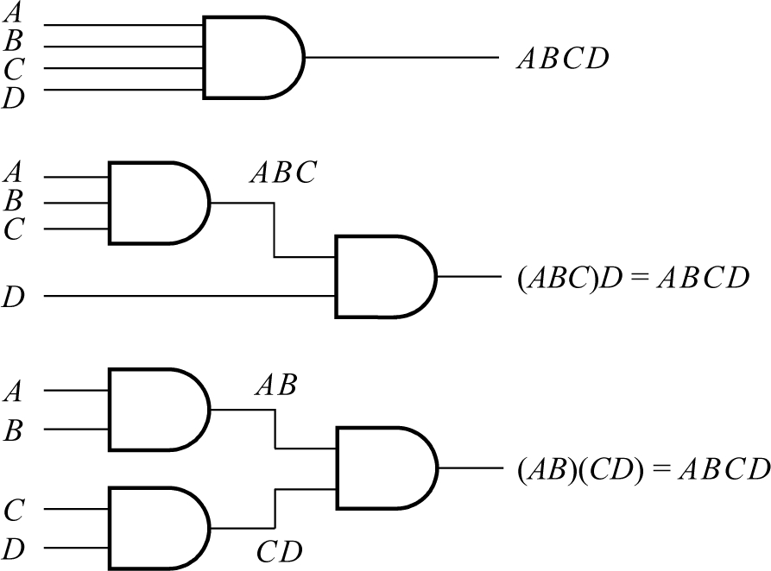
Using the associative law for implementing the function f = ABCD

Slide 31
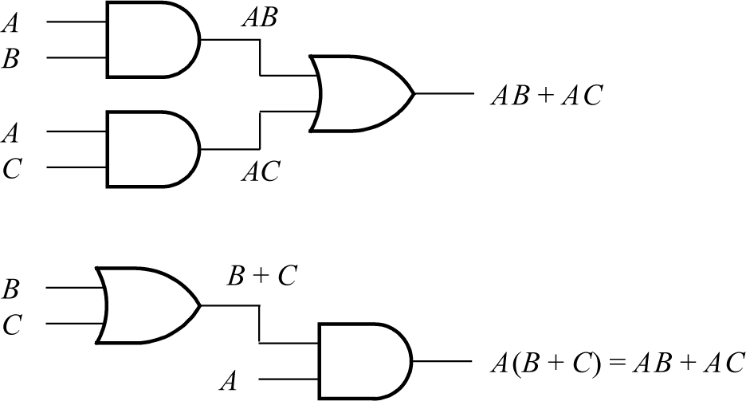
Using the distributive law for implementing the function f = AB + AC

