Slide 1
3-Designing combinational circuits
Logic circuits whose outputs are dependent upon the values placed on the inputs at that time are called combinational circuits because the output values depend upon particular combinations of input values.
Gates are basic combinational circuits themselves, and gates to construct more complex combinational functions.
From © 2015 B. Wilkinson Modification date: Sep. 2015 and Jan. 2019 (edited by Mostafavi)
This material is for the sole and exclusive use of students at UNC-Charlotte. It is not to be sold, reproduced, or generally distributed.

Slide 2
Combinational circuits
A combinational function can be defined by a Boolean expression.
Example
f₁ = A B¯ + C
which describes a function which is a 1 when A = 1 and B = 0 together or when C = 1.

Slide 3
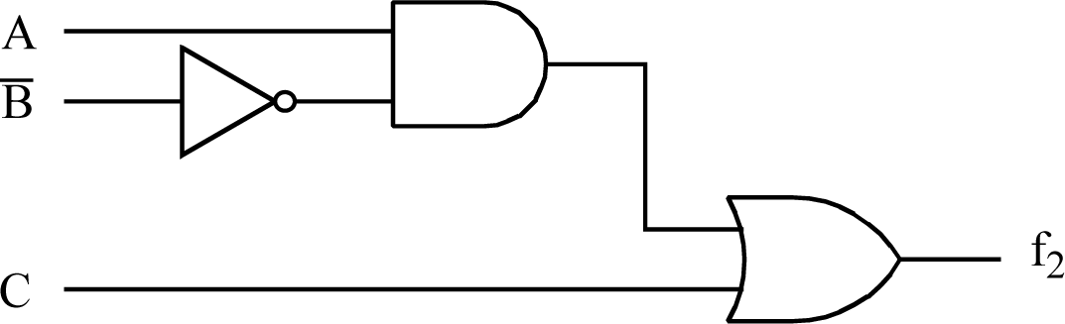
Gate implementation of function f₁ = AB¯ + C
f₁
Above is an example of a two-level circuit as signals pass through a maximum of two gates from input to output ( ignoring the NOT gate).
Two-level circuits are significant because they implement functions with the minimum signal delay from input to output.

Slide 4
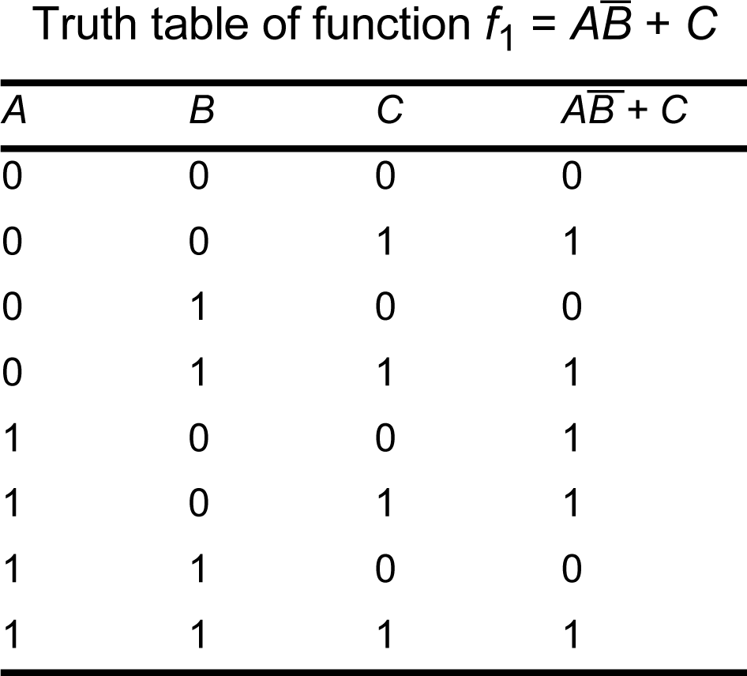
Just as basic AND, OR and NOT functions can be described by a truth table, more complex functions can be described by a truth table. A truth table of f₁ is shown below:

Slide 5
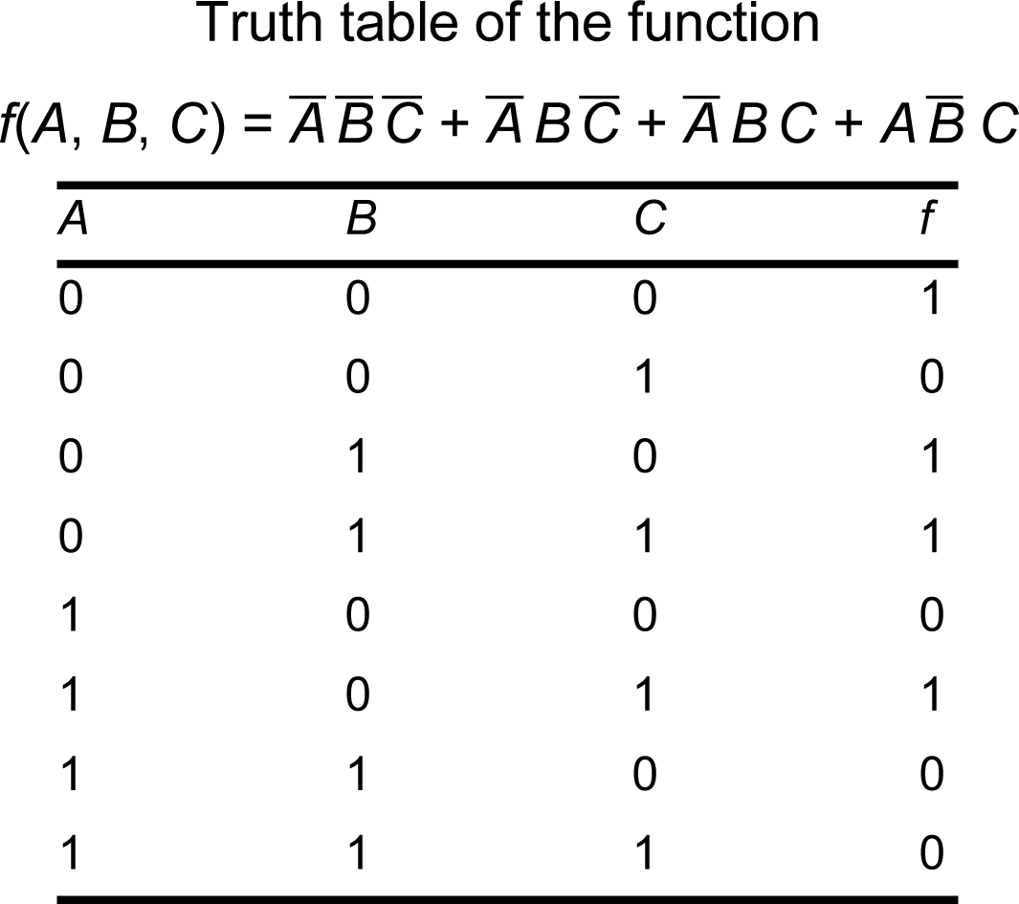
Truth table description
Design problems might begin with a truth table description:
A¯ B¯ C¯
A¯ BC¯
A¯ BC
A B¯ C

Slide 6
Truth table example
A multiplexer is a component that has n select lines, 2^{n} input lines, and one output. The select lines decide which input line goes to the output… (Full description in few slides)

Slide 7
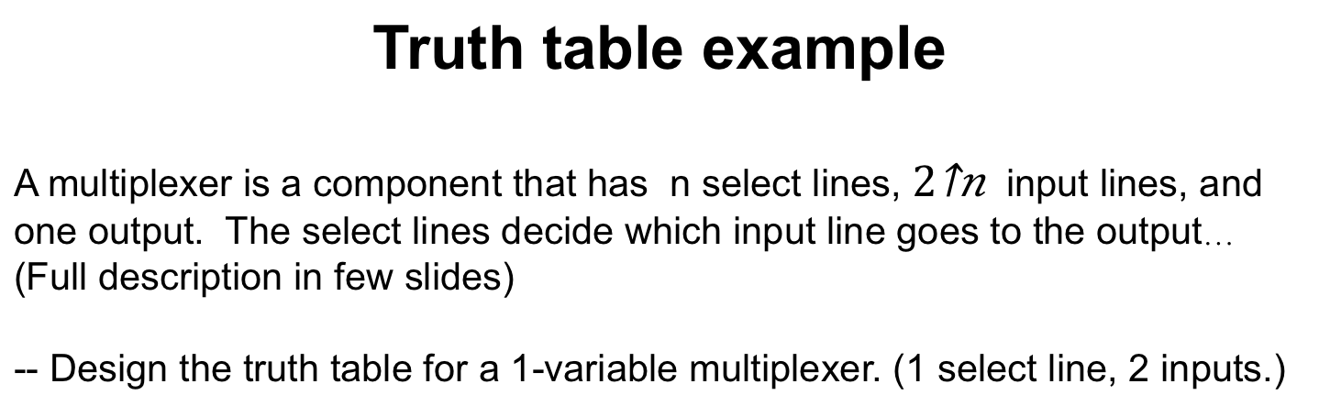
Truth table example
A multiplexer is a component that has n select lines, $2^{n}$ input lines, and one output. The select lines decide which input line goes to the output… (Full description in few slides)
-- Design the truth table for a 1-variable multiplexer. (1 select line, 2 inputs.)
Input 1 | Input 2 | Select line | Output

Slide 8
Sum-of-product expressions
A “standard” form of Boolean expression consisting of Boolean variables connected with AND operators to form terms that are connected with OR operators.
AND operations viewed as Boolean multiplication (product).
Term consisting of variables connected with AND operators is a product term.
OR operations can be viewed as Boolean summation. A term consisting of variables connected with OR operators is a sum term.
sum-of-product (SOP) expression - an expression with product terms connected by OR operators. E.g.:

Slide 9
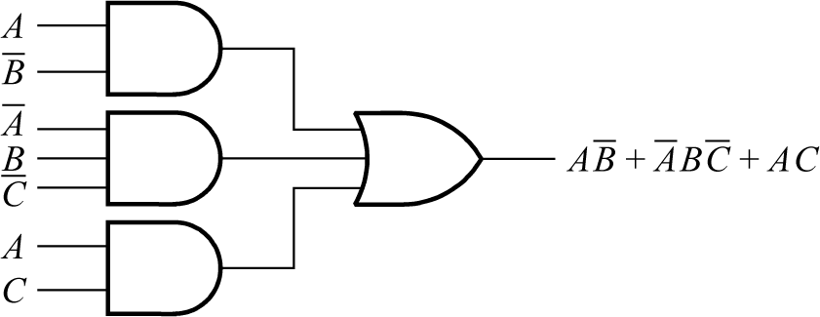
Implementing Sum-of-product expressions

Slide 10
Question
Draw the logic circuit for the function.

Slide 11
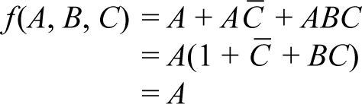
Simplifying Boolean expressions algebraically
Algebraic simplification applies Boolean identities and laws. Various strategies:
Applying identities after grouping
Example:

Slide 12

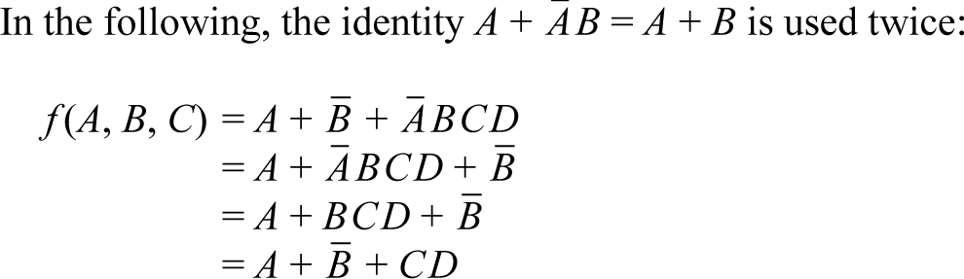
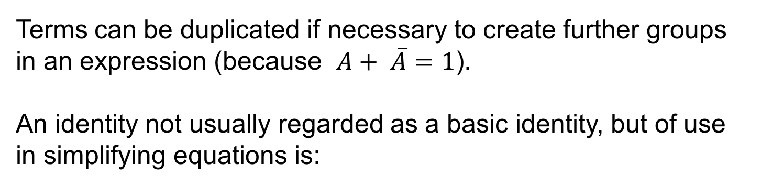
Terms can be duplicated if necessary to create further groups in an expression (because $A+ \overline{A}=1$).
An identity not usually regarded as a basic identity, but of use in simplifying equations is:
Example

Slide 13
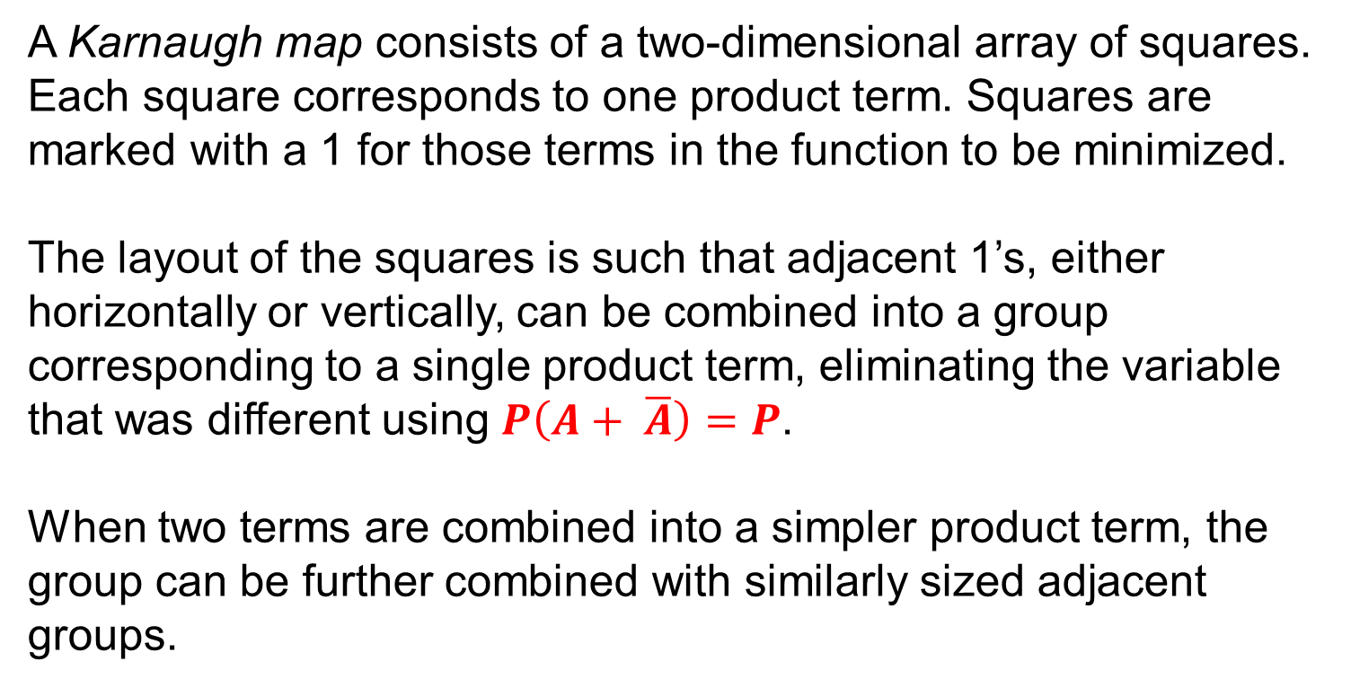
Karnaugh map minimization method
A Karnaugh map consists of a two-dimensional array of squares. Each square corresponds to one product term. Squares are marked with a 1 for those terms in the function to be minimized.
The layout of the squares is such that adjacent 1’s, either horizontally or vertically, can be combined into a group corresponding to a single product term, eliminating the variable that was different using $P\left(A+ \overline{A}\right)=P$.
When two terms are combined into a simpler product term, the group can be further combined with similarly sized adjacent groups.

Slide 14
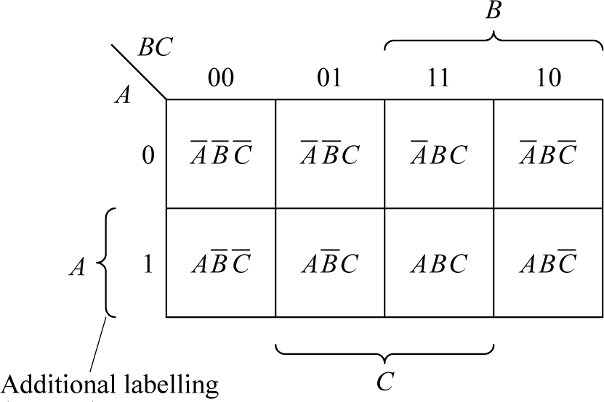
3-variable Karnaugh Map
Eight combinations of three variables and each combination assigned a square on Karnaugh map.
Squares labelled by the three variables along two edges of map.
0 indicates that variable is complemented and 1 indicates that it is not complemented.
Adjacent squares horizontally and vertically assigned terms which differ by one variable (actually a Gray code).

Slide 15
Minimization technique
First let us assume a canonical (see appendix) sum-of-product expression
Three basic steps:
Mark those squares with a 1 that correspond to the terms in the expression.
Form the 1’s into the largest valid groups of 1’s.
Read the terms from the map which correspond to the groups (“cover” the 1’s).

Slide 16
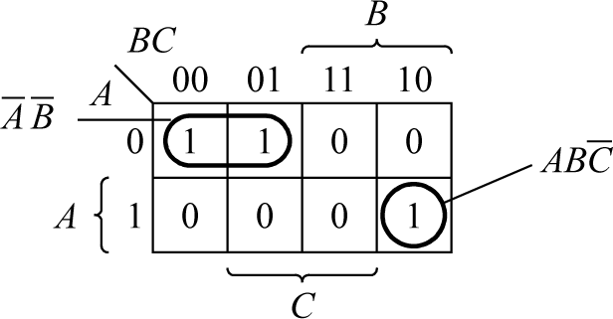
Example
To minimize:
Three terms and hence three 1’s on the map.
Two of these 1’s are adjacent and indicate that the two terms can be combined to eliminate C in term
Final 1 not adjacent to any other 1 and cannot be combined.
Combined group shown by circling the terms together and labelling the group.
Variable eliminated recognized by looking at the labels.

Slide 17
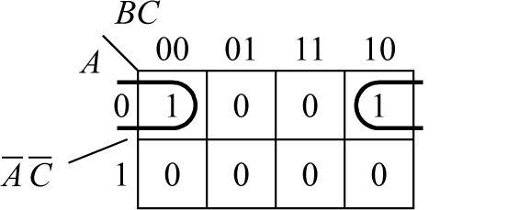
Groups between edges
Squares on one edge considered adjacent to squares on opposite edge (top and bottom or left and right) as such squares correspond to terms with one variable different.
Example

Slide 18
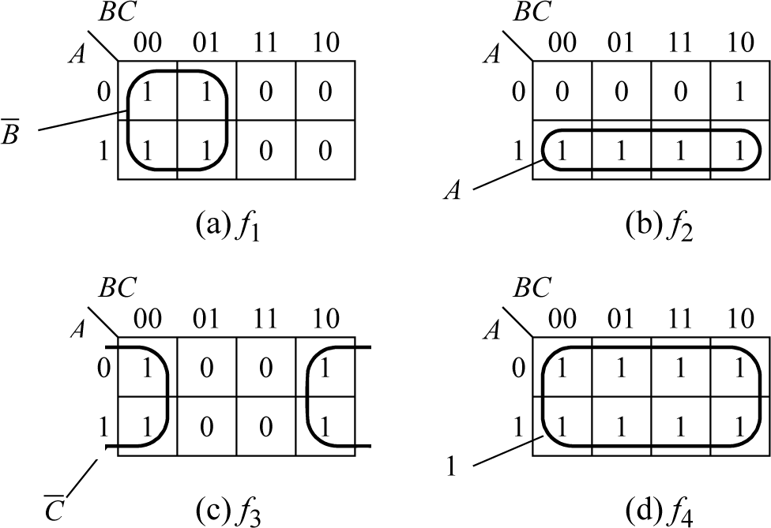
Larger groups
If two combined groups have only one variable different (and will be adjacent), these groups could be combined again to eliminate a second variable.
Larger groups formed in the same way as smaller groups by looking for groups that are adjacent, either horizontally or vertically.
Examples

Slide 19
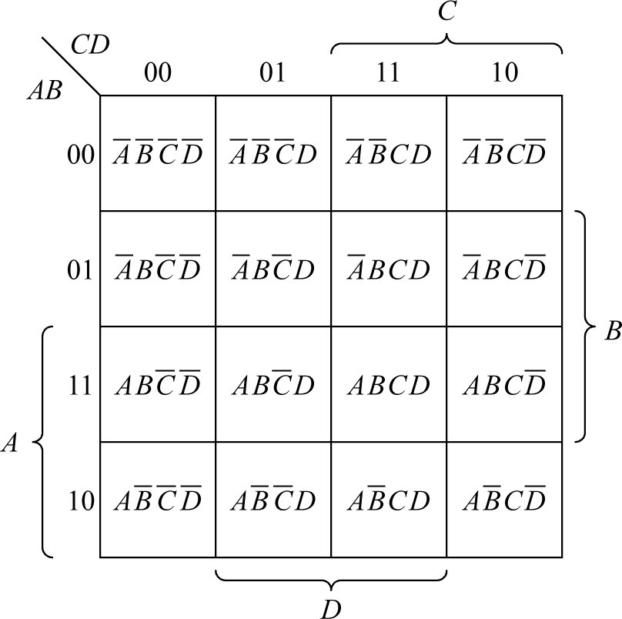
Four-variable maps
Functions of four variables requires a Karnaugh map with sixteen squares:

Slide 20
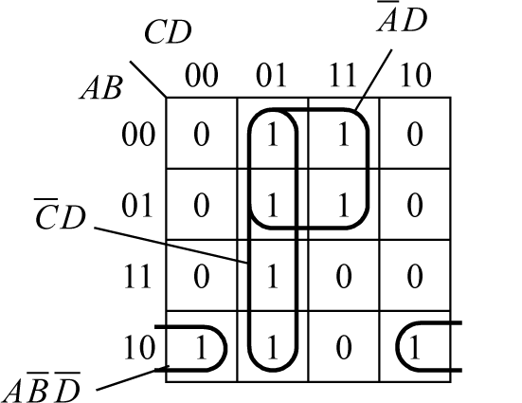
Example

Slide 21
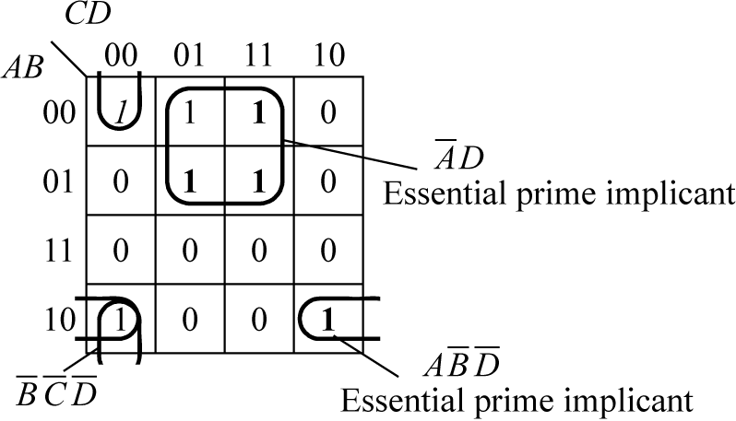
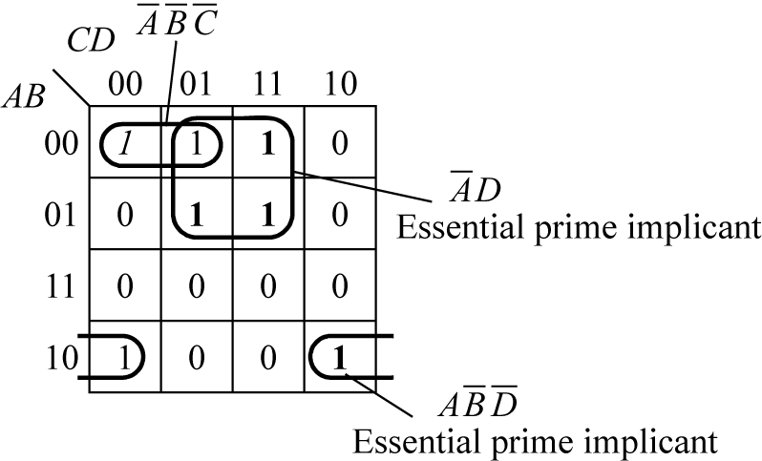
General minimization strategy
First to identify essential prime implicants, found by identifying at least one 1 which cannot be covered in any other way.
Then select best set of non-essential prime implicants to cover remaining uncovered 1’s.
Example: Minimize:
Alternative solutions

Slide 22
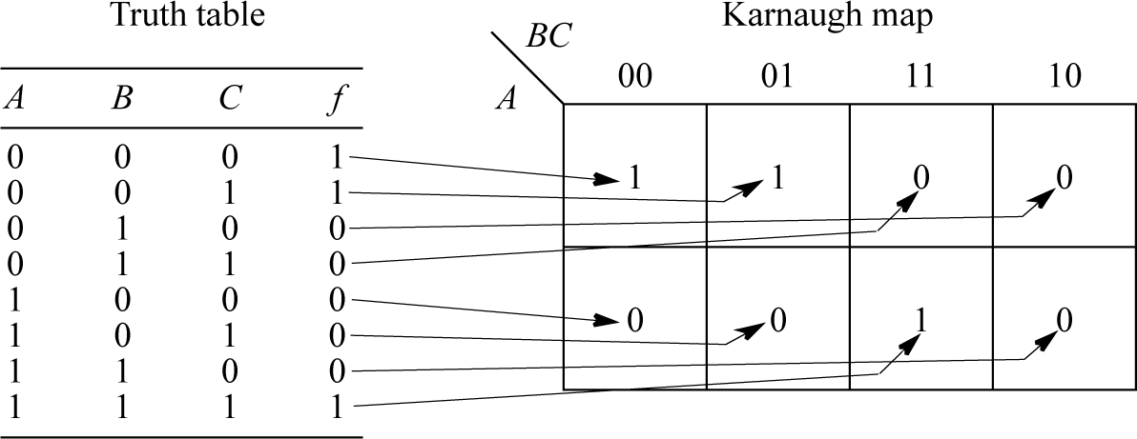
Truth table description and Karnaugh map
Direct relationship between squares on Karnaugh map and truth table description of the function:

Slide 23
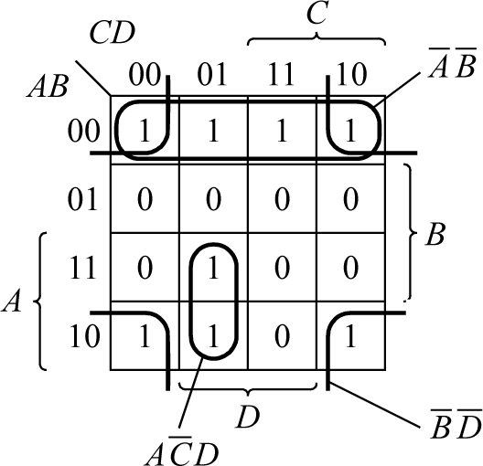

Functions not in canonical form
A non-canonical expression could be expanded into a canonical expression. However, can recognize squares that expanded terms would cover without actually expanding the terms.
Example
Notice use of four corners to form a group.

Slide 24
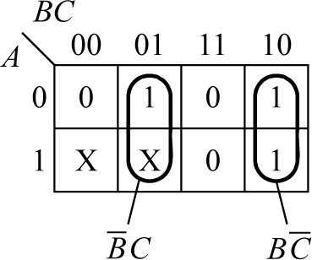
Incompletely specified functions
When a function is not specified for certain combinations of input values because they cannot occur, or if they do, output irrelevant.
Each is marked by an X (called don’t cares). Each X can be considered as 0 or 1 whichever leads to the simplest function
Example
Input combinations 100 and 101 cannot occur:

Slide 25
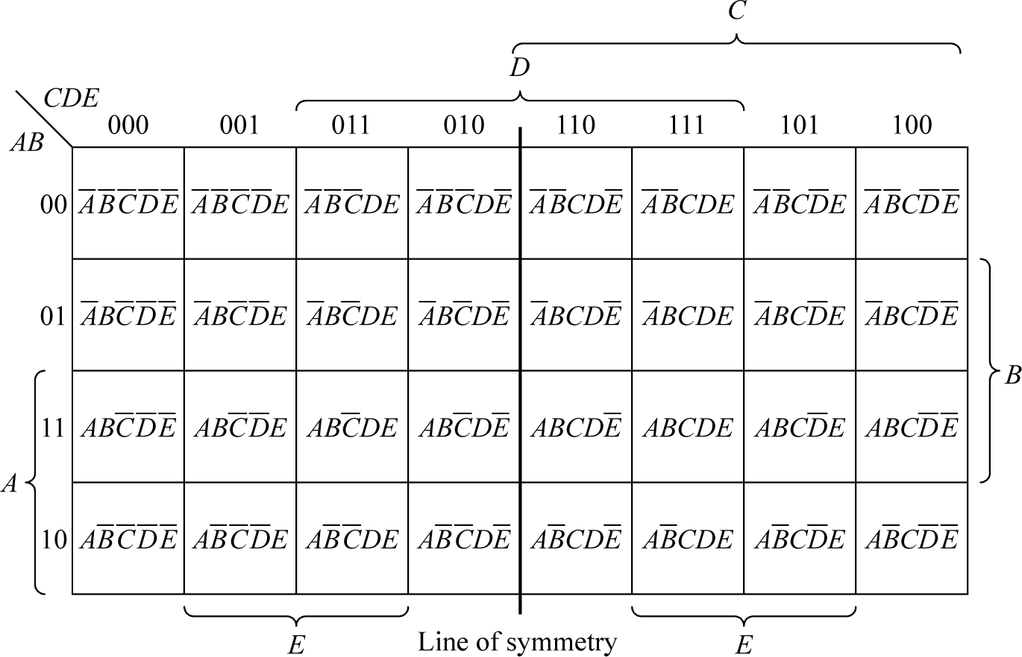
Large Karnaugh maps
3-variable map consists of two 2-variable maps, one a mirror image of other.
4-variable map consists of two 3-variable maps , one a mirror image of other.
5-variable map consists of two 4-variable maps, one a mirror image of other:

Slide 26
Packaged combinational logic circuits
Some Boolean functions commonly required and manufactured inside a single package. We shall describe common packages:
1. Decoder/demultiplexer
2. Data selector/multiplexer
3. Arithmetic circuits

Slide 27
1. Decoders/demultiplexers
A decoder is designed to recognize the different patterns that can occur on a set of inputs.
One output of the decoder is “activated” for each of the possible binary patterns that can occur on the inputs.
Suppose there are three inputs. There are eight possible patterns on three inputs and hence eight outputs are needed (as 2³ = 8). This decoder would be called a 3-line-to-8-line decoder.

Slide 28
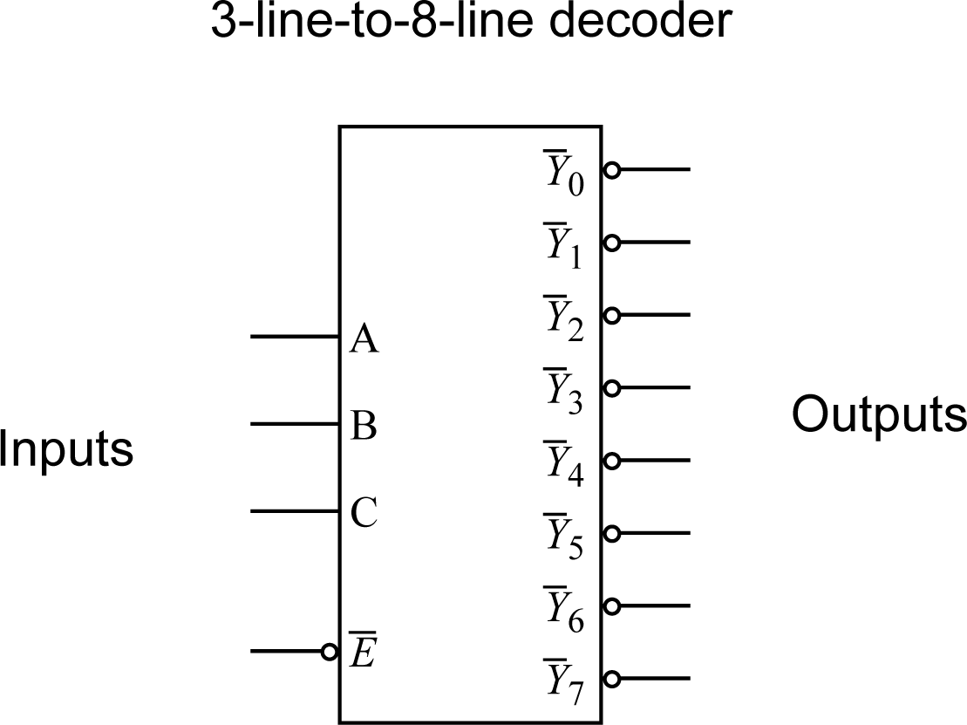

Slide 29
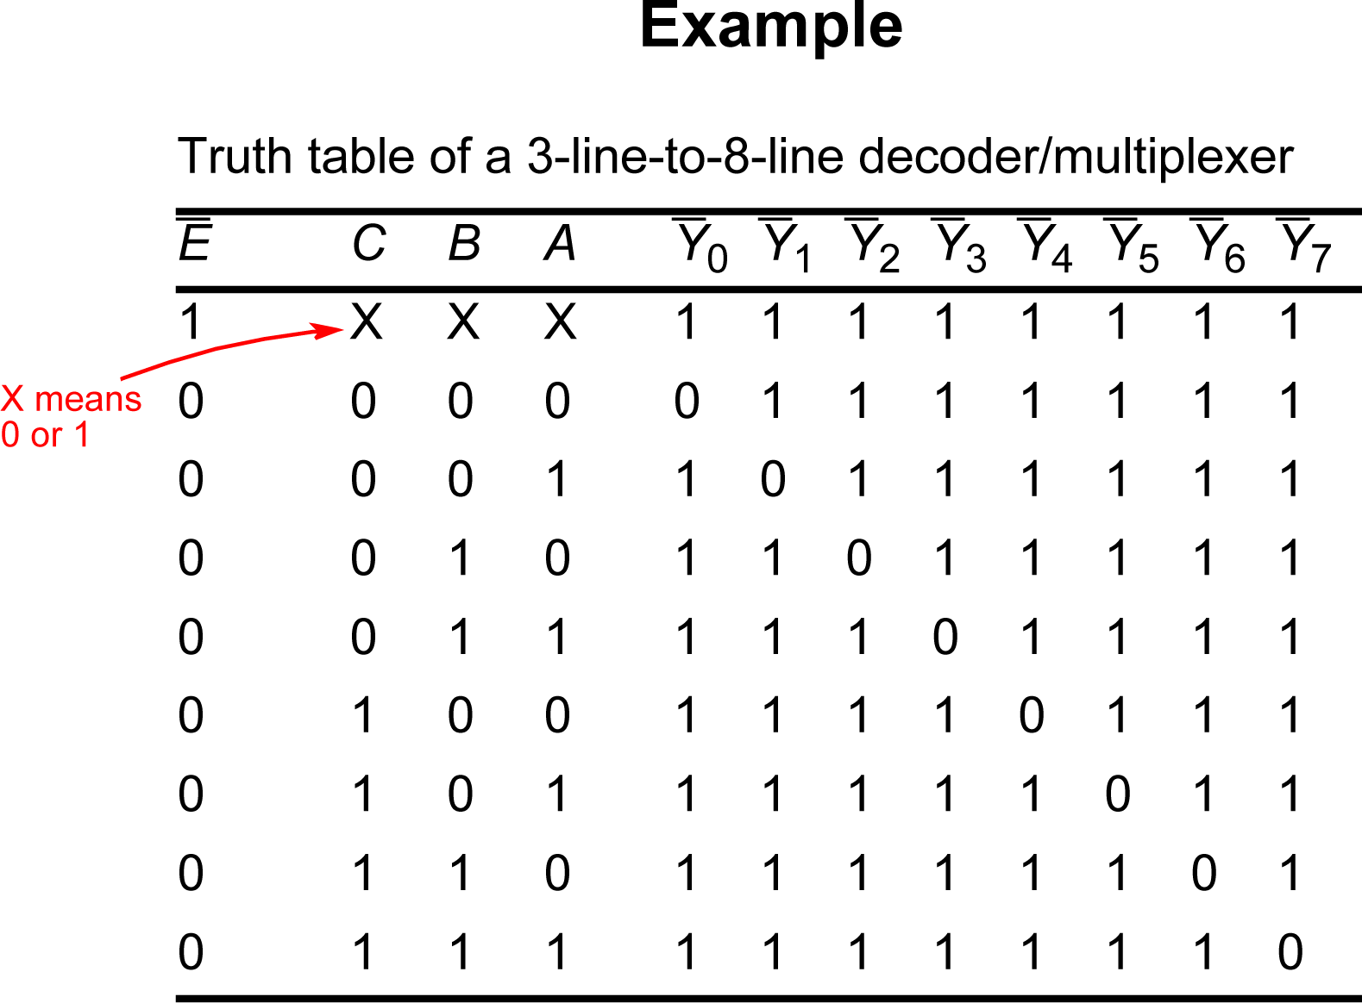

Slide 30
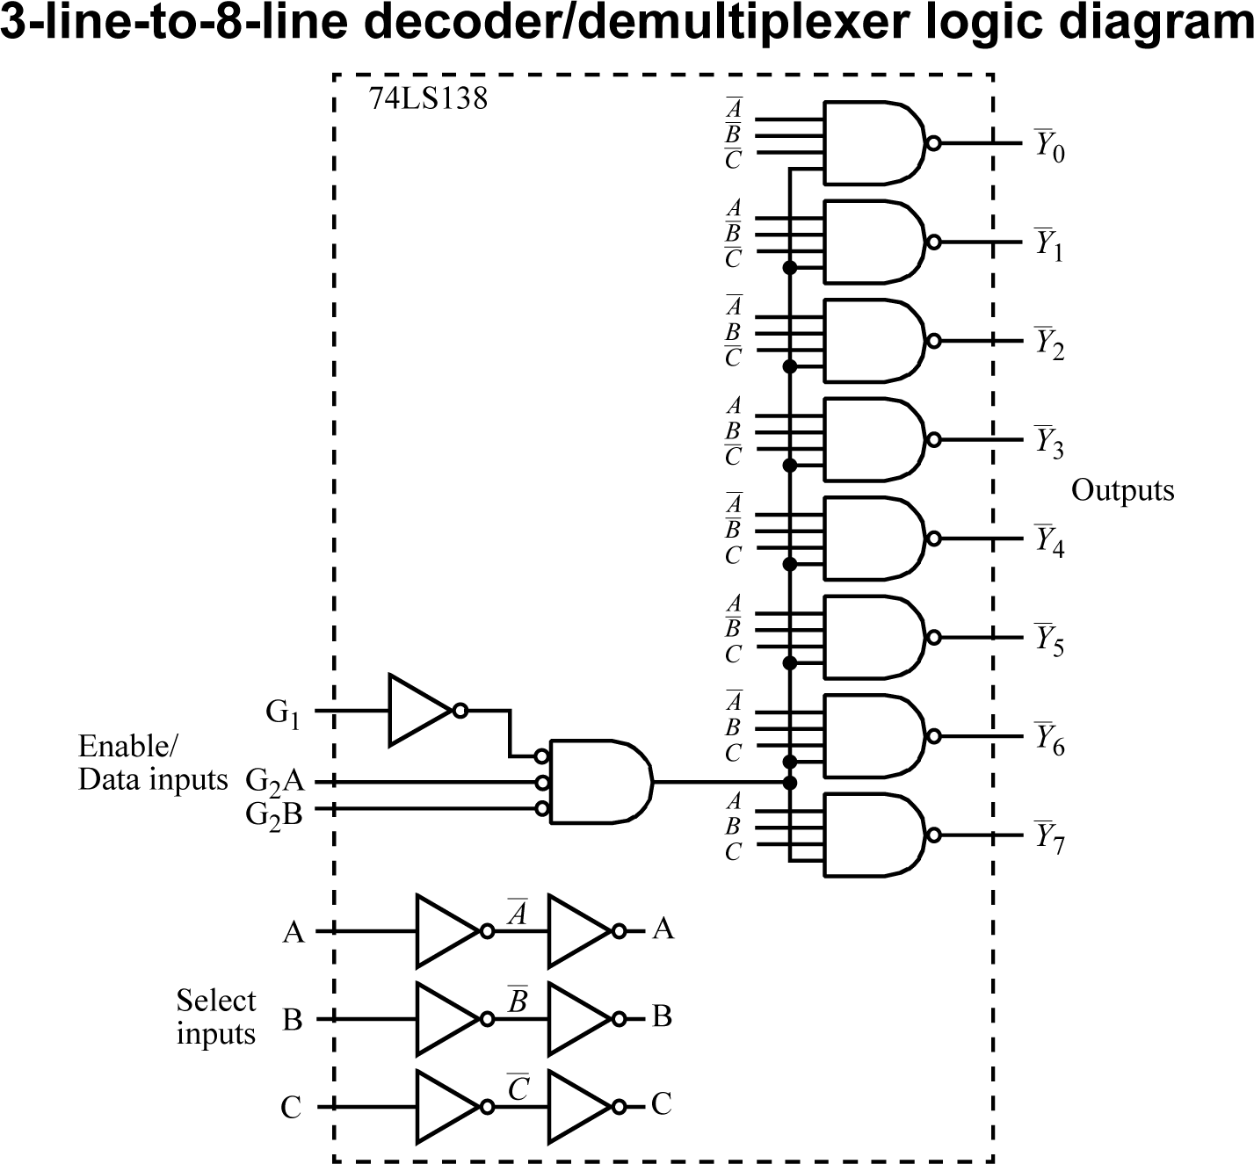

Slide 31
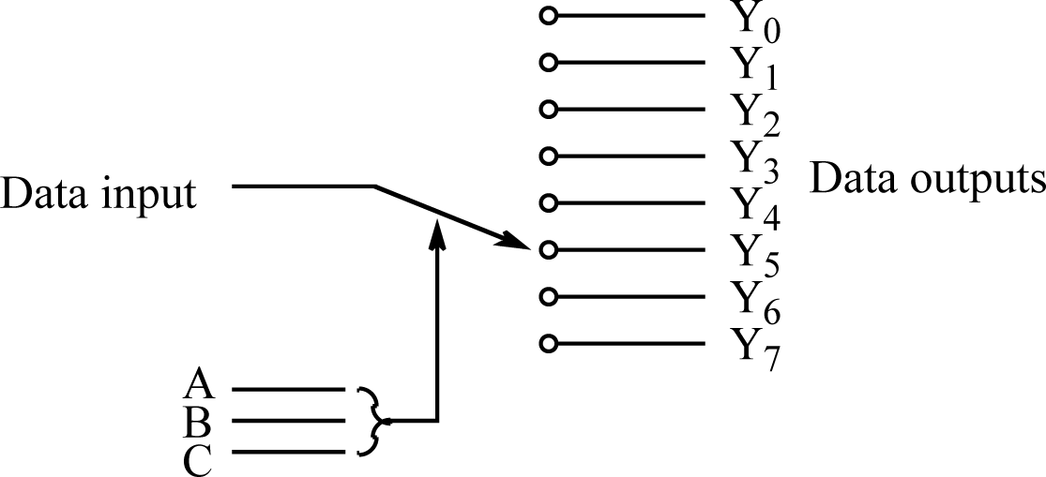
Demultiplexer
A component similar to a decoder but would be viewed as
Single data input line routed to one output dependent upon pattern on select inputs.
Logic circuits for both decoder and demultiplexer are essentially the same. Data input is the enable input in decoder.

Slide 32
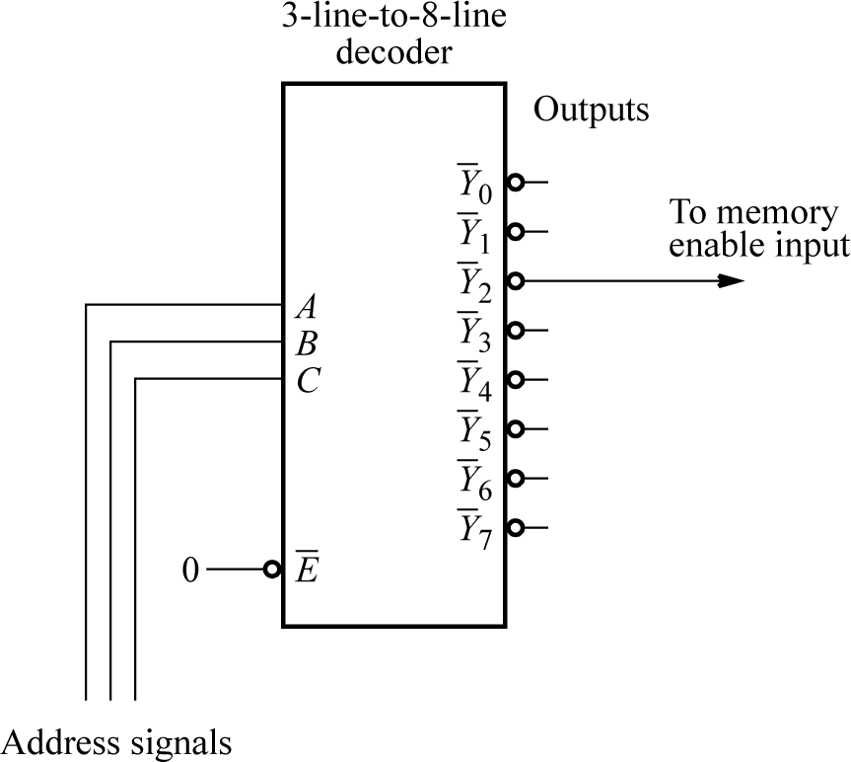
Applications
Address decoder
In memory system design need to recognize memory module.

Slide 33
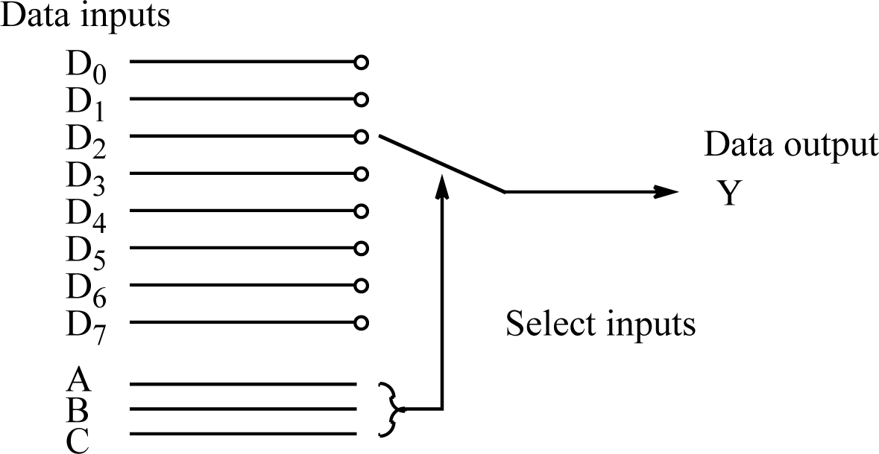
2. Data Selector/Multiplexers
A logic circuit which allows one of a set of data inputs to be selected and fed into a single output

Slide 34
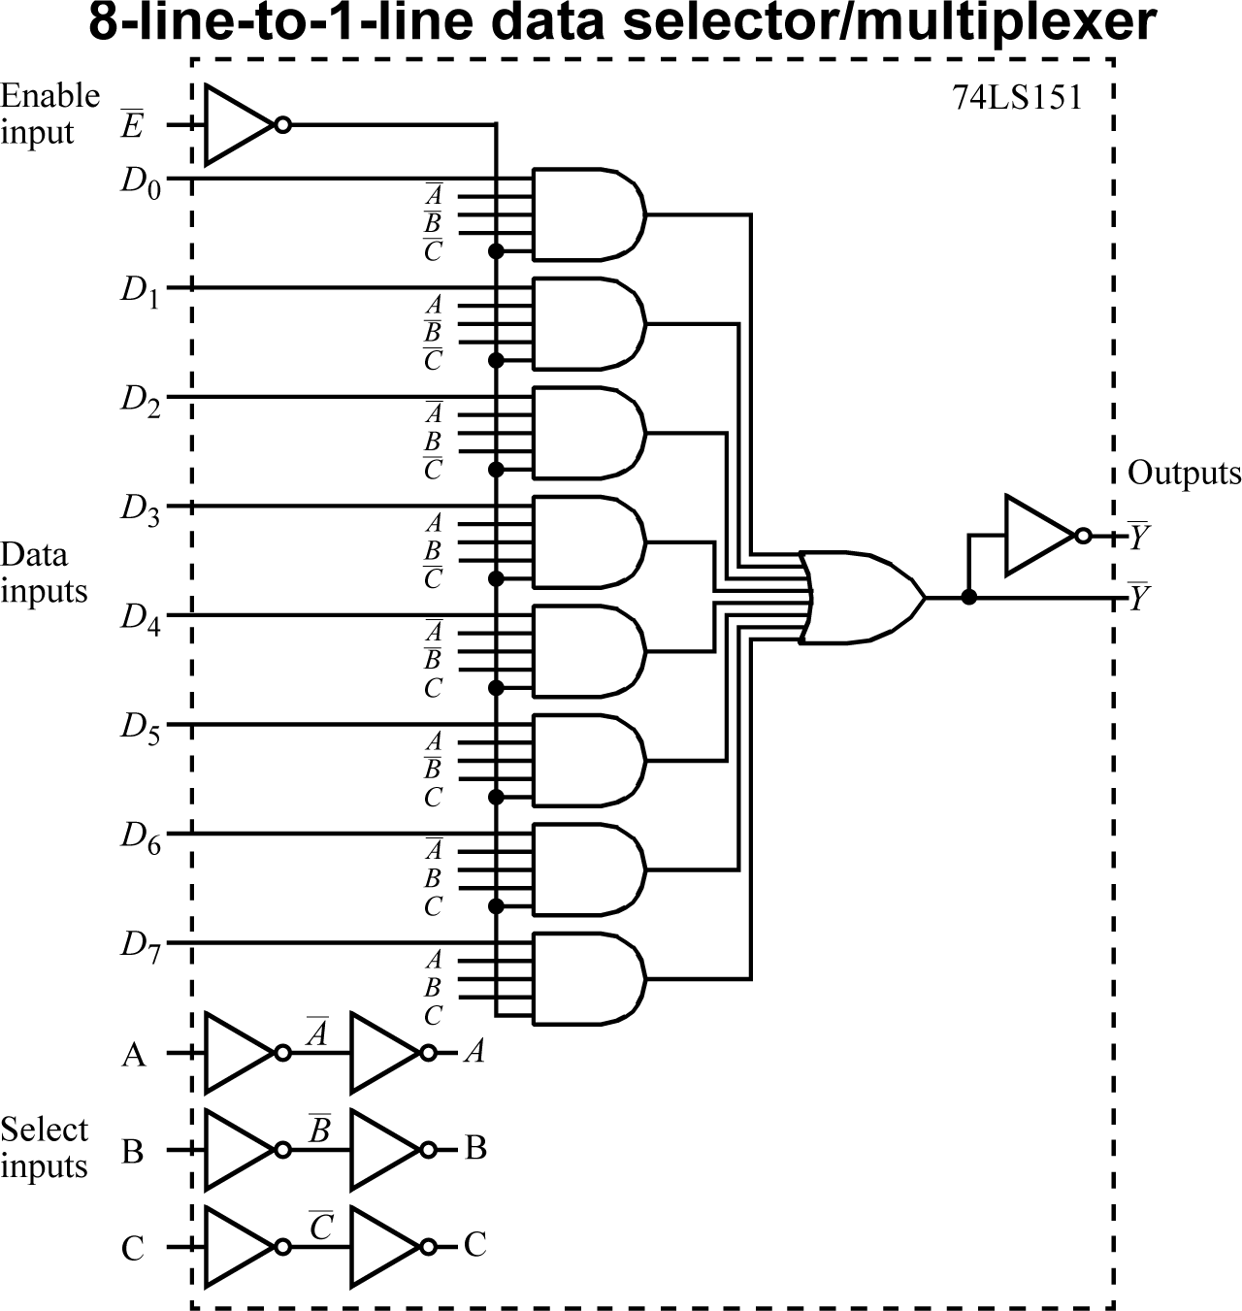

Slide 35
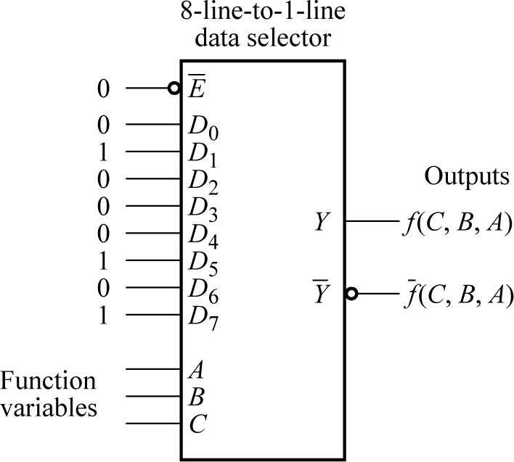
Using a data selector to implement a combinational logic function
Example
Suppose we want to implement the function:
Can be extended to four variables, with fourth variable applied to specific D inputs, see in class

Slide 36
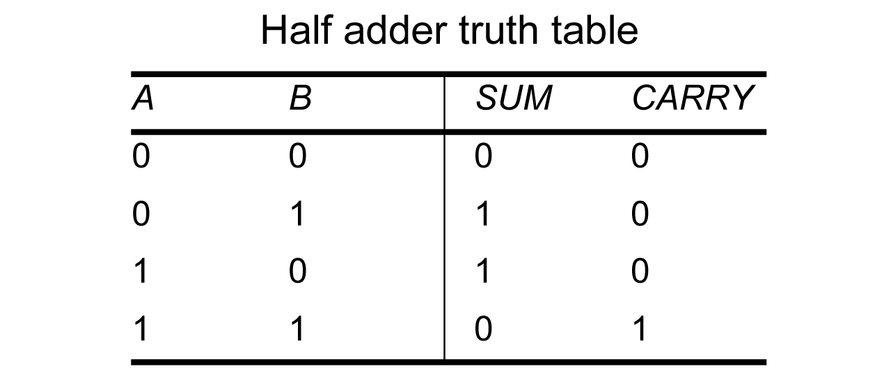
3. Arithmetic circuits - Addition
Half adder
First, a circuit needed that can add together two binary digits, for the least significant bits of the two numbers being added together. This circuit is called a half adder:

Slide 37
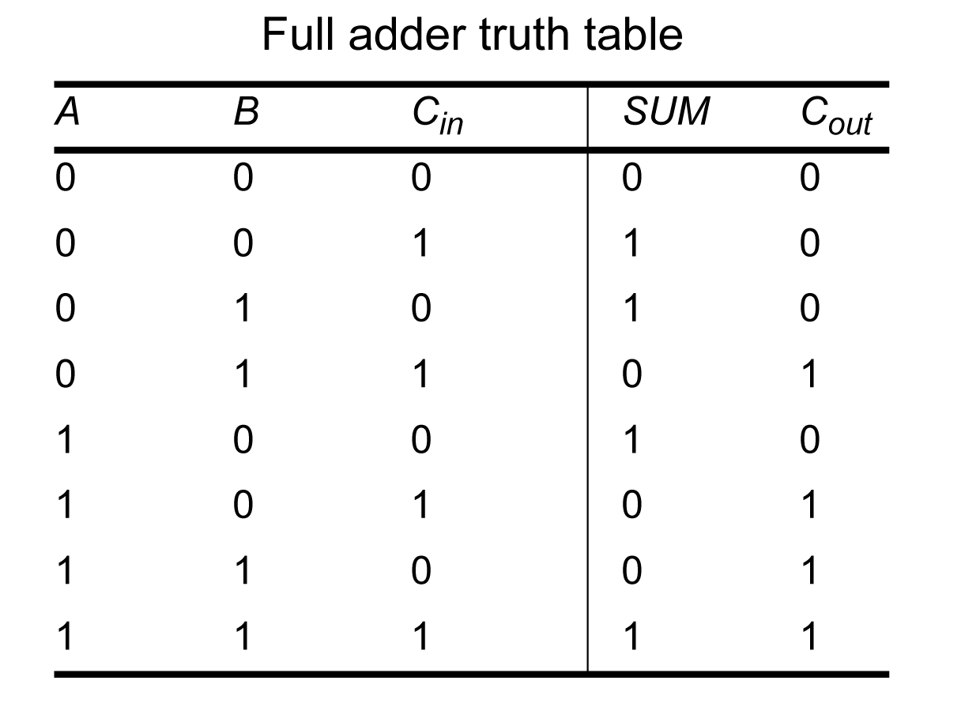
Full adder
Next, a circuit needed that can add together two binary digits with a carry from a previous addition. This circuit is called a full adder.

Slide 38
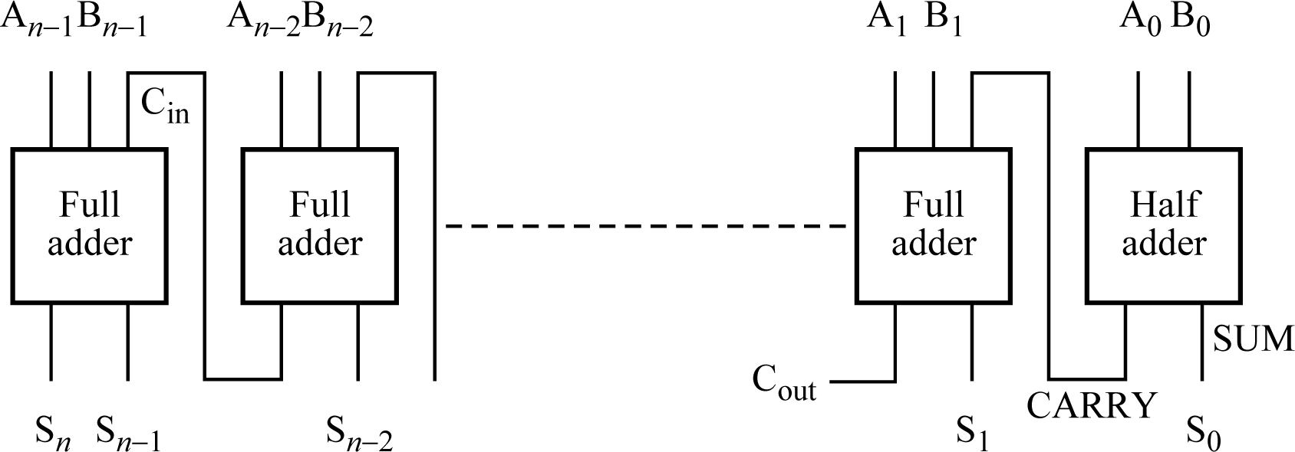
Parallel adder
An addition circuit to add together, two numbers as shown below:
Pair of digits added together “in parallel” (not strictly, since a carry passes from one stage to next but term parallel always used here).
There are faster ways to add numbers.

Slide 39
Half adder logic circuit equations
Half adder functions are:
SUM = A¯ B + AB¯
CARRY = AB
Just corresponding to the 1’s in the output column of the truth tables.

Slide 40
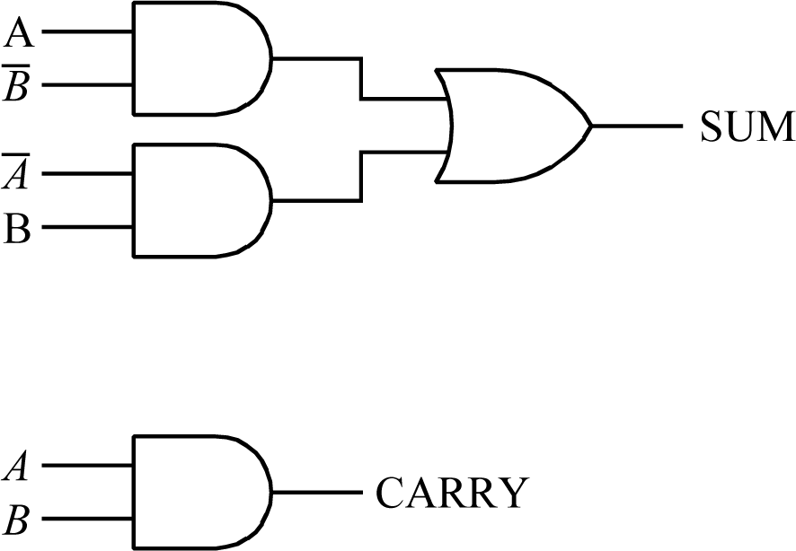
Half adder logic circuits

Slide 41
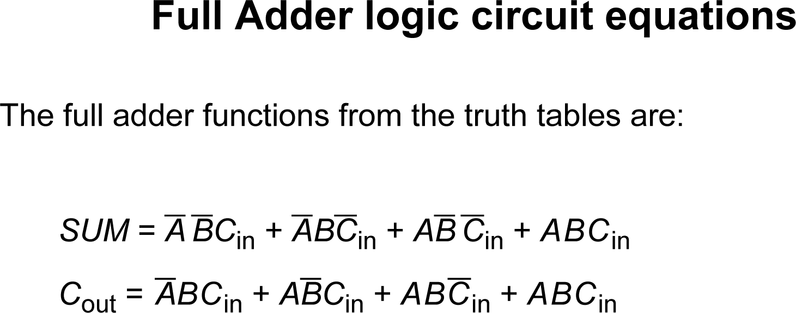

Slide 42
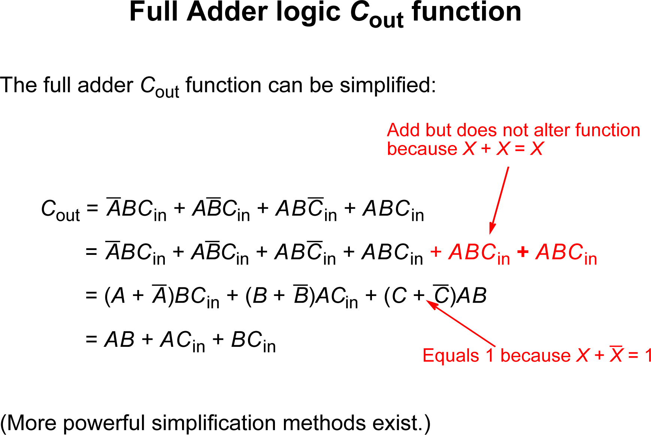

Slide 43
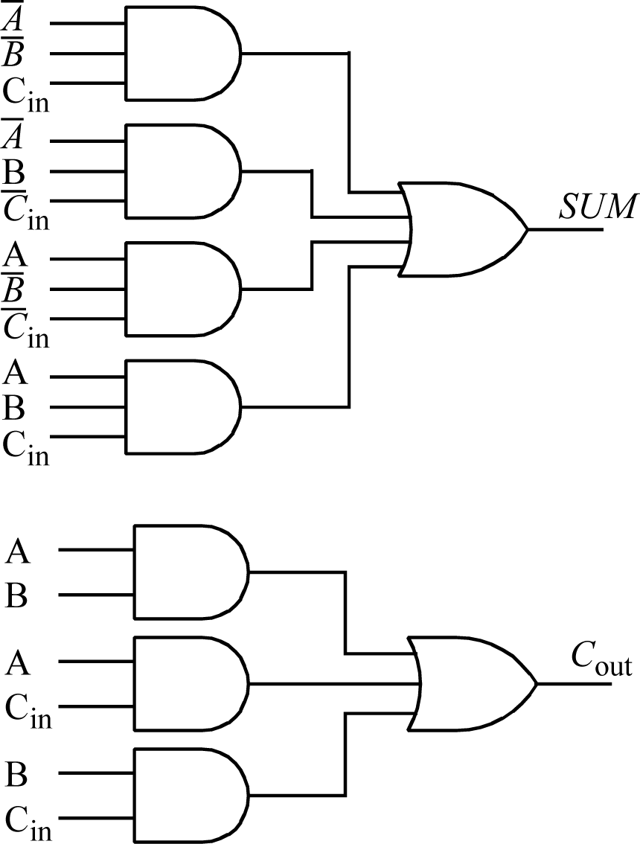
Full adder logic circuits

Slide 44
Subtraction
A - B done with 2’s complement arithmetic by adding negative of B to A.
Negative (2’s complement) representation achieved by inverting digits of B and adding 1.
Adding 1 can be done by changing first stage from a half adder to a full adder and setting the carry input to this stage to 1.

Slide 45
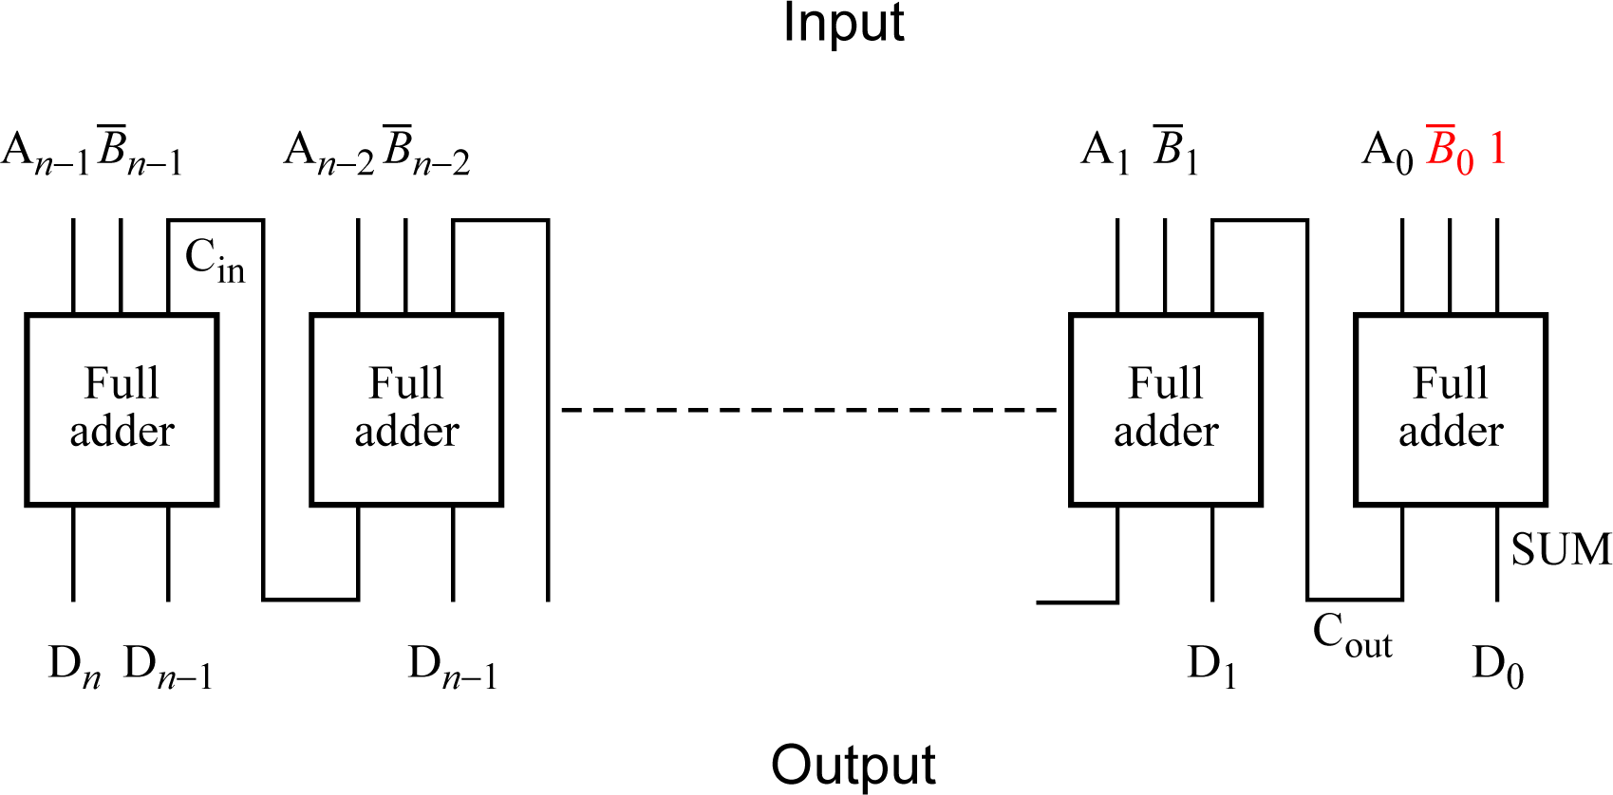
Circuit arrangement to subtract two binary numbers

Slide 46
Appendix

Slide 47
Canonical expressions
- a sum-of-product expression contains all the variables (or their complements) in each product term, such as in:

Slide 48
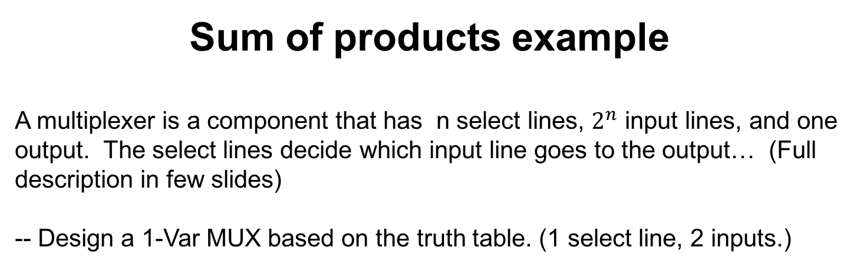
Sum of products example
A multiplexer is a component that has n select lines, $2^{n}$ input lines, and one output. The select lines decide which input line goes to the output… (Full description in few slides)
-- Design a 1-Var MUX based on the truth table. (1 select line, 2 inputs.)
Input 1 | Input 2 | Select line | Output

Slide 49
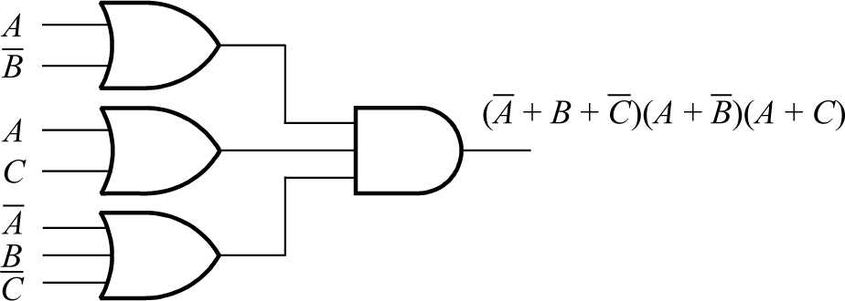
Product-of-sum expressions
Not as common -- Variables (or their complement) connected with OR operators to form terms that are connected with AND operators. E.g:

Slide 50
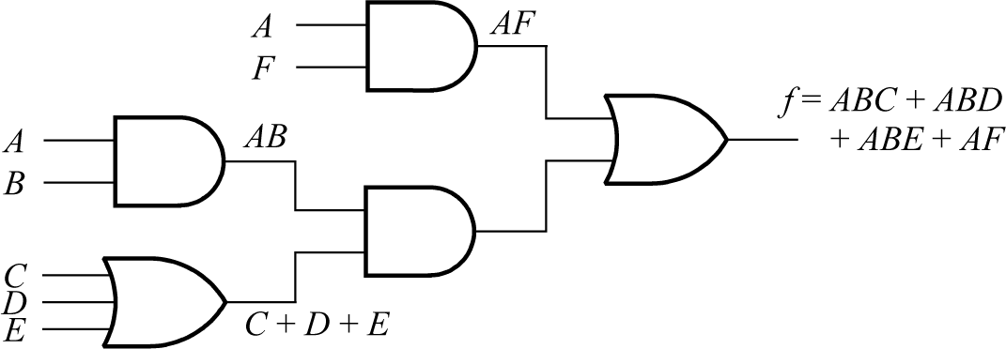
Multilevel Implementations
Multilevel implementations can be achieved through factorizing the expressions, which may reduce the number of inputs to individual gates but at the expense of a greater delay.
Example
f = ABC + ABD + ABE + AF = AB(C + D + E) + AF

Slide 51
By using DeMorgan’s theorem
DeMorgan’s theorem is most useful with complex expressions involving multiple levels of inversion. Repeated use of DeMorgan's theorem can reduce the number of levels.
An aid to remembering how to apply DeMorgan’s theorem is as follows:
If there is a continuous bar over an expression consisting of terms linked with an operator (AND or OR), break-up the bar into parts and change the operator (from AND to OR, or from OR to AND).
Similarly, if there are separate bars over terms linked by an operator, combine the bars and change the operator.

Slide 52
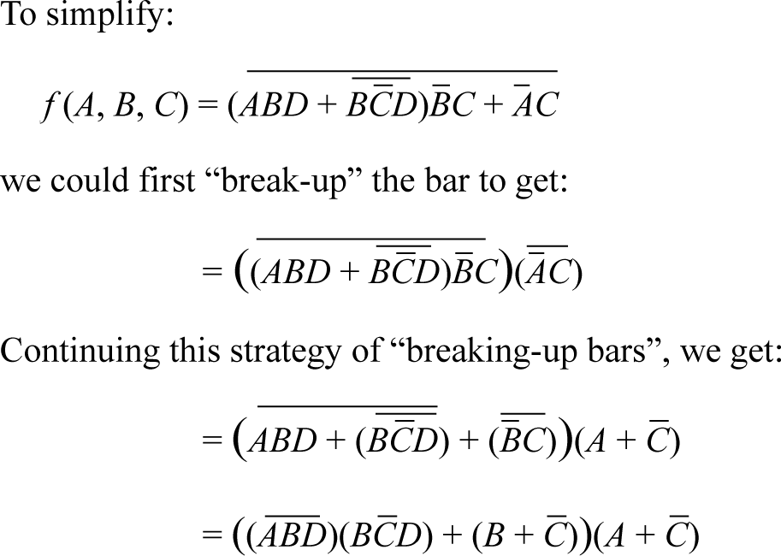
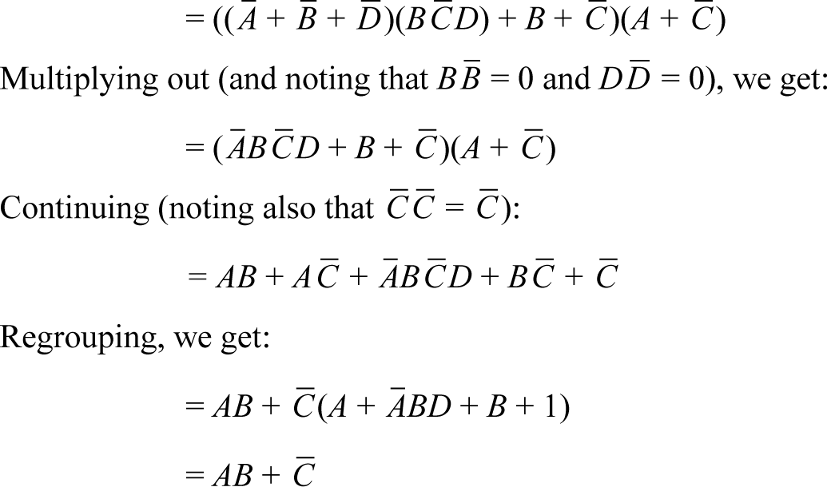
Example

Slide 53
Selecting the best cover
Terms:
Implicants - Groups on a Karnaugh map (including single 1’s)
Prime implicants - Groups not including groups contained within larger groups. Prime implicants cannot be combined with others to make them bigger.
Essential prime implicants - Cover at least one 1 that cannot be covered by another prime implicant, and necessary in the solution.
Non-essential prime implicants - Not essential but nevertheless cover 1’s not covered by essential prime implicants and may be required in the solution.
(Essentially) redundant prime implicants - cover 1’s already covered by one or more essential prime implicants. Not required in the solution in any circumstances.

Slide 54
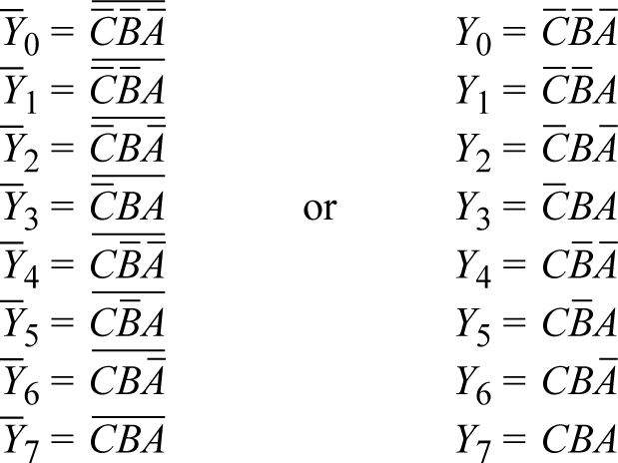
Using a decoder/demultiplexer to implement a combinational logic function
Each output of a decoder/demultiplexer implements one product term (minterm).
Example - a 3-line-to-8-line decoder having inputs A, B and C, implements the functions:

Slide 55
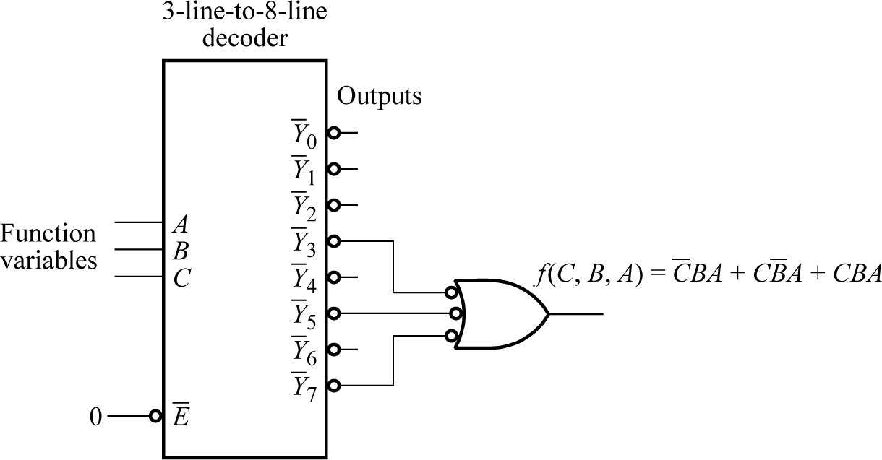
By selecting outputs and using an OR gate, any sum-of-product expression can be formed.
Example
Suppose we want to implement the function:

