Slide 1
机器学习大作业
Vison and Language Tuning
助教：何晓轩

Slide 2
Outline
Task introduction
Dataset
Rules and Policy

Slide 3
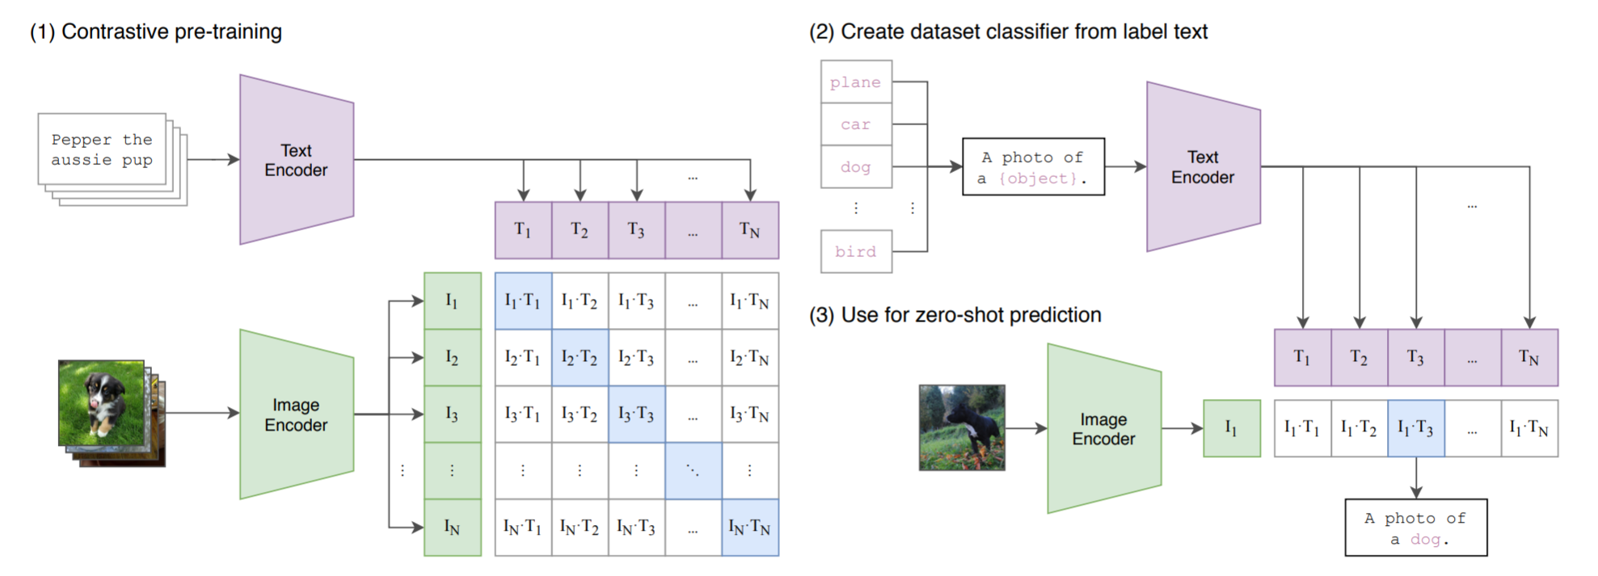
Task – Vison and Language Tuning
What is CLIP？
Introduction about CLIP and how to use for zero-shot prediction：
https://github.com/openai/CLIP
You tasks：
You need to further enhance CLIP's few-shot/zero-shot capability as few parameters as possible.
Note： zero-shot is optional

Slide 4
Dataset – ImageNet^{[1]}
本次作业需要在ImageNet上进行测试。但是只需要用到一小部分的ImageNet数据集。
简单的例子关于如何增强CLIP性能以及使用ImageNet数据集：
[1] Learning to Prompt for Vision-Language Models.
https://arxiv.org/pdf/2109.01134.pdf
[2] CLIP-Adapter: Better Vision-Language Models with Feature Adapters
Note: Project 不需要过多的训练资源，只需要tuning一小部分参数，重点在于如何理解CLIP tuning。
CodeBase
https://github.com/KaiyangZhou/CoOp
This is a type of tuning method --- prompt tuning
You can also choose other methods (adapter tuning, lora)

Slide 5
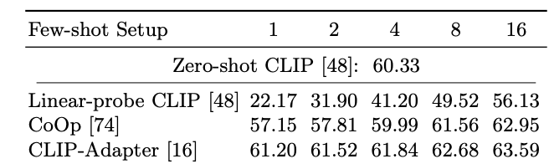
Rules and Policy
You should demonstrate your understanding of Vison and Language Tuning as fully as possible and analyse your architecture. For example:
1、The performance of your method. Base:
2、The training parameters of your method. We would like to further enhance CLIP's few-shot/zero-shot capability as few parameters as possible.
3、 If your method supports training-free mode, you can also explore the zero-shot capability of your method on ImageNet (optional).

Slide 6
Report
The introduction of your method and model, including the model architecture、training method (if you train it by yourself) as well as the analysis of prediction results.
Explain the improvements in your method or your analysis methods (show me your illustration or code).
What other ideas do you think you can try (opitional)

