Slide 1
Sectional MinHash for Near Duplicate Detection
Bhagyashri Bhamare (181IT111)
Chinmayi C. Ramakrishna (181IT113)
Naman Vijayvargiya (181IT129)

Slide 2
Introduction
There are many applications of finding similarity between two documents/images/videos.
One common method to find similarity is Min Hash.
Min Hash alone doesn't consider the location of the attributes.
So we present a enhanced version of minhash data structure Sectional Minhash.
It has many applications such as near duplicate detection,which can be again used to alter search results,identifying abusive content etc.
The similarity measure used with minhash like data structures is Jaccard Similarity.

Slide 3
Objectives
To develop a sectional minhash algorithm to measure similarity between documents
To develop a minhash inspired algorithm to measure similarity of images
To calculate J(A,B) quickly ,without explicitly computing the intersection and union.

Slide 4
Reason for using MinHash
If we have a collection of 10,000 articles which contain, on average, 250 shingles each, computing the Jaccard similarities directly for all pairs will take a long time. Here, generating and comparing the MinHash signatures takes much less time.

Slide 5
Literature Review
Title | Method Used | Problems
One permutation hashing P. Li, A. Owen, C.-H. Zhang 2012 | Each column is only permuted once. The column is then split into k bins, whereby the smallest non-zero position is placed in each bin. | This method is not good for small sets.
Finding interesting associations without support pruning E. Cohen et al 2001 | k minimum items are sampled and k-mins Sketch maintains the least k of a random permutation for non-negative integer values, which eliminate the need for multiple parts. | It can not be translated efficiently into hash tables. It also leads to a complicated estimator that requires a complex compared to Min-wise Sketch.

Slide 6
Dataset
We are using the GoldSet corpus which consists of news articles data. The dataset consists of 68 near-duplicate groups, 2168 number of documents, 82,934 number of near-duplicate pairs and 2568 average number of words per document.

Slide 7
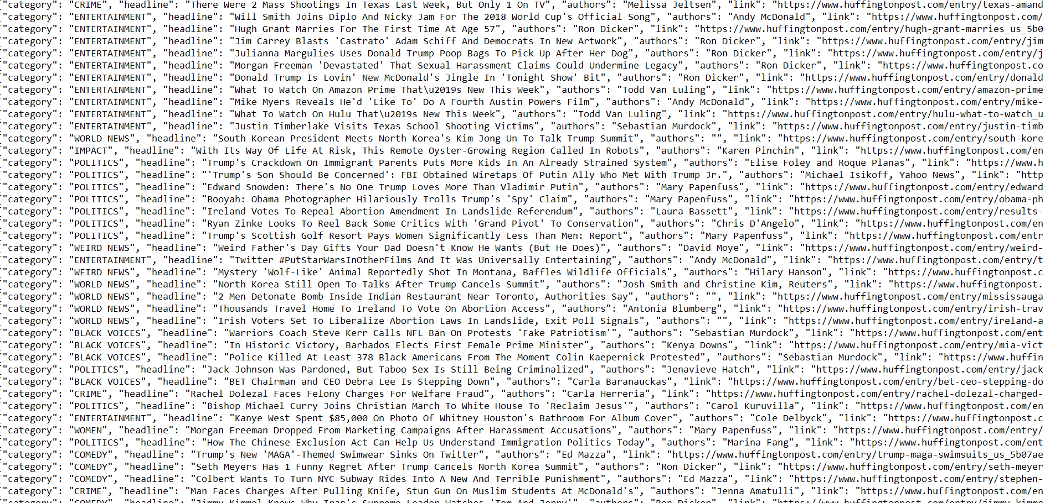
Original Dataset

Slide 8
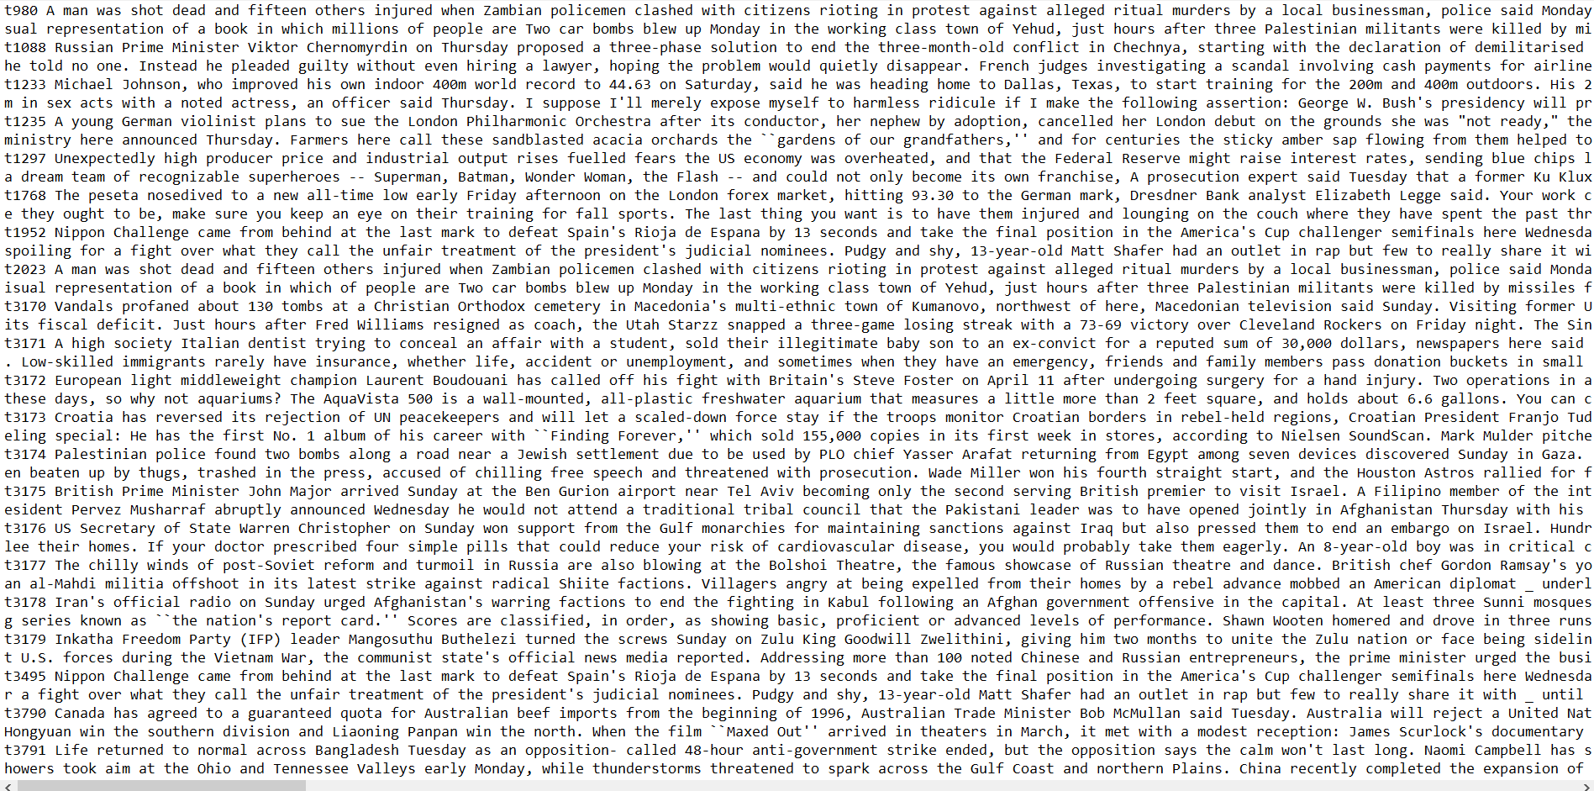
Preprocessed Dataset with ID mapping

Slide 9
Proposed Methodology
MinHash function is defined as the index of the first (in permuted order) row which the column c has 1, plus the location of that attribute in the original text.
Document is divided into s sections.
An enhanced characteristic matrix is built so that if the attribute exists in the text, instead of storing the binary value of one, the ID of the section where the attribute appeared in is stored, and if the attribute does not exist in the text, we consider that value as 0.
Thereafter, K random permutations P1, P2….PK are applied on the indexe and the matrices are rearranged.
The S-MinHash signature matrix is built as follows:
Each row of the signature matrix is derived from one rearranged matrix.
For each signature, an ordered pair is made based on (MinHash signature, SID) that is the index of the first row with non-zero value, and the stored section ID for that row in each rearranged matrix. The second index will be used resulting to the S-MinHash signature.

Slide 10
Proposed Methodology
In the last step, each ordered pair is mapped into a strictly monotone value by the use of a pairing function : a, b := ½(a + b)(a + b + 1) + b where π: N x N → N
The resultant values are stored in the S-MinHash signature matrix.
For calculating pairwise similarity scores, Jaccard similarity measure is used.

Slide 11
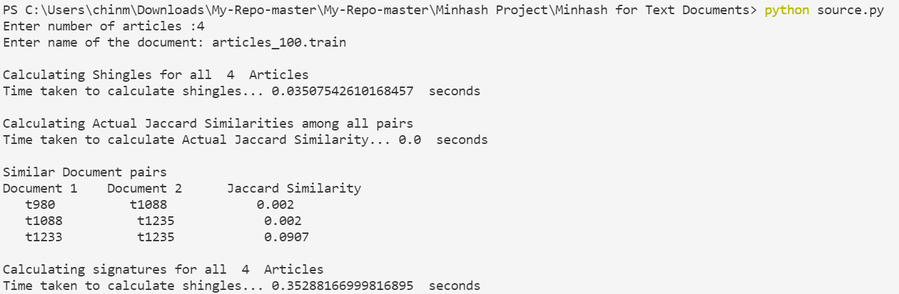
Results
MinHash for Text Documents

Slide 12
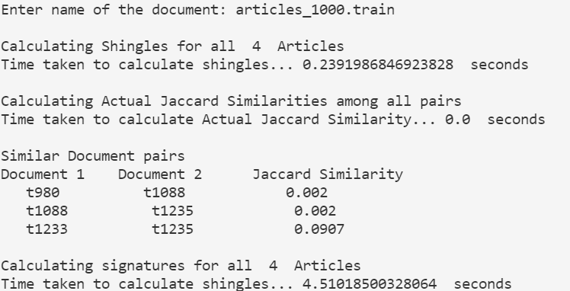
Results

Slide 13
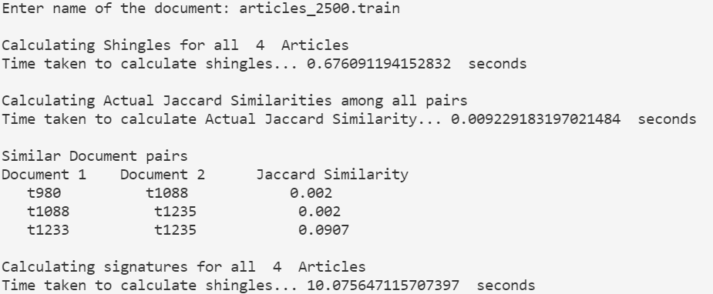
Results

Slide 14
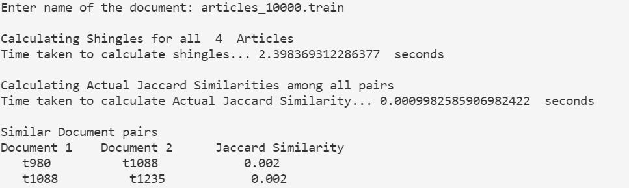
Results

Slide 15
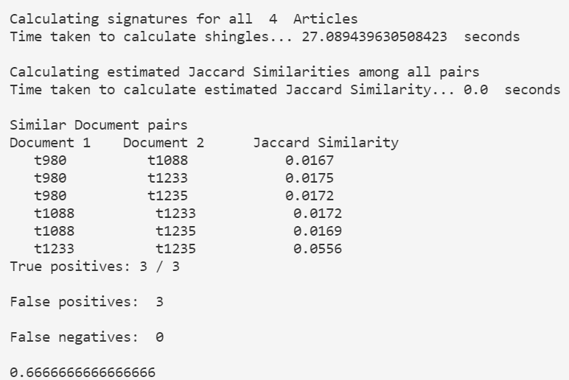
Results

Slide 16
THANK YOU

