Slide 1
Implicit Browser Networking
The browser may make several network requests to one or more servers to fetch resources when building up the DOM
When a client makes a request for a specific URL, other resources may need to be fetched, such as images, script elements, linked files
This is implicit browser networking and, until JS came along, this is the only kind of implicit networking there was

Slide 2
Explicit Networking with Javascript
When JS was introduced to the browser it became possible for the programmer to explicitly trigger network requests to a server
Typically, this is done in reaction to some UI event such as a mouse click, resulting in asynchronous execution
For example, setting a URL value for an image src attribute would cause the browser to connect to that URL and request the image from it
const el = document.getElementById("myImage"); el.src = "http://www.funnycatpix.com/_pics/Whoaaa_Dude498.jpg";

Slide 3
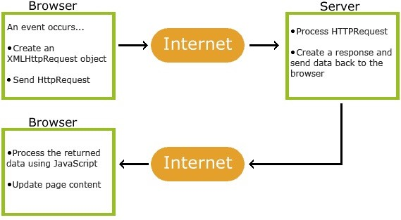
Asynchronous Javascript and XML (AJAX)
AJAX: web development technology used to send and retrieve data in the background without refreshing the page
It makes use of the XMLHttpRequest object to communicate with the servers and retrieve data

Slide 4
Asynchronous Javascript and XML (AJAX) Steps
Step 1: Make a XMLHttpRequest
Step 2: Once you get the response, use onreadystatechange property to tell what function will run after the response
Step 3: Use .open method to get data
Step 4: Use .send method to send data
const xhr = new XMLHttpRequest(); xhr.onreadystatechange = () => {
if (xhr.readyState === XMLHttpRequest.DONE) {
// The response is received
}
};
xhr.open("GET", "http://example.com/some/resource/endpoint"); xhr.send();

Slide 5
Asynchronous Javascript and XML (AJAX)
AJAX allows the programmer to initiate explicit network requests of some HTTP type (e.g. GET) to a specific URL
The asynchronous request requires a callback function to be specified to handle the response which will arrive in the future

Slide 6
The onreadystatechange() Handler
When the request completes, the XMLHttpRequest object properties can be queried to access the response in the onreadystatechange() handler
let response; const xhr = new XMLHttpRequest(); xhr.onreadystatechange = () => { if (xhr.readyState === XMLHttpRequest.DONE) { if (xhr.status === 200) { response = JSON.parse(xhr.responseText); } else { console.log('Error ' + xhr.statusText); } } }

Slide 7
The fetch() API
const whenCatLoaded = fetch(cat.jpg', options); // A promise is returned whenCatLoaded .then((response) => { if (response.ok) { // Happy path. Image is available ... let image = response.blob(); } else { // Process other response status ... } }) .catch((error) => { // Request completely failed console.log(Error: ' + error.message); });

