Slide 1
Implicit Browser Networking
The browser may make several network requests to one or more servers to fetch resources when building up the DOM
Network requests include such things as the processing of anchor elements, images, script elements, link elements and so on
When a user refreshes the view or posts a form, a network request is made to fetch the document at a specific URL which, in turn, may fetch more resources and so on until the last resource has been fetched
This is implicit browser networking and, until JS came along, this is the only kind of networking there was

Slide 2
Explicit Networking with Javascript
When JS was introduced to the browser it became possible for the programmer to explicitly trigger network requests to a server
Typically this is done in reaction to some UI event such as a button press or a mouse click so it is asynchronous to program execution
For example, setting a url value on an image src attribute would cause the browser to connect that url and attempt to load an image from it
const el = document.getElementById("myImage"); el.src = "http://www.funnycatpix.com/_pics/Whoaaa_Dude498.jpg";

Slide 3
Asynchronous Javascript and XML (AJAX)
AJAX: web development technology used to send and retrieve data in the background without refreshing the page
It makes use of the XMLHttpRequest object to communicate with the servers and getting data without reloading the page
Examples of web app: Twitter timeline and Google search
const xhr = new XMLHttpRequest(); xhr.onreadystatechange = () => { if (xhr.readyState === XMLHttpRequest.DONE) { // The response is received } }; xhr.open("GET", "http://example.com/some/resource/endpoint"); xhr.send();

Slide 4
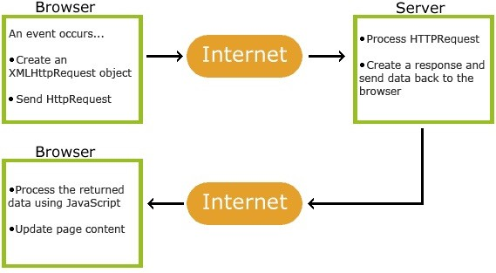
Asynchronous Javascript and XML (AJAX)

Slide 5
Asynchronous Javascript and XML (AJAX) Steps
Step 1: Make a XMLHttpRequest
Step 2: Once you get the response, use onreadystatechange property to tell what function will run after the response
Step 3: Use .open method to get data
Step 4: Use .send method to send data
const xhr = new XMLHttpRequest(); xhr.onreadystatechange = () => {
if (xhr.readyState === XMLHttpRequest.DONE) {
// The response is received
}
};
xhr.open("GET", "http://example.com/some/resource/endpoint"); xhr.send();

Slide 6
Asynchronous Javascript and XML (AJAX)
AJAX allows the programmer to initiate explicit network requests of some HTTP type (e.g. GET) to a specific URL
The asynchronous request requires a callback function to be specified to handle the response which will arrive in the future
The basic, native DOM API mechanism uses the XMLHttpRequest object

Slide 7
The onreadystatechange() Handler
When the request completes, the XMLHttpRequest object properties can be queried to access the response in the onreadystatechange() handler
let response; const xhr = new XMLHttpRequest(); xhr.onreadystatechange = () => { if (xhr.readyState === XMLHttpRequest.DONE) { if (xhr.status === 200) { response = JSON.parse(xhr.responseText); } else { console.log('Error ' + xhr.statusText); } } }

Slide 8
Same-origin Policy
The same origin policy restricts how a script loaded from on origin can interact with a resource from another origin
This is to prevent users from unknowingly loading malicious scripts from sites they are browsing or apps they are loading
The default policy is to deny anything other than HTTP GET requests to non-origin sources
However, a server may create exceptions to the default SOP through a cross-origin-request policy (CORS)
The browser can query the policy using the OPTIONS request to see what verbs and headers are permitted for a particular endpoint

Slide 9
The fetch() API
const whenCatLoaded = fetch(cat.jpg', options); // A promise is returned whenCatLoaded .then((response) => { if (response.ok) { // Happy path. Image is available ... let image = response.blob(); } else { // Process other response status ... } }) .catch((error) => { // Request completely failed console.log(Error: ' + error.message); });

Slide 10
The fetch() API
Example – retrieving Github users data: XMLHttpRequest: https://jsfiddle.net/lairdp/qr8vc7ak/ Fetch( ) API: https://jsfiddle.net/lairdp/9bjed4po/

Slide 11
Summary
The browser performs implicit network requests during page loads which may contain additional elements such as scripts or images which, in turn, make external network requests
JS allows the programmer to make explicit, asynchronous requests using the XHLHttpRequest() or the newer fetch() API call
By default, the same origin policy restricts network requests to the originating server
CORS allows servers to make exceptions to the SOP for specific operations on specific resources

