Slide 1
HTML5
Rich Web Application Technologies

Slide 2
HyperText Markup Language
HTML5 is the latest standard encompassing a collection of related technologies for page layout and rendering
This standards track, started in 2004, supercedes HTML4 which dates back to 1997
Includes all the page elements and attributes from HTML4 and adds some more
Crucially, it removes the need for plugins such as Flash or Silverlight
New semantic tags to help crawlers and screen readers
There are additional features which are not strictly part of the W3C standards but considered part of the HTML5 suite

Slide 3
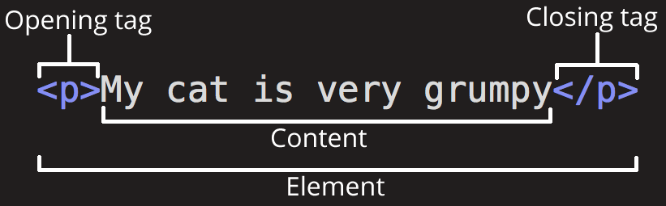
HTML - anatomy

Slide 4
Inline and Block Elements
HTML elements are usually "inline" or "block-level" elements. An inline element occupies only the space bounded by the tags that define it. A block-level element occupies the entire space of its parent element (container), thereby creating a "block".

Slide 5
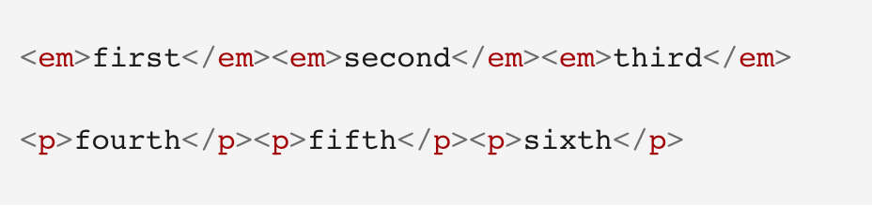
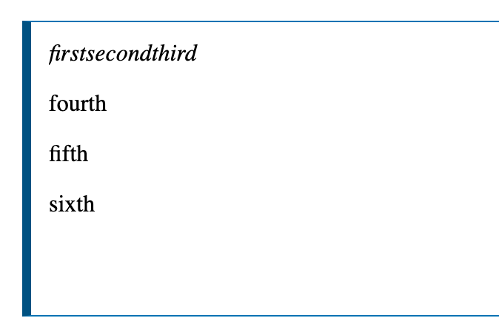
Inline and Block Elements
CODE: the emphasis tag is a inline element, while the paragraph tag is a block element
OUTPUT: each p element appears on a new line, with space above and below

Slide 6
Block Elements
Block elements having semantic meaning but no prescribed visual representation
article | header | footer
section | address | aside
figure | figcaption | nav
audio | video | canvas
summary | details

Slide 7
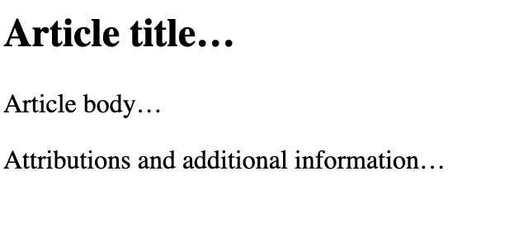
Example 1: News Post
Let’s consider how a news article might be laid out in HTML5
<section class=”post”> <article> <header> <h2>Article title…</h2> </header> <p> Article body… </p> <footer> Attributions and additional information… </footer> </article> </section>

Slide 8
Example 2: Product Catalogue
The <article> element can be used for other layouts too
<section class=”product”> <article> <header> <p>Description…</p> </header> <figure> <img src=”...” alt=”...”> <figcaption>Caption…</figcaption> </figure> </article> </section>

Slide 9
Example 3: Page Footer
HTML5 adds support for common page sections like footers
<footer> &copy; ACME Trading limited <address> 1800 Pennsylvania Avenue, Washington, DC </address> Last updated on <time>May 15</time> </footer>

Slide 10
Inline Elements
New inline elements have been added to HTML5 help with common visualisations such a text highlighting and progress bars
mark | meter | progress
output | time

Slide 11
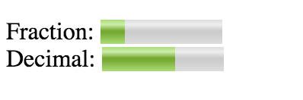
Example 4: The <meter> element
The meter element gives a visual representation of a fraction or decimal value with alternative text if the tag is not supported by the browser
The exact visualisation will depend on the browser
Fraction: <meter value="2" min="0" max="10">2 out of 10</meter><br> Decimal: <meter value="0.6">60%</meter>

Slide 12
Form Input Types
HTML5 makes it easier to get the right kinds of data types as input from the user and to validate those inputs on the client
Previously, it required the developer to use external libraries such as JQuery
There are several new <input> types which provide a richer experience
color | email | number
date,datetime,week,month | range | search
tel | url

Slide 13
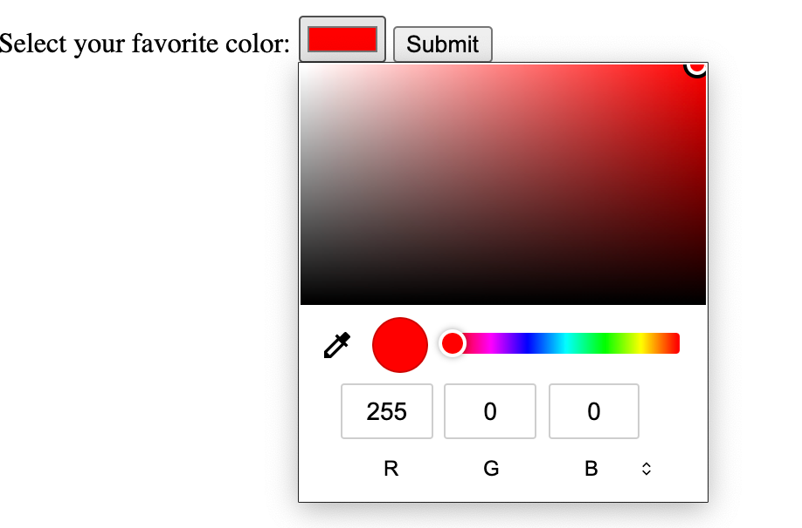
Example 5: Input – Color attribute
<label for="favcolor">Select your favorite color:</label>
<input type="color" id="favcolor" name="favcolor" value="#ff0000">
<input type="submit" value="Submit">

Slide 14
Form Input Qualifiers
HTML5 added a number of <input> element attributes to help with UX and data validation
Let’s see an example of how these are used
autofocus | height,width | min,max
pattern (regexp) | placeholder | step

Slide 15
Example 6: Input Form
<form> <input name="name" type="text" placeholder="Name"> <input name="age" type="range" min=1 max=100> <input list="education"> <datalist id="education"> <option value="Primary"> <option value="Secondary"> <option value="University"> </datalist> <input type="image" src="submit.gif" alt="Submit" width="32" height="32"> </form>

Slide 16
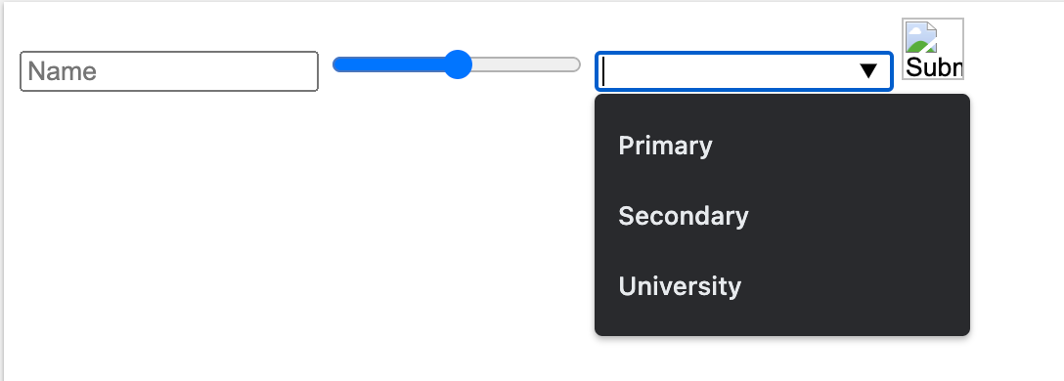
Example 6: Input Form

Slide 17
2D Graphics
Scalable Vector Graphics SVG is a language for describing 2D graphics in XML
The XML tags build elements in the SVG DOM similar to how traditional HTML works
SVG operates inside a container in the browser DOM and supports drawing primitives for rendering boxes, circles, polygons, text and images
The language models the idea of a stroke pen for rendering object exteriors and a fill pen for rendering object interiors

Slide 18
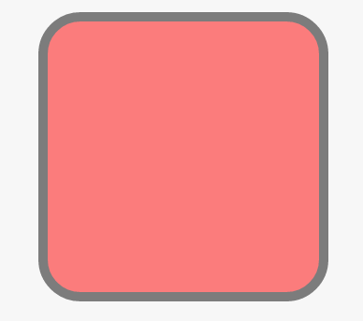
Example 7: SVG Rounded Square
The <svg> tag defines the container and the nested tags perform the drawing of the contained objects
Inlined CSS (using the style attribute) is often used to style the rendered objects as shown in the example below
<svg width="200" height="200"> <rect x="10" y="20" rx="20" ry="20" width="150" height="150" style="fill:red;stroke:black;stroke-width:5;opacity:0.5" /> </svg>

Slide 19
Audio and Video
Prior to HTML5, the browser had no standardised native support for multimedia content
A workaround for this was to use plugins like Flash and Silverlight
HTML5 introduced the <video> and <audio> tags to support rich-content formats to allow open, royalty-free, patent-unencumbered media to be distributed and rendered directly in the browser
The built-in support is still pretty basic though and often requires third-party libraries such as video players to enhance the user experience

Slide 20
Example 8: Embedded Video
The <video> tag allows the idea of one or more fallback source inputs until a supported format can be loaded
The controls attribute turns on basic native player controls
Most apps will enhance the basic player with third-party libraries
<video width="600" controls> <source src="movie.mp4" type="video/mp4"> <source src="movie.ogg" type="video/ogg"> HTML5 video is not supported by your browser </video>

Slide 21
Microdata
HML5 microdata is nested metadata providing a standardised way to provide additional semantics about your page contents
Microdata consists of groups of key/value pairs called items
To create an item you used the itemscope attribute
To assign a property, you use the itemprop attribute
Search engines and web crawlers can extract and process microdata from a web page and use it to provide a richer browsing experience for users. Some communities try to maintain a vocabulary that can be used in the microdata.
<section itemscope> <p>Firstname <span itemprop="firstname">Jane</span></p> <p>Lastname <span itemprop="lastname"> Joe </span></p> </section>

Slide 22
Local Storage
The remainder of this HTML5 feature review will be largely concerned with Javascript and the JS API extensions to access these features (see https://developer.mozilla.org/en-US/docs/Web/API)
Local storage is a simple key/value store for persisting small values and objects to the browser’s local storage
This can be useful as a short term storage solution such as remembering access tokens across logins
It is not a replacement for server-side persistence

Slide 23
Example 9: Local Storage
Use the predefined object localStorage and call the setItem method to store the key name and key value. Return it by accessing the HTML element by ID.
// Save localStorage.setItem("lastname", "Doe"); // Load document.getElementById("name").innerHTML = localStorage.getItem("lastname");

Slide 24
IndexedDB
Whereas local storage is a simple key/value store, IndexedDB offers a more sophisticated storage and retrieval facility for larger data sets
The primary use case for IndexedDB is to support an offline operating mode for your Web App
Offline here means when the browser is disconnected from the server’s network somehow
A user can continue to use the App in offline mode and any updates from the client or server can be synchronised when they subsequently reconnect

Slide 25
Drag and Drop
HTML5 allows designated elements to be dragged by the mouse or touchpad and dropped to other locations on the screen
However, this behaviour is not enabled by default
The programmer must mark an element as draggable and then set up a set of event listeners in Javascript to react to drag-and-drop events by the user
The native Javascript API is typically powerful and verbose so many programmers use third-party libraries to work with drag-and-drop

Slide 26
Geolocation
This interface allows you to get the GPS coordinates of the browser, subject to user permission
Example: https://www.w3schools.com/html/tryit.asp?filename=tryhtml5_geolocation
const showLocation = (pos) => { console.log(pos.coords.latitude, pos.coords.longitude); }; const errorHandler = (err) => { console.log(err); }; () => { let geolocation = navigator.geolocation; geolocation.getCurrentPosition(showLocation, errorHandler); }();

Slide 27
Websockets
Traditional HTTP is a request/response protocol exclusively initiated by the client browser
Websockets were introduced as a standard to solve the problem of bidirectional communications between the client and server
In particular to allow the server to push data to the client without the need for the client to poll or request from the server
An example of where this is useful is in a chat application where two or more browsers are connected to a chat server
The server can push messages to client B coming from client A over a websocket connection

Slide 28
Websocket API
let connection = new WebSocket('ws://example.com/endpoint'); // When the connection is open, send some data to the server connection.onopen = () => { connection.send('Ping'); };d // Handle errors connection.onerror = (error) => { console.log('WebSocket Error ' + error); }; // Receive asynchronous messages from the server connection.onmessage = function (e) { console.log('Server: ' + e.data); };

Slide 29
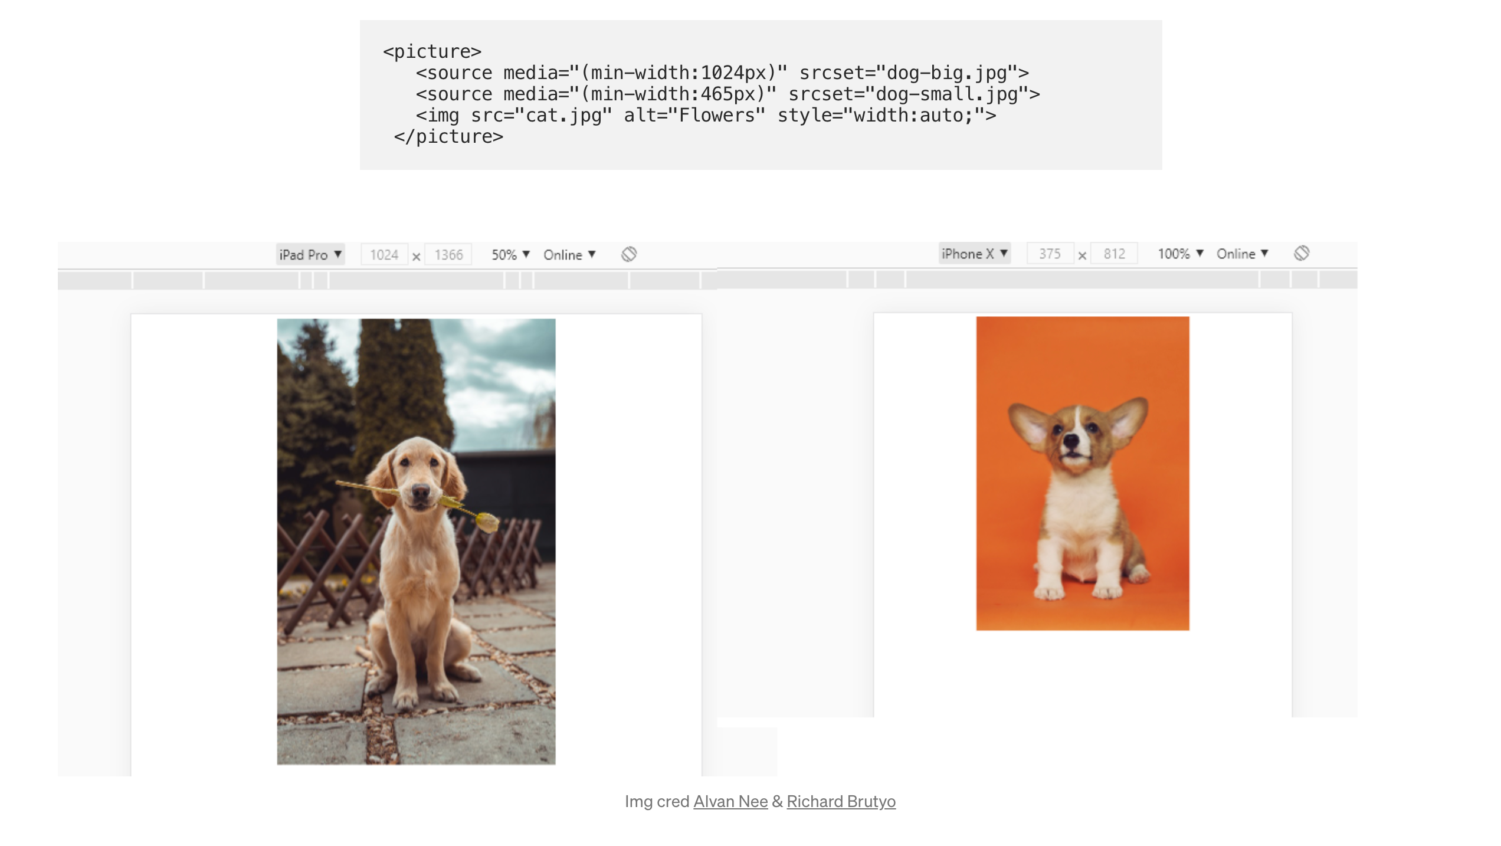
Few other things you can do with HTML
Using the <picture> tag, you can tell the browser which image to use depending on the type of device/screen.
More cool stuff here.

Slide 30
Summary
Although the Web has been using HTML4 since 1997, it required a lot of hacks, plugins and third-party Javascript code to make it work smoothly
The HTML5 suite of technologies and standards addresses many of the shortcomings of HTML4
Plugins are no longer needed for multimedia rendering
New elements are available to enrich the semantics of a page for machine readers
And the browser now has access to sophisticated features such as indexed storage, geolocation and background workers

