Slide 1

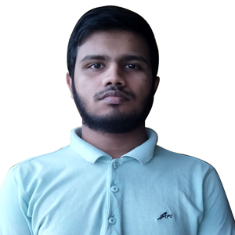

Welcome to My Profile
Hello My Name is
Abul Hasan Zaid Al-Mahi
I’m a Student of Dept. of CSE in International Islamic University Chittagong.

Slide 2

Welcome to My Profile
I Completed My Alim (HSC Equivalent) From Darul Ulum Kamil (Hon's-Masters) Madrasah with GPA 4.81

Slide 3
Welcome to My Profile
I Completed My Dakhil (SSC Equivalent) From Darul Ulum Kamil (Hon's-Masters) Madrasah with GPA 4.72

Slide 4

Welcome to My Profile
I Completed My JDC From Garangia Islamia Kamil Madrasah
with GPA 4.85

