Slide 1
eNPA
NON-PROFIT ORGANIZATION ACCOUNT
MUHAMMAD ZAKI BIN AB. MULUK
ZARIYAH BINTI ABDULLAH

Slide 2
Introduction
A Non-Profit Organization Account refers to the accounting system used by organizations that operate to provide services and benefits to the public or their members rather than to earn profit. These organizations include charities, clubs, religious institutions, educational societies, and non-governmental organizations (NGOs).
The main purpose of this accounting system is to record financial transactions accurately, ensure transparency and accountability, and show how funds such as donations, grants, sponsorships, and membership fees are utilized. Unlike business organizations, non-profit organizations do not distribute profits to owners or shareholders. Instead, any surplus earned is reinvested into the organization to support its activities and objectives.
Non-profit organizations usually prepare several financial statements, including the Receipts and Payments Account, Income and Expenditure Account, and Balance Sheet or Statement of Financial Position. The Receipts and Payments Account records all cash received and paid during a specific period, while the Income and Expenditure Account determines whether the organization has a surplus or deficit. The Balance Sheet shows the organization’s assets, liabilities, and accumulated funds.
Proper accounting practices are important for non-profit organizations to maintain public trust, ensure responsible management of funds, and support effective decision-making for future programs and activities.

Slide 3
Select your option
eBook
Game
Quiz
Exercise
A
B
C
D
eBook Here
Game Here
Quiz Here
Exercise Here

Slide 4
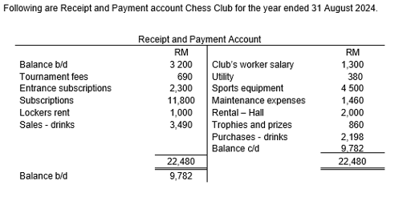
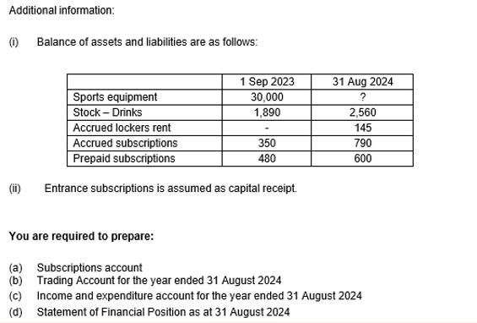
Question

Slide 5
Game
Mix and Match
Subscription Account | Subscription Account
1/9/2023 |  |  | 1/9/2023
31/8/2024 |  |  | 31/8/2024
11,800
Balance c/d
Balance b/d
Balance c/d
Bank
350
790
480
600
12,120
Income & expenditure
Balance b/d

Slide 6
Game
Mix and Match
Chess Club Trading Account for the year ended 31 Aug 2024
 | 3490 |  | 3490
Sales
Opening stock
Purchase
(-)Closing Stock
3490
4088
(2560)
3490
1962
2198
Profit
Cost of sales
1528

Slide 7
Game
Mix and Match
Chess Club Income and expenditure account for the year ended 31 Aug 2024
 | 15, 917 |  | 15, 917
Club worker salary
Maintenance expense
Surplus
Lockers rent
380
9917
860
Rental - hall
1460
12120
Tournament fees
Profit - drinks
2000
690
Utility
Trophies and prizes
Subscriptions
1300
1962
1145

Slide 8
Chess Club Statement of Financial Position as at 31 August 2024
Non-current Assets
Current Assets
 | 13,277 | 13,277
 |  | 47,777
Owner’s Equity
Current Liabilities
 |  | 47,777

Slide 9
continue
Sport equipment
Closing stock
Cash
Accrued lockers rent
Accrued subscription
Accumulated fund
600
2300
2560
34500
34960
145
9782
Prepaid subscriptions
47177
9917
790
Entrance subscriptions
(+)surplus

Slide 10
THANK YOU
NON-PROFIT ORGANIZATION ACCOUNT

