Slide 1



UHF tag
Selfmade Reader
UHF RFID tags to your computer over Ethernet
Reader
Configure · Monitor · Store · Forward
Your computer
Demo and walkthrough
Notes:
Welcome. This is Selfmade Reader: a small program that takes the tags a UHF RFID reader sees, and gets them onto a computer over a normal Ethernet cable. It lets you configure the reader from a web page, watch tags live, store them in a CSV file and forward them to the internet. In the next 15-20 minutes I will explain the problem we solved, how it works, show it live, and then say exactly what is tested and what is not.

Slide 2


The reader beeped, but no data arrived
A UHF reader was cabled over Ethernet and beeped on every tag it read.
The computer could see the reader on the network, yet received 0 bytes of tag data.
Guessing protocols failed. The manufacturer's own logs and software showed how it really works.
Radio side works
The reader beeps on every tag.
Ethernet side silent
0 bytes of tag data reached the computer.
Notes:
When we started, the reader worked: it beeped on every tag. But over Ethernet nothing arrived. We tried the common reader protocols, a packet capture and listeners on many ports, and always got silence. The breakthrough was reading the manufacturer's own logs, which showed the real message format and the real settings.

Slide 3

Root cause: tags left through the wrong port
BEFORE
AFTER
Output interface
Output interface
RS232 / RS485 (serial)
RJ45 (Ethernet)
Remote server
Remote server
120.78.148.145 : 0
192.168.1.10 : 6000
Result
Result
Tags never leave the serial cable
Reader connects to the PC and pushes every tag
Keep the reader in Active mode. Never use Answer mode: it silences the buzzer and stops pushing tags.
Notes:
The cause was a setting, not a cable or a bug. The reader had its Interface set to RS232/RS485, so it pushed tags out of its serial port. The Ethernet port was only used for settings. Its remote server was still the factory default. We switched the Interface to RJ45 and pointed the remote server at the computer. One warning for everyone: do not set Work mode to Answer; the reader then stops pushing and the buzzer goes silent.

Slide 4





How it works
CSV file
868 MHz
Ethernet
save, send
HTTP webhook
UHF tag
Reader
Selfmade Reader
MQTT broker
EPC Gen2 tag, read at 865-868 MHz
SN5300 / CF5300 type, pushes each read
Listens on port 6000, shows and stores tags
TCP server
Outputs
Saved and sent over any network
Tags go straight from the reader to your computer: no cloud and no vendor software needed.
Notes:
Left to right: a UHF tag is read by the reader over 868 MHz radio. The reader is set to RJ45, so it opens a TCP connection to the computer, on port 6000, and pushes every tag it reads. Selfmade Reader receives it, shows it live, writes it to a CSV file and can forward each read to an HTTP address, an MQTT broker or a TCP server, using whatever network the computer has: Ethernet, WiFi or a 4G/5G hotspot.

Slide 5


Two connections, two jobs
Settings
Tag data
PC to reader · TCP 60000
Reader to PC · TCP 6000
Read and write the reader's settings, restart it. A backup is saved before every change.
The reader connects to the computer and pushes every tag: EPC, signal strength (RSSI) and antenna.
What one pushed tag message looks like
43 54 00 1c 01 45 01 c3 9b 24 03 14 45 2c 01 0f 01 01 30 08 33 b2 dd d9 01 40 00 00 00 00 3c 9a
decodes to EPC 300833B2DDD9014000000000 RSSI 60 antenna 1
Notes:
There are two separate connections. Port 60000 lives on the reader: the computer uses it to read and change settings. Port 6000 lives on the computer: the reader connects to it and pushes tags. The box at the bottom is a real message captured from the reader; it decodes to a 12-byte EPC, the signal strength and the antenna number.

Slide 6




Demo: five steps
1
2
3
4
5
Start
Find
Set up
Read
Use
python3
selfmade_reader.py
Reader setup, then Find readers
One-click Ethernet setup
Hold a tag: it beeps and appears
Open the CSV or forward it
Needs only Python 3.8+ and one file. The computer needs an address in the reader's network, for example 192.168.1.20.
Notes:
This is the whole demo. One: start the program. Two: open the Reader setup tab and click Find readers on the network. Three: click One-click Ethernet setup; it saves a backup, sets the interface to RJ45, points the reader at this computer and restarts it. Four: hold a tag near the antenna; the reader beeps and the tag appears. Five: open the CSV, or switch on forwarding. The next three slides show the screens.

Slide 7
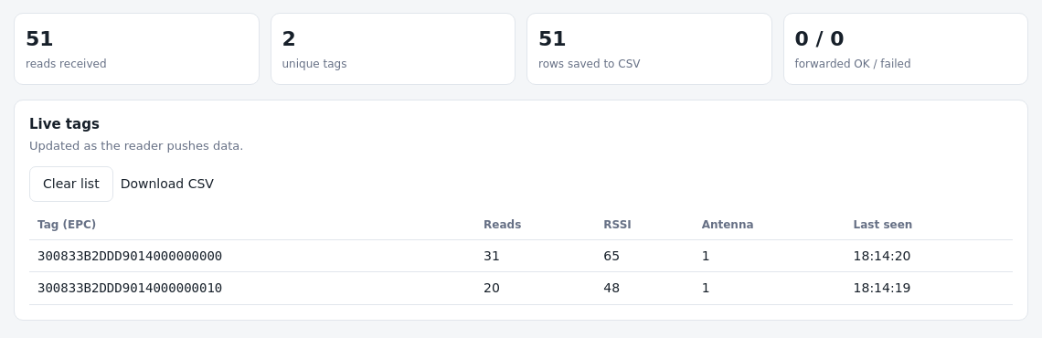



Screen 1: live dashboard
Counters
Reads, unique tags, CSV rows, forwarded OK and failed
Live table
EPC, reads, RSSI, antenna and last seen, updating as tags arrive
Recorded reads replayed for the demo
The top bar tells you the state at a glance
Export
reader connected
reachable, not sending
not reachable
Download the CSV or clear the list in one click
Not reachable: check cable, power and IP. Reachable but not sending: run One-click setup.
Notes:
Screen one is the dashboard. The pill at the top is the most useful part: green means the reader is connected and pushing; amber means the reader answers but is not sending, so run One-click setup; red means the computer cannot reach the reader at all, so check cable, power and IP. Below it, the counters and the live table. This screenshot uses recorded reads from our reader, replayed so we can show it without a live tag.

Slide 8
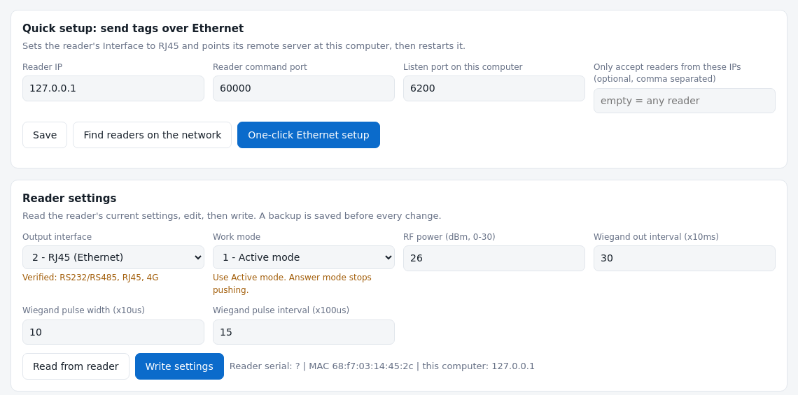


Screen 2: reader setup
One-click setup
Interface to RJ45, remote server to this computer, then restart
Backup first
Every write saves the old settings to a backup file you can restore
WiFi and network
Reader IP, remote server, WiFi name and password in one place
Settings read from recorded reader data
Notes:
Screen two is where you configure the reader. The big blue button runs the whole fix in one go. Underneath are the individual settings: output interface, work mode, RF power, the network block with the remote server, and WiFi. Before any write the program saves the reader's current settings into a backup folder, and there is a Restore button. WiFi and the 4G interface are present in the form but are not yet tested on our reader.

Slide 9
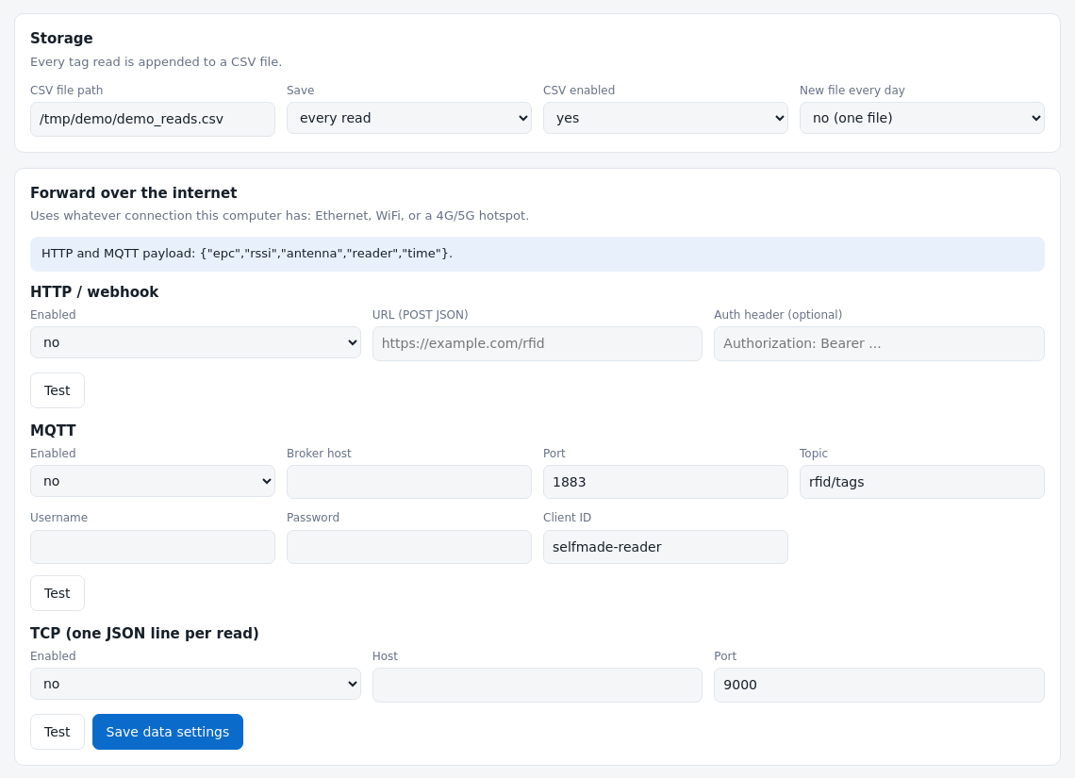


Screen 3: data and forwarding
Storage
CSV path, one row per tag per 1, 5 or 60 seconds, optional daily files
Forwarding
HTTP webhook, MQTT broker or TCP server, each with a Test button
Credentials
Kept in a local settings file that is never committed to GitHub
Notes:
Screen three is storage and forwarding. Tags are written to a CSV file; by default one row per tag per second so the file stays small, or every read, or one file per day. Below, you can forward every read to an HTTP address, an MQTT broker or a TCP server. Each has a Test button. This uses the computer's own connection, so WiFi or a 4G/5G phone hotspot works.

Slide 10


Where the data goes
Real rows from our reader's CSV
Tag read
timestamp | epc | rssi | ant
2026-10-01T16:14:01.654 | 300833B2DDD9014000000000 | 70 | 1
2026-10-01T16:14:01.734 | 300833B2DDD9014000000000 | 80 | 1
2026-10-01T16:14:02.205 | 300833B2DDD9014000000000 | 20 | 1
2026-10-01T16:14:02.223 | 300833B2DDD9014000000010 | 50 | 1
2026-10-01T16:14:03.674 | 300833B2DDD9014000000010 | 60 | 1
Saved to CSV first, always
Send
HTTP, MQTT or TCP
Link down?
Saved to a spool file on disk
One row per tag per second by default; every read if you prefer.
Auto-resend
Every 30 seconds, oldest first
Notes:
On the left, real rows from our reader's CSV: timestamp, the 12-byte EPC, signal strength and antenna. On the right, what happens to each read. It is always saved to CSV first. If forwarding is on it is sent; if the network or the server is down, the item is saved in a spool file on disk and resent automatically every 30 seconds, oldest first. We tested that with a server that was down and then came back.

Slide 11



Run it on any computer
Windows
macOS
Linux
Start
Start
Start
START_WINDOWS.bat
START_MAC.command
./START_LINUX.sh
Auto-start
Auto-start
Auto-start
Task Scheduler task at logon
launchd agent at login
systemd service, also at boot
Needs only Python 3.8+ and one file. No packages to install. Give the computer an address on the reader's network, for example 192.168.1.20 with no gateway, then use the one-click setup.
Notes:
To run it anywhere you need Python 3.8 or newer and the one file. There are double-click launchers for Windows, macOS and Linux, and a single command, --install-autostart, that makes it start by itself: a systemd service on Linux, a launch agent on macOS, a scheduled task on Windows. Important honesty: only the Linux version has been tested so far.

Slide 12




Built for deployment
Clear status
Health URL
Password
Green, amber or red bar tells you what to check
/api/health returns 200 when a reader is pushing, else 503
Optional password for the web page
Reader allow-list
Self-recovery
Backup and restore
Only chosen reader IPs may send tags
Restarts after a crash; started on 3 reboots in a row
Reader settings backed up before every change
Notes:
These are the features added for real deployment. A clear status bar. A health URL a monitoring tool can poll. An optional password for the web page and an allow-list of reader IPs, because anyone who can open the page can change reader settings. It restarts after a crash, and on our test computer it started by itself after three reboots. And the reader's settings are backed up before every change. When we looked at the machine after a few days, it had also shown us a real-world failure: the Ethernet port was down, so no data came, and the status bar would now say so in red.

Slide 13

What is tested, and what is not yet
Tested
Not yet tested
Tags over Ethernet into the CSV on the real reader (Linux)
Reading and decoding the reader's settings
Start at boot (3 reboots) and restart after a crash
HTTP, MQTT and TCP forwarding against test servers
Spool and automatic resend, password, allow-list, health URL
Windows and macOS (launchers, auto-start)
WiFi and 4G interface on the reader
Forwarding to a real cloud service
One-click button and Restore on the real reader
Writing RF power and Wiegand values
Notes:
Being straight about status. On the left is what we actually exercised. On the right is what is written but not yet proven. The SOP has a test-record table so each person who deploys can record the result for Windows, macOS, WiFi and a real cloud endpoint, and report back.

Slide 14


Get it, run it, tell us what breaks
Test on Windows and macOS
Run the launcher, reboot, check auto-start
Private repository
Try WiFi on the reader
github.com/C2A-2796/selfmade-reader
Interface WIFI plus network name and password
Access by invitation. Start with docs/SOP.md: install, set up, verify, sign off.
Connect a real endpoint
HTTP URL or MQTT broker, then unplug to test the spool
Questions?
Notes:
To finish: three things we would like people to try. Test Windows and macOS. Try the reader's WiFi interface. Connect a real HTTP or MQTT endpoint and unplug the network to see the spool work. Everything is in a private GitHub repository by invitation, and the SOP in the docs folder walks through install, setup, verification and sign-off. Thank you; questions?

