Slide 1
C2E PROJECT
DIGITAL BANK
Presented By:
Amisha Kumari (498535)
Brunda Kalappa (498532)
Krishna Sai Gandi (498539)
Souvick Mondal (498543)
Veena Prathyusha Bollapragada (498533)
.

Slide 2
OVERVIEW
Objective
Proposed Solution
Architecture
Data Flow
Future Work

Slide 3
OBJECTIVE
Bank wants to introduce a new feature in its banking app offering customized deals to buy a house or vehicle for its consumers.
The bank has collaborated with multiple builders & Car dealers and has decided to develop a state of the art system which tracks builder/dealer track record, financial health & based on customer financial health and behavior provides them one stop option to make a buy decision providing them loan and hassle free buy with minimal documentation.
The system is expected to be a win win solution for builders / dealers , consumers as well as the bank. The system consists of bank’s mobile app and supporting server side components and uses cutting edge algorithms to come up with the adaptive quotes.

Slide 4
PROPOSED SOLUTION
A customer should login with his/her Customer ID and check the customized deals available for him/her.
Deal customization and Loan Amount Calculation is done based on the analysis of his/her income, credit history and other factors.
Through our portal one customer can see the EMI amount he is required to pay based on tenure selected.
Lastly a customer can apply for Loan for a deal.

Slide 5
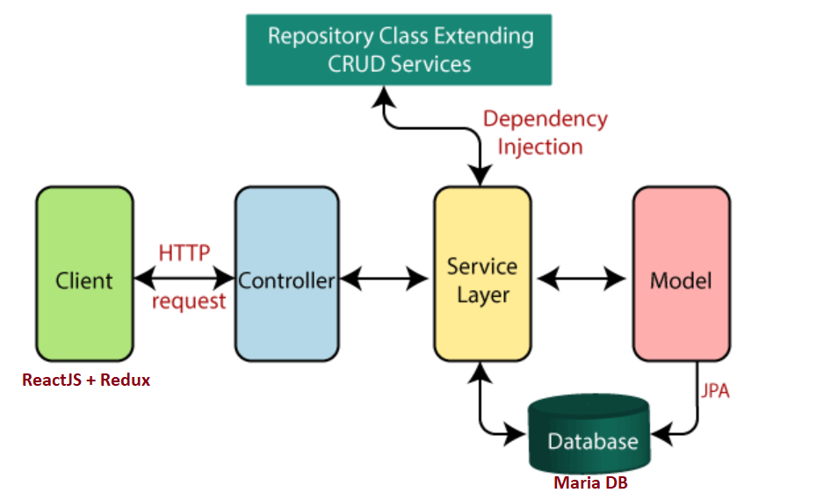
ARCHITECTURE

Slide 6
DEMO

Slide 7
ALGORITHM
TDSR( Total Debt Servicing Ratio)
  It limits the amount borrowers can spend on debt repayments to 60 per cent of their monthly income.
Monthly Income = Applicant Income + Co applicant Income – Living expenses
We have used factors like marital status, dependents, education, employment type, credit history and geographic information to estimate living expenses.
Borrower capacity = 60% of Monthly income – EMI for existing loans.

Slide 8
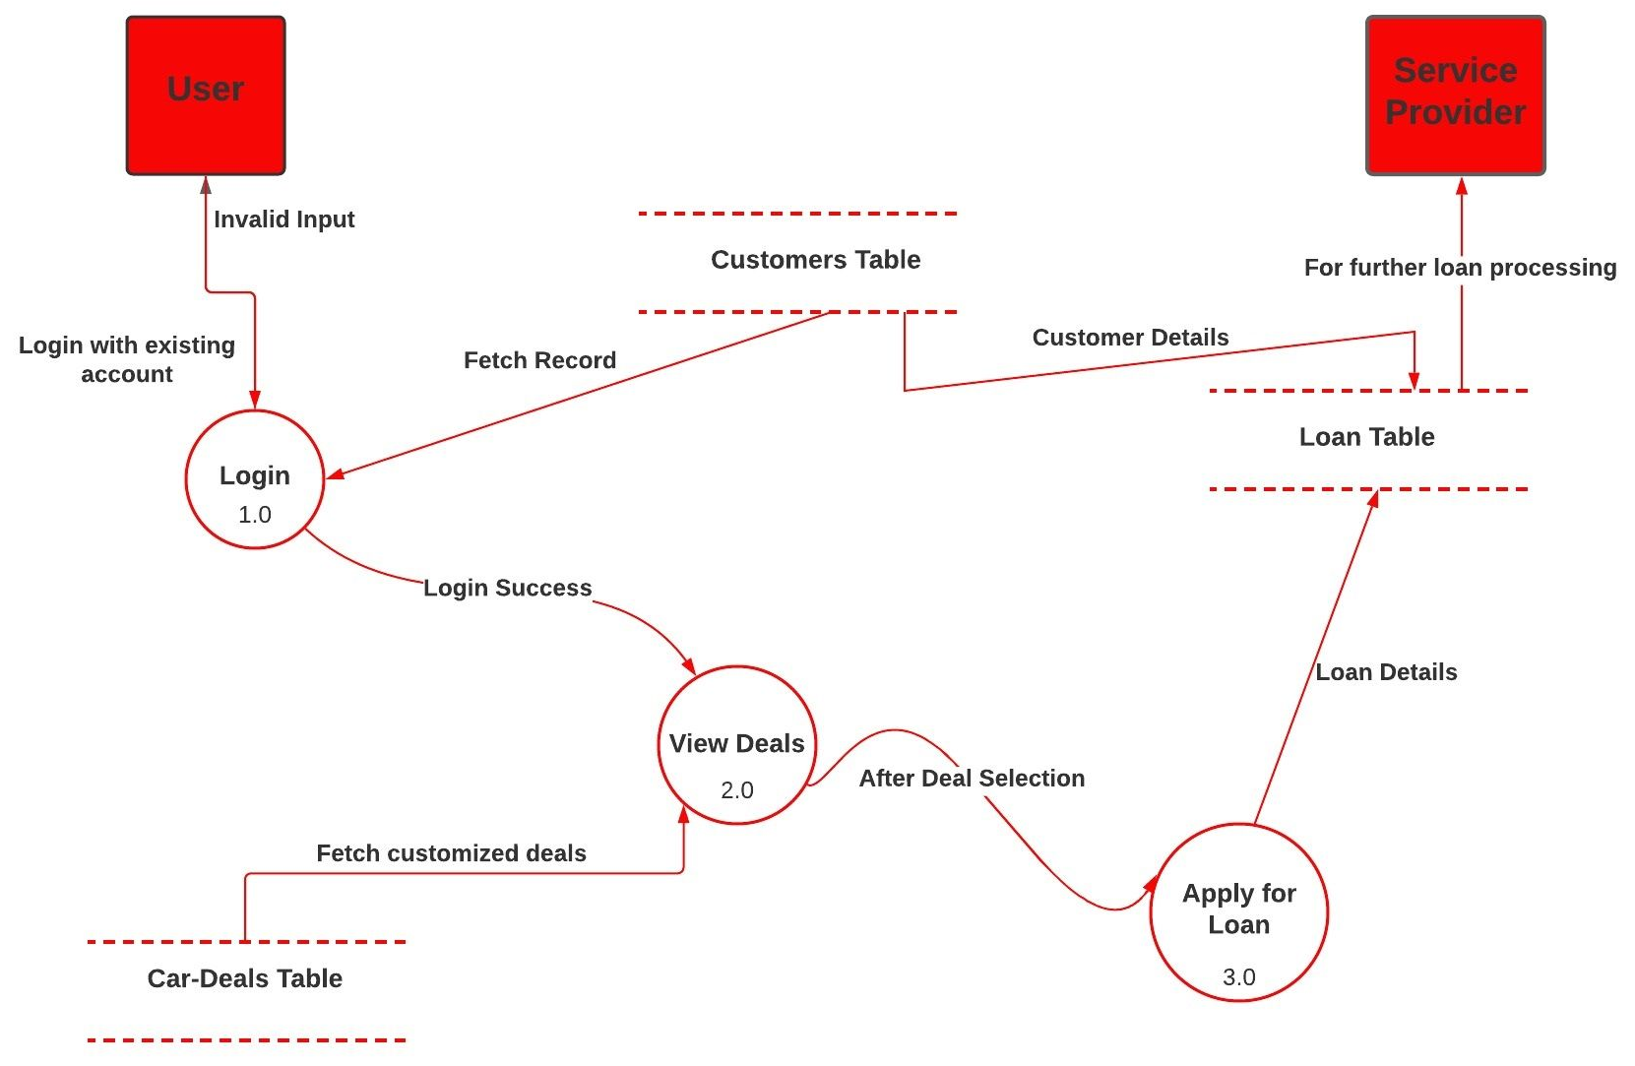

DATA
FLOW
DIAGRAM

Slide 9
FUTURE WORK
We can build Sign Up option where users first have to create bank account and then log in to this portal.
We can build API for the dealers through which they can have some idea regarding the interest of the customer.

Slide 10

ANY QUESTIONS

