Slide 1
Coin Detector

Slide 2


Slide 3






Technical Motivation for the Project
Object recognition as an interesting field
Time intensive training & prediction
Computationally intensive
Performing multiple tasks
Communication between client & server
Data poses a challenge
Notes:
Perform multiple tasks: Count coins & cumulative value

Slide 4







Technology Stack
Client
Server
API
Model

Slide 5
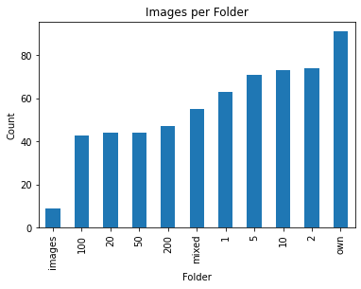
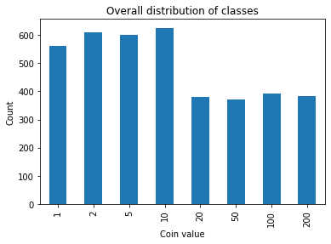
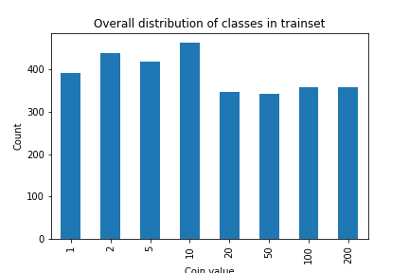

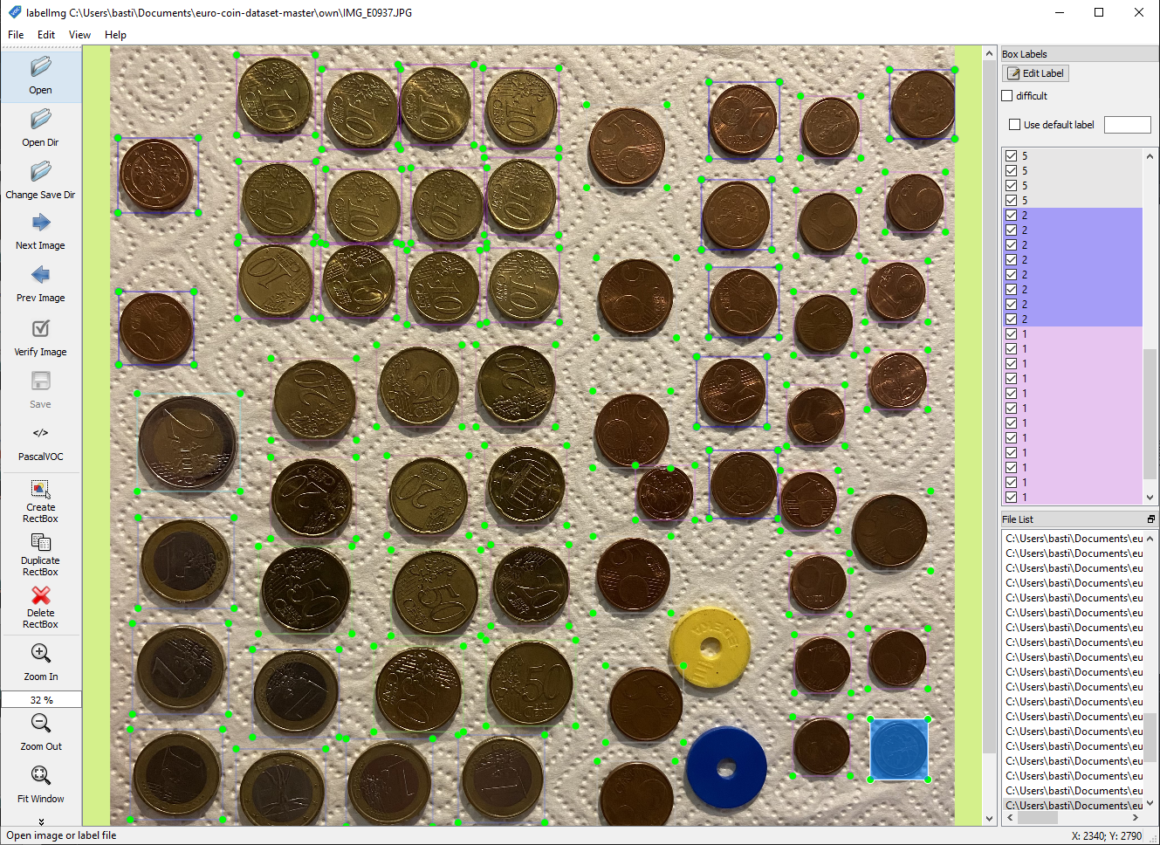
Data
In addition to public dataset, other images were self-labeled
Training data is comparatively similarly distributed → Test data is less similarly distributed
Images are challenging → Even a person does not recognize all coins → Head side is barely distinguishable
Notes:
Overall, care had to be taken to ensure classes were equally distributed in training data → but now test data is not equally distributed → Metrics not meaningful

Slide 6
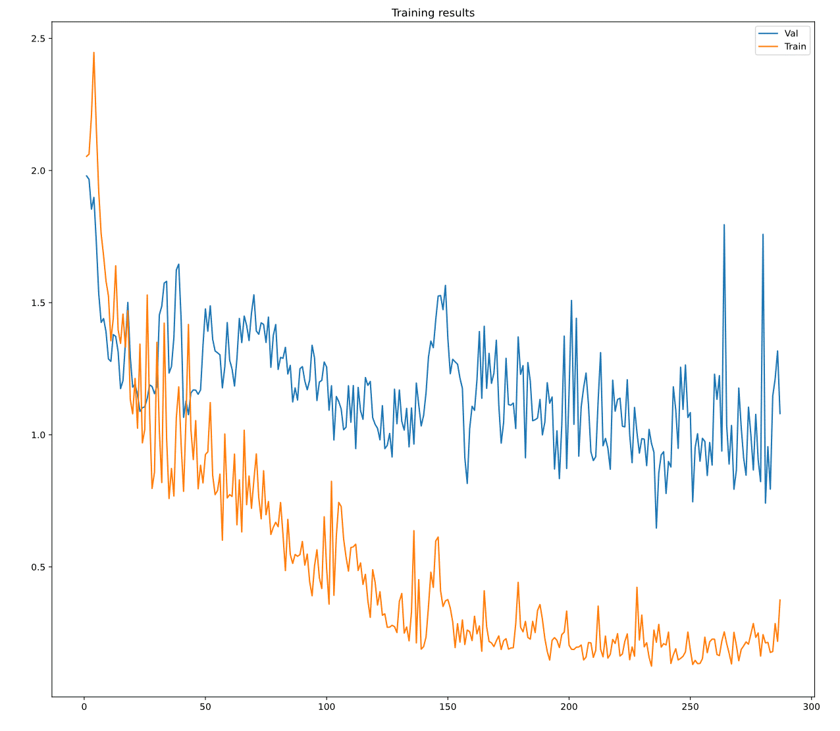


Model Selection & Training
PyTorch
Epochs: 287
Batch Size: 4
Pretrained: COCO
Graphics Card: P100
Faster R-CNN
MobileNet v3
Fewer parameters than ResNet-50 or VGG-16, thus: faster & less expensive training faster predictions → faster & cheaper training → faster predictions
Notes:
RPN: Regional Proposal Network
Backbone
Why does the one loss not go down

Slide 7
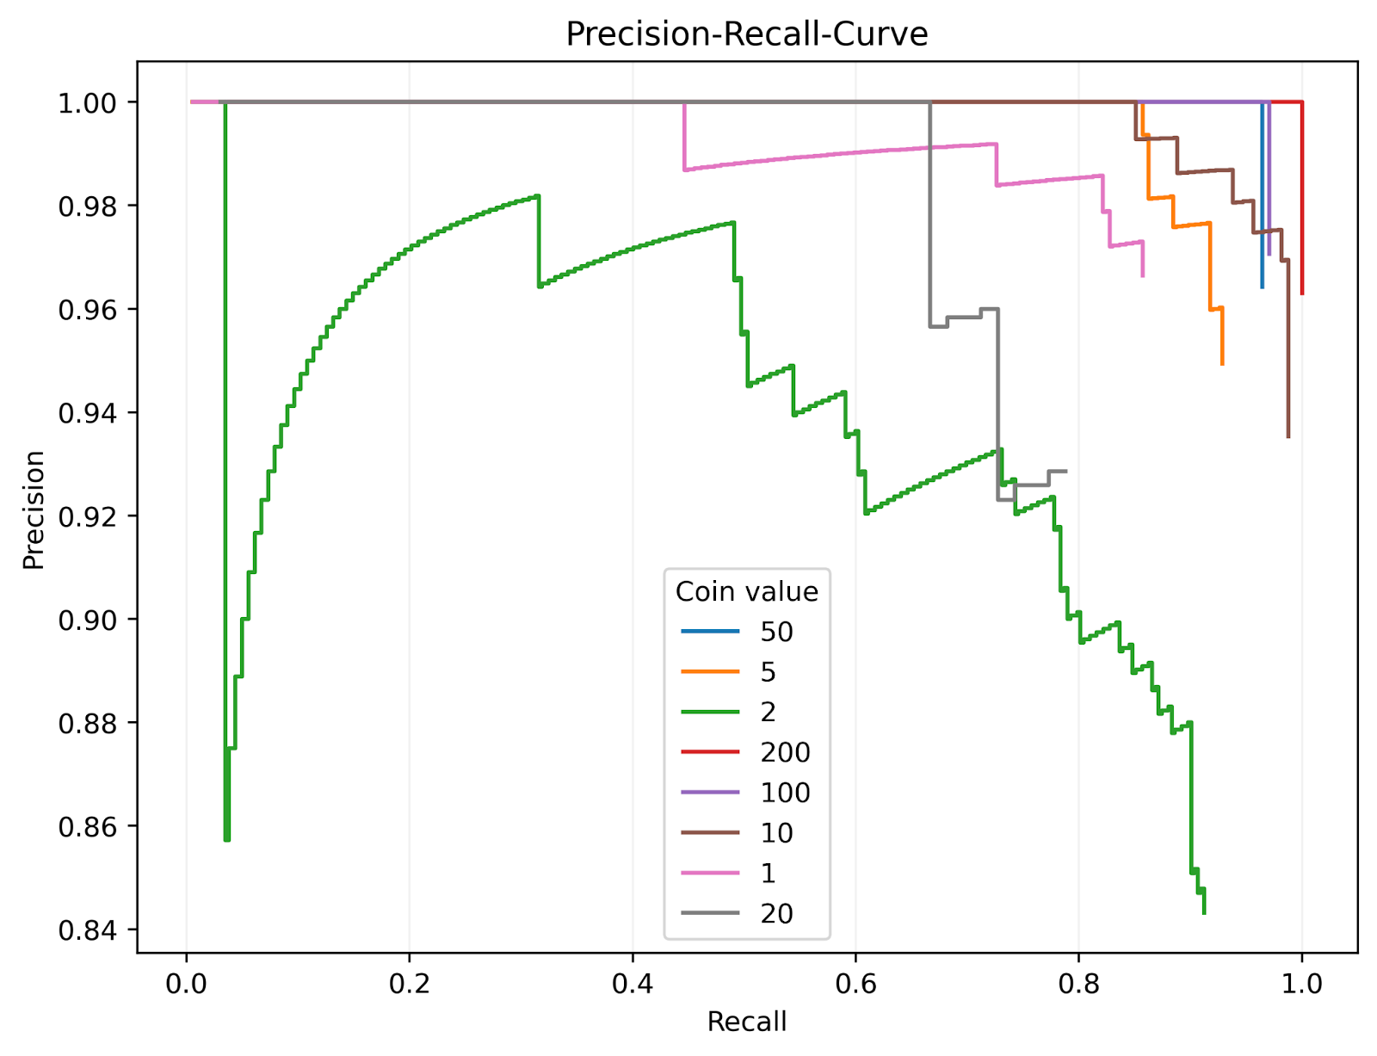

Model Evaluation
S
M
L
Average Precision
Average Recall
Findings:
Average Precision of 0.79
No large jumps between object sizes
Big problems with 1 and 2 cent coins → Why?
Notes:
Subdivision into large, small, medium objects (clustering)
Average Precision: Average over all recall values between 0 & 1
Model is considered a good predictive model if precision remains high with increasing recall
Recall: how complete are the results? → how many relevant elements are selected?
Precision: how useful are the predictions? → how many selected elements are relevant?
Average Precision 0.7892 (ca. 79%)

Slide 8

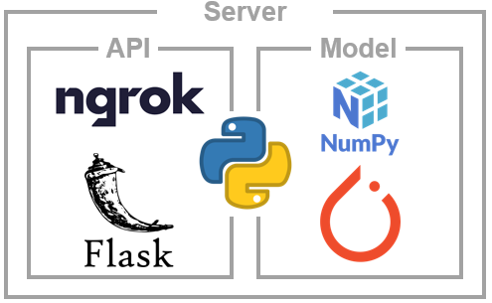

Server
The model is in the backend for several reasons:
Easy change
Performance → long inference time on cpu
Memory size of the model
Returned values :
Accumulated value of coins
Bounding boxes of recognized coins
Labels of recognized coins
Confidences for recognized coins
→ Why not a fully rendered image?
Notes:
Why not a fully rendered image?
Well, you can't send it back as a response → but link to a URL
But it doesn't really matter, because the image is in the frontend anyway

Slide 9
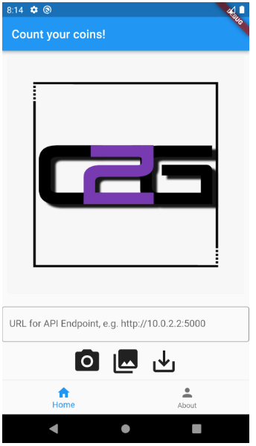
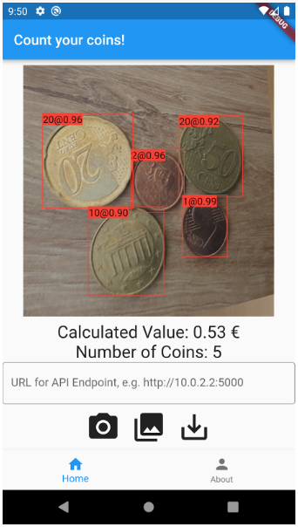


App
Take photo from gallery
Take new photo
Photos are allowed only in rectangular format
Send image to backend
Coordinates of bounding boxes, labels and confidences are sent back to the app
Information displayed in app on image
Save image with new info

Slide 10
Outlook
Model deployment on the client device
Host server on cloud instance
Label new images
iOS support
Differentiation of the training data in head or number
Publish app

