Slide 1
GoldFish 1.0 Framework
Title Slide
Heading
• Font: Calibri, 32 pt, Bold
• Color: White
Secondary Heading
• Font: Calibri, 18 pt
• Color: White
Date
• Font: Calibri, 16 pt
• Color: White
NO SLIDE NUMBER
Click on the corner of this text box to delete

Slide 2
Overview
Overview
This PPT describes base GoldFish1.0 functionality
Objectives
Creating tests in project
Use existed features

Slide 3
Simple scenario in detail (Sepa)
Explain what youre doing ( exchange cond... What is the file supposed to do...)
How does it look like in BVA ( for relevant steps)
Stucturing – naming conventions for class name, method etc.
Good practices
...

Slide 4
Base tests creation
@TestMeta and Junit annotations
Class and methods
GoldFish Api
Selenium IDE

Slide 5
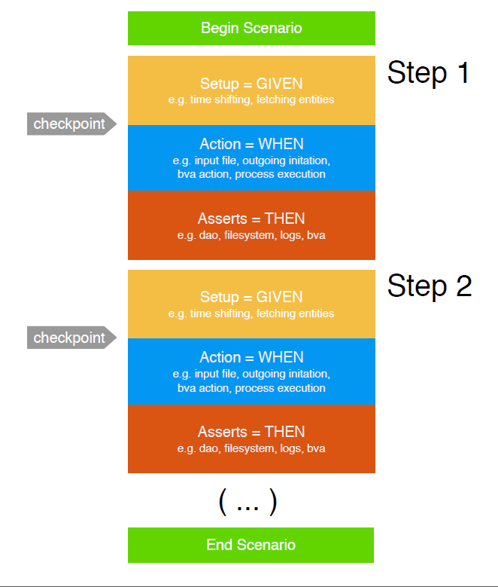
Basic test scenario

Slide 6

Goldfish test structure
Test set | Whats inside | When run?
Smoke tests | Smoke tests made by the BA’s + E2E extra tests | Every CI Build
New feature tests | Tests for new features | Manually one by one and all togeteher before a release
Regression tests | After new feature tests pass, they move down to Regression set. They are maintained and structured | Either manually or automatically on nightly build or weekly base
Tests for bugs | Every flow related bug gets a test case. The developer can reproduce the bug by running the test. | Manually

Slide 7
Goldfish 1.x or 2.0?
Goldfish 1.0 | Goldfish 2.0
Copy paste code solution ( error prone) | Downloadable library
Stable – a lot of features available | Still in development – less features available today compared to goldfish 2.0
Attached to Sepa | Stand alone deployable Jar – depending on OPF
Complicated structure that has been evolved in time. | Simplified and safer structure (less chances to make mistakes)
Very little guidance | Wiki page with instructions and feature wishlist and a monthly board to decide about new features

Slide 8
Overall test organization
Total set
Manual
Goldfish pre-tests
Regression set
- Goldfish
Requirements
Test Case Catalogue
- Manual
- OASIS / OTP
*Overlaps are needed to cover automation gaps
and funcitonality hard to maintain in automation

Slide 9
Other test automation tools used by QA - overlap?
 | Goldfish | OTP | Oasis
E2E flows | Yes – (whitebox) with focus on back end | Yes – but blackbox | Yes – (whitebox) with focus on front end and hard to maintain
Parsers – submitters | Yes – but hard to maintain | Yes (submitters only) | Yes for parsers but hard to maintain
Validations | Yes | Yes | Yes
Services | Yes | No | Yes but hard to maintain and focus on front end
BVA features | Yes but hard to maintain | No | Yes but hard to maintain

Slide 10
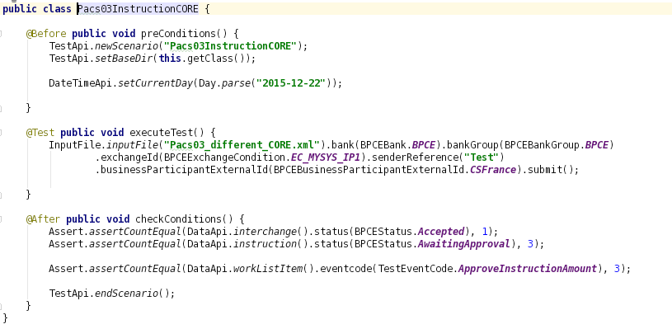
@Test annotations
In projects we can use meta such as:
@Before
@Test
@After
as a predecessor
of
execution method

Slide 11
Class and methods
Class name describes name of your Test Case, should be placed in proper package based on it’s functionality:
for bugs test name should include jira number, sucha as:
for base features:
for new features:

Slide 12
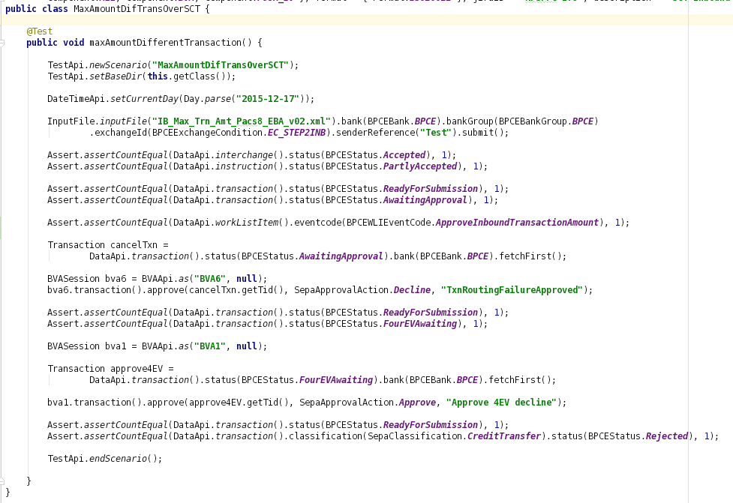
Test example

Slide 13
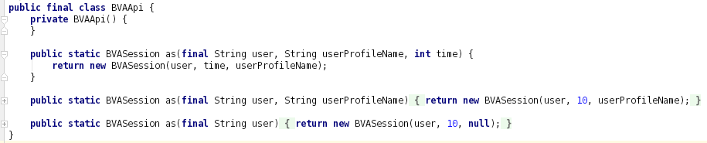
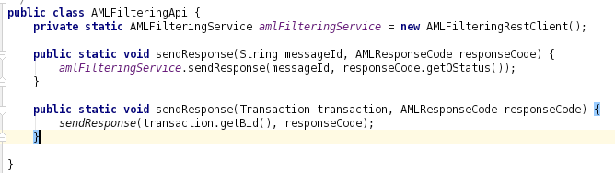
GoldFish Api
Is a set of tools that enable various applications behaviour, access to the implemented functionalities. It enables connection to Selenium, SQL database, BVA, TVA features, etc. It is fully configurable tool which can provide any type of information requested. For example:
BVAApi provides methods for Selenium use:
AMLFilteringApi is a simulator of third party application:

Slide 14
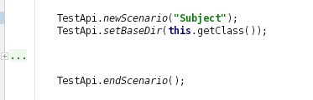
TestApi
TestApi.newScenario(„”) – cleans data, queues, etc. before test execution,
TestApi.setBaseDir() – set up location of current test data files,
TestApi.endScenario – clears memory, resets setting after test execution.

Slide 15

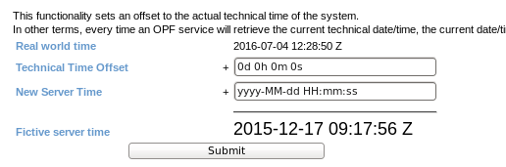
DateTimeApi
DateTimeApi.setCurrentDay() – sets server time for test purpose (future and past),
DateTimeApi.setTime() – sets time of the server.
Enables functionality the same as AlterSystemTime in TVA:

Slide 16
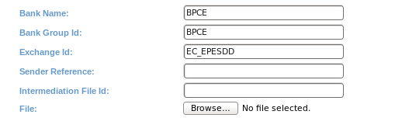
InputFile
Input file gives us the same functionality as a TVA PostInterchangeForm:
Depending on project there are several mandatory conditions that must be fullfilled.

Slide 17
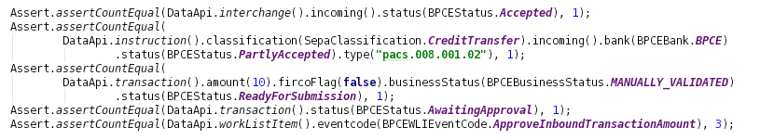
Assertions
Assertions are conditions that need to be met for test to pass. Those are data which are stored in our database and some of them visible in BVA.

Slide 18
Interchange assertion
JAVA:
BVA:
Database:

Slide 19
Instruction assertion

Slide 20
Transaction assertion

Slide 21
WorkListItem assertion
JAVA:
BVA:
Database:

Slide 22
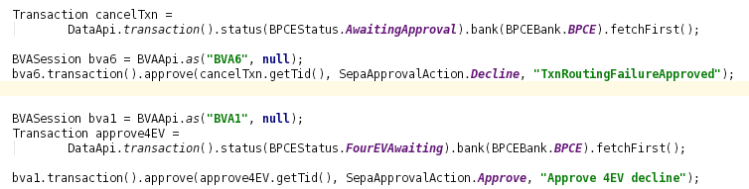
Selenium based test
GoldFish 1.0 has the Selenium libraries, which can be used via BVA user actions:

Slide 23


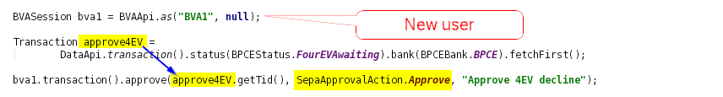
Selenium based test
First step is to initialiaze and login as a BVA user:
Next action is decline action on AwaitingApproval transaction:
Last action is new user 4EyeVerification approval of transaction:

Slide 24
Selenium IDE
Information HOW TO as an example from NPSPPG:
https://wiki.clear2pay.com/display/NPSPPG/Enable+Firefox+showing+Junit+testing+process

Slide 25
SQL based test

Slide 26
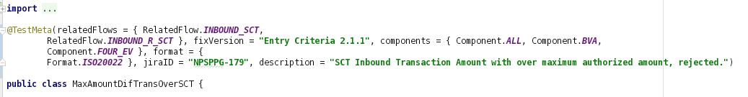
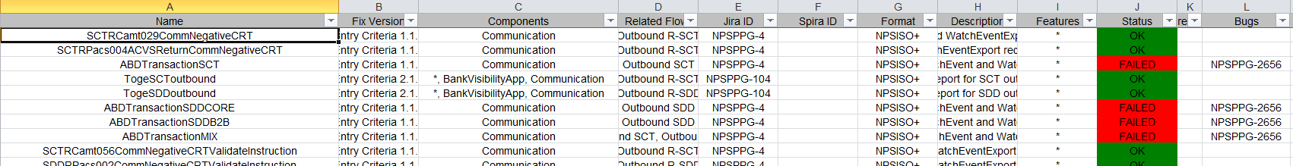
@TestMeta
Before the Class name you have to add @TestMeta annotation for report purpose:
After run of reporting suite we will have execution output in XLS format:

Slide 27
GoldFish 2.0 big fish ☺

Slide 28

Goldfish – more information?
Training (still GF1.x https://e-academy.clear2pay.com/mod/scorm/view.php?id=398 )
Wiki: https://wiki.clear2pay.com/display/GFISH/Overview
Roadmap of new features
Installation guide
User guide
Piotr Dudzik (technical)
Mike Meurs (functional)

Slide 29
Thank you!
Thank you slide
Header
• Font: Calibri, 32 pt, Bold
• Color: White
Presenter Name
• Font: Calibri, 18 pt, Bold
• Color: White
Contact information
• Font: Calibri, 16 pt
• Color: White
NO PAGE NUMBER
Click on the corner of this text box to delete

