Slide 1
Lagranto 2.0

Slide 2
Contents
An new object - trajectory
Tutorial trajectory case study
Goodies
Documentation
Libraries
Installation
Outlook

Slide 3
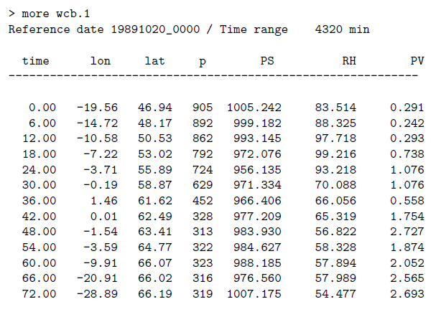
„It‘s the trajectory, stupid!“
Philospohy: There is a object called trajectory and Lagranto offers tools to create,
modify, select, extend, visualise, .. these objects
New header line

Slide 4
Overview
Main programs
startf, caltra, trace, select, density, lagranto
Goodies
trainfo, reformat, extract, mergetra, datelist,
difference, list2lsl, lsl2list, timeres, lagrantohelp
Documentation
man pages, tutorial (PDF), reference guide (PDF)

Slide 5

A now a tutorial
case study

Slide 6


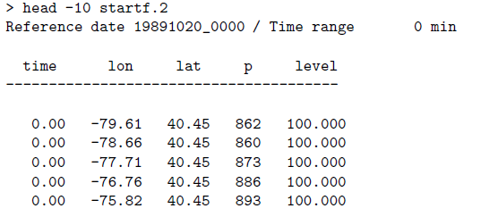
A. Creating the starting positions
Region 1: 80 W to 20 E, 40 N to 80 N
equidistant (80 km) in region 1
name and format of starting file
reference date
100 hPa above ground level
the starting file can be itself
a trajectory file

Slide 7
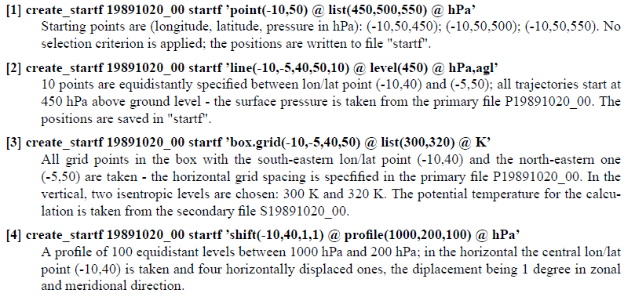
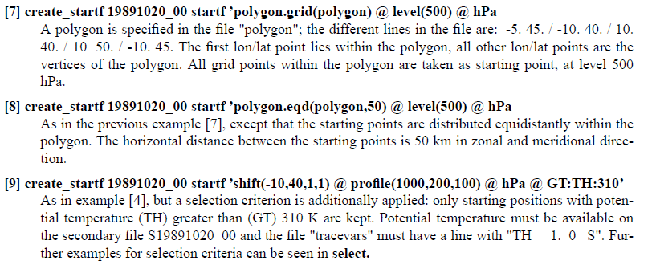
Further examples

Slide 8
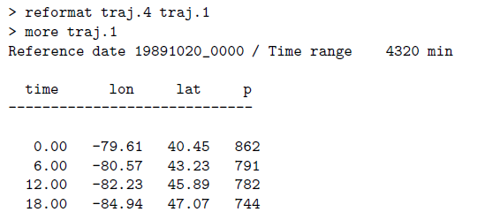

B. Calculating Trajectories
jumping flag set
start date
end date
output trajectory in netCDF (4)
starting positions
reformat trajectory into ASCII (1) and then show it
show it without reformatting

Slide 9
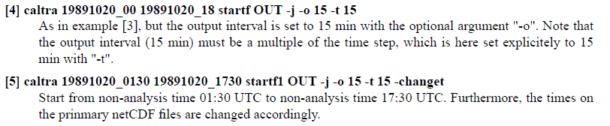
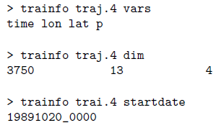
use <trainfo> to get metadata for
trajectory
names of variables
dimensions
startdate
- …

Slide 10
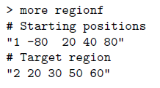

C. Preselecting Trajectories
pressure is larger than
700 hPa at first time
take all times from 0 to 48 h and take the
minimum pressure for these times; then
select trajectories where p(min) < 400 hPa
distance to starting position at
time 48 h larger than 5000 km
(DIST0 is implicit!)
trajectory is within region 2 at any time between 42 h and 54 h

Slide 11
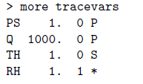


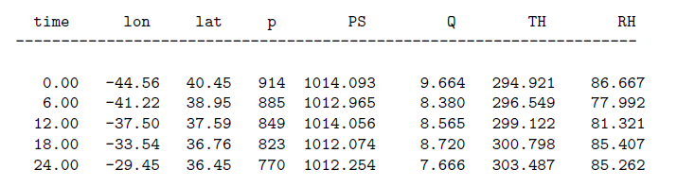


D. Tracing along Trajectories
specify fields in <tracevar>
online calculation
add extra column to trajectory file
extract columns from trajecory file

Slide 12
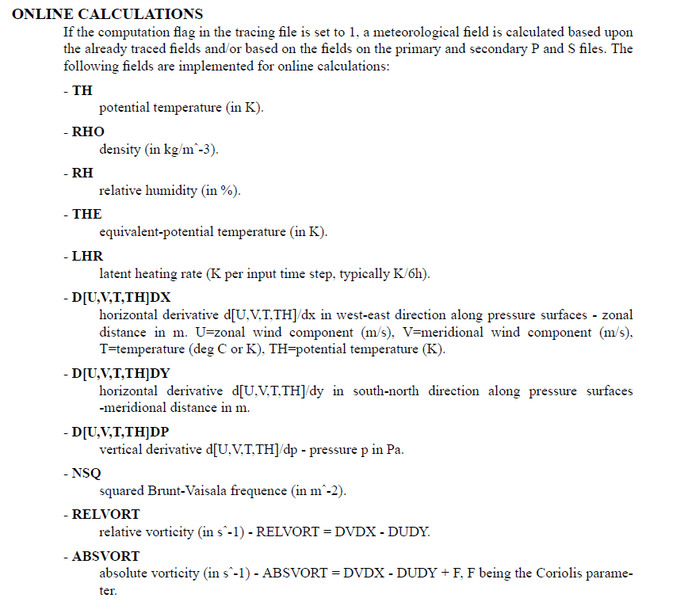

Slide 13
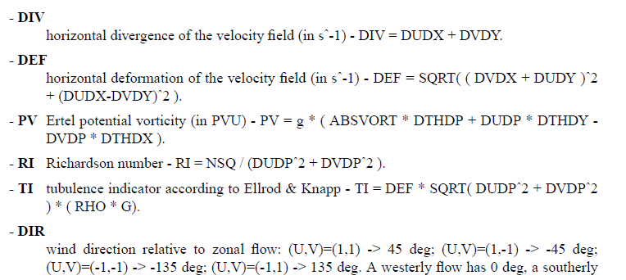
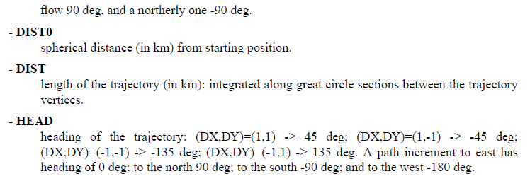

Slide 14
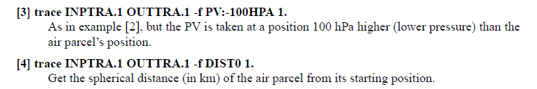
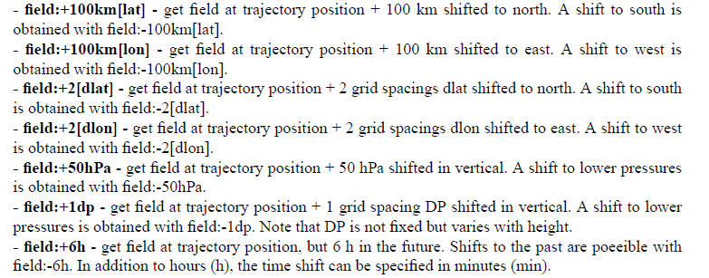

Slide 15
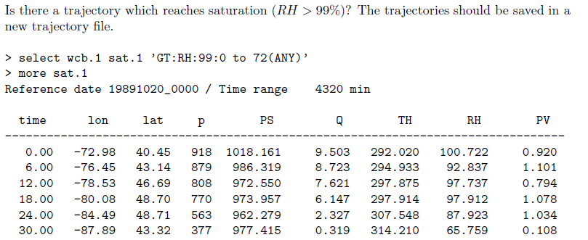
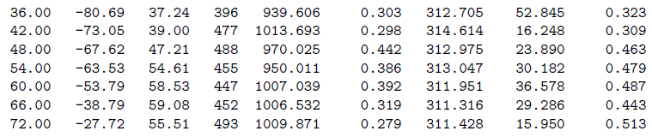
E. Final Selection of Trajectories

Slide 16
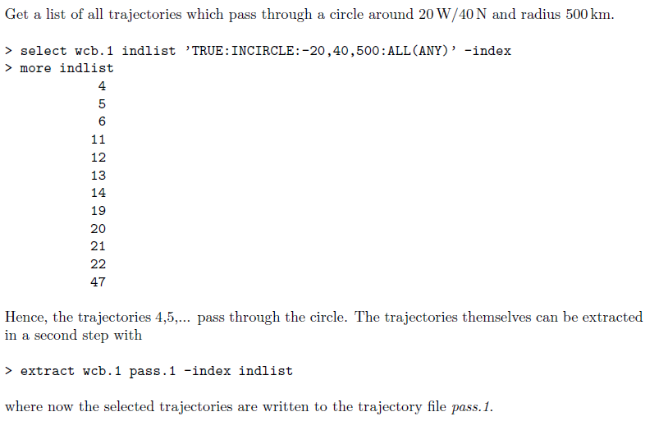

Slide 17
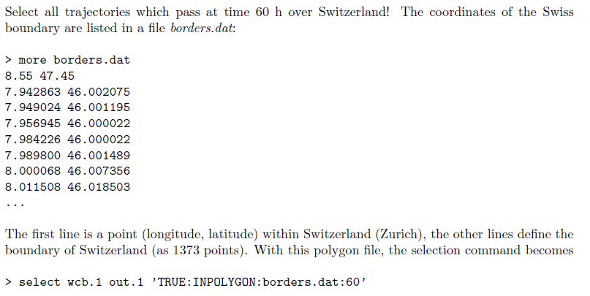

Slide 18
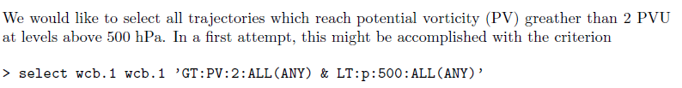
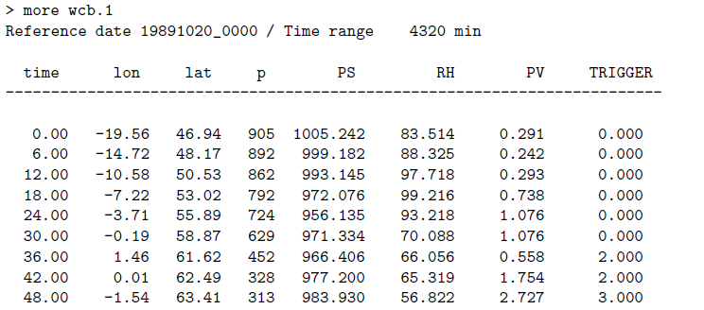
wrong !!!

Slide 19
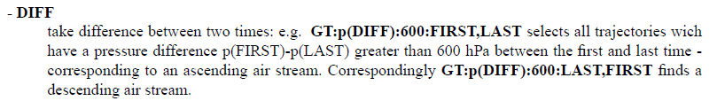
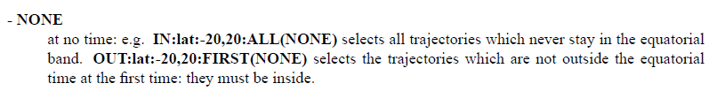


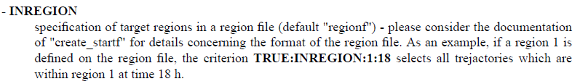
… and many more options ( 5 pages in reference guide)

Slide 20
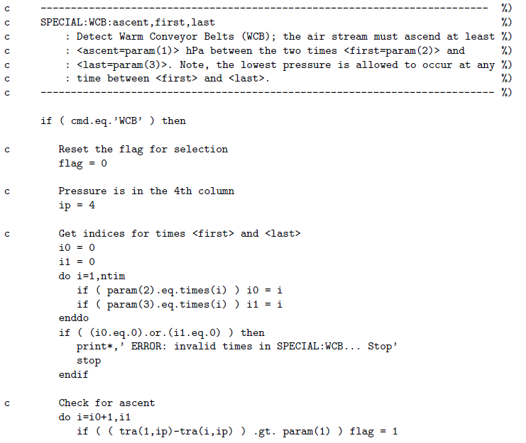
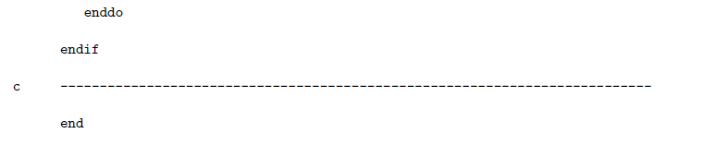

Slide 21

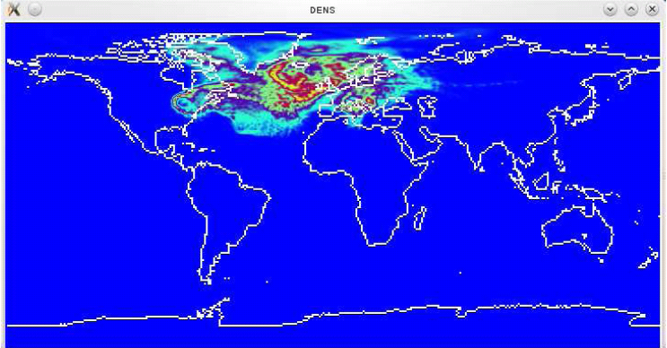
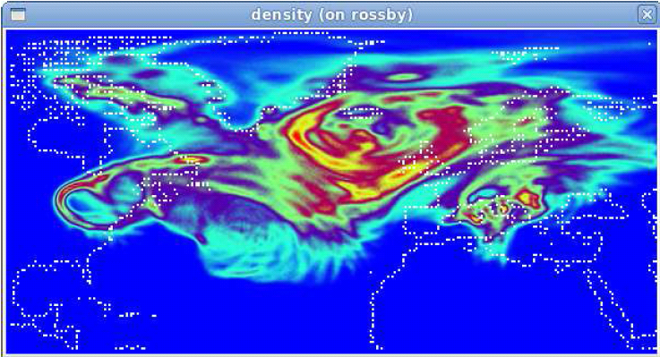
F. Gridding of Trajectories

Slide 22
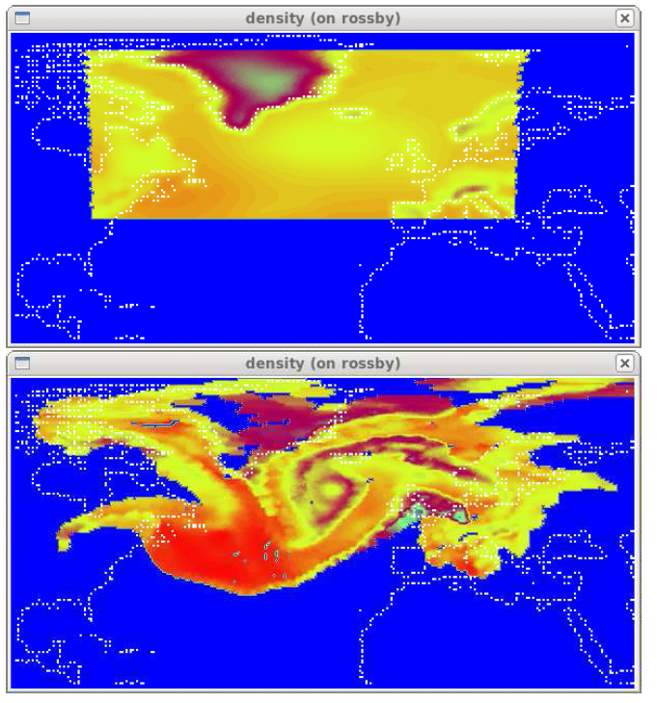
time 0
time 24 h

Slide 23
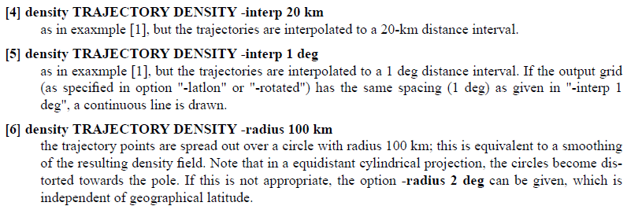
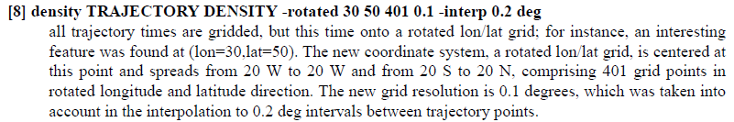

Slide 24

G. Can we use <lagranto>? „ Yes, we can!“
run Lagranto in local directory
no selection criterion
three different files will be saved
output trajectory file (lsl_19891020_00)
log file (runscript.logfile)
run script (runscript.sh)
prepare, but do not run

Slide 25
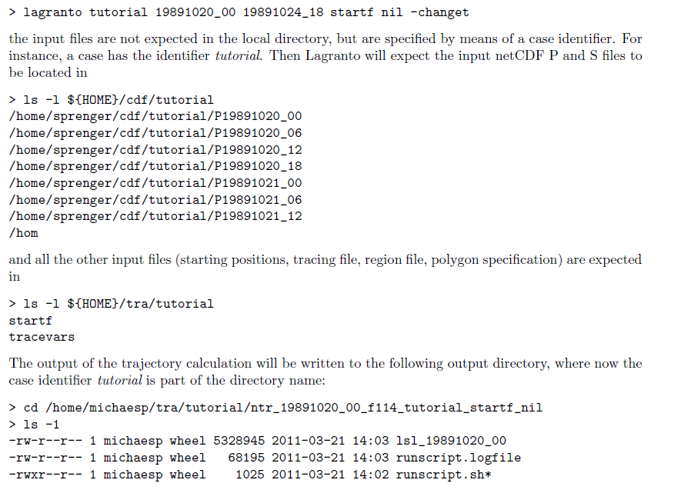
files in the <tra> directory
startf 3. polygon files
tracevars 4. region files

Slide 26
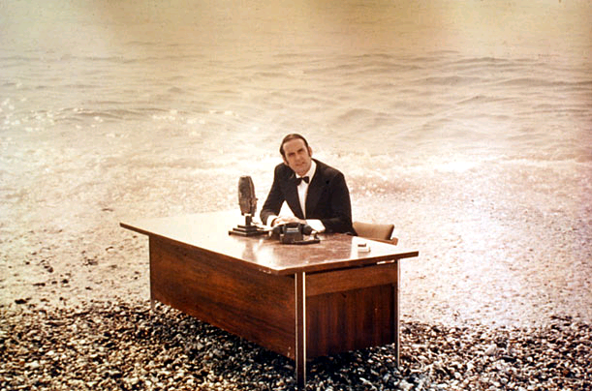
„And now for something completely different!“
Goodies !!!

Slide 27
trainfo - metainformation about trajectories
reformat - change format of trajectory file
extract - extract columns, times or single trajectories
difference - get the difference between two trajectory files
mergetra - merge two trajectory files
list2lsl - change (lon,lat,p) list to trajectory file
lsl2list - write trajectory positions to (lon,lat,p) list
datelist - create and handle date lists
timeres - change time resolution of trajectory file (interpolation)
lagrantohelp - show help pages

Slide 28
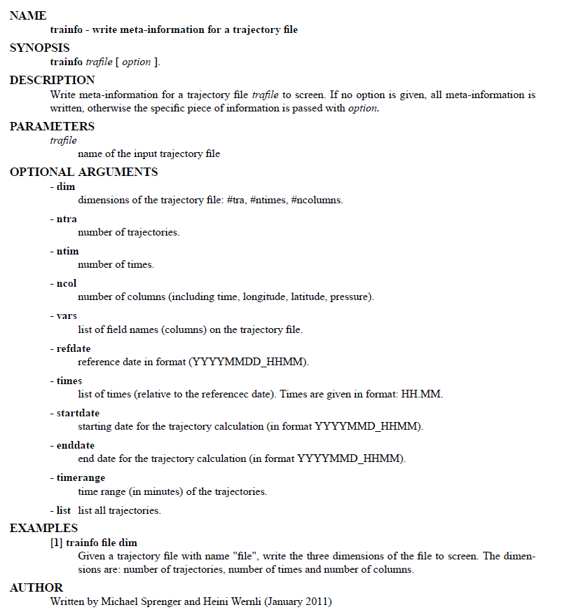
> lagrantohelp trainfo

Slide 29
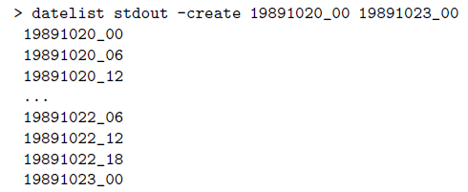
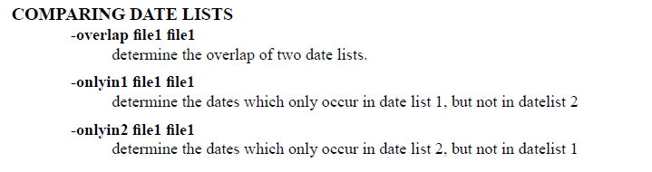
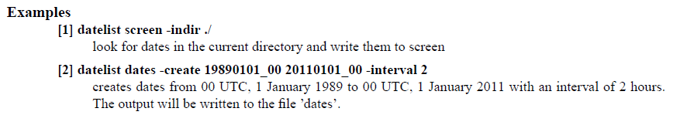

Slide 30

Working with Trajectories in Fortran - Libraries

Slide 31
tra(1:ntra,1:ntim,1:ncol)
c Read parameters
open(10,file='reformat.param')
read(10,*) inpfile
read(10,*) outfile
read(10,*) ntra,ntim,ncol
close(10)
c Determine the formats
call mode_tra(inpmode,inpfile)
if (inpmode.eq.-1) inpmode=1
call mode_tra(outmode,outfile)
if (outmode.eq.-1) outmode=1
c Allocate memory
allocate(tra(ntra,ntim,ncol),stat=stat)
if (stat.ne.0) print*,'*** error allocating array tra ***'
c Read inpufile
call ropen_tra(fid,inpfile,ntra,ntim,ncol,refdate,vars,inpmode)
call read_tra (fid,tra,ntra,ntim,ncol,inpmode)
call close_tra(fid,inpmode)
c Write output file
call wopen_tra(fid,outfile,ntra,ntim,ncol,refdate,vars,outmode)
call write_tra(fid,tra,ntra,ntim,ncol,outmode)
call close_tra(fid,outmode)

Slide 32
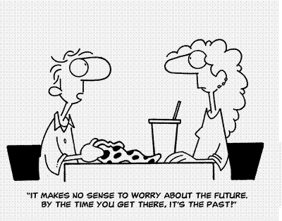

Slide 33
compact trajectory format (JPEG compression - Harald!)
interface to CF-netCDF and ECMWF GRIB
trace fields along 3d-box around air parcel (min, max, sum, …)
stochastic or physical wind fluctuations (turbulence)
webLagranto
cosmoLagranto
gridding of the type time vs PV, lat vs p, TH vs RH,…
goody <residence>: time within region/polygon
goody <distance>: distance from specified point
extension forward and backward of an existing trajectory
…

Slide 34
“Ask not what Lagranto can do for you.
Ask what you can do for Lagranto!”
compare sample trajectories of old and new Lagranto - report any discrepancy!!!
the online calculation of fields needs some thorough testing. Help!!
report any bug, inconsistency, counter-intuitive behaviour of any program….
read the tutorial and reference guide: whoever finds most errors wins a Haribo
Gummibärli-Pack. I have written the tutorial and the reference guide, but I have
never read it!!!
bring in or implement new ideas what can be done with trajectories
don‘t give up, if it doesn‘t work! It‘s not yet perfect….

