Slide 1

Manufactorio
Ri'chard McCray
Joshua Parrilla

Slide 2
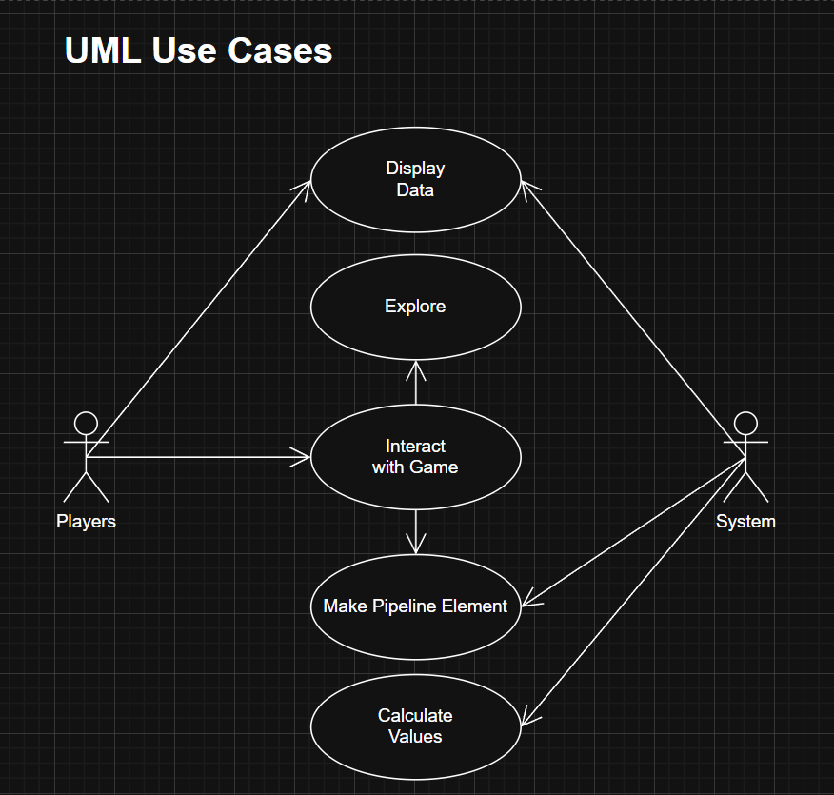
UML Use Cases

Slide 3
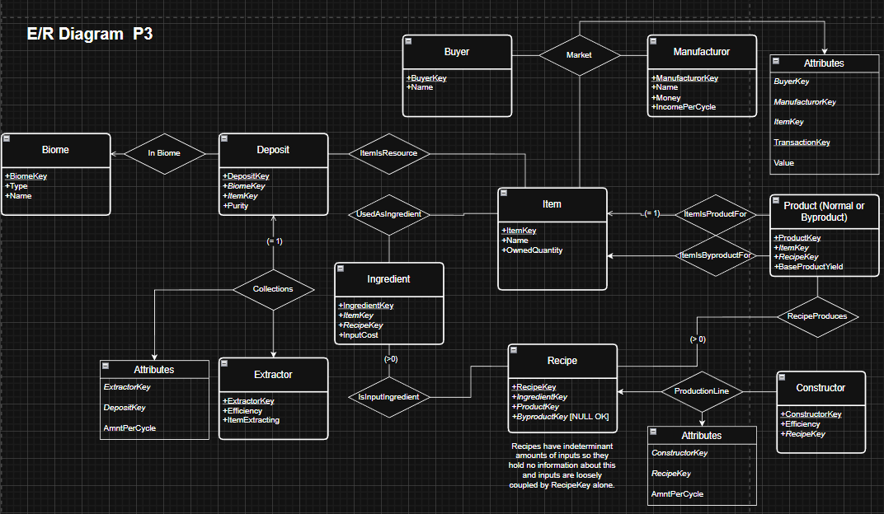
E/R Diagram

Slide 4
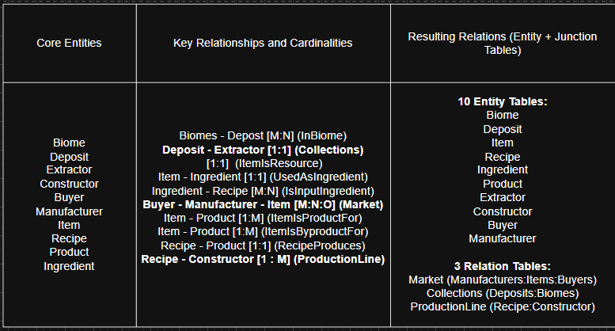
Relation Specification

