Slide 1
Argus API
Team: Canadian Centre for Child Protection
Alex Kim
Aalekh Patel
Ernest Tsang
Jacques Marcoux

Slide 2
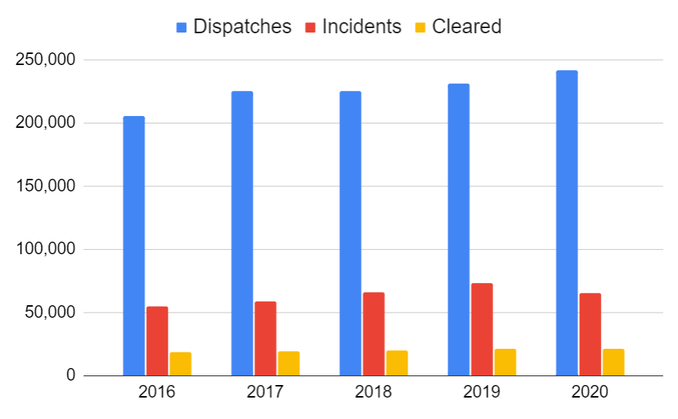
Winnipeg Police Service activities
Source: WPS annual reports, Statistica Canada UCR survey

Slide 3

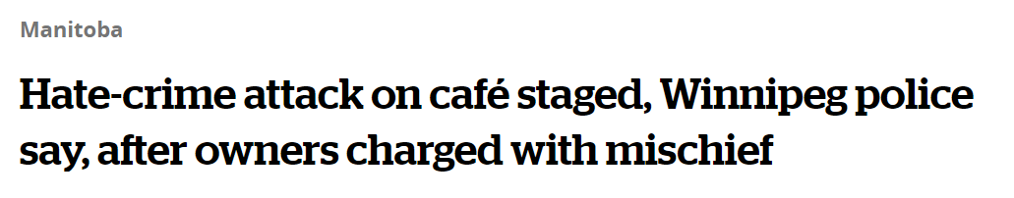
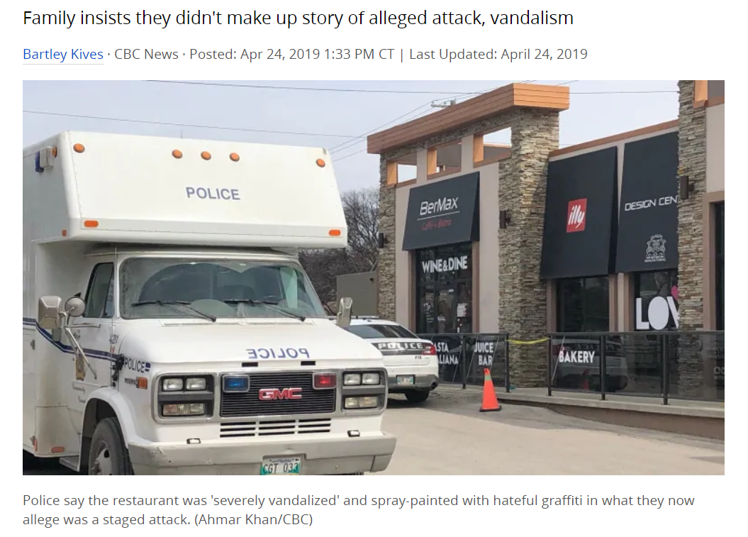

Slide 4
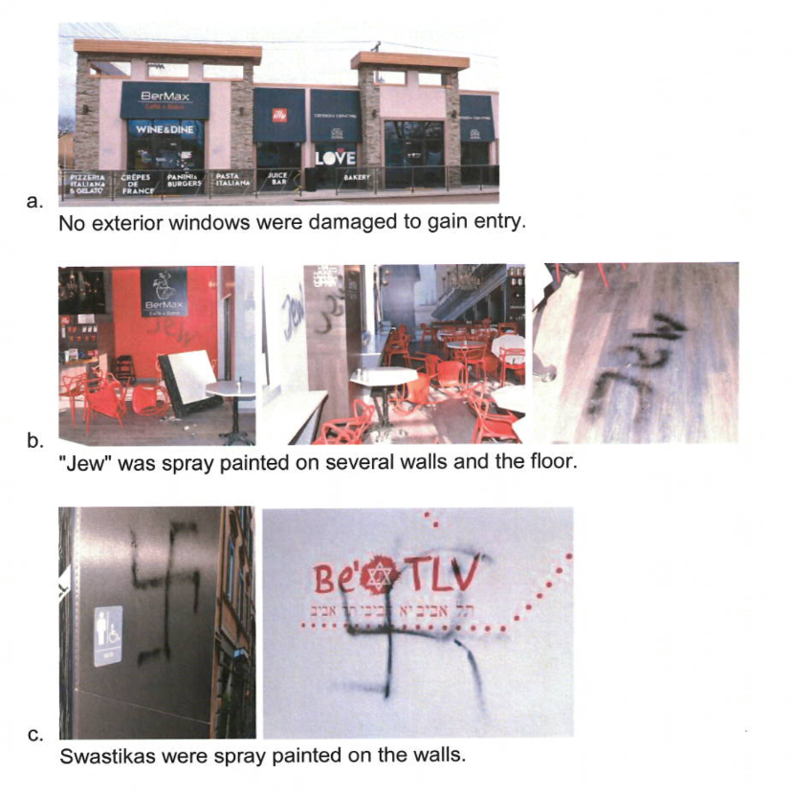

Slide 5
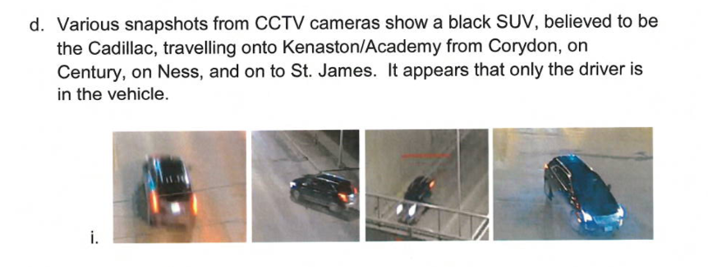
Traffic Management Centre cameras

Slide 6
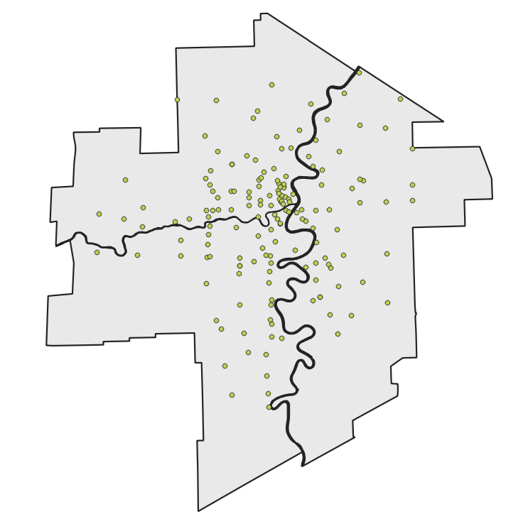
161 cameras
Source:
https://data.winnipeg.ca/Transportation-Planning-Traffic-Management/Traffic-Signal-Inventory-Cameras-Detail/42pk-2u2c

Slide 7
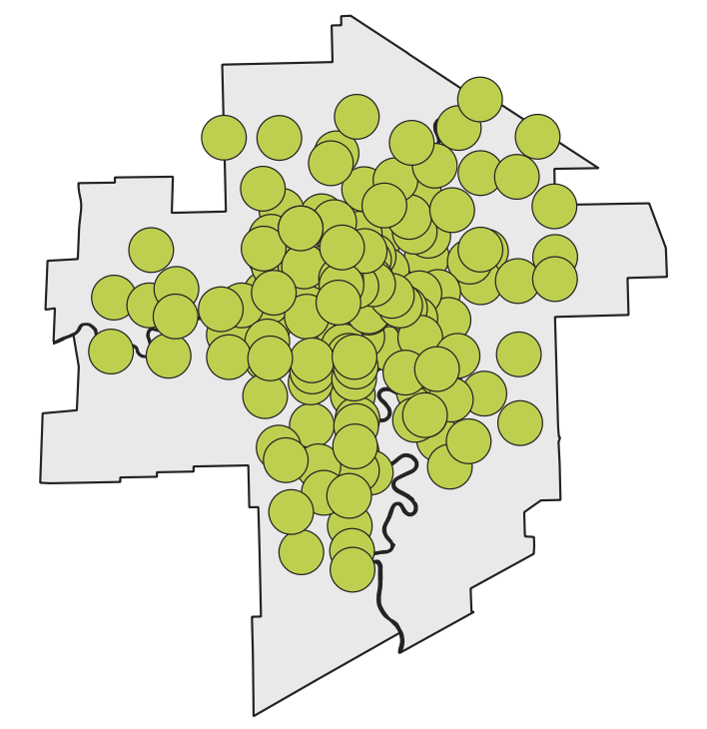
1000m buffer

Slide 8
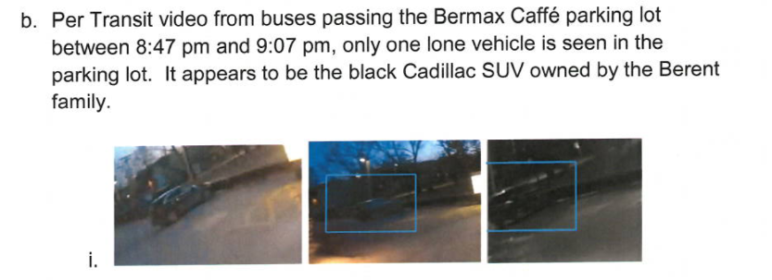
Winnipeg Transit on-board cameras

Slide 9
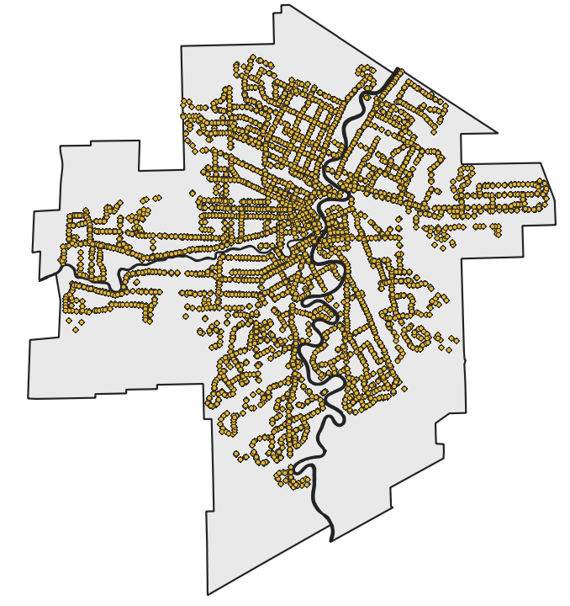

Slide 10
User input for event
Latitude
Longitude
Date
Time

Slide 13
Endpoint response
List of TMC cameras
List of bus IDs

Slide 15
In between bus stops…

Slide 16
In between bus stops…

Slide 17
In between bus stops…

Slide 18
Data sources used for REST API
Winnipeg Transit API
Traffic Management Centre camera location data
Internal Winnipeg Police Service CCTV sources

Slide 19
Legal considerations
Pan/Tilt/Zoom capabilities may be used [...] when used for law enforcement or crime prevention.
TMC traffic cameras do not operate as a surveillance tool, however, where approved under exceptional circumstances, TMC cameras may be used by Winnipeg Police Service for law enforcement or crime prevention purposes, as permitted under FIPPA, section 36(1)(c).

Slide 20
Let’s test out the API….

