Slide 1

Project 6

Slide 2
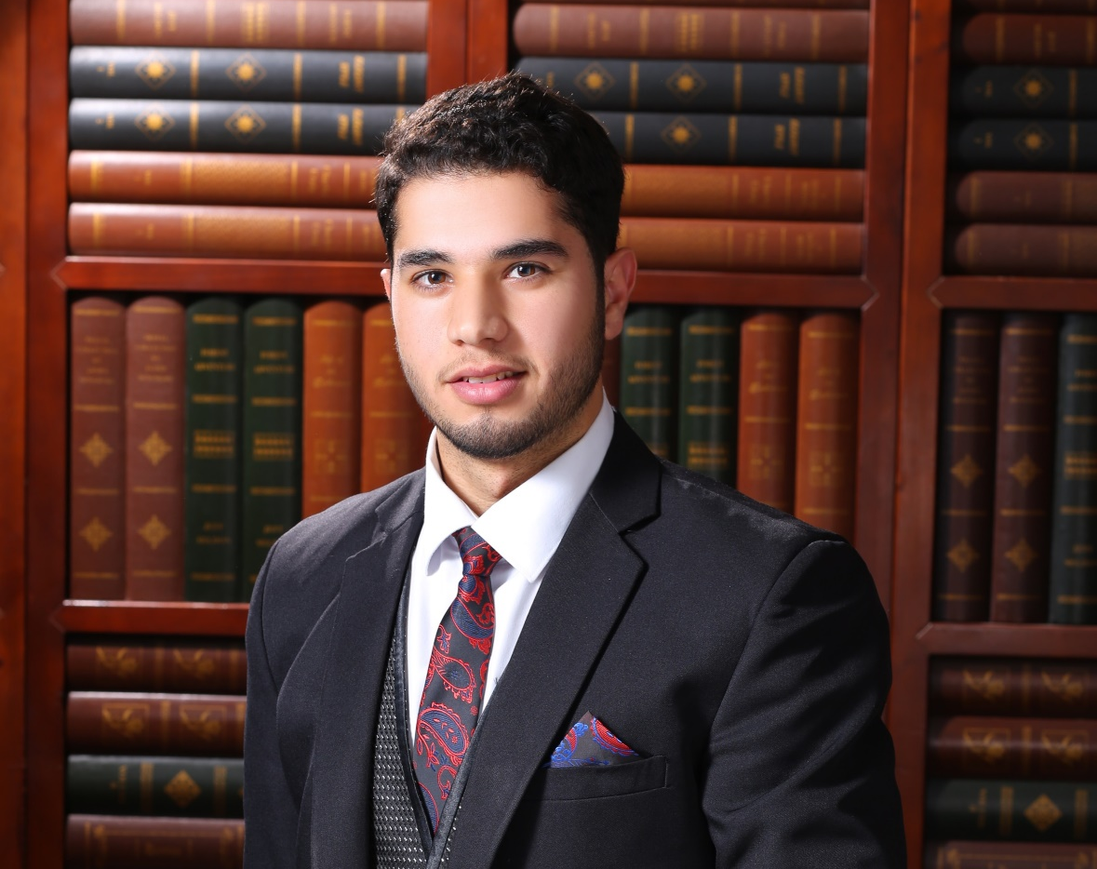
OMAR KATA’A
Role:scrum

Slide 3
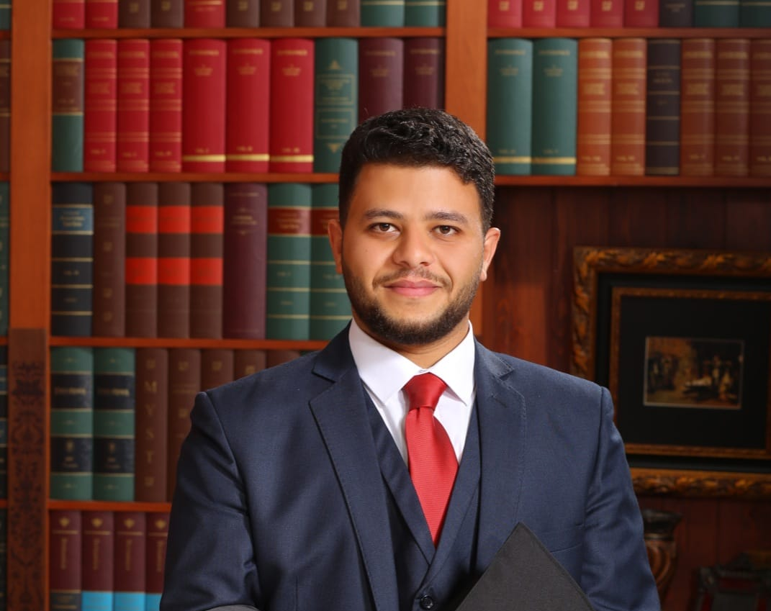
Haitham Al-Ulaimi
Role:MEMBER

Slide 4


Slide 5

Enroll Course
Join as A Teacher.
Live Video
Chatting.
Filter& Search.
Online Payment
Verification Email
Feedback
Course Review

Slide 6


Slide 7
How we did it ?
Sketch
Trello
Diagram
Start

Slide 8
The End

Slide 9

What went well ?
Build The backend .
Build The frontend .

