Slide 1
What does it take to get a job these days? Analyzing jobs.code4lib.org data to understand current technology skillsets
Monica G. Maceli, Ph.D.
Assistant Professor @ Pratt Institute | School of Information

Slide 2



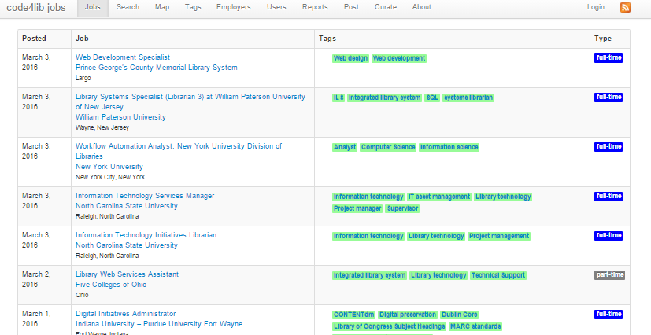

Research: Technology in LIS
Curriculum
Jobs
Practitioners

Slide 3
Curriculum Analysis
Topic Area | # of Courses
User Experience | 77
Web Design And Development | 72
Database Design And Development | 56
Introduction To Information Technology | 54
Digital Libraries | 52
Information Retrieval | 52
Metadata | 43
Digital Collections | 34
Systems Analysis And Design | 31
Networking | 25
Understand and categorize current technology offerings
56 ALA-accredited programs studied in 2015
Qualitative coding and thematic analysis of 822 tech courses
Track changes in curriculum over time
Ongoing data collection via web scraping with Python and Beautiful Soup
http://www.crummy.com/software/BeautifulSoup/

Slide 4
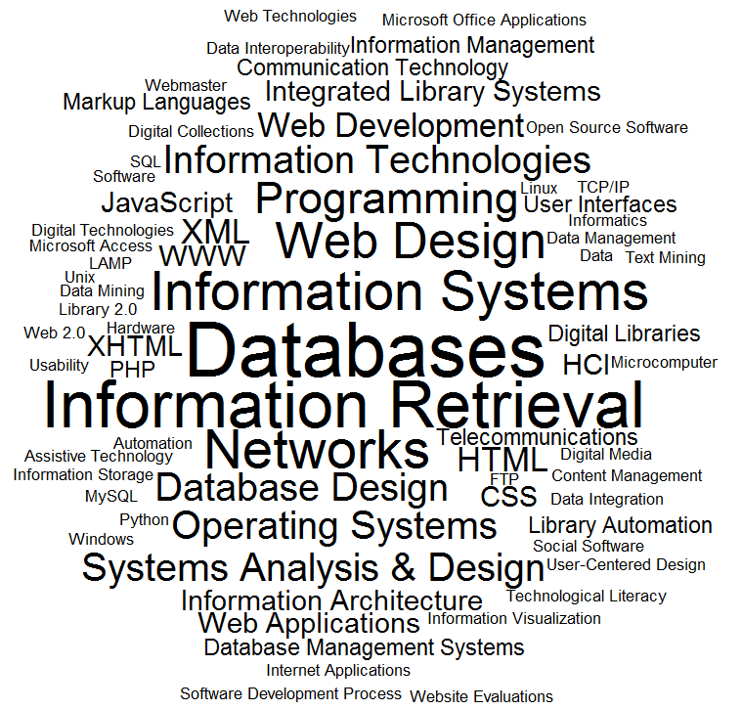
Introduction to Information Technology…

Slide 5

Jobs Analysis
Code4lib jobs provides web platform for job search and posting:
http://jobs.code4lib.org/
Jobs tagged and curated by volunteers
Developed by Ed Summers (iSchool UMD)
https://twitter.com/edsu
Source code available
https://github.com/code4lib/shortimer
jobs.code4lib.org data is available under CC BY license
Db dump included:
Job titles
Job descriptions
Editor-assigned tags
Analysis of jobs:
Text mining (R with tm package)
Plotting correlations (R graphics package)
Term clustering (hclust in core stats package)

Slide 6
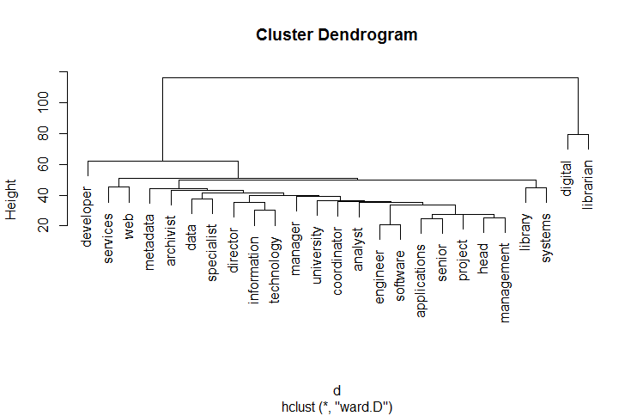
Job Titles
1006 job listings posted in 2015, including:
316 librarian positions
690 non-librarian positions
Cluster analysis of title terms using hclust

Slide 7
"Metadata" appears 1,191 times in the raw data

Slide 8
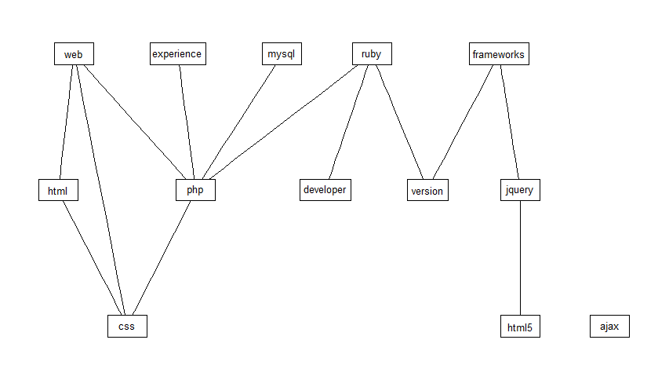
Terms Correlated with Javascript
All associations generated and plotted in R with the findAssocs function looking for terms with a minimum correlation coefficient of 0.3

Slide 9
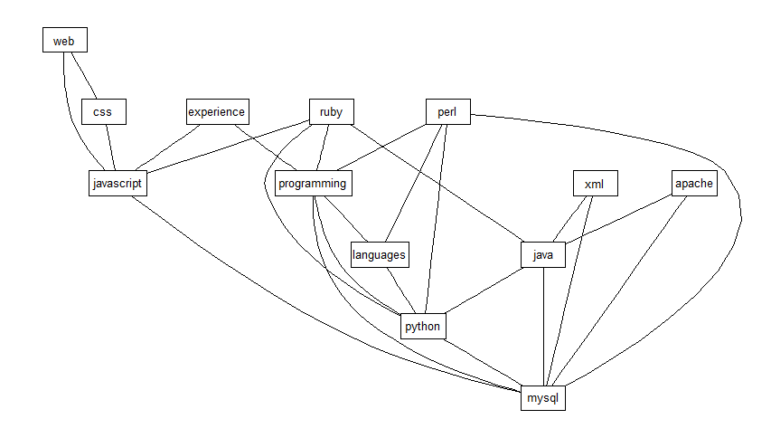
Terms Correlated with PHP

Slide 10
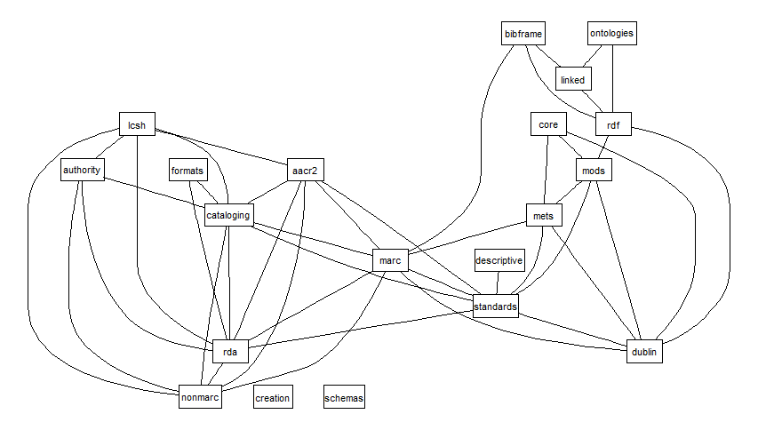
Terms Correlated with Metadata

Slide 11
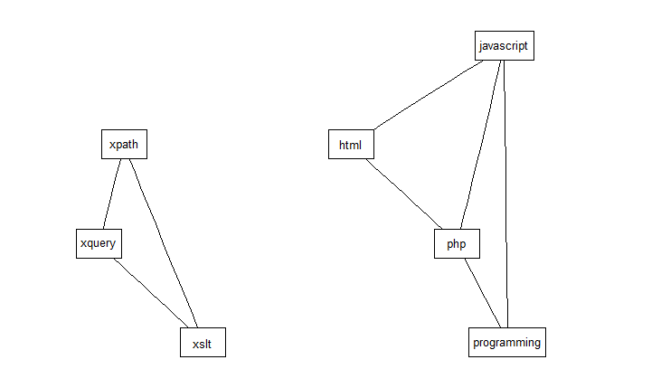
Terms Correlated with XML

Slide 12
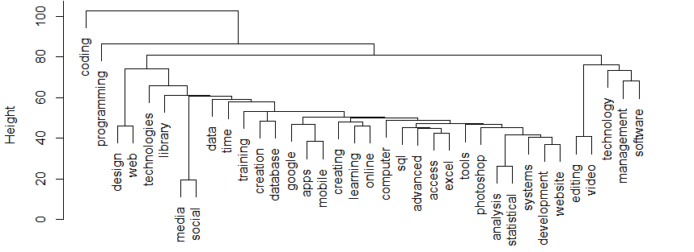
Current Practitioners' Technology Needs and Usage
Ongoing analysis of data from John Burke's 2015 survey (http://www.users.miamioh.edu/burkejj/)
Surveyed ~2200 library practitioners about technologies used and those they'd like to learn to connect job listings to actual practice
Cluster analysis of tech wants using hclust

Slide 13
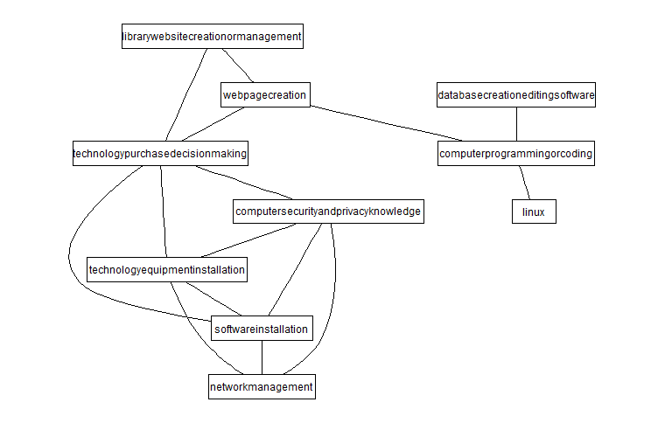
One Collection of Commonly Co-occurring Skillsets

Slide 14
In Summary
The areas of web design/development and digital collections (e.g. working with XML, metadata, archives, etc.) were well-aligned in frequency of course offerings and popularity of related job listings
User experience courses (covering topics such as information architecture, human-computer interaction, usability, etc.) topped the list of topics offered across all programs, but there was not a corresponding level of library-related positions observed in this area
This study and its predecessors indicated a general need to revisit incoming student technology requirements
Open questions:
How frequently are technology-related library positions filled by those with and without LIS graduate degrees?
What concentrations/tracks are increasing in popularity across all programs?
What are the skill differences between librarian and non-librarian titled technology positions?

Slide 15
More Information
Monica G. Maceli, Ph.D.
Assistant Professor @ Pratt Institute School of Information
mmaceli@pratt.edu | @MonicaMaceli
monicamaceli.com
Related citations:
Maceli, M. (2015). What Technology Skills Do Developers Need? A Text Analysis of Job Listings in Library and Information Science (LIS) from Jobs.code4lib.org. Information Technology and Libraries, 34(3), 8-21. doi: 10.6017/ital.v34i3.5893
http://ejournals.bc.edu/ojs/index.php/ital/article/view/5893/pdf
Maceli, M. (2015). Creating Tomorrow's Technologists: Contrasting Information Technology Curriculum in North American Library and Information Science Graduate Programs against Code4lib Job Listings. Journal of Education for Library and Information Science, 56(3), 198-212. doi:10.12783/issn.2328-2967/56/3/3
http://monicamaceli.com/sites/default/files/pdf/Maceli_JELIS_2015.pdf
Visualizations of curriculum findings: http://monicamaceli.com/node/11

