Slide 1
Build Your Own Identity Hub
Ted Lawless
Code4Lib 2016 – March 8th, 2016

Slide 2
Abstract
Libraries, archives, and museums have begun publishing Linked Open Data (LOD). Yet for many technical teams working in these organizations, the path towards implementing tools or services that both benefit users and utilize LOD remains elusive or out of reach. This talk will walk the audience through identifying and creating a useful, lightweight "identity hub" of academic journals. It will cover interlinking multiple sources of data and publishing as LOD using a Linked Data Fragments (LDF) server, and embedding useful contextual information in existing web pages. All data and code used to produce the "identity hub" will be shared. The principles of interlinking and publishing will be applicable to other types of data.

Slide 3
Outline
Observations
Work through an example
Show an integration
Talk about tools
Suggest future directions

Slide 4
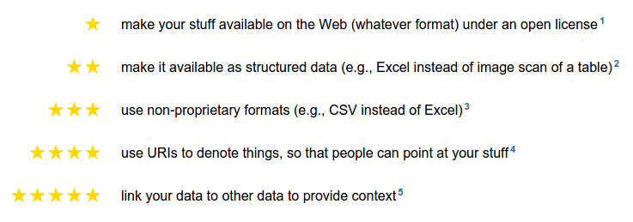
Motivation
The Semantic Web isn't just about putting data on the web. It is about making links, so that a person or machine can explore the web of data. With linked data, when you have some of it, you can find other, related, data.
Tim Berners-Lee, Linked Data, 2006.
https://www.w3.org/DesignIssues/LinkedData.html
http://5stardata.info/

Slide 5
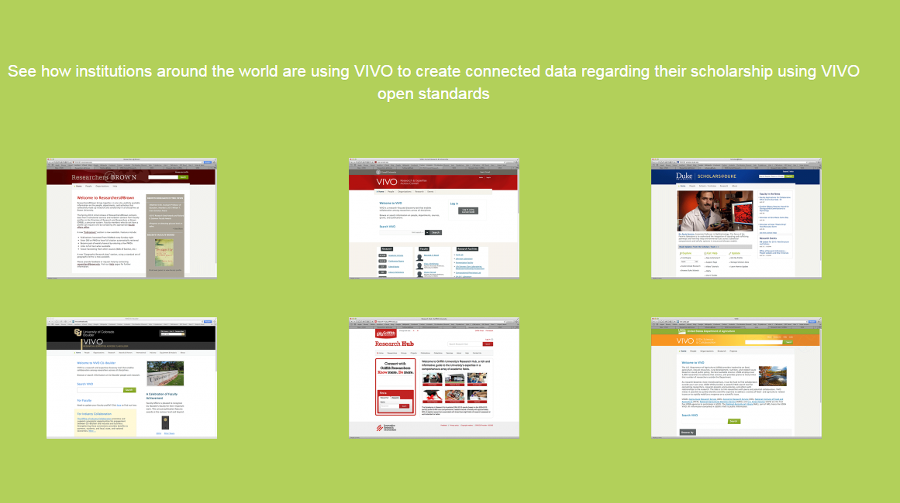

Motivation – experience with VIVO
http://vivoweb.org

Slide 6
Linked Data
http://5stardata.info/

Slide 7
Why hasn’t this happened?
It’s difficult and time consuming
Often no clear, immediate benefit
Overwhelming

Slide 8
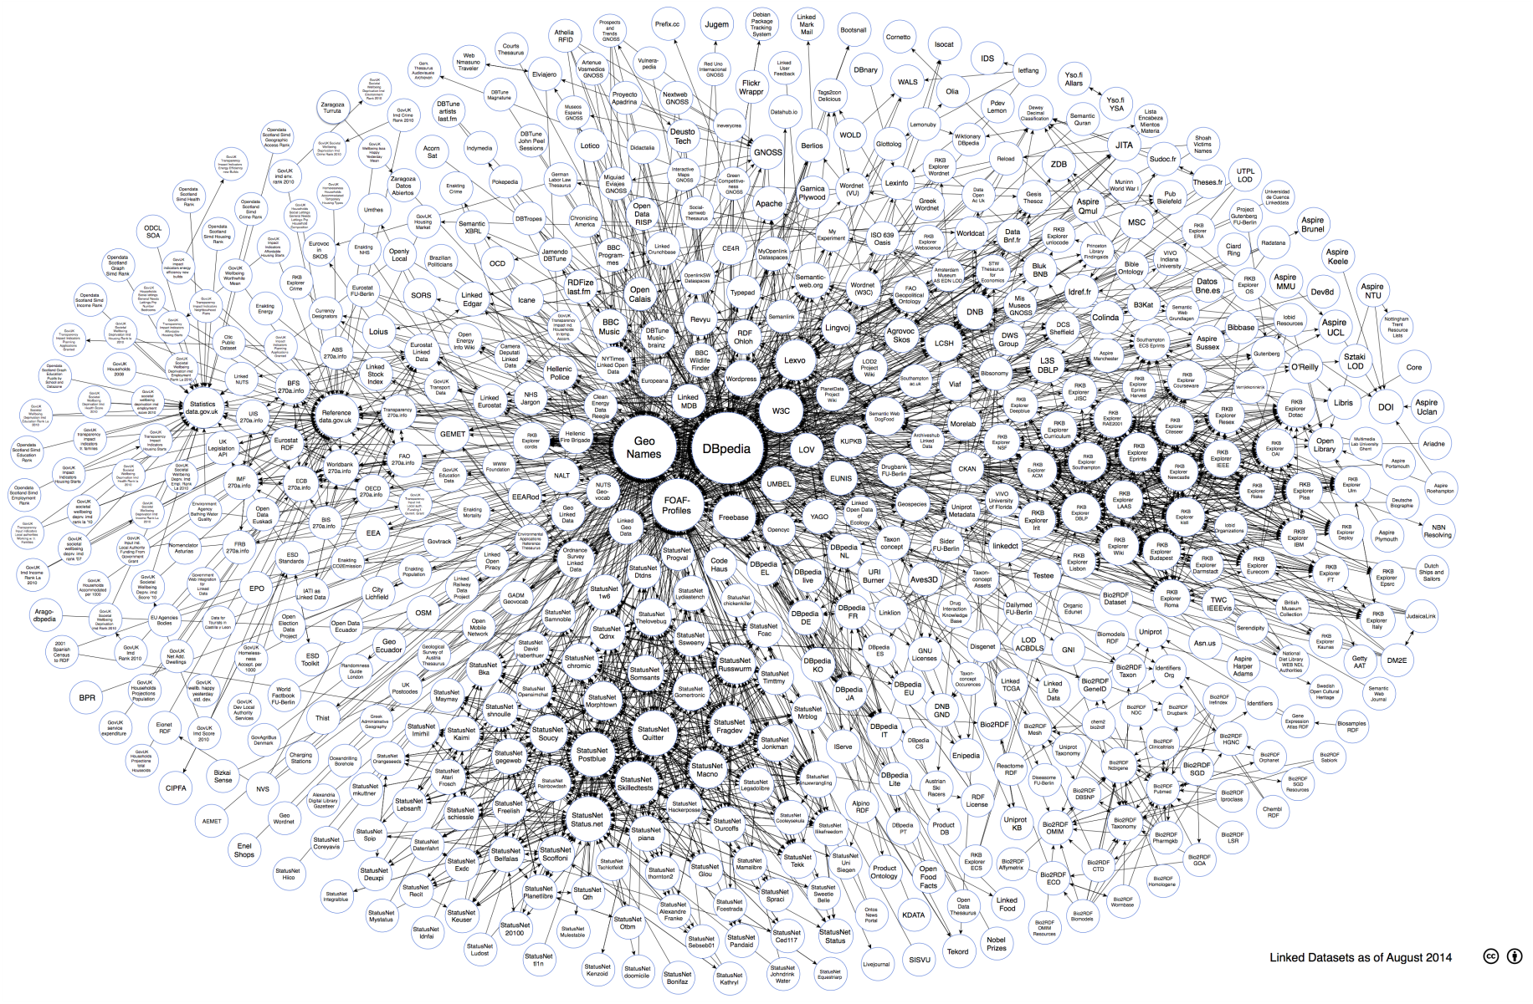
"Linking Open Data cloud diagram 2014, by Max Schmachtenberg, Christian Bizer, Anja Jentzsch and Richard Cyganiak. http://lod-cloud.net/"

Slide 9

Current state

Slide 10
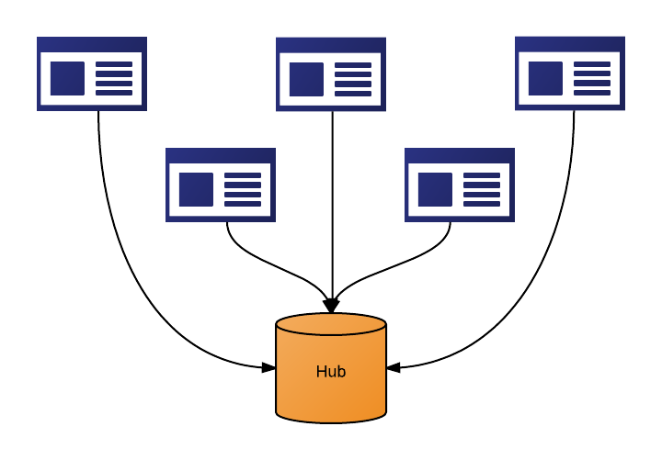
What is desired - Identity Hub

Slide 11
Process
Identify important collection
Match data to a central source
Map existing data to RDF
Publish as linked data with Linked Data Fragments server

Slide 12
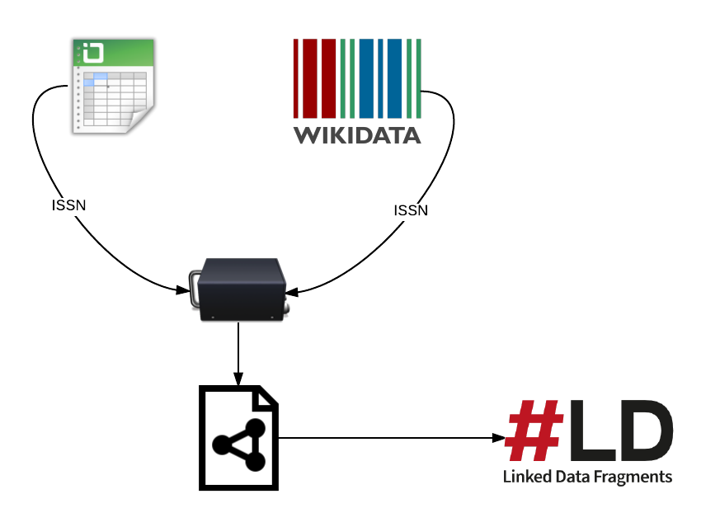
Process
https://github.com/lawlesst/c4l16-idhub

Slide 13
Collection – Web of Science™
Web of Science Core Collection - Science Citation Index
8,797 journals as of 2016
Started in Philadelphia in 1964 by Eugene Garfield
Carefully selected and curated to include only most important peer reviewed journals
Evolved to include Social Sciences, Humanities, Conference Proceedings, and Scholarly Books

Slide 14
Process
https://github.com/lawlesst/c4l16-idhub

Slide 15
Matching to Central Source
Local ID | Title | ISSN
70884J | Nature | 0028-0836
Local ID | Title | ISSN | Wikidata ID
70884J | Nature | 0028-0836 | Q180445

Slide 16
Results
8,797 journals
7,331 links to Wikidata
83%

Slide 17
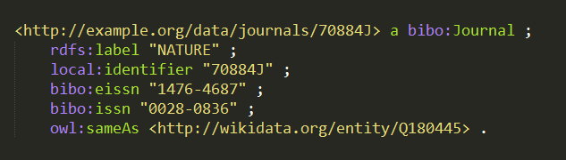
CSV to RDF

Slide 18
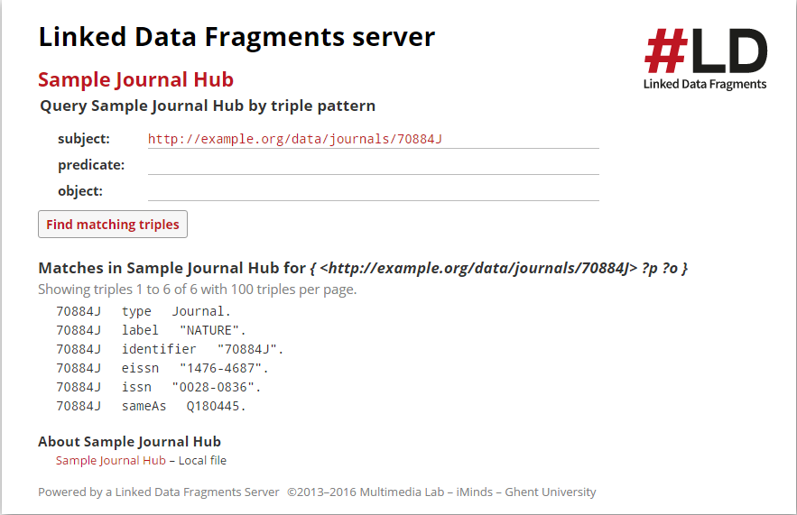
Publishing with LDF
https://ldf-vivo.herokuapp.com/journals

Slide 19
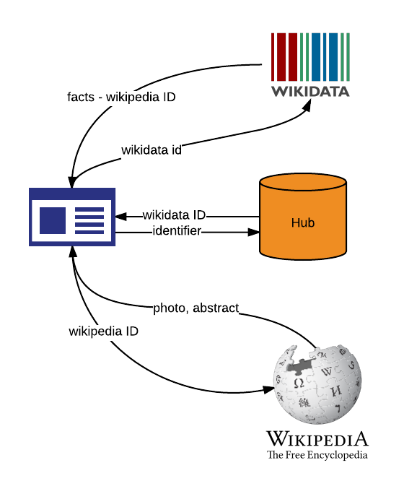
Tying it together

Slide 20
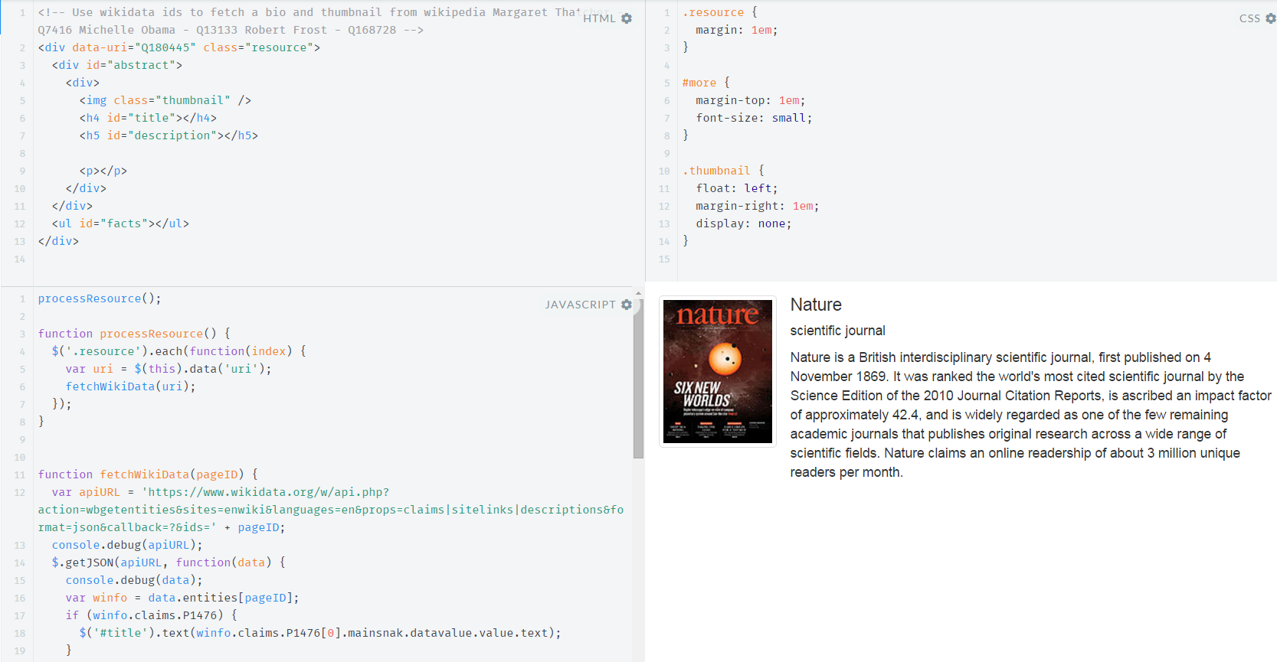
Tying it together
https://jsfiddle.net/lawlesst/n5pLx38j/

Slide 21
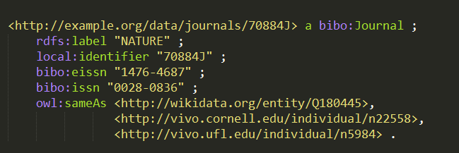
Extending the Hub
Match with peers
Share widgets/services

Slide 22
Tools
Python
RDFLib, csvkit, petl, fuzzywuzzy
Karma http://usc-isi-i2.github.io/karma/
Graphical, ontology mapping, data integration, sophisticated.
Linked Data Fragments http://linkeddatafragments.org
Low cost of serving data, modern framework, works in the browser.
VIVO as a platform http://vivoweb.org
Triple store manager, ontology editor, instance editor, user accounts, Solr search index of triples, Refine reconciliation endpoint.

Slide 23
Future Directions
Share reconciliation techniques and tools
Reusable services and widgets (Web components)
Expansion to other identity types
More Hubs

Slide 24
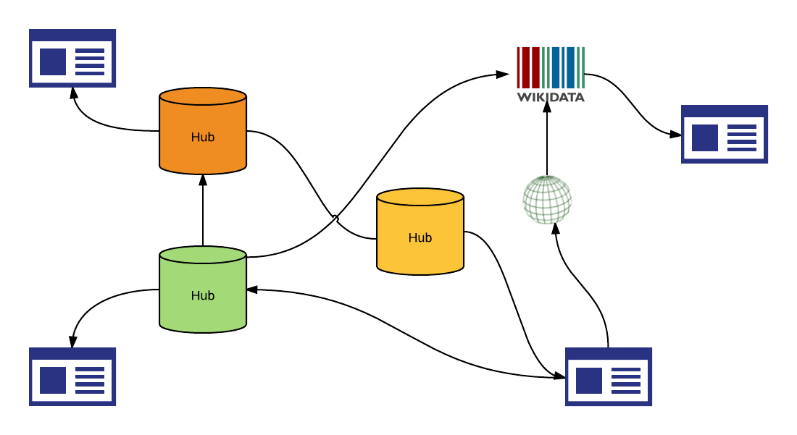
Future

Slide 25
Build Your Own Identity Hub
Thank you
Demo hub: https://ldf-vivo.herokuapp.com/
Sample code: https://github.com/lawlesst/c4l16-idhub
Here for the remainder of the conference
Visit Thomson Reuters table during breaks to discuss this or how you can use Web of Science APIs in your projects
Contact information: ted.lawless@thomsonreuters.com

Slide 26
Why interlink?
Reuse existing, more authoritative and comprehensive data
Enrich local presentation
Make future, unknown uses possible

Slide 27
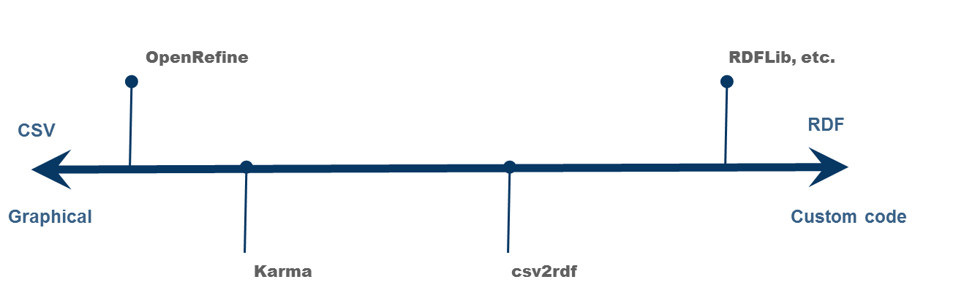
CSV to RDF

