Slide 1
The Fancy Finding Aid
Makeover your Collections with HTML5, Responsive Design, RDFa, Circulation Management, and Visual Content
Allison Jai O’Dell and Steven Duckworth, University of Florida, George A. Smathers Libraries

Slide 2
We’re on Twitter
@AllisonJaiODell | @ ArchiveSteve

Slide 3
The ever-evolving finding aid
“Users will follow the path of least resistance in seeking information. They expect speed [and] accuracy … archivists must develop new finding aids based on the convenience of users.”
“We can’t afford to continue making trains … if people want quicker, more convenient transportation.”
Randall C. Jimerson
1989
Jimerson, Randall C. 1989. “Redefining Archival Identity: Meeting User Needs in the Information Society”. The American Archivist 52 (3). Society of American Archivists: 332–40. http://www.jstor.org/stable/40293362

Slide 4
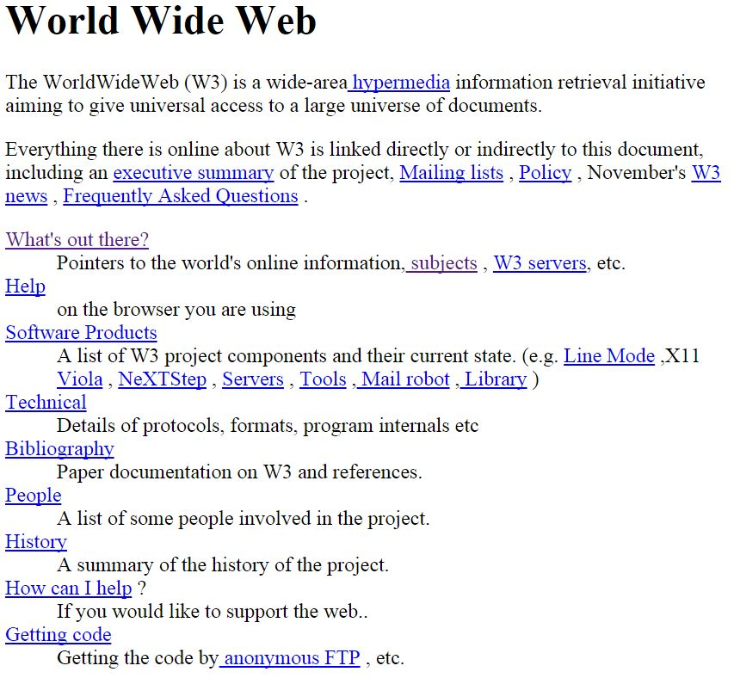

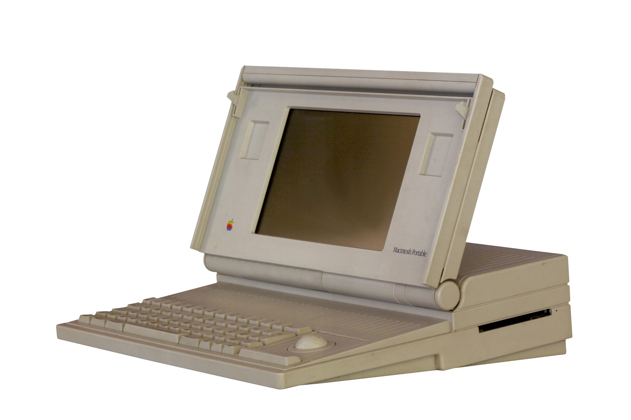
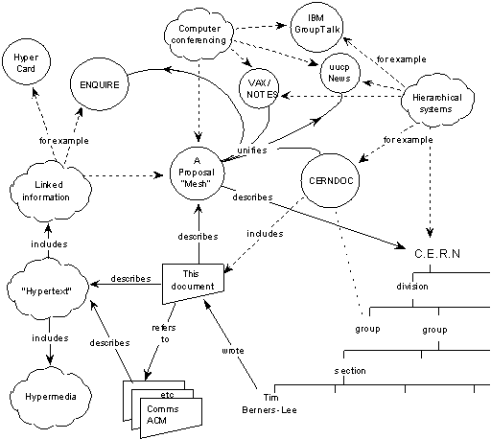
https://commons.wikimedia.org/wiki/File%3AMacintosh_Portable-IMG_7541.jpg
Notes:
Gameboy, Macintosh Portable, Compaq LTE and LTE/286, Sega Genesis.

Slide 5
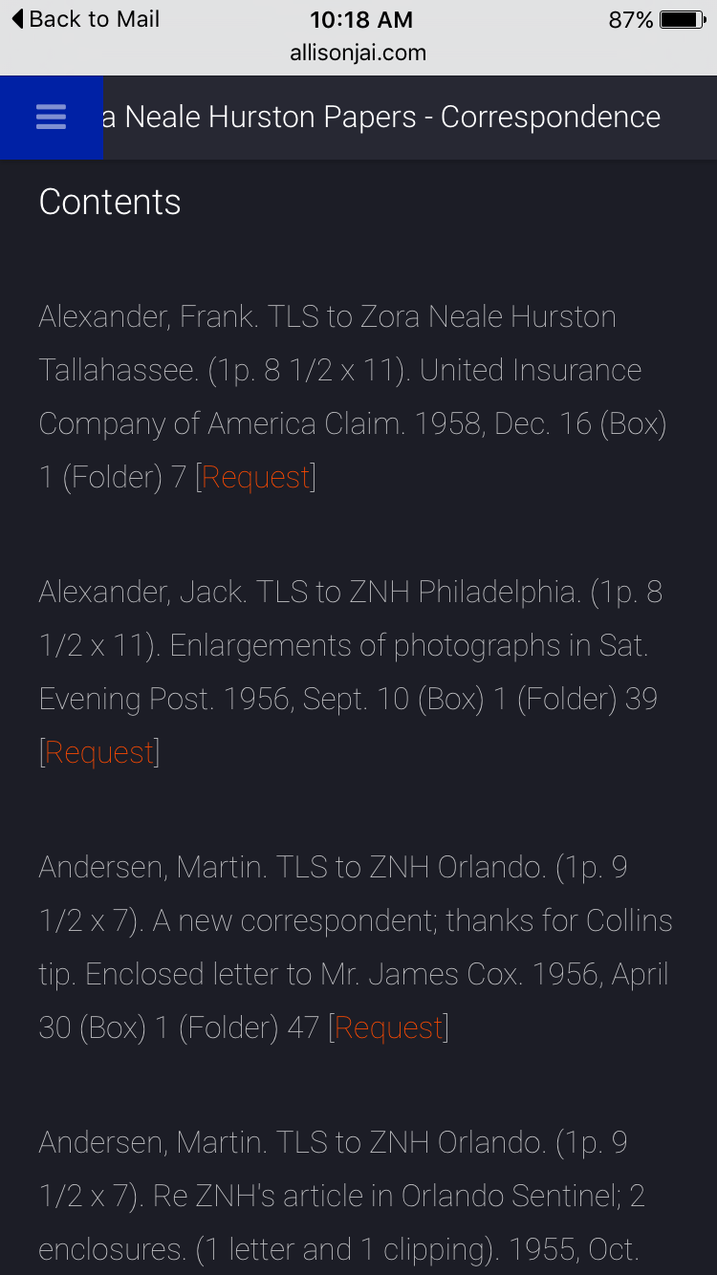
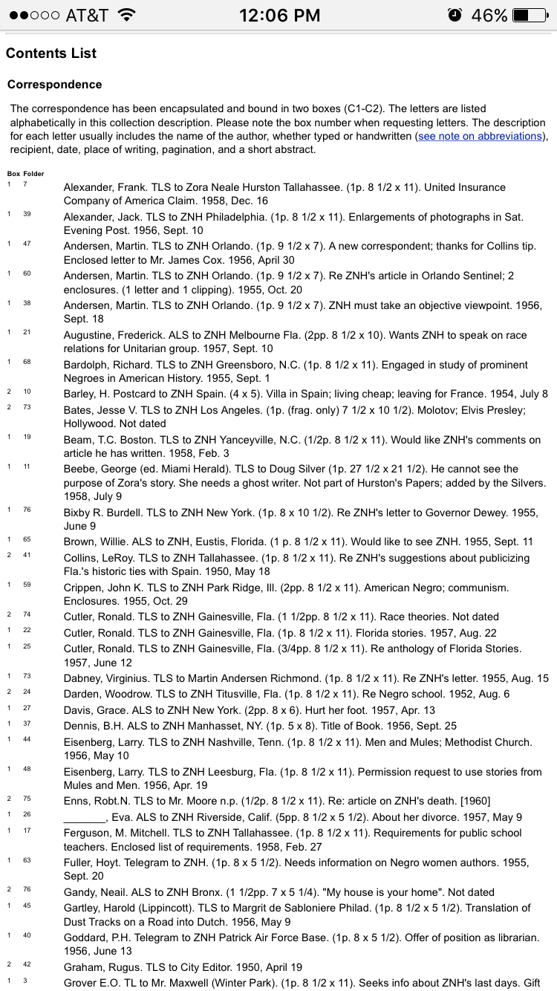



Today’s tech
Responsive design
Circulation management
GIS integration

Slide 6
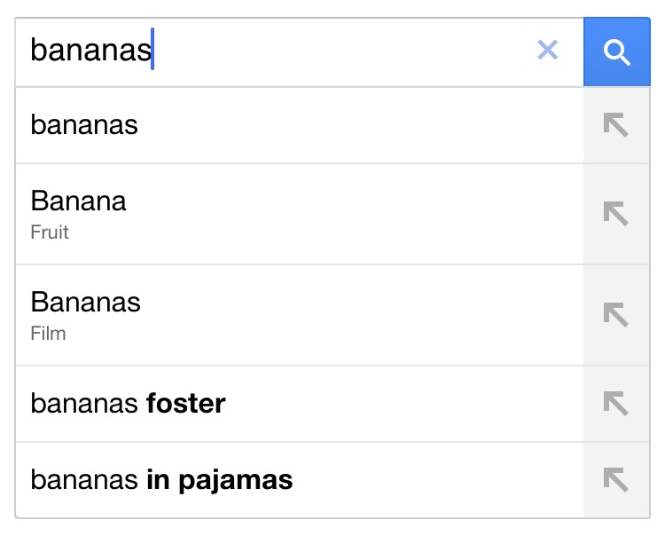
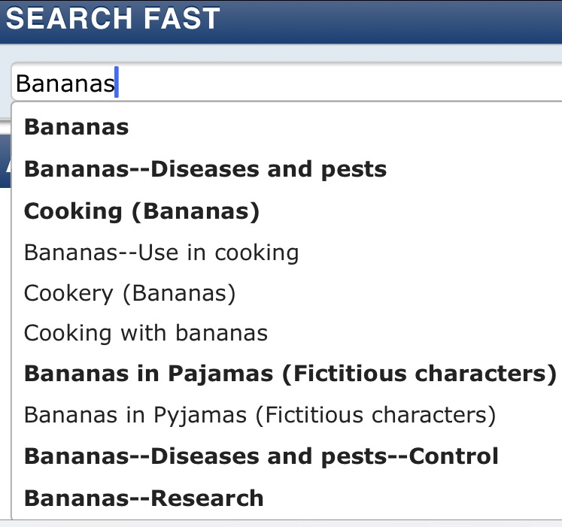

Googleability
Semantic searching
Autonomy (less archivist mediation)
Relevant results

Slide 7
Subject searching (about-ness rather than of-ness)
Corporate Names
Ahtna, Inc.
Kennecott Copper Corporation
Geological Survey (U.S.)
National Historic Landmarks Program (U.S.)
United States. Bureau of Land Management. Alaska State Office
Wrangell-Saint Elias National Park and Preserve (Agency : U.S.)
Geographic Names
Alaska
Alaska--Copper River Valley
Alaska--Kennecott Copper Mine
Alaska--Kennicott
Alaska--McCarthy
Subjects
Alaska Native corporations
Copper mines and mining
Copper mines and mining--Environmental aspects
Historic preservation
Alaska National Interest Lands Conservation Act (United States)
Alaska Native Claims Settlement Act (United States)
The “Records of Wrangell-St. Elias National Park and Preserve” document all aspects of the establishment and management of the park, as well as the history of the area, which includes Alaska Native communities, mining sites and companies, small mountain communities, hazardous waste cleanup, subsistence lifestyles, all manner of research, minerals exploration, and early exploration of what now constitutes the park’s boundaries. These records evidence the legislative process of establishing the park and the day-to-day operations of managing the park, including interactions with inhabitants, cultural and natural resource management, interpretation and education, and facilities management. Additionally, these records also help to illuminate over a century of life and activity in the remote area of the country that now constitutes the largest National Park in the United States of America.
These papers consist of correspondence, manuscripts and writings, scrapbooks, newspaper clippings, legal papers, and photographs. The correspondence includes approximately 3,100 letters. The writings include early drafts of novels, short fiction, speeches, and poems. Manuscripts, drafts, and notes are included for major works. Included are examples of Christmas greetings, family history, personal memorabilia, notes on writing, yearbooks, and University documents.

Slide 8






















Digital media
Integration of (born and re-born) digital media
Retaining context
VISUALS!

Slide 9
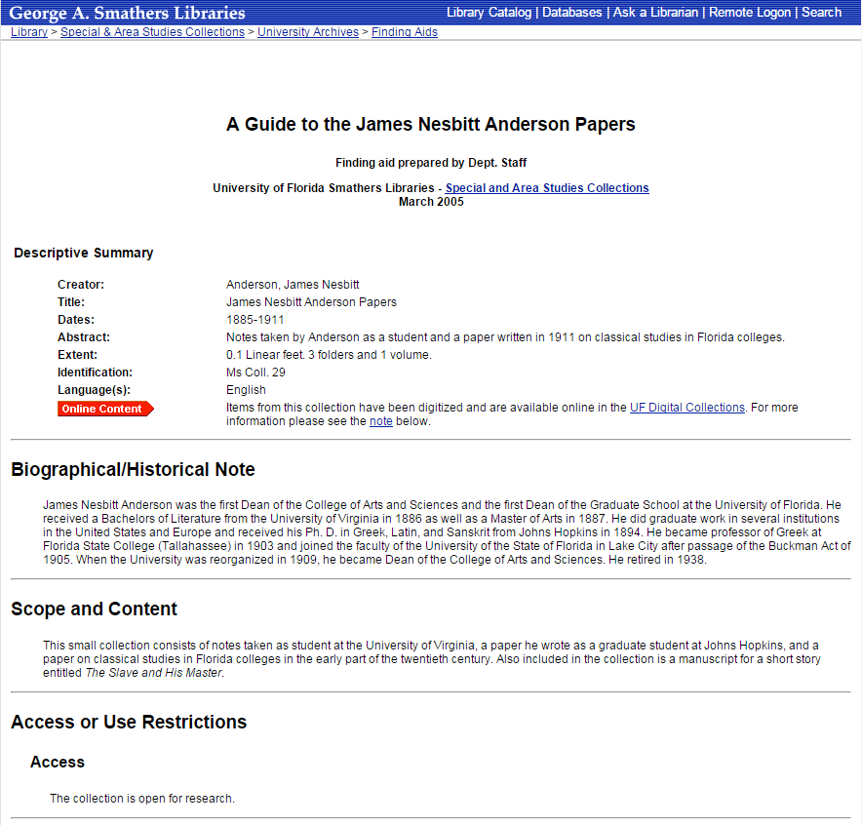
It’s time to revisit those finding aids.
EAD3
HTML5
Responsive design
RDF & linked data
Digitization initiatives
It’s 2016. Users expect more.

Slide 10
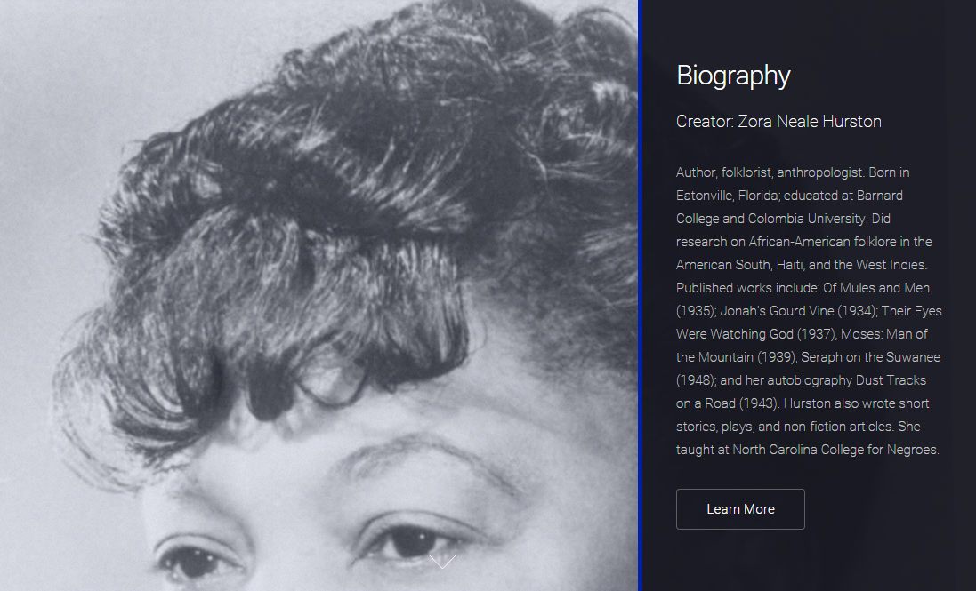
Mobile-friendly, mobile-fun
Demo:
http://allisonjai.com/hurston/finding_aid/index.html
Built with HTML5 UP!
responsive site templates
http://html5up.net/

Slide 11

Visual Content
Demo: http://www.allisonjai.com/hurston/swipebox.html
Details:
http://practicaltechnologyforarchives.org/issue5_odell/
Built with Swipebox,
a touch-able jQuery lightbox
http://brutaldesign.github.io/swipebox/

Slide 12
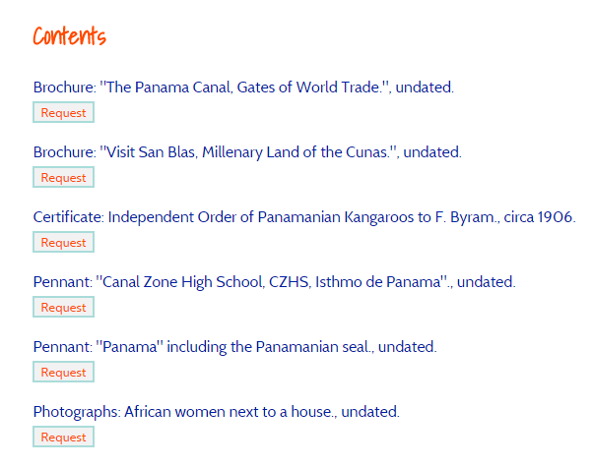
Circulation Management
Demo: http://allisonjai.com/hack/circulate/
Details:
http://libjournal.uncg.edu/index.php/ap/article/view/762/534
Built with simpleCart.js, an e-commerce shopping cart that integrates with existing mark-up
http://simplecartjs.org/

Slide 13
RDFa
<div vocab="http://bib.schema.org/">
<div typeof="Collection">
<span property="name"><xsl:value-of select="ead/archdesc/did/unittitle"/>, <xsl:value-of select="ead/archdesc/did/unitdate"/></span>
<span property="description"><xsl:value-of select="ead/archdesc/did/abstract"/></span>
<xsl:for-each select="ead/archdesc/scopecontent/p"><span property="description"><xsl:value-of select="."/></span><br/></xsl:for-each>
<xsl:for-each select="ead/archdesc/controlaccess/subject"><span property="about"><xsl:value-of select="."/></span><br/></xsl:for-each>
<span property="inLanguage"><xsl:value-of select="langmaterial/language"/></span>
<span property="creator"><xsl:value-of select="ead/archdesc/did/origination/persname"/></span>
<div class="item_name"><item property="hasPart"><xsl:value-of select="unittitle"/>, <xsl:value-of select="unitdate"/></item></div>
</div>
</div>
Demo
http://www.allisonjai.com/hack/circulate/c01file.xsl
http://allisonjai.com/hack/circulate/mabel_rdf.txt

Slide 14
We want to do more Get in touch
Allison Jai O’Dell | @AllisonJaiODell | ajodell@ufl.edu
Steven Duckworth | @ ArchiveSteve | steveduckworth@ufl.edu

