Slide 1
Guerilla Usability Testing and Communicating Value
Eka Grguric @egrguric
NCSU Libraries Fellow
Code4Lib conference, 8 March 2016

Slide 2
Outline:
1. What is usability and usability testing
2. Where it fits in a project
3. Why do it
4. How to get started with it
5. How and When to communicate

Slide 3
What is Usability?

Slide 4
What is Usability?
“Usability is a quality attribute that assesses how easy user interfaces are to use.”
– Jacob Nielsen
Source: “Usability 101: Introduction to Usability” by Jacob Nielsen
https://www.nngroup.com/articles/usability-101-introduction-to-usability/

Slide 5
What is Usability?
“Usability means that making sure that something works well…”
– Steve Krug
Source: “Don’t Make Me Think” by Steve Krug

Slide 6
How do you test for it?

Slide 7
Different Strategies at Different Stages
 | Pre Design | Early Design | Mid-Design | Late-Design
Observation | X | X
Ethnography | X
Interviews | X | X
Questionnaires | X | X
Task Analysis | X
Participatory Interaction |  | X
Cognitive Walk-Throughs |  | X
Task-Based Usability Testing |  |  | X
Heuristic Evaluation | X |  | X
Field Testing |  |  |  | X
Adapted from: Karon Maclean’s CS544 course notes, UBC; originally adapted from Saul Greenberg’s course notes, U Calgary.

Slide 8
Different Strategies at Different Stages
 | Pre Design | Early Design | Mid-Design | Late-Design
Observation | X | X
Ethnography | X
Interviews | X | X
Questionnaires | X | X
Task Analysis | X
Participatory Interaction | X | X
Cognitive Walk-Throughs | X | X
Task-Based Usability Testing | X |  | X | X
Heuristic Evaluation | X |  | X | X
Field Testing | X |  |  | X
Existing Designs
New Designs

Slide 9
Give a real life user tasks to complete
+
Tell them to think out loud
(a “think out loud protocol”)

Slide 10
Where does it fit in?
Notes:
Low cost
Context-specific
(particularly good for libraries)
Fast execution
No fancy equipment or methodology
Amateurs can make it work
(no fancy equipment or methodology)
As opposed to “curiosity-centered” design, also known as “technology-centered”
sometimes awesome
exploratory
can result in innovation
Most of what we do in libraries is user-centered

Slide 11
Analysis and Decisions
Design
Development
Assessment
Launch and Maintenance
Waterfall Approach:

Slide 12
Iterative Design Approach:
Development
Design
Usability Testing
Analysis and Decisions
Launch
Notes:
And my best advice to you is to schedule regularly occuring testing sessions and then cancel as needed.
If you have a 6 week turn around, this might be once a week; a six month turn around, once a month.
At least this way you’ll have budgeted checkpoints in your project workflow to do assessment.

Slide 13
Guerilla vs. Standard Usability Testing?

Slide 14
Cheaper (a lot)

Slide 15
Minimal Equipment (Amateurs can make it work)

Slide 16
Recruiting during the test
3-6 participants to pick up most bugs
“recruit loosely and grade on a curve”
– Steven Krug

Slide 17
Fast and Context Specific (Particularly good for libraries)

Slide 18
Why do it?

Slide 19
Libraries are user-centered environments
Notes:
Usability testing brings users into your design process
This means that what you make remains relevant to the people who will have to use it
Increases investment by stakeholders
Libraries are user-centered environments

Slide 20
Brings users into the design
process early on

Slide 21
Supports decision making
(and objectivity)

Slide 22
Challenges assumptions

Slide 23
Maintains stakeholder buy-in
(keeps everybody involved and interested)
Notes:
Usability testing is a way to connect all these varied roles that have a tendency to get siloed in big projects

Slide 24
Uncovers problems while they’re
still cheap to fix

Slide 25
Getting started
Notes:
Low cost
Context-specific
(particularly good for libraries)
Fast execution
No fancy equipment or methodology
Amateurs can make it work
(no fancy equipment or methodology)
As opposed to “curiosity-centered” design, also known as “technology-centered”
sometimes awesome
exploratory
can result in innovation
Most of what we do in libraries is user-centered

Slide 26
Figure out what you’re testing and who the stakeholders are
Notes:
Low cost
Context-specific
(particularly good for libraries)
Fast execution
No fancy equipment or methodology
Amateurs can make it work
(no fancy equipment or methodology)
As opposed to “curiosity-centered” design, also known as “technology-centered”
sometimes awesome
exploratory
can result in innovation
Most of what we do in libraries is user-centered

Slide 27
Make some personas and tasks
(keep it simple)
Notes:
Low cost
Context-specific
(particularly good for libraries)
Fast execution
No fancy equipment or methodology
Amateurs can make it work
(no fancy equipment or methodology)
As opposed to “curiosity-centered” design, also known as “technology-centered”
sometimes awesome
exploratory
can result in innovation
Most of what we do in libraries is user-centered

Slide 28
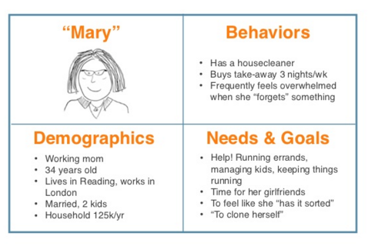
This is what a Persona Might Look Like
(keep it simple, relevant, and use templates)
Source “LUXr One-Day Workshop” slides by Janice Fraser, slide 73, http://www.slideshare.net/clevergirl/luxr-oneday-workshop

Slide 29
Here’s an Example of a Good / Bad Task
(your tasks can change as necessary)
User goal: Look up grades.
Source: Nielsen Norman Group. “Turn User Goals into Task Scenarios for Usability Testing.” https://www.nngroup.com/articles/task-scenarios-usability-testing/

Slide 30
Here’s an Example of a Good / Bad Task
(your tasks can change as necessary)
Good task: Look up the results of your midterm exams.

Slide 31
Here’s an Example of a Good / Bad Task
(your tasks can change as necessary)
Poor task: You want to see the results of your midterm exams. Go to the website, sign in, and tell me where you would click to get your transcript.

Slide 32
Here’s an Example of a Good / Bad Task
(your tasks can change as necessary)
Poor task: You want to see the results of your midterm exams. Go to the website, sign in, and tell me where you would click to get your transcript.

Slide 33
Here’s an Example of a Good / Bad Task
(your tasks can change as necessary)
User goal: Look up grades.
Source: Nielsen Norman Group. “Turn User Goals into Task Scenarios for Usability Testing.” https://www.nngroup.com/articles/task-scenarios-usability-testing/

Slide 34
Here’s an Example of a Good / Bad Task
(your tasks can change as necessary)
Good task: Look up the results of your midterm exams.

Slide 35
Practical Needs
A representative device / design
(to record with / test on)
2 facilitators
(a talker + a notetaker)
A busy location that isn’t boxed in

Slide 36
Screen-recording software
(not necessary but easier)
Notes:
Low cost
Context-specific
(particularly good for libraries)
Fast execution
No fancy equipment or methodology
Amateurs can make it work
(no fancy equipment or methodology)
As opposed to “curiosity-centered” design, also known as “technology-centered”
sometimes awesome
exploratory
can result in innovation
Most of what we do in libraries is user-centered

Slide 37

Silverback
is popular and inexpensive
Notes:
Low cost
Context-specific
(particularly good for libraries)
Fast execution
No fancy equipment or methodology
Amateurs can make it work
(no fancy equipment or methodology)
As opposed to “curiosity-centered” design, also known as “technology-centered”
sometimes awesome
exploratory
can result in innovation
Most of what we do in libraries is user-centered

Slide 38
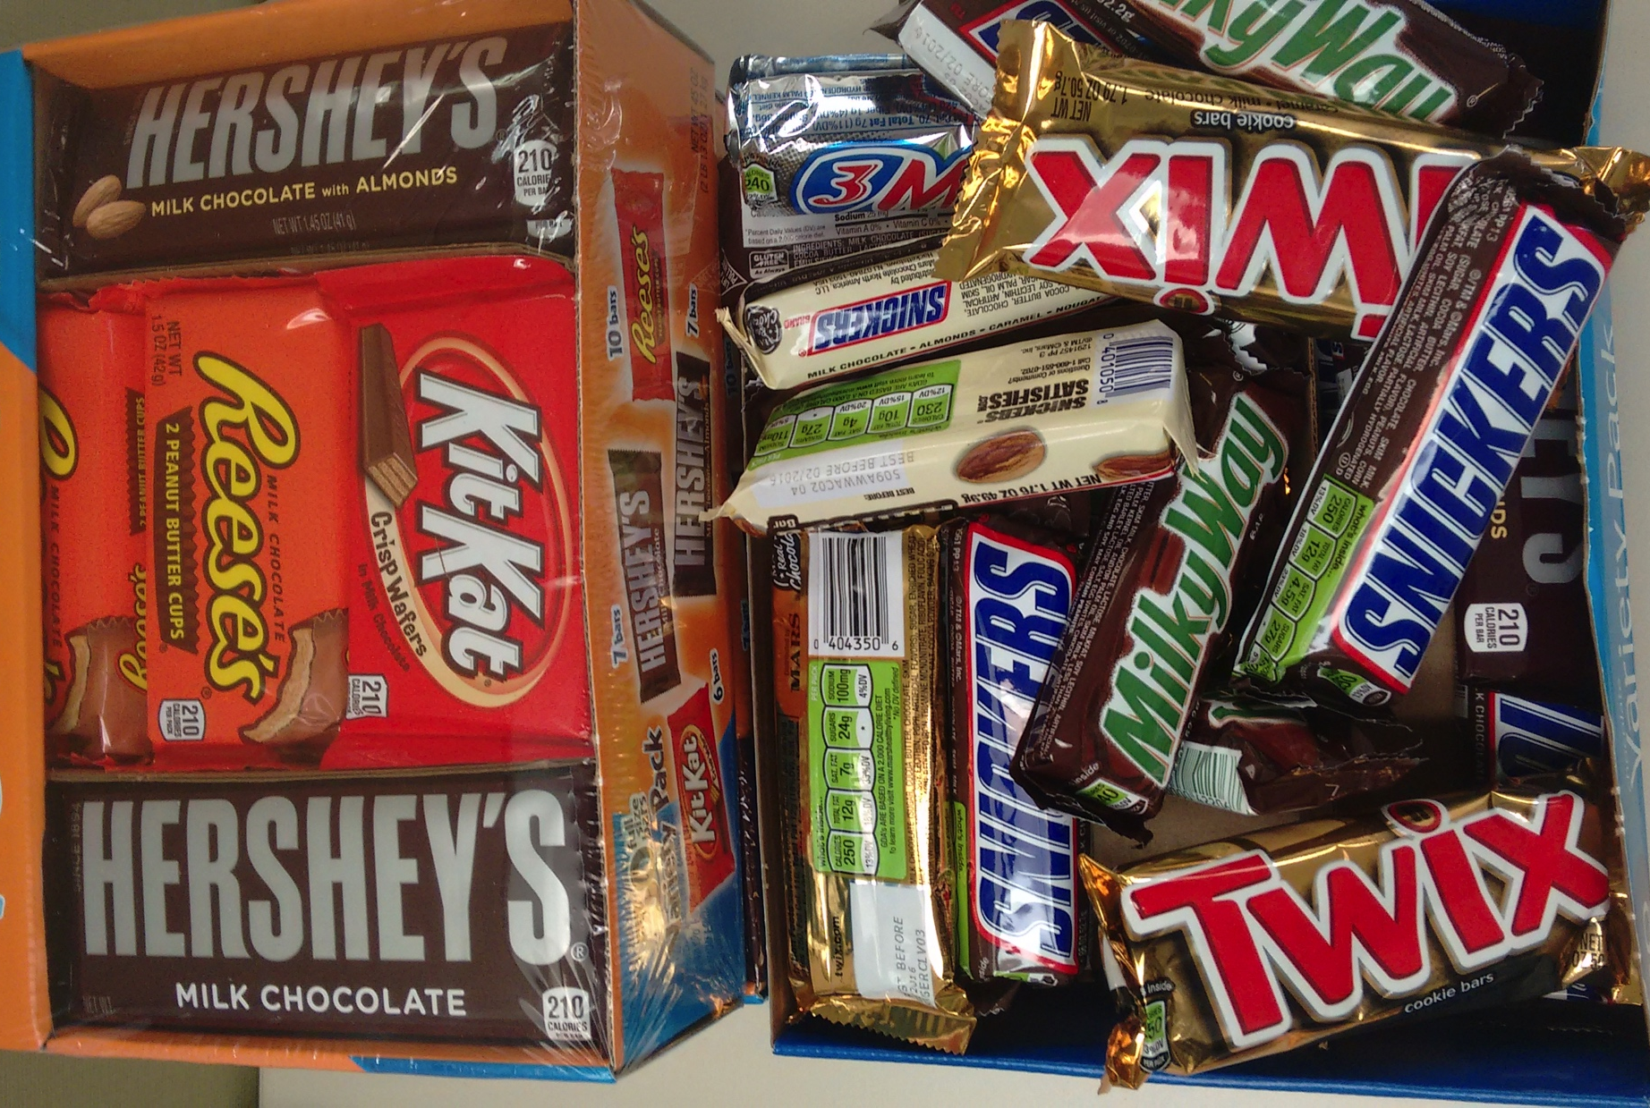
Incentives
(keep it simple)

Slide 39
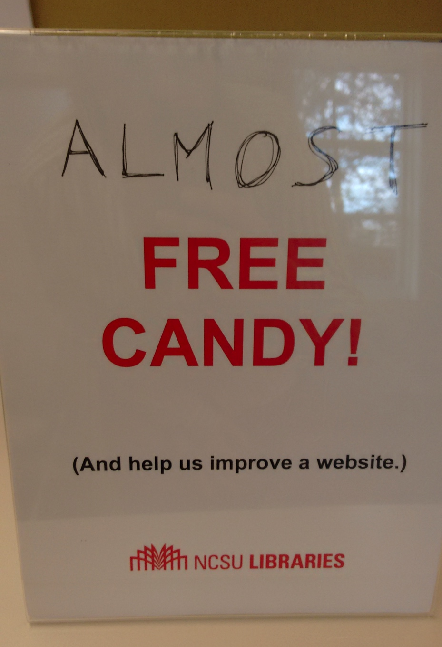
Avoid Misleading Signs

Slide 40
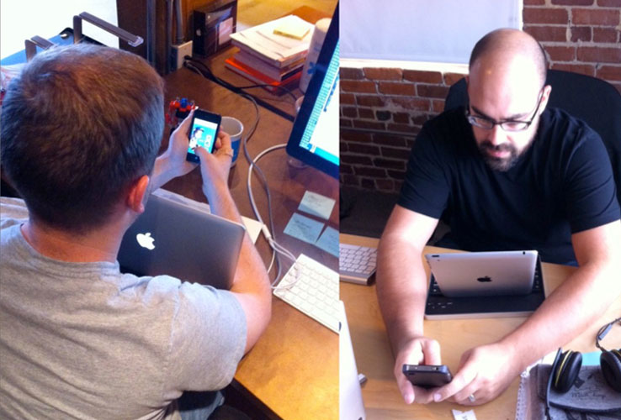
Be creative
Jen Down’s “Laptop Hugging” Method

Slide 41
During the Test
Aim for 3-6 participants
to do 3-4 tasks each
Be informative and friendly
Notes:
Low cost
Context-specific
(particularly good for libraries)
Fast execution
No fancy equipment or methodology
Amateurs can make it work
(no fancy equipment or methodology)
As opposed to “curiosity-centered” design, also known as “technology-centered”
sometimes awesome
exploratory
can result in innovation
Most of what we do in libraries is user-centered

Slide 42
Avoid verbal prompts
Notes:
Be informative and friendly.
Do not say “good job” or otherwise make the participant feel they are being tested. Good alternate lines for moving on:
“Ok, great. The next task is...”
“Thank you; our next task is…”
Do not prompt your participant. Instead say:
“Could you explain what you mean by that?”
“What would you do next?”
“What did you expect to happen?”

Slide 43
Example of a verbal prompt:
“Maybe you should try logging out?”

Slide 44
Better:
“Can you describe to me what you are expecting to see / happen right now?

Slide 45
After the Test
Quickly summarize
the key findings
(make some action items)
That may be enough for smaller projects
Notes:
Low cost
Context-specific
(particularly good for libraries)
Fast execution
No fancy equipment or methodology
Amateurs can make it work
(no fancy equipment or methodology)
As opposed to “curiosity-centered” design, also known as “technology-centered”
sometimes awesome
exploratory
can result in innovation
Most of what we do in libraries is user-centered

Slide 46
Useful data points:
Who you tested (demographic info)
Success / Failure of tasks
Items that were always (3 M’s):
Missed
Misunderstood
Misused
Notes:
Two stages of recording:
Part 1: quickly summarize the main take aways from testing while it is fresh in your mind. An e-mail or a one-pager are good enough for this. Very informal.
Part 2: review recordings and use your initial list of tested items to determine success rate by individuals as they completed the tasks
This lets you uncover problem areas or flow that is unexpected

Slide 47
Communicating Value

Slide 48
Value Communication
Generating and maintaining buy-in

Slide 49
Make your process user-centric
“make it a spectator sport”
– Steve Krug

Slide 50
Share your documents and data
(Google Drive, Dropbox, etc.)

Slide 51
A blog
(Or otherwise accessible publishing)

Slide 52
Presentations
(Major findings, Process Q & A)

Slide 53
Early Project Stages
Set up one-on-one meetings with key “funder” and “creator” stakeholders (Project manager(s), Designers, Developers, etc.)

Slide 54
Early Project Stages
Attend planning meetings

Slide 55
Mid-Project Stages
Check in with designer / developer before each scheduled testing session
If there is nothing to test, do not test

Slide 56
Final Project Stages
Record what you did
(keep it simple; use a template)
Notes:
Identify stakeholder groups; with a focus on users
Develop Personas
Determine Goals for each type of user
Determine what you want to test (keep it simple)
Make a list of usability questions and elements you want to test
Determine what kinds of usability testing will be best for the stages of your project
Set up one-on-one meetings with key “funder” and “creator” stakeholders
Project manager(s)
Designers
Developers
Attend planning meetings
Introduce Usability Testing in regularly scheduled intervals in the project schedule
Ensure practical resources
Place to test
Device to test with (usually)
Templates
Script
Data Recording
Reporting
Incentives (read: candy)
Prior to each session test-run tasks on device
Develop new tasks to reflect new elements / questions to test
Test quickly and often, don’t strive for perfection
Aim to map out mental models that folks have
Try not to jump to global conclusions
Check in with designer / developer before each scheduled testing session to ask for questions
If there is nothing to test, do not test
Continue new tasks to reflect new elements / questions to test
Compile the record of testing for final report
Brief and Readable (no jargon)
What, Why, How
Interactive and visual
video clips
before and after screenshots
Use a template
Get feedback on the process of the testing from stakeholders for process iteration
Check in with designer / developer before each scheduled testing session to ask for questions
If there is nothing to test, do not test
Pass on final report to major stakeholders that explains
What you did
Major Changes made (use screenshots)

Slide 57
Final Project Stages
Ask for Feedback
(always take the chance to improve your methods)
Notes:
Identify stakeholder groups; with a focus on users
Develop Personas
Determine Goals for each type of user
Determine what you want to test (keep it simple)
Make a list of usability questions and elements you want to test
Determine what kinds of usability testing will be best for the stages of your project
Set up one-on-one meetings with key “funder” and “creator” stakeholders
Project manager(s)
Designers
Developers
Attend planning meetings
Introduce Usability Testing in regularly scheduled intervals in the project schedule
Ensure practical resources
Place to test
Device to test with (usually)
Templates
Script
Data Recording
Reporting
Incentives (read: candy)
Prior to each session test-run tasks on device
Develop new tasks to reflect new elements / questions to test
Test quickly and often, don’t strive for perfection
Aim to map out mental models that folks have
Try not to jump to global conclusions
Check in with designer / developer before each scheduled testing session to ask for questions
If there is nothing to test, do not test
Continue new tasks to reflect new elements / questions to test
Compile the record of testing for final report
Brief and Readable (no jargon)
What, Why, How
Interactive and visual
video clips
before and after screenshots
Use a template
Get feedback on the process of the testing from stakeholders for process iteration
Check in with designer / developer before each scheduled testing session to ask for questions
If there is nothing to test, do not test
Pass on final report to major stakeholders that explains
What you did
Major Changes made (use screenshots)

Slide 58
Re-Cap
Libraries are user-centered environments
Guerilla Usability Testing is a low-cost high gain method for making sure things work
Keep it simple and be creative with resources
Thinking about user goals makes for better tasks
Good communication results in higher perceived value; be user centric with your process

Slide 59
Resources (start here)
Nielsen Norman Group (and most things Don Norman has written)
Usability.gov (esp. for templates and checklists)
Steve Krug’s books (for web usability but also for big idea guidelines and scripts)
Guerilla Testing Slideshares (lots of good ones out there)

Slide 60
Questions?
@egrguric
egrguri@ncsu.edu

