Slide 1

Crash Course on Machine Learning
Alex Mariakakis
University of Toronto
Department of Computer Science

Slide 2
Outline
What is covered
What is not covered
High-level terms and definitions
Conceptual walkthrough of how to approach machine learning problems
Supervised machine learning on simple tabular data
Underlying math
Machine learning on sequences, images, and text
Unsupervised learning
Deep learning
Code examples
Scikit-learn for Python
Weka for Java

Slide 3
What Is Machine Learning?
Traditional Programming
Machine Learning
Inputs
Program
Inputs
Outputs
Outputs
Program
Machine learning learns programs from data!

Slide 4
Step-By-Step Process for Machine Learning
Define the problem you are trying to solve
Create your features and labels
Decide how the data should be split for training and testing
(Optional) Add feature selection
(Optional) Balance your dataset
Select an appropriate model
(Optional) Select your hyperparameters
Train and test your model
Use an appropriate method for interpreting results

Slide 5


Types of Learning
Supervised Learning
Unsupervised Learning
The goal is for the model to produce the desired output based on examples with labels (i.e., expected outcomes)
The goal is for the model to extract meaningful trends or associations in the data without having access to labels (or assuming they do not exist)
?
healthy
sick
Group 1
Group 2

Slide 6
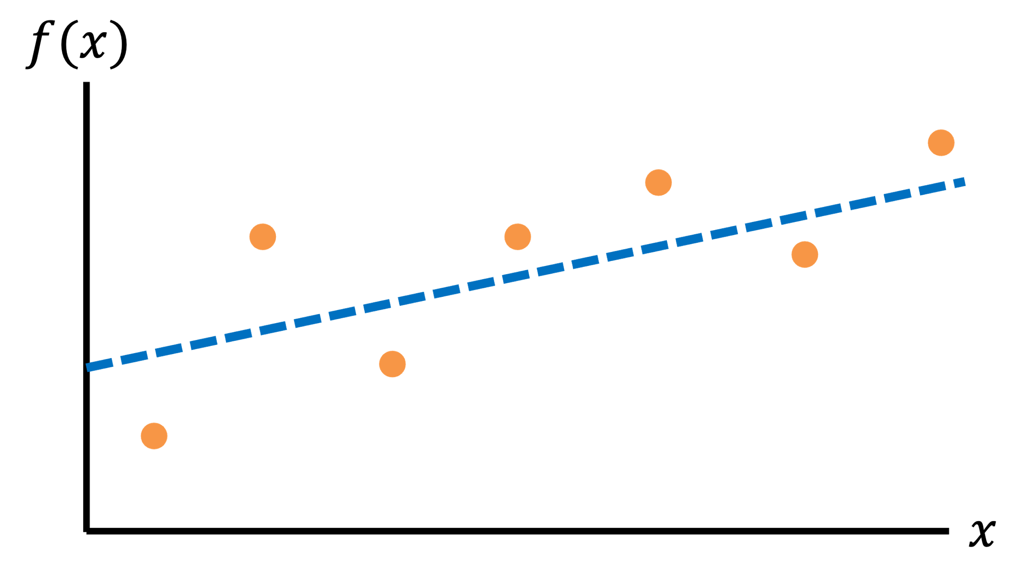
Types of Supervised Learning
Regression
Classification
Questions that can be answered with a continuous output
What will the patient’s heart rate be in one hour?
For how long will the patient experience symptoms?
Questions that can be answered with a categorical answer
Is this person sick or not?
Is this person going to become sick in the future?

Slide 7


Example of Unsupervised Learning
Clustering
$$x_{2}$$
Segregates the data into groups such that samples in the same group are more similar to other samples in the same group and dissimilar to samples in other groups
Since the clusters do not depend on labels, the groups may or may not be related to meaningful distinctions in the data
$$x_{1}$$

Slide 8
What We Will Cover
We are going to focus on supervised learning, which means that we can assume that are data comes with labels that represent the expected outcome for each data sample

Slide 9
Step-By-Step Process for Machine Learning
Define the problem you are trying to solve
Create your features and labels
Decide how the data should be split for training and testing
(Optional) Add feature selection
(Optional) Balance your dataset
Select an appropriate model
(Optional) Select your hyperparameters
Train and test your model
Use an appropriate method for interpreting results

Slide 10
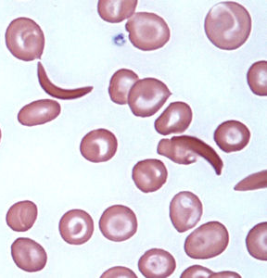
Feature Representations
Patient ID | Heart Rate | SpO₂ | Cough?
P01 | 60 | 97% | Yes
In the end, we want to work with tabular data
This is true for traditional machine learning; deep learning can handle raw time-series and images
We can use the techniques we have discussed to process data into tabular form
Clip ID | Loudness | Peak Freq
C01 | 60 dB | 200 Hz
Image ID | # Cells | # Sickles | Avg Hue
I01 | 60 | 5 | 54

Slide 11
What Does Our Data Look Like
Subject ID | Age | Heart Rate | Systolic Blood Pressure | Diastolic Blood Pressure | SpO₂ | Has Sepsis?
P01 | 34 | 77 | 117 | 72 | 100.0 | No
P02 | 78 | 87 | 163 | 79 | 95.9 | Yes
P03 | 57 | 66 | 144 | 81 | 97.6 | No
P04 | 23 | 93 | 167 | 94 | 94.0 | Yes
P05 | 81 | 90 | 123 | 86 | 99.7 | Yes
Samples
Identifying information that should not be used for learning
Features
Labels

Slide 12
What Does Our Data Look Like
Each feature can be thought of as a dimension of a new coordinate system that represents our data
Classification
Worsening
Healthy
Cough status
Sick
Normal
92.5%
95%
97.5%
100%
SpO₂ (%)

Slide 13
What Does Our Data Look Like
Each feature can be thought of as a dimension of a new coordinate system that represents our data
5
Regression
4
Data point
Days with Symptoms
3
2
1
92.5%
95%
97.5%
100%
SpO₂ (%)

Slide 14
Dealing with Missing Data
It is easiest to work with data when all the entries in your dataset have the same number of features
You can fill in blanks using imputation techniques:
Technique | Note
Placeholder value (e.g., 0, -999) | Not a good idea for models that cannot distinguish between real and fake data
Mean / median | Pretty limited in the level of accuracy that can be achieved since it only cares about one feature at a time
Nearest neighbor | Requires training and tuning a special model for filling in data based on other examples

Slide 15
Step-By-Step Process for Machine Learning
Define the problem you are trying to solve
Create your features and labels
Decide how the data should be split for training and testing
(Optional) Add feature selection
(Optional) Balance your dataset
Select an appropriate model
(Optional) Select your hyperparameters
Train and test your model
Use an appropriate method for interpreting results

Slide 16
Dataset Splitting
When you evaluate your model, it is important that you see how well it works on data it has never seen before
To do this, we often partition our dataset into distinct “splits”
Train: Used to help the model learn how to set its internal parameters so that it can generate predictions
(Optional) Validation: Used to tune hyperparameters (more on that later)
Test: Used to evaluate the trained model’s performance

Slide 17
Standard Methods of Dataset Splitting
The amount of training data should be significantly higher than the amount of validation and/or testing data
These are three standard methods without a validation split (which can often be just taken from the train set)
Single Split: Generate a single partition (e.g., 80% train & 20% test)
N-Fold Cross-Validation: Split the data into N equal partitions, train one model with each partition as the test set, and then average the results
Leave-One-Out Cross-Validation: Similar to N-Fold cross-validation, but when the splits correspond to an important aspect of the dataset (e.g., N = number of users)
A
B
C
Fold 1:
A
B
C
Fold 2:
A
B
C
Fold 3:
Train
Test

Slide 18
Considerations for Dataset Splitting
It is usually good practice to shuffle the rows of your data so that there are not any biases based on how the data was recorded or grouped
Make sure you have good representation of all possible labels in each of your data splits
If your train split only includes healthy patients and your test split only includes sick patients, then you will get bad performance
This problem becomes more apparent as your dataset and splits become smaller

Slide 19


Considerations for Dataset Splitting
If your model has not been trained on a certain kind of data before, it probably will not predict well on that data either
$$y$$
No guarantees on model performance
Region where model should work best
No guarantees on model performance
$$x$$

Slide 20
Considerations for Dataset Splitting
Pick the right training method to answer your question
If you want to show that your approach works on patients that have never been seen by the model, then you should make sure that no individuals are represented in both the train and test sets
If you think that personalized models are needed for each person, then you should split each patient’s data into train and test sets and build individual models

Slide 21
Step-By-Step Process for Machine Learning
Define the problem you are trying to solve
Create your features and labels
Decide how the data should be split for training and testing
(Optional) Add feature selection
(Optional) Balance your dataset
Select an appropriate model
(Optional) Select your hyperparameters
Train and test your model
Use an appropriate method for interpreting results

Slide 22
Why Use Feature Selection?
The more features we use, the higher the likelihood that we can successfully solve our problem
However, if we use too many features, the model may learn complicated rules that neither make sense nor generalize well to unseen data
This tradeoff is known as the “curse of dimensionality” and is closely tied to overfitting

Slide 23
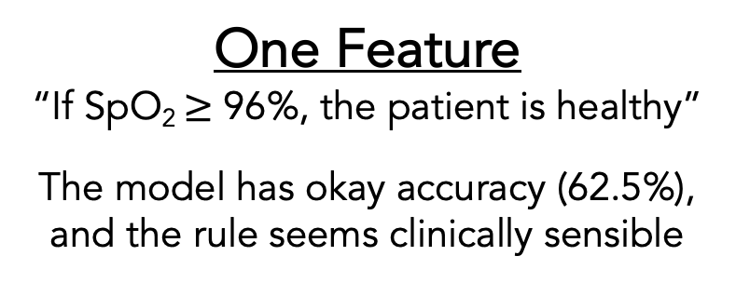
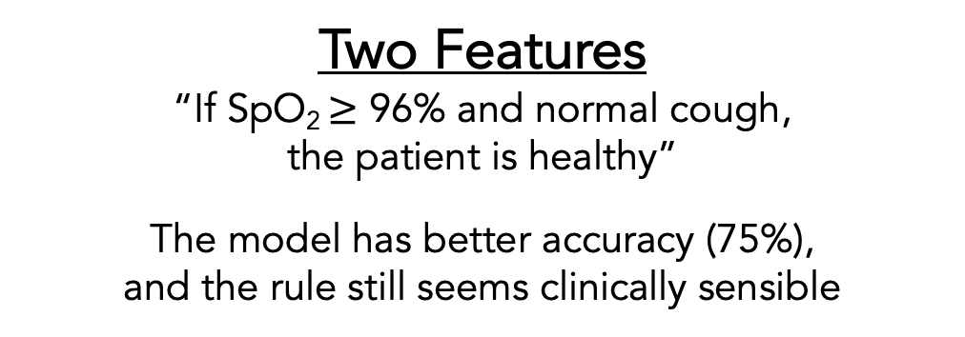
Why Use Feature Selection?
Classification
Healthy
Sick
Worsening
Cough status
Normal
92.5%
95%
97.5%
100%
92.5%
95%
97.5%
100%
SpO₂ (%)
SpO₂ (%)
One Feature
“If SpO₂ $≥$ 96%, the patient is healthy”
The model has okay accuracy (62.5%), and the rule seems clinically sensible
Two Features
“If SpO₂ $≥$ 96% and normal cough, the patient is healthy”
The model has better accuracy (75%), and the rule still seems clinically sensible

Slide 24
Why Use Feature Selection?
Classification
Healthy
Sick
Worsening
1
2
9
Number in yellow: last digit of SIN
Cough status
Normal
4
3
2
7
6
92.5%
95%
97.5%
100%
SpO₂ (%)
Three Features
“If normal cough AND last digit of SIN is even, the patient is healthy”
The model has perfect accuracy (100%), but it took advantage of a random feature to make a rule that does not seem to be clinically sensible

Slide 25
How to Select the Best Features
You can use domain expertise to ignore features that do not make sense
There are also automated techniques you can use to automatically pick the features that are likely to be the most interesting mathematically
Some techniques care about the labels, while others just care about properties of the data itself

Slide 26
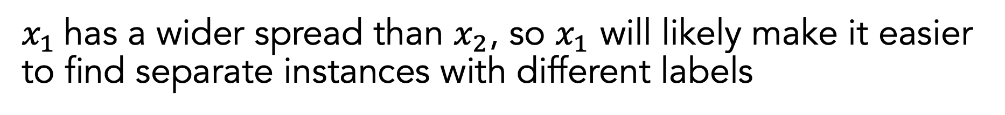

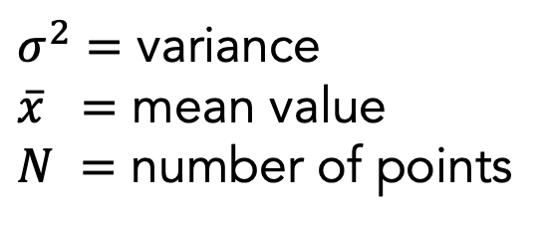
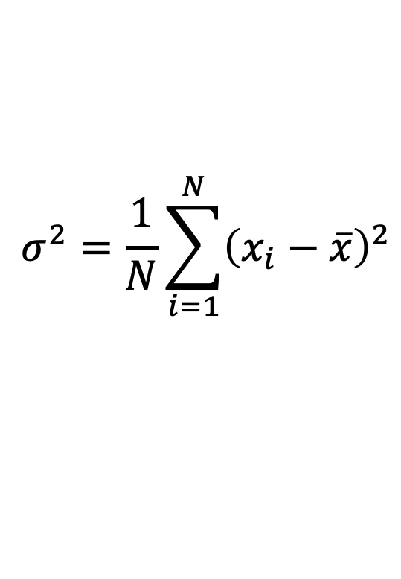

Example of Label-Agnostic Feature Selection: Variance Threshold
Only keep features that are spread apart (high variance) to keep the data as “unique” as possible
$$σ^{2}=\frac{1}{N}\sum_{i=1}^{N}{{\left(x_{i}−\overline{x}\right)}^{2}}$$
$$x_{2}$$
$σ^{2}=$ variance
$\overline{x} =$ mean value
$N =$ number of points
$$x_{1}$$
$x_{1}$has a wider spread than $x_{2}$, so $x_{1}$ will likely make it easier to find separate instances with different labels

Slide 27




Example of Label-Aware Feature Selection: Univariate Feature Selection
Performs statistical tests using one feature at a time and picks the ones that work best
good at separating labels
$$x_{2}$$
$$x_{2}$$
$$x_{1}$$
$$x_{1}$$
bad at separating labels

Slide 28
Step-By-Step Process for Machine Learning
Define the problem you are trying to solve
Create your features and labels
Decide how the data should be split for training and testing
(Optional) Add feature selection
(Optional) Balance your dataset
Select an appropriate model
(Optional) Select your hyperparameters
Train and test your model
Use an appropriate method for interpreting results

Slide 29
What Is Wrong with Imbalanced Data?
Imagine that we are trying to build a classifier for a rare disease and have a label distribution shown on the right
How should we feel about a model with 95% prediction accuracy?
We could just be predicting that everyone is healthy, and we would be correct most of the time

Slide 30
What Is Wrong with Imbalanced Data?
Balancing a dataset *can* help reduce biases towards a particular outcome, but…
Balancing a dataset is not always necessary and will not always improve performance
If one outcome is less common than the other, then maybe the model should learn that!
Depends on the importance of getting specific outcomes correct (e.g., cancer diagnosis)
Similar considerations should be considered with regression, only that there are many possible outcomes

Slide 31
Potential Solutions for Handling Imbalanced Data
Optimize our pipeline for an accuracy metric that accounts for data imbalance
I.e., if there are only a few positive samples, getting those samples correct should “mean more” when judging performance
Use models that allow you to consider more samples as “more important” than others
I.e., if there are only a few positive samples, those samples should “mean more” during model training
Manipulate our dataset so that it is balanced before model training and testing

Slide 32
How To Create A Balanced Dataset: Random Undersampling
Randomly remove samples from the majority class to make the number of samples in the majority class equal to the number of samples in the minority class
Pros: Relies solely on real data
Cons: Reduces the number of samples available for model training
Majority Class
Minority Class
# Healthy | # Sick
900 | 100
Original:
# Healthy | # Sick
900-800 = 100 | 100
New:

Slide 33
How To Create A Balanced Dataset: Random Oversampling
Randomly copy samples from the minority class to make the number of samples in the minority class equal to the number of samples in the majority class
Pros: Relies solely on real data; generates lots of samples for model training
Cons: Repeated samples may skew how the model learns
Majority Class
Minority Class
# Healthy | # Sick
900 | 100
Original:
# Healthy | # Sick
900 | 100×9 = 900
New:

Slide 34
How To Create A Balanced Dataset: Synthetic Minority Oversampling Technique (SMOTE)
Randomly create fake samples from the minority class to make the number of samples in the minority class equal to the number of samples in the majority class
Pros: Generates lots of samples for model training without repeats
Cons: Creates fake data that may not be realistic
Majority Class
Minority Class
# Healthy | # Sick
900 | 100
Original:
# Healthy | # Sick
900 | 100+800 = 900
New:

Slide 35
When Should We Balance The Dataset?
Undersampling can be done before or after splitting
We aren’t creating new data, so removing before or after splitting doesn’t matter
Oversampling should be done after splitting
We are using existing data to generate new data, and we should never look at our test split until the very end
If we replicate new data and then split, then copies of the same sample can be in both train and test

Slide 36
Step-By-Step Process for Machine Learning
Define the problem you are trying to solve
Create your features and labels
Decide how the data should be split for training and testing
(Optional) Add feature selection
(Optional) Balance your dataset
Select an appropriate model
(Optional) Select your hyperparameters
Train and test your model
Use an appropriate method for interpreting results

Slide 37
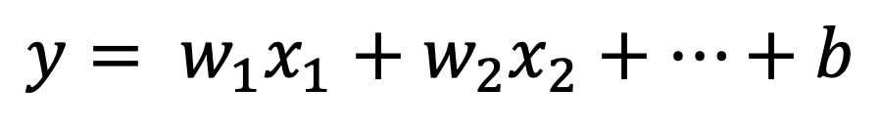
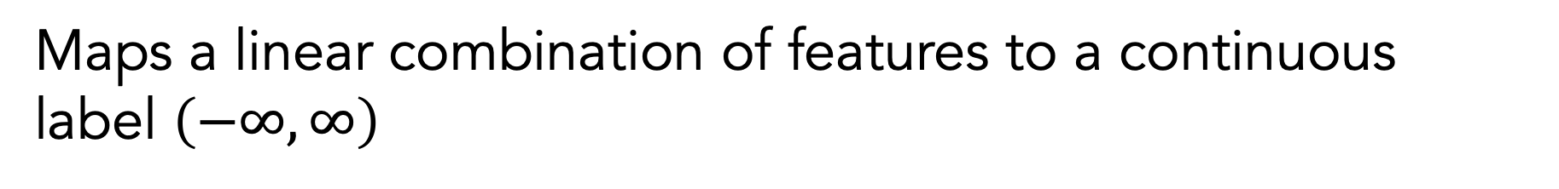


Regression: Linear Regression
Maps a linear combination of features to a continuous label $\left(−∞, ∞\right)$
$$y= w_{1}x_{1}+w_{2}x_{2}+…+b$$
$$f(x)$$
$$x$$

Slide 38
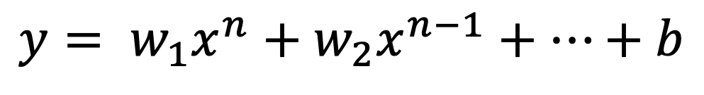
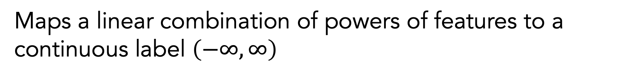


Regression: Polynomial Regression
Maps a linear combination of powers of features to a continuous label $\left(−∞, ∞\right)$
$$y= w_{1}x^{n}+w_{2}x^{n−1}+…+b$$
$$f(x)$$
$$x$$

Slide 39
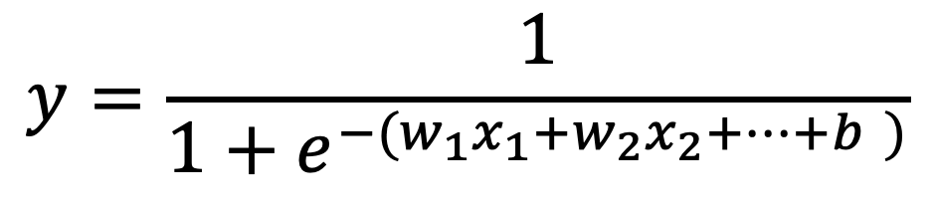
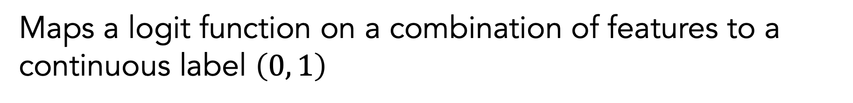

Regression: Logistic Regression
Maps a logit function on a combination of features to a continuous label $\left(0, 1\right)$
$$y=\frac{1}{1+e^{−(w_{1}x_{1}+w_{2}x_{2}+…+b )}}$$
$$f(x)$$
1
0
$$x$$

Slide 40
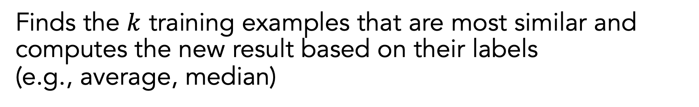



Regression: K-Nearest Neighbor
Finds the $k$ training examples that are most similar and computes the new result based on their labels (e.g., average, median)
$$f(x)$$
$$k=1$$
$$f(x)$$
$$k=3$$
$$x$$
$$x$$

Slide 41
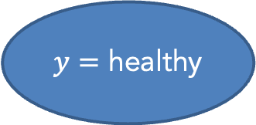
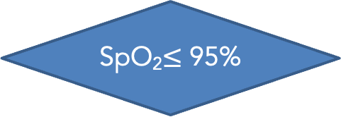
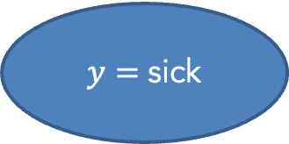
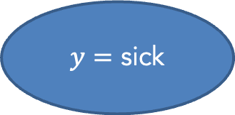
Classification: Decision Tree
Maps a combination of features to a class label based on a series of binary decisions
no
SpO₂$≤$ 95%
yes
Worsening cough?
yes
$y=$ sick
no
$y=$ healthy
$y=$ sick

Slide 42
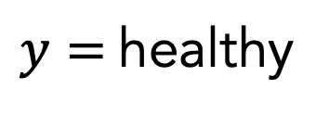
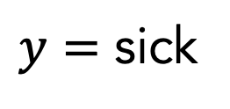
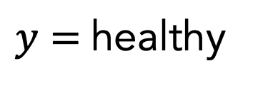
Classification: Random Forest
Uses a collection of decision trees (forest = multiple trees) to make a decision
$y=$healthy
$y=$ sick
𝑦 = healthy
$y=$healthy

Slide 43
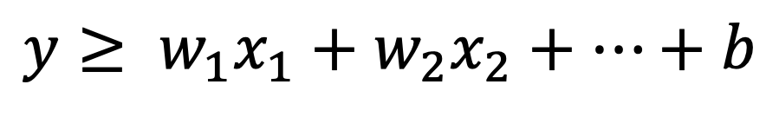
Classification: Support Vector Machine (SVM)
Separates two different classes with a hyperplane that maximizes the separation between the classes
$$y≥ w_{1}x_{1}+w_{2}x_{2}+…+b$$
$$x_{2}$$
“support vector”
$$x_{1}$$

Slide 44




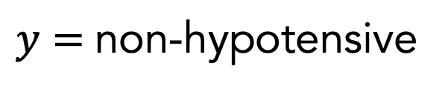

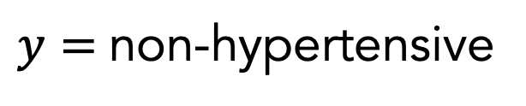
Classification: Support Vector Machine (SVM)
Can separate between multiple classes by combining the results of multiple one-versus-rest classifiers
$$x_{2}$$
$$x_{2}$$
$$x_{2}$$
$$x_{1}$$
$$x_{1}$$
$$x_{1}$$
Hypertensive vs. non-hypertensive
healthy vs. non-healthy
Hypotensive vs. non-hypotensive
$y=$non-hypertensive
$y=$healthy
$y=$non-hypotensive
$y=$healthy

Slide 45
Regression vs. Classification
Regression gives more information
Rather than knowing that two people are sick vs. not sick, it might be better to know how sick they are
Classification may be “easier” in some cases since there is less room for making mistakes
It might be easier to tell the difference between sick vs. not sick instead of a risk score

Slide 46
Step-By-Step Process for Machine Learning
Define the problem you are trying to solve
Create your features and labels
Decide how the data should be split for training and testing
(Optional) Add feature selection
(Optional) Balance your dataset
Select an appropriate model
(Optional) Select your hyperparameters
Train and test your model
Use an appropriate method for interpreting results

Slide 47
Hyperparameters
Hyperparameters are tunable parameters that are set before you train your model to control how it learns
We can learn the best settings for these values by doing a separate round of training with a validation split
Model | Examples of Hyperparameters
K-Nearest Neighbors | Number of neighbors: how many neighbors to use for calculation Radius of neighbors: the radius within which neighbors can be considered
Decision Tree | Max depth: how deep is the tree allowed to be Min samples for split: the minimum of samples required to justify a new decision

Slide 48
Why Care About Hyperparameters?
Machine learning is great because it can learn complex relationships that we can not readily identify ourselves
However, if we give the model too much flexibility, the model may learn complicated rules that neither make sense nor generalize well to unseen data

Slide 49
Step-By-Step Process for Machine Learning
Define the problem you are trying to solve
Create your features and labels
Decide how the data should be split for training and testing
(Optional) Add feature selection
(Optional) Balance your dataset
Select an appropriate model
(Optional) Select your hyperparameters
Train and test your model
Use an appropriate method for interpreting results

Slide 50
Training and Testing Your Model
You will train your model by only feeding in the features and labels in your training dataset
You can evaluate how well the model is working by feeding in only the features and comparing the model’s outputs to the known labels
Evaluating on training split: Accuracy should be very high (assuming the model learned anything) since the model has seen that data before
Evaluating on test split: Accuracy is a better indicator of real-world performance since the model hasn’t seen that data before

Slide 51
Overfitting
When we achieve high accuracy on the training split and low accuracy on the test split, then the model has failed to generalize to unseen data
We call this “overfitting"
There can be many causes of overfitting:
Not enough training data
Too many features to choose from
Too much flexibility in the model structure

Slide 52
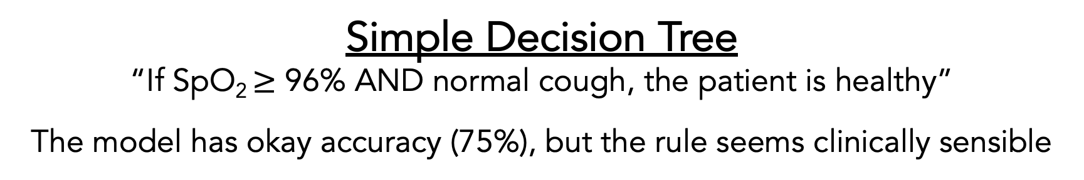
Overfitting
Classification
Healthy
Sick
Worsening
Cough status
Normal
92.5%
95%
97.5%
100%
SpO₂ (%)
Simple Decision Tree
“If SpO₂ $≥$ 96% AND normal cough, the patient is healthy”
The model has okay accuracy (75%), but the rule seems clinically sensible

Slide 53
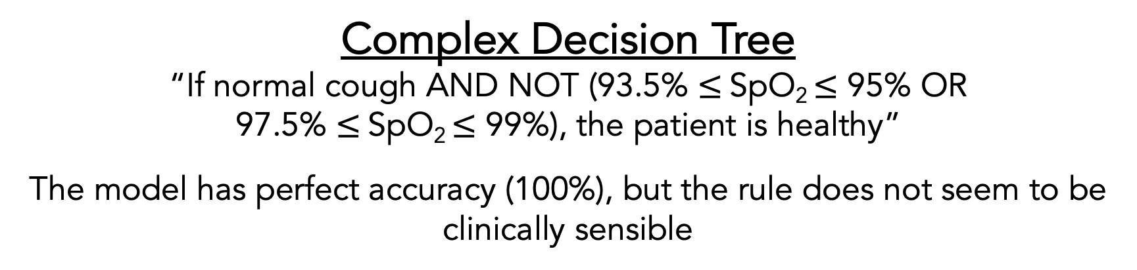
Overfitting
Classification
Healthy
Sick
Worsening
Cough status
Normal
92.5%
95%
97.5%
100%
SpO₂ (%)
Complex Decision Tree
“If normal cough AND NOT (93.5% $≤$SpO₂ $≤$ 95% OR 97.5% $≤$SpO₂ $≤$ 99%), the patient is healthy”
The model has perfect accuracy (100%), but the rule does not seem to be clinically sensible

Slide 54
Step-By-Step Process for Machine Learning
Define the problem you are trying to solve
Create your features and labels
Decide how the data should be split for training and testing
(Optional) Add feature selection
(Optional) Balance your dataset
Select an appropriate model
(Optional) Select your hyperparameters
Train and test your model
Use an appropriate method for interpreting results

Slide 55
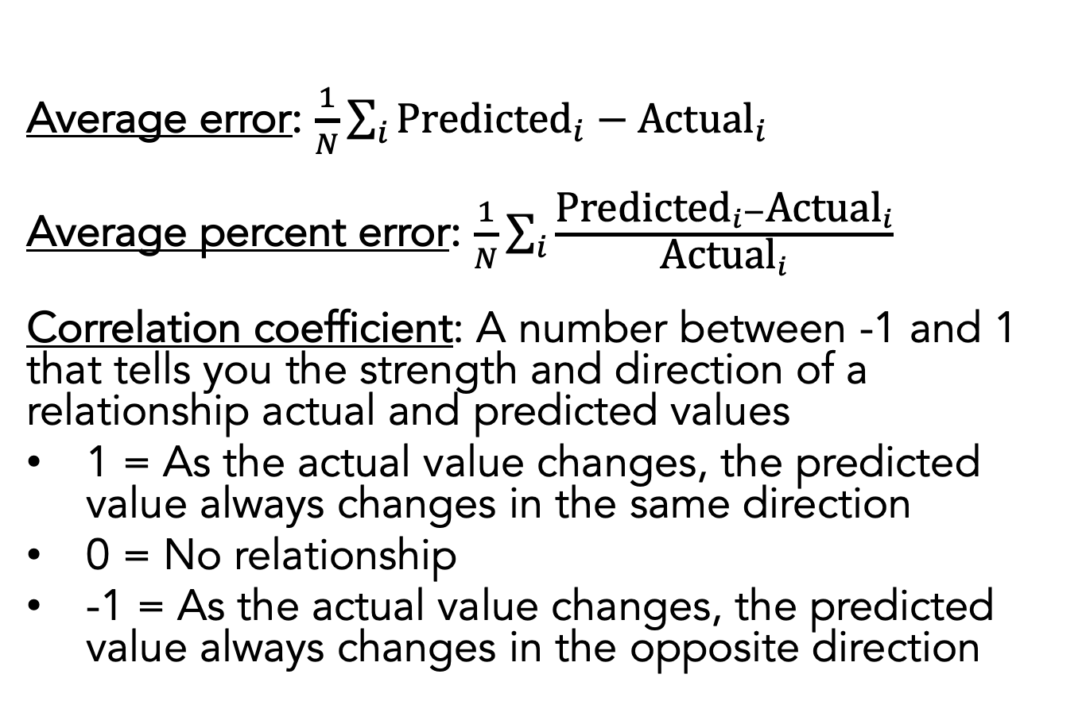
Regression Results
Average error: $\frac{1}{N}\sum_{i}{{\text{Predicted}}_{i}−{\text{Actual}}_{i}}$
Average percent error: $\frac{1}{N}\sum_{i}{\frac{{\text{Predicted}}_{i}−{\text{Actual}}_{i}}{{\text{Actual}}_{i}}}$
Correlation coefficient: A number between -1 and 1 that tells you the strength and direction of a relationship actual and predicted values
1 = As the actual value changes, the predicted value always changes in the same direction
0 = No relationship
-1 = As the actual value changes, the predicted value always changes in the opposite direction
Actual (days) | Predicted (days)
4 | 3
5 | 5
5 | 10
3 | 2
4 | 6

Slide 56
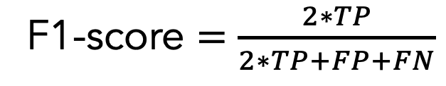
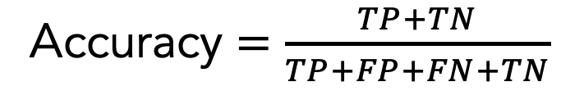
Binary Classification Results: Overall Performance
 |  | Actual Label
 |  | Positive | Negative
Predicted Label | Positive (sick) | True positive (TP) | False positive (FP)
 | Negative (healthy) | False negative (FN) | True negative (TN)
Confusion Matrix
Actual (diagnosis) | Predicted (diagnosis)
healthy | healthy
sick | healthy
sick | sick
sick | sick
healthy | sick
Accuracy $=\frac{TP+TN}{TP+FP+FN+TN}$
F1-score $=\frac{2∗TP}{2∗TP+FP+FN}$
F1-score is better suited for imbalanced datasets (i.e., significantly different numbers of positives and negatives)

Slide 57
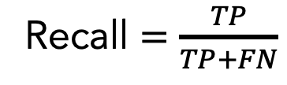
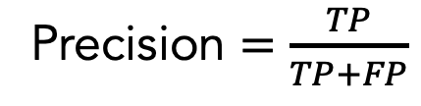
Binary Classification Results: Information Retrieval
 |  | Actual Label
 |  | Positive | Negative
Predicted Label | Positive (sick) | True positive (TP) | False positive (FP)
 | Negative (healthy) | False negative (FN) | True negative (TN)
Confusion Matrix
Actual (diagnosis) | Predicted (diagnosis)
healthy | healthy
sick | healthy
sick | sick
sick | sick
healthy | sick
Precision $=\frac{TP}{TP+FP}$
What fraction of items that were returned were relevant to my query?
Recall $=\frac{TP}{TP+FN}$
What fraction of items that were relevant to my query were returned?

Slide 58
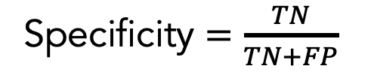
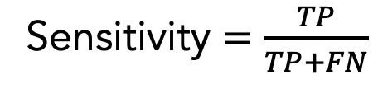
Binary Classification Results: Diagnostics
 |  | Actual Label
 |  | Positive | Negative
Predicted Label | Positive (sick) | True positive (TP) | False positive (FP)
 | Negative (healthy) | False negative (FN) | True negative (TN)
Confusion Matrix
Actual (diagnosis) | Predicted (diagnosis)
healthy | healthy
sick | healthy
sick | sick
sick | sick
healthy | sick
Sensitivity $=\frac{TP}{TP+FN}$
What fraction of people with the given health condition were given a positive test result?
Specificity $=\frac{TN}{TN+FP}$
What fraction of people without the given health condition were given a negative test result?

Slide 59
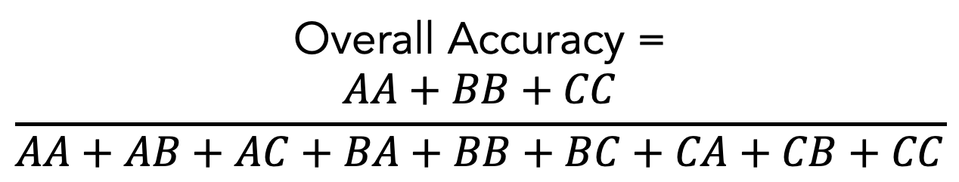
Multi-Class Classification Results: Overall Performance
 |  | Actual Label
 |  | Healthy | Hypotensive | Hypertensive
Predicted Label | Healthy | AA | AB | AC
 | Hypotensive | BA | BB | BC
 | Hypertensive | CA | CB | CC
Overall Accuracy =
$$\frac{AA+BB+CC}{AA+AB+AC+BA+BB+BC+CA+CB+CC}$$

Slide 60
Receiver Operating Characteristic (ROC) Curve
Shows how a classifier’s performance changes depending on its internal decision threshold
Area under the ROC Curve (AUROC) is an aggregate measure between 0 and 1 that reports summarizes model performance across all thresholds
B
Perfect (AUROC = 1)
Random chance (AUROC = 0.5)
True positive rate
Okay curve
A
A
Conservative threshold (lower recall, higher precision)
B
Liberal threshold (higher recall, lower precision)
False positive rate

Slide 61
Step-By-Step Process for Machine Learning
Define the problem you are trying to solve
Create your features and labels
Decide how the data should be split for training and testing
(Optional) Add feature selection
(Optional) Balance your dataset
Select an appropriate model
(Optional) Select your hyperparameters
Train and test your model
Use an appropriate method for interpreting results

Slide 62
Parting Words
We have covered a lot of concepts and terminology; don’t worry if it’s overwhelming
We will go over this step-by-step process over the next few sessions to see how it translates to code

Slide 63
Resources
Overviews of Machine Learning
“Glossary of Machine Learning Terms” | Google
Coding Examples
“Machine Learning Mastery” | Jason Brownlee

