Slide 1

Crash Course on Machine Learning
Alex Mariakakis
University of Toronto
Department of Computer Science

Slide 2
Outline
What is covered
What is not covered
High-level terms and definitions
Conceptual walkthrough of how to approach machine learning problems
Supervised machine learning on simple tabular data
Underlying math
Machine learning on sequences, images, and text
Unsupervised learning
Deep learning
Code examples
Scikit-learn for Python
Weka for Java

Slide 3
What Is Machine Learning?
Traditional Programming
Machine Learning
Inputs
Program
Inputs
Outputs
Outputs
Program
Machine learning learns programs from data!

Slide 4
Step-By-Step Process for Machine Learning
Define the problem you are trying to solve
Create your features and labels
Decide how the data should be split for training and testing
(Optional) Add feature selection
(Optional) Balance your dataset
Select an appropriate model
(Optional) Select your hyperparameters
Train and test your model
Use an appropriate method for interpreting results

Slide 5


Types of Learning
Supervised Learning
Unsupervised Learning
The goal is for the model to produce the desired output based on known examples with information about expected outcomes
The goal is for the model to extract meaningful trends or associations in the data without having access to the expected outcomes (or assuming they do not exist)
?
healthy
sick
Group 1
Group 2

Slide 6
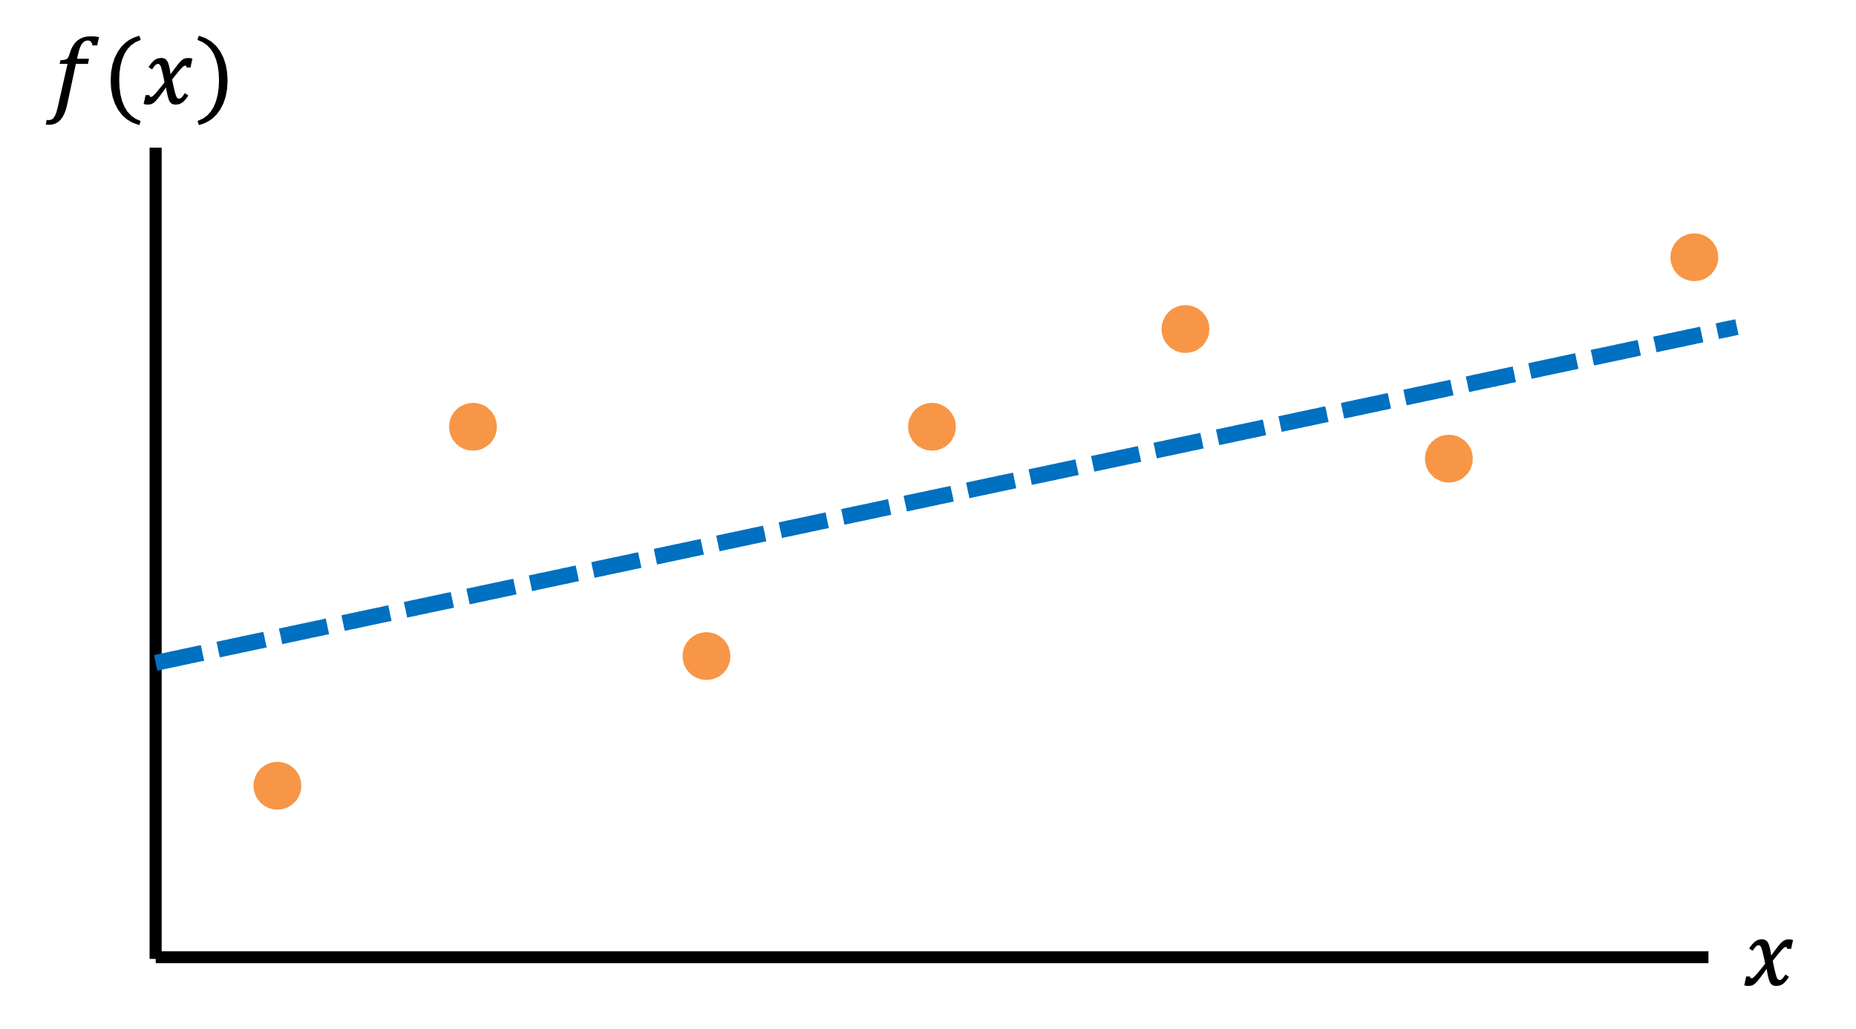
Types of Supervised Learning
Regression
Classification
Questions that can be answered with a continuous output
What will the patient’s heart rate be in one hour?
For how long will the patient experience symptoms?
Questions that can be answered with a categorical answer
Is this person sick or not?
Is this person going to become sick in the future?

Slide 7


Example of Unsupervised Learning
Clustering
$$x_{2}$$
Segregates the data into groups such that samples in the same group are more similar to other samples in the same group and dissimilar to samples in other groups
Since the clusters do not depend on outcomes of interest, the groups may or may not be related to meaningful distinctions in the data
$$x_{1}$$

Slide 8
What We Will Cover
We are going to focus on supervised learning, which means that we can assume that our data comes with the expected outcome for each data sample

Slide 9
Step-By-Step Process for Machine Learning
Define the problem you are trying to solve
Create your features and labels
Decide how the data should be split for training and testing
(Optional) Add feature selection
(Optional) Balance your dataset
Select an appropriate model
(Optional) Select your hyperparameters
Train and test your model
Use an appropriate method for interpreting results

Slide 10
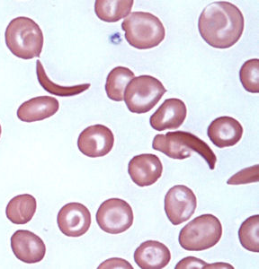
Feature Representations
Patient ID | Heart Rate | SpO₂ | Cough?
P01 | 60 | 97% | Yes
In the end, we want to work with tabular data
This is true for traditional machine learning; deep learning can handle raw time-series and images
We can use the techniques we have discussed to process data into tabular form
Clip ID | Loudness | Peak Freq
C01 | 60 dB | 200 Hz
Image ID | # Cells | # Sickles | Avg Hue
I01 | 60 | 5 | 54

Slide 11
What Does Our Data Look Like
Subject ID | Age | Heart Rate | Systolic Blood Pressure | Diastolic Blood Pressure | SpO₂ | Has Sepsis?
P01 | 34 | 77 | 117 | 72 | 100.0 | No
P02 | 78 | 87 | 163 | 79 | 95.9 | Yes
P03 | 57 | 66 | 144 | 81 | 97.6 | No
P04 | 23 | 93 | 167 | 94 | 94.0 | Yes
P05 | 81 | 90 | 123 | 86 | 99.7 | Yes
Samples
Identifying information that should not be used for learning
Features
Labels

Slide 12
What Does Our Data Look Like
Each feature can be thought of as a dimension of a new coordinate system that represents our data
Classification
Worsening
Healthy
Cough status
Sick
Normal
92.5%
95%
97.5%
100%
SpO₂ (%)

Slide 13
What Does Our Data Look Like
Each feature can be thought of as a dimension of a new coordinate system that represents our data
5
Regression
4
Data point
Days with Symptoms
3
2
1
92.5%
95%
97.5%
100%
SpO₂ (%)

Slide 14
Step-By-Step Process for Machine Learning
Define the problem you are trying to solve
Create your features and labels
Decide how the data should be split for training and testing
(Optional) Add feature selection
(Optional) Balance your dataset
Select an appropriate model
(Optional) Select your hyperparameters
Train and test your model
Use an appropriate method for interpreting results

Slide 15


Analogy To Human Learning
When you evaluate a model, it is important that you see how well it works on data it has never seen before
Poor evaluation of learning Taking a test after studying the answer key
Better evaluation of learning Taking a test after studying similar problems from homework

Slide 16
Splitting A Dataset
To evaluate how the model performs on ”unseen” data, we often partition our dataset into distinct splits
Train: Used to help the model learn how to set its internal parameters so that it can generate predictions
Test: Used to evaluate the trained model’s performance
(Optional) Validation: Used to tune hyperparameters (more on that later)
NEVER TRAIN A MODEL ON THE TEST DATA!

Slide 17
Standard Methods of Dataset Splitting
The amount of training data should be significantly higher than the amount of validation and/or testing data
These are three standard methods without a validation split (which can often be just taken from the train set)
Single Split: Generate a single partition (e.g., 80% train & 20% test)
N-Fold Cross-Validation: Split the data into N equal partitions, train one model with each partition as the test set, and then average the results
Leave-One-Out Cross-Validation: Similar to N-Fold cross-validation, but the splits correspond to an important aspect of the dataset (e.g., N = number of users)
A
B
C
Fold 1:
A
B
C
Fold 2:
A
B
C
Fold 3:
Train
Test

Slide 18
Picking a Dataset Splitting Approach
Single Train-Test Split
Cross-Validation
Trains and evaluates a single model, which is conceptually straightforward
Only evaluates the model on a small subset of the data
You may have 100 patients in your dataset, but you will have only tested on 20 of them
Good for massive datasets (>1k samples) since the splits are likely to be comprehensive
Necessary when cross-validation is intractable due to computational limitations
Allows you to evaluate your “modeling approach” on your entire dataset
Generates multiple models that may learn different things
The model for predicting on Fold 1 may prioritize vital signs, while the model for predicting on Fold 2 may prioritize symptom reports
If your dataset is big enough, it would hopefully learn the same things across folds
Good for leveraging your full dataset
If you want to understand the importance of features after cross-validation: You can look at the average feature importance across folds (we will discuss this in a future session)
If you want to deploy a single model after cross-validation: You can train on the entire dataset

Slide 19
Picking a Dataset Splitting Approach
Pick the right training method to answer your question
Generalizing across individuals: If you want to show that your approach works on patients who have never been seen by the model, then you should make sure that no individuals appear in both the train and test sets
Person-specific calibration: If you think that personalized models are needed for each person, then you should split each patient’s data into train and test sets and build individual models

Slide 20
Step-By-Step Process for Machine Learning
Define the problem you are trying to solve
Create your features and labels
Decide how the data should be split for training and testing
(Optional) Add feature selection
(Optional) Balance your dataset
Select an appropriate model
(Optional) Select your hyperparameters
Train and test your model
Use an appropriate method for interpreting results

Slide 21
Why Use Feature Selection?
The more features we use, the higher the likelihood that we can successfully solve our problem
However, if we use too many features, the model may learn complicated rules that neither make sense nor generalize well to unseen data
This tradeoff is known as the “curse of dimensionality”

Slide 22
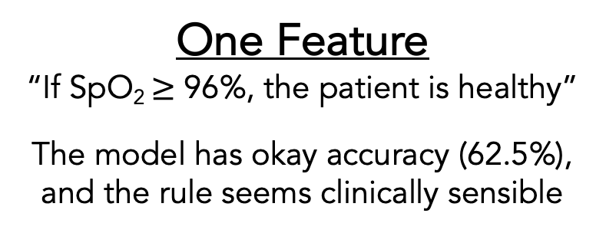
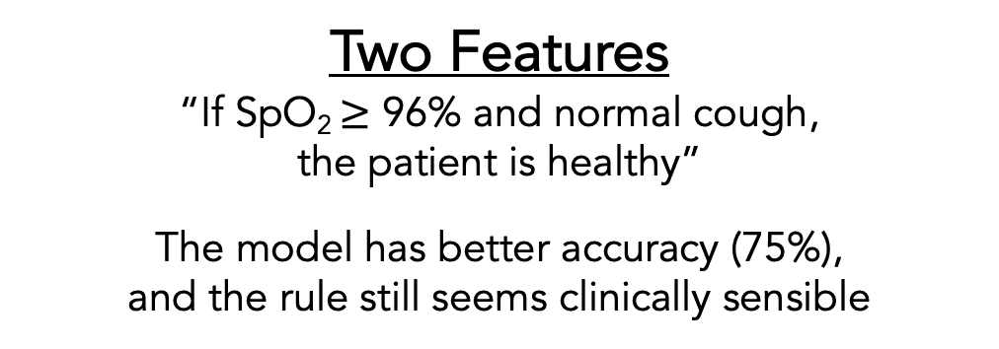
Why Use Feature Selection?
Classification
Healthy
Sick
Worsening
Cough status
Normal
92.5%
95%
97.5%
100%
92.5%
95%
97.5%
100%
SpO₂ (%)
SpO₂ (%)
One Feature
“If SpO₂ $≥$ 96%, the patient is healthy”
The model has okay accuracy (62.5%), and the rule seems clinically sensible
Two Features
“If SpO₂ $≥$ 96% and normal cough, the patient is healthy”
The model has better accuracy (75%), and the rule still seems clinically sensible

Slide 23
Why Use Feature Selection?
Classification
Healthy
Sick
Worsening
1
2
9
Number in yellow: last digit of SIN
Cough status
Normal
4
3
2
7
6
92.5%
95%
97.5%
100%
SpO₂ (%)
Three Features
“If normal cough AND last digit of SIN is even, the patient is healthy”
The model has perfect accuracy (100%), but it took advantage of a random feature to make a rule that does not seem to be clinically sensible

Slide 24
How to Select the Best Features
You can use domain expertise to ignore features that do not make sense
There are also techniques you can use to automatically pick the features that are likely to be the most “mathematically interesting”
Some techniques care about the labels, while others just care about properties of the data itself

Slide 25
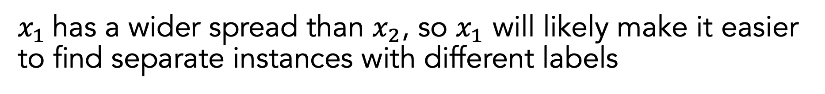

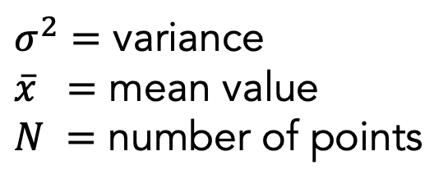
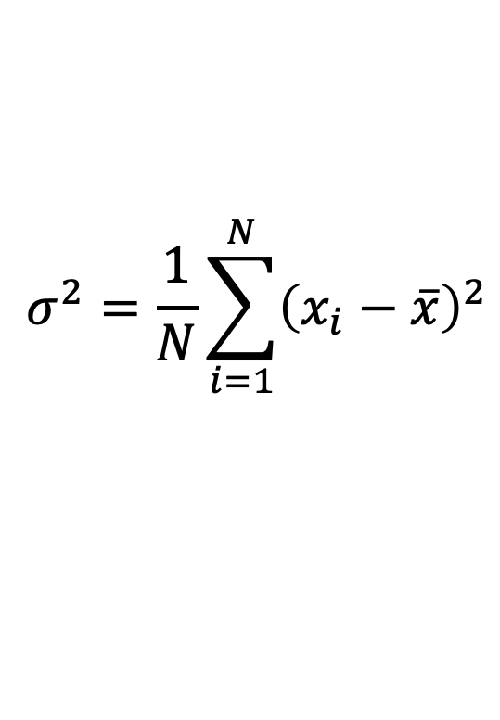

Example of Label-Agnostic Feature Selection: Variance Threshold
Only keep features that are spread apart (high variance) to keep the data as “unique” as possible
$$σ^{2}=\frac{1}{N}\sum_{i=1}^{N}{{\left(x_{i}−\overline{x}\right)}^{2}}$$
$$x_{2}$$
$σ^{2}=$ variance
$\overline{x} =$ mean value
$N =$ number of points
$$x_{1}$$
$x_{1}$has a wider spread than $x_{2}$, so $x_{1}$ will likely make it easier to find separate instances with different labels

Slide 26




Example of Label-Aware Feature Selection: Univariate Feature Selection
Performs statistical tests using one feature at a time and picks the ones that work best
good at separating labels
$$x_{2}$$
$$x_{2}$$
$$x_{1}$$
$$x_{1}$$
bad at separating labels

Slide 27
Step-By-Step Process for Machine Learning
Define the problem you are trying to solve
Create your features and labels
Decide how the data should be split for training and testing
(Optional) Add feature selection
(Optional) Balance your dataset
Select an appropriate model
(Optional) Select your hyperparameters
Train and test your model
Use an appropriate method for interpreting results

Slide 28
What Is Wrong with Imbalanced Data?
Imagine that we are trying to build a classifier for a rare disease and have a label distribution shown on the right
How should we feel about a model with 95% prediction accuracy?
We could just be predicting that everyone is healthy, and we would be correct most of the time
Similar considerations should be considered with regression, only that there are many possible outcomes

Slide 29
Potential Solutions for Handling Imbalanced Data
Optimize our pipeline for an accuracy metric that accounts for data imbalance
I.e., if there are only a few positive samples, getting those samples correct should “mean more” when judging performance
Use models that allow you to consider some samples as “more important” than others
I.e., if there are only a few positive samples, those samples should “mean more” during model training
Manipulate our dataset so that it is balanced for model training (not testing)

Slide 30
How To Create A Balanced Dataset: Random Undersampling
Randomly remove samples from the majority class to make the number of samples in the majority class equal to the number of samples in the minority class
Pros: Relies solely on real data
Cons: Reduces the number of samples available for model training
Majority Class
Minority Class
# Healthy | # Sick
900 | 100
Original:
# Healthy | # Sick
900-800 = 100 | 100
New:

Slide 31
How To Create A Balanced Dataset: Random Oversampling
Randomly copy samples from the minority class to make the number of samples in the minority class equal to the number of samples in the majority class
Pros: Relies solely on real data; generates lots of samples for model training
Cons: Repeated samples may skew how the model learns
Majority Class
Minority Class
# Healthy | # Sick
900 | 100
Original:
# Healthy | # Sick
900 | 100×9 = 900
New:

Slide 32
How To Create A Balanced Dataset: Synthetic Minority Oversampling Technique (SMOTE)
Randomly create fake samples from the minority class to make the number of samples in the minority class equal to the number of samples in the majority class
Pros: Generates lots of samples for model training without repeats
Cons: Creates fake data that may not be realistic
Majority Class
Minority Class
# Healthy | # Sick
900 | 100
Original:
# Healthy | # Sick
900 | 100+800 = 900
New:

Slide 33
How Balanced Should The Dataset Be?
There is no rule of thumb, but be reasonable
If most of your data is synthetic, then you aren’t learning from real data
If you remove too much data, your claims about performance will be weaker
Many people use undersampling + oversampling to achieve a happy middle-ground
Pay attention to the balance of all dataset splits
If your train split only includes healthy patients and your test split only includes sick patients, then you will get bad performance
This problem becomes more apparent as your dataset and splits become smaller

Slide 34
When Should We Balance The Dataset?
Undersampling can be done before or after splitting
We aren’t creating new data, so removing before or after splitting doesn’t matter
Synthetic oversampling should be done after splitting
We are using existing data to generate new data, and we should never look at our test split until the very end
If we replicate new data and then split, then copies of the same sample can be in both train and test

Slide 35
Step-By-Step Process for Machine Learning
Define the problem you are trying to solve
Create your features and labels
Decide how the data should be split for training and testing
(Optional) Add feature selection
(Optional) Balance your dataset
Select an appropriate model
(Optional) Select your hyperparameters
Train and test your model
Use an appropriate method for interpreting results

Slide 36
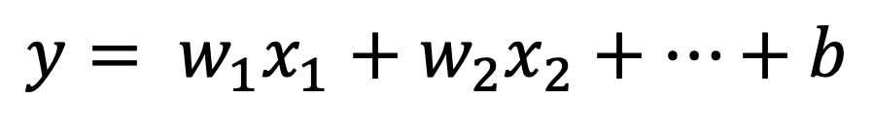
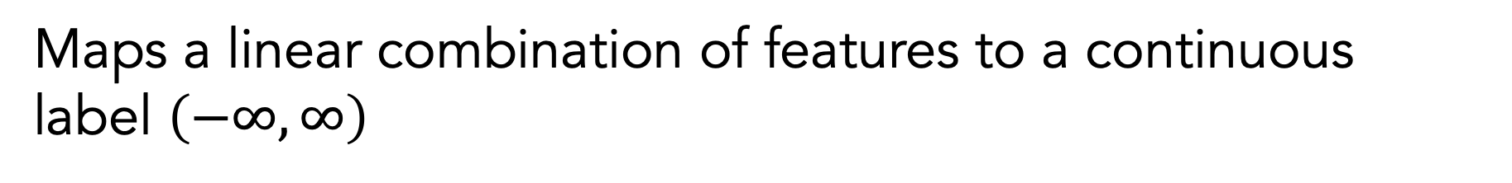


Regression: Linear Regression
Maps a linear combination of features to a continuous label $\left(−∞, ∞\right)$
$$y= w_{1}x_{1}+w_{2}x_{2}+…+b$$
$$f(x)$$
$$x$$

Slide 37
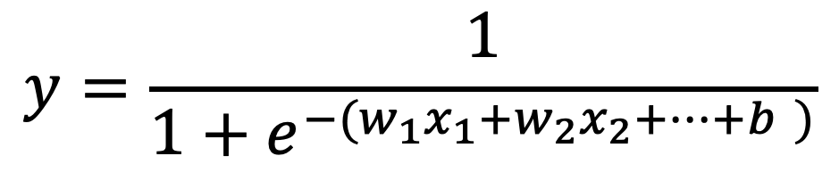
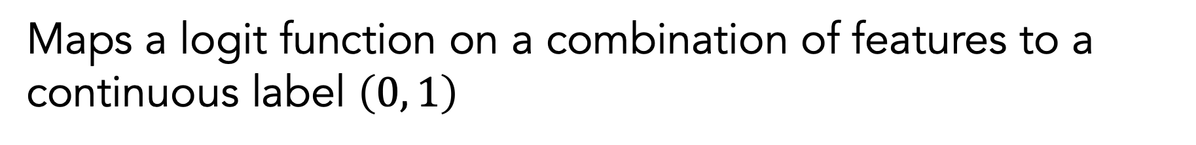

Regression: Logistic Regression
Maps a logit function on a combination of features to a continuous label $\left(0, 1\right)$
$$y=\frac{1}{1+e^{−(w_{1}x_{1}+w_{2}x_{2}+…+b )}}$$
$$f(x)$$
1
0
$$x$$

Slide 38

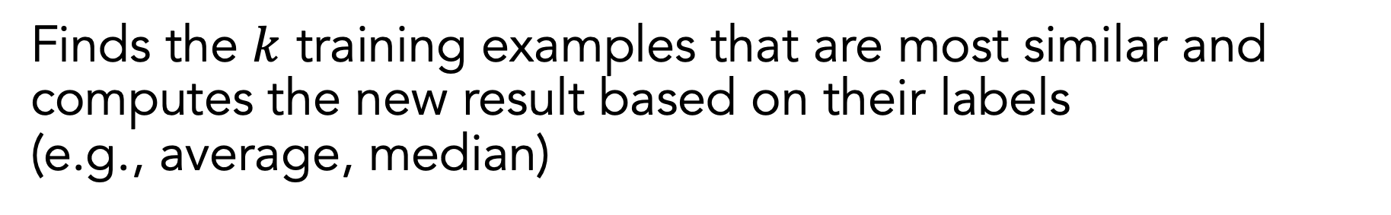



Regression: K-Nearest Neighbor
Finds the $k$ training examples that are most similar and computes the new result based on their labels (e.g., average, median)
$$f(x)$$
$$k=1$$
$$f(x)$$
$$k=3$$
$$x$$
$$x$$

Slide 39
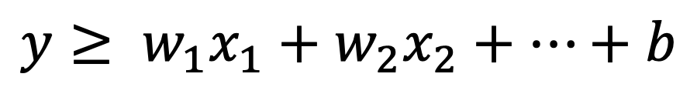
Classification: Support Vector Machine (SVM)
Separates two different classes with a hyperplane that maximizes the separation between the classes
$$y≥ w_{1}x_{1}+w_{2}x_{2}+…+b$$
$$x_{2}$$
“support vector”
$$x_{1}$$

Slide 40




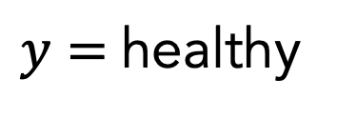
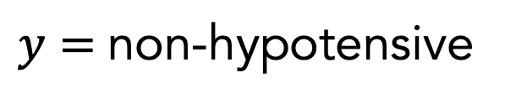

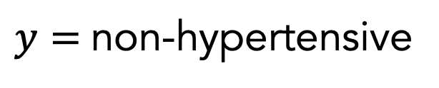
Classification: Support Vector Machine (SVM)
Can separate between multiple classes by combining the results of multiple one-versus-rest classifiers
$$x_{2}$$
$$x_{2}$$
$$x_{2}$$
$$x_{1}$$
$$x_{1}$$
$$x_{1}$$
Hypertensive vs. non-hypertensive
healthy vs. non-healthy
Hypotensive vs. non-hypotensive
$y=$non-hypertensive
$y=$healthy
$y=$non-hypotensive
$y=$healthy

Slide 41
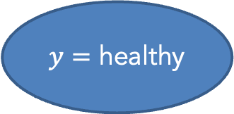
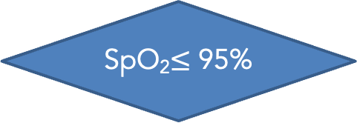
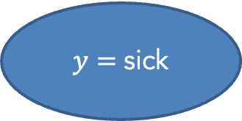
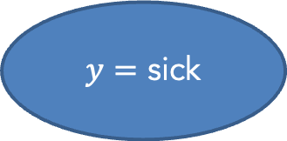
Classification: Decision Tree
Maps a combination of features to a class label based on a series of binary decisions
no
SpO₂$≤$ 95%
yes
Worsening cough?
yes
$y=$ sick
no
$y=$ healthy
$y=$ sick

Slide 42
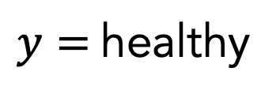
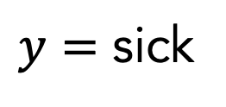
Classification: Random Forest
Uses a collection of decision trees (forest = multiple trees) to make a decision
$y=$healthy
$y=$ sick
𝑦 = healthy
$y=$healthy

Slide 43
Missing Data
Most of these architectures only work when you have values for all of the features
You can fill in the blanks using imputation techniques:
Technique | Note
Placeholder value (e.g., 0, -999) | Not a good idea for models that cannot distinguish between real and fake data
Mean / median | Pretty limited in the level of accuracy that can be achieved since it only cares about one feature at a time
Nearest neighbor | Requires training and tuning a special model for filling in data based on other examples
Data-driven imputation should only be informed by the training dataset

Slide 44
Step-By-Step Process for Machine Learning
Define the problem you are trying to solve
Create your features and labels
Decide how the data should be split for training and testing
(Optional) Add feature selection
(Optional) Balance your dataset
Select an appropriate model
(Optional) Select your hyperparameters
Train and test your model
Use an appropriate method for interpreting results

Slide 45
Hyperparameters
Hyperparameters are tunable parameters that are set before you train your model to control how it learns
Model | Examples of Hyperparameters
K-Nearest Neighbors | Number of neighbors: how many neighbors to use for calculation Radius of neighbors: the radius within which neighbors can be considered
Decision Tree | Max depth: how deep is the tree allowed to be Min samples for split: the minimum of samples required to justify a new decision

Slide 46
Setting Hyperparameters
Models often have more hyperparameters than worth exploring
In most software libraries, they are usually ordered by importance, and you can look at code examples to see the ones that people tweak
There are a few ways you can approach hyperparameters:
Specify required hyperparameters and assume the default settings for the rest
Train models with different hyperparameter values and see what works on the test set *
Use a validation set to identify the optimal hyperparameters before doing the final training and testing
* This is technically cheating because you are looking at the test data to inform your model performance, but this is common nonetheless

Slide 47
Step-By-Step Process for Machine Learning
Define the problem you are trying to solve
Create your features and labels
Decide how the data should be split for training and testing
(Optional) Add feature selection
(Optional) Balance your dataset
Select an appropriate model
(Optional) Select your hyperparameters
Train and test your model
Use an appropriate method for interpreting results

Slide 48
Training and Testing Your Model
You will train your model by only feeding in the features and labels in your training dataset
You can evaluate how well the model is working by feeding in only the features and comparing the model’s outputs to the known labels
Evaluating on training split: Accuracy should be very high (assuming the model learned anything) since the model has seen that data before
Evaluating on test split: Accuracy is a better indicator of real-world performance since the model hasn’t seen that data before

Slide 49
Overfitting
When we achieve high accuracy on the training split and low accuracy on the test split, then the model has failed to generalize to unseen data
There can be many causes of overfitting:
Not enough representative training data
Too many features to choose from
Too much flexibility in the model structure

Slide 50


Overfitting: Not Enough Representative Training Data
If your training data is biased, it probably will not predict well on test data that goes against that bias
$$y$$
Limited guarantees on model performance
Region where model should work best
No guarantees on model performance
$$x$$

Slide 51
Overfitting: Too Many Features
Classification
Healthy
Sick
Worsening
1
2
9
Number in yellow: last digit of SIN
Cough status
Normal
4
3
2
7
6
92.5%
95%
97.5%
100%
SpO₂ (%)
Three Features
“If normal cough AND last digit of SIN is even, the patient is healthy”
The model has perfect accuracy (100%), but it took advantage of a random feature to make a rule that does not seem to be clinically sensible

Slide 52
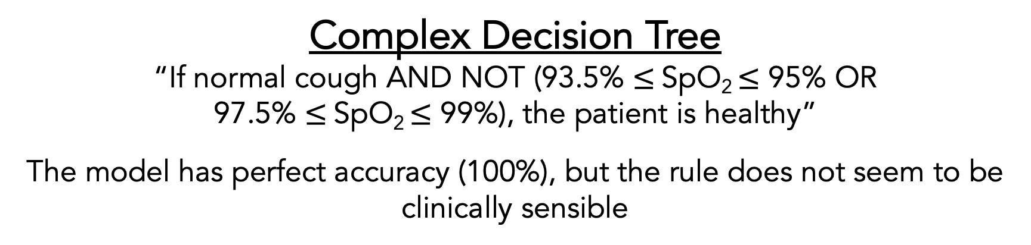
Overfitting: Too Much Model Flexibility
Classification
Healthy
Sick
Worsening
Cough status
Normal
92.5%
95%
97.5%
100%
SpO₂ (%)
Complex Decision Tree
“If normal cough AND NOT (93.5% $≤$SpO₂ $≤$ 95% OR 97.5% $≤$SpO₂ $≤$ 99%), the patient is healthy”
The model has perfect accuracy (100%), but the rule does not seem to be clinically sensible

Slide 53
Step-By-Step Process for Machine Learning
Define the problem you are trying to solve
Create your features and labels
Decide how the data should be split for training and testing
(Optional) Add feature selection
(Optional) Balance your dataset
Select an appropriate model
(Optional) Select your hyperparameters
Train and test your model
Use an appropriate method for interpreting results

Slide 54
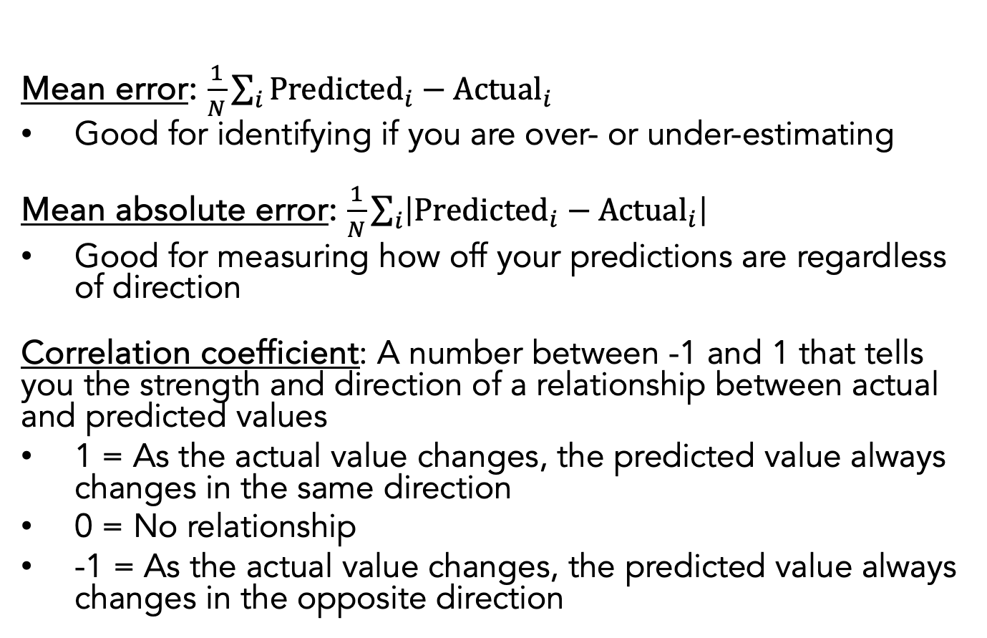
Regression Results
Mean error: $\frac{1}{N}\sum_{i}{{\text{Predicted}}_{i}−{\text{Actual}}_{i}}$
Good for identifying if you are over- or under-estimating
Mean absolute error: $\frac{1}{N}\sum_{i}{\left|{\text{Predicted}}_{i}−{\text{Actual}}_{i}\right|}$
Good for measuring how off your predictions are regardless of direction
Correlation coefficient: A number between -1 and 1 that tells you the strength and direction of a relationship between actual and predicted values
1 = As the actual value changes, the predicted value always changes in the same direction
0 = No relationship
-1 = As the actual value changes, the predicted value always changes in the opposite direction
Actual (days) | Predicted (days)
4 | 3
5 | 5
5 | 10
3 | 2
4 | 6

Slide 55
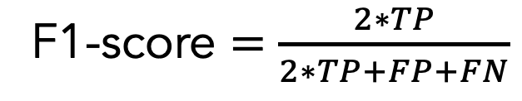
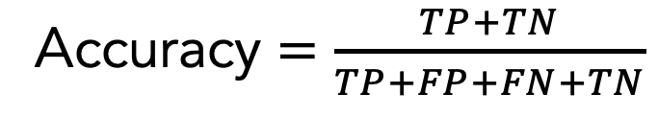
Binary Classification Results: Overall Performance
 |  | Actual Label
 |  | Positive | Negative
Predicted Label | Positive (sick) | True positive (TP) | False positive (FP)
 | Negative (healthy) | False negative (FN) | True negative (TN)
Confusion Matrix
Actual (diagnosis) | Predicted (diagnosis)
healthy | healthy
sick | healthy
sick | sick
sick | sick
healthy | sick
Accuracy $=\frac{TP+TN}{TP+FP+FN+TN}$
F1-score $=\frac{2∗TP}{2∗TP+FP+FN}$
F1-score is better suited for imbalanced datasets (i.e., significantly different numbers of positives and negatives)

Slide 56
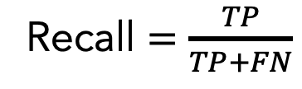
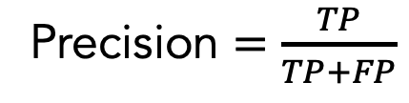
Binary Classification Results: Information Retrieval
 |  | Actual Label
 |  | Positive | Negative
Predicted Label | Positive (sick) | True positive (TP) | False positive (FP)
 | Negative (healthy) | False negative (FN) | True negative (TN)
Confusion Matrix
Actual (diagnosis) | Predicted (diagnosis)
healthy | healthy
sick | healthy
sick | sick
sick | sick
healthy | sick
Precision $=\frac{TP}{TP+FP}$
What fraction of items that were returned were relevant to my query?
Recall $=\frac{TP}{TP+FN}$
What fraction of items that were relevant to my query were returned?

Slide 57
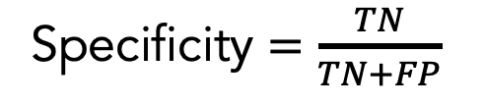
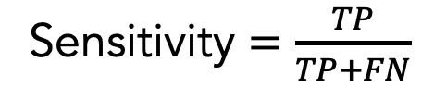
Binary Classification Results: Diagnostics
 |  | Actual Label
 |  | Positive | Negative
Predicted Label | Positive (sick) | True positive (TP) | False positive (FP)
 | Negative (healthy) | False negative (FN) | True negative (TN)
Confusion Matrix
Actual (diagnosis) | Predicted (diagnosis)
healthy | healthy
sick | healthy
sick | sick
sick | sick
healthy | sick
Sensitivity $=\frac{TP}{TP+FN}$
What fraction of people with the given health condition were given a positive test result?
Specificity $=\frac{TN}{TN+FP}$
What fraction of people without the given health condition were given a negative test result?

Slide 58
Multi-Class Classification Results: Overall Performance
 |  | Actual Label
 |  | Healthy | Hypotensive | Hypertensive
Predicted Label | Healthy | AA | AB | AC
 | Hypotensive | BA | BB | BC
 | Hypertensive | CA | CB | CC
Overall Accuracy = $\frac{AA+BB+CC}{AA+AB+AC+BA+BB+BC+CA+CB+CC}$

Slide 59
Receiver Operating Characteristic (ROC) Curve
Shows how a classifier’s performance changes depending on its internal decision threshold
Area under the ROC Curve (AUROC) is an aggregate measure between 0 and 1 that reports summarizes model performance across all thresholds
B
A
Conservative threshold (lower recall, higher precision)
B
Liberal threshold (higher recall, lower precision)
True positive rate
A
Perfect (AUROC = 1)
Random chance (AUROC = 0.5)
Okay curve
False positive rate

Slide 60
Step-By-Step Process for Machine Learning
Define the problem you are trying to solve
Create your features and labels
Decide how the data should be split for training and testing
(Optional) Add feature selection
(Optional) Balance your dataset
Select an appropriate model
(Optional) Select your hyperparameters
Train and test your model
Use an appropriate method for interpreting results

Slide 61
Notes On Data Quantity
There is no notion of a “power analysis” for machine learning
The amount of data needed to train a machine learning model depends on many factors, including...
Problem complexity
Data quality
Number of features
Representation of outcomes
Model architecture

Slide 62
Notes On Data Quantity
Some people say that you should have at least 10 times the number of samples as you do “degrees of freedom” in your model (e.g., linear regression coefficients, decisions tree branches)
Traditional machine learning models: Hundreds of samples
Deep learning models: Thousands of samples
Simple models on large datasets often outperform complex models on small datasets
Testing on unseen data will tell you a lot about whether your model has enough data to learn generalizable information

Slide 63
Parting Words
We have covered a lot of concepts and terminology; don’t worry if it’s overwhelming
We will go over this step-by-step process over the next few sessions to see how it translates to code

Slide 64
Resources
Overviews of Machine Learning
“Glossary of Machine Learning Terms” | Google
Coding Examples
“Machine Learning Mastery” | Jason Brownlee

