Slide 1
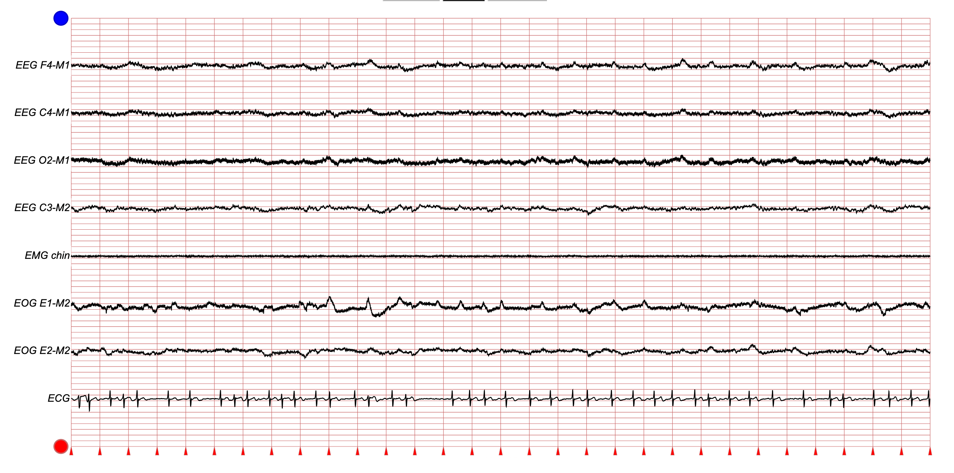
Sleep Stage
W
W
N1
N1
N2
00:00
00:30
01:00
01:30
02:00
Time (min)

