Slide 1

Computing for Medicine: Phase 3, Seminar 5 Project
Jennifer Campbell
Associate Professor, Teaching Stream
c4m@cs.toronto.edu

Slide 2
Seminar 5 Project
The project handout is posted:
http://c4m.cdf.toronto.edu/cohort2/phase3/
Two approaches for doing your work:
Use the Computer Science Teaching Labs computing network.
Use your personal computer.
Python’s requests module
pip3 install requests

Slide 3
Overview
Notes:
-

Slide 4
Starter code and data
Starter code:
phenotips_project.py (TODOs)
ontology_parser.py (complete)
ontology_explorer.py (TODOs)
Data:
hp.obo (Human phenotype ontology)

Slide 5
Your tasks
0) Explore PhenoTips using your web browser.
Write a program to interact with PhenoTips.
Write a program to get information about the Human Phenotype Ontology (HPO).
Q&A: revisiting design decisions; more exploration

Slide 6
Programming concepts
Notes:
-

Slide 7
Type set
Python sets are unordered collections of unique immutable objects.
https://docs.python.org/3/library/stdtypes.html#set
s = set() # an empty set
s.add(1)
s.add(2)
s2 = set([1, 2, 3, 4]) # new set with 4 items
s2.add(3) # 3 already in s2, so s2 is unchanged
Note: using type set is not a requirement, but you may find it helpful.

Slide 8
Assigning parameters default values
For certain functions, including range and print, the number of arguments that you pass to them can vary.
For example:
print(‘hello’)
print(1, 2, 3)
print(‘a’, ‘b’, ‘c’, end=’xyz')
print(1, 2, 3, sep='..', end='!')
Demo: default_parameters.py

Slide 9
Recursion
To solve a problem, identify how it can be broken down into smaller instances with the same structure.
A recursive function is a function that calls itself.
Any problem that we can solve with recursion can be solved with iteration (loops) and vice versa.
Some problems have simple recursive solutions and complex iterative solutions.
Demo:
Searching a list; reversing a list
Resources:
http://www.cdf.toronto.edu/~csc148h/fall/lectures/recursion/common/recursion.html
http://www.cdf.toronto.edu/~csc148h/fall/lectures/recursion/diane/Recursion-wrapup.pdf

Slide 10
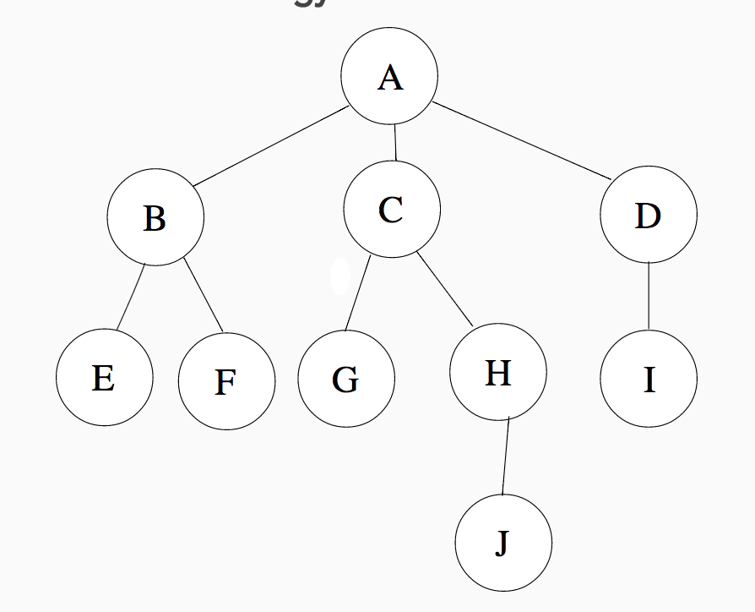
Trees
http://www.cdf.toronto.edu/~csc148h/fall/lectures/trees/common/trees.html
Trees can represent data that
has a hierarchical structure.
A, B, C … J are nodes.
A is the root of the tree.
A is the parent of B, C, D.
B, C, D are children of A.
E, F, G, J, I are leaf nodes (nodes with no children).

Slide 11
More recursion: getting leaf nodes
Demo:
tree_recursive.py
tree =
{'A': ['B', 'C', 'D'],
'B': ['E', 'F'],
'C': ['G', 'H'],
'H': ['J'],
'D': ['I']}

Slide 12
Starter code: class Ontology
You already know how to use Python’s classes (e.g., str and list) and methods (e.g., str.startswith and list.append).
In ontology_parser.py , a class named Ontology is defined.
For this project, you will use class Ontology and call on its methods.
You do not need to know how to define classes to complete this project. However, if you would like to learn more about object-oriented programming, you may find these videos helpful.

Slide 13
Ontology representation
The starter code produces two dictionaries to represent the human phenotype ontology:
pid_to_name: each key is an ID for a phenotypic feature and each value is its name
pid_to_parents: each key is an ID for a phenotypic feature and each value is a list of its parent IDs

Slide 14
Example
Phenotypic abnormality
0000118
Abnormality of
the immune system
0002715
Abnormality of blood
and blood-forming tissues
0001871
Abnormality of cellular
immune system
0010987
{'0004332': ['0001881'],
'0001881': ['0010987','0001871'],
'0010987': ['0002715'],
'0001871': ['0000118'],
'0002715': ['0000118']}
Abnormality of leukocytes
0001881
Abnormality of lymphocytes
0004332
Notes:
This is a directed, acyclic graph. Unlike trees, children can have more than one parent.

Slide 15
Tips
Test your code as you write it, a little bit at a time.
Use the Wing debugger, especially when implementing recursive code.
The Ontology class represents the HPO using a dictionary that maps a child node to its parents, unlike the tree dictionary which mapped a parent to its children. If you prefer to have the opposite, you can write a helper function to invert the dictionary.

Slide 16
Feedback
Notes:
-

