Slide 1

Computing for Medicine: Phase 3, Seminar 1 Project
Jennifer Campbell
Associate Professor, Teaching Stream
campbell@cs.toronto.edu

Slide 2
Seminar 1 Project
The project handout, starter code, and data are posted:
http://http//c4m.cdf.toronto.edu/cohort2/phase3/
Two options for doing your work:
Use the Computer Science Teaching Labs computing network from your computer (internet connection required).
Use only your computer.

Slide 3
WORKING ON CS TEACHING LABs NETWORK

Slide 4
CS Teaching Labs Account
Information you will need:
Username: your UTORid
Password: See email “C4M: Phase 3 account information” for your temporary password.
Key: For the cdf_nx_key.key file, see:
http://www.teach.cs.toronto.edu/using_cdf/remote_access_server.html

Slide 5
Connecting to CS Teaching Labs
To connect to the CS Teaching Labs from your computer, please follow the instructions here:
http://www.teach.cs.toronto.edu/using_cdf/remote_access_server.html
Notes:
http://computing.help.inf.ed.ac.uk/nomachine
Name: CS Teaching Labs
Host: nxsrv1.cdf.toronto.edu
Protocol: SSH
Port: 22
Key: use the file sent to you by email

Slide 6
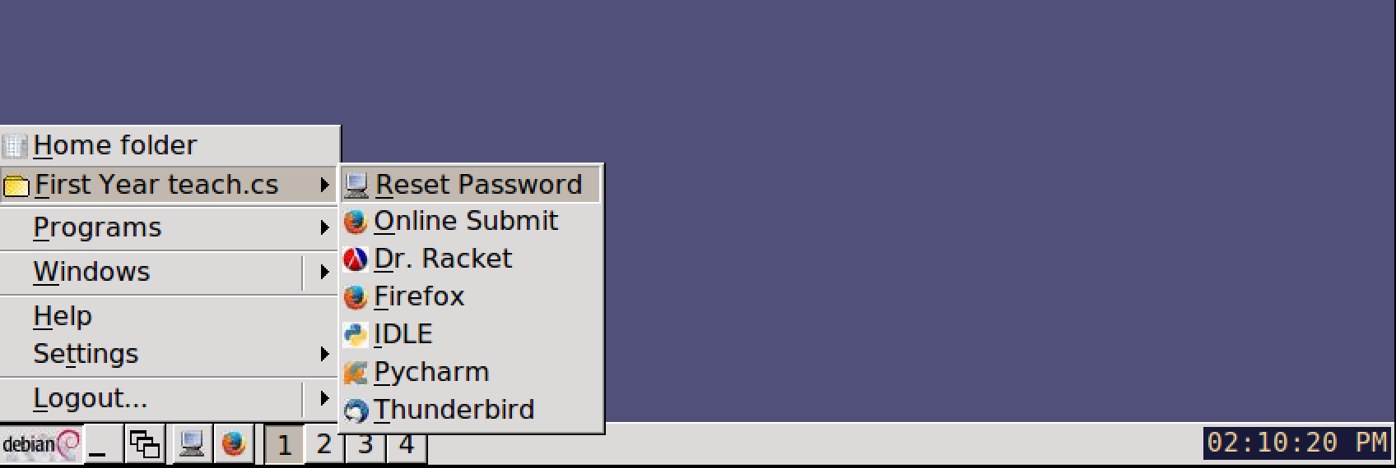
Changing your password
Once you’ve logged in to the CS Teaching Labs, please change your password.
At the bottom of the screen, to change your password use:
Application Launch Menu -> First Year teach.cs-> Reset Password

Slide 7
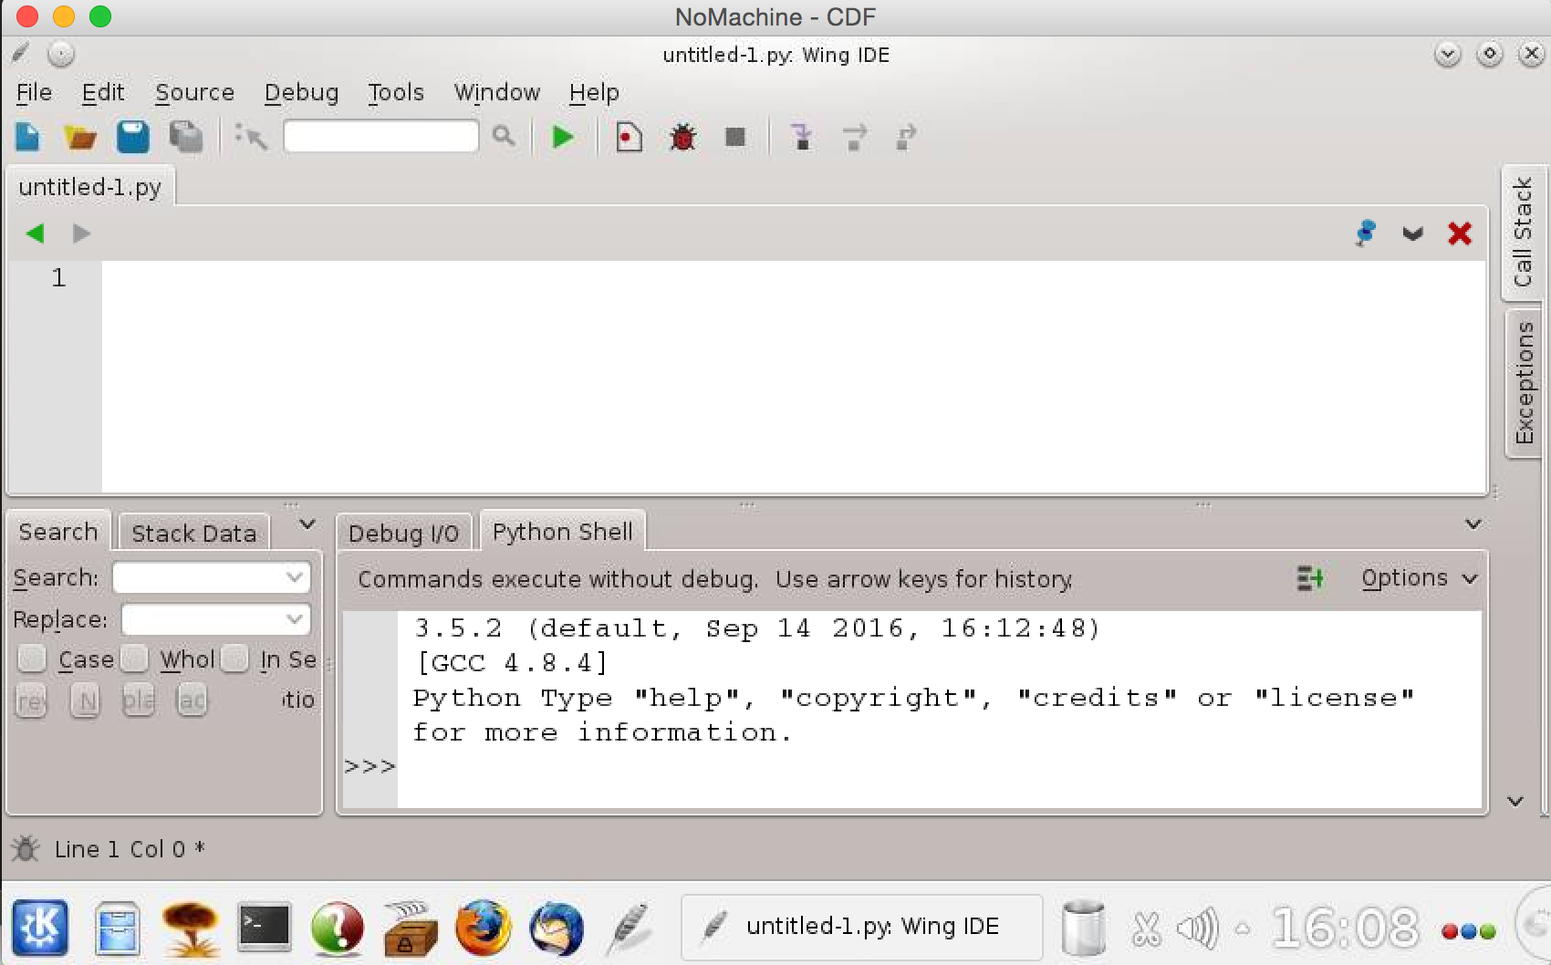
Wing 101 IDE

Slide 8
Working on your own laptop
Notes:
-

Slide 9
Software installation
To work on your own laptop, you will need to install the following software:
http://www.nltk.org/install.html
http://scikit-learn.org/stable/install.html
For Windows users, follow the instructions on the websites above.
For Mac OS X users, open a Terminal window and type these commands (you’ll need Python 3.4 or higher installed first):
sudo pip3 install –U numpy
sudo pip3 install –U nltk
sudo pip3 install –U scipy
sudo pip3 install –U scikit-learn

Slide 10
Download data (and tagger)
Download the ZIP file that contains the project starter code and data from the C4M website: http://http//c4m.cdf.toronto.edu/cohort2/phase3/
(Optional – not needed unless you want to run the preprocessing code yourself)
Download the Stanford Log-linear Part-Of-Speech Tagger from http://nlp.stanford.edu/software/stanford-postagger-2015-12-09.zip and save it in the same directory as the starter code and data.
Unzip the file stanford-postagger-2015-12-09.zip

Slide 11
MODULES & PACKAGES
Notes:
-

Slide 12
Modules and Packages used in project
nltk (Natural Language Toolkit)
http://www.nltk.org/api/nltk.html
csv (Comma Separated Values files)
https://docs.python.org/3/library/csv.html
math (Mathematical functions)
https://docs.python.org/3/library/math.html
numpy (Numerical Python)
https://docs.scipy.org/doc/numpy/reference/routines.html
Click on the links above for documentation for each module/package. You can also use dir() and help().

Slide 13
NumPy
A scientific computing package for Python.
For this project, you’ll use NumPy’s N-dimensional array.
NumPy’s 2D array vs Python’s nested lists
NumPy’s array may contain only elements of the same type, whereas Python’s lists may contain different types.
NumPy’s arrays are more efficient and take less space.
NumPy supports a variety of array operations.
Notes:
From http://www.scipy.org/scipylib/faq.html#what-advantages-do-numpy-arrays-offer-over-nested-python-lists:
Python’s lists are efficient general-purpose containers. They support (fairly) efficient insertion, deletion, appending, and concatenation, and Python’s list comprehensions make them easy to construct and manipulate. However, they have certain limitations: they don’t support “vectorized” operations like elementwise addition and multiplication, and the fact that they can contain objects of differing types mean that Python must store type information for every element, and must execute type dispatching code when operating on each element. This also means that very few list operations can be carried out by efficient C loops – each iteration would require type checks and other Python API bookkeeping.

Slide 14
NumPy 2D array demo
>>> import numpy as np
>>> my_array = np.array([[1, 2, 3], [4, 5, 6]])
>>> my_array.shape
(2, 3)
>>> my_array.size
6
>>> my_array.sum()
21
>>> my_array.min()
1
>>> my_array.max()
6
>>> my_array.mean()
3.5
>>> my_array.var()
2.9166666666666665
>>> my_array.std()
1.707825127659933

Slide 15
Upcoming Seminars
Notes:
-

Slide 16
Seminar 2: Dr. Chris McIntosh
Tuesday October 17 2017 4-6pm
Location: DCS Innovation Lab
Topic: Computer Vision
https://www.researchgate.net/profile/Chris_Mcintosh

Slide 17
SEMINAR FEEDBACK
Notes:
-

Slide 18
Phase 3, Seminar 1 Survey
Tomorrow, you will be invited to complete a short survey.
We would like your (anonymous) feedback on the seminar.

