Slide 1

Computing for Medicine: Phase 3, Seminar 6 Project
Jennifer Campbell
Associate Professor, Teaching Stream
c4m@cs.toronto.edu

Slide 2
Seminar 6 Project
The project handout is posted:
http://c4m.cdf.toronto.edu/cohort2/phase3/
Two approaches for doing your work:
Use the Computer Science Teaching Labs computing network.
Use your personal computer.
Python3 packages to install:
numpy
matplotlib (pyplot)

Slide 3
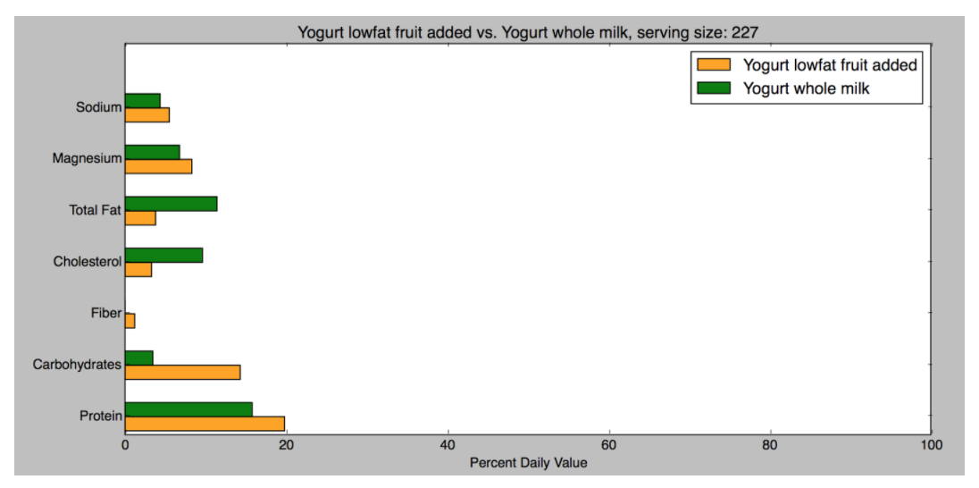
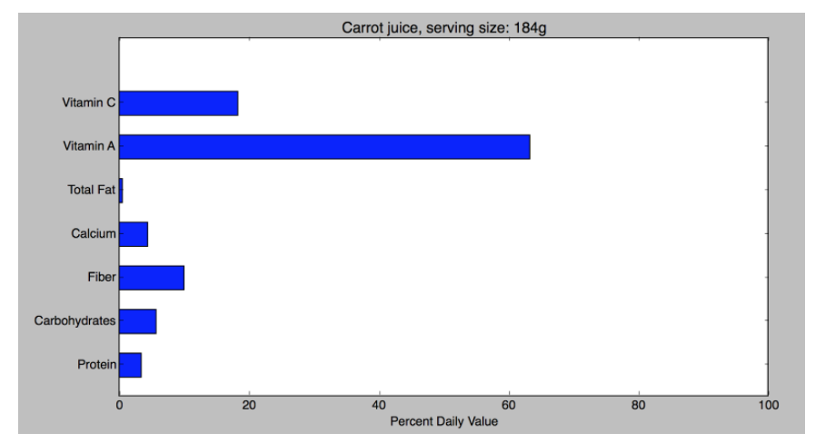
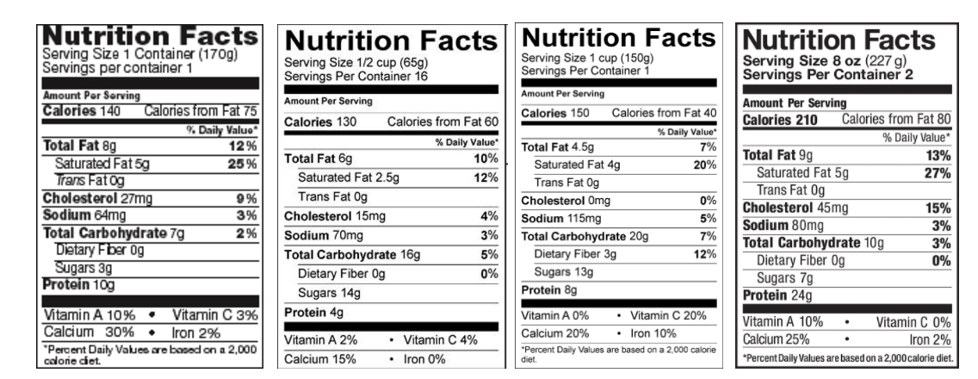

Slide 4
JSON
Notes:
-

Slide 5
JSON (JavaScript Object Notation)
Standard data-interchange format.
Commonly used in web programming for communication between a web browser and server.
Example of JSON to represent a person:
{
"firstName": "John",
"lastName": "Smith",
"isAlive": true,
"age": 25,
"children": []
}
(Example source: Wikipedia)

Slide 6
Another JSON Example
{
"id": 1,
"name": "Foo",
"price": 123,
"tags": [ "Bar", "Eek" ],
"stock": {
"warehouse": 300,
"retail": 20
}
}
(Example source: Wikipedia)

Slide 7
Terminology from handout
“In this project, we will work with food labels stored in a JSON format since most APIs (e.g. Open Food Facts, MyNetDiary, Spoonacular’s food API) provide detailed information in this format.”
API: Application programming interface
A set of programming routines (e.g., functions) used for producing software applications.

Slide 8
Exploring Matplotlib
Notes:
-

Slide 9
matplotlib.pyplot
http://matplotlib.org/api/pyplot_api.html
For this project, you will need to explore the pyplot documentation to find appropriate functions to use for the data visualization tasks.
Demo: using pyplot to display a pie chart.

Slide 10
Python: import and main
Notes:
-

Slide 11
Example 1: without __main__
Sample run of temperature.py:
Enter a temp: 102.6
Celsius: 39.22222222222222
Patient’s temp: 101.4
Fever report: True
def fahr_to_cels(temp):
return (temp - 32) * 5 / 9
t = input("Enter a temp: ")
result = fahr_to_cels(float(t))
print("Celsius:", result)
convert.py
import convert
def has_fever(c_temp):
f_temp = convert.fahr_to_cels(c_temp)
return f_temp > 37.5
t = input("Patient's temp: ")
result = has_fever(float(t))
print("Fever report: ", result)
temperature.py

Slide 12
Example 2: with __main__
Sample run of temperature.py:
Patient’s temp: 101.4
Fever report: True
def fahr_to_cels(temp):
return (temp - 32) * 5 / 9
if __name__ == '__main__':
t = input("Enter a temp: ")
result = fahr_to_cels(float(t))
print("Celsius:", result)
convert.py
import convert
def has_fever(c_temp):
f_temp = convert.fahr_to_cels(c_temp)
return f_temp > 37.5
t = input("Patient's temp: ")
result = has_fever(float(t))
print("Fever report: ", result)
temperature.py

Slide 13
Summary
Importing a module, executes the code in that module.
If the module being imported contains a main block (if __name__ == ‘__main__’), the code within the main block will NOT be executed when that module is imported.
However, when that module is run directly, both the code inside and outside of the main block is executed.

Slide 14
How this applies to your project
You will write code in three files:
seminar6_part1.py
seminar6_part2.py
seminar6_part3.py
To reuse functions written in part 1, you will import seminar6_part1 in seminar6_part2.py.
To prevent the user interaction code from seminar6_part1 from being executed when that module is imported by seminar6_part2, place that code within a main block.

