Slide 1

Crash Course on Machine Learning
Alex Mariakakis
University of Toronto
Department of Computer Science

Slide 2
Outline
What is covered
What is not covered
High-level terms and definitions
Conceptual walkthrough of how to approach machine learning problems
Supervised machine learning on simple tabular data
Underlying math
Machine learning on sequences, images, and text
Unsupervised learning
Deep learning
Code examples
Scikit-learn for Python
Weka for Java

Slide 3
What Is Machine Learning?
Machine learning takes some example data to train a model
It then learns patterns from those examples so that it can produce results for future data
This code (not the patterns) can often be re-used across problems
if email contains “Viagra”:
then mark as spam;
if email contains “limited offer”:
then mark as spam;
...
while accuracy low:
classify some emails;
check errors;
change to reduce errors;
“Traditional” Programs
Machine Learning Programs

Slide 4
How to Do Machine Learning in 6–8 Easy Steps
Define the problem we are trying to solve
Create your features and labels
Decide how the data should be split for training and testing
(Optional) Add feature selection
Select an appropriate model
(Optional) Select your hyperparameters
Train and test your model
Use an appropriate method for interpreting results

Slide 5


Types of Learning
Supervised Learning
Unsupervised Learning
The goal is for the model to produce the desired output based on examples with labels (i.e., expected outcomes)
The goal is for the model to extract meaningful trends or associations in the data without having access to labels (or assuming they do not exist)
?
healthy
sick
Group 1
Group 2

Slide 6
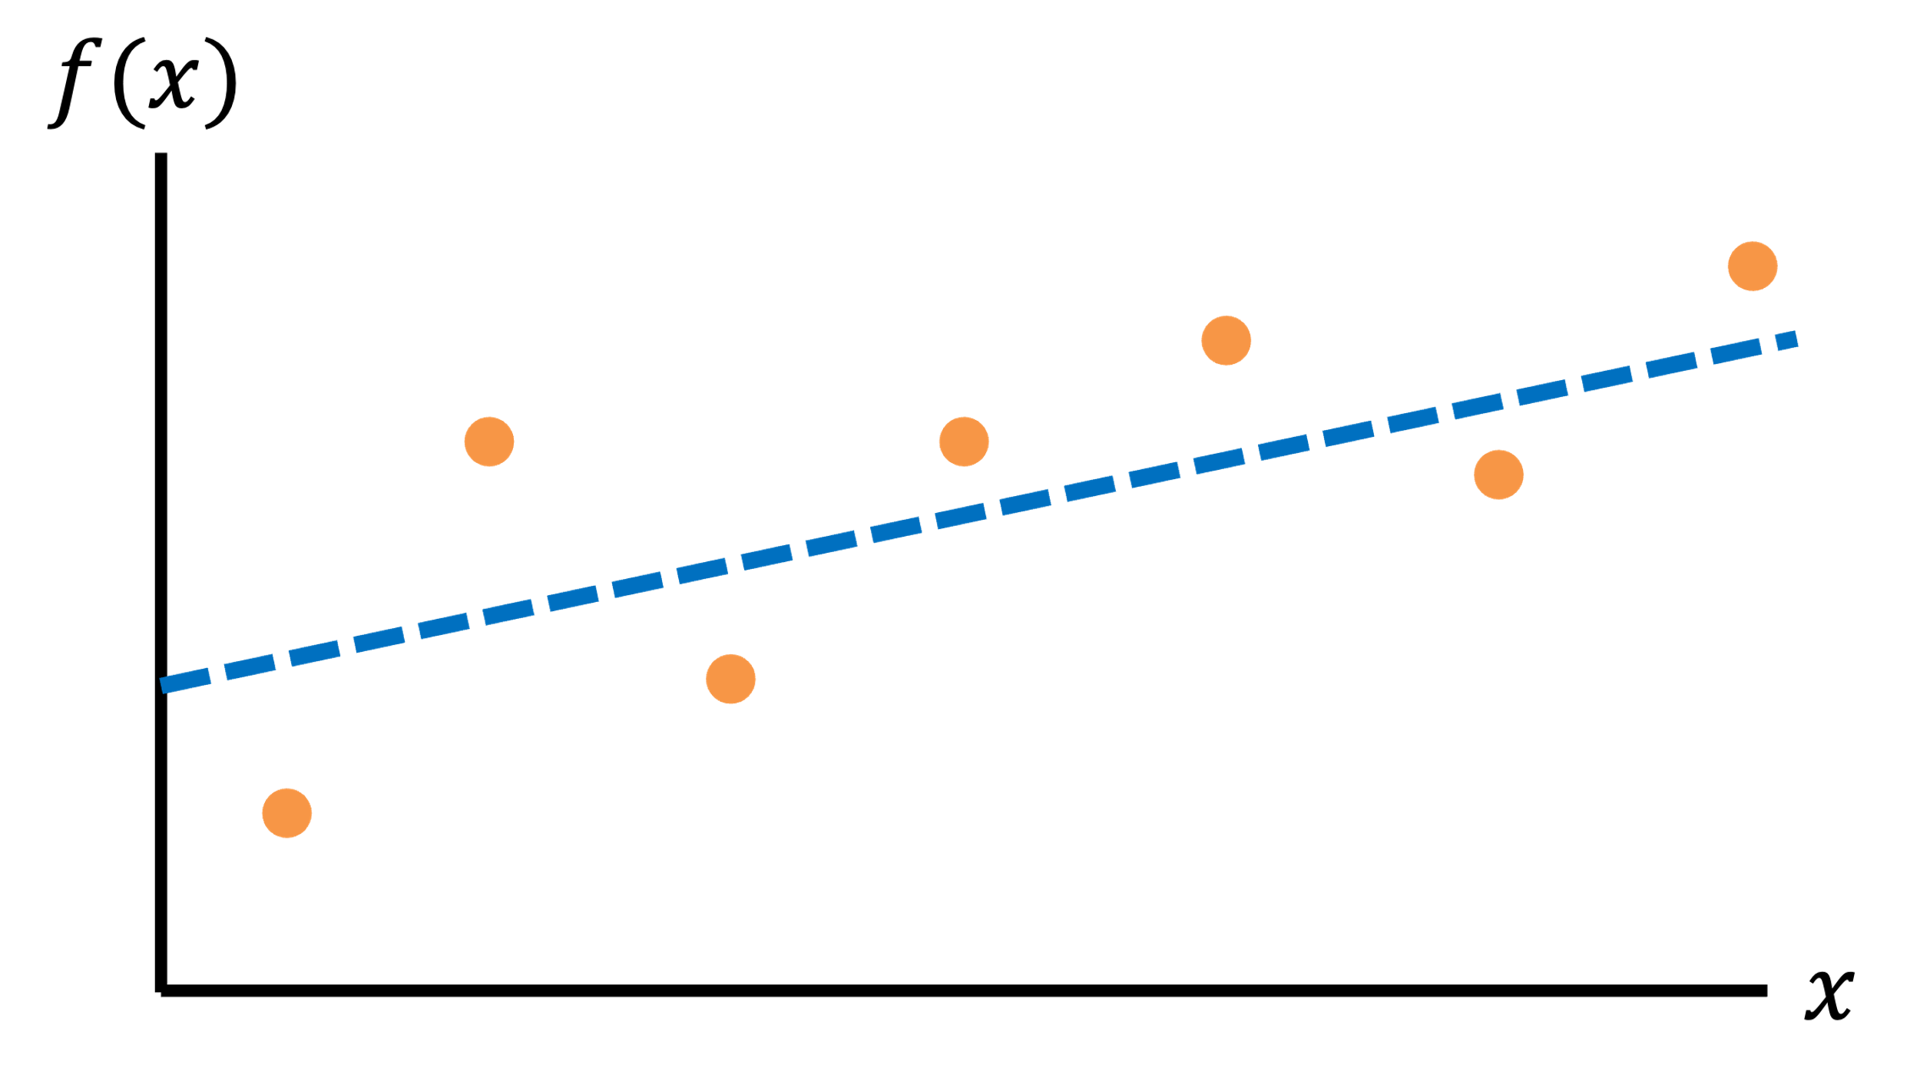
Types of Supervised Learning
Regression
Classification
Questions that can be answered with a continuous output
What will the patient’s heart rate be in one hour?
For how long will the patient experience symptoms?
Questions that can be answered with a categorical answer
Is this person sick or not?
Is this person going to become sick in the future?

Slide 7


Example of Unsupervised Learning
Clustering
$$x_{2}$$
Segregates the data into groups such that samples in the same group are more similar to other samples in the same group and dissimilar to samples in other groups
Since the clusters do not depend on labels, the groups may or may not be related to meaningful distinctions in the data
$$x_{1}$$

Slide 8
What We Will Cover
We are going to focus on supervised learning, which means that we can assume that are data comes with labels that represent the expected outcome for each data sample

Slide 9
How to Do Machine Learning in 6–8 Easy Steps
Define the problem we are trying to solve
Create your features and labels
Decide how the data should be split for training and testing
(Optional) Add feature selection
Select an appropriate model
(Optional) Select your hyperparameters
Train and test your model
Use an appropriate method for interpreting results

Slide 10
Feature Representations
There are millions of ways to represent data!
What differentiates sick people from healthy people?
Resting heart rate = 60 bpm
SpO₂ = 97%
Cough status = normal
Resting heart rate = 80 bpm
SpO₂ = 92%
Cough status = worsening

Slide 11
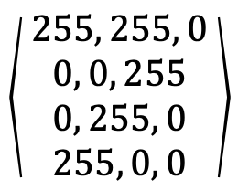

Feature Representations: Images
There are millions of ways to represent data!
$$\left\langle 255, 255, 0\right\rangle$$
Color
RGB values
$$\left\langle \begin{aligned} 255, 255, 0 \\ 0, 0, 255 \\ 0, 255, 0 \\ 255, 0, 0\end{aligned}\right\rangle$$
Image
Group of RGB values

Slide 12

Feature Representations: Sequences
There are millions of ways to represent data!
$$\left\langle 10, 12, 8, 5, 3, 5, …\right\rangle$$
Time-varying signal (e.g., audio)
Series of a fixed number of samples
Mean = 5 Average slope = -0.1 Kurtosis = 0.1
Time-varying signal (e.g., audio)
Summary features that describe the signal

Slide 13
What Does Our Data Look Like
Subject ID | Age | Heart Rate | Systolic Blood Pressure | Diastolic Blood Pressure | SpO₂ | Has Sepsis?
P01 | 34 | 77 | 117 | 72 | 100.0 | No
P02 | 78 | 87 | 163 | 79 | 95.9 | Yes
P03 | 57 | 66 | 144 | 81 | 97.6 | No
P04 | 23 | 93 | 167 | 94 | 94.0 | Yes
P05 | 81 | 90 | 123 | 86 | 99.7 | Yes
Samples
Identifying information that should not be used for learning
Features
Labels

Slide 14
What Does Our Data Look Like
Each feature can be thought of as a dimension of a new coordinate system that represents our data
Classification
Worsening
Healthy
Cough status
Sick
Normal
92.5%
95%
97.5%
100%
SpO₂ (%)

Slide 15
What Does Our Data Look Like
Each feature can be thought of as a dimension of a new coordinate system that represents our data
5
Regression
4
Data point
Days with Symptoms
3
2
1
92.5%
95%
97.5%
100%
SpO₂ (%)

Slide 16
Dealing with Missing Data
It is easiest to work with data when all the entries in your dataset have the same number of features
You can fill in blanks using imputation techniques:
Technique | Note
Placeholder value (e.g., 0, -999) | Not a good idea for models that cannot distinguish between real and fake data
Mean / median | Pretty limited in the level of accuracy that can be achieved since it only cares about one feature at a time
Nearest neighbor | Requires training and tuning a special model for filling in data based on other examples

Slide 17
How to Do Machine Learning in 6–8 Easy Steps
Define the problem we are trying to solve
Create your features and labels
Decide how the data should be split for training and testing
(Optional) Add feature selection
Select an appropriate model
(Optional) Select your hyperparameters
Train and test your model
Use an appropriate method for interpreting results

Slide 18
Dataset Splitting
When you evaluate your model, it is important that you see how well it works on data it has never seen before
To do this, we often partition our dataset into distinct “splits”
Train: Used to help the model learn how to set its internal parameters so that it can generate predictions
(Optional) Validation: Used to tune hyperparameters (more on that later)
Test: Used to evaluate the trained model’s performance

Slide 19
Standard Methods of Dataset Splitting
The amount of training data should be significantly higher than the amount of validation and/or testing data
These are three standard methods without a validation split (which can often be just taken from the train set)
Single Split: Generate a single partition (e.g., 80% train & 20% test)
N-Fold Cross-Validation: Split the data into N equal partitions, train one model with each partition as the test set, and then average the results
Leave-One-Out Cross-Validation: Similar to N-Fold cross-validation, but when the splits correspond to an important aspect of the dataset (e.g., N = number of users)
A
B
C
Fold 1:
A
B
C
Fold 2:
A
B
C
Fold 3:
Train
Test

Slide 20
Considerations for Dataset Splitting
It is usually good practice to shuffle the rows of your data so that there are not any biases based on how the data was recorded or grouped
Make sure you have good representation of all possible labels in each of your data splits
If your train split only includes healthy patients and your test split only includes sick patients, then you will get bad performance
This problem becomes more apparent as your dataset and splits become smaller

Slide 21


Considerations for Dataset Splitting
If your model has not been trained on a certain kind of data before, it probably will not predict well on that data either
$$y$$
No guarantees on model performance
Region where model should work best
No guarantees on model performance
$$x$$

Slide 22
Considerations for Dataset Splitting
Pick the right training method to answer your question
If you want to show that your approach works on patients that have never been seen by the model, then you should make sure that no individuals are represented in both the train and test sets
If you think that personalized models are needed for each person, then you should split each patient’s data into train and test sets and build individual models

Slide 23
How to Do Machine Learning in 6–8 Easy Steps
Define the problem we are trying to solve
Create your features and labels
Decide how the data should be split for training and testing
(Optional) Add feature selection
Select an appropriate model
(Optional) Select your hyperparameters
Train and test your model
Use an appropriate method for interpreting results

Slide 24
Why Use Feature Selection?
The more features we use, the higher the likelihood that we can successfully solve our problem
However, if we use too many features, the model may learn complicated rules that neither make sense nor generalize well to unseen data
This tradeoff is known as the “curse of dimensionality” and is closely tied to overfitting

Slide 25
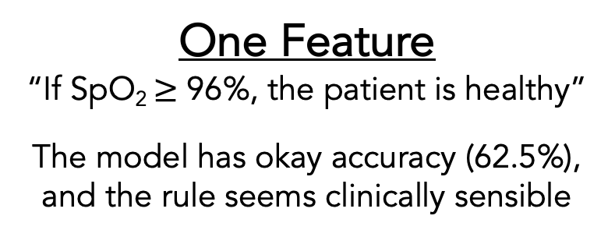
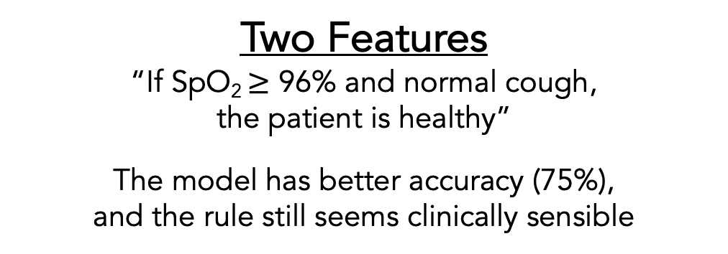
Why Use Feature Selection?
Classification
Healthy
Sick
Worsening
Cough status
Normal
92.5%
95%
97.5%
100%
92.5%
95%
97.5%
100%
SpO₂ (%)
SpO₂ (%)
One Feature
“If SpO₂ $≥$ 96%, the patient is healthy”
The model has okay accuracy (62.5%), and the rule seems clinically sensible
Two Features
“If SpO₂ $≥$ 96% and normal cough, the patient is healthy”
The model has better accuracy (75%), and the rule still seems clinically sensible

Slide 26
Why Use Feature Selection?
Classification
Healthy
Sick
Worsening
1
2
9
Number in yellow: last digit of SIN
Cough status
Normal
4
3
2
7
6
92.5%
95%
97.5%
100%
SpO₂ (%)
Three Features
“If normal cough AND last digit of SIN is even, the patient is healthy”
The model has perfect accuracy (100%), but it took advantage of a random feature to make a rule that does not seem to be clinically sensible

Slide 27
How to Select the Best Features
You can use domain expertise to ignore features that do not make sense
There are also automated techniques you can use to automatically pick the features that are likely to be the most interesting mathematically
Some techniques care about the labels, while others just care about properties of the data itself

Slide 28
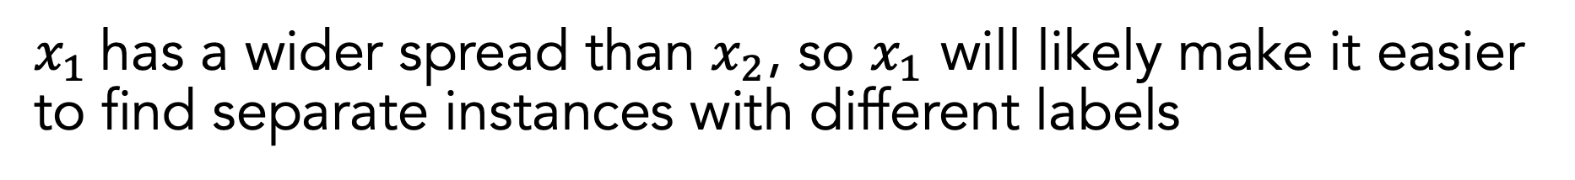

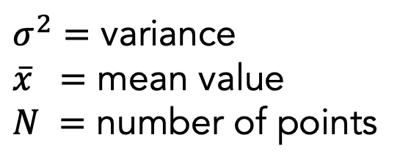
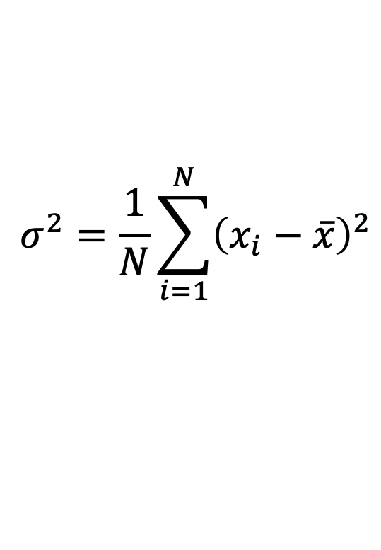

Example of Label-Agnostic Feature Selection: Variance Threshold
Only keep features that are spread apart (high variance) to keep the data as “unique” as possible
$$σ^{2}=\frac{1}{N}\sum_{i=1}^{N}{{\left(x_{i}−\overline{x}\right)}^{2}}$$
$$x_{2}$$
$σ^{2}=$ variance
$\overline{x} =$ mean value
$N =$ number of points
$$x_{1}$$
$x_{1}$has a wider spread than $x_{2}$, so $x_{1}$ will likely make it easier to find separate instances with different labels

Slide 29




Example of Label-Aware Feature Selection: Univariate Feature Selection
Performs statistical tests using one feature at a time and picks the ones that work best
good at separating labels
$$x_{2}$$
$$x_{2}$$
$$x_{1}$$
$$x_{1}$$
bad at separating labels

Slide 30
How to Do Machine Learning in 6–8 Easy Steps
Define the problem we are trying to solve
Create your features and labels
Decide how the data should be split for training and testing
(Optional) Add feature selection
Select an appropriate model
(Optional) Select your hyperparameters
Train and test your model
Use an appropriate method for interpreting results

Slide 31
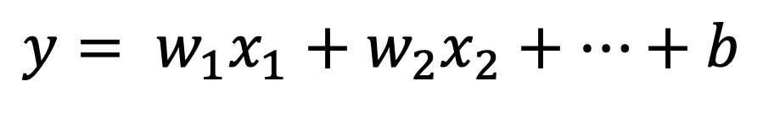
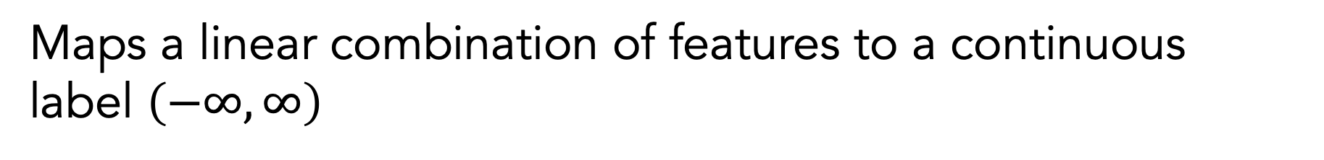


Regression: Linear Regression
Maps a linear combination of features to a continuous label $\left(−∞, ∞\right)$
$$y= w_{1}x_{1}+w_{2}x_{2}+…+b$$
$$f(x)$$
$$x$$

Slide 32
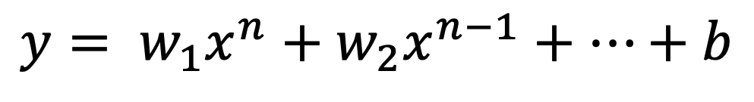
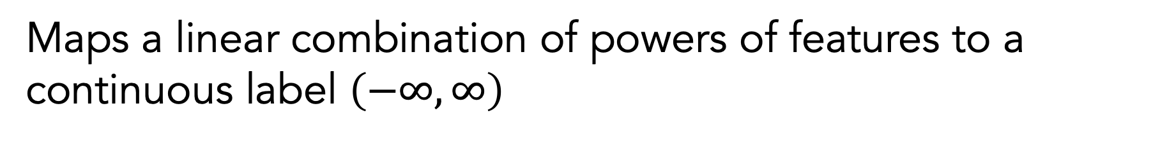


Regression: Polynomial Regression
Maps a linear combination of powers of features to a continuous label $\left(−∞, ∞\right)$
$$y= w_{1}x^{n}+w_{2}x^{n−1}+…+b$$
$$f(x)$$
$$x$$

Slide 33
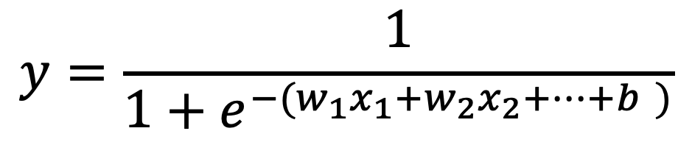
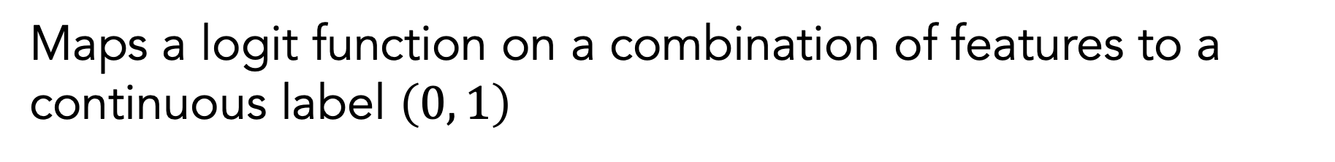

Regression: Logistic Regression
Maps a logit function on a combination of features to a continuous label $\left(0, 1\right)$
$$y=\frac{1}{1+e^{−(w_{1}x_{1}+w_{2}x_{2}+…+b )}}$$
$$f(x)$$
1
0
$$x$$

Slide 34
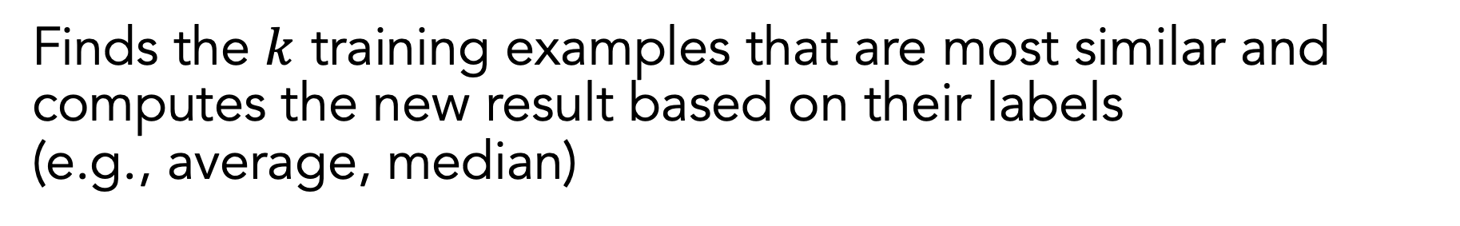



Regression: K-Nearest Neighbor
Finds the $k$ training examples that are most similar and computes the new result based on their labels (e.g., average, median)
$$f(x)$$
$$k=1$$
$$f(x)$$
$$k=3$$
$$x$$
$$x$$

Slide 35
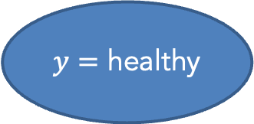
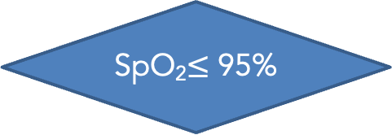
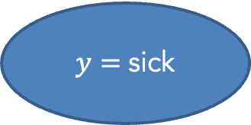
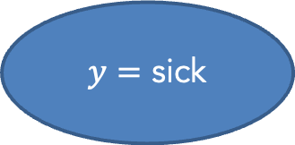
Classification: Decision Tree
Maps a combination of features to a class label based on a series of binary decisions
no
SpO₂$≤$ 95%
yes
Worsening cough?
yes
$y=$ sick
no
$y=$ healthy
$y=$ sick

Slide 36
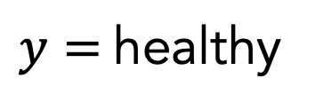
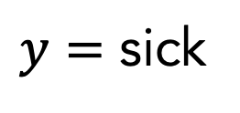
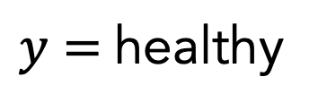
Classification: Random Forest
Uses a collection of decision trees (forest = multiple trees) to make a decision
$y=$healthy
$y=$ sick
𝑦 = healthy
$y=$healthy

Slide 37
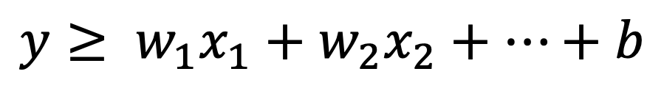
Classification: Support Vector Machine (SVM)
Separates two different classes with a hyperplane that maximizes the separation between the classes
$$y≥ w_{1}x_{1}+w_{2}x_{2}+…+b$$
$$x_{2}$$
“support vector”
$$x_{1}$$

Slide 38




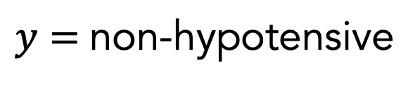

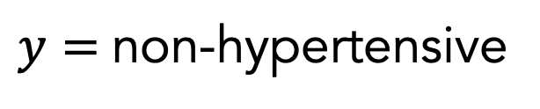
Classification: Support Vector Machine (SVM)
Can separate between multiple classes by combining the results of multiple one-versus-rest classifiers
$$x_{2}$$
$$x_{2}$$
$$x_{2}$$
$$x_{1}$$
$$x_{1}$$
$$x_{1}$$
Hypertensive vs. non-hypertensive
healthy vs. non-healthy
Hypotensive vs. non-hypotensive
$y=$non-hypertensive
$y=$healthy
$y=$non-hypotensive
$y=$healthy

Slide 39
Regression ⟷ Classification
Models for classification often have an analogue for doing regression
Classification | Regression
Support Vector Machine (SVM) Classifies based on which side of the decision boundary the input is on | Support Vector Regression (SVR) Regresses based on how far away the input is from the decision boundary
Decision Tree Leaf nodes correspond to classes | Decision Tree Regression Leaf nodes correspond to continuous values

Slide 40
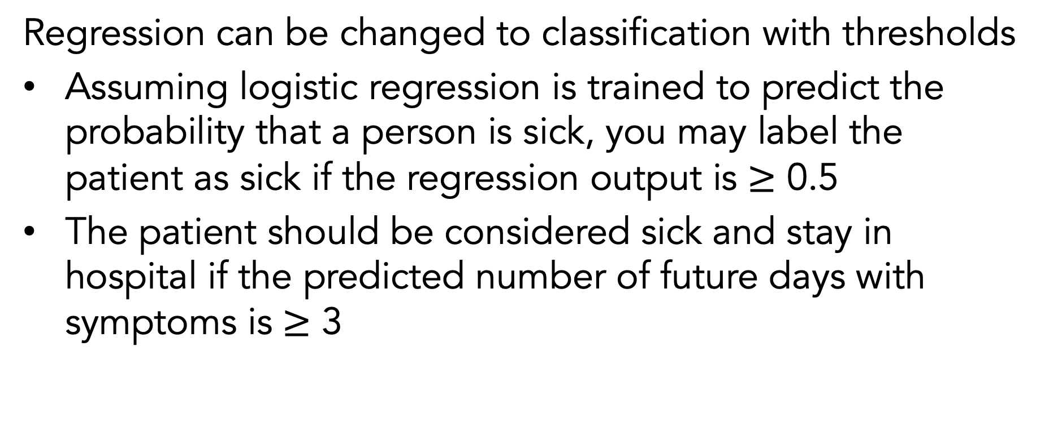
Regression ⟷ Classification
Regression can be changed to classification with thresholds
Assuming logistic regression is trained to predict the probability that a person is sick, you may label the patient as sick if the regression output is $≥$ 0.5
The patient should be considered sick and stay in hospital if the predicted number of future days with symptoms is $≥$ 3

Slide 41
Regression ⟷ Classification
Regression gives more information
Imagine if one patient is predicted to have 4 future days of symptoms and another patient is predicted to have 8 future days of symptoms
Both would be considered “sick” and may be asked to stay in the hospital, but I may want to prioritize treating the latter
Classification may be “easier” in some cases since there is less room for making mistakes
Telling the difference between 1…2…3… future days of symptoms may be harder than telling the difference between sick and healthy patients

Slide 42
How to Do Machine Learning in 6–8 Easy Steps
Define the problem we are trying to solve
Create your features and labels
Decide how the data should be split for training and testing
(Optional) Add feature selection
Select an appropriate model
(Optional) Select your hyperparameters
Train and test your model
Use an appropriate method for interpreting results

Slide 43
Hyperparameters
Hyperparameters are tunable parameters that are set before you train your model to control how it learns
We can learn the best settings for these values by doing a separate round of training with a validation split
Model | Examples of Hyperparameters
K-Nearest Neighbors | Number of neighbors: how many neighbors to use for calculation Radius of neighbors: the radius within which neighbors can be considered
Decision Tree | Max depth: how deep is the tree allowed to be Min samples for split: the minimum of samples required to justify a new decision

Slide 44
Why Care About Hyperparameters?
Machine learning is great because it can learn complex relationships that we can not readily identify ourselves
However, if we give the model too much flexibility, the model may learn complicated rules that neither make sense nor generalize well to unseen data
This is known as “overfitting”

Slide 45
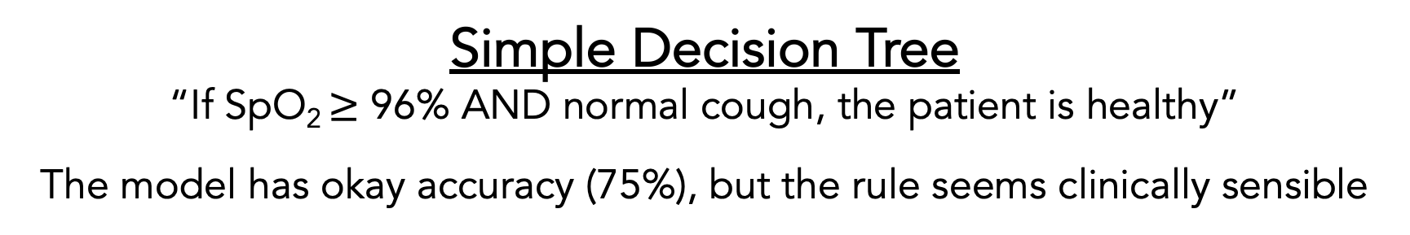
Why Care About Hyperparameters?
Classification
Healthy
Sick
Worsening
Cough status
Normal
92.5%
95%
97.5%
100%
SpO₂ (%)
Simple Decision Tree
“If SpO₂ $≥$ 96% AND normal cough, the patient is healthy”
The model has okay accuracy (75%), but the rule seems clinically sensible

Slide 46
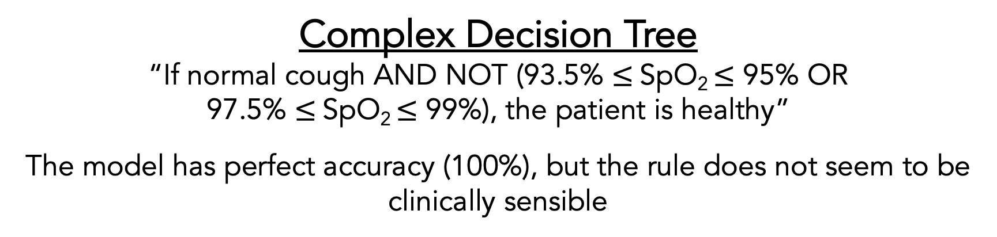
Why Care About Hyperparameters?
Classification
Healthy
Sick
Worsening
Cough status
Normal
92.5%
95%
97.5%
100%
SpO₂ (%)
Complex Decision Tree
“If normal cough AND NOT (93.5% $≤$SpO₂ $≤$ 95% OR 97.5% $≤$SpO₂ $≤$ 99%), the patient is healthy”
The model has perfect accuracy (100%), but the rule does not seem to be clinically sensible

Slide 47
How to Do Machine Learning in 6–8 Easy Steps
Define the problem we are trying to solve
Create your features and labels
Decide how the data should be split for training and testing
(Optional) Add feature selection
Select an appropriate model
(Optional) Select your hyperparameters
Train and test your model
Use an appropriate method for interpreting results

Slide 48
Training and Testing Your Model
You will train your model by only feeding in the features and labels in your training dataset
You can generate model predictions and compare them to the known labels for both the train and test features
Evaluating on training dataset: Accuracy should be very high (assuming the model learned anything) since the model has seen that data before
Evaluating on test dataset: Accuracy is a better indicator of real-world performance since the model hasn’t seen that data before

Slide 49
How to Do Machine Learning in 6–8 Easy Steps
Define the problem we are trying to solve
Create your features and labels
Decide how the data should be split for training and testing
(Optional) Add feature selection
Select an appropriate model
(Optional) Select your hyperparameters
Train and test your model
Use an appropriate method for interpreting results

Slide 50
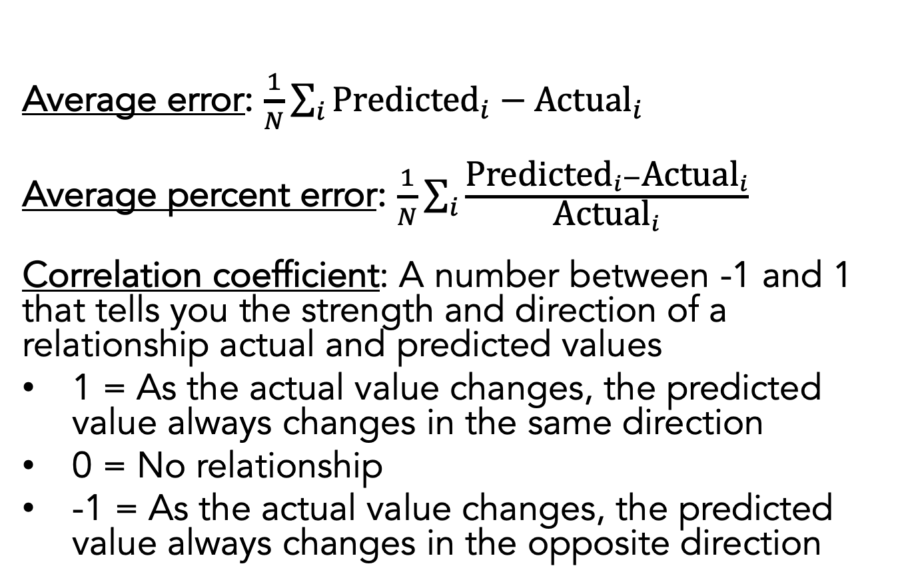
Regression Results
Average error: $\frac{1}{N}\sum_{i}{{\text{Predicted}}_{i}−{\text{Actual}}_{i}}$
Average percent error: $\frac{1}{N}\sum_{i}{\frac{{\text{Predicted}}_{i}−{\text{Actual}}_{i}}{{\text{Actual}}_{i}}}$
Correlation coefficient: A number between -1 and 1 that tells you the strength and direction of a relationship actual and predicted values
1 = As the actual value changes, the predicted value always changes in the same direction
0 = No relationship
-1 = As the actual value changes, the predicted value always changes in the opposite direction
Actual (days) | Predicted (days)
4 | 3
5 | 5
5 | 10
3 | 2
4 | 6

Slide 51
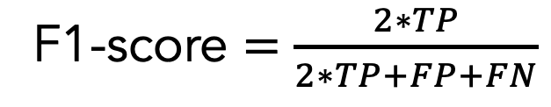
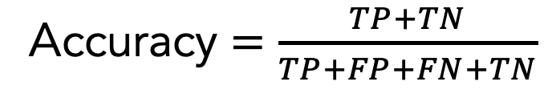
Binary Classification Results: Overall Performance
 |  | Actual Label
 |  | Positive | Negative
Predicted Label | Positive (sick) | True positive (TP) | False positive (FP)
 | Negative (healthy) | False negative (FN) | True negative (TN)
Confusion Matrix
Actual (diagnosis) | Predicted (diagnosis)
healthy | healthy
sick | healthy
sick | sick
sick | sick
healthy | sick
Accuracy $=\frac{TP+TN}{TP+FP+FN+TN}$
F1-score $=\frac{2∗TP}{2∗TP+FP+FN}$
F1-score is better suited for imbalanced datasets (i.e., significantly different numbers of positives and negatives)

Slide 52
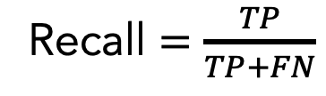
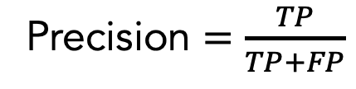
Binary Classification Results: Information Retrieval
 |  | Actual Label
 |  | Positive | Negative
Predicted Label | Positive (sick) | True positive (TP) | False positive (FP)
 | Negative (healthy) | False negative (FN) | True negative (TN)
Confusion Matrix
Actual (diagnosis) | Predicted (diagnosis)
healthy | healthy
sick | healthy
sick | sick
sick | sick
healthy | sick
Precision $=\frac{TP}{TP+FP}$
What fraction of items that were returned were relevant to my query?
Recall $=\frac{TP}{TP+FN}$
What fraction of items that were relevant to my query were returned?

Slide 53
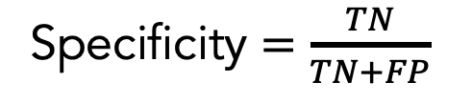
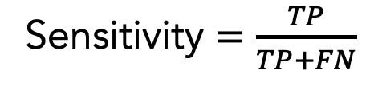
Binary Classification Results: Diagnostics
 |  | Actual Label
 |  | Positive | Negative
Predicted Label | Positive (sick) | True positive (TP) | False positive (FP)
 | Negative (healthy) | False negative (FN) | True negative (TN)
Confusion Matrix
Actual (diagnosis) | Predicted (diagnosis)
healthy | healthy
sick | healthy
sick | sick
sick | sick
healthy | sick
Sensitivity $=\frac{TP}{TP+FN}$
What fraction of people with the given health condition were given a positive test result?
Specificity $=\frac{TN}{TN+FP}$
What fraction of people without the given health condition were given a negative test result?

Slide 54
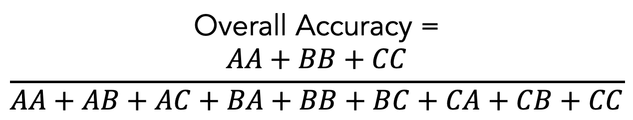
Multi-Class Classification Results: Overall Performance
 |  | Actual Label
 |  | Healthy | Hypotensive | Hypertensive
Predicted Label | Healthy | AA | AB | AC
 | Hypotensive | BA | BB | BC
 | Hypertensive | CA | CB | CC
Overall Accuracy =
$$\frac{AA+BB+CC}{AA+AB+AC+BA+BB+BC+CA+CB+CC}$$

Slide 55
Receiver Operating Characteristic (ROC) Curve
Shows how a classifier’s performance changes depending on its internal decision threshold
Area under the ROC Curve (AUROC) is an aggregate measure between 0 and 1 that reports summarizes model performance across all thresholds
B
Perfect (AUROC = 1)
Random chance (AUROC = 0.5)
True positive rate
Okay curve
A
A
Conservative threshold (lower recall, higher precision)
B
Liberal threshold (higher recall, lower precision)
False positive rate

Slide 56
How to Do Machine Learning in 6–8 Easy Steps
Define the problem we are trying to solve
Create your features and labels
Decide how the data should be split for training and testing
(Optional) Add feature selection
Select an appropriate model
(Optional) Select your hyperparameters
Train and test your model
Use an appropriate method for interpreting results

Slide 57
Resources
Overviews of Machine Learning
“Glossary of Machine Learning Terms” | Google
Coding Examples
“Machine Learning Mastery” | Jason Brownlee

