Slide 1
RANSOMWARE
By Vladimir Shelkovnikov
IVAN
Team

Slide 2
DISCLAIMER
Article 273 of the Criminal Codex of the Russian Federation. Creation, use and distribution of malicious computer programs
Creation, distribution or use of computer programs or other computer information deliberately intended for unauthorized destruction, blocking, modification, copying of computer information or neutralization of computer information protection means,
-are punished by restriction of liberty for a term of up to four years, or forced labor for a term of up to four years, or imprisonment for the same term with a fine of up to two hundred thousand rubles or in the amount of wages or other income of the convicted person for a period of up to eighteen months.

Slide 3
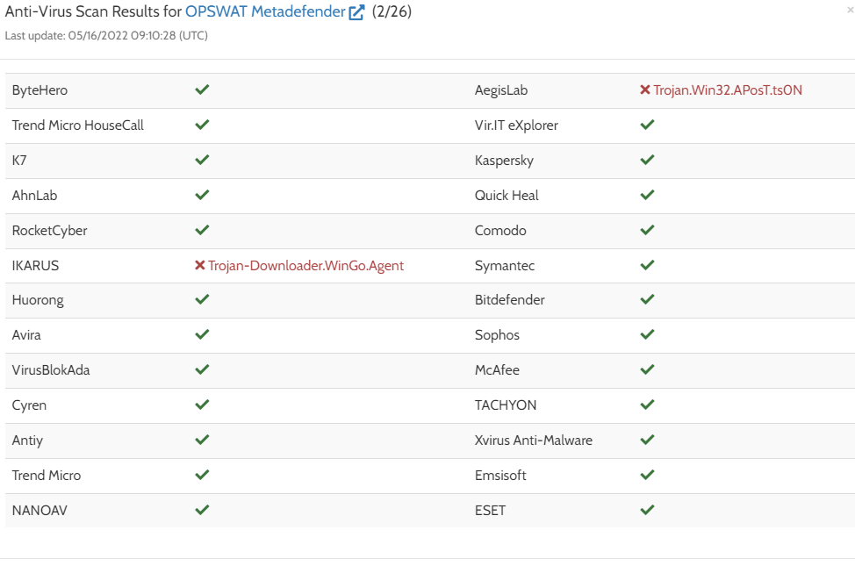

Slide 4
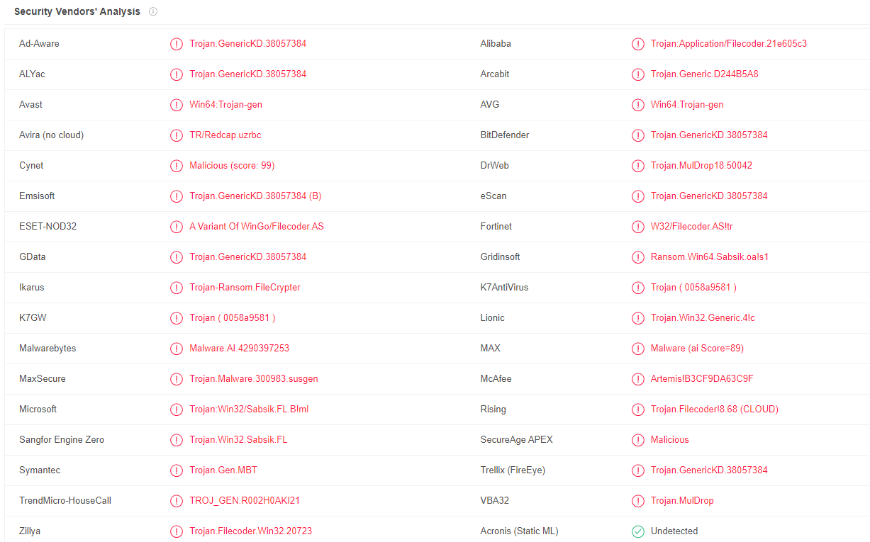

Slide 5
WHAT IS RANSOMWARE?
What’s about RaaS?

Slide 6
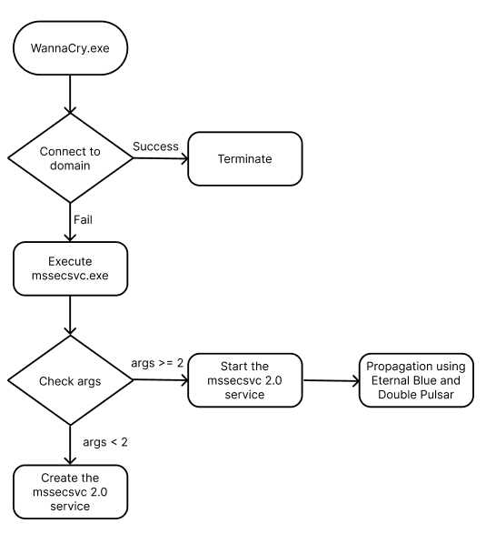
WANNACRY AS EXAMPLE

Slide 7
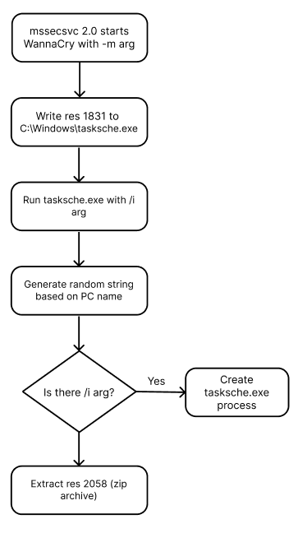
msg is a folder that contains a list of RTF files with the .wnry extension. These files are instructions for ransom message;
b.wnry is an image file. This is also instruction for victim;
c.wnry contains a list of Tor addresses and a link to a installation file of the Tor browser;
r.wnry is a text file with additional decryption instructions;
s.wnry file is a ZIP archive with the Tor browser.
t.wnry is an encrypted file with the WANACRY! encryption format;
taskdl.exe is used for the deletion of files with the .WNCRY extension;
taskse.exe is used for malware execution on RDP sessions.
u.wnry is decryption component called @WanaDecryptor@.exe.

Slide 8
What I get from analysing the ransomware samples:
Propagation function with exploitation of relevant vulnerabilities (EternalBlue)
WannaCry is split up into several components of code, which are each encrypted separately.
Encryption component (.dll) is encrypted in t.wnry. Key is also embedded in it.
Whitelist of system directories to doesn’t encrypt important system elements
List of extensions
Usage of Tor browser and .onion domains
Try to kill MSExchange and MySQL processes
Get rid of possible recovery opportunities
Dynamical API resolver;
Encrypted configuration with RSA-1024 and aPlib compression;
More complicated work with processes and services
UAC bypass via ICMLuaUtil to escalate its privileges
Obfuscated import table

Slide 9

I HAVE AN IDEA!

Slide 10
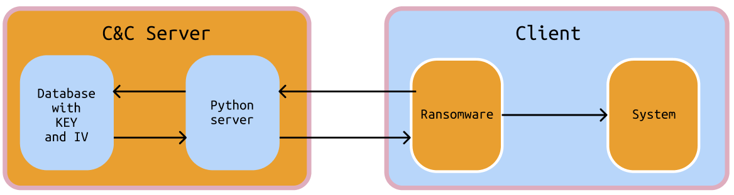
MY PROGRAMM
1
1 – Start of malware, check the environment, add itself to autorun

Slide 11
MY PROGRAMM
2
2 – Connect to server using TLS

Slide 12
MY PROGRAMM
3
3 – Generate key and IV, add them to the DB

Slide 13
MY PROGRAMM
4
4
4 – Retrieve keyIV from DB and send to malware

Slide 14
MY PROGRAMM
5
5 – Find precious files in home directory, encrypt them, create files – identificator to retrieve keys from server, list of encrypted files and html file with instructions

Slide 15
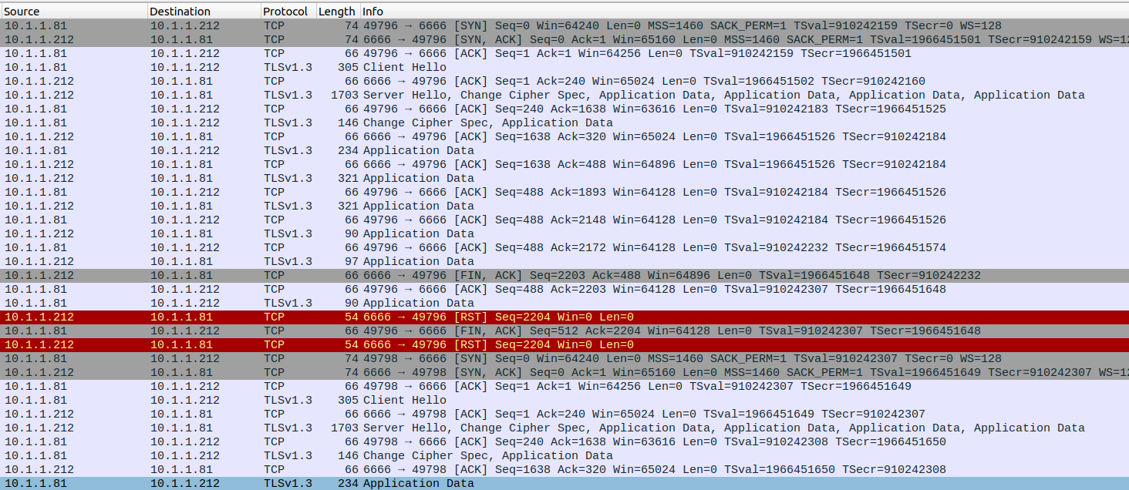

Slide 16
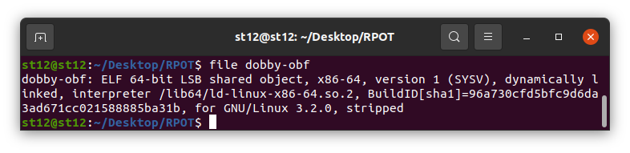
LIVE DEMO

Slide 17
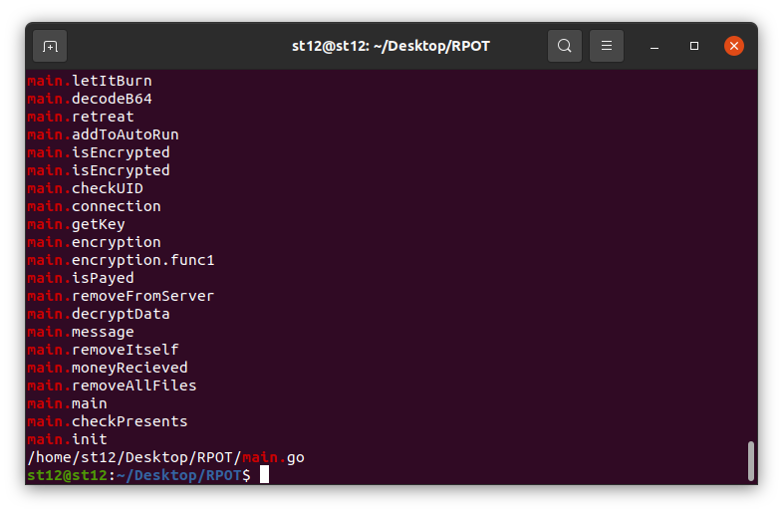

Slide 18

LET’S TALK ABOUT THE Q

