Slide 1
Crunching
Gigabytes
Locally
Dima Korolev
DataFest.by, May 19 2018

Slide 2
Data crunching TL;DR
The #1 productivity booster in data science is fast iterations.
Use the shell for under 10MB, use Hadoop for over 100GB.
In between there’s room for creativity, and it is what this talk is about.

Slide 3





About me
Machine learning, data science, and feature engineering for over 10 years.
Competitive programming, algorithms, infra, and C/C++ for over 20 years.

Slide 4

About the measurements
Timings measured on my laptop, which is:
ThinkPad X1 Carbon 4th gen.
On AC power and on battery, no significant difference.
Intel Core i7-7500U, 3.5 GHz, 4MB cache.
16GB LPDDR3 1866.
256 GB SSD, OPAL2.0 PCIe-NVMe.
Also validated on a Hetzner box, with no surprises.
All code snippets are on GitHub.

Slide 5

About the dataset
2016 Green Taxi Trip Data (hosted by Google for BigQuery, link).
2.1GB, 16.3M rides.
Generally speaking, dataset integrity, as well as licensing, are real things.
If you want the results reproducible, keep immutable copies of the datasets.

Slide 6
Data cleanup
You would imagine the Google-hosted dataset is clean enough. Well, no.
Two major sources of issues:
Timestamps.
Ultra-short and/or ultra-fast rides.

Slide 7

Issues with timestamps
Ambiguity. Real example: 07/11/2016 01:05:09 AM $ TZ=America/New_York date -d @1478408709 Sun Nov 6 01:05:09 EDT 2016 $ TZ=America/New_York date -d @1478412309 Sun Nov 6 01:05:09 EST 2016
Straight out invalid dates. Real example: 03/13/2016 02:58:40 AM $ TZ=America/New_York date -d '03/13/2016 02:58:40 AM' date: invalid date ‘03/13/2016 02:58:40 AM’ $ TZ=America/New_York date -d @$(($(TZ=America/New_York date -d '03/13/2016 01:59:59' +%s) + 1)) Sun= Mar 13 03:00:00 EDT 2016
Trip into the past. Example: 07/17/2016 03:16:35 PM,07/16/2016 08:30:10 AM

Slide 8
Lesson learned
Human time is hard to deal with for computers.
Unix epoch timestamps are the safest way.
If “derived” data, such as day of week, is needed, keep in mind it may change!
Even a dataset published by Google is not immune to this.
Solution: Re-annotate timestamps in the input CSV.
For this one-time task, use Python to keep things simple.

Slide 9
Crunching tasks
Follow the first two examples from the dataset page on Google cloud:
How many trips did Yellow taxis take each month in 2015?
What was the average speed of Yellow taxi trips in 2015?

Slide 10
Crunching
How many trips did Yellow taxis take each month in 2015?

Slide 11
Crunching
How many trips did Yellow taxis take each month in 2015? $ ./step1_rides_by_months_python.py | tee >(md5sum) 1445285 01/2016 1510722 02/2016 1576393 03/2016 1543925 04/2016 1536979 05/2016 1404726 06/2016 1332510 07/2016 1247675 08/2016 1162373 09/2016 1252572 10/2016 1148214 11/2016 1224158 12/2016 bd5b6d7f389e64aab50c56fed61eaded -

Slide 12
Python timing
The Python script runs for 24 seconds.
Take a moment to think of this number.
Is 24 seconds fast or slow?

Slide 13
History
Python is a fine scripting language, but what did people use before it?

Slide 14
History
Python is a fine scripting language, but what did people use before it?
Aho-Weinberger-Kernighan.
Or awk.
From the 70s.
One can say it has a built-in map-reduce.
And, at 16 seconds running time, it is actually faster.
Shell classics: grep, cut, sort, uniq.
This approach is even faster, completing in 12 seconds total.
2x the Python speed.
Truly, “without any programming”.

Slide 15
Shell
What we should really be asking ourselves is:
How long does it take to look for something in the input data, such as that bad timestamp?
Wait, and how long does it take to count the number of lines in the file?

Slide 16
Shell
What we should really be asking ourselves is:
How long does it take to look for something in the input data, such as that bad timestamp?
Wait, and how long does it take to count the number of lines in the file?
Both are valid questions, both require full file scan, both are doable in shell. Timings:
grep … : ~ 0.9s (for what’s only found a few times in the input)
wc -l … : < 0.5s
In other words, grep and wc operate at over 1GB/s throughput.

Slide 17
All timings
Approach | Duration
python | ~24s (<100MB/s)
“very naive” c++ | ~18s (~27s on Hetzner)
awk | ~17s
cut, sort, uniq | ~14s
“naive” c++, string views instead of strings | ~13s
read full file, malloc() + { open()+read() / fopen()+fread() } | ~3s / ~2.4s
mmap() full file, C | 1.4s (>1GB/s)
“naive” C, fopen() + fgets(), analyze digits at fixed string offset | 1.0s

Slide 18

Python, at ~24s
histogram = {}
with open('../cooked.csv') as f: for line in f: date = line.split(',')[1] yyyy_mm_dd = date.split('-') yyyy = yyyy_mm_dd[0] mm = yyyy_mm_dd[1] histogram_key = mm + '/' + yyyy if not histogram_key in histogram: histogram[histogram_key] = 1 else: histogram[histogram_key] += 1 for mm_yyyy, count in sorted(histogram.iteritems()): print "%s %s" % (count, mm_yyyy)

Slide 19

awk, at ~17s
# Keep in mind, this code is from the 70s!
BEGIN { FS="," }
{ split($2, date_time, " "); split(date_time[1], yyyy_mm_dd, "-"); ++histogram[yyyy_mm_dd[2] "/" yyyy_mm_dd[1]]; }
END { for (i in histogram) printf "%d %s\n", histogram[i], i; }

Slide 20
The winner, plain C, consistently at 1.0s
#include <stdio.h> int MM[12]; int main(int argc, char** argv) { char line[10000]; // Unsafe, of course. FILE* f = fopen(argc >= 2 ? argv[1] : "../cooked.csv", "r"); while (fgets(line, sizeof(line), f)) { ++MM[(line[7] - '0') * 10 + (line[8] - '0') - 1]; // Unsafe, of course. } fclose(f); for (int m = 0; m < 12; ++m) { printf("%d %02d/%d\n", MM[m], m + 1, 2016); } }

Slide 21
Lessons learned
Unix rocks.
When it comes to textual throughput, shell-grade tools are the fastest.
Unsophisticated old-school [unsafe] plain C is not far behind.

Slide 22
Lessons learned
Unix rocks.
When it comes to textual throughput, shell-grade tools are the fastest.
Unsophisticated old-school [unsafe] plain C is not far behind.
Scripting is ~20x slower.
Even splitting the row into vector<string> increases the running time from 13s to 18s.
In other words, just creating temporary strings each row takes ~33% of CPU cycles.
Or, to put it another way, meanwhile, the “dumb C” solution could have run five times.
Here goes a rant about using a “high-level language” such as Java for storage-heavy tasks.
Python can be read by more people, but it’s a pain for the CPUs.

Slide 23
Going native
The fastest code snippets are less readable, as CSV is not natural for C.
To achieve higher speeds, machine-friendly data formats should be used.
void Run(const struct Ride* data, size_t n) { for (size_t i = 0; i < n; ++i) { ++MM[data[i].pickup.month - 1] } for (int m = 0; m < 12; ++m) { printf("%d %02d/2016\n", MM[m], m + 1); } }
Runs in under 0.2s, including mmap()-ing the entire 1.5GB binary input file.

Slide 24
Crunching, exercise two
What was the average speed of Yellow taxi trips in 2015?

Slide 25
Crunching, exercise two
What was the average speed of Yellow taxi trips in 2015? $ gcc -O3 step3_sanitycheck_avg_speed_by_hour.c && time ./a.out | tee >(md5sum) Total rides considered: 15592085 (95.2%) 00 15.37 01 15.85 02 16.10 03 16.67 04 17.81 05 19.72 06 19.47 07 14.82 08 12.99 09 13.55 10 13.49 11 13.51 12 13.22 13 13.18 14 12.40 15 12.02 16 11.61 17 11.29 18 11.74 19 12.70 20 13.51 21 14.00 22 14.46 23 14.93 ddba3b195052774ddc8e5f4d4ff26bec -

Slide 26
Analysis
Rides filtering logic blindly copied from the BigQuery example.
And the result is reasonable compared to the BigQuery example.
The computation uses the same constraints as the original code snippet.
Including “cost per mile is between $2 and $10”.
Which is floating point.

Slide 27
Non-integers
Comparison and rounding are always a path to trouble.
Especially if we want results that are reproducible in various ways.
Generally, if floating point can be avoided, avoid it.

Slide 28
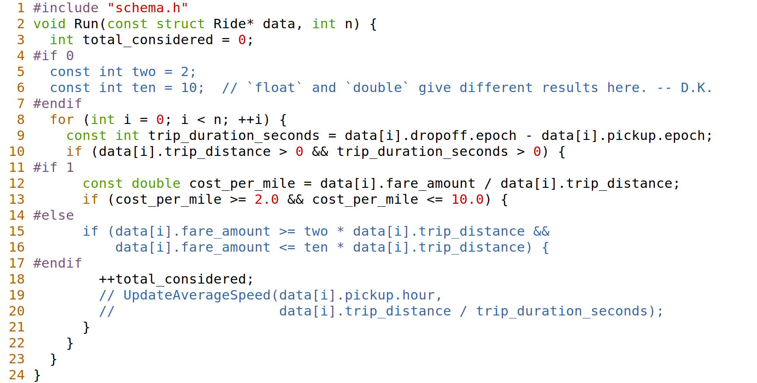
Floating point surprises: three (!) different results

Slide 29
Crunching, do over
What was the average speed of Yellow taxi trips in 2015? $ gcc -O3 step3_sanitycheck_avg_speed_by_dow.c && time ./a.out | tee >(md5sum) Total rides considered: 15592077 (95.2%) 00 15.37 01 15.85 02 16.10 03 16.67 04 17.81 05 19.72 06 19.47 07 14.82 08 12.99 09 13.55 10 13.49 11 13.51 12 13.22 13 13.18 14 12.40 15 12.02 16 11.61 17 11.29 18 11.74 19 12.70 20 13.51 21 14.00 22 14.46 23 14.93 ddba3b195052774ddc8e5f4d4ff26bec -

Slide 30
Dealing with non-integers
In the yellow cabs case:
All times are in seconds, which are integers.
All amounts are in dollars, which are integer cents.
Distance can be rounded, and let’s round to 1/100th of a mile to simplify division.
Solution: Update the schema to use integers, and re-cook the binary file.
The file can even get smaller thanks to it.

Slide 31
But wait, there’s more!
for (size_t i = 0; i < n; ++i) { const int trip_duration_s = data[i].dropoff.epoch - data[i].pickup.epoch; if (data[i].trip_distance_times_100 > 0 && trip_duration_s > 0) { if (data[i].fare_amount_cents >= 2 * data[i].trip_distance_times_100 && data[i].fare_amount_cents <= 10 * data[i].trip_distance_times_100) { ++total_considered; UpdateAverageSpeed(&per_hour_counters[data[i].pickup.hour], data[i].trip_distance_times_100, trip_duration_seconds); } } }
// The true average cab speed is total miles traveled divided by total hours traveled. // The average cab speed and the average of average ride speeds are not the same! // The original code computed something else, and rewriting the code helped locate it.

Slide 32
Recap
A.k.a. “so what?”:
We know Python is slow, but developers understand it. Their time is still more valuable than the time the machine spends running their code. Thanks, we’re not considering sed or awk.
We know mmap()-ing a file is fast, thanks, Captain Obvious. We don’t plan on doing it though, sorry.
We know binary formats are fast. Would be nice had they been some Protobuf or Thrift or Cap’n Proto or Avro. For pure binary, we, of course, have no plans to switch to C/C++.

Slide 33
The real thing
Move code to data, not data to code.
In this particular example we mmap()-ed the file.
Which is OK for a few GBs, but not fun for a file that barely fits in memory.
Still keeping a weak laptop in mind.

Slide 34
The real thing
Move code to data, not data to code.
In this particular example we mmap()-ed the file.
Which is OK for a few GBs, but not fun for a file that barely fits in memory.
Still keeping a weak laptop in mind.
We need another superpower to complement mmap(), and it’s dlopen().
Load a library dynamically, and natively call user-defined functions from it.

Slide 35
The real thing
Move code to data, not data to code.
In this particular example we mmap()-ed the file.
Which is OK for a few GBs, but not fun for a file that barely fits in memory.
Still keeping a weak laptop in mind.
We need another superpower to complement mmap(), and it’s dlopen().
Load a library dynamically, and natively call user-defined functions from it.
The production design then is:
The binary, that has all the data loaded up, runs as a daemon.
Introduce a lightweight interface to run “custom queries” against it.

Slide 36
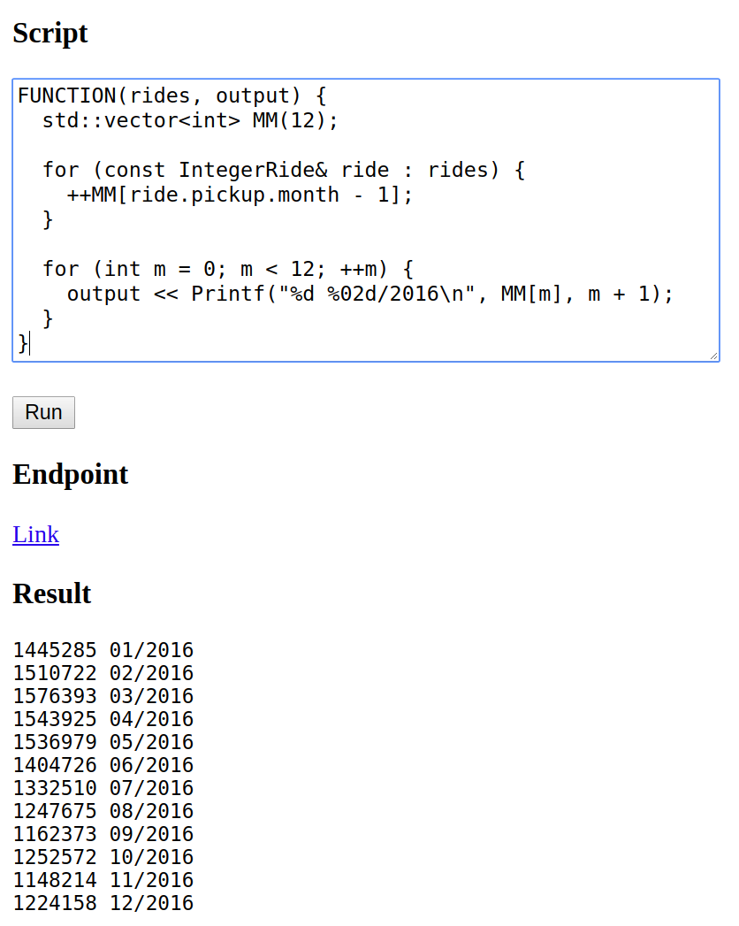
Worth a thousand words!
It’s in the browser.

Slide 37
How does it work
An obligatory disclaimer: I am not a frontend developer.
The browser UX is just a demo, we never used it, really.
Obviously, syntax highlighting, completion, and on-the-fly compilation can be added.
The user code is wrapped into a boilerplate for compilation.
The boilerplate it service-defined, hence Printf() and the FUNCTION() macro above.
The code is then SHA256-hashed, and each unique hash is only compiled once.
The user code can accept parameters, from the URL/querystring, or from HTTP headers.
The compilation is run from a dedicated temporary directory.
With a symlink to the framework, to enable accessing extra headers as necessary.
With a dummy, empty, header file the user could #include locally to “fix” completion.
A #line directive is injected between the boilerplate and the user code.
So that the IDE can jump to exact locations of the error should one occur in user code.

Slide 38
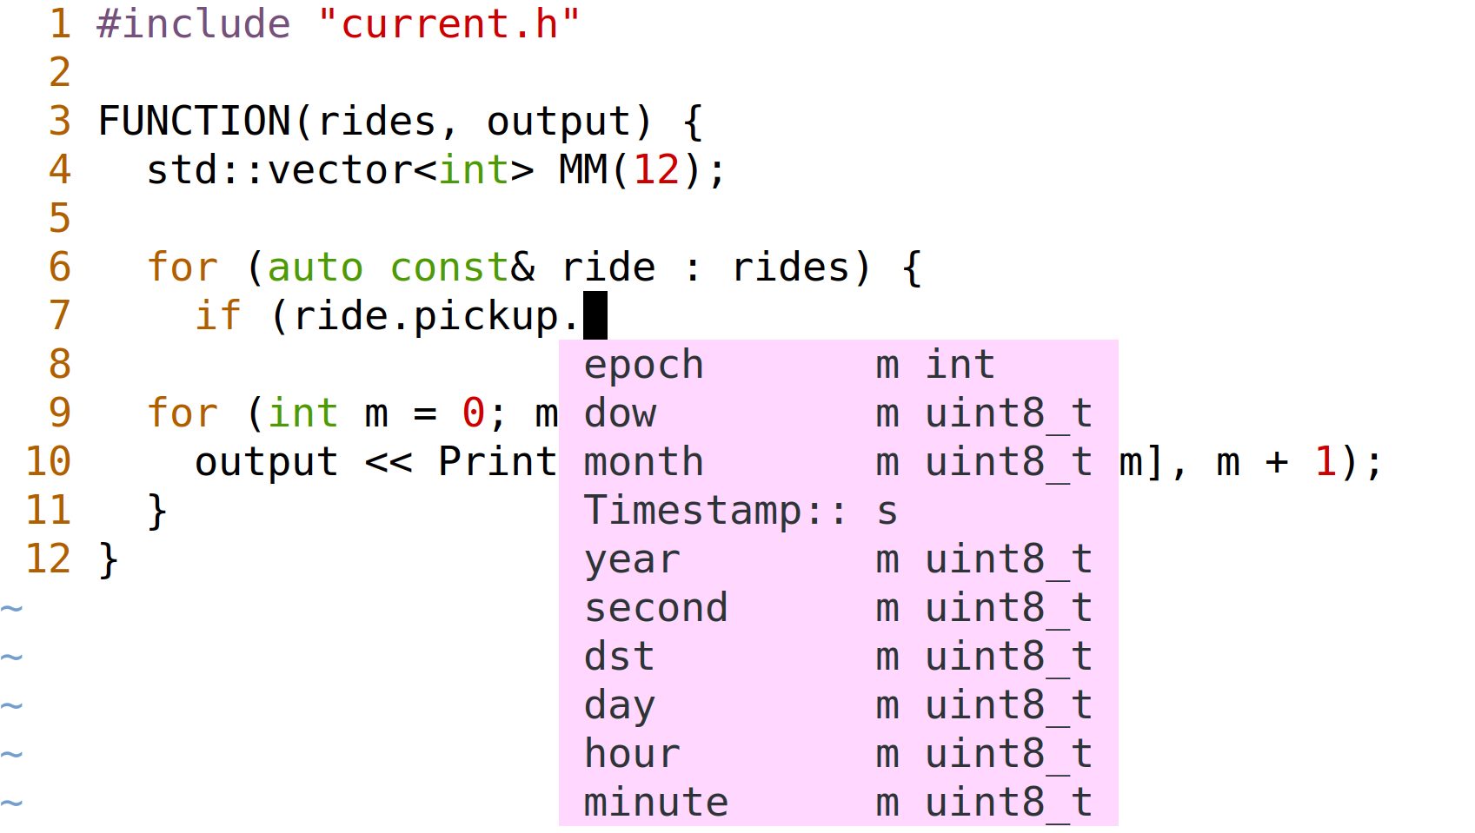
Also, completion! (No, this pink is not my color scheme. I code on a dark background.)

Slide 39
How does it work cont’d
To function flawlessly, best is to put three more files alongside the “script”.
The dummy header file.
To define the same symbols as the boilerplate, such as FUNCTION().
This enables proper syntax highlighting and completion.
In fact, in the demo it’s a symlink to the boilerplate.
A symlink to the very framework.
So that “library” functions such as Printf() or JSON() are easy to access.
A Makefile.
To push the code to the service using curl.
To “build” the code and “run” it, if built successfully.
To set the HTTP header with the original source name, for the IDE to jump to errors.

Slide 40
Bonus: JSON support and auto-set Content-Type
$ cat snippet.txt ENDPOINT(data, params) { std::map<int, int> histogram; for (const IntegerRide& ride : data) { ++histogram[ride.pickup.month - 1]; } return histogram; }
$ curl --data-binary @snippet.txt http://localhost:3000/full # Takes a bit longer, as JSON support is some wild metaprogramming. -- D.K. Compiled: @54108e84c0
$ curl -i http://localhost:3000/full/54108e84c0 HTTP/1.1 200 OK Content-Type: application/json; charset=utf-8 Connection: close Access-Control-Allow-Origin: * Content-Length: 148 [[0,1445285],[1,1510722],[2,1576393],[3,1543925],[4,1536979],[5,1404726],[6,1332510],[7,1247675],[8,1162373],[9,1252572],[10,1148214],[11,1224158]]

Slide 41
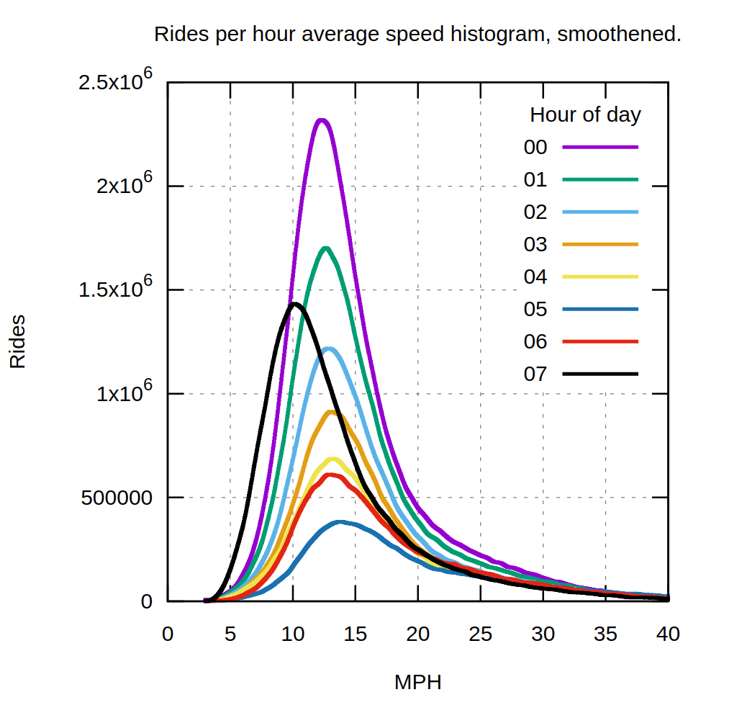
Bonus II: Visualizations
gnuplot
Using the existing binding.
Compile once.
Use URL parameters later.
/e3fcdadf67?from=0&to=8
Ready to use endpoint.
For monitoring and reporting.

Slide 42
Pros, aside from performance and zero configuration
Brings together the best of both worlds:
For the old-schoolers:
Code completion.
Build and run with one command, Makefile-friendly.
Every functional code snippet immediately becomes a curl-able endpoint.
For browser-cherishing folks:
Zero entry barrier.
Even this trivial demo is sharing-enabled.
User-defined logic can accept URL parameters.
If the backend is in C/C++, the above is a prototyping framework.
Production-ready for internal alerts, monitoring, and reporting.
A playground for real-time ML features.
The very same code then goes through the review, and makes it as a prod API endpoint.

Slide 43
Cons
Zero security.
Bad memory access would SEGFAULT the serving daemon.
I’m not sharing this very URL, as one could run rm -rf / on my machine.
Can run from under an unprivileged user.
Not really an issue with modern virtualization and containers.
Even less of an issue as data scientists tend to self-organize into friendly sub-teams.
You have to write C++.
I made it as “JavaScript” as possible for you, but, face it, it is C++ behind the scenes.
Although one can argue whether it’s a bad thing.

Slide 44

Cons
Zero security.
Bad memory access would SEGFAULT the serving daemon.
I’m not sharing this very URL, as one could run rm -rf / on my machine.
Can run from under an unprivileged user.
Not really an issue with modern virtualization and containers.
Even less of an issue as data scientists tend to self-organize into friendly sub-teams.
You have to write C++.

Slide 45
Conclusions and Q&A
“Big” data is in the eye of the shell holder.
For single- and even double-digit gigabytes, most crunching still fits a laptop.
Streaming data in real time is also no problem whatsoever.
As long as the daemon binary is listening to some pub-sub bus, which most of us have.
Don’t rush to use fancy trending toolkits until they are needed.
I personally have stopped people from using tools for the sake of using them.
First principles and C++ rock.
And C++ is a simple and safe enough language by 2018. If you speak JS, you can do modern C++, and you will enjoy it.

Slide 46
Thanks
Q&A

