Slide 1
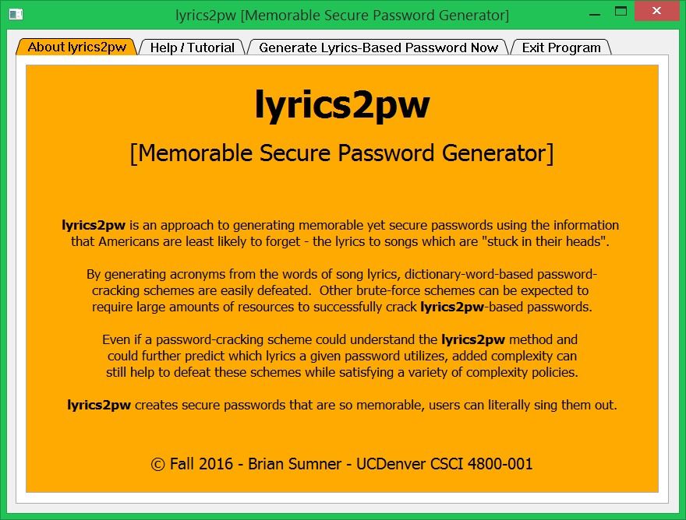

Slide 2
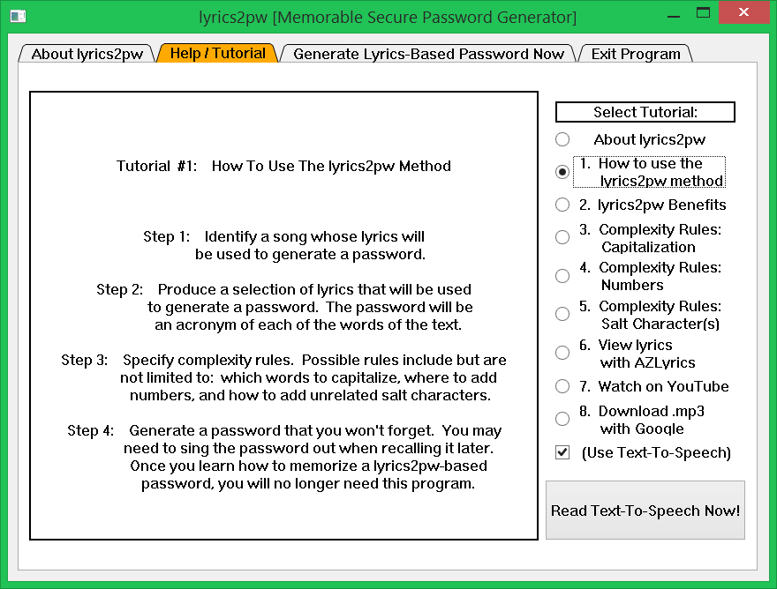

Slide 3
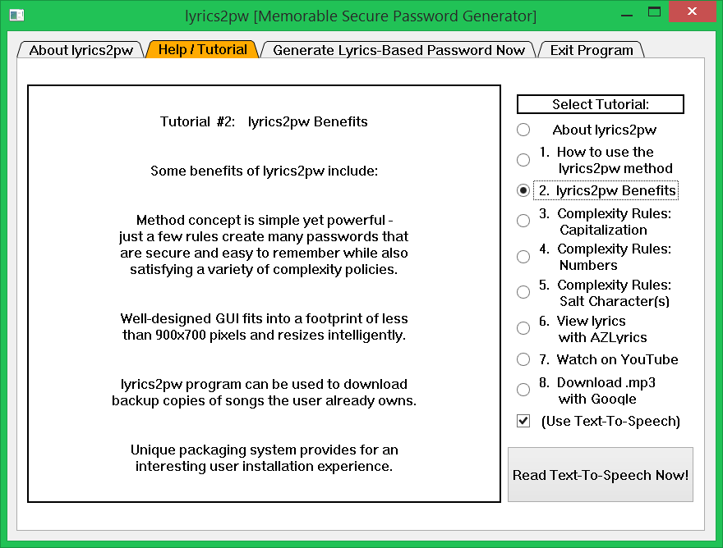

Slide 4
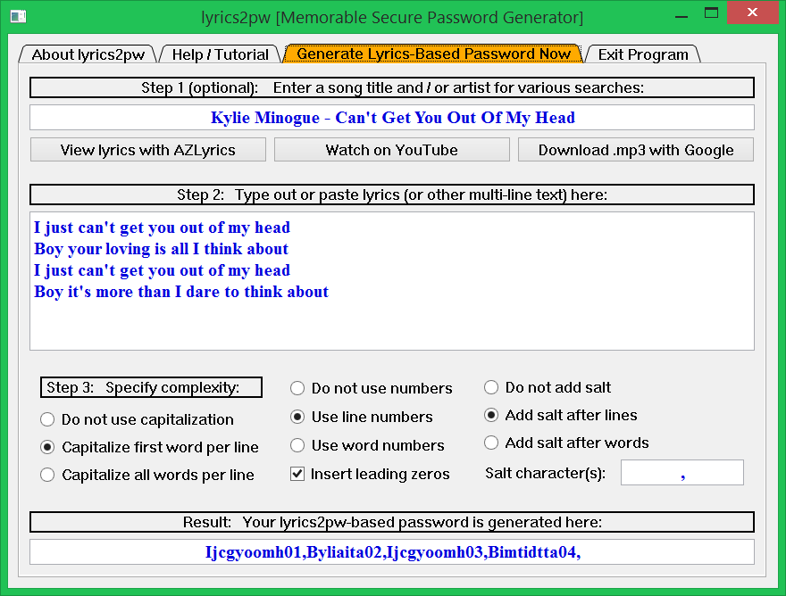

Slide 5
lyrics2pw Required Dependencies:
1. manifest-lyrics2pw-embryo.py (this file exists in current directory)
2. python3
3. Qt5 and PyQt5
4. g++ (available in system path)
5. Python Win32 Extensions (optional - provides Text-To-Speech support)

Slide 6
lyrics2pw Manifestation
(Installation) Instructions:
Please see the readme-lyrics2pw.txt file for details.

Slide 7
Acknowledgments:
The following resources were indispensable in creating this program:
“Automate the Boring Stuff with Python” by Al Sweigart
https://automatetheboringstuff.com/
“Google hack to instantly search for files”
http://www.techrepublic.com/blog/it-news-digest/google-hack-to-instantly-search-for-files/
“Why can't I use “Speech.SpVoice” instead of “SAPI.SpVoice” with python and win32com?”
http://stackoverflow.com/questions/35222346/why-cant-i-use-speech-spvoice-instead-of-sapi-spvoice-with-python-and-win32

