Slide 1
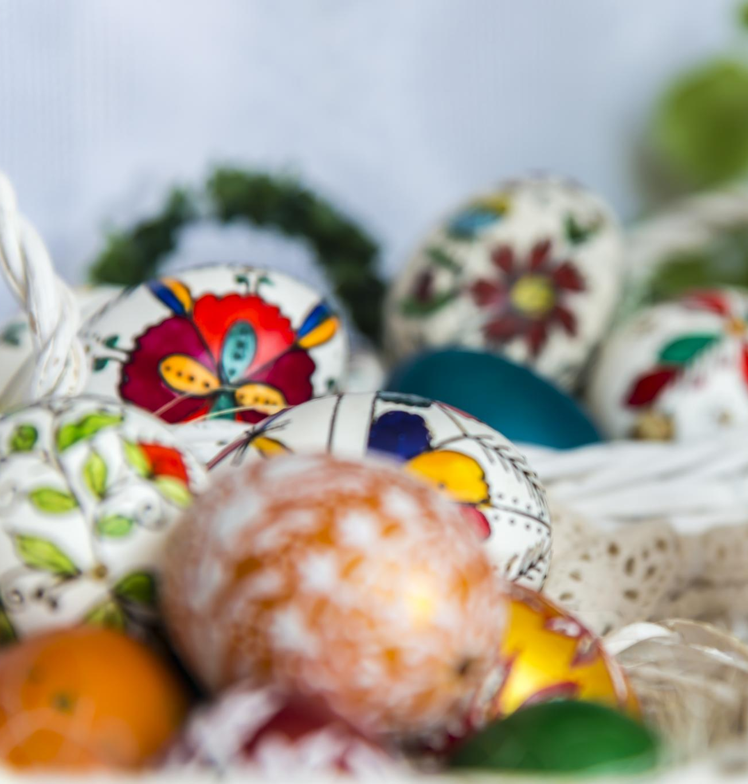
The Art and Tradition of Easter Egg Painting
Exploring the cultural significance and techniques involved
Notes:
AI-generated content may be incorrect. --- Easter egg painting is a cherished tradition that combines artistry with cultural significance. This presentation will explore the historical background, materials used, and various techniques involved in this delightful art form.

Slide 2
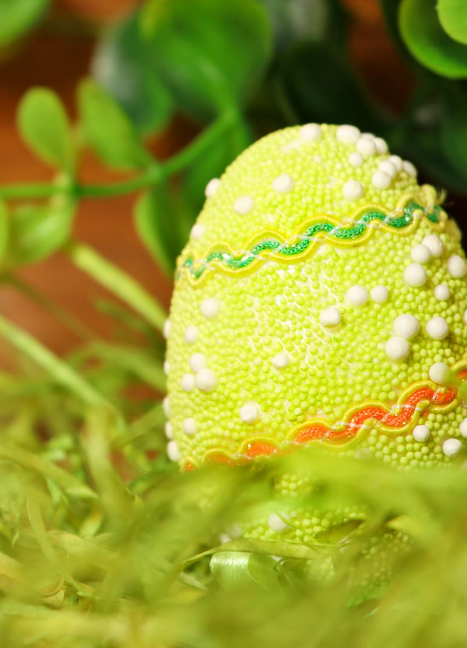
Origins of the Easter egg tradition
Ancient Symbolism
The tradition of Easter eggs originates from ancient cultures where eggs symbolised fertility and new life.
Christian Adoption
Early Christians adopted eggs to symbolise the resurrection of Jesus, intertwining the egg tradition with Easter celebrations.
Continued Tradition
The practice of decorating and exchanging Easter eggs has persisted, evolving into various cultural celebrations around the world.
Notes:
The tradition of Easter eggs dates back to ancient times, symbolising new life and rebirth. Early Christians adopted eggs as a symbol of the resurrection of Jesus, and this practice has continued through the centuries.

Slide 3
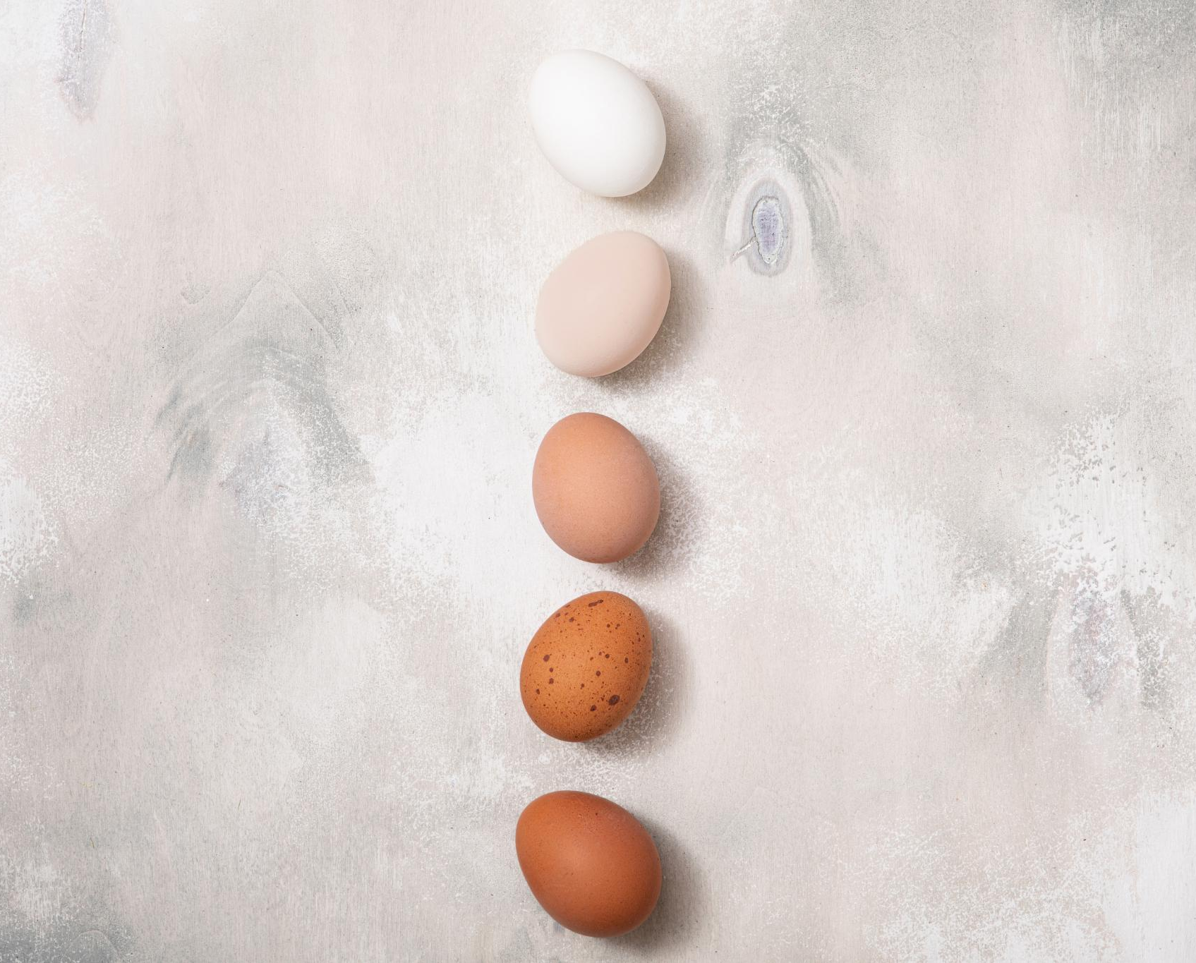
Types of Eggs Used
Chicken Eggs
Chicken eggs are the most popular choice for artists due to their availability and ease of use for painting.
Duck Eggs
Duck eggs offer a different texture and size, which can challenge artists but also provide unique artistic opportunities.
Quail Eggs
Quail eggs are smaller and have a speckled appearance, making them ideal for intricate and detailed designs.
Wooden Eggs
Wooden eggs are a versatile alternative that artists can paint on, allowing for durable and lasting creations.
Notes:
While chicken eggs are the most commonly used for painting, other types of eggs, such as duck, quail, and even wooden eggs, can be used to create unique designs. Each type of egg presents different challenges and opportunities for artists.

Slide 4
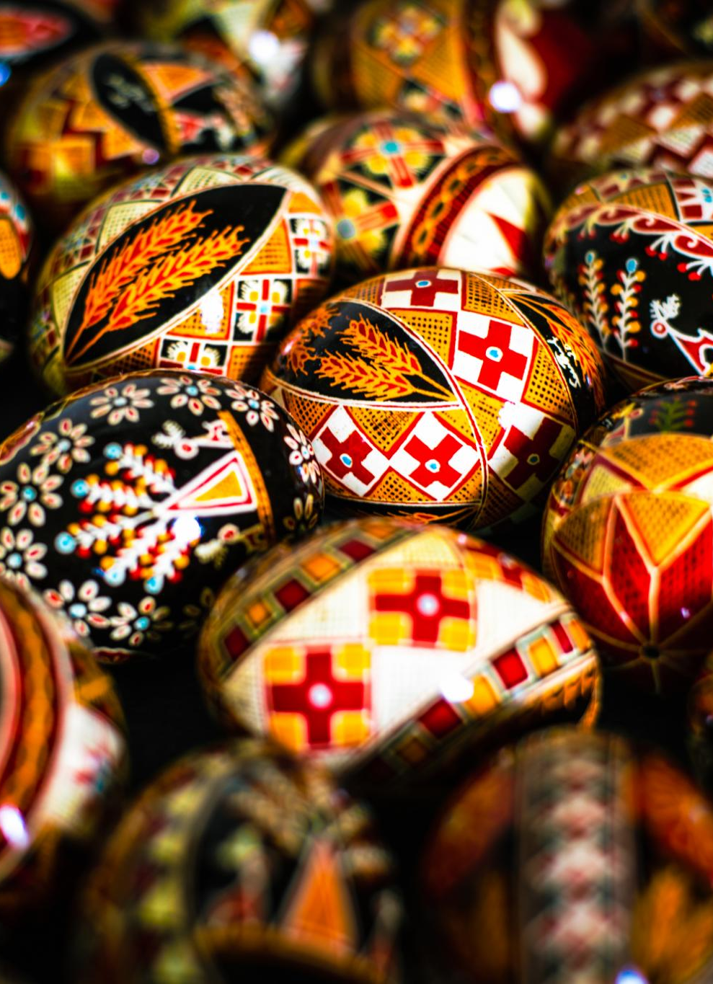
Regional styles and patterns
Distinct Regional Styles
Various regions have unique styles that showcase their local culture, history, and traditions in egg painting.
Geometric Polish Patterns
Polish egg painting features intricate geometric patterns that highlight the craftsmanship and cultural significance in their traditions.
Floral Russian Motifs
Russian eggs are renowned for their floral motifs, symbolizing beauty and nature, adding an artistic touch to the tradition.
Notes:
Different regions have distinct styles and patterns that reflect local culture and history. From the geometric patterns of Polish eggs to the floral motifs of Russian eggs, these regional styles add depth to the tradition of egg painting.

