Slide 1
Multi-Agent DevOps Incident Analysis Suite
Design, Build & Deployment
AI Engineering Accelerator — Class 7 – Group 2
Wayne Johnston
Ramesh Rajareddy
Sunil Joseph
Vinod Dasyam
Built with Claude Opus 4.6 | LangGraph | LangChain | Streamlit
June 2026

Slide 2
Agenda
1. Executive Summary
2. Architecture & Design
3. Technology Stack
4. Agent Deep Dive (5 agents)
5. LangGraph Orchestration
6. Slack Channel Routing
7. Streamlit UI & Security
8. Unit Testing & Code Coverage
9. Deployment
10. Future Enhancements

Slide 3
Executive Summary
AI-driven incident analysis for DevOps & SRE teams
• Upload infrastructure logs (routers, switches, firewalls, servers)
• AI infers log formats — no hardcoded regex or format parsers
• 5-agent pipeline: parse → classify → remediate → notify → runbook
• Multi-channel Slack routing by incident category
• JIRA ticket creation for critical-severity issues
• Actionable Markdown runbook with CLI commands & checklists
• Mock/live integration toggles for safe demoing
• Directory watcher for automated log ingestion

Slide 4
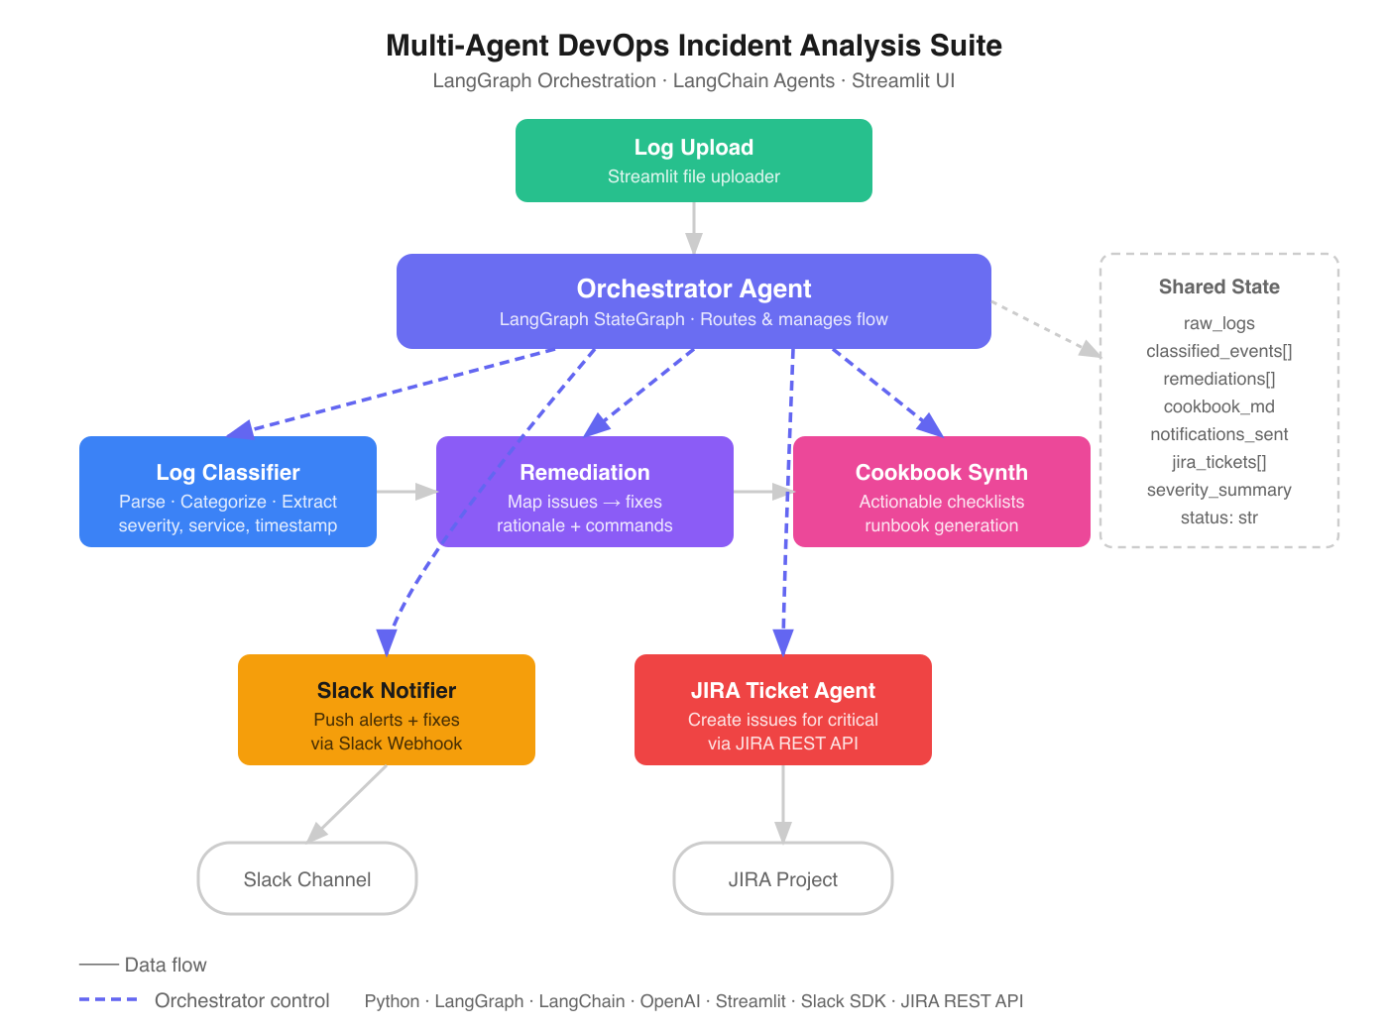
Architecture & Design
LangGraph StateGraph orchestrates 5 specialized agents

Slide 5
Pipeline Flow
Conditional routing based on incident severity
Log Reader
Remediation
Route
has_critical?
no critical
Slack Notifier
JIRA Agent
Cookbook
END

Slide 6
Technology Stack
LLM
GPT-4o via OpenRouter
Orchestration
LangGraph StateGraph
Framework
LangChain Core
UI
Streamlit
Notifications
Slack Webhook API
Ticketing
JIRA REST API
File Watcher
watchdog

Slide 7
Agent Deep Dive
5 specialized agents with distinct responsibilities
Log Reader / Classifier
Remediation Agent
Cookbook Synthesizer
3-stage AI pipeline: 1. Schema inference (first 15 lines) 2. Full parse (100-line chunks) 3. Severity + category classification
Filters warning/critical events Root cause analysis Vendor-specific CLI commands Risk assessment per fix
Markdown runbook generation Priority matrix table Checkbox checklists + code blocks Escalation criteria
Slack Notifier
JIRA Ticket Agent
Groups by incident category Routes to correct channel Rich formatted messages Mock/live toggle
Critical issues only Structured ticket descriptions {noformat} CLI command blocks Mock/live toggle

Slide 8
Slack Channel Routing
Incidents auto-route to the right team's channel
#ops-incidents
Operations team
Categories:
resource, application, database
#secops-incidents
Security operations
Categories:
security, auth, policy
#network-incidents
Network engineering
Categories:
interface, routing, network, hardware

Slide 9
Shared State Schema
IncidentState TypedDict — all agents read/write shared state
Field
Type
Description
raw_logs
dict[str, str]
Filename → full log text
inferred_schemas
dict[str, list]
AI-detected field definitions
parsed_events
list[dict]
Structured parsed events
classified_events
list[dict]
Events + severity + category
remediations
list[dict]
Issue → fix + CLI commands
cookbook
str
Markdown runbook
notifications_sent
list[dict]
Slack message results
jira_tickets
list[dict]
JIRA ticket references
status
str
Current pipeline stage
errors
list[str]
Accumulated errors

Slide 10
Streamlit UI & Security
UI Features
Security
• Multi-file upload (.log, .txt)
• Load Samples button for demo
• Directory watcher auto-ingestion
• 6 result tabs: Events, Remediations,
Runbook, Slack, JIRA, Schemas
• Severity color coding (red/yellow/blue)
• Runbook download button
• API keys never pre-filled in UI
• Users enter own keys per session
• Secrets reserved for /api endpoint
• Analyze blocked without API key
• Mock-first integrations (safe demos)
• .env excluded from git
• Framework-agnostic core (0 UI deps)

Slide 11
Unit Testing & Code Coverage
81 tests | 99% coverage | pytest + unittest.mock
81
Tests Passed
0
Failed
99%
Coverage
5
Test Modules
Module
Stmts
Miss
Cover
Missing
state.py
12
0
100%
—
tools.py
36
0
100%
—
watcher.py
64
0
100%
—
graph.py
21
0
100%
—
agents.py
143
2
99%
13, 17
TOTAL
276
2
99%
Lines 13, 17 in agents.py are import-time .env path checks (load_dotenv calls) — both branches are exercised but coverage can't attribute them to a specific test due to module import timing.

Slide 12
Test Suite Breakdown
Comprehensive mocking of LLM, Slack, and JIRA integrations
test_state.py (2 tests)
test_tools.py (23 tests)
test_watcher.py (10 tests)
TypedDict instantiation Populated data validation
Channel routing (12 categories) Slack mock/live modes JIRA mock/live modes Webhook POST verification
File type filtering Debounce logic Directory create/scan Unreadable file handling
test_agents.py (25 tests)
test_graph.py (8 tests)
Lazy LLM pattern All 5 agent nodes JSON parse failures Edge cases (empty, malformed)
Severity routing logic Graph compilation Full pipeline (critical path) Normal path (skip Slack/JIRA)
Run: python -m pytest test_*.py -v --cov=state --cov=tools --cov=watcher --cov=agents --cov=graph --cov-report=term-missing

Slide 13
Deployment
Streamlit Cloud
https://devops-incident-suite-main-group2.streamlit.app/
GitHub Repository
https://devops-incident-suite-main-group2.streamlit.app/
Streamlit Cloud Steps
1. Sign in to share.streamlit.io with GitHub
2. Click 'New app' → select devops-incident-suite repo
3. Branch: main | Main file: app.py
4. No secrets needed (users enter own keys)
5. Click Deploy — live in ~2 minutes
Future: Flask API endpoint — core pipeline has zero Streamlit dependencies, enabling a Flask/FastAPI frontend swap with no agent changes.

Slide 14
Project Structure
Framework-agnostic core + Streamlit UI
app.py
Streamlit UI entry point
state.py
IncidentState TypedDict (shared state)
agents.py
5 agent node functions + lazy LLM
graph.py
LangGraph StateGraph wiring
tools.py
@tool wrappers (Slack, JIRA) + routing
watcher.py
Directory watcher (watchdog)
log_samples/
4 synthetic log files (IOS, CEF, RFC5424, tabular)
test_*.py
81 unit tests (pytest)

Slide 15
Future Enhancements
• Flask API endpoint (POST /api/analyze) with server-side secrets
• RAG-based remediation using historical runbook embeddings
• Real-time streaming via LangGraph's streaming interface
• Cross-file correlation engine for cascading failure detection
• Persistent storage (SQLite/PostgreSQL) for trend analysis
• PagerDuty integration for critical incident escalation
• Custom log format registry (save & share inferred schemas)

Slide 16
Thank You
Multi-Agent DevOps Incident Analysis Suite
Wayne Johnston | AI Engineering Accelerator | Cohort 7
github.com/wjohnston99/devops-incident-suite

