Slide 1
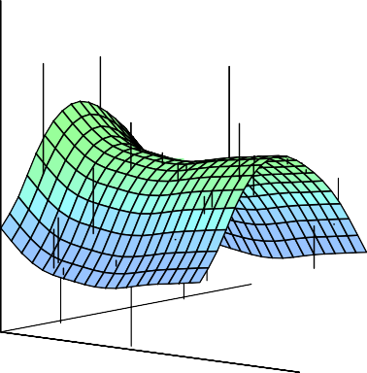


Statistical Analysis for Data Science C7081
Ed Harris
•
•
•
•
•
•
•• • •• • •• •
• ••••
•
•
• • •
••
• ••
•
••
•
•
•
•
•
•
•
•
• •
•
•

Slide 2

06: Model selection
“All models are wrong but some are useful.”
-George Box

Slide 3
Linear Model Selection and Regularization
Recall the linear model
Y = β₀ + β₁X₁ + · · · + β_{p}X_{p} + E.
In the next few lecture topics, we consider some approaches for extending the linear model framework. Eventually, we will generalize the linear model in order to accommodate non-linear, but still additive, relationships.
In the lectures covering Chapter 8 we consider even more general non-linear models.

Slide 4
In praise of linear models!
Despite its simplicity, the linear model has distinct advantages in terms of its interpretability and often shows good predictive performance.
Hence we discuss in this lecture some ways in which the simple linear model can be improved, by replacing ordinary least squares fitting with some alternative fitting procedures.

Slide 5
Why consider alternatives to least squares?
Prediction Accuracy: especially when p > n, to control the variance.
Model Interpretability: By removing irrelevant features — that is, by setting the corresponding coefficient estimates to zero — we can obtain a model that is more easily interpreted. We will present some approaches for automatically performing feature selection.

Slide 6
Three classes of methods
Subset Selection. We identify a subset of the p predictors that we believe to be related to the response. We then fit a model using least squares on the reduced set of variables.
Shrinkage. We fit a model involving all p predictors, but the estimated coefficients are shrunken towards zero relative to the least squares estimates. This shrinkage (also known as regularization) has the effect of reducing variance and can also perform variable selection.
Dimension Reduction. We project the p predictors into a M -dimensional subspace, where M < p. This is achieved by computing M different linear combinations, or projections, of the variables. Then these M projections are used as predictors to fit a linear regression model by least squares.

Slide 7
Subset Selection
Best subset and stepwise model selection procedures
Best Subset Selection
1. Let M₀ denote the null model, which contains no predictors. This model simply predicts the sample mean for each observation.
2. For k = 1, 2, . . . p:
p
(a) Fit all models that contain exactly k predictors.
( )
k
p
( )
(b) Pick the best among these models, and call it M_{k}. Here
k
best is defined as having the smallest RSS, or equivalently largest R².
3. Select a single best model from among M₀, . . . , M_{p} using cross-validated prediction error, C_{p} (AIC), BIC, or adjusted R².

Slide 8
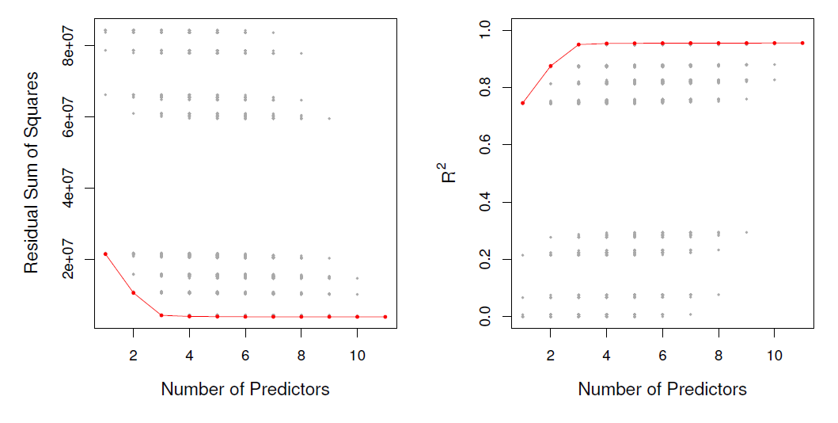
Example- Credit data set
For each possible model containing a subset of the ten predictors in the Credit data set, the RSS and R² are displayed. The red frontier tracks the best model for a given number of predictors, according to RSS and R². Though the data set contains only ten predictors, the x-axis ranges from 1 to 11, since one of the variables is categorical and takes on three values, leading to the creation of two dummy variables

Slide 9
Extensions to other models
Although the best subset selection presented here for least squares regression, the same ideas apply to other types of models, such as logistic regression.
The deviance— negative two times the maximized
log-likelihood— plays the role of RSS for a broader class of models.

Slide 10
Stepwise Selection
For computational reasons, best subset selection cannot usually be applied with very large p. Why not?
Best subset selection may also suffer from statistical problems when p is large: larger the search space, the higher the chance of finding models that look good on the training data, even though they might not have any predictive power on future data.
Thus an enormous search space can lead to overfitting and high variance of the coefficient estimates.
For both of these reasons, stepwise methods, which explore a far more restricted set of models, are attractive alternatives to best subset selection.

Slide 11
Forward Stepwise Selection
Forward stepwise selection begins with a model containing no predictors, and then adds predictors to the model,
one-at-a-time, until all of the predictors are in the model.
In particular, at each step the variable that gives the greatest additional improvement to the fit is added to the model.

Slide 12
In Detail
Forward Stepwise Selection
1. Let M₀ denote the null model, which contains no predictors.
2. For k = 0, . . . , p − 1:
Consider all p − k models that augment the predictors in
M_{k} with one additional predictor.
Choose the best among these p − k models, and call it M_{k+1}. Here best is defined as having smallest RSS or highest R².
3. Select a single best model from among M₀, . . . , M_{p} using cross-validated prediction error, C_{p} (AIC), BIC, or adjusted R².

Slide 13
More on Forward Stepwise Selection
Computational advantage over best subset selection is clear.
It is not guaranteed to find the best possible model out of all 2^{p} models containing subsets of the p predictors. Why not? Give an example.

Slide 14
Credit data example
# Variables
Best subset
Forward stepwise
One Two Three Four
rating rating, income
rating, income, student cards, income
student, limit
rating rating, income
rating, income, student rating, income, student, limit
The first four selected models for best subset selection and forward stepwise selection on the Credit data set. The first three models are identical but the fourth models differ.

Slide 15
Backward Stepwise Selection
Like forward stepwise selection, backward stepwise selection
provides an efficient alternative to best subset selection.
However, unlike forward stepwise selection, it begins with the full least squares model containing all p predictors, and then iteratively removes the least useful predictor,
one-at-a-time.

Slide 16
Backward Stepwise Selection: details
Backward Stepwise Selection
1. Let M_{p} denote the full model, which contains all p
predictors.
2. For k = p, p − 1, . . . , 1:
Consider all k models that contain all but one of the predictors in M_{k}, for a total of k − 1 predictors.
Choose the best among these k models, and call it M_{k−1}. Here best is defined as having smallest RSS or highest R².
3. Select a single best model from among M₀, . . . , M_{p} using cross-validated prediction error, C_{p} (AIC), BIC, or adjusted R².

Slide 17
More on Backward Stepwise Selection
Like forward stepwise selection, the backward selection approach searches through only 1 + p(p + 1)/2 models, and so can be applied in settings where p is too large to apply best subset selection
Like forward stepwise selection, backward stepwise selection is not guaranteed to yield the best model containing a subset of the p predictors.
Backward selection requires that the number of samples n is larger than the number of variables p (so that the full model can be fit). In contrast, forward stepwise can be used even when n < p, and so is the only viable subset method when p is very large.

Slide 18
Choosing the Optimal Model
The model containing all of the predictors will always have the smallest RSS and the largest R², since these quantities are related to the training error.
We wish to choose a model with low test error, not a model with low training error. Recall that training error is usually a poor estimate of test error.
Therefore, RSS and R² are not suitable for selecting the best model among a collection of models with different numbers of predictors.

Slide 19
Estimating test error: two approaches
We can indirectly estimate test error by making an adjustment to the training error to account for the bias due to overfitting.
We can directly estimate the test error, using either a validation set approach or a cross-validation approach, as discussed in previous lectures.
We illustrate both approaches next.

Slide 20
C_{p}, AIC, BIC, and Adjusted R²
These techniques adjust the training error for the model size, and can be used to select among a set of models with different numbers of variables.
The next figure displays C_{p}, BIC, and adjusted R² for the best model of each size produced by best subset selection on the Credit data set.

Slide 21
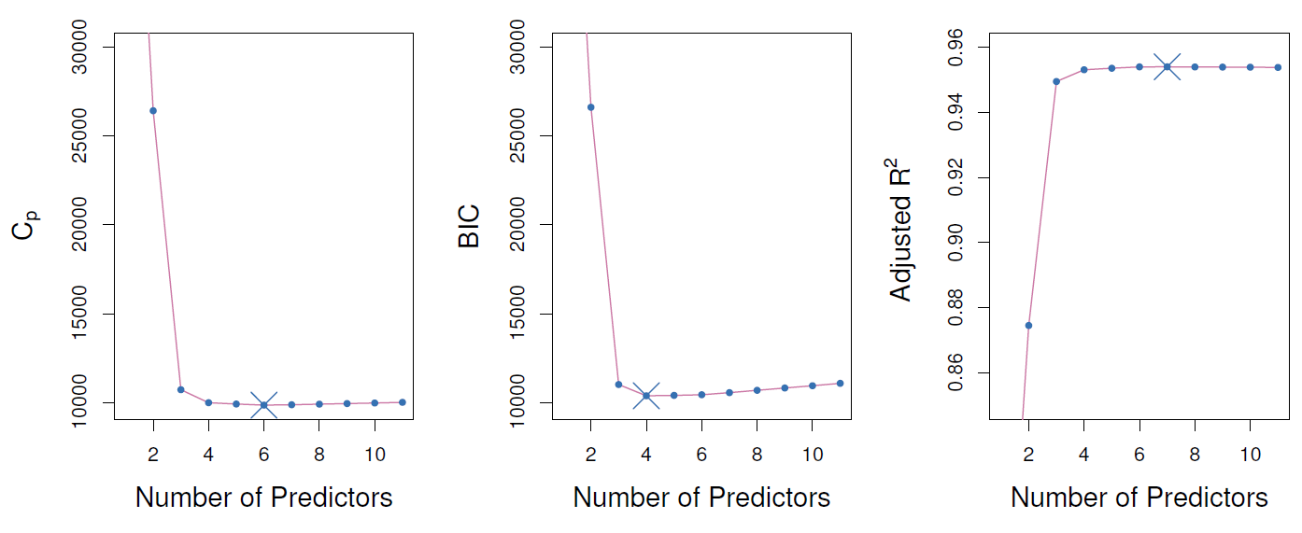
Credit data example
Cp, BIC, and adjusted R2 are shown for the best models of each size for the Credit data set. Cp and BIC are estimates of test MSE.
In the middle plot we see that the BIC estimate of test error shows an increase after four variables are selected. The other two plots are
rather flat after four variables are included.

Slide 22
Now for some details
Mallow’s C_{p}:
1
( )
2
C = RSS + 2dσˆ ,
p
n
where d is the total # of parameters used and σˆ² is an estimate of the variance of the error E associated with each response measurement.
The AIC criterion is defined for a large class of models fit by maximum likelihood:
AIC = −2 log L + 2 · d
where L is the maximized value of the likelihood function for the estimated model.
In the case of the linear model with Gaussian errors, maximum likelihood and least squares are the same thing, and C_{p} and AIC are equivalent. Prove this.

Slide 23
Details on BIC
1
2
( )
BIC = RSS + log(n)dσˆ .
n
Like C_{p}, the BIC will tend to take on a small value for a model with a low test error, and so generally we select the model that has the lowest BIC value.
Notice that BIC replaces the 2dσˆ² used by C_{p} with a log(n)dσˆ² term, where n is the number of observations.
Since log n > 2 for any n > 7, the BIC statistic generally places a heavier penalty on models with many variables, and hence results in the selection of smaller models than C_{p}.

Slide 24
Adjusted R²
For a least squares model with d variables, the adjusted R²
statistic is calculated as
RSS/(n − d − 1)
Adjusted R² = 1 − .
TSS/(n − 1)
where TSS is the total sum of squares.
Unlike C_{p}, AIC, and BIC, for which a small value indicates a model with a low test error, a large value of adjusted R² indicates a model with a small test error.
Maximizing the adjusted R² is equivalent to minimizing
^{RSS} While RSS always decreases as the number of
n−d−1
RSS
variables in the model increases, _{n−d−1} may increase or
decrease, due to the presence of d in the denominator.
Unlike the R² statistic, the adjusted R² statistic pays a price for the inclusion of unnecessary variables in the model. (see Figure on previous slide)

Slide 25
Validation and Cross-Validation
Each of the procedures returns a sequence of models M_{k} indexed by model size k = 0, 1, 2, . . .. Our job here is to select k^{ˆ}. Once selected, we will return model M_{kˆ}
We compute the validation set error or the cross-validation error for each model M_{k} under consideration, and then select the k for which the resulting estimated test error is smallest.
This procedure has an advantage relative to AIC, BIC, C_{p}, and adjusted R², in that it provides a direct estimate of the test error, and doesn’t require an estimate of the error variance σ².
It can also be used in a wider range of model selection tasks, even in cases where it is hard to pinpoint the model degrees of freedom (e.g. the number of predictors in the model) or hard to estimate the error variance σ².

Slide 26
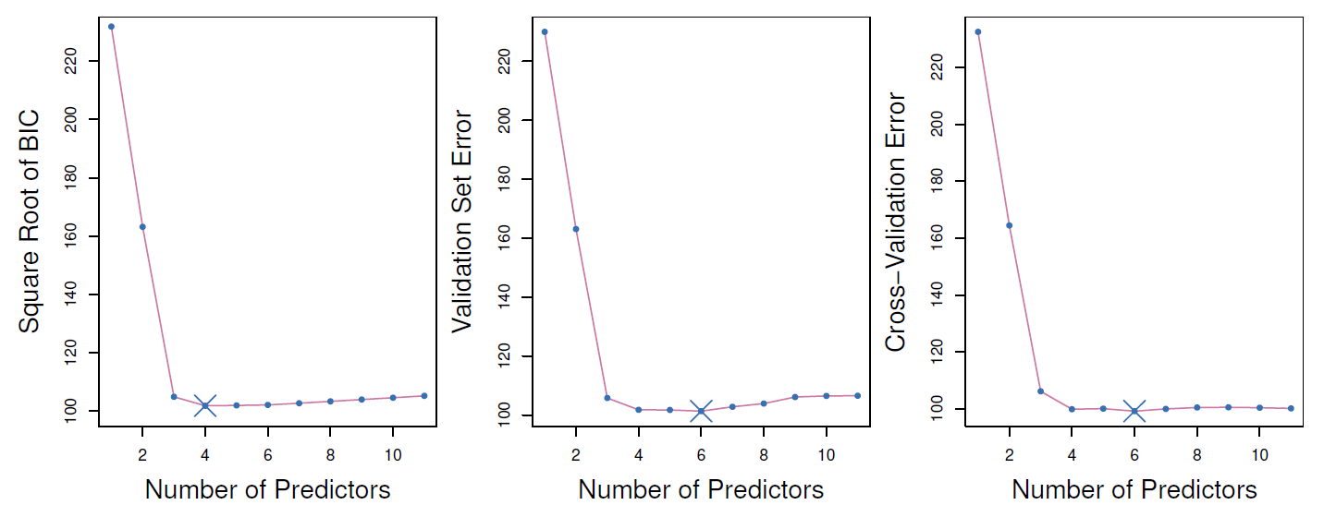
Credit data example

Slide 27
Details of Previous Figure
The validation errors were calculated by randomly selecting three-quarters of the observations as the training set, and the remainder as the validation set.
The cross-validation errors were computed using k = 10 folds. In this case, the validation and cross-validation methods both result in a six-variable model.

Slide 28
Details of Previous Figure
However, all three approaches suggest that the four-, five-, and six-variable models are roughly equivalent in terms of their test errors.
In this setting, we can select a model using the
one-standard-error rule. We first calculate the standard error of the estimated test MSE for each model size, and then select the smallest model for which the estimated test error is within one standard error of the lowest point on the curve. What is the rationale for this?

Slide 29
Shrinkage Methods
Ridge regression and Lasso
The subset selection methods use least squares to fit a linear model that contains a subset of the predictors.
As an alternative, we can fit a model containing all p predictors using a technique that constrains or regularizes the coefficient estimates, or equivalently, that shrinks the coefficient estimates towards zero.
It may not be immediately obvious why such a constraint should improve the fit, but it turns out that shrinking the coefficient estimates can significantly reduce their variance.

Slide 30
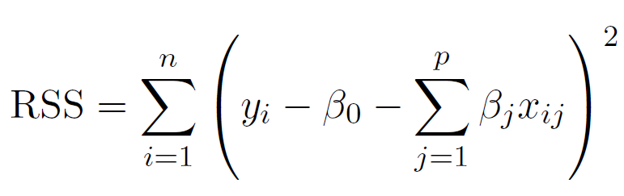
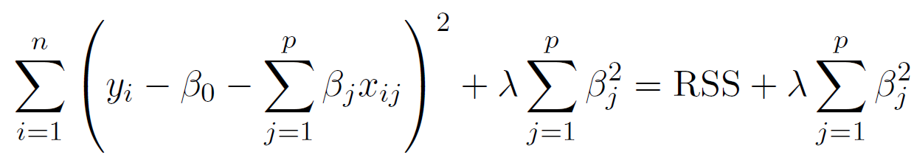
Ridge regression
Recall that the least squares fitting procedure estimates
β₀, β₁, . . . , β_{p} using the values that minimize
In contrast, the ridge regression coefficient estimates β^{ˆR}
are the values that minimize
where λ ≥ 0 is a tuning parameter, to be determined separately.

Slide 31

Ridge regression: continued
As with least squares, ridge regression seeks coefficient
estimates that fit the data well, by making the RSS small.
However, the second term, , called a shrinkage
penalty, is small when β₁, . . . , β_{p} are close to zero, and so it has the effect of shrinking the estimates of β_{j} towards zero.
The tuning parameter λ serves to control the relative impact of these two terms on the regression coefficient estimates.
Selecting a good value for λ is critical; cross-validation is used for this.

Slide 32
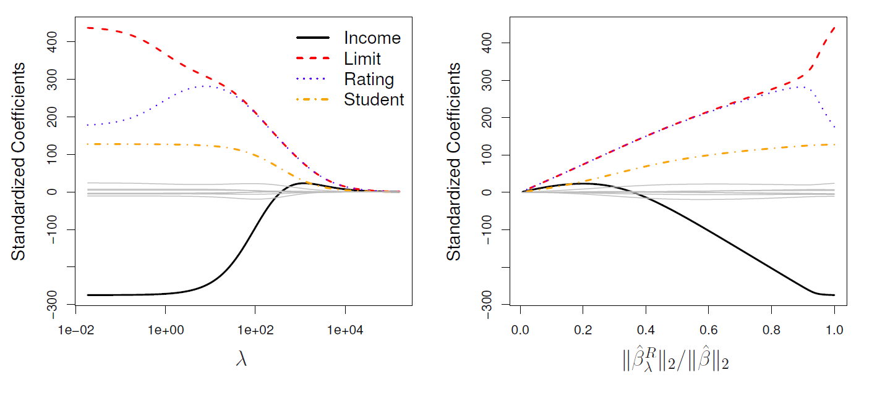
Credit data example

Slide 33
Details of Previous Figure
In the left-hand panel, each curve corresponds to the ridge regression coefficient estimate for one of the ten variables, plotted as a function of λ.

Slide 34
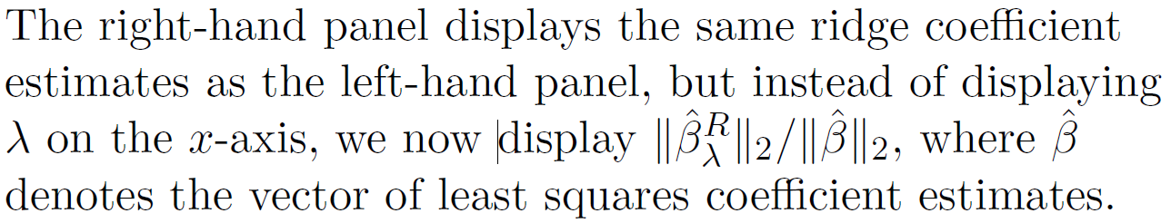
Details of Previous Figure

Slide 35
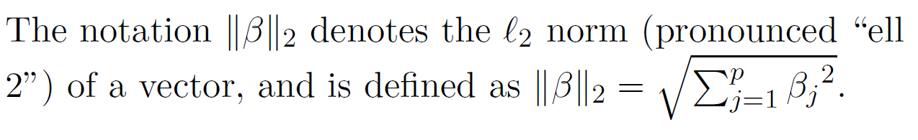
Details of Previous Figure

Slide 36
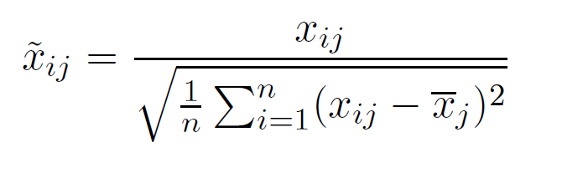
Ridge regression: scaling of predictors
The standard least squares coefficient estimates are scale equivariant: multiplying X_{j} by a constant c simply leads to a scaling of the least squares coefficient estimates by a factor of 1/c. In other words, regardless of how the jth predictor is scaled, X_{j} β^{ˆ}_{j} will remain the same.
In contrast, the ridge regression coefficient estimates can change substantially when multiplying a given predictor by a constant, due to the sum of squared coefficients term in the penalty part of the ridge regression objective function.
Therefore, it is best to apply ridge regression after
standardizing the predictors, using the formula

Slide 37
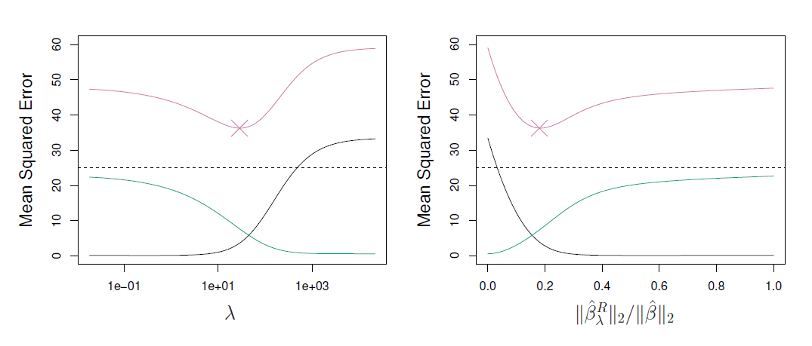
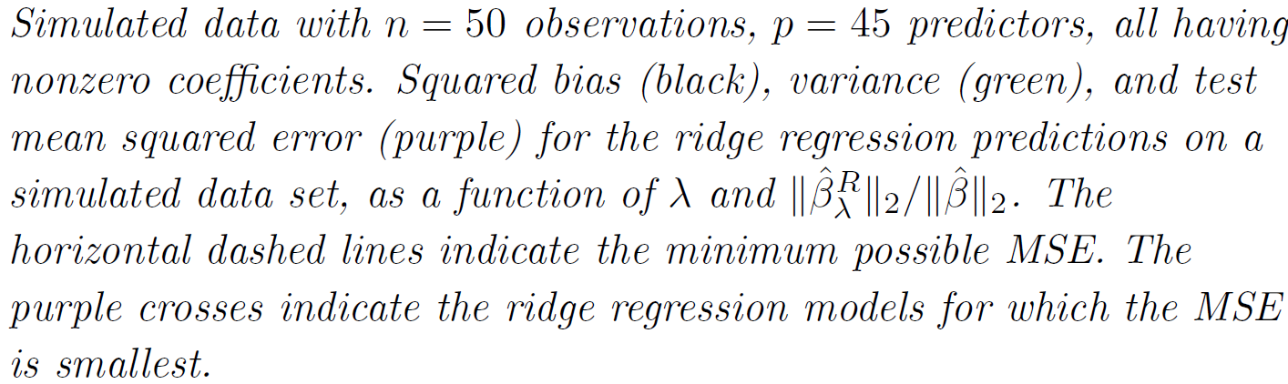
Why Does Ridge Regression Improve over Least Squares?
The Bias-Variance tradeoff
32 / 57

Slide 38
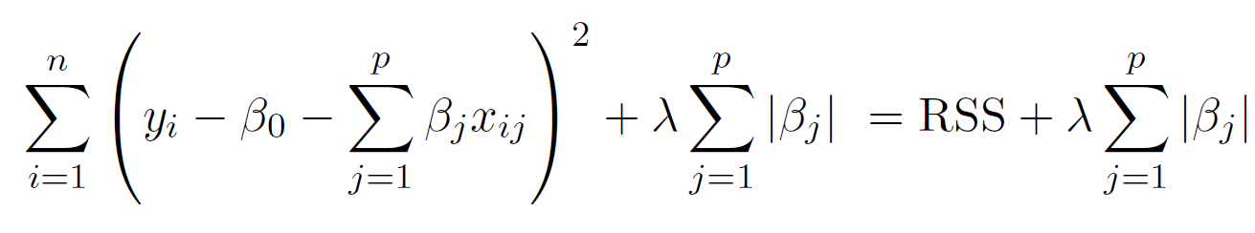
The Lasso
Ridge regression does have one obvious disadvantage: unlike subset selection, which will generally select models that involve just a subset of the variables, ridge regression will include all p predictors in the final model
The Lasso is a relatively recent alternative to ridge regression that overcomes this disadvantage. The lasso
coefficients, β^{ˆL}, minimize the quantity
λ
In statistical parlance, the lasso uses an f₁ (pronounced “ell 1”) penalty instead of an f₂ penalty. The f₁ norm of a coefficient vector β is given by ||β||₁ = |β_{j}|.

Slide 39
The Lasso: continued
As with ridge regression, the lasso shrinks the coefficient estimates towards zero.
However, in the case of the lasso, the f₁ penalty has the effect of forcing some of the coefficient estimates to be exactly equal to zero when the tuning parameter λ is sufficiently large.
Hence, much like best subset selection, the lasso performs
variable selection.
We say that the lasso yields sparse models — that is, models that involve only a subset of the variables.
As in ridge regression, selecting a good value of λ for the lasso is critical; cross-validation is again the method of choice.

Slide 40
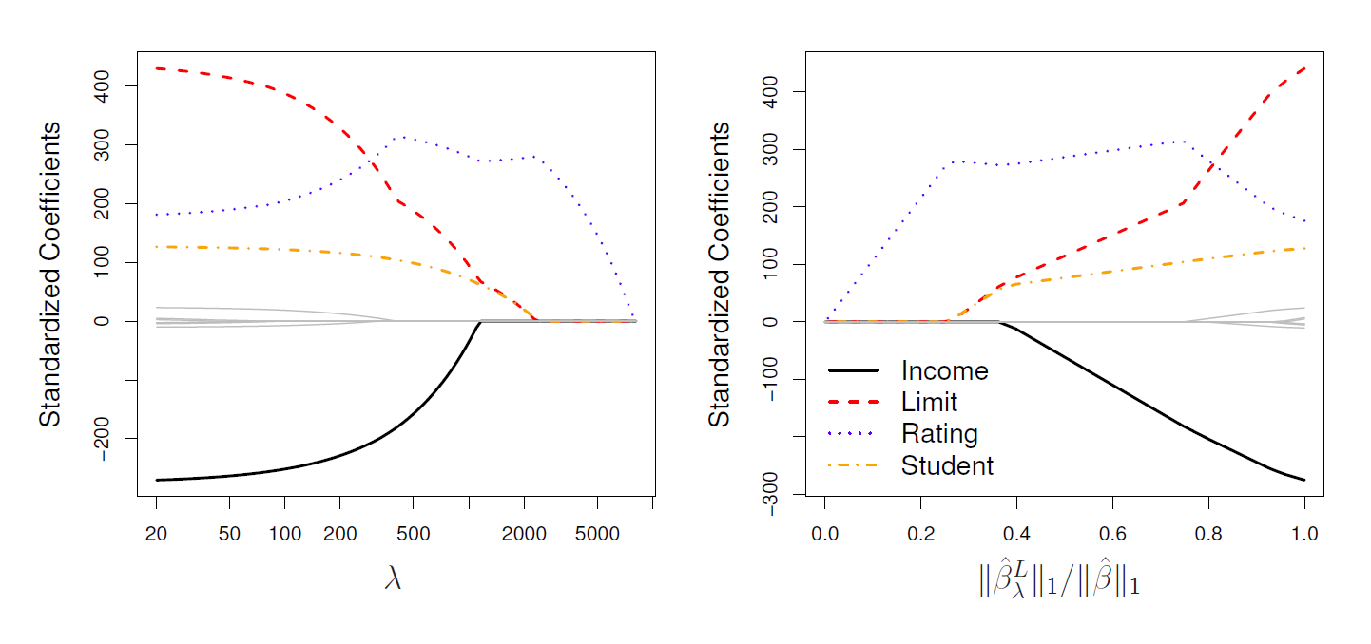
Example: Credit dataset

Slide 41
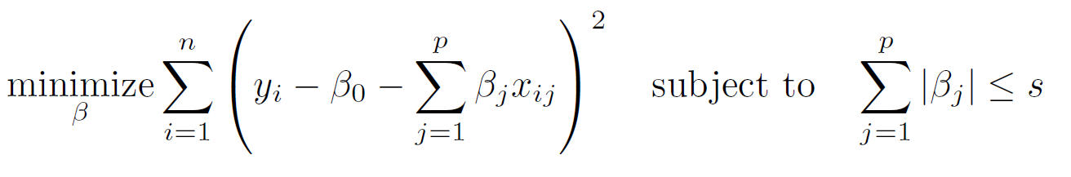
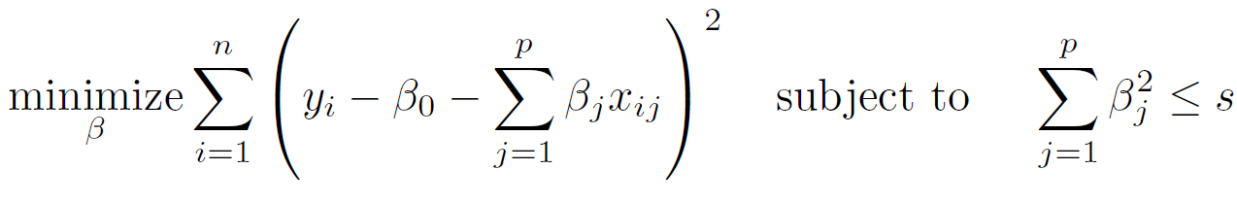
The Variable Selection Property of the Lasso
Why is it that the lasso, unlike ridge regression, results in coefficient estimates that are exactly equal to zero?
One can show that the lasso and ridge regression coefficient estimates solve the problems
and
respectively.

Slide 42
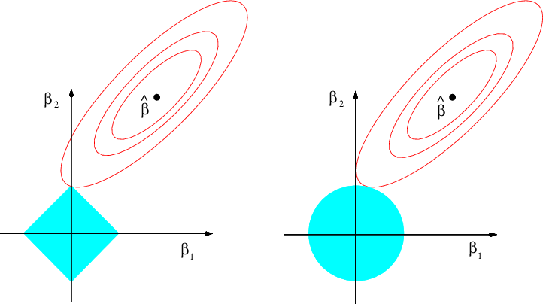
The Lasso Picture
Contours of the error and constraint functions for the lasso (left) and ridge regression (right). The solid blue areas are the constraint regions,
The red ellipses are the contours of the RSS.

Slide 43
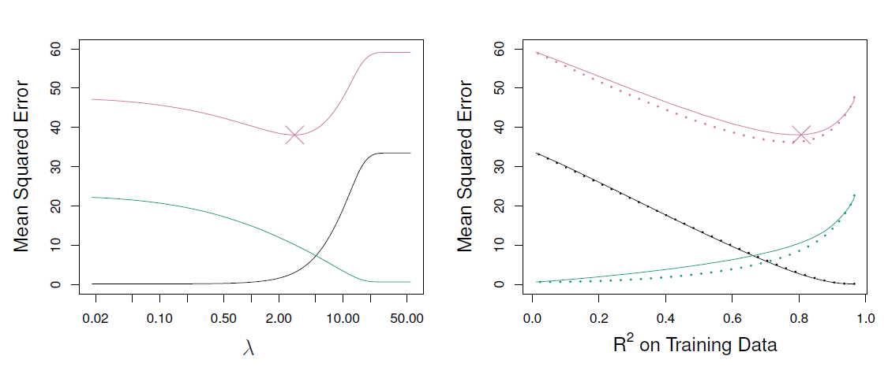
Comparing the Lasso and Ridge Regression
Left: Plots of squared bias (black), variance (green), and test MSE (purple) for the lasso on simulated data set we looked at
Right: Comparison of squared bias, variance and test MSE between lasso (solid) and ridge (dashed). Both are plotted against their R² on the training data, as a common form of indexing. The crosses in both plots indicate the lasso model for which the MSE is smallest.

Slide 44
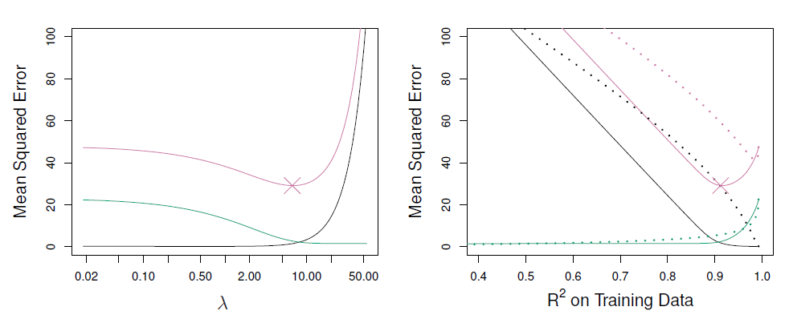
Comparing the Lasso and Ridge Regression: continued
Left: Plots of squared bias (black), variance (green), and test MSE (purple) for the lasso. The simulated data is like the previous slide except that now only two predictors are related to the response.
Right: Comparison of squared bias, variance and test MSE between lasso (solid) and ridge (dashed). Both are plotted against their R² on the training data, as a common form of indexing. The crosses in both plots indicate the lasso model for which the MSE is smallest.

Slide 45
Conclusions
These two examples illustrate that neither ridge regression nor the lasso will universally dominate the other.
In general, one might expect the lasso to perform better when the response is a function of only a relatively small number of predictors.
However, the number of predictors that is related to the response is never known a priori for real data sets.
A technique such as cross-validation can be used in order to determine which approach is better on a particular data set.

Slide 46
Selecting the Tuning Parameter for
Ridge Regression and Lasso
As for subset selection, for ridge regression and lasso we require a method to determine which of the models under consideration is best.
That is, we require a method selecting a value for the tuning parameter λ or equivalently, the value of the constraint s.

Slide 47
Selecting the Tuning Parameter for
Ridge Regression and Lasso
Cross-validation provides a simple way to tackle this problem. We choose a grid of λ values, and compute the cross-validation error rate for each value of λ.
We then select the tuning parameter value for which the cross-validation error is smallest.
Finally, the model is re-fit using all of the available observations and the selected value of the tuning parameter.

Slide 48
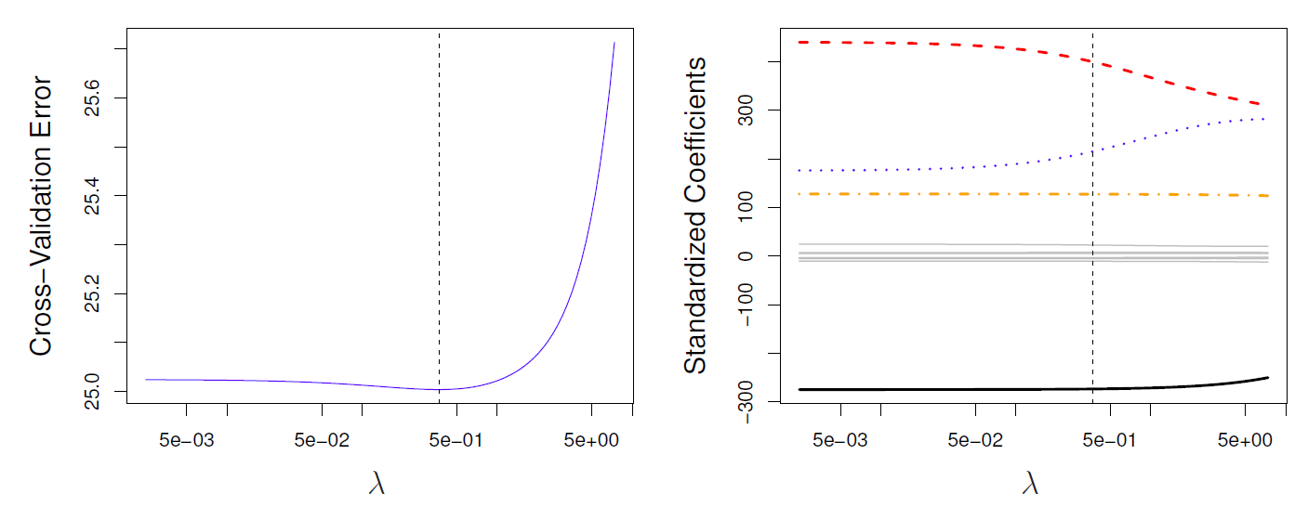
Credit data example
Left: Cross-validation errors that result from applying ridge regression to the Credit data set with various values of λ.
Right: The coefficient estimates as a function of λ. The vertical dashed lines indicates the value of λ selected by cross-validation.

Slide 49
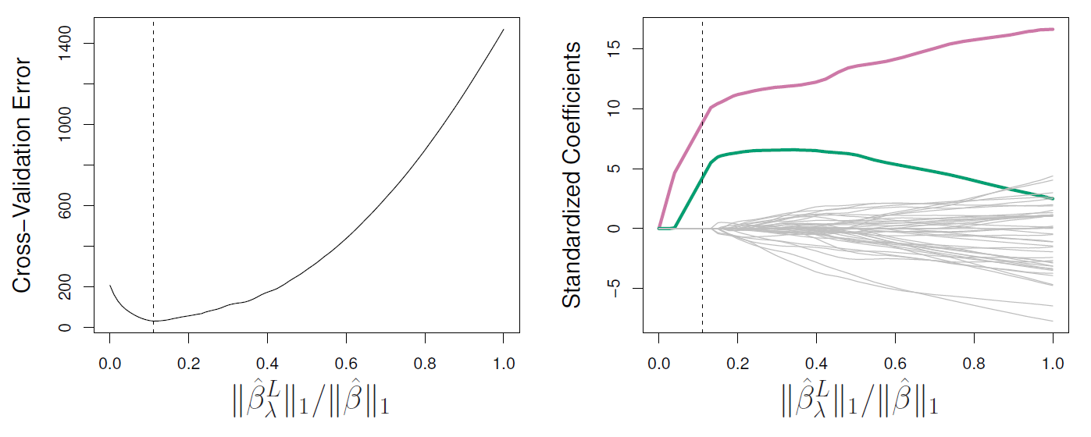
Simulated data example
Left: Ten-fold cross-validation MSE for the lasso, applied to the sparse simulated data set we looked at earlier
Right: The corresponding lasso coefficient estimates are displayed. The vertical dashed lines indicate the lasso fit for which the cross-validation error is smallest.

Slide 50
Dimension Reduction Methods
The methods that we have discussed so far in this chapter have involved fitting linear regression models, via least squares or a shrunken approach, using the original predictors, X₁, X₂, . . . , X_{p}.
We now explore a class of approaches that transform the predictors and then fit a least squares model using the transformed variables. We will refer to these techniques as dimension reduction methods.

Slide 51
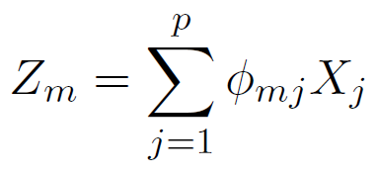
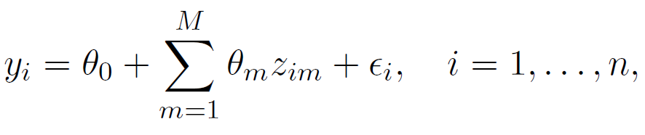
Dimension Reduction Methods: details
Let Z₁, Z₂, . . . , Z_{M} represent M < p linear combinations of
our original p predictors. That is,
(1)
for some constants φ_{m1}, . . . , φ_{mp}.
We can then fit the linear regression model,
(2)
using ordinary least squares.
Note that in model (2), the regression coefficients are given by θ₀, θ₁, . . . , θ_{M} . If the constants φ_{m1}, . . . , φ_{mp} are chosen wisely, then such dimension reduction approaches can often outperform OLS regression.

Slide 52
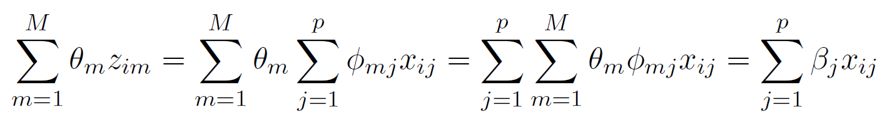
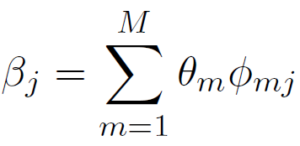
Notice that from definition (1),
where
(3)
Hence model (2) can be thought of as a special case of the original linear regression model.
Dimension reduction serves to constrain the estimated β_{j}
coefficients, since now they must take the form (3).
Can win in the bias-variance tradeoff.

Slide 53
Principal Components Regression
Here we apply principal components analysis (PCA) (discussed in Chapter 10 of the text) to define the linear combinations of the predictors, for use in our regression.
The first principal component is that (normalized) linear combination of the variables with the largest variance.
The second principal component has largest variance, subject to being uncorrelated with the first. And so on.
Hence with many correlated original variables, we replace them with a small set of principal components that capture their joint variation.

Slide 54
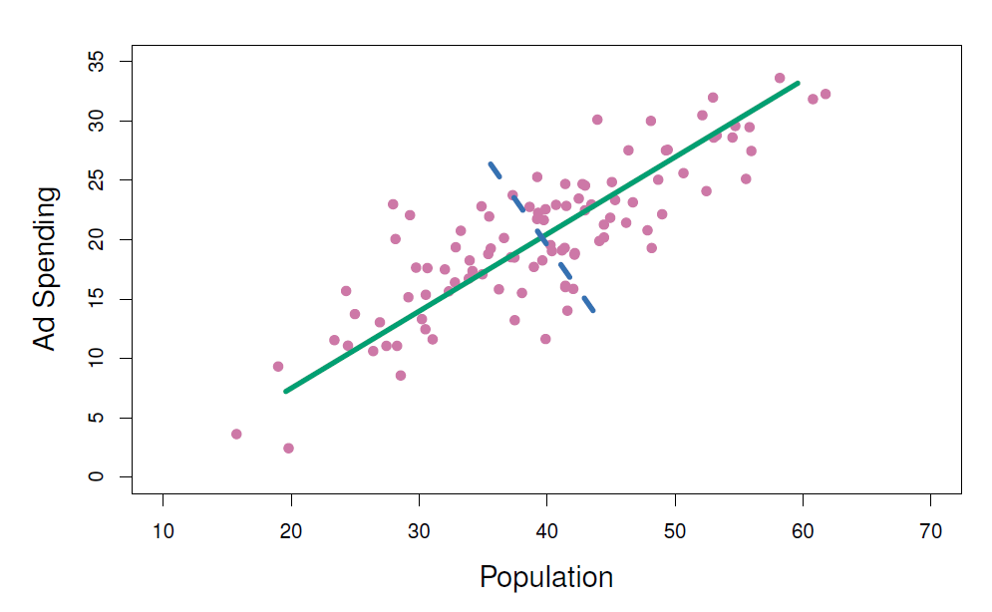
Pictures of PCA
The population size (pop) and ad spending (ad) for 100 different cities are shown as purple circles. The green solid line indicates the first principal component, and the blue dashed line indicates the second principal component.

Slide 55
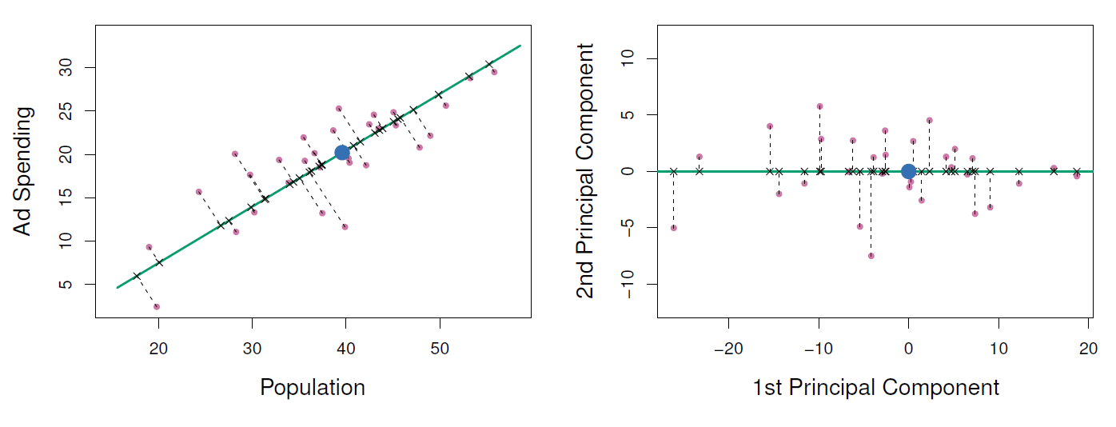
Pictures of PCA
A subset of the advertising data. Left: The first principal component, chosen to minimize the sum of the squared perpendicular distances to each point, is shown in green. These distances are represented using the black dashed line segments. Right: The left-hand panel has been rotated so that the first principal component lies on the x-axis.
55 / 57

Slide 56
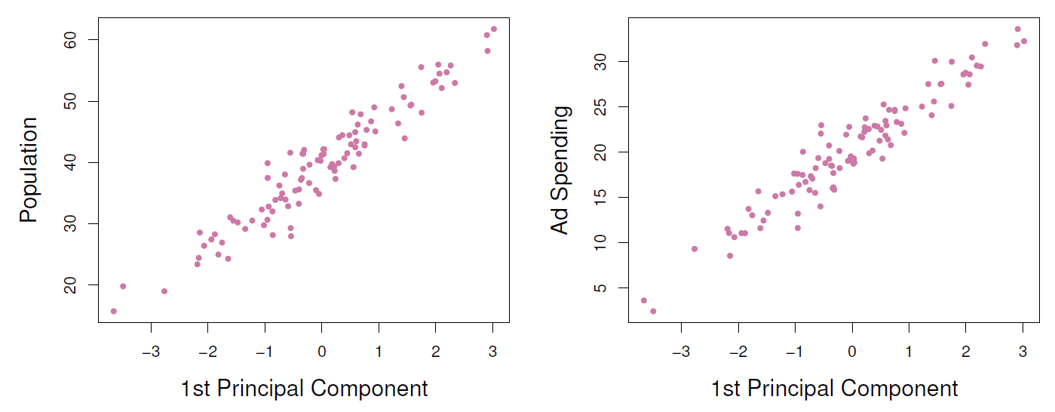
Pictures of PCA
Plots of the first principal component scores z_{i1} versus pop and
ad. The relationships are strong.
56 / 57

Slide 57
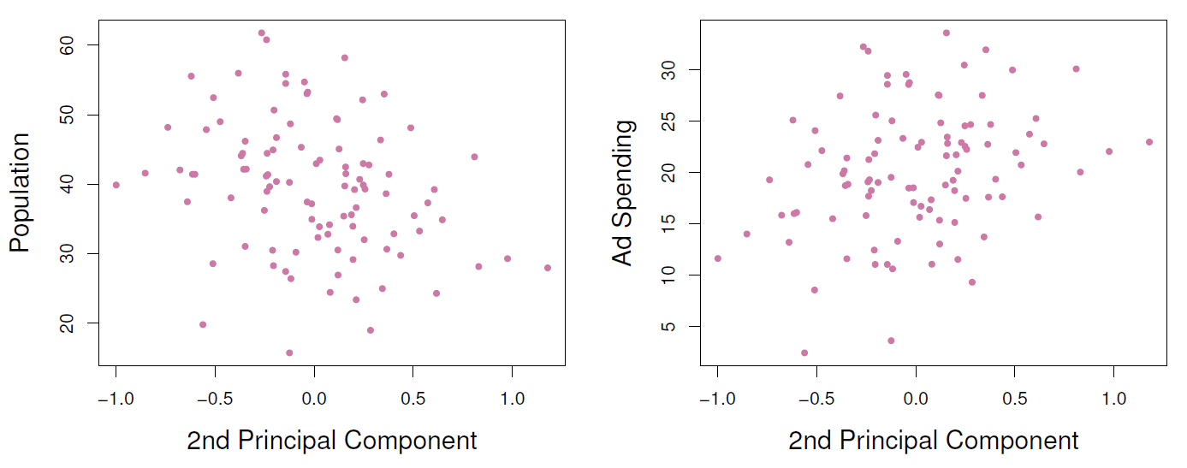
Pictures of PCA
Plots of the second principal component scores z_{i2} versus pop
and ad. The relationships are weak.

Slide 58
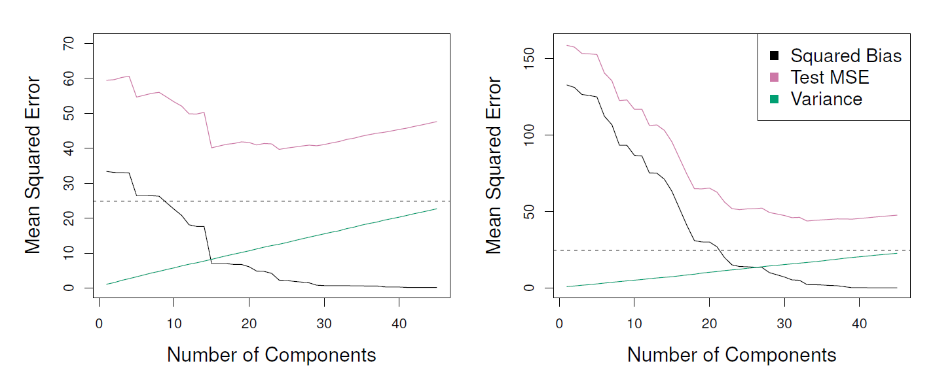
Application to Principal Components Regression
PCR was applied to two simulated data sets. The black, green, and purple lines correspond to squared bias, variance, and test mean squared error, respectively. Left: Simulated data from slide 32. Right: Simulated data from slide 39.

Slide 59
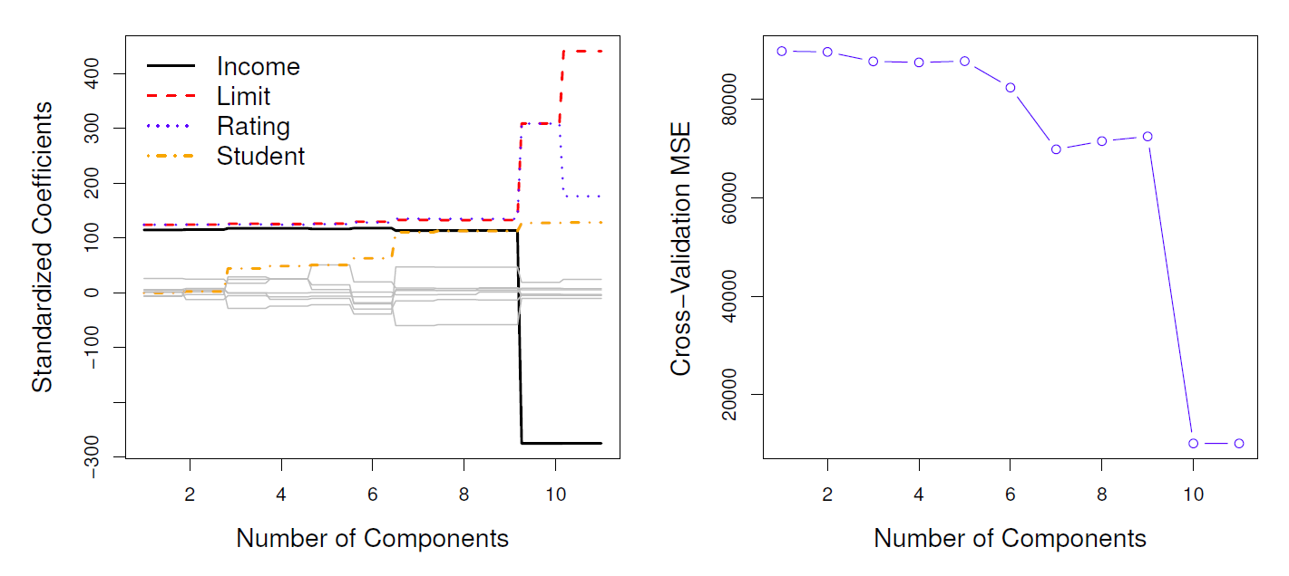
Choosing the number of directions M
Left: PCR standardized coefficient estimates on the Credit data set for different values of M. Right: The 10-fold cross validation MSE obtained using PCR, as a function of M.

Slide 60
Partial Least Squares
PCR identifies linear combinations, or directions, that best represent the predictors X₁, . . . , X_{p}.
These directions are identified in an unsupervised way, since the response Y is not used to help determine the principal component directions.
That is, the response does not supervise the identification of the principal components.
Consequently, PCR suffers from a potentially serious drawback: there is no guarantee that the directions that best explain the predictors will also be the best directions to use for predicting the response.

Slide 61
Partial Least Squares: continued
Like PCR, PLS is a dimension reduction method, which first identifies a new set of features Z₁, . . . , Z_{M} that are linear combinations of the original features, and then fits a linear model via OLS using these M new features.
But unlike PCR, PLS identifies these new features in a supervised way – that is, it makes use of the response Y in order to identify new features that not only approximate the old features well, but also that are related to the response.
Roughly speaking, the PLS approach attempts to find directions that help explain both the response and the predictors.

Slide 62
Details of Partial Least Squares
After standardizing the p predictors, PLS computes the first direction Z₁ by setting each φ_{1j} in (1) equal to the coefficient from the simple linear regression of Y onto X_{j} .
One can show that this coefficient is proportional to the
correlation between Y and X_{j} .
Hence, in computing Z =
p j=1
φ_{1j} X_{j} , PLS places the
1
highest weight on the variables that are most strongly related to the response.
Subsequent directions are found by taking residuals and then repeating the above prescription.

Slide 63
Summary
Model selection methods are an essential tool for data analysis, especially for big datasets involving many predictors.
Research into methods that give sparsity, such as the lasso is an especially hot area.
Later, we will return to sparsity in more detail, and will describe related approaches such as the elastic net.

