Slide 1
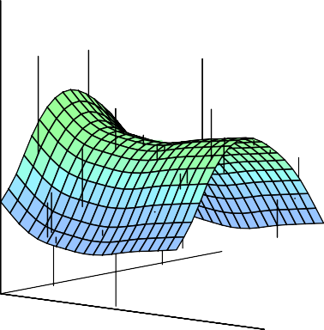
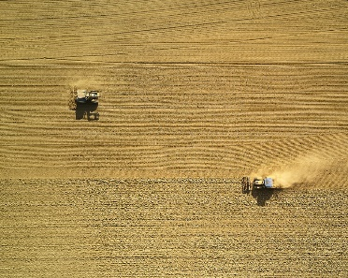

Statistical Analysis for Data Science C7081
Ed Harris
•
•
•
•
•
•
•• • •• • •• •
• ••••
•
•
• • •
••
• ••
•
••
•
•
•
•
•
•
•
•
• •
•
•

Slide 2

10: Unsupervised learning
“You can have data without information, but you cannot have information without data.”
-Daniel Keys Moran

Slide 3
Unsupervised Learning
Unsupervised vs Supervised Learning:
So far, we have focused on supervised learning methods such as regression and classification.
We observe both a set of features
X₁, X₂, . . . , X_{p} for each object, as well as a response or outcome variable Y . The goal is then to predict Y using X₁, X₂, . . . , X_{p}.
Here we will focus on unsupervised learning, we where observe only the features X₁, X₂, . . . , X_{p}. We are not interested in prediction, because we do not have an associated response variable Y .

Slide 4
The Goals of Unsupervised Learning
The goal is to discover interesting things about the measurements: is there an informative way to visualize the data? Can we discover subgroups among the variables or among the observations?
We discuss two methods:
principal components analysis, a tool used for data visualization or data pre-processing before supervised techniques are applied, and
clustering, a broad class of methods for discovering unknown subgroups in data.

Slide 5
The Challenge of Unsupervised Learning
Unsupervised learning is more subjective than supervised learning, as there is no simple goal for the analysis, such as prediction of a response.
But techniques for unsupervised learning are of growing importance in a number of fields:
subgroups of breast cancer patients grouped by their gene expression measurements,
groups of shoppers characterized by their browsing and purchase histories,
movies grouped by the ratings assigned by movie viewers.

Slide 6
Another advantage
It is often easier to obtain unlabeled data — from a lab instrument or a computer — than labeled data, which can require human intervention.
For example it is difficult to automatically assess the overall sentiment of a movie review: is it favorable or not?

Slide 7
Principal Components Analysis
PCA produces a low-dimensional representation of a dataset. It finds a sequence of linear combinations of the variables that have maximal variance, and are mutually uncorrelated.
Apart from producing derived variables for use in supervised learning problems, PCA also serves as a tool for data visualization.

Slide 8
Principal Components Analysis: details
The first principal component of a set of features
X₁, X₂, . . . , X_{p} is the normalized linear combination of the features
Z₁ = φ₁₁X₁ + φ₂₁X₂ + . . . + φ_{p1}X_{p}
that has the largest variance. By normalized, it means that
p
_{φ}2
= 1.
j=1 j1

Slide 9
Principal Components Analysis: details
We refer to the elements φ₁₁, . . . , φ_{p1} as the loadings of the first principal component; together, the loadings make up the principal component loading vector,
φ₁ = (φ₁₁ φ₂₁ . . . φ_{p1})^{T} .
We constrain the loadings so that their sum of squares is equal to one, since otherwise setting these elements to be arbitrarily large in absolute value could result in an arbitrarily large variance.

Slide 10
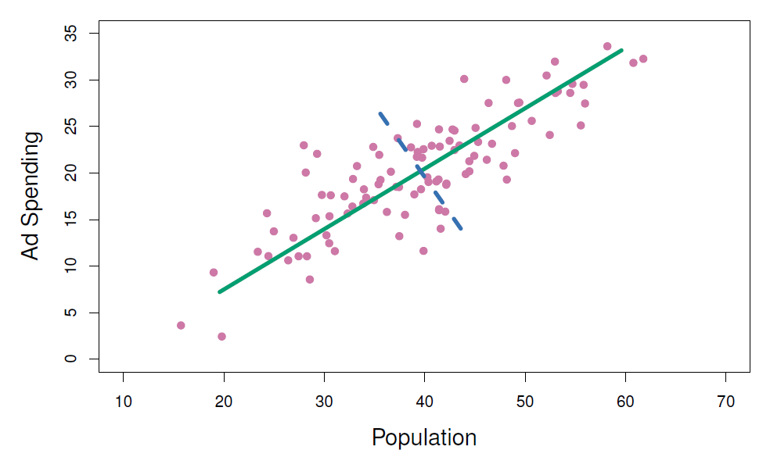
PCA: example
The population size (pop) and ad spending (ad) for 100 different cities are shown as purple circles. The green solid line indicates the first principal component direction, and the blue dashed line indicates the second principal component direction.

Slide 11
Computation of Principal Components
Suppose we have a n × p data set X. Since we are only interested in variance, we assume that each of the variables in X has been centered to have mean zero (that is, the column means of X are zero).
We then look for the linear combination of the sample feature values of the form
z_{i1} = φ₁₁x_{i1} + φ₂₁x_{i2} + . . . + φ_{p1}x_{ip} (1)
for i = 1, . . . , n that has largest sample variance, subject to
p
_{φ}2
the constraint that
= 1.
j=1 j1
Since each of the x_{ij} has mean zero, then so does z_{i1} (for
any values of φ_{j1}). Hence the sample variance of the z_{i1}
can be written as
1
n
n
i=1 i1
z² .

Slide 12
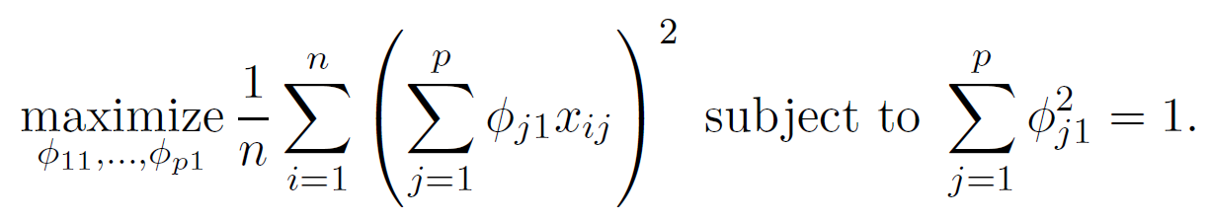
Computation: continued
Plugging in (1) the first principal component loading vector solves the optimization problem
This problem can be solved via a singular-value decomposition of the matrix X, a standard technique in linear algebra.
We refer to Z₁ as the first principal component, with realized values z₁₁, . . . , z_{n1}

Slide 13
Geometry of PCA
The loading vector φ₁ with elements φ₁₁, φ₂₁, . . . , φ_{p1} defines a direction in feature space along which the data vary the most.
If we project the n data points x₁, . . . , x_{n} onto this direction, the projected values are the principal component scores z₁₁, . . . , z_{n1} themselves.

Slide 14
Further principal components
The second principal component is the linear combination of X₁, . . . , X_{p} that has maximal variance among all linear combinations that are uncorrelated with Z₁.
The second principal component scores z₁₂, z₂₂, . . . , z_{n2}
take the form
z_{i2} = φ₁₂x_{i1} + φ₂₂x_{i2} + . . . + φ_{p2}x_{ip},
where φ₂ is the second principal component loading vector, with elements φ₁₂, φ₂₂, . . . , φ_{p2}.

Slide 15
Further principal components: continued
It turns out that constraining Z₂ to be uncorrelated with Z₁ is equivalent to constraining the direction φ₂ to be orthogonal (perpendicular) to the direction φ₁. And so on.
The principal component directions φ₁, φ₂, φ₃, . . . are the ordered sequence of right singular vectors of the matrix X,
and the variances of the components are ¹ times the
n
squares of the singular values. There are at most
min(n − 1, p) principal components.

Slide 16
Illustration
USAarrests data: For each of the fifty states in the United States, the data set contains the number of arrests per
100, 000 residents for each of three crimes: Assault, Murder, and Rape. We also record UrbanPop (the percent of the population in each state living in urban areas).
The principal component score vectors have length n = 50, and the principal component loading vectors have length
p = 4.
PCA was performed after standardizing each variable to have mean zero and standard deviation one.

Slide 17
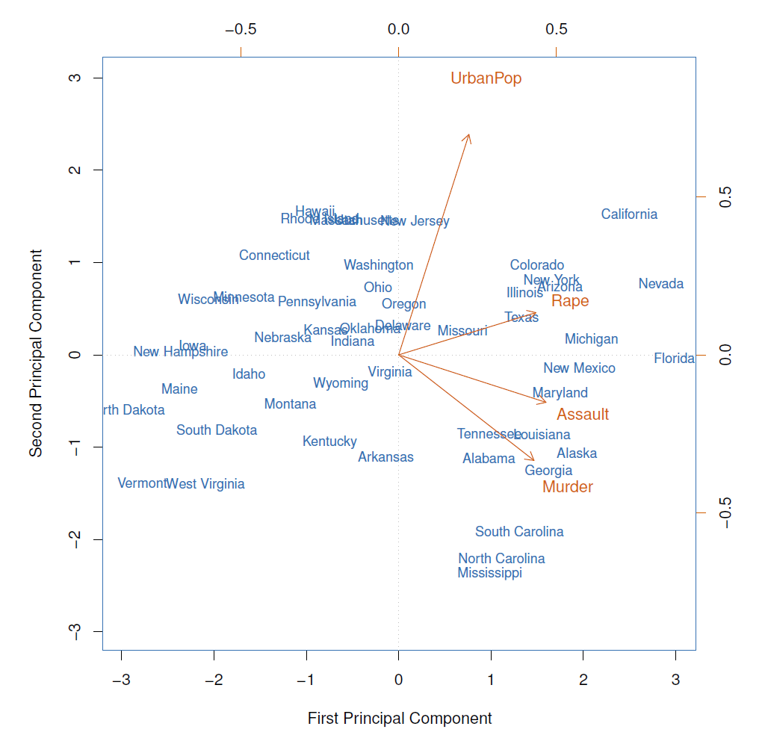
USAarrests data: PCA plot

Slide 18
Figure details
The first two principal components for the USArrests data.
The blue state names represent the PC1 and PC2 scores for the first two principal components.
The orange arrows indicate the first two principal component loading vectors (with axes on the top and right). For example, the loading for Rape on the first component is 0.54, and its loading on the second principal component 0.17 [the word Rape is centered at the point (0.54, 0.17)].
This figure is known as a biplot, because it displays both the principal component scores and the principal component loadings.

Slide 19
PCA loadings
 | PC1 | PC2
Murder | 0.5358995 | -0.4181809
Assault | 0.5831836 | -0.1879856
UrbanPop | 0.2781909 | 0.8728062
Rape | 0.5434321 | 0.1673186

Slide 20
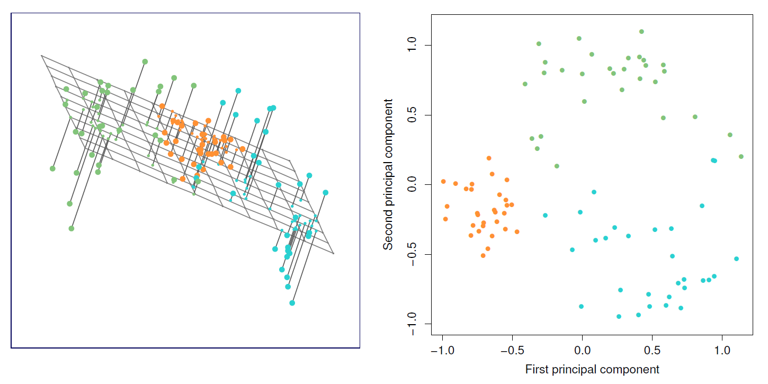
Another Interpretation of Principal Components
Ninety observations simulated in three dimensions. Left: the first two principal component directions span the plane that best fits the data. It
minimizes the sum of squared distances from each point to the plane.
Right: the first two principal component score vectors give the coordinates of the projection of the 90 observations onto the plane. The variance in the plane is maximized

Slide 21
PCA find the hyperplane closest to the observations
The first principal component loading vector has a very special property: it defines the line in p-dimensional space that is closest to the n observations (using average squared Euclidean distance as a measure of closeness)
The notion of principal components as the dimensions that are closest to the n observations extends beyond just the first principal component.
For instance, the first two principal components of a data set span the plane that is closest to the n observations, in terms of average squared Euclidean distance.

Slide 22
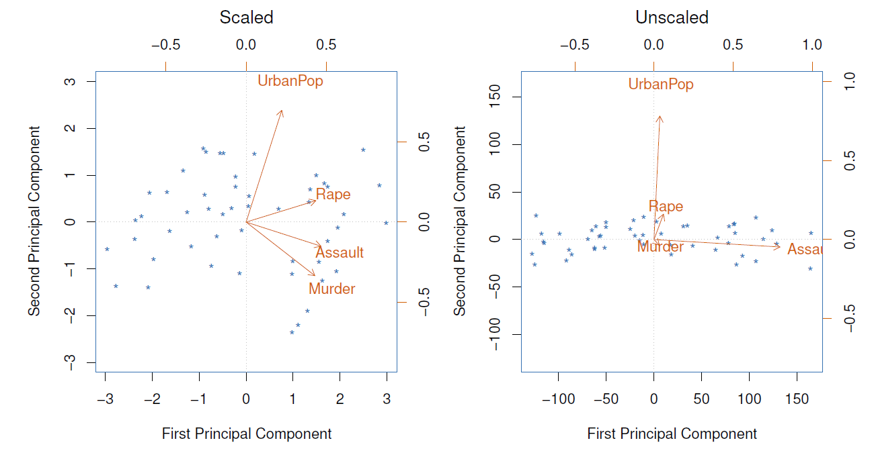
Scaling of the variables matters
If the variables are in different units, scaling each to have standard deviation equal to one is recommended.
If they are in the same units, you might or might not scale the variables.

Slide 23
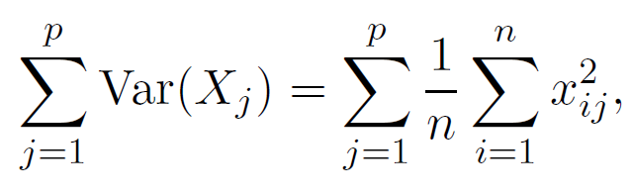
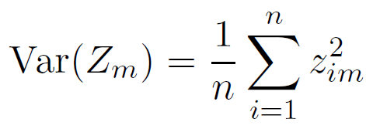

Proportion Variance Explained
To understand the strength of each component, we are interested in knowing the proportion of variance explained (PVE) by each one.
The total variance present in a data set (assuming that the variables have been centered to have mean zero) is defined
as
and the variance explained by the mth principal component is
It can be shown that
with M = min(n − 1, p).

Slide 24
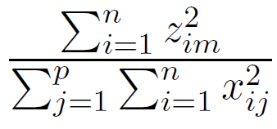
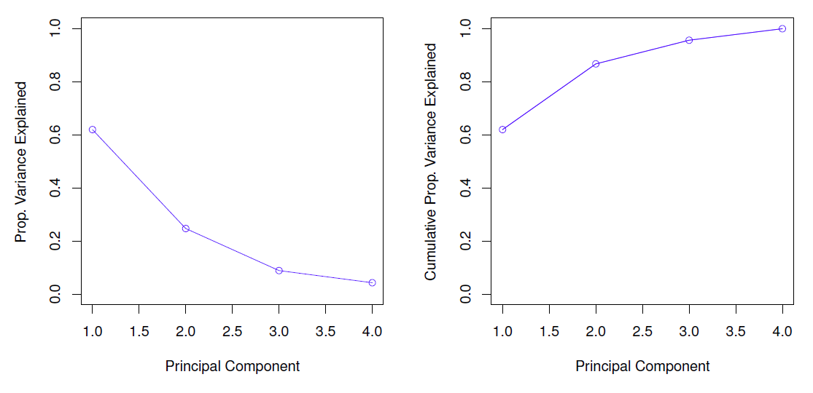
Proportion Variance Explained: continued
Therefore, the PVE of the mth principal component is
given by the positive quantity between 0 and 1
The PVEs sum to one. We sometimes display the cumulative PVEs.

Slide 25
How many principal components should we use?
If we use principal components as a summary of our data, how many components are sufficient?
No simple answer to this question, as cross-validation is not available for this purpose.
Why not?
When could we use cross-validation to select the number of components?
the “scree plot” on the previous slide can be used as a guide: we look for an“elbow”.

Slide 26
Clustering
Clustering refers to a very broad set of techniques for finding subgroups, or clusters, in a data set.
We seek a partition of the data into distinct groups so that the observations within each group are quite similar to each other,
It make this concrete, we must define what it means for two or more observations to be similar or different.
Indeed, this is often a domain-specific consideration that must be made based on knowledge of the data being studied.

Slide 27
PCA vs Clustering
PCA looks for a low-dimensional representation of the observations that explains a good fraction of the variance.
Clustering looks for homogeneous subgroups among the observations.

Slide 28
Clustering for Market Segmentation
Suppose we have access to a large number of measurements (e.g. median household income, occupation, distance from nearest urban area, and so forth) for a large number of people.
Our goal is to perform market segmentation by identifying subgroups of people who might be more receptive to a particular form of advertising, or more likely to purchase a particular product.
The task of performing market segmentation amounts to clustering the people in the data set.

Slide 29
Two clustering methods
In K-means clustering, we seek to partition the observations into a pre-specified number of clusters.
In hierarchical clustering, we do not know in advance how many clusters we want; in fact, we end up with a tree-like visual representation of the observations, called a dendrogram, that allows us to view at once the clusterings obtained for each possible number of clusters, from 1 to n.

Slide 30
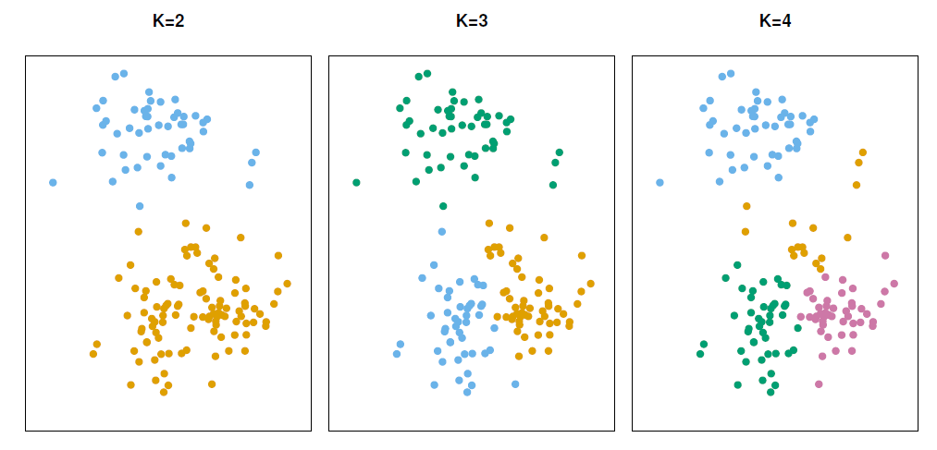
K-means clustering
A simulated data set with 150 observations in 2-dimensional space. Panels show the results of applying K-means clustering with different values of K, the number of clusters.
The colour of each observation indicates the cluster to which it was assigned using the K-means clustering algorithm. Note that there is no ordering of the clusters, so the cluster colouring is arbitrary.
These cluster labels were not used in clustering; instead, they are the outputs of the clustering procedure.

Slide 31
Details of K-means clustering
Let C₁, . . . , C_{K} denote sets containing the indices of the observations in each cluster. These sets satisfy two properties:
C₁ ∪ C₂ ∪ . . . ∪ C_{K} = {1, . . . , n}. In other words, each observation belongs to at least one of the K clusters.
C_{k} ∩ C_{k}, = ∅ for all k /= k^{I}. In other words, the clusters are non-overlapping: no observation belongs to more than one cluster.
For instance, if the ith observation is in the kth cluster, then
i ∈ C_{k}.

Slide 32
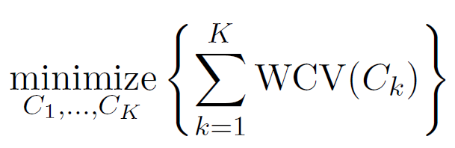
Details of K-means clustering: continued
The idea behind K-means clustering is that a good clustering is one for which the within-cluster variation is as small as possible.
The within-cluster variation for cluster C_{k} is a measure WCV(C_{k}) of the amount by which the observations within a cluster differ from each other.
Hence we want to solve the problem
(2)
In words, this formula says that we want to partition the observations into K clusters such that the total
within-cluster variation, summed over all K clusters, is as small as possible.

Slide 33
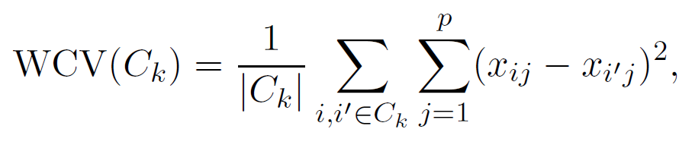
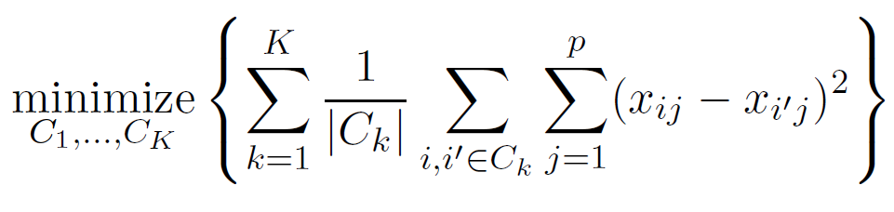
How to define within-cluster variation?
Typically we use Euclidean distance
where |C_{k}| denotes the number of observations in the kth cluster.
Combining (2) and (3) gives the optimization problem that defines K-means clustering,
(3)
(4)

Slide 34
K-Means Clustering Algorithm
Randomly assign a number, from 1 to K, to each of the observations. These serve as initial cluster assignments for the observations.
Iterate until the cluster assignments stop changing:
For each of the K clusters, compute the cluster centroid. The kth cluster centroid is the vector of the p feature means for the observations in the kth cluster.
Assign each observation to the cluster whose centroid is closest (where closest is defined using Euclidean distance).

Slide 35
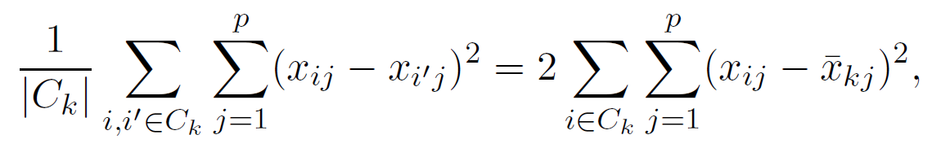

Properties of the Algorithm
This algorithm is guaranteed to decrease the value of the objective (4) at each step. Why? Note that
where
is the mean for feature j in cluster C_{k}.
however it is not guaranteed to give the global minimum.
Why not?

Slide 36
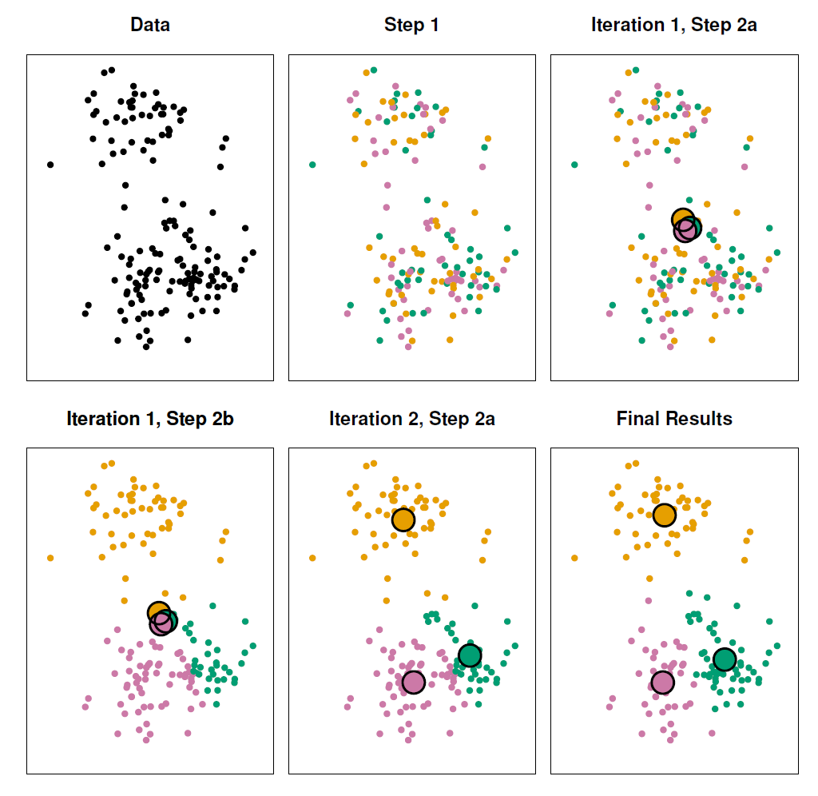
Example

Slide 37
Details of Previous Figure
The progress of the K-means algorithm with K=3.
Top left: The observations are shown.
Top center: In Step 1 of the algorithm, each observation is randomly assigned to a cluster.
Top right: In Step 2(a), the cluster centroids are computed. These are shown as large colored disks. Initially the centroids are almost completely overlapping because the initial cluster assignments were chosen at random.
Bottom left: In Step 2(b), each observation is assigned to the nearest centroid.
Bottom center: Step 2(a) is once again performed, leading to new cluster centroids.
Bottom right: The results obtained after 10 iterations.

Slide 38
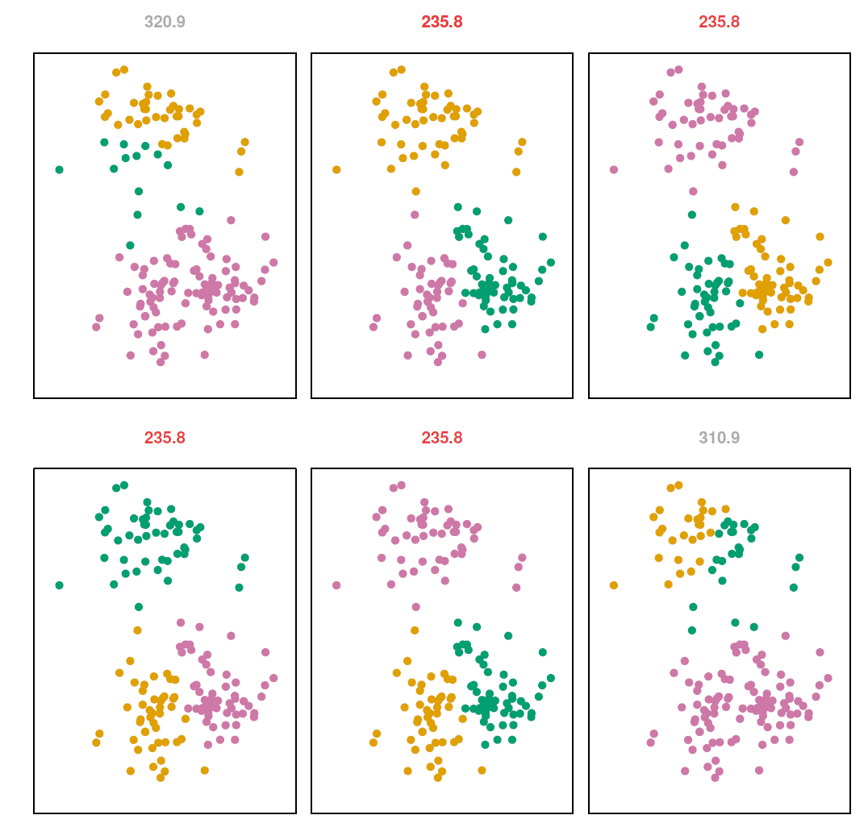
Example: different starting values

Slide 39
Details of Previous Figure
K-means clustering performed six times on the data from previous figure with K = 3, each time with a different random assignment of the observations in Step 1 of the K-means algorithm.
Above each plot is the value of the objective (4).
Three different local optima were obtained, one of which resulted in a smaller value of the objective and provides better separation between the clusters.
Those labeled in red all achieved the same best solution, with an objective value of 235.8

Slide 40
Hierarchical Clustering
K-means clustering requires us to pre-specify the number of clusters K. This can be a disadvantage (later we discuss strategies for choosing K)
Hierarchical clustering is an alternative approach which does not require that we commit to a particular choice of K.
In this section, we describe bottom-up or agglomerative clustering. This is the most common type of hierarchical clustering, and refers to the fact that a dendrogram is built starting from the leaves and combining clusters up to the trunk.

Slide 41
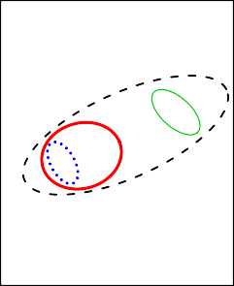
Hierarchical Clustering Algorithm
The approach in words:
Start with each point in its own cluster.
Identify the closest two clusters and merge them.
Repeat.
Ends when all points are in a single cluster.
Dendrogram
4
D
3
E
A
B
2
C
1
0
D
E B A C

Slide 42
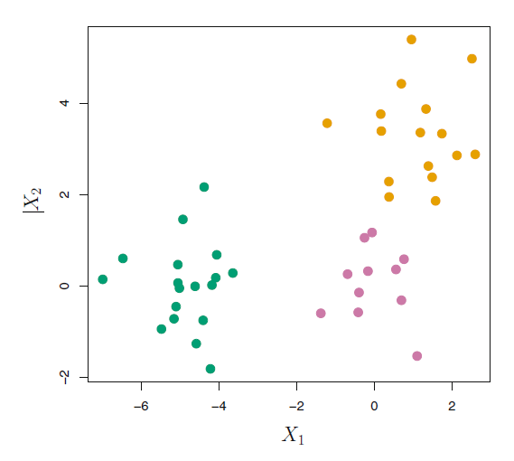
An Example
45 observations generated in 2-dimensional space. In reality there are three distinct classes, shown in separate colors.
However, we will treat these class labels as unknown and will seek to cluster the observations in order to discover the classes from the data.

Slide 43
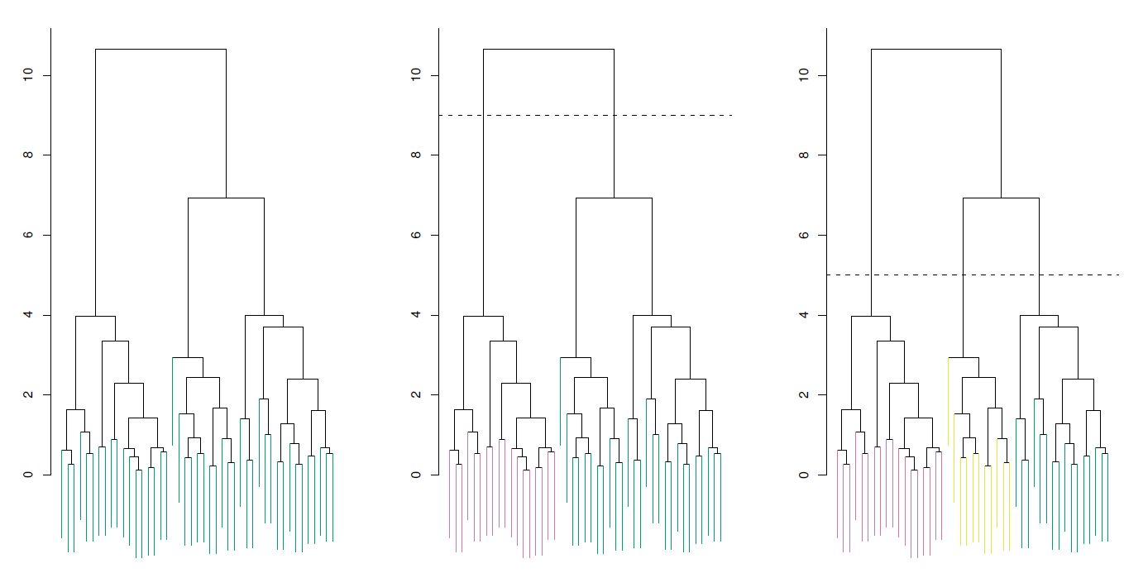
Application of hierarchical clustering

Slide 44
Details of previous figure
Left: Dendrogram obtained from hierarchically clustering the data from previous slide, with complete linkage and Euclidean distance.
Center: The dendrogram from the left-hand panel, cut at a height of 9 (indicated by the dashed line). This cut results in two distinct clusters, shown in different colors.
Right: The dendrogram from the left-hand panel, now cut at a height of 5. This cut results in three distinct clusters, shown in different colors. Note that the colors were not used in clustering, but are simply used for display purposes in this figure

Slide 45
Types of Linkage
Linkage | Description
Complete | Maximal inter-cluster dissimilarity. Compute all pairwise dissimilarities between the observations in cluster A and the observations in cluster B, and record the largest of these dissimilarities.
Single | Minimal inter-cluster dissimilarity. Compute all pairwise dissimilarities between the observations in cluster A and the observations in cluster B, and record the smallest of these dissimilarities.
Average | Mean inter-cluster dissimilarity. Compute all pairwise dissimilarities between the observations in cluster A and the observations in cluster B, and record the average of these dissimilarities.
Centroid | Dissimilarity between the centroid for cluster A (a mean vector of length p) and the centroid for cluster B. Centroid linkage can result in undesirable inversions.

Slide 46
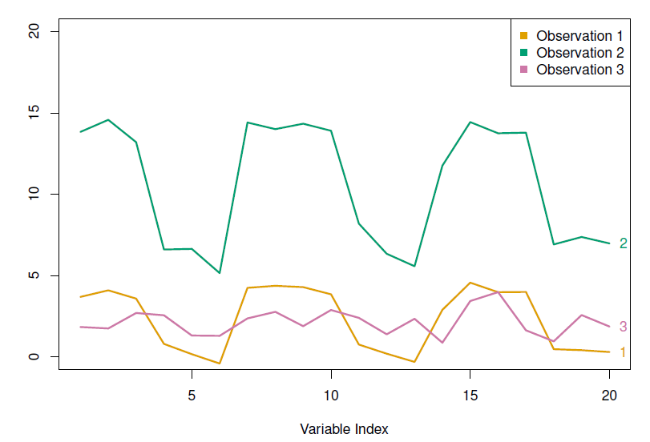
Choice of Dissimilarity Measure
So far have used Euclidean distance.
An alternative is correlation-based distance which considers two observations to be similar if their features are highly correlated.
This is an unusual use of correlation, which is normally computed between variables; here it is computed between the observation profiles for each pair of observations.
45 / 50

Slide 47
Practical issues
Scaling of the variables matters!. Should the observations or features first be standardized in some way? For instance, maybe the variables should be centered to have mean zero and scaled to have standard deviation one.
In the case of hierarchical clustering,
What dissimilarity measure should be used?
What type of linkage should be used?
How many clusters to choose? (in both K-means or hierarchical clustering). Difficult problem. No agreed-upon method. See Elements of Statistical Learning, chapter 13 for more details.
Which features should we use to drive the clustering?

Slide 48
Example: breast cancer microarray study
“Repeated observation of breast tumor subtypes in independent gene expression data sets;” Sorlie at el, PNAS 2003
Gene expression measurements for about ∼ 8000 genes, for each of 88 breast cancer patients.
Average linkage, correlation metric
Clustered samples using 500 intrinsic genes: each woman was measured before and after chemotherapy. Intrinsic genes have smallest within/between variation.

Slide 49
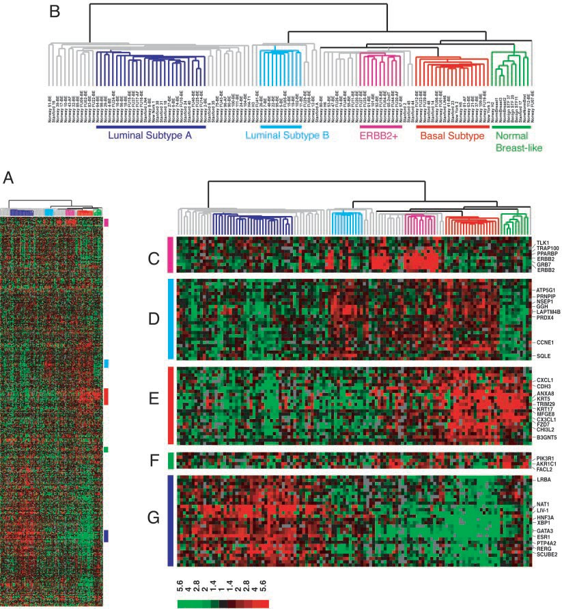

Slide 50
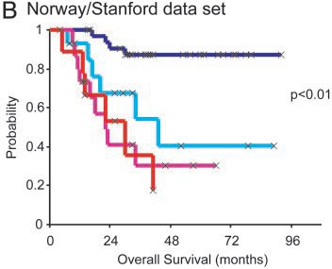

Slide 51
Conclusions
Unsupervised learning is important for understanding the variation and grouping structure of a set of unlabeled data, and can be a useful pre-processor for supervised learning
It is intrinsically more difficult than supervised learning because there is no gold standard (like an outcome variable) and no single objective (like test set accuracy).
It is an active field of research, with many recently developed tools such as self-organizing maps, independent components analysis and spectral clustering.

