Slide 1

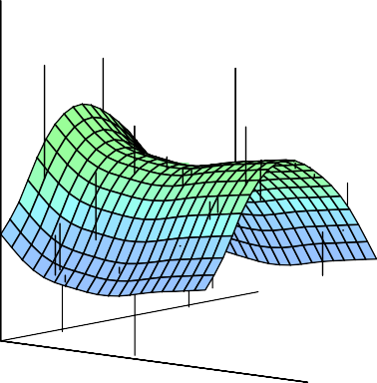



C7081 Statistical Analysis for Data Science
Ed Harris
•
•
•
•
•
•
•• • •• • •• •
• ••••
•
•
• • •
••
• ••
•
••
•
•
•
•
•
•
•
•
• •
•
•

Slide 2
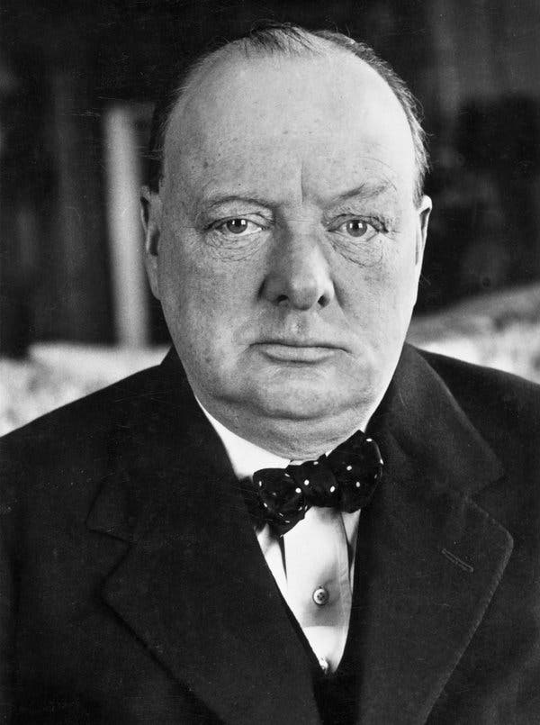
Module overview
“I am always ready to learn although I do not always like being taught."
-Winston Churchill

Slide 3
Module overview
Look at Module hub page
Translate module descriptor doc
How will the module "work"?
Assessment

Slide 4
Module overview
Look at Module hub page
- Documents
- Information dissemination

Slide 5
Module overview
Translate module descriptor doc
- Description
- Learning outcomes
- Reading list

Slide 6
Module overview
How will the module "work"?
- Schedule doc
- Live sessions / videos / readings
- Problems

Slide 7
Module overview
Assessment
- Assignment brief

Slide 8

Module overview
Available free
from the authors

