Slide 1
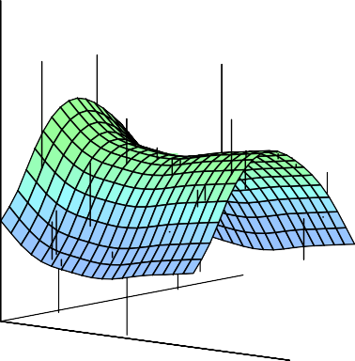


Statistical Analysis for Data Science C7081
Ed Harris
•
•
•
•
•
•
•• • •• • •• •
• ••••
•
•
• • •
••
• ••
•
••
•
•
•
•
•
•
•
•
• •
•
•

Slide 2
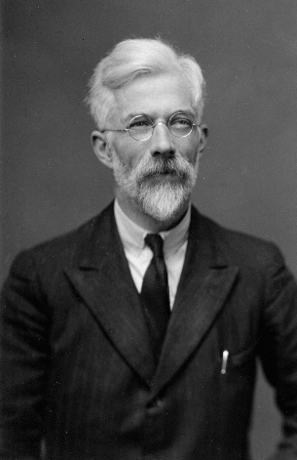
02: Statistical learning
That’s not an experiment you have there, that’s an experience.
-R. A. Fisher (England, 1890–1962)

Slide 3
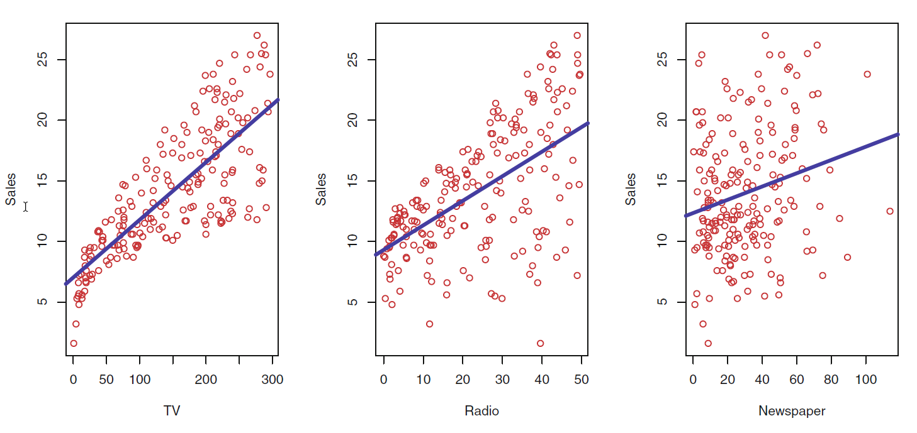
What is Statistical Learning?
Shown are Sales vs TV, Radio and Newspaper, with a blue linear-regression line fit separately to each.
Can we predict Sales using these three? Perhaps we can do better using a model
Sales ≈ f (TV, Radio, Newspaper)
3 / 30

Slide 4
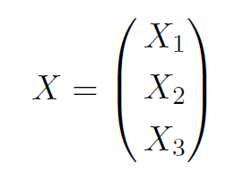
Notation
Here Sales is a response or target that we wish to predict. We generically refer to the response as Y.
TV is a feature, or input, or predictor; we name it X₁.
Likewise name Radio as X₂, and so on.
We can refer to the input vector collectively as:
4 / 30

Slide 5
Notation
Now we write our model as:
Y = f (X) + E
where E captures measurement errors and other discrepancies.
5 / 30

Slide 6
What is f(X) good for?
With a good f we can make predictions of Y at new points X = x.
We can understand which components of X = (X₁, X₂, . . . , X_{p}) are important in explaining Y , and which are irrelevant. e.g. Seniority and Years of Education have a big impact on Income, but Marital Status typically does not.
Depending on the complexity of f, we may be able to understand how each component X_{j} of X affects Y.
6 / 30

Slide 7
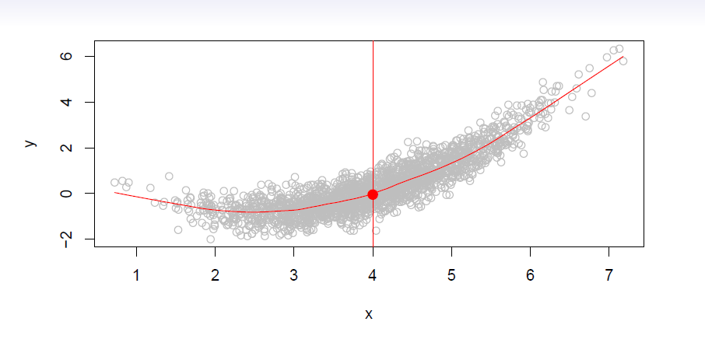
Is there an ideal f(X)? In particular, what is a good value for f(X) at any selected value of X, say X=4?
There can be many Y values at X = 4.

Slide 8
A good value is
f (4) = E(Y |X = 4)
E(Y |X =4) means expected value (average) of Y given X=4.
This ideal f (x) = E(Y |X = x) is called the regression function.

Slide 9
The regression function f (x)
Is also defined for vector X;
e.g.
f (x) = f (x₁, x₂, x₃) = E(Y |X₁ = x₁, X₂ = x₂, X₃ = x₃)
Is the ideal or optimal predictor of Y with regard to
mean-squared prediction error:
f (x) = E(Y |X = x) is the function that minimizes E[(Y − g(X))²|X = x] over all functions g at all points X = x.

Slide 10
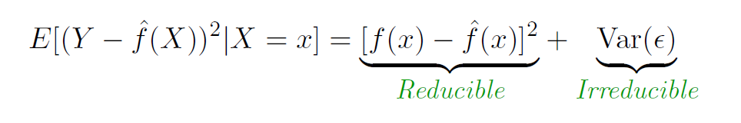
The regression function f (x)
E =Y − f(x) is the irreducible error — i.e. even if we knew f(x), we would still make errors in prediction, since at each X = x there is typically a distribution of possible Y values.
For any estimate, f^{ˆ}(x), of f(x), we have

Slide 11

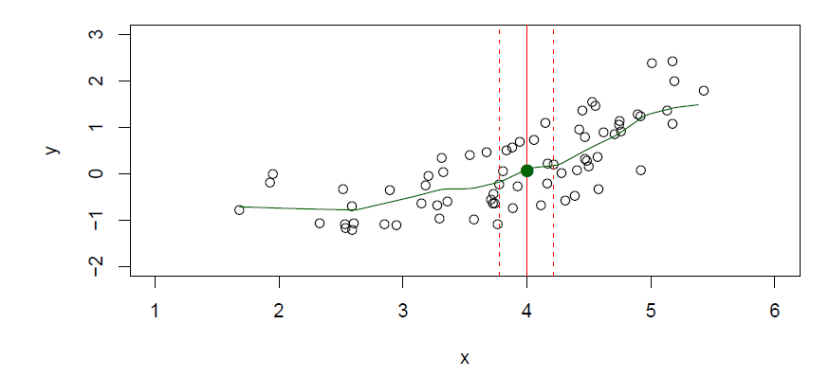
How to estimate f
Typically we may have few if any data points with X = 4 exactly.
So we cannot compute E(Y |X = x)!
Relax the definition and let
where N (x) is some neighborhood of x.

Slide 12
Nearest neighbor averaging can be pretty good for small p — i.e. p ≤ 4 and large-ish N
We will discuss smoother versions, such as kernel- and spline-smoothing later
Nearest neighbor methods can be lousy when p is large. Reason: the curse of dimensionality. Nearest neighbors tend to be far away in high dimensions

Slide 13
We need to get a reasonable fraction of the N values of y_{i} to average to bring the variance down - e.g. ~10%
A 10% neighborhood in high dimensions need no longer be local, so we lose the spirit of estimating E(Y |X = x) by local averaging

Slide 14
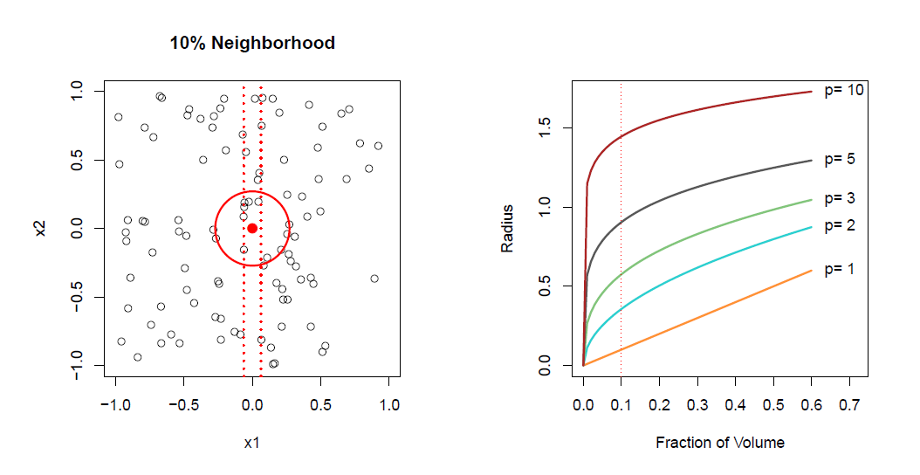
The curse of dimensionality

Slide 15
Parametric and structured models
The linear model is an important example of a parametric model:
Y = β₀ + β₁X₁ + β₂X₂ + . . . β_{p}X_{p}.
A linear model is specified in terms of p +1 parameters
β₀, β₁, . . . , β_{p}
We estimate the parameters by fitting the model to training data
Although it is almost never correct, a linear model often serves as a good and interpretable approximation to the unknown true function f (X)

Slide 16
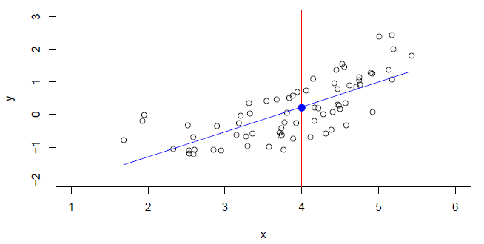

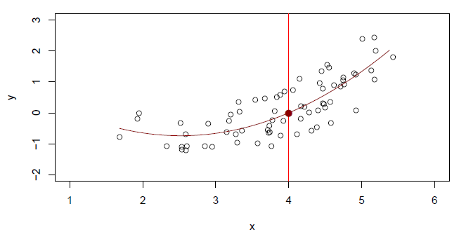

A linear model gives a reasonable fit here
A quadratic model fits slightly better

Slide 17
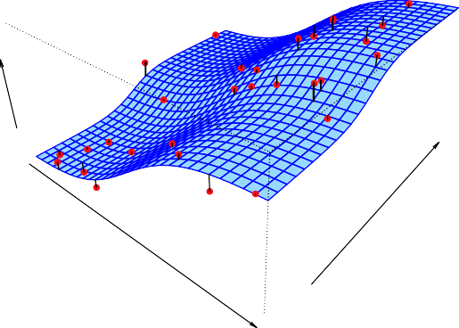
Income
Seniority
Years of Education
Simulated example. Red points are simulated values for income from the model
income = f(education, seniority)+E
f is the blue surface.

Slide 18
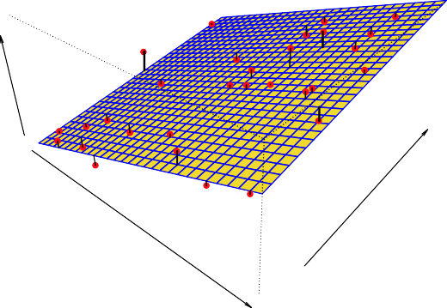
Income
Seniority
Years of Education
Linear regression model fit to the simulated data.

Slide 19
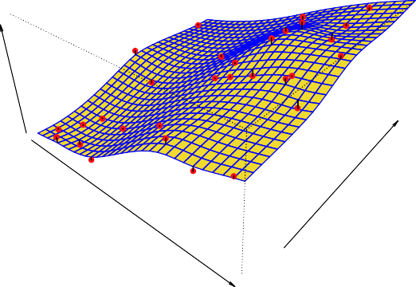
Income
Seniority
Years of Education
More flexible regression model f^{ˆ}_{S} (education, seniority) fit to the simulated data. Here we use a technique called a thin-plate spline to fit a flexible surface. (We will discuss this later on)
13 / 30

Slide 20
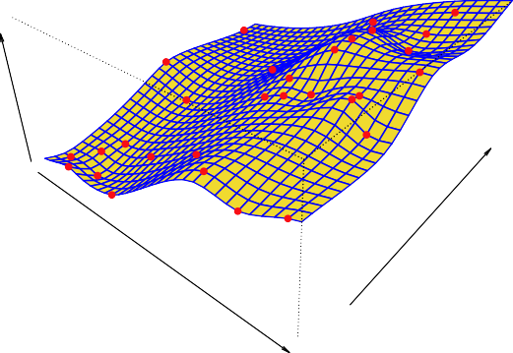

Income
Seniority
Years of Education
Even more flexible spline regression model
f^{ˆ}_{S} (education, seniority) fit to the simulated data. Here the fitted model makes no errors on the training data! Also known as overfitting (i.e. fits training data well, but not generalisable to new data…).

Slide 21
Some trade-offs
Prediction accuracy versus interpretability.
Linear models are easy to interpret; thin-plate splines are not.
Good fit versus over-fit or under-fit.
How do we know when the fit is just right?
Parsimony versus black-box.
We often prefer a simpler model involving fewer variables over a black-box predictor involving them all.

Slide 22
We will cover all of these
High
Subset Selection Lasso
Least Squares
Generalized Additive Models Trees
Interpretability
Bagging, Boosting
Support Vector Machines
Low
Low
High
Flexibility

Slide 23




Assessing Model Accuracy
Suppose we fit a model f^{ˆ}(x) to some training data and we wish to see how well it performs.
We could compute the average squared prediction error over Tr:
This may be biased toward more overfit models.
Instead we should, if possible, compute it using fresh test data

Slide 24
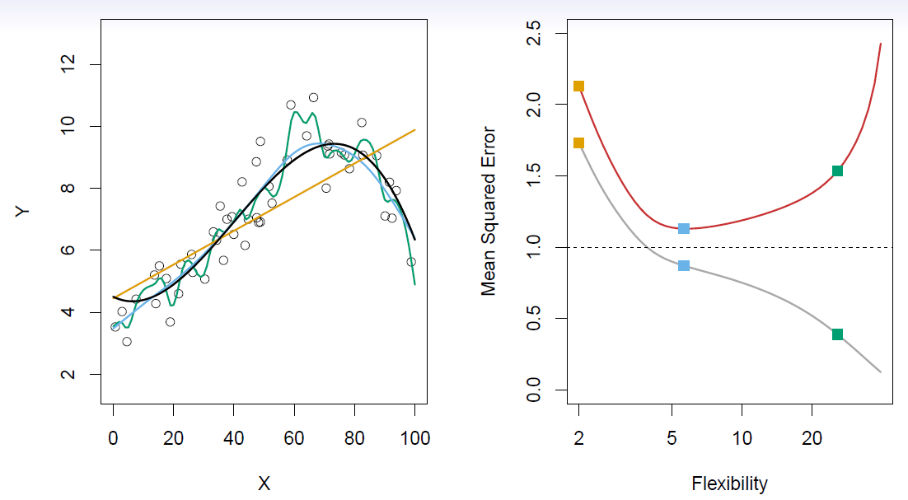
Black curve is truth. Red curve on right is MSE_{Te}, grey curve is MSE_{Tr}. Orange, blue and green curves/squares correspond to fits of different flexibility.

Slide 25
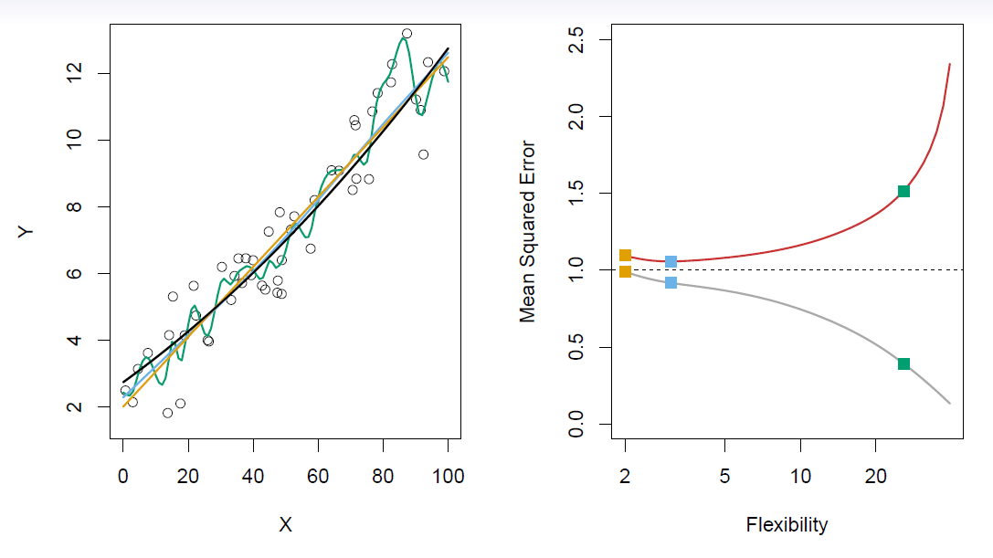
Here the truth is smoother, so the smoother fit and linear model do really well.

Slide 26
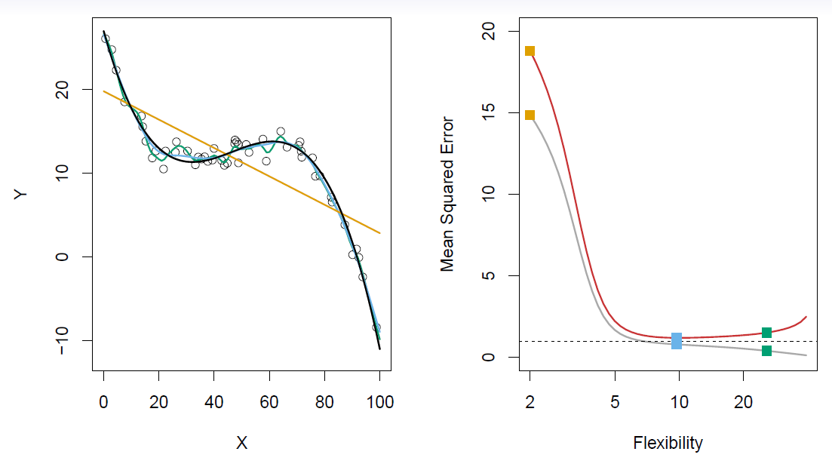
Here the truth is wiggly and the noise is low, so the more flexible fits do the best.
20 / 30

Slide 27
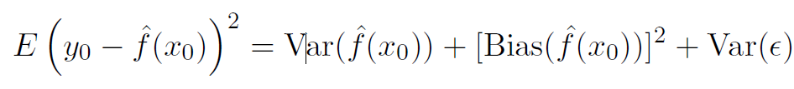
Bias-Variance Trade-off
Suppose we have fit a model f^{ˆ}(x) to some training data Tr, and let (x₀, y₀) be a test observation drawn from the population.
If the true model is
then
27 / 30

Slide 28

Bias-Variance Trade-off
The expectation averages over the variability of y₀ as well as the variability in Tr. Note that
Typically as the flexibility of f^{ˆ} increases, its variance increases, and its bias decreases. So choosing the flexibility based on average test error amounts to a bias-variance trade-off.
28 / 30

Slide 29
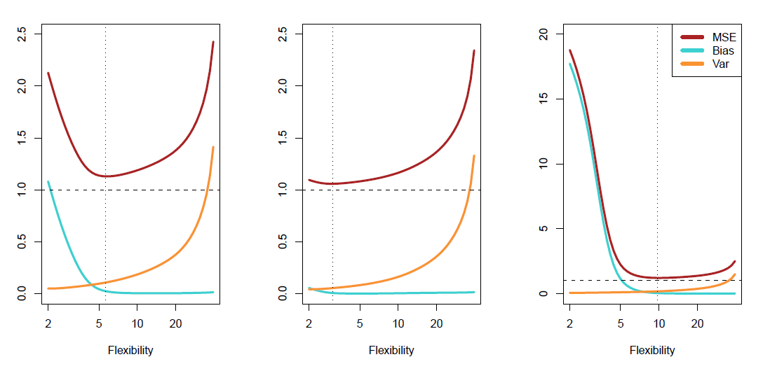
Bias-variance trade-off for the three examples
29 / 30

Slide 30
Classification Problems
Here the response variable Y is qualitative | e.g. email is one
of C = (spam; ham) (ham=good email), digit class is one of
C = {0, 1…, 9}. Our goals are to:
Build a classifier C(X) that assigns a class label from C to
a future unlabelled observation X.
Assess the uncertainty in each classification
Understand the roles of the different predictors among
X = (X₁, X₂,…, X_{p}).
30 / 30

Slide 31
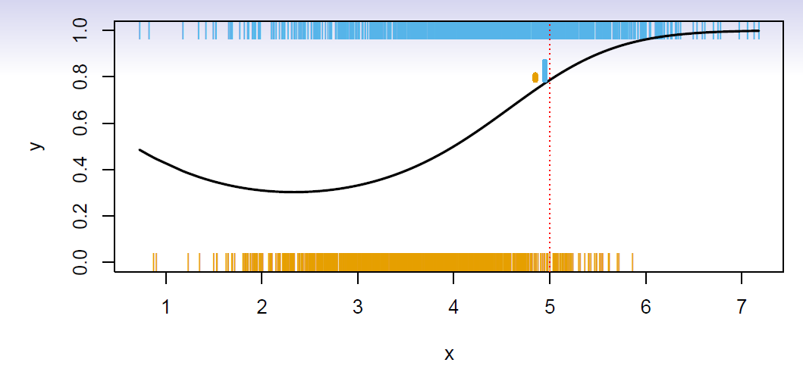
Is there an ideal C(X)? Suppose the K elements in C are
numbered 1, 2, . . . , K. Let
p_{k}(x) = Pr(Y = k|X = x), k = 1, 2, . . . , K.
These are the conditional class probabilities at x; e.g. see little barplot at x = 5. Then the Bayes optimal classifier at x is
C(x) = j if p_{j} (x) = max{p₁(x), p₂(x), . . . , p_{K} (x)}
31 / 30

Slide 32
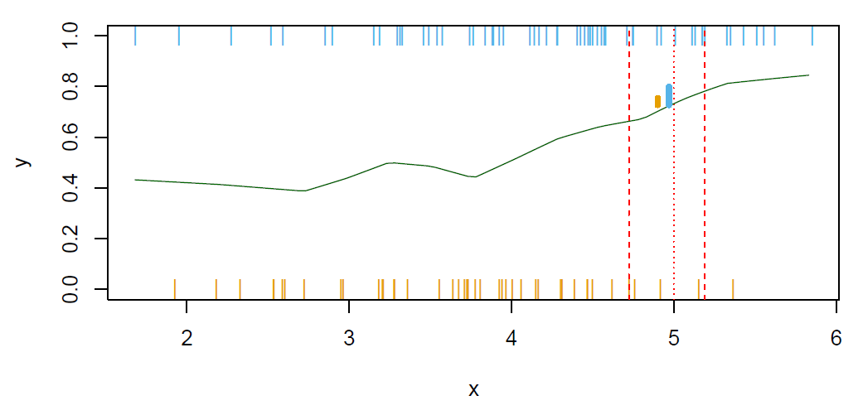
Nearest-neighbor averaging can be used as before.
Also breaks down as dimension grows. However, the impact on
C^{ˆ}(x) is less than on pˆ_{k}(x), k = 1, . . . , K.
32 / 30

Slide 33

Classification: some details
Typically we measure the performance of C^{ˆ}(x) using the misclassification error rate:
The Bayes classifier (using the true p_{k}(x)) has smallest error (in the population).
Support-vector machines build structured models for C(x).
We will also build structured models for representing the p_{k}(x). e.g. Logistic regression, generalized additive models.
33 / 30

Slide 34
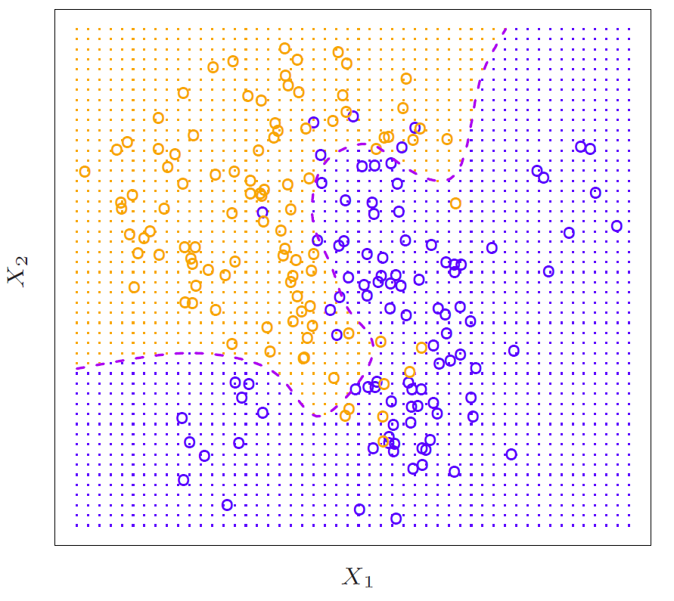
Example: K-nearest neighbors in two dimensions
34 / 30

Slide 35
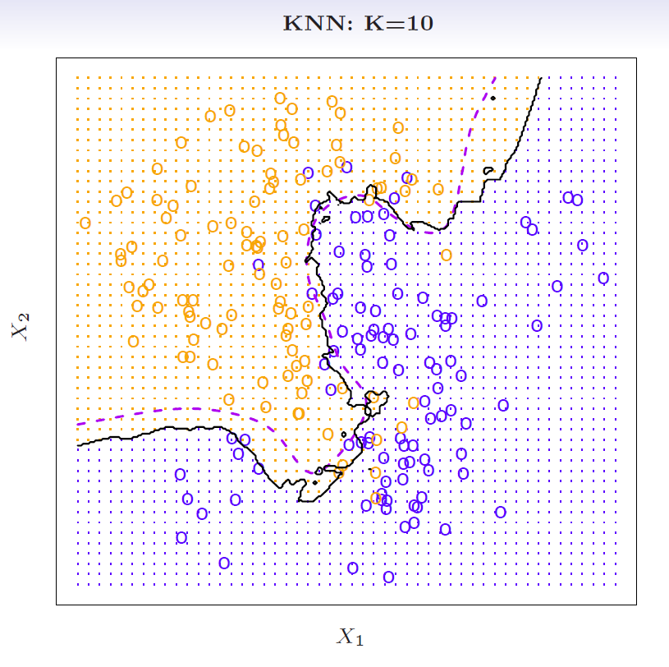

Slide 36
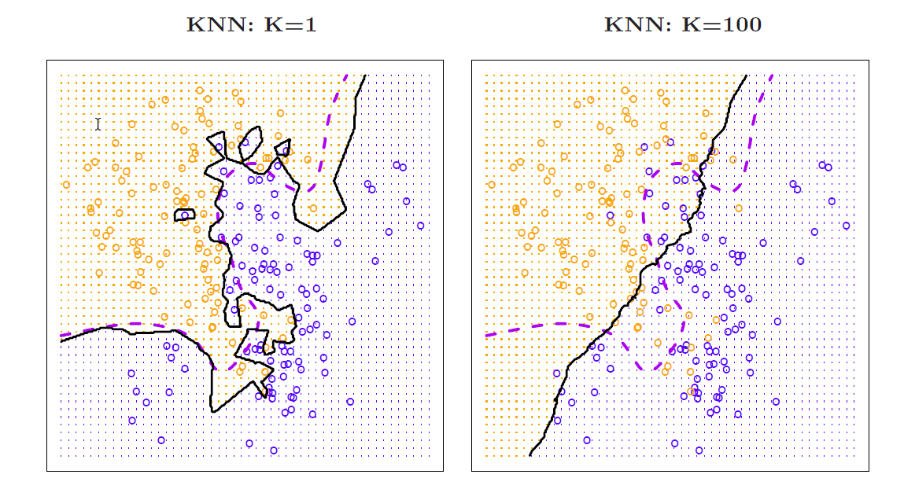

Slide 37
