Slide 1
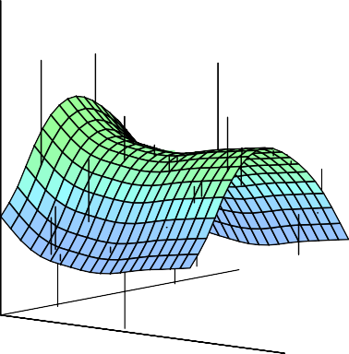


Statistical Analysis for Data Science C7081
Ed Harris
•
•
•
•
•
•
•• • •• • •• •
• ••••
•
•
• • •
••
• ••
•
••
•
•
•
•
•
•
•
•
• •
•
•

Slide 2

04: Classification
“A lot of people say there’s a fine line between genius and insanity. I don’t think there’s a fine line, I actually think there’s a yawning gulf.”
-Bill Bailey

Slide 3
Classification
Qualitative variables take values in an unordered set C, such as:
eye color∈ {brown, blue, green}
email∈ {spam, ham}.
Given a feature vector X and a qualitative response Y taking values in the set C, the classification task is to build a function C(X) that takes as input the feature vector X and predicts its value for Y ; i.e. C(X) ∈ C.
1 / 40

Slide 4
Classification
Often we are more interested in estimating the probabilities that X belongs to each category in C.
For example, it might be more valuable to have an estimate of the probability that an insurance claim is fraudulent, than a classification fraudulent or not.
1 / 40

Slide 5
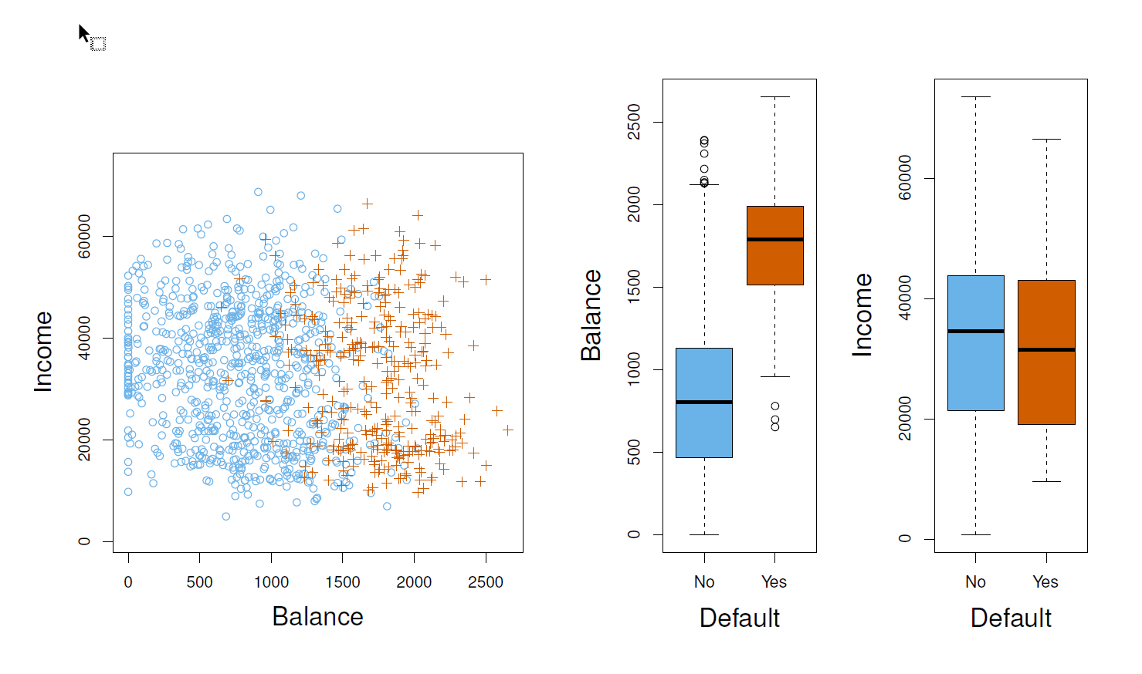
Example: Credit Card Default
2 / 40

Slide 6
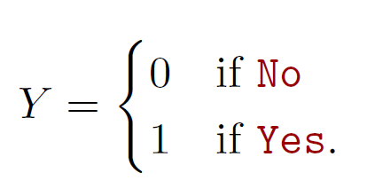
Can we use Linear Regression?
Suppose for the Default classification task that we code
Can we simply perform a linear regression of Y on X and classify as Yes if Y^{ˆ} > 0.5?
3 / 40

Slide 7
Can we use Linear Regression?
In this case of a binary outcome, linear regression does a good job as a classifier, and is equivalent to linear discriminant analysis which we discuss later.
Since in the population E(Y |X = x) = Pr(Y = 1|X = x), we might think that regression is perfect for this task.
However, linear regression might produce probabilities less than zero or bigger than one. Logistic regression is more appropriate.
3 / 40

Slide 8
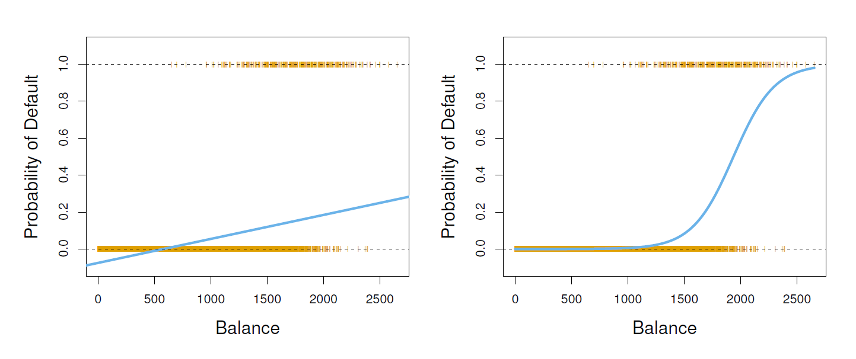
Linear versus Logistic Regression
The orange marks indicate the response Y , either 0 or 1. Linear regression does not estimate Pr(Y = 1|X) well. Logistic regression seems well suited to the task.
4 / 40

Slide 9
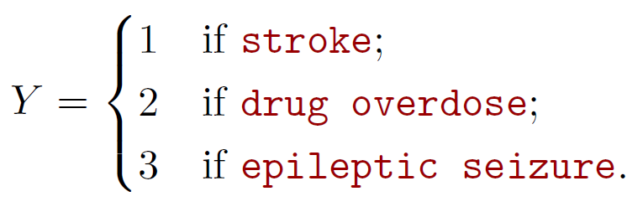
Linear Regression continued
Now suppose we have a response variable with three possible values. A patient presents at the emergency room, and we must classify them according to their symptoms.
5 / 40

Slide 10
Linear Regression continued
This coding suggests an ordering, and in fact implies that the difference between stroke and drug overdose is the same as between drug overdose and epileptic seizure.
Linear regression is not appropriate here.
Multiclass Logistic Regression or Discriminant Analysis are more appropriate.
5 / 40

Slide 11
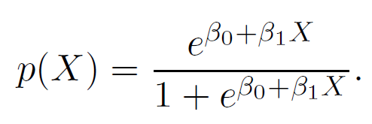

Logistic Regression
U s e p(X) = Pr(Y = 1|X) for short and consider using
balance to predict default. Logistic regression uses the form
(e ≈ 2.71828 is a mathematical constant [Euler’s number.]) It is easy to see that no matter what values β0, β1 or X take, p(X) will have values between 0 and 1.
6 / 40

Slide 12
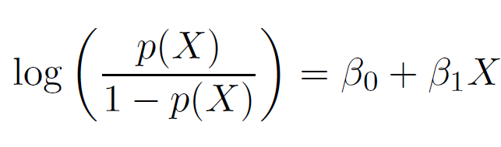
Logistic Regression
A bit of algebra gives
This monotone transformation is called the log odds or logit
transformation of p(X). (by log we mean natural log: ln.)
6 / 40

Slide 13
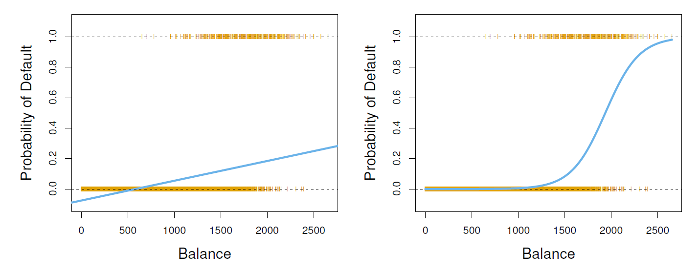
Linear versus Logistic Regression
Logistic regression ensures that our estimate for p(X) lies between 0 and 1.
7 / 40

Slide 14
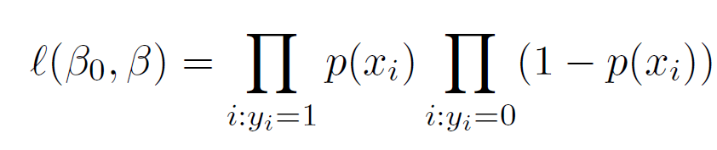
Maximum Likelihood
We use maximum likelihood to estimate the parameters.
This likelihood gives the probability of the observed zeros and ones in the data. We pick β₀ and β₁ to maximize the likelihood of the observed data.
8 / 40

Slide 15
Maximum Likelihood
Most statistical packages can fit linear logistic regression models by maximum likelihood. In R we use the glm function.
 | Coefficient | Std. | Error | Z-statistic | P-value
Intercept | -10.6513 | 0.3612 |  | -29.5 | < 0.0001
balance | 0.0055 | 0.0002 |  | 24.9 | < 0.0001
8 / 40

Slide 16
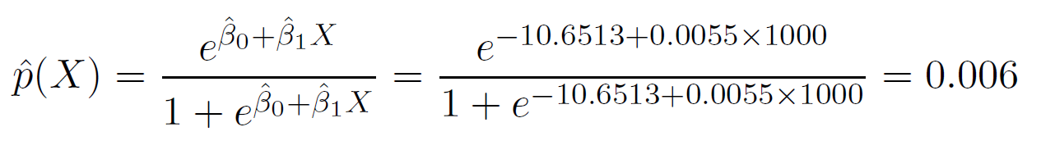
Making Predictions
What is our estimated probability of default for someone with a balance of $1000?
9 / 40

Slide 17
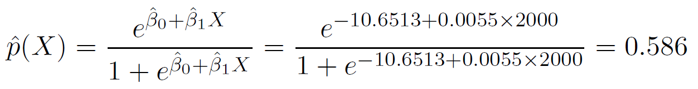
Making Predictions
What is our estimated probability of default for someone with a balance of $1000?
With a balance of $2000?
9 / 40

Slide 18
Lets do it again, using student as the predictor.
 | Coefficient | Std. | Error | Z-statistic | P-value
Intercept | -3.5041 | 0.0707 |  | -49.55 | < 0.0001
student[Yes] | 0.4049 | 0.1150 |  | 3.52 | 0.0004
10 / 40

Slide 19
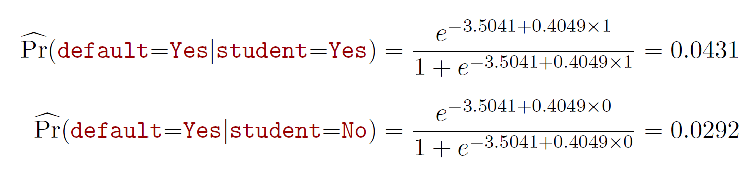
Lets do it again, using student as the predictor.
 | Coefficient | Std. | Error | Z-statistic | P-value
Intercept | -3.5041 | 0.0707 |  | -49.55 | < 0.0001
student[Yes] | 0.4049 | 0.1150 |  | 3.52 | 0.0004
10 / 40

Slide 20
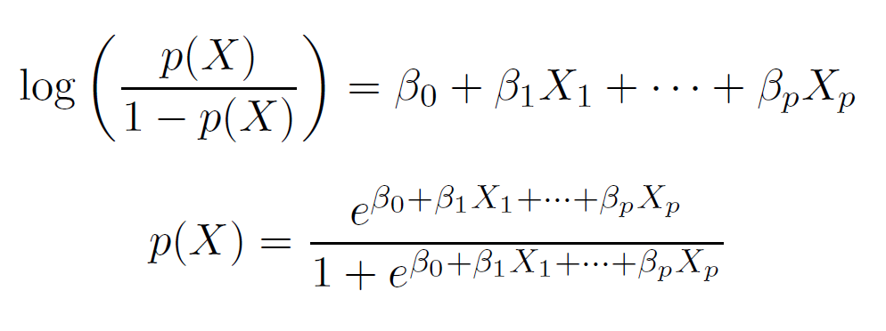
Logistic regression with several variables
 | Coefficient | Std. | Error | Z-statistic | P-value
Intercept | -10.8690 | 0.4923 |  | -22.08 | < 0.0001
balance | 0.0057 | 0.0002 |  | 24.74 | < 0.0001
income | 0.0030 | 0.0082 |  | 0.37 | 0.7115
student[Yes] | -0.6468 | 0.2362 |  | -2.74 | 0.0062
Why is coefficient for student negative, while it was positive before?

Slide 21
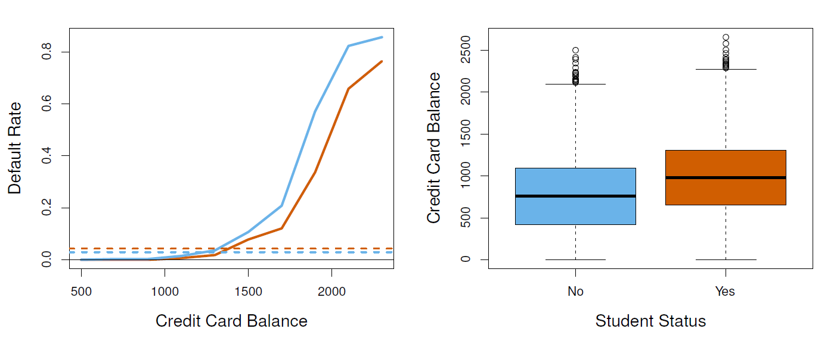
Confounding
Students tend to have higher balances than non-students, so their marginal default rate is higher than for non-students.
But for each level of balance, students default less than non-students.
Multiple logistic regression can tease this out.

Slide 22
Example: Heart Disease
160 cases of MI (myocardial infarction) and 302 controls (all male in age range 15-64), from Western Cape, South Africa in early 1980s.
Overall prevalence very high in this region: 5.1%.
Measurements on seven predictors (risk factors), shown in scatterplot matrix.
Goal is to identify relative strengths and directions of risk factors.
This was part of an intervention study aimed at educating the public on healthier diets.

Slide 23
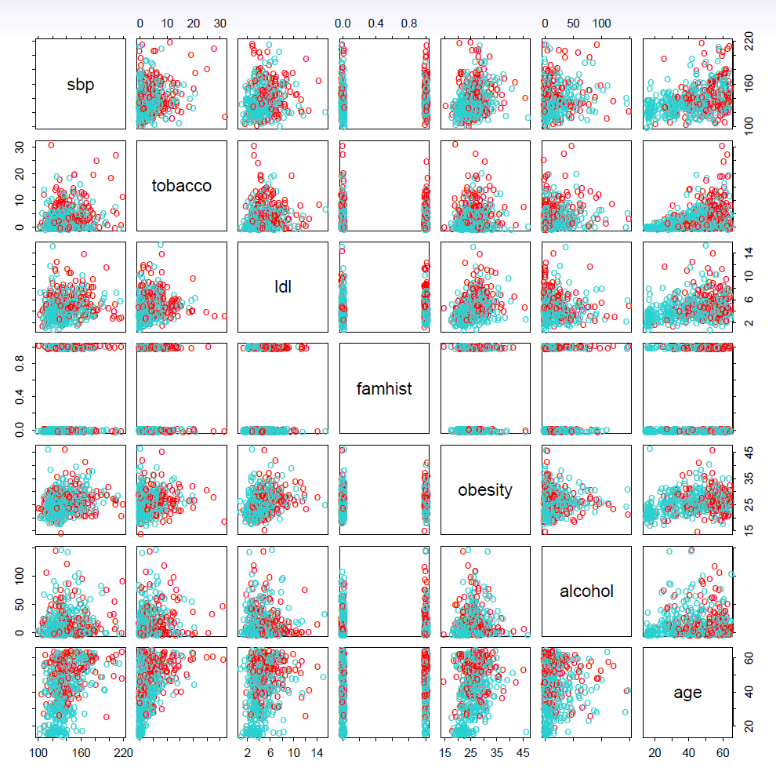
Scatterplot matrix of the South African Heart Disease data.
The response is color coded
The cases (MI) are red, the controls turquoise.
famhist is a binary variable, with 1 indicating family history of MI.

Slide 24
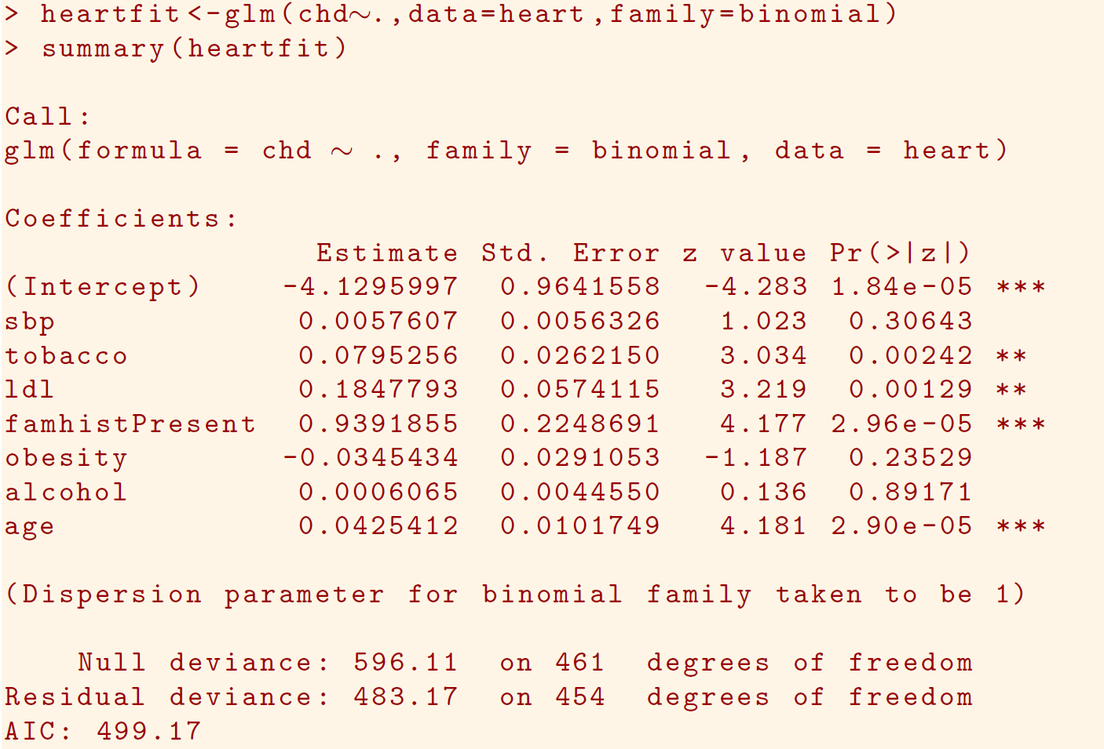

Slide 25
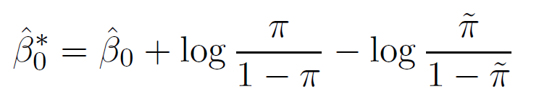
Case-control sampling and logistic regression
In South African data, there are 160 cases, 302 controls — π˜ = 0.35 are cases. Yet the prevalence of MI in this region is π = 0.05.
With case-control samples, we can estimate the regression parameters β_{j} accurately (if our model is correct); the constant term β₀ is incorrect.
We can correct the estimated intercept by a simple transformation
Often cases are rare and we take them all; up to five times that number of controls is sufficient. See next frame

Slide 26
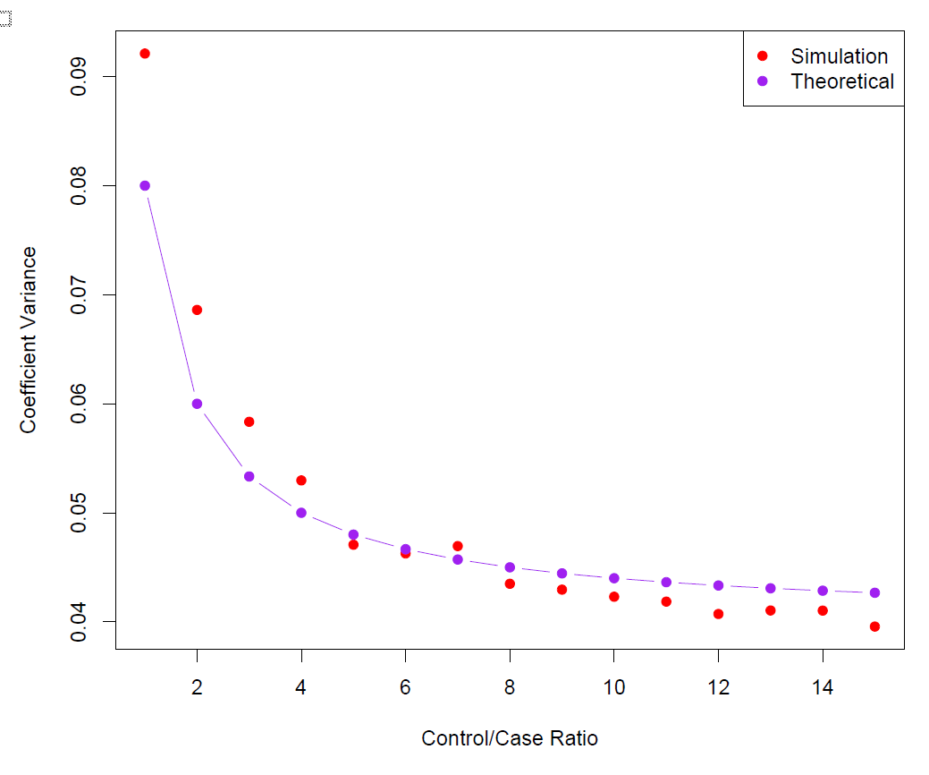
Diminishing returns in unbalanced binary data
Sampling more controls than cases reduces the variance of the parameter estimates.
But after a ratio of about 5 to 1 the variance reduction flattens out.

Slide 27
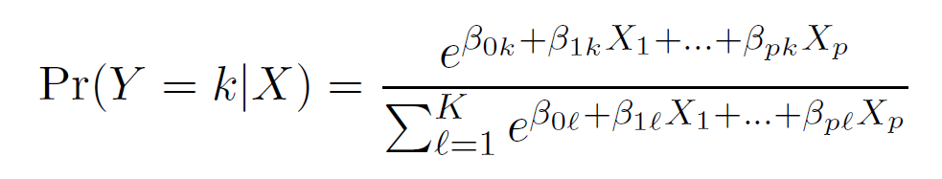
Logistic regression with more than two classes
So far we have discussed logistic regression with two classes. It is easily generalized to more than two classes. One version (used in the R package glmnet) has the symmetric form
Here there is a linear function for each class.
Multiclass logistic regression is also referred to as multinomial regression.
18 / 40

Slide 28
Discriminant Analysis
Here the approach is to model the distribution of X in each of the classes separately, and then use Bayes theorem to flip things around and obtain Pr(Y |X).
When we use normal (Gaussian) distributions for each class, this leads to linear or quadratic discriminant analysis.
However, this approach is quite general, and other distributions can be used as well. We will focus on normal distributions.
19 / 40

Slide 29



Bayes theorem for classification
Thomas Bayes was a famous mathematician whose name represents a big subfield of statistical and probabilistic modeling. Here we focus on a simple result, known as Bayes' theorem:
Pr(X = x|Y = k) · Pr(Y = k) Pr(X = x)
Pr(Y = k|X = x) =
Bunhill Fields, London
20 / 40

Slide 30
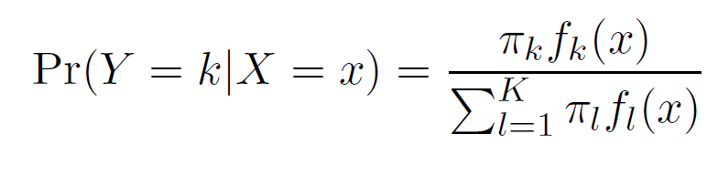
Bayes theorem for classification
One writes this slightly differently for discriminant analysis:
f_{k}(x) = Pr(X = x|Y = k) is the density for X in class k. Here we will use normal densities for these, separately in each class.
π_{k} = Pr(Y = k) is the marginal or prior probability for class k.
20 / 40

Slide 31
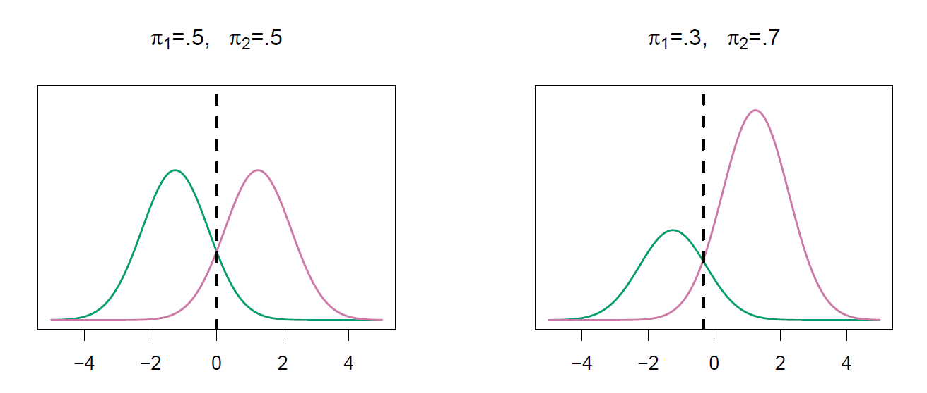
Classify to the highest density
We classify a new point according to which density is highest.
When the priors are different, we take them into account as well, and compare π_{k}f_{k}(x). On the right, we favor the pink class — the decision boundary has shifted to the left.
21 / 40

Slide 32
Why discriminant analysis?
When the classes are well-separated, the parameter estimates for the logistic regression model are surprisingly unstable. Linear discriminant analysis does not suffer from this problem.
If n is small and the distribution of the predictors X is approximately normal in each of the classes, the linear discriminant model is again more stable than the logistic regression model.
Linear discriminant analysis is popular when we have more than two response classes, because it also provides
low-dimensional views of the data.

Slide 33
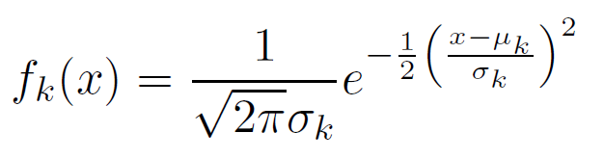
Linear Discriminant Analysis when p =1
The Gaussian density has the form
Here µ_{k} is the mean, and σ² the variance (in class k). We will
k
assume that all the σ_{k} = σ are the same.
23 / 40

Slide 34
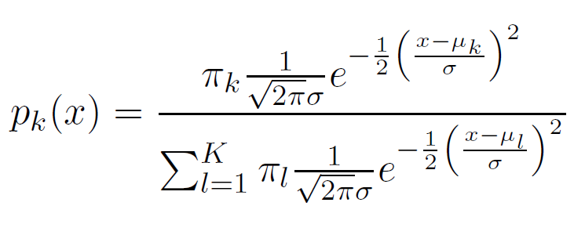
Linear Discriminant Analysis when p =1
Plugging this into Bayes formula, we get a rather complex expression for p_{k}(x) = Pr(Y = k|X = x):
Happily, there are simplifications and cancellations.
23 / 40

Slide 35
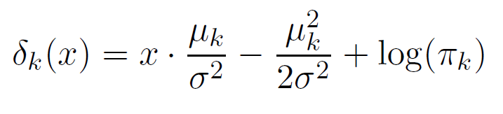
Discriminant functions
To classify at the value X = x, we need to see which of the p_{k}(x) is largest. Taking logs, and discarding terms that do not depend on k, we see that this is equivalent to assigning x to the class with the largest discriminant score:
Note that δ_{k}(x) is a linear function of x.
24 / 40

Slide 36
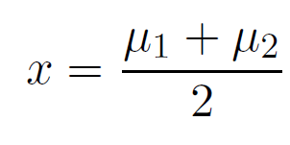
Discriminant functions
If there are K = 2 classes and π₁ = π₂ = 0.5, then one can see that the decision boundary is at
(Can we show this?)
24 / 40

Slide 37
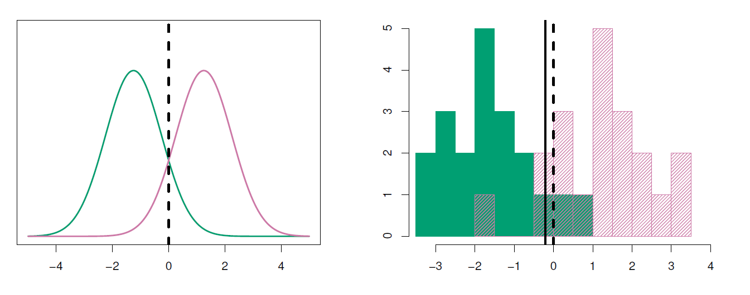
Example with µ₁ = −1.5, µ₂ = 1.5, π₁ = π₂ = 0.5, and σ² = 1.
Typically we don’t know these parameters; we just have the training data. In that case we simply estimate the parameters and plug them into the rule.
25 / 40

Slide 38
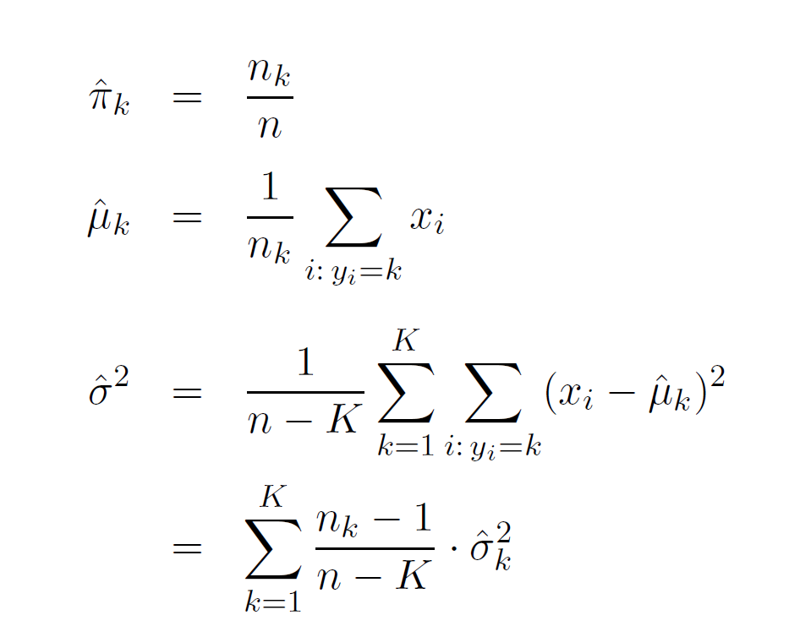

Estimating the parameters
is the usual formula for the estimated variance in the kth class.

Slide 39
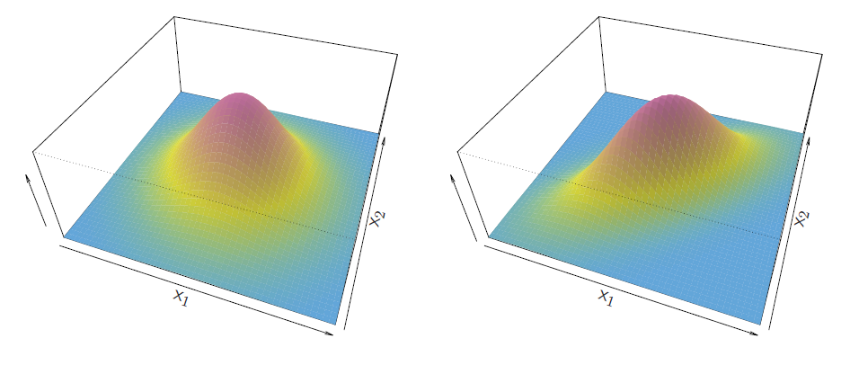
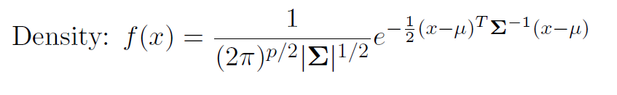
Linear Discriminant Analysis when p >1
27 / 40

Slide 40
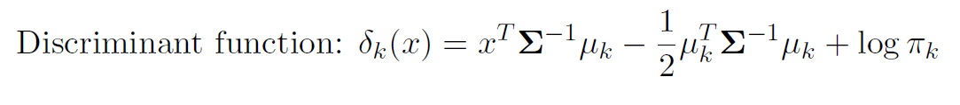
Linear Discriminant Analysis when p >1
27 / 40

Slide 41
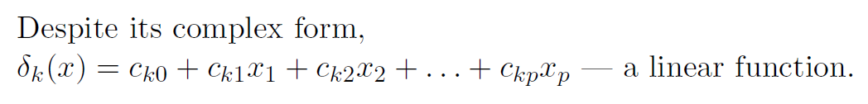
Linear Discriminant Analysis when p >1
27 / 40

Slide 42
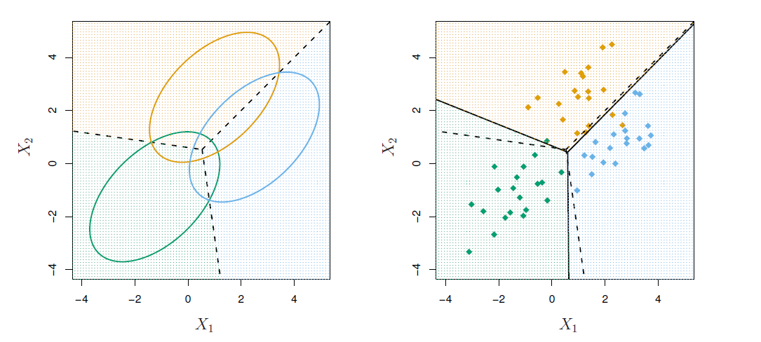
Illustration: p =2 and K=3 classes
Here π₁ = π₂ = π₃ = 1/3.
The dashed lines are known as the Bayes decision boundaries. Were they known, they would yield the fewest misclassification errors, among all possible classifiers.

Slide 43
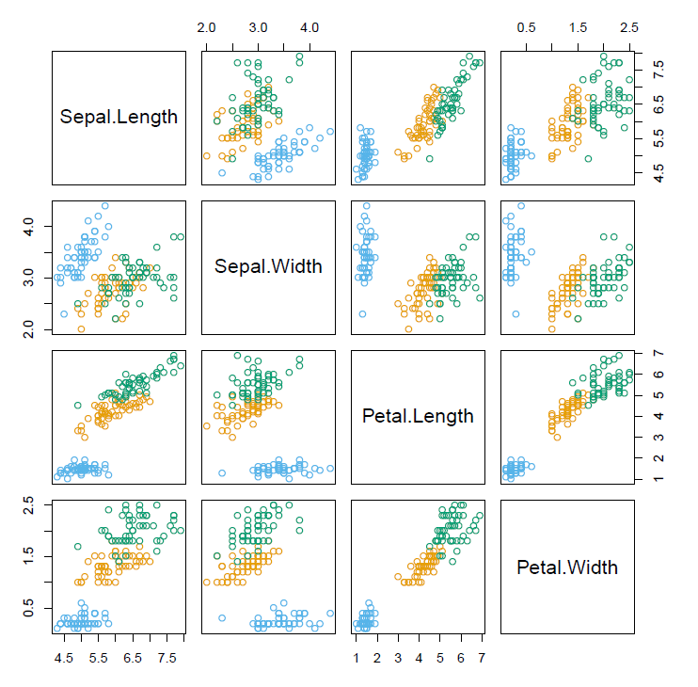
Fisher’s Iris Data
4 variables
3 species
50 samples/class
Setosa
Versicolor
Virginica
LDA classifies all but 3 of the 150 training samples correctly!

Slide 44
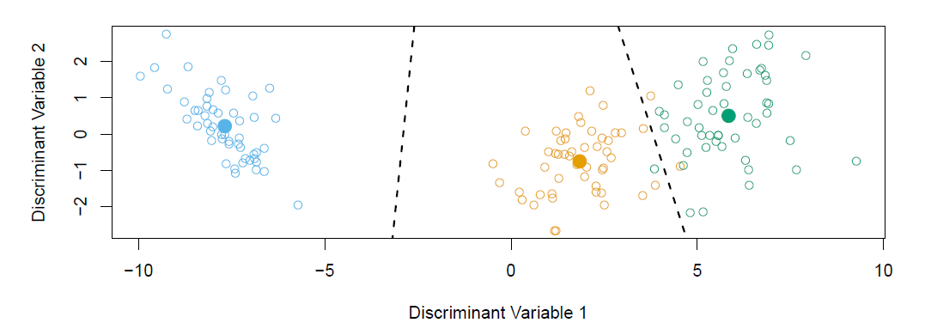
Fisher’s Discriminant Plot
When there are K classes, linear discriminant analysis can be viewed exactly in a K − 1 dimensional plot.
Why?
30 / 40

Slide 45
Fisher’s Discriminant Plot
Because it essentially classifies to the closest centroid, and they span a K − 1 dimensional plane.
Even when K > 3, we can find the “best” 2-dimensional plane for visualizing the discriminant rule.
30 / 40

Slide 46
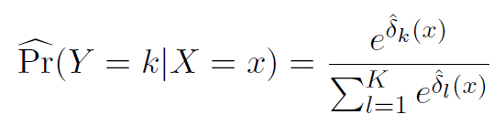



From δ_{k}(x) to probabilities
Once we have estimates δ^{ˆ}_{k}(x), we can turn these into estimates for class probabilities:
So classifying to the largest amounts to classifying to the class for which is largest.
When K = 2, we classify to class 2 if
else we classify to class 1.
31 / 40

Slide 47
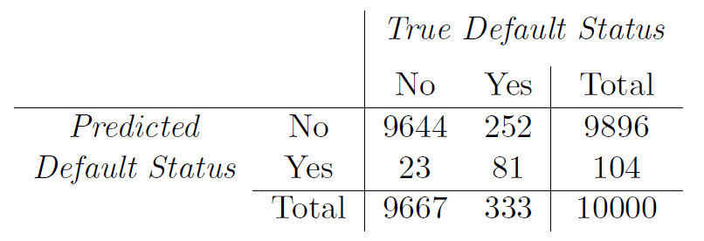
LDA on Credit Data
(23 + 252)/10000 errors — a 2.75% misclassification rate! Some caveats:
This is training error, and we may be overfitting.
32 / 40

Slide 48
LDA on Credit Data
(23 + 252)/10000 errors — a 2.75% misclassification rate! Some caveats:
This is training error, and we may be overfitting. Not a big concern here since n = 10000 and p = 2!
32 / 40

Slide 49
LDA on Credit Data
(23 + 252)/10000 errors — a 2.75% misclassification rate! Some caveats:
This is training error, and we may be overfitting. Not a big concern here since n = 10000 and p = 2!
If we classified to the prior — always to class No in this case — we would make 333/10000 errors, or only 3.33%.
32 / 40

Slide 50
LDA on Credit Data
(23 + 252)/10000 errors — a 2.75% misclassification rate! Some caveats:
This is training error, and we may be overfitting. Not a big concern here since n = 10000 and p = 2!
If we classified to the prior — always to class No in this case — we would make 333/10000 errors, or only 3.33%.
True No we make 23/9667 = 0.2% errors;
True Yes we make 252/333 = 75.7% errors!
32 / 40

Slide 51
Types of errors
False positive rate: The fraction of negative examples that are classified as positive — 0.2% in example.
False negative rate: The fraction of positive examples that are classified as negative — 75.7% in example.
We produced this table by classifying to class Yes if
We can change the two error rates by changing the threshold from 0.5 to some other value in [0, 1]:
and vary threshold.

Slide 52
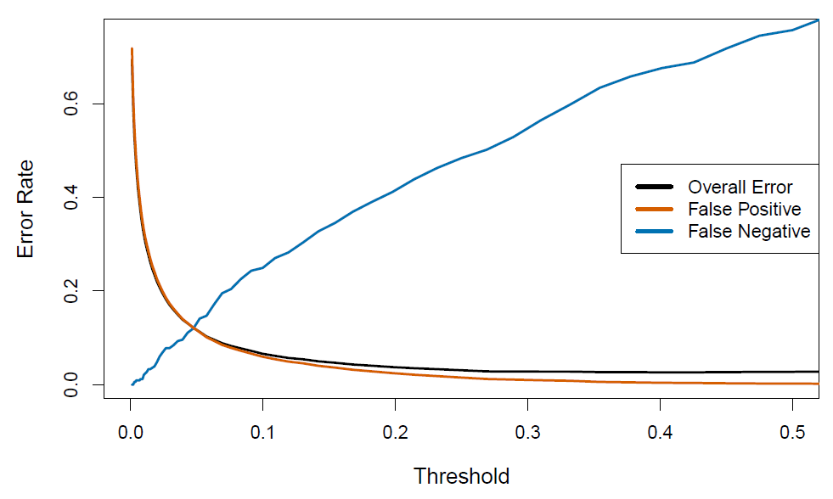
Varying the threshold
In order to reduce the false negative rate, we may want to reduce the threshold to 0.1 or less.

Slide 53
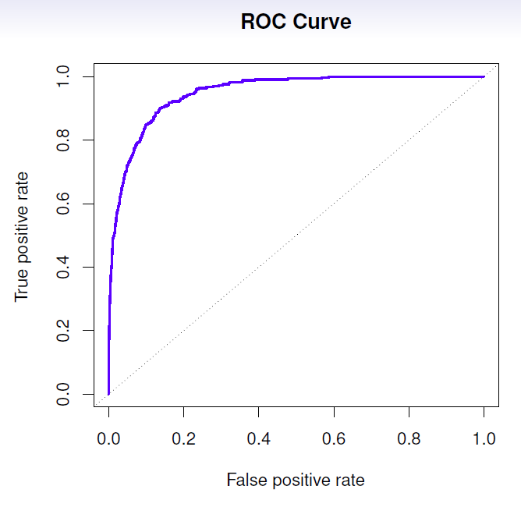
The ROC plot displays both simultaneously.
Sometimes we use the AUC or area under the curve to summarize the overall performance. Higher AUC is good.
35 / 40

Slide 54
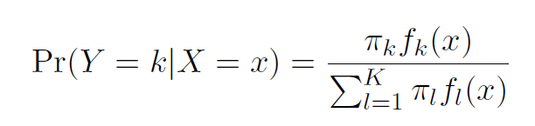
Other forms of Discriminant Analysis
When f_{k}(x) are Gaussian densities, with the same covariance matrix Σ in each class, this leads to linear discriminant analysis. By altering the forms for f_{k}(x), we get different classifiers.
36 / 40

Slide 55

Other forms of Discriminant Analysis
With Gaussians but different Σ_{k} in each class, we get quadratic discriminant analysis.
(conditional independence model) in each class we get naive Bayes. For Gaussian this means the Σ_{k} are diagonal.
Many other forms, by proposing specific density models for
f_{k}(x), including nonparametric approaches.
36 / 40

Slide 56
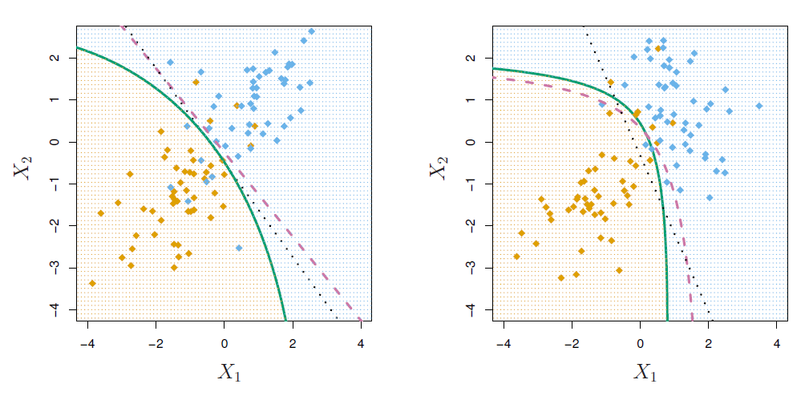
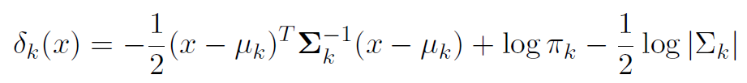
Quadratic Discriminant Analysis
Because the Σ_{k} are different, the quadratic terms matter.

Slide 57
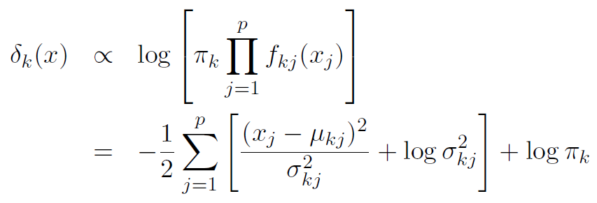
Naive Bayes
Assumes features are independent in each class.
Useful when p is large, and so multivariate methods like QDA and even LDA break down.
Gaussian naive Bayes assumes each Σ_{k} is diagonal:
can use for mixed feature vectors (qualitative and quantitative). If X_{j} is qualitative, replace f_{kj} (x_{j} ) with probability mass function (histogram) over discrete categories.
Despite strong assumptions, naive Bayes often produces good classification results.

Slide 58
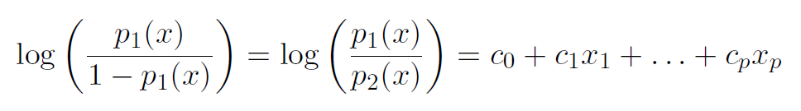
Logistic Regression versus LDA
For a two-class problem, one can show that for LDA
So it has the same form as logistic regression.
The difference is in how the parameters are estimated.
39 / 40

Slide 59
Logistic Regression versus LDA
Logistic regression uses the conditional likelihood based on Pr(Y |X) (known as discriminative learning).
LDA uses the full likelihood based on Pr(X, Y ) (known as
generative learning).
Despite these differences, in practice the results are often very similar.
Footnote: logistic regression can also fit quadratic boundaries like QDA, by explicitly including quadratic terms in the model.
39 / 40

Slide 60
Summary
Logistic regression is very popular for classification, especially when K = 2.
LDA is useful when n is small, or the classes are well separated, and Gaussian assumptions are reasonable. Also when K > 2.
Naive Bayes is useful when p is very large.
See Section 4.5 for some comparisons of logistic regression, LDA and KNN.
40 / 40

