Slide 1
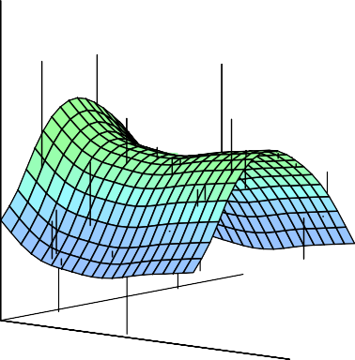


Statistical Analysis for Data Science C7081
Ed Harris
•
•
•
•
•
•
•• • •• • •• •
• ••••
•
•
• • •
••
• ••
•
••
•
•
•
•
•
•
•
•
• •
•
•

Slide 2
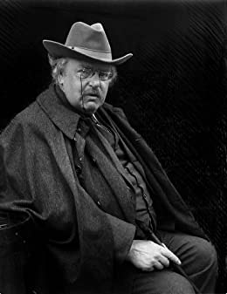
03: Linear regression
Art, like morality, consists in drawing the line somewhere.
-G. K. Chesterton

Slide 3
Linear regression
Linear regression is a simple approach to supervised learning. It assumes that the dependence of Y on X₁, X₂, . . . X_{p} is linear.
True regression functions are never linear!
7
6
f(X)
5
4
3
2
4
6
8
X
although it may seem overly simplistic, linear regression is extremely useful both conceptually and practically.

Slide 4
Linear regression for the advertising data
Consider the advertising data shown on the next slide. Questions we might ask:
Is there a relationship between advertising budget and sales?
How strong is the relationship between advertising budget and sales?
Which media contribute to sales?
How accurately can we predict future sales?
Is the relationship linear?
Is there synergy among the advertising media?

Slide 5
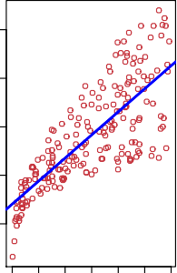
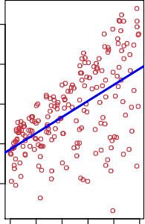
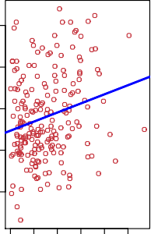
Advertising data
25
25
25
20
20
20
Sales
15
Sales
15
Sales
15
10
10
10
5
5
5
0 50 100
200
300
0 10 20 30 40 50
0 20 40 60 80 100
TV
Radio
Newspaper

Slide 6

Simple linear regression using a single predictor X.
We assume a model
Y = β₀ + β₁X + E,
where β₀ and β₁ are two unknown constants that represent the intercept and slope, also known as coefficients or parameters, and E is the error term.
Given some estimates β^{ˆ}₀ and β^{ˆ}₁ for the model coefficients, we predict future sales using
where yˆ indicates a prediction of Y on the basis of X = x.
The hat symbol denotes an estimated value.

Slide 7

Estimation of the parameters by least squares
Let yˆ_{i} = β^{ˆ}₀ + β^{ˆ}₁x_{i} be the prediction for Y based on the ith value of X. Then e_{i} = y_{i} − yˆ_{i} represents the ith residual
We define the residual sum of squares (RSS) as
or equivalently as

Slide 8
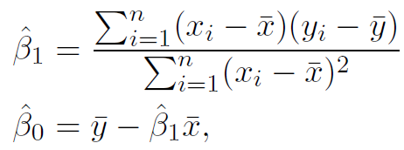


Estimation of the parameters by least squares
The least squares approach chooses β^{ˆ}₀ and β^{ˆ}₁ to minimize the RSS.
The minimizing values can be shown to be
Sample means:

Slide 9
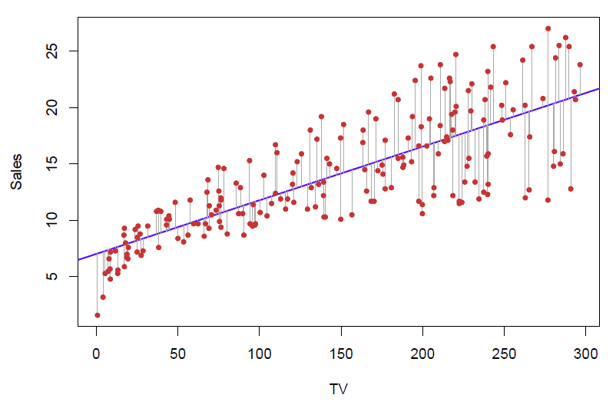
Example: advertising data
The least squares fit for the regression of sales onto TV.
In this case a linear fit captures the essence of the relationship, although it is somewhat deficient in the left of the plot.

Slide 10
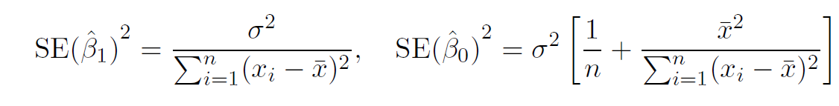
Assessing the Accuracy of the Coefficient Estimates
The standard error of an estimator reflects how it varies under repeated sampling. We have
where σ² = Var(E)
These standard errors can be used to compute confidence intervals. A 95% confidence interval is defined as a range of values such that with 95% probability, the range will contain the true unknown value of the parameter. It has the form
β^{ˆ}₁ ± 2 · SE(β^{ˆ}₁).

Slide 11
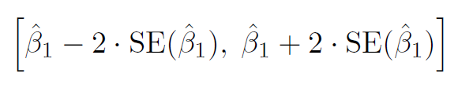
Confidence intervals — continued
That is, there is approximately a 95% chance that the interval
will contain the true value of β₁ (under a scenario where we got repeated samples like the present sample)
For the advertising data, the 95% confidence interval for β₁ is [0.042, 0.053]

Slide 12
Hypothesis testing
Standard errors can also be used to perform hypothesis tests on the coefficients. The most common hypothesis test involves testing the null hypothesis of
H₀ : There is no relationship between X and Y
versus the alternative hypothesis
H_{A} : There is some relationship between X and Y .
Mathematically, this corresponds to testing
H₀ : β₁ = 0
versus
H_{A} : β₁ =/ 0,
since if β₁ = 0 then the model reduces to Y = β₀ + E, and
X is not associated with Y .

Slide 13
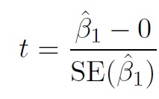
Hypothesis testing — continued
To test the null hypothesis, we compute a t-statistic, given by
This will have a t-distribution with n − 2 degrees of freedom, assuming β₁ = 0.
Using statistical software, it is easy to compute the probability of observing any value equal to |t| or larger. We call this probability the p-value.

Slide 14
Results for the advertising data
 | Coefficient | Std. | Error | t-statistic | p-value
Intercept | 7.0325 | 0.4578 |  | 15.36 | < 0.0001
TV | 0.0475 | 0.0027 |  | 17.67 | < 0.0001

Slide 15
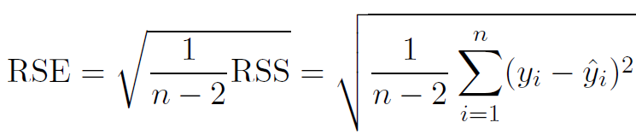

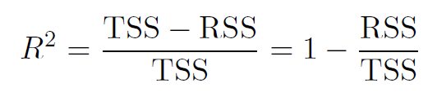

Assessing the Overall Accuracy of the Model
We compute the Residual Standard Error
where the residual sum-of-squares is
R-squared or fraction of variance explained is
where
is the total sum of squares.

Slide 16
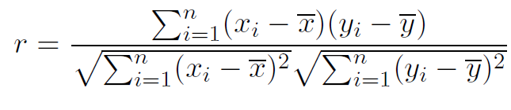
Assessing the Overall Accuracy of the Model
It can be shown that in this simple linear regression setting that R² = r², where r is the correlation between X and Y :

Slide 17
Advertising data results
Quantity | Value
Residual Standard Error _{R}2 | 3.26 0.612
F-statistic | 312.1

Slide 18
Multiple Linear Regression
Here our model is
Y = β₀ + β₁X₁ + β₂X₂ + · · · + β_{p}X_{p} + E
We interpret β_{j} as the average effect on Y of a one unit increase in X_{j} , holding all other predictors fixed. In the advertising example, the model becomes
sales = β₀ + β₁ × TV + β₂ × radio + β₃ × newspaper + E

Slide 19
Interpreting regression coefficients
The ideal scenario is when the predictors are uncorrelated
a balanced design:
Each coefficient can be estimated and tested separately.
Interpretations such as “a unit change in X_{j} is associated with a β_{j} change in Y , while all the other variables stay fixed”, are possible.
Correlations amongst predictors cause problems:
The variance of all coefficients tends to increase, sometimes dramatically
Interpretations become hazardous — when X_{j} changes, everything else changes.
Claims of causality should be avoided for observational data.

Slide 20
The woes of (interpreting) regression coefficients
“Data Analysis and Regression” Mosteller and Tukey 1977
a regression coefficient β_{j} estimates the expected change in Y per unit change in X_{j} , with all other predictors held fixed. But predictors usually change together!
Example: Y total amount of change in your pocket;
X₁ = # of coins; X₂ = # of pennies, nickels and dimes. By itself, regression coefficient of Y on X₂ will be > 0. But how about with X₁ in model?
Y = number of tackles by a football player in a season; W and H are his weight and height. Fitted regression model is Y^{ˆ} = b₀ + .50W − .10H. How do we interpret β^{ˆ}₂ < 0?

Slide 21
Two quotes by famous Statisticians
“Essentially, all models are wrong, but some are useful”
George Box
“The only way to find out what will happen when a complex system is disturbed is to disturb the system, not merely to observe it passively”
Fred Mosteller and John Tukey, paraphrasing George Box

Slide 22

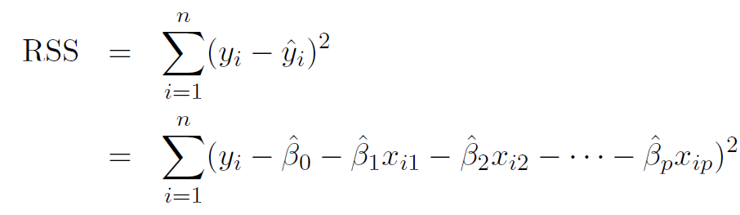
Estimation and Prediction for Multiple Regression
Given estimates β^{ˆ}₀ , β^{ˆ}₁ , . . . β^{ˆ}_{p} , we can make predictions using the formula
We estimate β₀, β₁, . . . , β_{p} as the values that minimize the
sum of squared residuals
This is done using standard statistical software. The values β^{ˆ}₀ , β^{ˆ}₁ , . . . , β^{ˆ}_{p} that minimize RSS are the multiple least squares regression coefficient estimates.

Slide 23
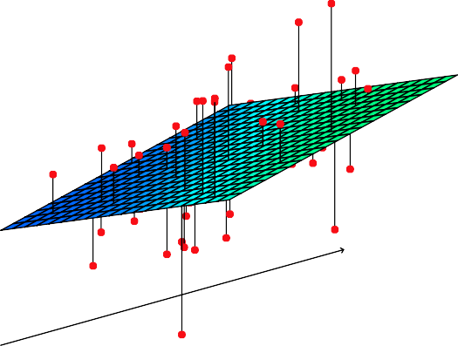
Y
X₂
X₁

Slide 24
Results for advertising data
 | Coefficient | Std. | Error | t-statistic | p-value
Intercept | 2.939 | 0.3119 |  | 9.42 | < 0.0001
TV | 0.046 | 0.0014 |  | 32.81 | < 0.0001
radio | 0.189 | 0.0086 |  | 21.89 | < 0.0001
newspaper | -0.001 | 0.0059 |  | -0.18 | 0.8599
Correlations:
TV radio newspaper
sales
TV | 1.0000 | 0.0548 | 0.0567 | 0.7822
radio |  | 1.0000 | 0.3541 | 0.5762
newspaper |  |  | 1.0000 | 0.2283
sales |  |  |  | 1.0000

Slide 25
Some important questions
Is at least one of the predictors X₁, X₂, . . . , X_{p} useful in predicting the response?
Do all the predictors help to explain Y , or is only a subset of the predictors useful?
How well does the model fit the data?
Given a set of predictor values, what response value should we predict, and how accurate is our prediction?

Slide 26
Is at least one predictor useful?
For the first question, we can use the F-statistic
(TSS − RSS)/p
F = ∼ F
RSS/(n − p − 1)
p,n−p−1
Quantity | Value
Residual Standard Error _{R}2 | 1.69 0.897
F-statistic | 570

Slide 27
Deciding on the important variables
The most direct approach is called all subsets or best subsets regression: we compute the least squares fit for all possible subsets and then choose between them based on some criterion that balances training error with model size.
However we often cannot examine all possible models, since they are 2^{p} of them; for example when p =40 there are over a billion models!
Instead we need an automated approach that searches through a subset of them. We discuss two commonly use approaches next.

Slide 28
Forward selection
Begin with the null model — a model that contains an intercept but no predictors.
Fit p simple linear regressions and add to the null model the variable that results in the lowest RSS.
Add to that model the variable that results in the lowest RSS amongst all two-variable models.
Continue until some stopping rule is satisfied, for example when all remaining variables have a p-value above some threshold.

Slide 29
Backward selection
Start with all variables in the model.
Remove the variable with the largest p-value — that is, the variable that is the least statistically significant.
The new (p − 1)-variable model is fit, and the variable with the largest p-value is removed.
Continue until a stopping rule is reached. For instance, we may stop when all remaining variables have a significant
p-value defined by some significance threshold.

Slide 30
Model selection continued
Later we discuss more systematic criteria for choosing an “optimal” member in the path of models produced by forward or backward stepwise selection.
These include Mallow’s C_{p}, Akaike information criterion (AIC), Bayesian information criterion (BIC), adjusted R² and Cross-validation (CV).

Slide 31
Other Considerations in the Regression Model
Qualitative Predictors
Some predictors are not quantitative but are qualitative, taking a discrete set of values.
These are also called categorical predictors or factor variables.
See for example the scatterplot matrix of the credit card
data in the next slide.
In addition to the 7 quantitative variables shown, there are four qualitative variables: gender, student (student status), status (marital status), and ethnicity (Caucasian, African American (AA) or Asian).

Slide 32
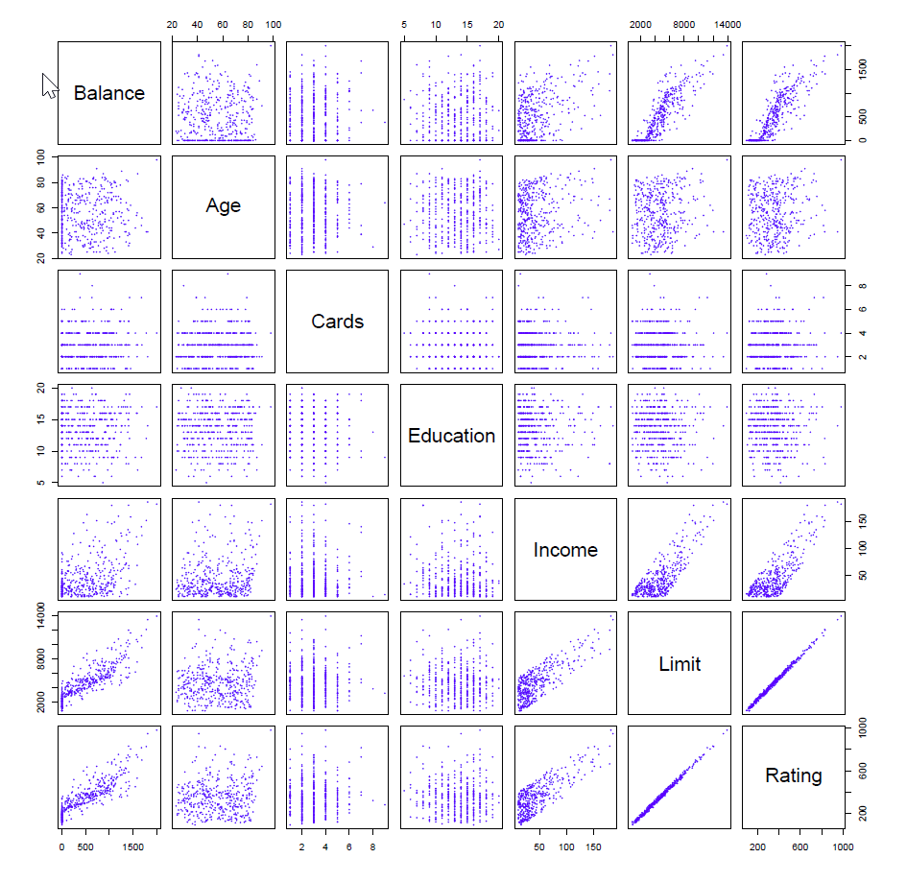
Credit Card Data

Slide 33
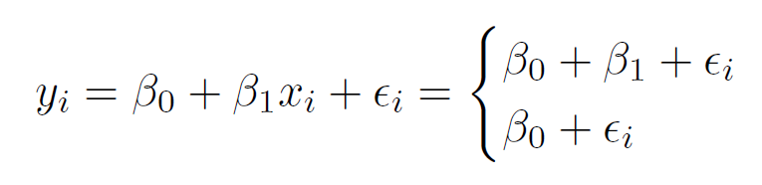
Qualitative Predictors — continued
Example: investigate differences in credit card balance between males and females, ignoring the other variables. We create a new variable
1
0
if ith person is female if ith person is male
x =
i
Resulting model:
if ith person is female if ith person is male.
Intrepretation?

Slide 34
Credit card data — continued
Results for gender model:
 | Coefficient | Std. | Error | t-statistic | p-value
Intercept | 509.80 | 33.13 |  | 15.389 | < 0.0001
gender[Female] | 19.73 | 46.05 |  | 0.429 | 0.6690

Slide 35
Qualitative predictors with more than two levels
With more than two levels, we create additional dummy variables. For example, for the ethnicity variable we create two dummy variables. The first could be
1
0
if ith person is Asian
if ith person is not Asian,
x =
i1
and the second could be
1
0
if ith person is Caucasian
if ith person is not Caucasian.
x =
i2

Slide 36
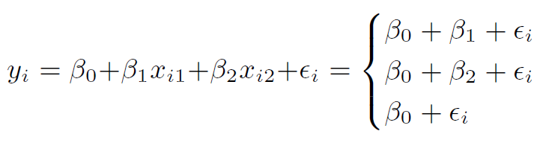
Qualitative predictors with more than two levels — continued.
Then both of these variables can be used in the regression equation, in order to obtain the model
if ith person is Asian
if ith person is Caucasian if ith person is AA.
There will always be one fewer dummy variable than the number of levels. The level with no dummy variable — African American in this example — is known as the baseline.

Slide 37
Results for ethnicity
 | Coefficient | Std. | Error | t-statistic | p-value
Intercept | 531.00 | 46.32 |  | 11.464 | < 0.0001
ethnicity[Asian] | -18.69 | 65.02 |  | -0.287 | 0.7740
ethnicity[Caucasian] | -12.50 | 56.68 |  | -0.221 | 0.8260

Slide 38
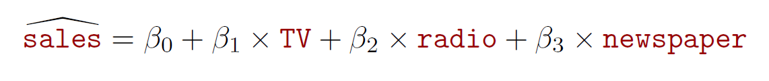
Extensions of the Linear Model
Removing the additive assumption: interactions and nonlinearity
Interactions:
In our previous analysis of the Advertising data, we assumed that the effect on sales of increasing one advertising medium is independent of the amount spent on the other media.
For example, the linear model
states that the average effect on sales of a one-unit increase in TV is always β₁, regardless of the amount spent on radio.

Slide 39
Interactions — continued
But suppose that spending money on radio advertising actually increases the effectiveness of TV advertising, so that the slope term for TV should increase as radio increases.
In this situation, given a fixed budget of $100, 000, spending half on radio and half on TV may increase sales more than allocating the entire amount to either TV or to radio.
In marketing, this is known as a synergy effect, and in statistics it is referred to as an interaction effect.

Slide 40
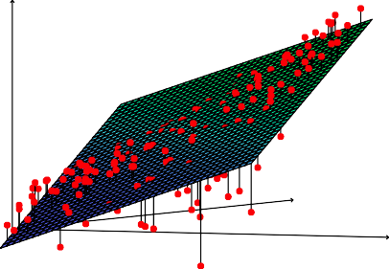
Interaction in the Advertising data?
Sales
TV
Radio
When levels of either TV or radio are low, then the true sales
are lower than predicted by the linear model.
But when advertising is split between the two media, then the model tends to underestimate sales.

Slide 41
Modelling interactions — Advertising data
Model takes the form
sales = β₀ + β₁ × TV + β₂ × radio + β₃ × (radio × TV) + E
= β₀ + (β₁ + β₃ × radio) × TV + β₂ × radio + E.
Results:
 | Coefficient | Std. | Error | t-statistic | p-value
Intercept | 6.7502 | 0.248 |  | 27.23 | < 0.0001
TV | 0.0191 | 0.002 |  | 12.70 | < 0.0001
radio | 0.0289 | 0.009 |  | 3.24 | 0.0014
TV×radio | 0.0011 | 0.000 |  | 20.73 | < 0.0001

Slide 42

Interpretation
The results in this table suggests that interactions are important.
The p-value for the interaction term TV × radio is extremely low, indicating that there is strong evidence for
The R² for the interaction model is 96.8%, compared to only 89.7% for the model that predicts sales using TV and radio without an interaction term.

Slide 43
Interpretation — continued
This means that (96.8 − 89.7)/(100 − 89.7) = 69% of the variability in sales that remains after fitting the additive model has been explained by the interaction term.
The coefficient estimates in the table suggest that an increase in TV advertising of $1, 000 is associated with increased sales of
(β^{ˆ}₁ + β^{ˆ}₃ × radio) × 1000 = 19 + 1.1 × radio units.
An increase in radio advertising of $1, 000 will be associated with an increase in sales of
(β^{ˆ}₂ + β^{ˆ}₃ × TV) × 1000 = 29 + 1.1 × TV units.

Slide 44
Hierarchy
Sometimes it is the case that an interaction term has a very small p-value, but the associated main effects (in this case, TV and radio) do not.
The hierarchy principle:
If we include an interaction in a model, we should also include the main effects, even if the p-values associated with their coefficients are not significant.

Slide 45
Hierarchy — continued
The rationale for this principle is that interactions are hard to interpret in a model without main effects — their meaning is changed.
Specifically, the interaction terms also contain main effects, if the model has no main effect terms.

Slide 46
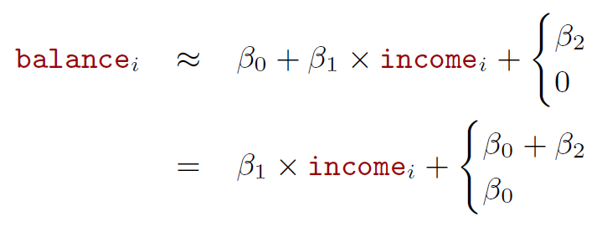
Interactions between qualitative and quantitative variables
Consider the Credit data set, and suppose that we wish to predict balance using income (quantitative) and student (qualitative).
Without an interaction term, the model takes the form
if ith person is a student
if ith person is not a student
if ith person is a student
if ith person is not a student.

Slide 47
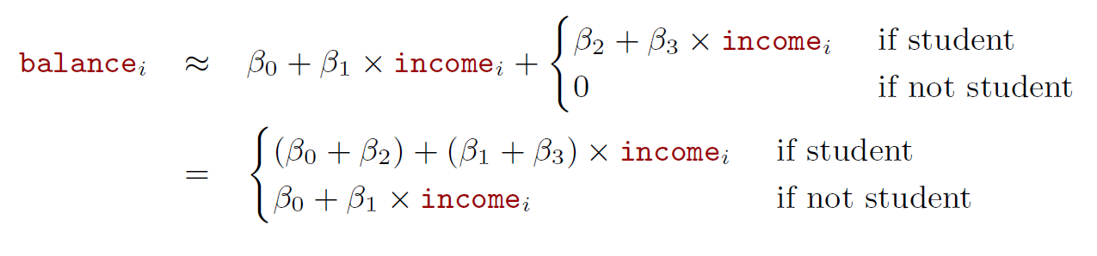
With interactions, it takes the form

Slide 48
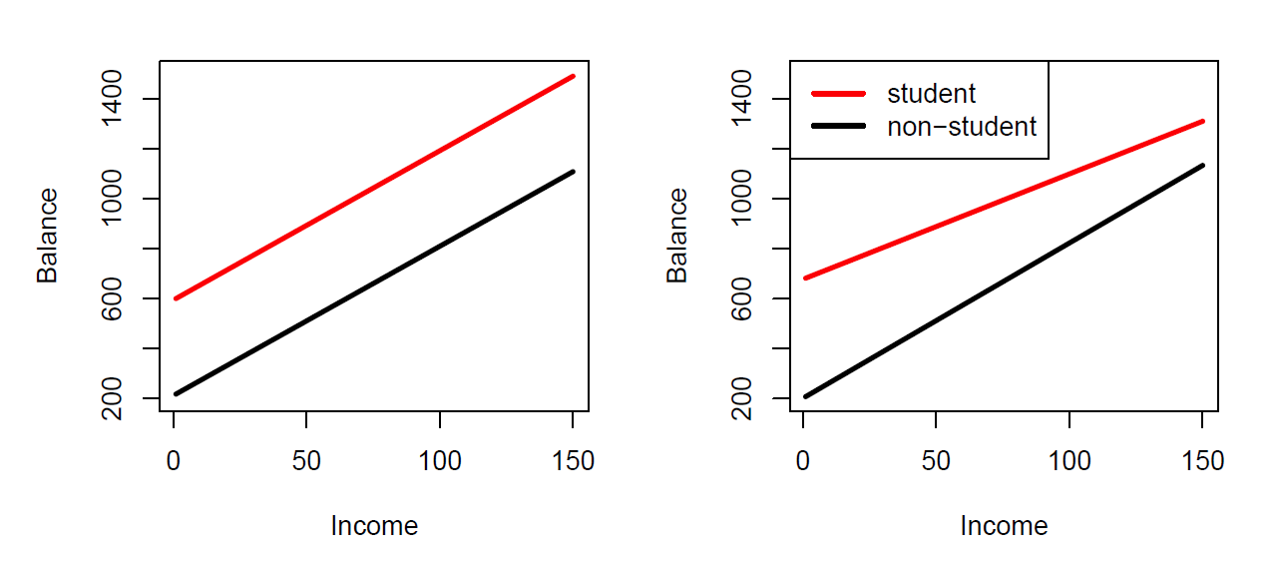
Credit data
Left: no interaction between income and student.
Right: with an interaction term between income and student.

Slide 49
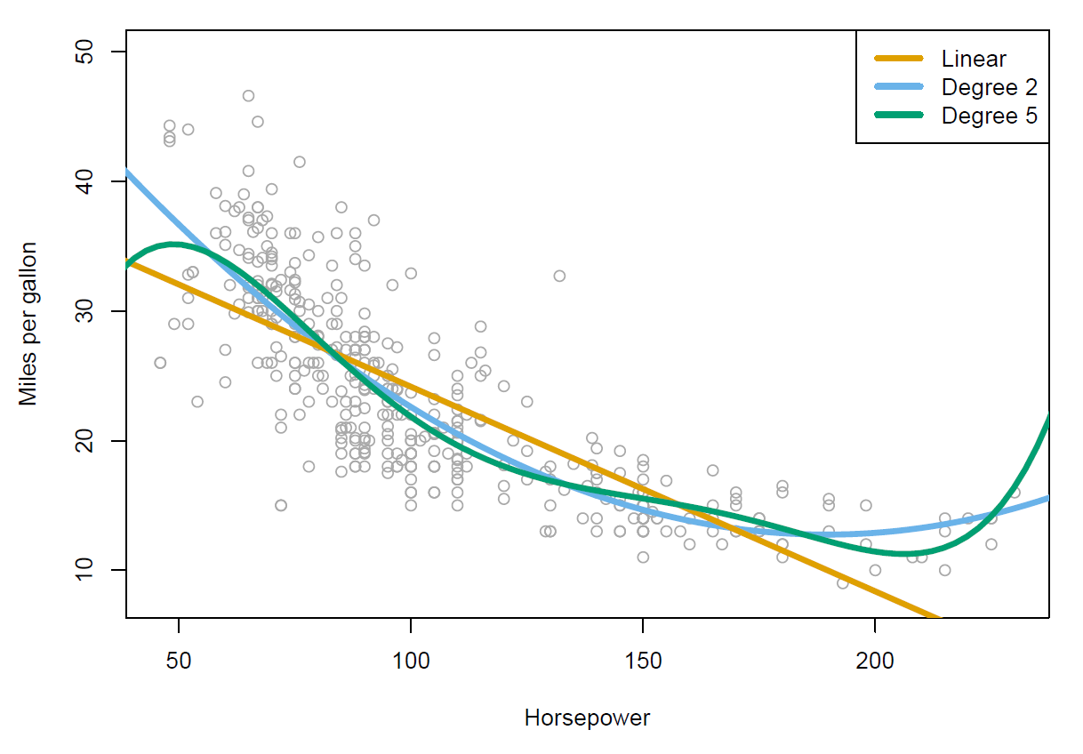
Non-linear effects of predictors
Polynomial regression on Auto data

Slide 50
The figure suggests that
mpg = β₀ + β₁ × horsepower + β₂ × horsepower² + E
may provide a better fit.
 | Coefficient | Std. | Error | t-statistic | p-value
Intercept | 56.9001 | 1.8004 |  | 31.6 | < 0.0001
horsepower | -0.4662 | 0.0311 |  | -15.0 | < 0.0001
horsepower² | 0.0012 | 0.0001 |  | 10.1 | < 0.0001

Slide 51
What we did not cover
Outliers
Non-constant variance of error terms
High leverage points
Collinearity
(See James et al. 2021 section 3.33 if this is new to you – this is important stuff

Slide 52
Generalizations of the Linear Model
In much of the rest of this module, we explore methods that expand the scope of linear models and how they are fit:
Classification problems: logistic regression, support vector machines
Non-linearity: kernel smoothing, splines and generalized additive models; nearest neighbor methods.
Interactions: Tree-based methods, bagging, random forests and boosting (these also capture non-linearities)
Regularized fitting: Ridge regression and lasso

