Slide 1
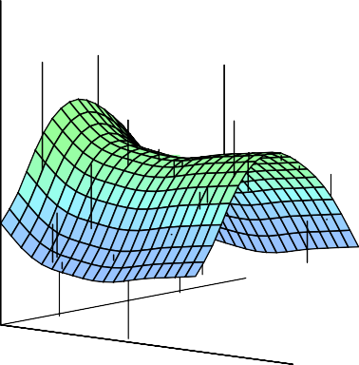


Statistical Analysis for Data Science C7081
Ed Harris
•
•
•
•
•
•
•• • •• • •• •
• ••••
•
•
• • •
••
• ••
•
••
•
•
•
•
•
•
•
•
• •
•
•

Slide 2

07: Nonlinear models
“The truth is never linear. Or almost never… But often the linearity assumption is good enough.”
-Trevor Hastie

Slide 3
Moving Beyond Linearity
When the linearity assumption is not good enough. . .
polynomials
step functions
splines
local regression
generalized additive models
These options offer a lot of flexibility, without losing the ease and interpretability of linear models.
1 / 23

Slide 4
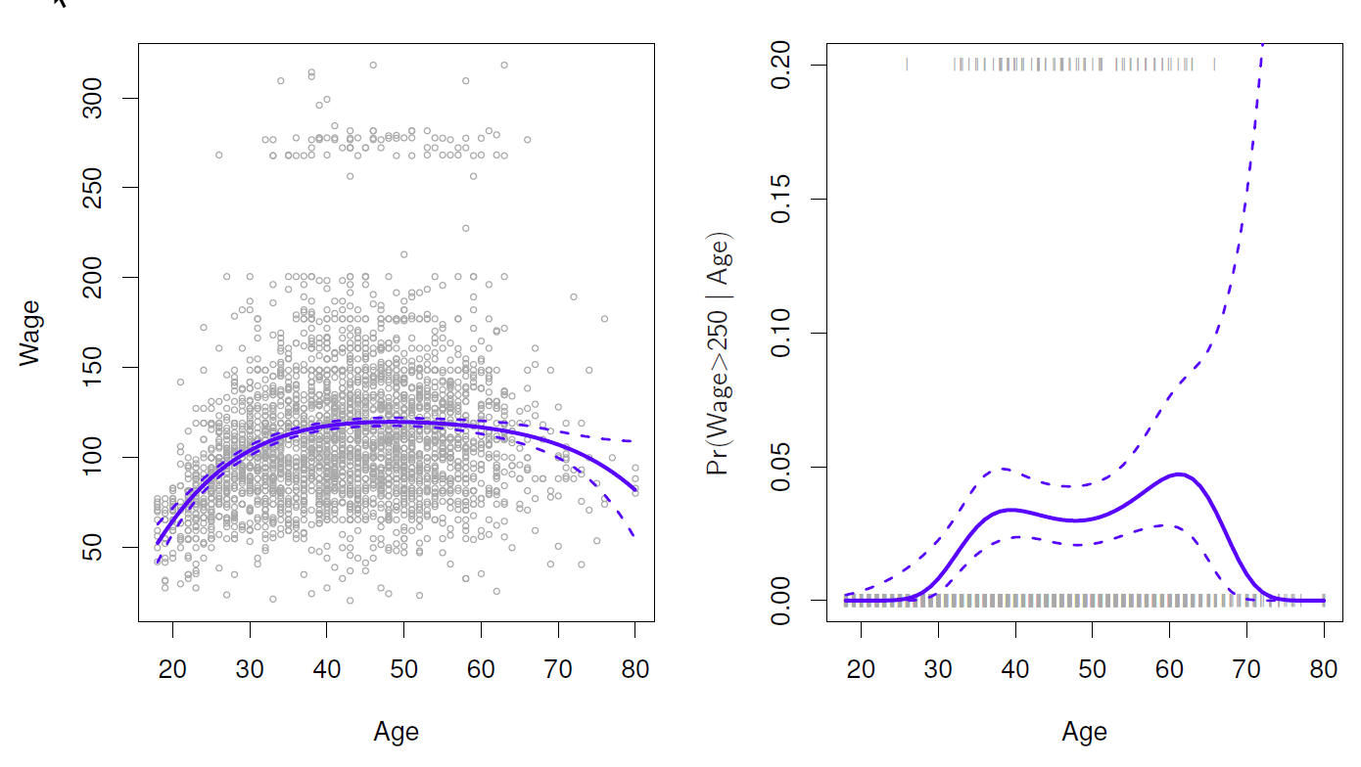
Polynomial Regression
Degree−4 Polynomial
2 / 23

Slide 5
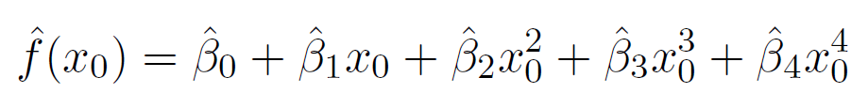
Details
Create new variables X₁ = X, X₂ = X², etc and then treat as multiple linear regression.
Not really interested in the coefficients; more interested in the fitted function values at any value x₀:
3 / 23

Slide 6

Details
Since f^{ˆ}(x₀) is a linear function of the can get a simple expression for pointwise-variances Var[f^{ˆ}(x₀)] at any value x₀.
The fit is computed and pointwise standard errors are calculated for values for x₀. Thus f^{ˆ}(x₀) ± 2 · se[f^{ˆ}(x₀)].
We either fix the degree of the polynomial, d, at some reasonably low value, else use cross-validation to choose d.
3 / 23

Slide 7
Details
Logistic regression follows naturally. For example, in figure we model
exp(β₀ + β₁x_{i} + β₂x² + . . . + β_{d}x^{d})
Pr(y_{i} > 250|x_{i}) =
i i
.
1 + exp(β₀ + β₁x_{i} + β₂x² + . . . + β_{d}x^{d})
i i
To get confidence intervals, compute upper and lower bounds on on the logit scale, and then invert to get on probability scale.
4 / 23

Slide 8
Details
Can do separately on several variables—just stack the variables into one matrix, and separate out the pieces afterwards (see GAMs later).
Caveat: polynomials have notorious tail behavior — very bad for extrapolation.
Can fit using y ∼ poly(x, degree = 3) in formula.
4 / 23

Slide 9
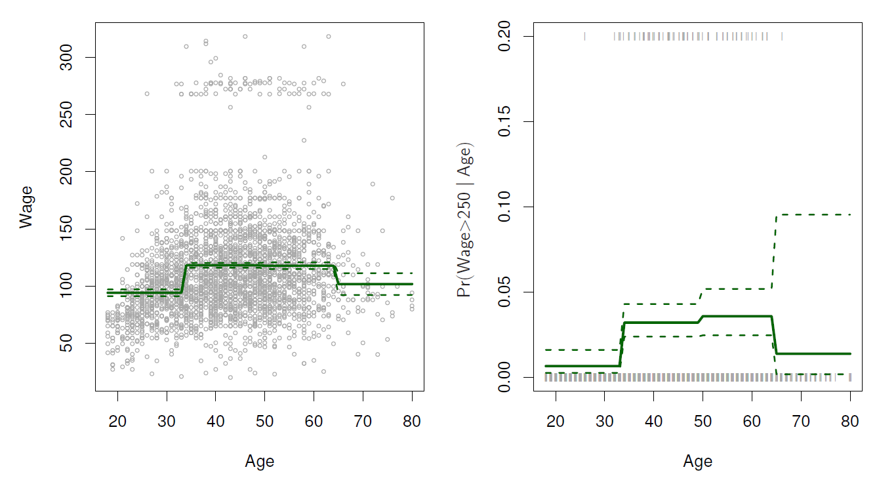
Step Functions
Another way of creating transformations of a variable — cut the variable into distinct regions.
C₁(X) = I(X < 35),
C₂(X) = I(35 ≤ X < 50), . . . , C₃(X) = I(X ≥ 65)
Piecewise Constant
5 / 23

Slide 10
Step functions continued
Easy to work with. Creates a series of dummy variables representing each group.
Useful way of creating interactions that are easy to interpret. For example, interaction effect of Year and Age:
I(Year < 2005) · Age, I(Year ≥ 2005) · Age
would allow for different linear functions in each age category.
6 / 23

Slide 11
Step functions continued
In R: I(year < 2005) or cut(age, c(18, 25, 40, 65, 90)).
Choice of cutpoints or knots can be problematic. For creating nonlinearities, smoother alternatives such as splines are available.
6 / 23

Slide 12
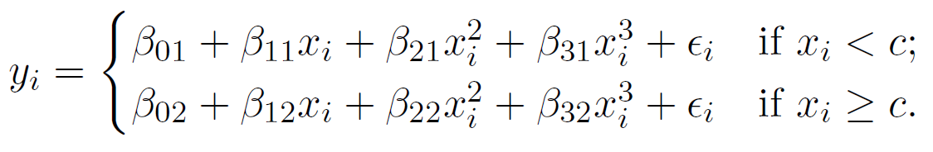
Piecewise Polynomials
Instead of a single polynomial in X over its whole domain, we can rather use different polynomials in regions defined by knots. E.g. (see figure)
Better to add constraints to the polynomials, e.g. continuity.
Splines have the “maximum” amount of continuity.
7 / 23

Slide 13
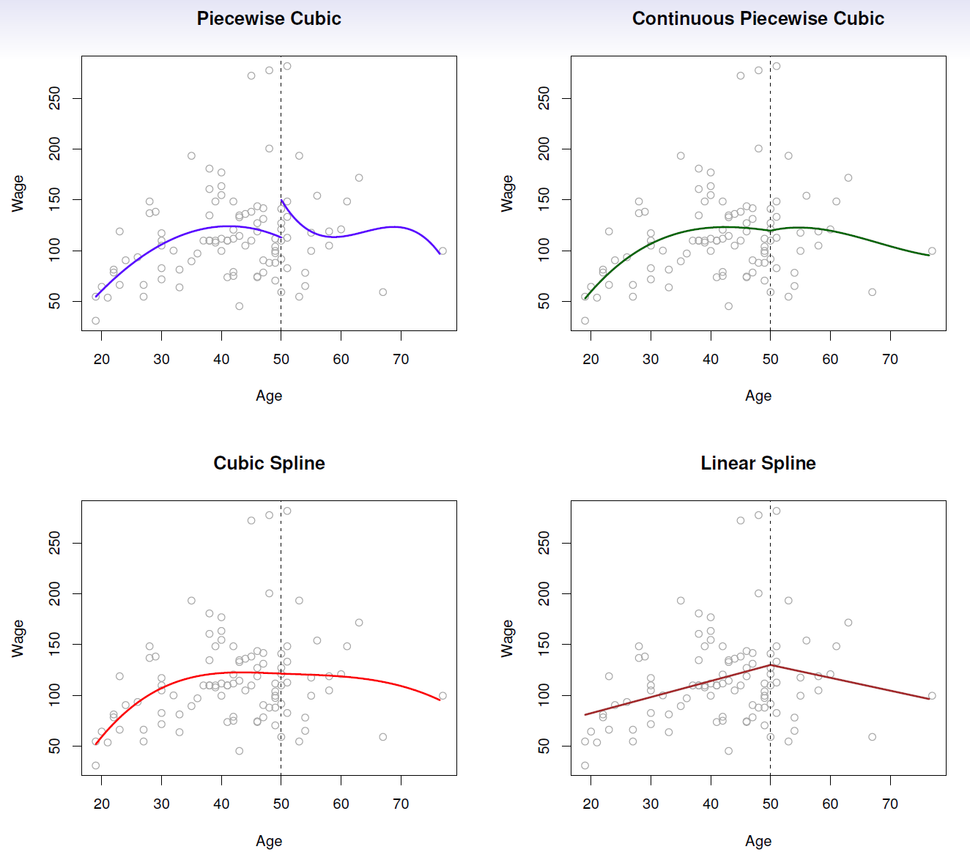
8 / 23

Slide 14
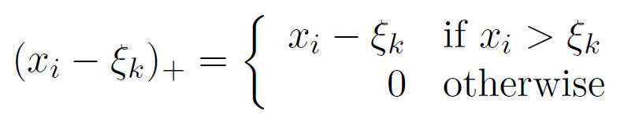
Linear Splines
A linear spline with knots at ξ_{k}, k = 1, . . . , K is a piecewise linear polynomial continuous at each knot.
We can represent this model as
y_{i} = β₀ + β₁b₁(x_{i}) + β₂b₂(x_{i}) + · · · + β_{K+1}b_{K+1}(x_{i}) + E_{i},
where the b_{k} are basis functions.
b₁(x_{i}) = x_{i}
b_{k+1}(x_{i}) = (x_{i} − ξ_{k})₊,
k = 1, . . . , K
Here the ()₊ means positive part; i.e.
9 / 23

Slide 15
0.9
0.7
f(x)
0.5
0.3
0.0
0.2
0.4
0.6
0.8
1.0
x
0.0 0.2 0.4
b(x)
0.0
0.2
0.4
0.6
0.8
1.0
x
10 / 23

Slide 16
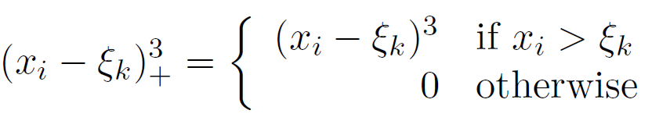
Cubic Splines
A cubic spline with knots at ξ_{k}, k = 1, . . . , K is a piecewise cubic polynomial with continuous derivatives up to order 2 at each knot.
Again we can represent this model with truncated power basis functions
y_{i} = β₀ + β₁b₁(x_{i}) + β₂b₂(x_{i}) + · · · + β_{K+3}b_{K+3}(x_{i}) + E_{i},
b₁(x_{i}) = x_{i} b₂(x_{i}) =
b₃(x_{i}) =
b_{k+3}(x_{i}) =
_{x}2
i
_{x}3
i
3
(x − ξ ) ,
k = 1, . . . , K
i k +
where

Slide 17
1.6
1.4
f(x)
1.2
1.0
0.0
0.2
0.4
0.6
0.8
1.0
x
0.0 0.2 0.4
b(x)
0.0
0.2
0.4
0.6
0.8
1.0
x

Slide 18
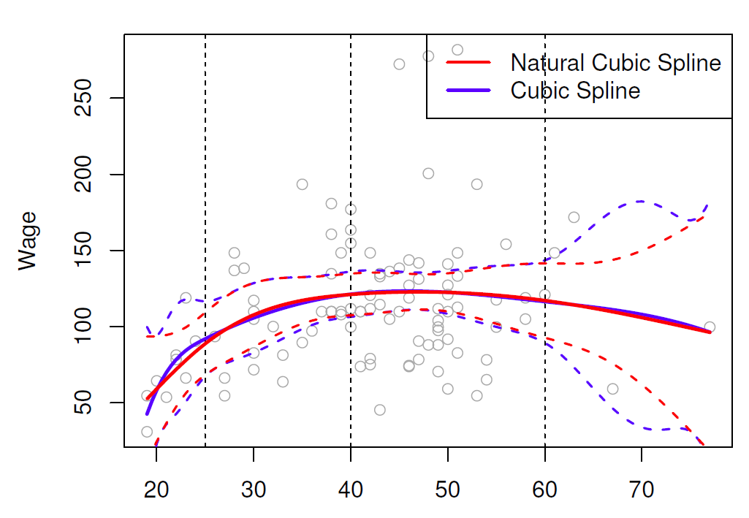
Natural Cubic Splines
A natural cubic spline extrapolates linearly beyond the boundary knots. This adds 4 =2 × 2 extra constraints, and allows us to put more internal knots for the same degrees of freedom as a regular cubic spline.

Slide 19
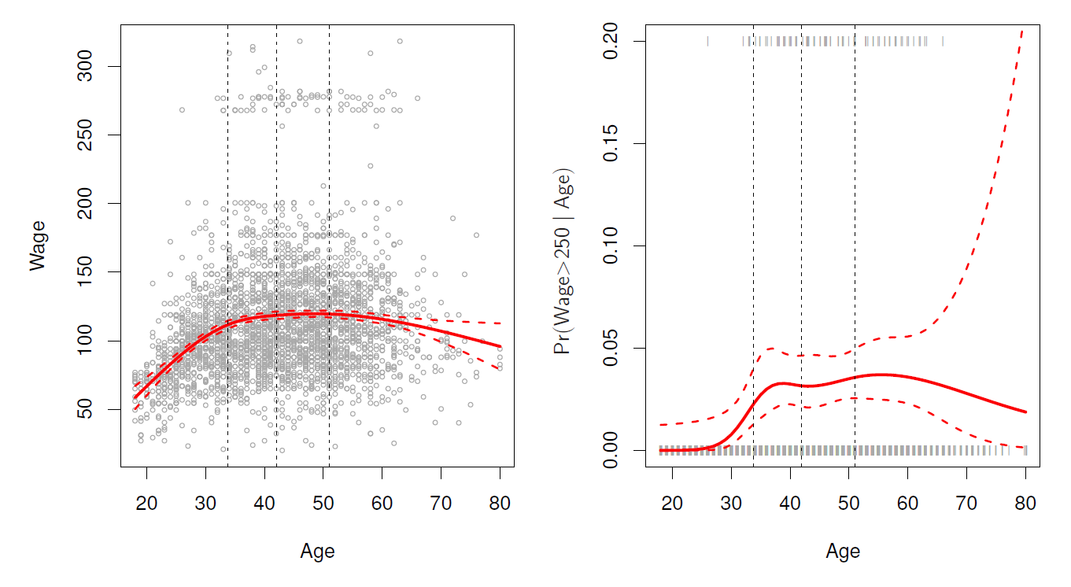
Fitting splines in R is easy: bs(x, ...) for any degree splines,
and ns(x, ...) for natural cubic splines, in package splines.
Natural Cubic Spline

Slide 20
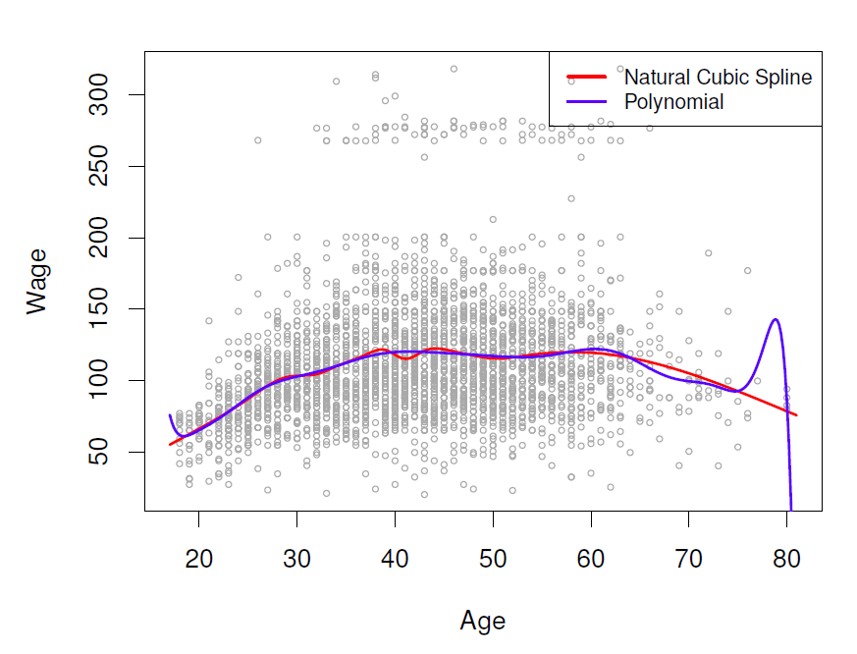
Knot placement
One strategy is to decide K, the number of knots, and then place them at appropriate quantiles of the observed X.
A cubic spline with K knots has K + 4 parameters or degrees of freedom.
A natural spline with K knots has K degrees of freedom.
Comparison of a degree-14 polynomial and a natural cubic spline, each with 15 df.
ns(age, df=14)
poly(age, deg=14)
15 / 23

Slide 21

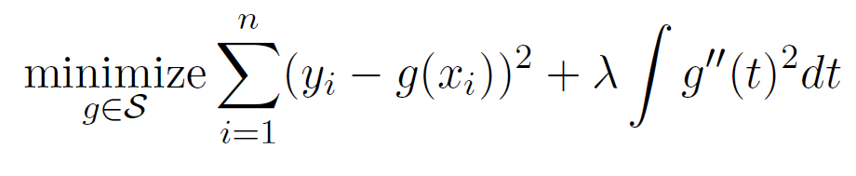
Smoothing Splines
This section is a little bit mathematical
Consider this criterion for fitting a smooth function g(x) to some data:
The first term is RSS, and tries to make g(x) match the data at each x_{i}.
The second term is a roughness penalty and controls how wiggly g(x) is. It is modulated by the tuning parameter λ ≥ 0.
The smaller λ, the more wiggly the function, eventually interpolating y_{i} when λ = 0.
As λ → ∞, the function g(x) becomes linear.
16 / 23
Notes:
RSS + “penalty parameter”
-second derivative
-integrates across whole range
-constrains linearity

Slide 22
Smoothing Splines continued
The solution is a natural cubic spline, with a knot at every unique value of x_{i}. The roughness penalty still controls the roughness via λ.
Some details
Smoothing splines avoid the knot-selection issue, leaving a single λ to be chosen.
The algorithmic details are too complex to describe here.
17 / 23

Slide 23
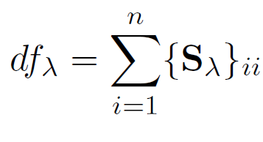
Smoothing Splines continued
In R, the function smooth.spline() will fit a smoothing spline.
The vector of n fitted values can be written as gˆ_{λ} = S_{λ}y, (so-called linear operator) where S_{λ} is a n × n matrix (determined by the x_{i} and λ).
The effective degrees of freedom are given by
17 / 23

Slide 24
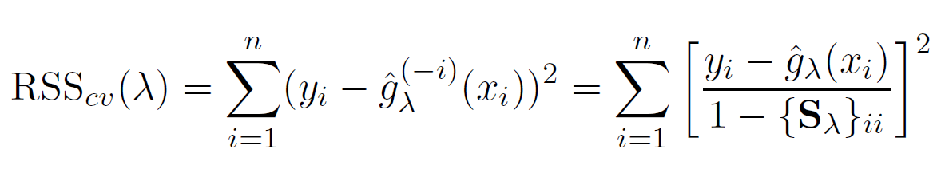
Smoothing Splines continued — choosing λ
We can specify df rather than λ!
In R: smooth.spline(age, wage, df = 10) # (nice trick)
The leave-one-out (LOO) cross-validated error is given by
In R: smooth.spline(age, wage)
18 / 23

Slide 25
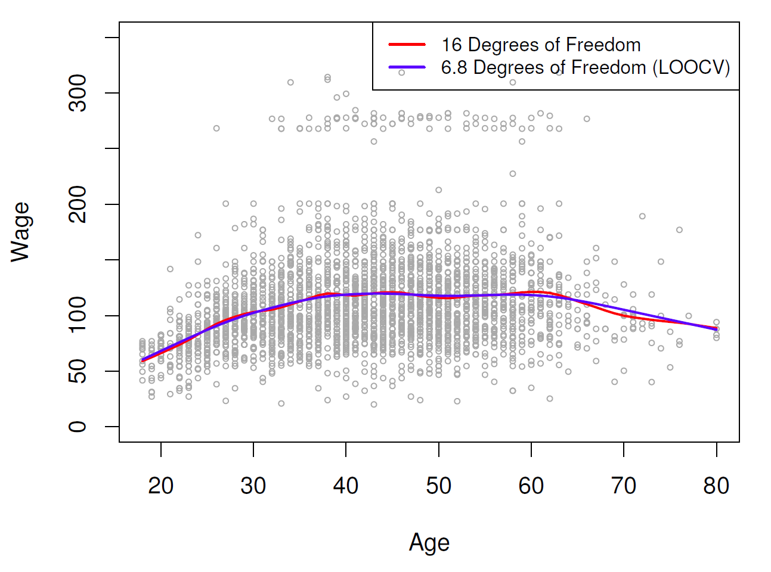
Smoothing Spline

Slide 26
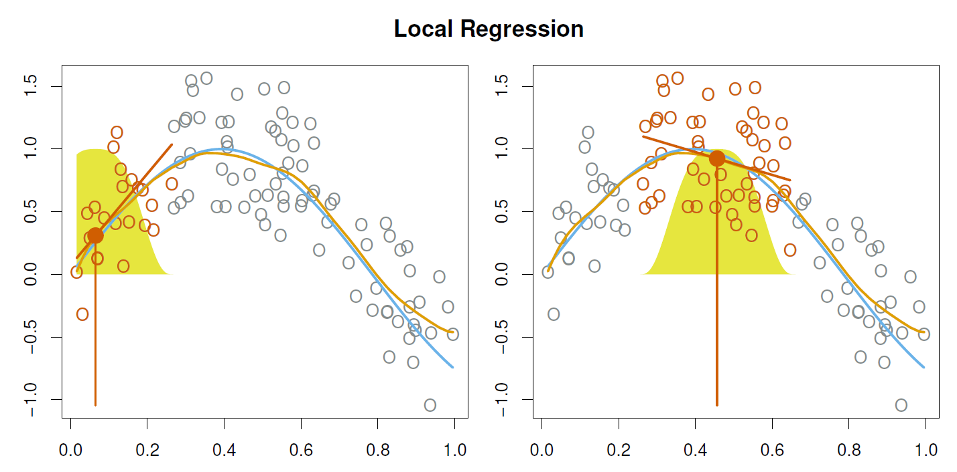
Local Regression
With a sliding weight function, we can fit separate linear fits over the range of X by weighted least squares.
See the loess() function in R.

Slide 27
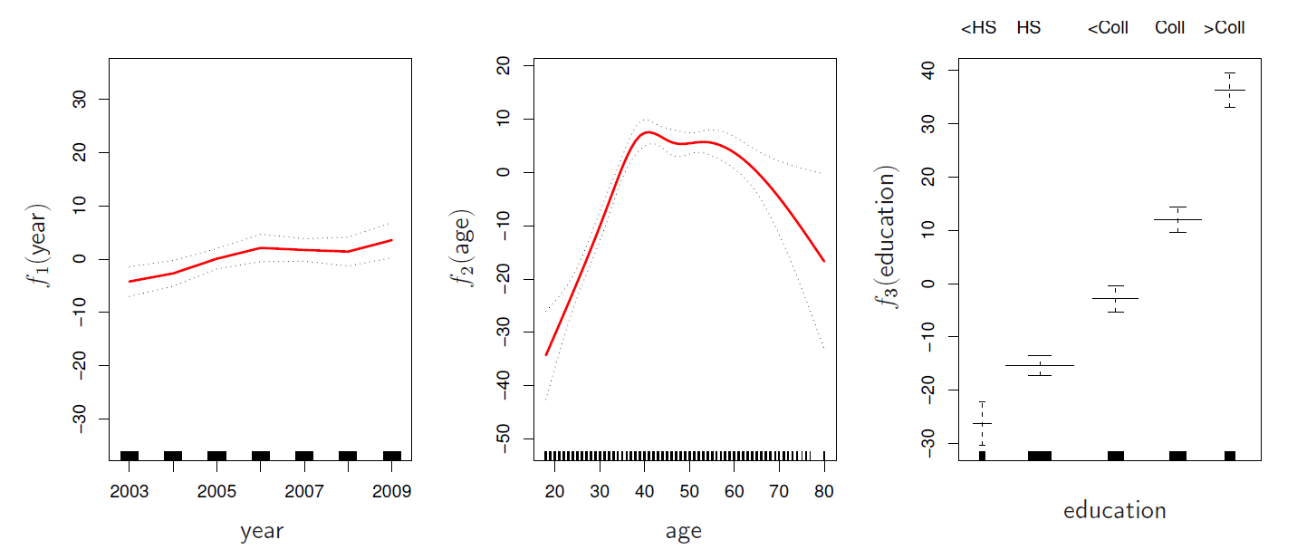
Generalized Additive Models
Allows for flexible nonlinearities in several variables, but retains the additive structure of linear models.
y_{i} = β₀ + f₁(x_{i1}) + f₂(x_{i2}) + · · · + f_{p}(x_{ip}) + E_{i}.

Slide 28
GAM details
Can fit a GAM simply using, e.g. natural splines:
lm(wage ∼ ns(year, df = 5) + ns(age, df = 5) + education)
Coefficients not that interesting; fitted functions are. The previous plot was produced using plot.gam.
Can mix terms — some linear, some nonlinear — and use
anova() to compare models.
22 / 23

Slide 29
GAM details
Can mix terms — some linear, some nonlinear — and use
anova() to compare models.
Can use smoothing splines or local regression as well:
gam(wage ∼ s(year, df = 5) + lo(age, span = .5) + education)
GAMs are additive, although low-order interactions can be included in a natural way using, e.g. bivariate smoothers or interactions of the form ns(age,df=5):ns(year,df=5).
22 / 23

Slide 30
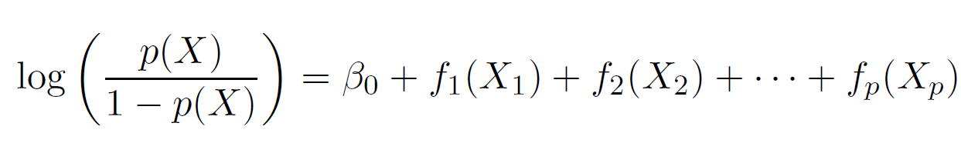
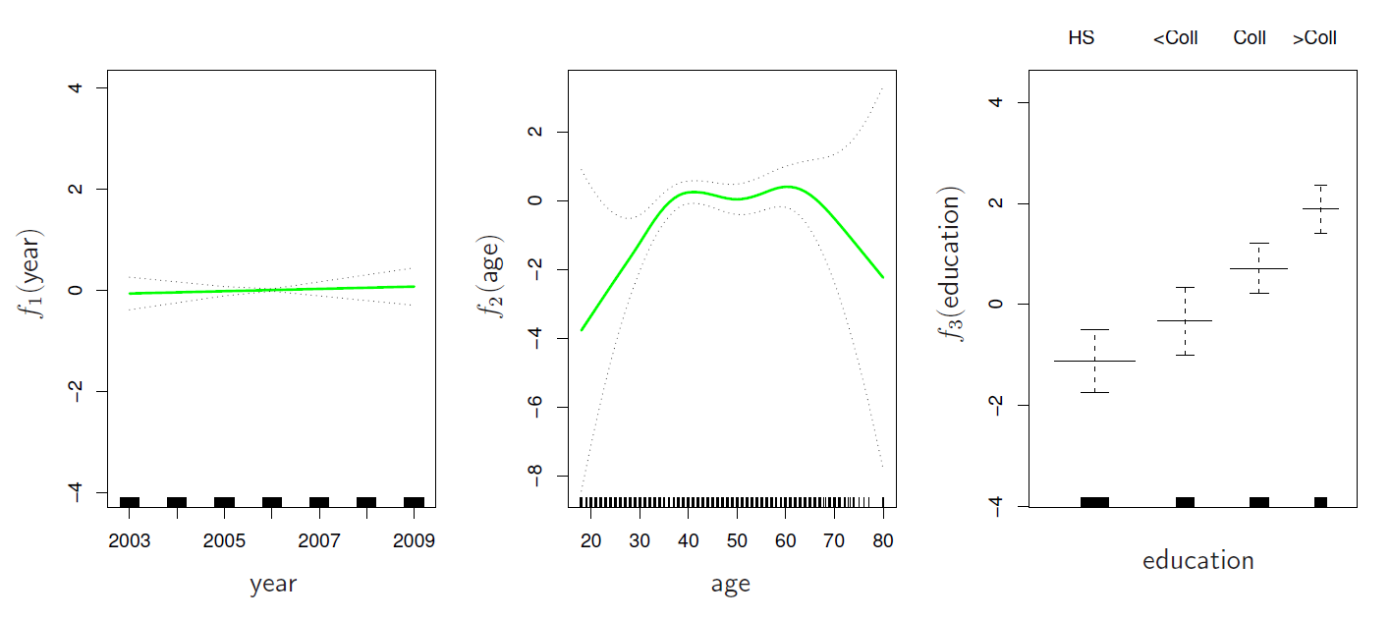
GAMs for classification
gam(I(wage > 250) ∼ year + s(age, df = 5) + education, family = binomial)
23 / 23

Slide 31

GAMs on the web
https://noamross.github.io/gams-in-r-course/
23 / 23

